Slide 1
Mesoscale Mission Manager Tool
Technical Review
May 6, 2019
GOES-R/NWS-OBS TOWR-S Team

Slide 2
Topics
Meso Mission Manager
Introduction & Context
Dependencies & Languages
Development environment & process
NOAA Virtual Lab
Introduction
Importance
Modules
MMM + Vlab
Notes:
Introduction - 5min
Dependencies & Languages - 5min
Development environment - 5min
User Authentication - 5min
Database Security - 5min
ElasticSearch
Data Flow - 10min
Input, process, output (include walkthrough of tool) - 8min
Document size, structure, DB speed - 2min
Indices explanation - 3min
Jsonws api (api call setup) - 2min
Redundancy - 5min
Production Environment
Explain workflow (dev to production env) - 5min
Performance - 5min

Slide 3
Introduction to MMM Tool
The Mesoscale Mission Manager (MMM) Tool is a task scheduling tool for the GOES-16 & GOES-17 Advanced Baseline Imager Mesoscale Domain Sectors (MDS)
MMM Tool allows visual representation of satellite mesoscale imagery locations at a specific time
Single-page VLab web application is created using open-source tools with strong support/ongoing releases
Comprised of 40 components (javascript files) - 6927 lines of Js code
Two versions of the tool exist
Private version allows users to make requests
Public version allows users to see where MDS will be located

Slide 4
Introduction Continued...
Gives forecasters ability to visualize and request tasking of GOES East and West ABI meso sectors
60 second, 30 second & Full Disk requests
Two 60 sec requests can be made at one time per satellite
One 30 sec request can be made at one time per satellite
Full Disk request provides 5 minute Full Disk imagery (no Mesoscale Imagery)
Allows NWS Senior Duty Meteorologist (SDM) to create plan based on requests from NWS Weather Forecast Offices and National Centers

Slide 5
Why Does NWS Need the MMM Tool?
• GOES-13/14/15 imagers have Rapid Scan Operations (RSO)
Either on or off, not targeted
Same area scanned every ~7 minutes
• GOES-16/17 ABIs have Mesoscale Domain Sectors (MDS)
Always on while in Flex Mode (Mode 6)
Different non-fixed geographic areas scanned every 1 minute or 30 seconds (1000x1000 km)
GOES-16/17 MDS is NOT an extension of RSO, it is a completely new capability further complicated by large geographic distribution of NWS operations community

Slide 6
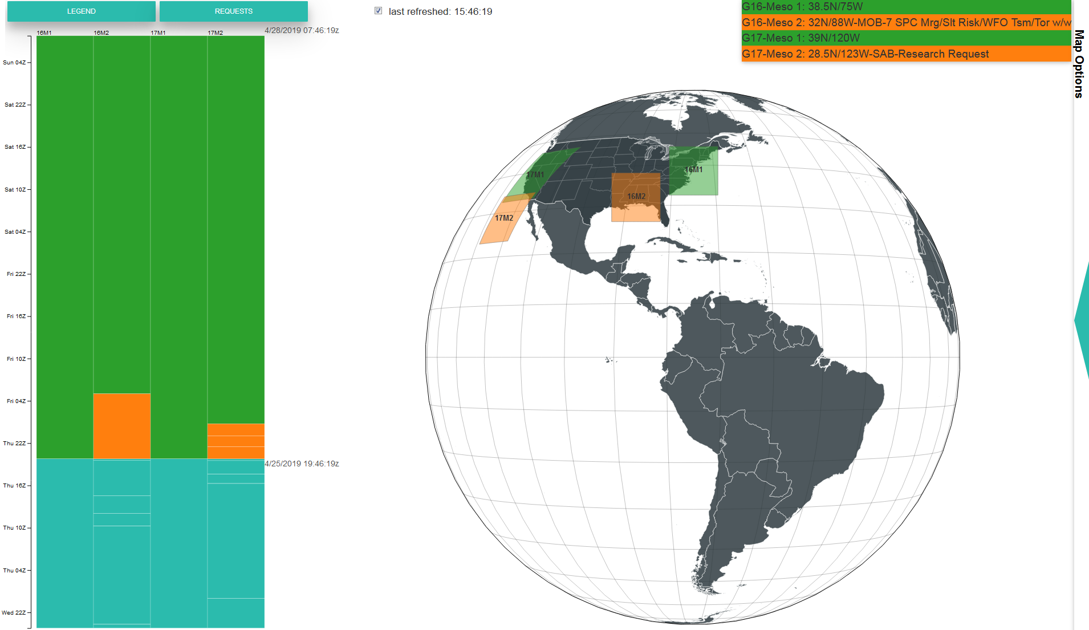

Slide 7
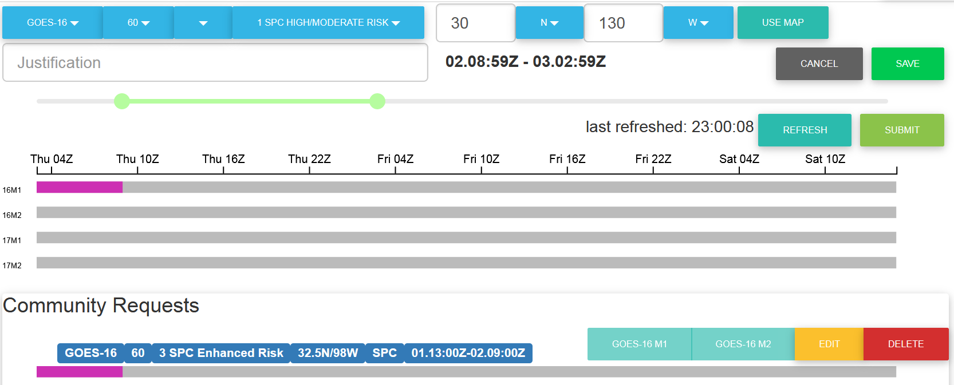
Notes:
• NWS Weather Forecast Offices make requests to their regional MDS focal point, focal point submits request to SDM using the MMM Tool
• NCEP Centers make requests directly to SDM using the MMM Tool

Slide 8
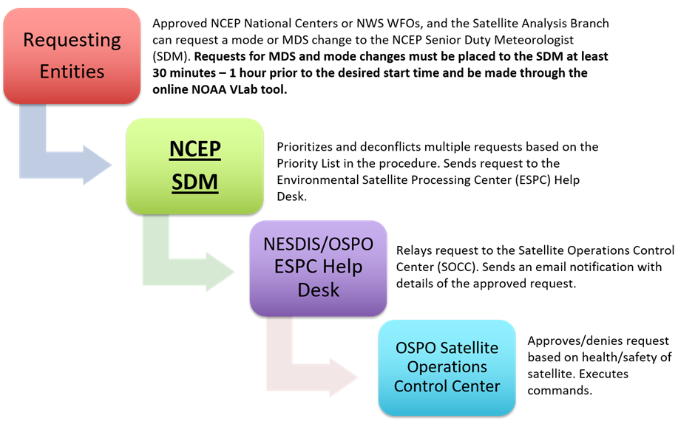
What is the MDS Request Process?
MDS Requesters can make MDS or mode change requests to the National Centers for Environmental Prediction Senior Duty Meteorologist (NCEP SDM). Requests must be placed at least 30 minutes prior to the desired start time via the MMM Tool.
SDM prioritizes and de-conflicts requests for maximum data coverage. The SDM sends requests to the NESDIS Environmental Satellite Processing Center (ESPC) Help Desk.
ESPC Help Desk relays MDS request to the Office of Satellite Products and Operations (OSPO) Satellite Operations Control Center (SOCC).
SOCC approves or rejects request based on the health and safety of the satellite. SOCC executes satellite command on approval.
Notes:
SAB make all research request
6 regions and 6 region focal points - must relay to focal points
National centers can make requests directly
Call it as name

Slide 9
How is the MMM Tool Governed?
The MMM Tool is developed and maintained by the NWS Office of Observations
The NWS Office of Observations supports the MDS Core Team, headed by the NWS Operations Division
MDS Core Team consists of NWS Regional Focal Points, National Centers, NWS Ops Center, and NESDIS
The MDS Core Team meets on a monthly basis to discuss MDS issues, including bugs or suggested improvements to the MMM Tool
That information is forwarded to the MMM Tool developers, who implement and test the changes to the MMM Tool
Changes to the MMM Tool are applied on a monthly development cycle for new features and ASAP for bug fixes

Slide 10
NOAA Virtual Lab

Slide 11
What is the VLab?
The NOAA Virtual Lab is a NOAA-wide content management system governed by the NWS Meteorological Development Lab (MDL) and hosted on the College Park instance of IDP.
The VLab is an instance of the Liferay platform that provides tools for:
Creating custom web content
developing software (all open source)
ElasticSearch database (NoSQL)
VLab provides an infrastructure for fast & simple development

Slide 12
Vlab Reliability
ElasticSearch
Master node and two backup nodes
If master node fails, a backup node takes over
When master node recovers, becomes master again and data is synchronized
Vlab
Located in College Park IDP
Backups handled via snapshots that can restore files when necessary
File system changes are written to Network FIle System (NFS) mounted directory and controlled by a netapp
Snapshots created every hour (6 copies)
Additionally, all snapshots are copied to Boulder IDP every 6hrs

Slide 13
Vlab User Authentication
Vlab provides user auth via noaa.gov account
Vlab login expires after 2 hours of inactivity
Admin assigns role to user for role-based access

Slide 14
Access Controls
Vlab provides role-based access to:
ESearch DB via Elastic Interface Manager
Documents
Web content
Interface allows for configuration of access rights to particular users or groups
Ability to create custom roles

Slide 15
JSON Web Services API
Esearch DB communication & forum
create, read, update, delete
AJAX call is triggered from JS function on load of application (caching disabled)
Authentication token is required for all data modification calls

Slide 16
Forums
Forums used for communication throughout community
Ability to create forum that community members can subscribe to for notifications
Ability to post custom content via HTML generated directly from application

Slide 17
MMM
Implementation
and the
NOAA Virtual Lab

Slide 18
Languages & Libraries
JavaScript (ES6+) - Web Application Devlopment
React.Js - UI components
Babel - Javascript Compiler
JQuery - UI manipulation
D3.Js - UI component interaction
AJAX - DB communication
Node.Js - server environment
NPM - Package manager

Slide 19
Languages & Libraries Continued...
Python - Back-end scripting
Script makes JSON Web Services API call to push data ElasticSearch
Listener is triggered on meso change event or every hour
Development tools
Node.Js - JS runtime environment
Atom - text editor
Git - repo management

Slide 20
Procedures
Development Workflow
A new branch is created from master for each new feature/bug fix
A local instance of the application is used for development
Utilize vlab-dev as staging environment for testing procedure
Production build is created from current branch
Files uploaded to vlab-dev
Regression testing procedure implemented
Branch merged into master

Slide 21
Procedures Continued...
Tag is created
Release notes are added to updates page of Vlab
Files are uploaded to production server
Production test procedure done in collaboration with SDM

Slide 22
Version Control
Versioning
Format for version: 2.<year>.<month>.<iteration in month>
All versions are tagged in Git repo
All release notes available on Vlab

Slide 23
Vlab Features Utilized in MMM Tool
MMM is implemented as user content on the NWS VLab
Features utilized:
File host/manager - host files for mmm tool
Authentication and user management (login, user roles interface, community membership)
Database host/manager - provides interface for creating indices and JSONWS api
Security - secure web server, role-based access controls, file security controls, DB access controls
Web content portlet/web page - url schema, application display setup
Forum post & Email notifications
Provides suite of features that make MMM tool cost effective and easier to develop/maintain

Slide 24
MMM Integration with VLab
IDP College Park
VLab Collaboration Services (Liferay)
ESearch
Browser
ISatSS
JSONWS
API
TOWR-S Comm
ISatSS
Web Page
Doc library
Web Content Display
NPM build
Forum
E-Mail
Repo
Notes:
Vlab provides
Database hosting (configurations, mapping interface, api)
Provides web server (https, url routing)
File server

Slide 25
Conclusion
GOES-16 & 17 satellites provide new technology that require a new workflow
MMM Tool provides workflow for proper utilization of new ABI instrument
Central location for collaboration of a widely dispersed NWS community
Tool is flexible, extensible, and low impact
VLab has proven to be an effective suite of modules for fast/easy implementation of applications

Slide 26
Questions?

