Slide 1
Lightning Jump Evaluation RITT Presentation Tom Filiaggi (NWS – MDL) 12/18/13
Reduction of FAR?

Slide 2
Agenda
Team Members
Total Lightning
Lightning Mapping Arrays (LMAs)
Previous Research Summary
Current Project
Analysis & Results
Future Work

Slide 3
Team Primary Members
Person | Role | Affiliation
Tom Filiaggi | Co-Lead | OST - MDL
Steve Goodman | Co-Lead | NASA
Larry Carey | PI | University of Alabama: Hunstville
Themis Chronis | Analyst | University of Alabama: Hunstville
Chris Schultz | Consultant | University of Alabama: Hunstville / NASA
Kristin Calhoun | PI | National Severe Storms Laboratory
Greg Stumpf | Consultant | OST - MDL
Geoffrey Stano | Consultant | NASA
Daniel Melendez | Consultant | OST - SPB
Scott Rudlosky | Consultant | NESDIS
Steve Zubrick | Consultant | WFO – Sterling, VA (LWX)
About 15 additional people from a handful of additional agencies participated in various discussions.

Slide 4
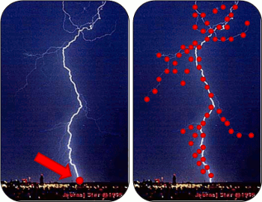
“Total Lightning”
Most familiar is Cloud-to-ground (CG):
point locations at ground level
Uses certain types of electromagnetic field sensors
Can directly impact more people
Total Lightning:
uses a different kind of sensor to obtain step charge release locations for all flashes (not just CG)
Location is in full 3 dimensions
More difficult to sense with ‘sufficient’ accuracy – need more sensors
Less direct societal impact to people, but can be used indirectly, perhaps with significant value
(Image borrowed from http://weather.msfc.nasa.gov/sport/lma/)

Slide 5
Sensors: Lightning Mapping Array
Predominant sensor array type used by this project
Uses time of arrival and multilateration to locate step charges

Slide 6
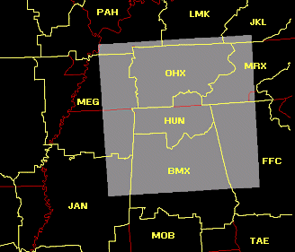
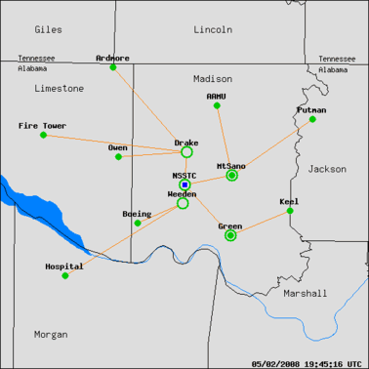
Sensors: Lightning Mapping Array
NALMA example
Sensor distribution and ‘effective’ domain
(Images borrowed from http://weather.msfc.nasa.gov/sport/lma/)

Slide 7
Summary of Previous Research
Schultz et al. (2009), JAMC
Six separate lightning jump configurations tested
Case study expansion:
107 T-storms analyzed
38 severe
69 non-severe
The “2σ” configuration yielded best results
FAR even better i.e.,15% lower (Barnes et al. 2007)
Caveat: Large difference in sample sizes, more cases are needed to finalize result.
Thunderstorm breakdown:
North Alabama – 83 storms
Washington D.C. – 2 storms
Houston TX – 13 storms
Dallas – 9 storms
Algorithm | POD | FAR | CSI | HSS
Gatlin | 90% | 66% | 33% | 0.49
Gatlin 45 | 97% | 64% | 35% | 0.52
2σ | 87% | 33% | 61% | 0.75
3σ | 56% | 29% | 45% | 0.65
Threshold 10 | 72% | 40% | 49% | 0.66
Threshold 8 | 83% | 42% | 50% | 0.67
Slide contents borrowed from Schultz (UofAH) presentation.

Slide 8
Summary of Previous Research
Schultz et al. 2011, WAF
Expanded to 711 thunderstorms
255 severe, 456 non severe
Primarily from N. Alabama (555)
Also included
Washington D.C. (109)
Oklahoma (25)
STEPS (22)
Slide contents borrowed from Schultz (UofAH) presentation.

Slide 9
Summary of Previous Research
The performance of using a 2σ Lightning Jump as an indicator of severe weather looked very promising (looking at POD, FAR, CSI)! But . . .
The Schultz studies were significantly manually QCed, for things like consistent and meteorologically sound storm cell identifications.
The Schultz studies also did not do a direct comparison to hoe NWS warnings performed for the same storms.
How would this approach fare in an operational environment, where forecasters do not have the luxury of baby-sitting the algorithms?

Slide 10
Current Project
Primary Goal:
Remove the burden of manual intervention via automation then compare results to previous studies to see if an operational Lightning Jump will have operational value.
Secondary Goals:
Use & evaluate a more “reliable” storm tracker (SegMotion (NSSL) over TITAN (NCAR) and SCIT (NSSL)).
Provide an opportunity to conduct improved verification techniques, which require some high-resolution observations.

Slide 11
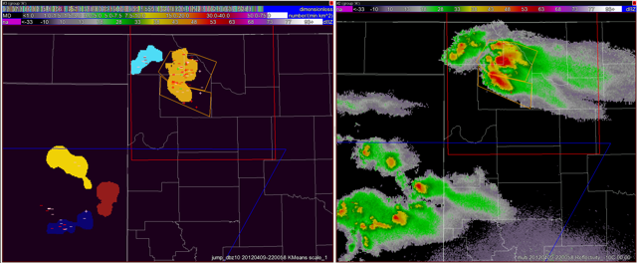
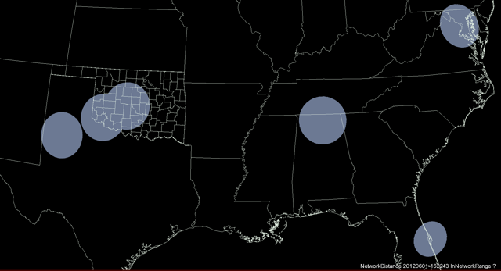
Current Project
Purpose: Evaluate potential for Schultz et al. (2009, 2011) LJA to improve NWS warning statistics, especially False Alarm Ratio (FAR).
Objective, real-time SegMotion cell tracking (radar-based example upper right)
LMA-based total flash rates (native LMA, not GLM proxy).
Increased sample size over variety of meteorological regimes (LMA test domains bottom right)
Storm Objects
WSR-88D
WDSSII K-means storm tracker.
DCLMA
OKLMA
NALMA
WTLMA
OKLMA
SWOK
KSC
LMA Test Domains
Slide contents borrowed from L. Carey (UofAH) presentation.

Slide 12
Analysis
Data
Data from 2012 was not usable due to integrity issues. Would need to re-process in order to use.
Collected from 3/29/13 through 8/14/13, includes:
131 storm days
3400+ tracked storm clusters
Nearly 600 of which experienced Lightning Jumps
Nearly 675 Storm Reports recorded
Results of variational analyses:
POD = 64-81%
FAR = 75-84%
Lead Time = ~25 minutes (but with standard deviation of 12-13 minutes)
Best Sigma = 1.2-1.7
Best Threshold = 9-12 flash/minute

Slide 13
Analysis
FAR values much higher than previous studies. (POD was essentially the same.)
FAR could improve to 55-60%, if we can account for:
Storm Tracking imperfections
Low-population storm report degradation
Application of a 50 flash/minute severe weather proxy
Change in verification methodology (allow double counting of severe reports)
But, FAR still significantly higher than previous studies - !?

Slide 14
Analysis: FAR Differences
What could explain the different results of FAR?
Geography
differing climatology (predominant severe weather types: hail in OK)
population density (storm reports: OK less dense)
Methodology
subjective storm track extension
Different Storm Tracker behaviors
Data Integrity
Some unexplained data drops were noted, but not analyzed

Slide 15
Future Work
Explore enhanced verification techniques using extensive SHAVE data (already gathered) and funded by the GOES-R program.
Explore refined methodologies (to compensate for the removal of manual QC care and attention).

Slide 16
The End
Questions?
Tom.Filiaggi@noaa.gov
VLab Community: https://nws.weather.gov/innovate/group/lightning/home
Email listserver: total_lightning@infolist.nws.noaa.gov

Slide 17
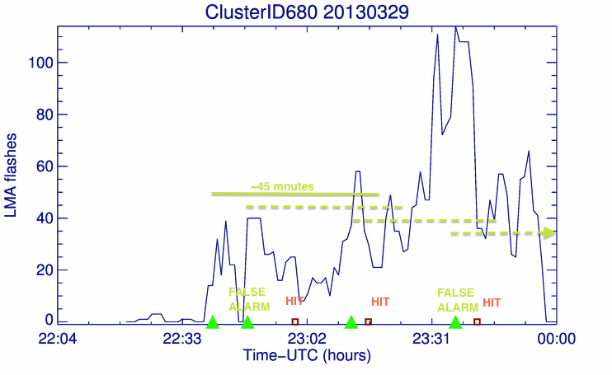
Graphics: Methodology
Example of POD and FAR calculation for a multi-jump and multi-report cluster. Green triangles represent the issued jumps while brown squares represent the “matched” SPC severe weather reports. Each jump is “valid” for 45 minutes. For the first jump’s time window, 2 severe weather reports are present. These are counted as 2 hits. For the second there are no additional SPC reports beyond the first two which are already accounted for by the first jump. The second jump constitutes a “false alarm”. The third jump counts as a “hit” 9with 3rd report). For the fourth there are no additional reports other than the third report which is already accounted for by the previous jump. This counts as an additional “false alarm”. From this particular cluster, a total of 3 hits, 2 false alarms and 0 misses are counted.

Slide 18
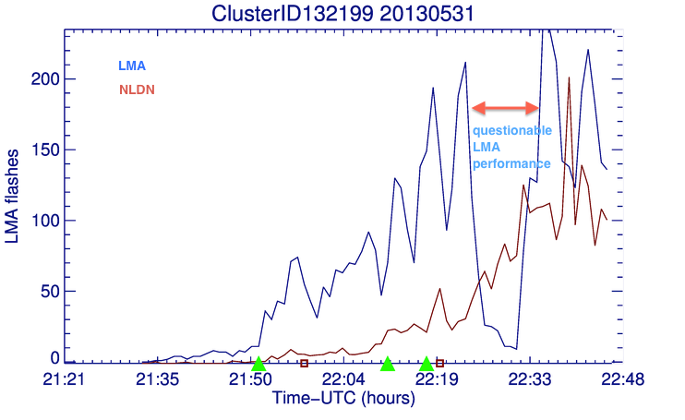
Graphics: Data Integrity
Related to the Oklahoma tornado outbreak on May 31, 2013. Blue line is LMA flashes/min/km² (left y-axis), red line is the NLDN flashes/min/km². Note the discrepancy around 22:20 - 22:33 between the two lightning detection systems.
(Green triangles represent the issued jumps while brown squares represent the “matched” SPC reports.)

Slide 19
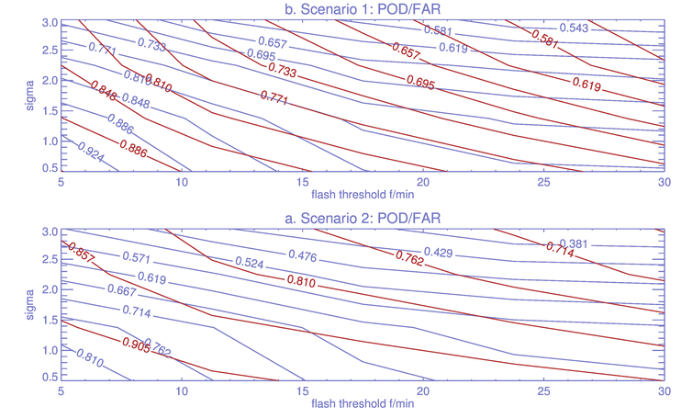
Graphics: Variational Analysis
Calculation of POD (blue) and FAR (red) as a function of LJA sigma (y-axis, flashes/min) and lightning flash rate (x-axis, flashes/min) for both Scenarios and imposing the “stricter” SPC-SWR spatial/temporal matching criteria [i.e. 5 km/20 minutes and considering for clusters that have a life span of at least 30 minutes].

