Slide 1
Lightning Jump Evaluation
RITT Presentation
Tom Filiaggi (NWS – MDL)
11/28/12
Evaluation of “2σ” as Predictor for Severe Weather

Slide 2
Agenda
Total Lightning
Lightning Mapping Arrays (LMAs)
Previous Research Summary
Current Project: Goals
Current Project: Progress
Current Project: Future Work
Related, but Beyond Scope

Slide 3
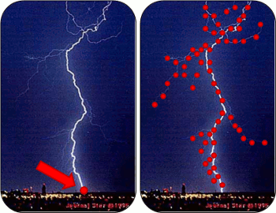
“Total Lightning”
Most familiar is Cloud-to-ground (CG):
  point locations at ground level
  Uses certain types of electromagnetic field sensors
  Can directly impact more people
Total Lightning:
  uses a different kind of sensor to obtain step charge release locations for all flashes (not just CG)
  Location is in full 3 dimensions
  More difficult to sense with ‘sufficient’ accuracy – need more sensors
  Less direct societal impact to people, but can be used indirectly, perhaps with significant value
(Image borrowed from http://weather.msfc.nasa.gov/sport/lma/)

Slide 4
Sensors:
Lightning Mapping Array
Predominant sensor array type used by this project
Uses time of arrival and multilateration to locate step charges

Slide 5
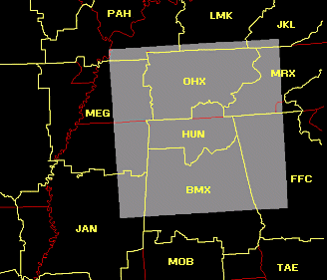
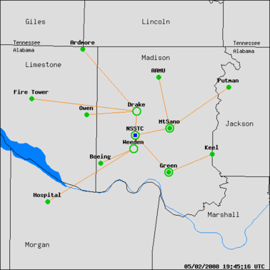
Sensors:
Lightning Mapping Array
NALMA example
Sensor distribution and ‘effective’ domain
(Images borrowed from http://weather.msfc.nasa.gov/sport/lma/)

Slide 6
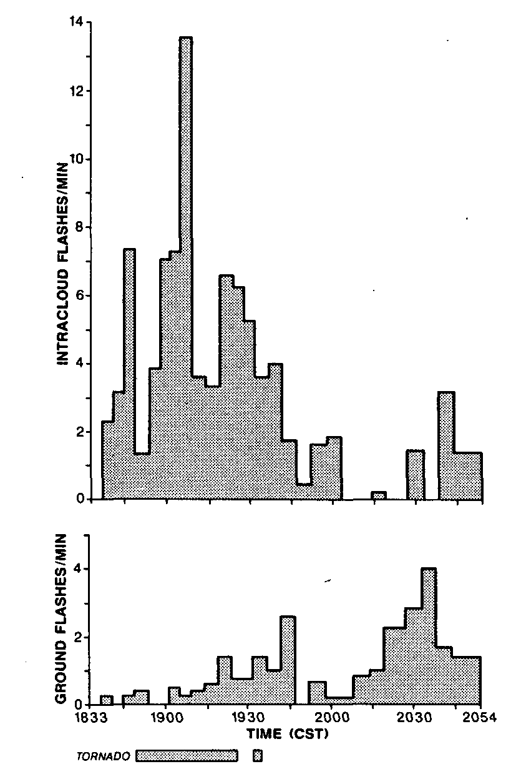
Summary of Previous Research
Goodman et al. (1988) demonstrated that total lightning peaked prior to the onset of a microburst.
Williams et al. (1989) showed that the peak total flash rate correlated with the maximum vertical extent of pulse thunderstorms, and preceded maximum outflow velocity by several minutes.
MacGorman et al. (1989) showed that the total flash rate peaked 5 minutes prior to a tornado touchdown, while the cloud-to-ground (CG) flash rate peaked 15 minutes after the peak in intra cloud flash rate.
Adapted from Goodman et al. (1988)
Adapted from MacGorman et al. (1989)
Slide contents borrowed from Schultz (UofAH)presentation.

Slide 7
Summary of Previous Research
Williams et al. (1999) examined a large number of severe storms in Central FL
Noticed that the total flash rate “jumped” prior to the onset of severe weather.
Williams also proposed 60 flashes min⁻¹ or greater for separation between severe and non-severe thunderstorms.
Adapted from Williams et al. (1999) (above)
Slide contents borrowed from Schultz (UofAH) presentation.

Slide 8
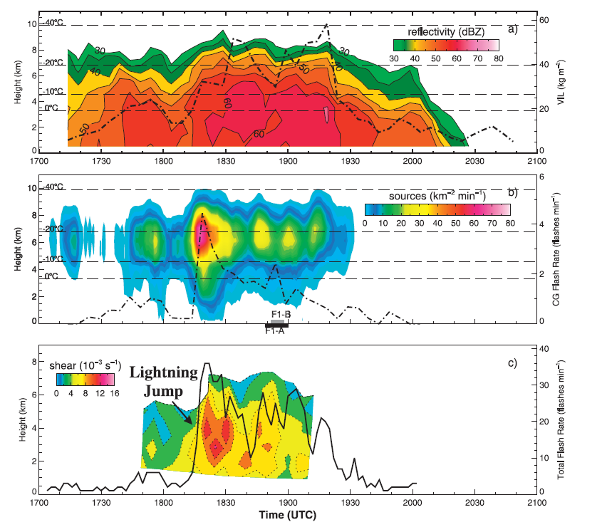
Summary of Previous Research
Gatlin and Goodman (2010) , JTECH; developed the first lightning jump algorithm
Study proved that it was indeed possible to develop an operational algorithm for severe weather detection
Mainly studied severe thunderstorms
  Only 1 non severe storm in a sample of 26 storms
Adapted from Gatlin and Goodman (2010)
Slide contents borrowed from Schultz (UofAH) presentation.

Slide 9
Summary of Previous Research
Schultz et al. (2009), JAMC
Six separate lightning jump configurations tested
Case study expansion:
  107 T-storms analyzed
    38 severe
    69 non-severe
The “2σ” configuration yielded best results
  POD beats NWS performance statistics (80-90%);
  FAR even better i.e.,15% lower (Barnes et al. 2007)
    Caveat: Large difference in sample sizes, more cases are needed to finalize result.
Thunderstorm breakdown:
North Alabama – 83 storms
Washington D.C. – 2 storms
Houston TX – 13 storms
Dallas – 9 storms
Algorithm | POD | FAR | CSI | HSS
Gatlin | 90% | 66% | 33% | 0.49
Gatlin 45 | 97% | 64% | 35% | 0.52
2σ | 87% | 33% | 61% | 0.75
3σ | 56% | 29% | 45% | 0.65
Threshold 10 | 72% | 40% | 49% | 0.66
Threshold 8 | 83% | 42% | 50% | 0.67
Slide contents borrowed from Schultz (UofAH) presentation.

Slide 10
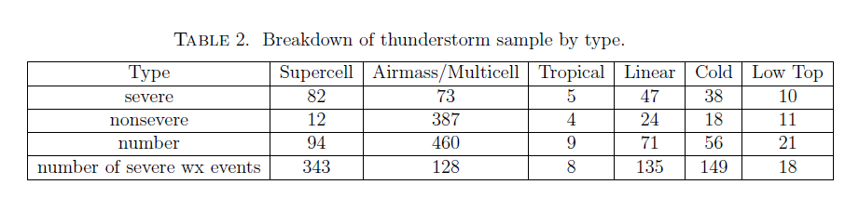
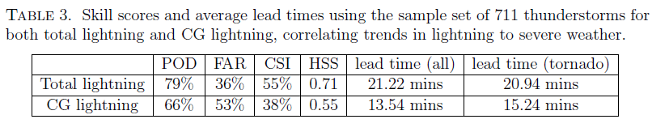
Summary of Previous Research
Schultz et al. 2011, WAF
Expanded to 711 thunderstorms
  255 severe, 456 non severe
  Primarily from N. Alabama (555)
  Also included
    Washington D.C. (109)
    Oklahoma (25)
    STEPS (22)
Slide contents borrowed from Schultz (UofAH) presentation.

Slide 11
Summary of Previous Research
Remember . . .
The LJA Can:
  Indicate when an updraft is strengthening or weakening on shorter timescales than current radar and satellite
  Identify when severe or hazardous weather potential has increased
  “Tip the scales” on whether or not to issue a severe warning
The LJA Cannot:
  Predict severe weather potential in every severe storm environment.
  Discern severe weather types
    i.e., a certain jump does not mean there will be a certain type of severe weather
  Issue specific types of severe warnings
Slide contents borrowed from L. Carey (UofAH) presentation.

Slide 12
Summary of Previous Research
The performance of using a 2σ Lightning Jump as an indicator of severe weather looks very promising (looking at POD, FAR, CSI)! But . . .
The Schultz studies were significantly manually QCed, for things like consistent and meteorologically sound storm cell identifications.
How would this approach fare in an operational environment, where forecasters do not have the luxury of baby-sitting the algorithms?

Slide 13
Current Project: Goals
Primary Goal:
  Remove the burden of manual intervention via automation then compare results to previous studies to see if an operational Lightning Jump will have operational value.
Secondary Goals:
  Use & evaluate a more “reliable” storm tracker (WDSSII K-means (NSSL) over TITAN (NCAR) and SCIT (NSSL)).
  Provide an opportunity to conduct improved verification techniques, which require some high-resolution observations.
But the bigger picture:
  “Objective - To refine, adapt and demonstrate the LJA for transition to GOES-R GLM (Geostationary Lightning Mapper) readiness and to establish a path to operations.” (from L. Carey presentation)

Slide 14
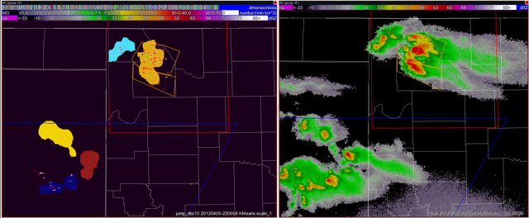
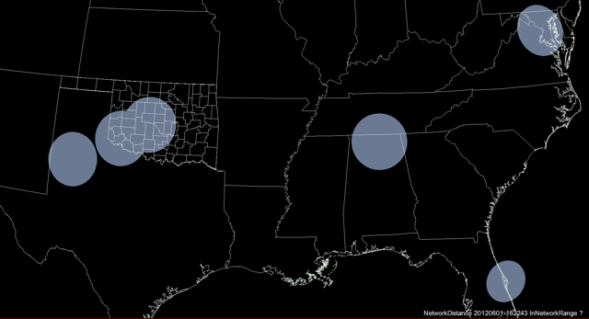
Current Project: Progress
Purpose: Evaluate potential for Schultz et al. (2009, 2011) LJA to improve NWS warning statistics, especially False Alarm Ratio (FAR).
  Objective, real-time WDSSII cell tracking (radar-based example upper right)
  LMA-based total flash rates (native LMA, not GLM proxy).
  Increased sample size over variety of meteorological regimes (LMA test domains bottom right)
  Enhanced verification data, SHAVE – (Severe Hazards Verification Experiment), and methods
Storm Objects
WSR-88D
WDSSII K-means storm tracker.
DCLMA
OKLMA
NALMA
WTLMA
OKLMA
SWOK
KSC
LMA Test Domains
Slide contents borrowed from L. Carey (UofAH) presentation.

Slide 15
Current Project: Progress
Data collected from April through October, 2012, includes:
  2000+ SHAVE storm reports
  190+ identified storms in the LMA domains
Early stages of data analysis – focusing on a small handful of picturesque cases

Slide 16
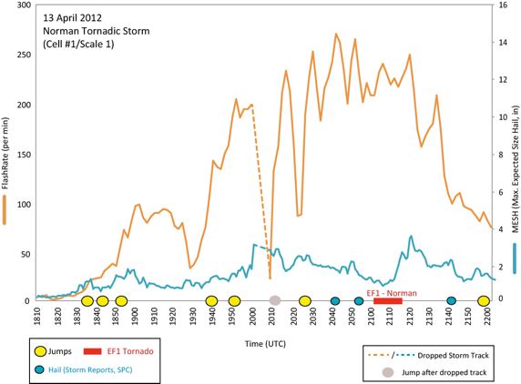
Current Project: Progress
Storm trends associated with the tracked storm that produced the EF1 tornado in Norman, OK on 13 April 2012. This storm moved through the center of the OKLMA domain and produced large hail as well as the tornado damage in Norman. Time series of the total lightning flash rate (orange) and the Maximum Expected Size of Hail (MESH) and time of the lightning jumps (yellow) and severe hail (blue) are shown.
(From Project Executive Summary)
(Image from NSSL)

Slide 17
Current Project: Future Work
Complete full data analysis
Potential for another round of data gathering and analysis, applying lessons learned
Explore enhanced verification techniques

Slide 18
Related, but Beyond Scope
How will the results of this study using LMA data translate to using GLM data (or GLM proxy)?
  Differences in sensors, detection technique, and sensor resolution

