Slide 1
Local Climate Analysis Tool (LCAT) in Support of Weather and Climate Extremes
Marina Timofeyeva and Fiona Horsfall
February 2012

Slide 2
Local Climate Analysis Tool (LCAT)
Developed to support NWS field offices
Online interactive tool
For regional and local climate studies
State-of-the-art station data
Best practices for climate analysis
Applications for assessing climate impacts on severe weather
Variables beyond average temp and total precip, including extreme events
Reduce field office time spent on responding to customers’ climate questions
Provides critical links for forecasters on climate drivers for weather and water events

Slide 3
LCAT Essentials
Requirements
Training^{Θ}
Integrated
Working
Team
Drought Analysis and
Impacts
Hinge*
Best fit line (Slope = 0) 1950 – 1976
EWMA**
Exponentially Weighted Moving Average
OCN***
Optimal Climate Normal
Best fit line 1976 - 2010
Ensemble
Average of all trend values
NOAA Recommended Trend Methods
Climate Change
Impacts
SMEs
NCDC, CPC,
NDMC, ESRL,
CBRFC, WWA
Science
Advisory
Teams
Climate Variability
Impacts
Water Resources
Applications
CSD, OST,
Contractors
LCAT
Development
Team
Attribution of
Extreme Events
* Livezey et al, 2007; J. Appl. Meteor. Climatol.
** NIST/SEMATECH e-­‐Handbook of Statistical Methods. 2012
*** Huang et al, 1996; J. Climate
^{Θ} Requirements pulled from NWS field, RCSDs, stakeholders
Notes:
NCDC – National Climatic Data Center (NOAA/NESDIS)
CPC – Climate Prediction Center (NOAA/NWS)
NDMC – National Drought Mitigation Center (U. Nebraska)
ESRL – Earth System Research Laboratory (NOAA/OAR)
CBRFC – Colorado Basin River Forecast Center (NOAA/NWS)
WWA – Western Water Assessment (NOAA RISA/U. Colorado)
CSD – Climate Services Division (NOAA/NWS)
OST – Office of Science and Technology (NOAA/NWS)

Slide 4
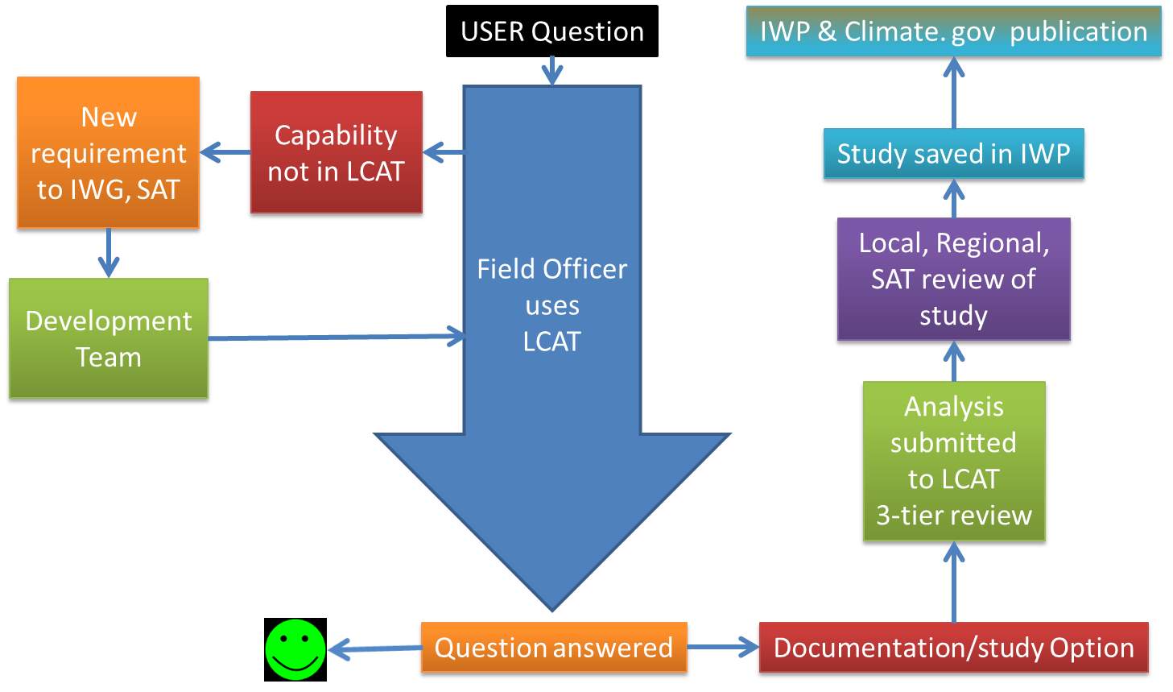
LCAT Essentials Peer review and coordination process

Slide 5
How does LCAT work?
LCAT uses principles of Artificial Intelligence to connect humans with computing capability to apply data and scientific techniques
How is the temperature in my town changing?
Data: Homogenized station maximum temperature
Analysis: best practices for trend; rate of change
Output: statistics, plots, metadata
NWS Forecasters
LCAT
Should we expect floods during La Nina events?
Data: Homogenized precipitation and river flow
Analysis: composites, risk assessment
Output: statistics, plots, metadata
How severe is the drought in my region this year?
Data: Drought indices
Analysis: time series analysis
Output: statistics, plots, metadata
Temp, precip, 30 years…………………………………..
Which climate model performs best in my region?
Data: Reanalysis and GCM fields
Analysis: downscaling, sensitivity tests
Output: statistics, plots, metadata
What are the projections for climate in my region?
Data: GCM outputs
Analysis: downscaling
Output: statistics, plots, metadata
Notes:
Ears, mouth, arms, brain – we train the brain.

Slide 6
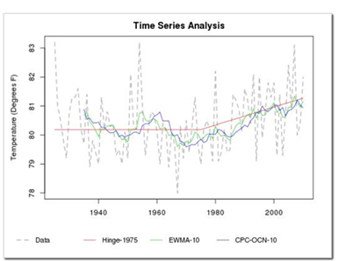
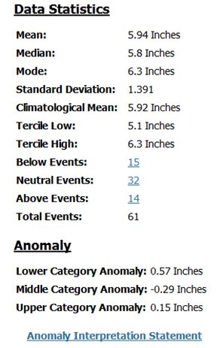
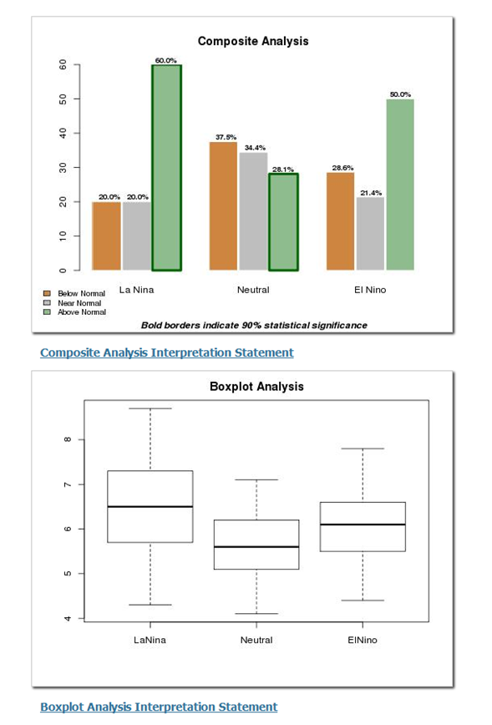
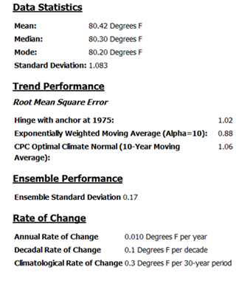
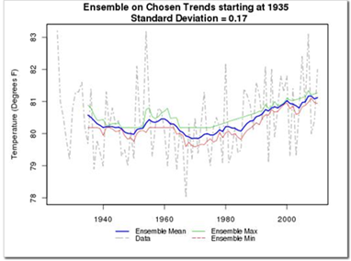
LCAT Output
Climate Change Impacts
Climate Variability Impacts
COOP Data: TALLAHASSEE WSO AP, FL
Variable: Average Temperature (degrees F)
Climate Division Data: Florida Panhandle
Variable: Total Precipitation (inches)
Link to LCAT Developmental Site

Slide 7
LCAT Milestones
Activity | Date
Complete LCAT Documentation and Training Modules | March 2013
Operational Deployment: Climate Variability Study (T/P data for station, CPC FR, NCDC CD) Climate Change Study (ENSO, T/P data for station, CPC FR, NCDC CD, 20 NCEP R1 fields) Correlation (20 NCEP R1 fields + 20 Climate Variability modes) | March 2013
Augmenting Datasets ACIS – extremes data NCDC Severe Weather NOS sea level | September 2013
DOE Year 1 User requirements Global gridding Reanalysis data | August 2013
DOE Year 2 New computational analysis capabilities for DOE applications Implement new web design Access CMIP5 data | August 2014

Slide 8
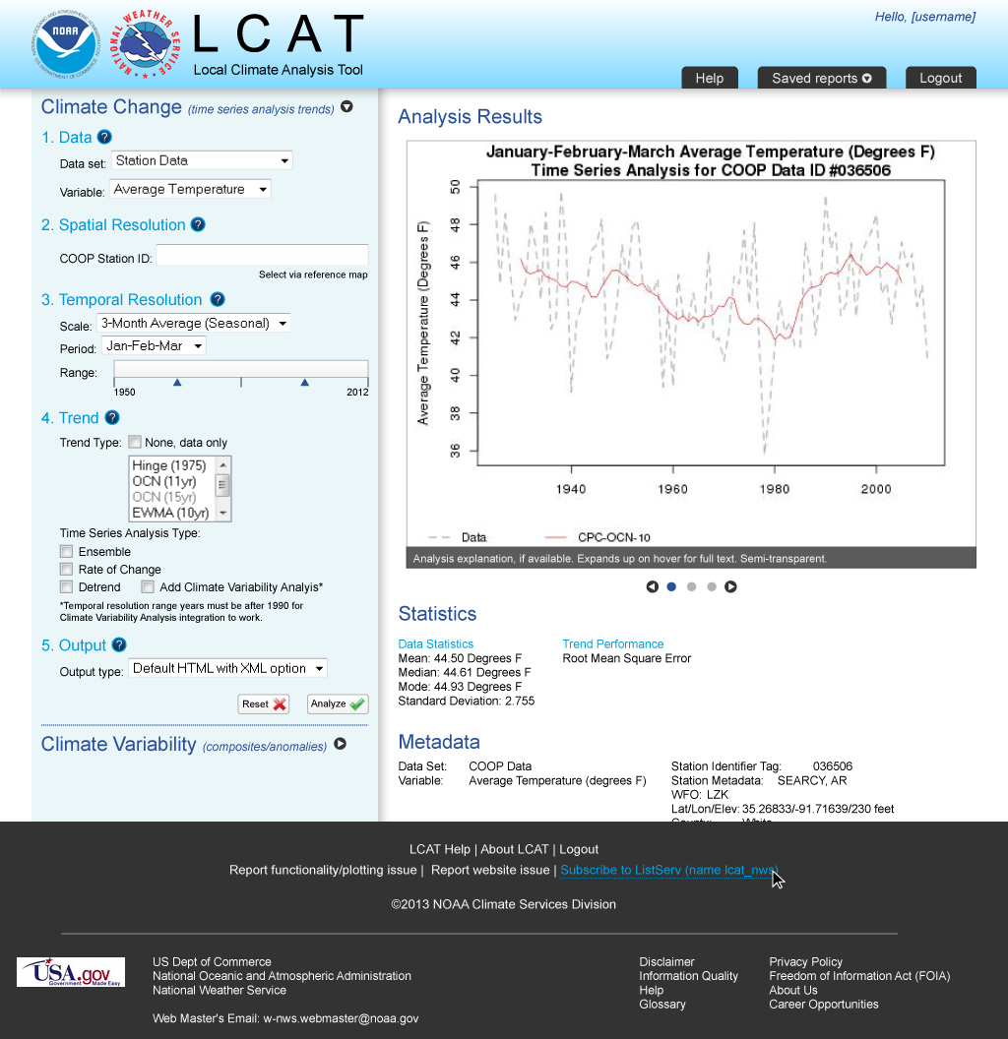
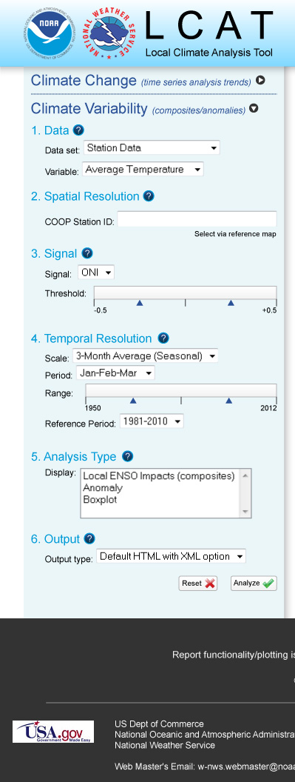
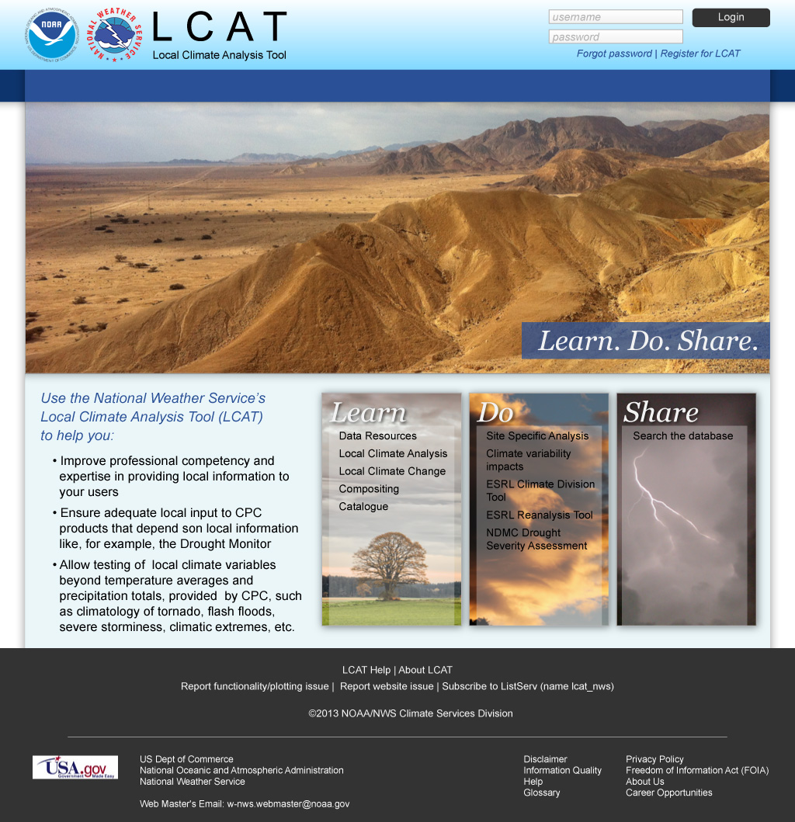
LCAT New Operational Look and Feel

Slide 9
LCAT – Learn
Total of 6.5 h of recorded training:
LCAT Utility
LCAT Data
LCAT Methods
LCAT Applications
Online guidance
Available in the end of March – April 2013
Online Help buttons and Dynamic Interpretation will bridge the gaps
We will rely on CSPMs and SOOs for ensuring proper training and utility of LCAT in operations

Slide 10
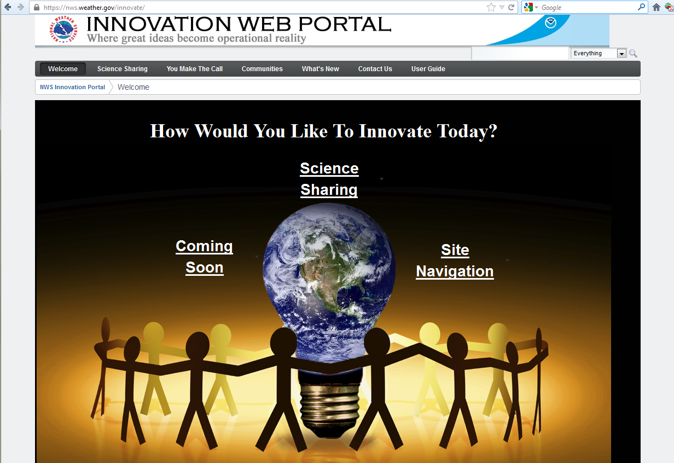
LCAT – Share
LCAT will leverage MDL Innovation Web Portal (IWP, OSIP project 11-002), a common, virtual, dynamic, interactive environment for field developers, meteorologists, other NOAA/NWS personnel, and partners to collaborate, share information, validate needs, exchange innovative ideas, concepts, research/science and technology information
https://nws.weather.gov/innovate/
Advantage:
Merging Climate Studies into the suite of NWS innovations
Use of existing capabilities
Located at the same operational server, and
Search for climate across broader data

Slide 11
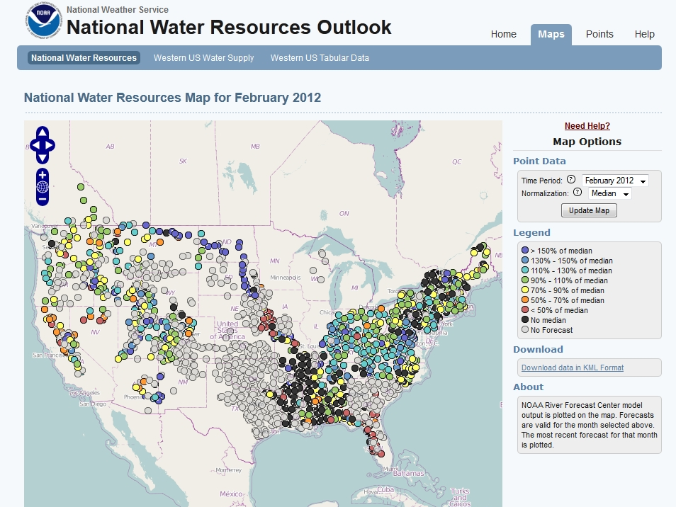
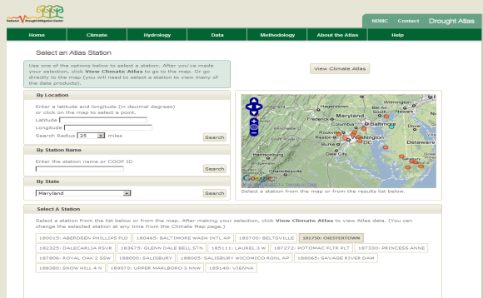
Water Resources Applications and Drought Studies
LCAT capabilities developed in partnership with
NIDIS
National Drought Mitigation Center (NDMC)
NWS Office of Hydrological Development (OHD)

Slide 12
LCAT – Shift of Priorities
DOE Project – with relevance to NOAA
Reanalysis data – CFSR
Grid point data
Averaging over a region
Model data at grid points and regions
CMIP / IPCC models – AR5
What’s next?
CFSv2, FIM
7 models of the NMME
New LCAT Application
Validation/evaluation of climate model output/performance by region
Analysis of regional trends in climate models
Spatial correlations of climate phenomena
Extracting climate signals from model data

Slide 13
LCAT – Shift of Priorities
The project is supported for 1 year, expiration in September 2013, with potential of extension up to 3 years
Support for:
Prescient Weather
NWS Local Climate Specialist
NWS contribution: support for Web development for LCAT integration

Slide 14
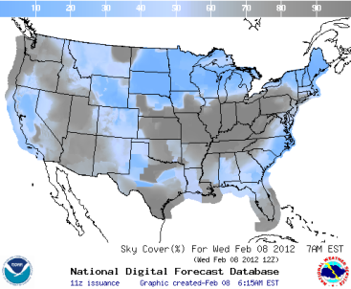
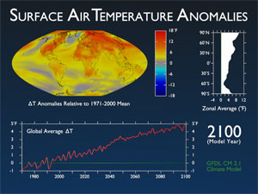
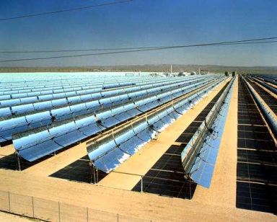
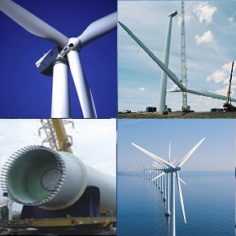
LCAT Future
Data and analyses for energy industry support
What has been the maximum wind speed over the past 30 years?
What is the projection for the next 20-50 years?
What is the average daily cloud cover in a region during an El Niño winter?
What is the average radiation in the North East when the AO is in the negative phase?

Slide 15
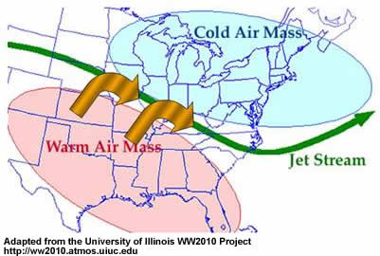
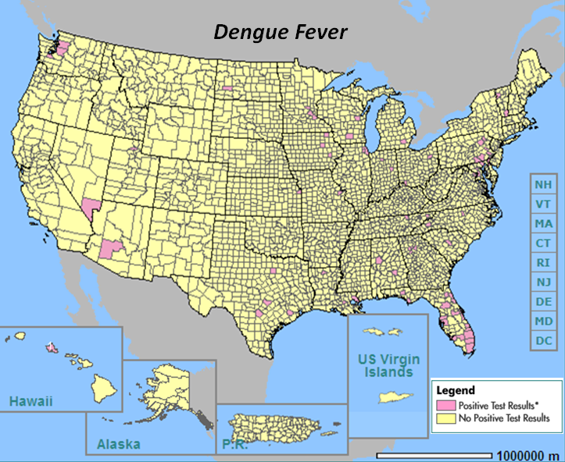
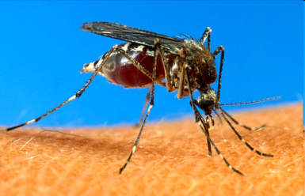
LCAT Future
Weather and Climate Extremes
Relative humidity, upper air, storminess, lightning, tornadoes, snow, radiation, large hail, high winds, lightning, winter storms, blizzards, tropical storms and hurricanes, flooding, dust storms, radiation, drought
What is the frequency and return period of extreme precipitation?
What is hydrologic hazard distribution at a specific watershed?
What is the trend in snowfall in the Pacific NW?
What is the average speed of the midlatitude jet over Kansas during ENSO neutral years?
What is the probability of a greater than average number of hurricanes during a La Niña year?
Health Applications
Mortality, morbidity, vectors, pathogens, contaminants
Is the local climatology favorable for spreading the Dengue Fever vector?
Will a spring drought increase the chance for spread of West Nile virus?
What is the trend in heat-related deaths in Chicago?
What is the relationship between severe precipitation events and the spread of contaminants?

Slide 16
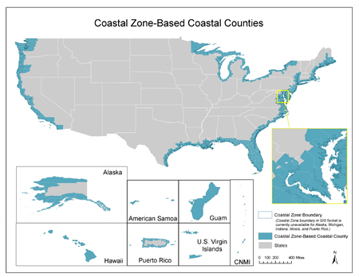
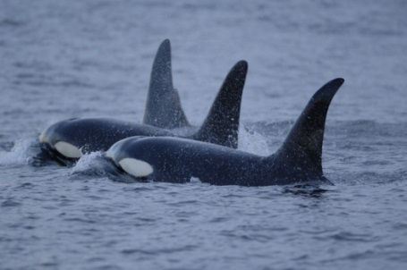
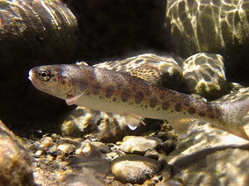
LCAT Future
Coastal Inundation
Incorporation of NOS sea level data and analysis techniques for correlations to regional and local climate variability and change
What are water level extremes during El Niño or La Niña events?
Are there seasonal extremes?
Marine Ecosystems
Support for Healthy Oceans
NOAA Habitat Blueprint: A framework to improve habitat for fisheries, marine life, and coastal communities
Relating climate variables with relevant data sets
Fisheries
Habitats
Iconic species
Climate change impacts to the ocean
Sea level
Acidification
Warming Water level (tides, etc.) and climate signals for coastal regions

Slide 17
Final Thoughts
LCAT is a unique, revolutionary tool for data analysis
Relieves user of burden of
Identifying which data is the most relevant and reliable
Identifying which analysis technique to use that is most appropriate and scientifically sound
Developing codes for data access and analysis techniques
LCAT has application for priorities of both Weather-Ready Nation strategy and the Climate Goal objectives
LCAT potential includes
Comprehensive environmental study of climate impacts at regional and local levels
National and global applications
Historical data out to climate projections
Partnerships growing
State Climatologists – joint proposals for analysis of state climates
DOE support for accelerated LCAT development to meet their needs
Fisheries for stock analysis
Marine Sanctuaries for management of protected areas and climate adaptation planning

