Slide 1
Local Climate Analysis Tool
(LCAT)
Marina Timofeyeva and Fiona Horsfall
National Weather Service
Climate Services Division
September 2012

Slide 2
What is the Local Climate Analysis Tool (LCAT)?
Developed originally to support NWS field offices
Online interactive tool
For regional and local climate studies
State-of-the-art station
Best practices for climate analysis
Variables beyond average temp and precip
NWS Field Office Need for LCAT
Easy access to standardized, scientifically sound methodologies for local climate analysis to meet growing needs of users
Manipulate and interpret local climate data
Make weather-climate linkages for better forecasts
Characterize climate impacts on water and weather elements

Slide 3
How does LCAT work?
LCAT uses principles of Artificial Intelligence in connecting human and computer perceptions on application of data and scientific techniques in multiprocessing simultaneous users’ tasks
How is the temperature in my town changing?
Data: Homogenized station maximum temperature
Analysis: best practices for trend; rate of change
Output: statistics, plots, metadata
LCAT USERS
LCAT
Should we expect floods during La Nina events?
Data: Homogenized precipitation and river flow
Analysis: composites, risk assessment
Output: statistics, plots, metadata
How severe is the drought in my region this year?
Data: Drought indices
Analysis: time series analysis
Output: statistics, plots, metadata
Which climate model performs best in my region?
Data: Reanalysis and GCM fields
Analysis: downscaling, sensitivity tests
Output: statistics, plots, metadata
What are the projections for climate in my region?
Data: GCM outputs
Analysis: downscaling
Output: statistics, plots, metadata

Slide 4
LCAT Process
USER Question
Climate. gov publication
New requirement to IWG, SAT
Capability not in LCAT
Field Officer uses
LCAT
Study saved in LCAT
Local, Regional, SAT review of study
Development Team
Analysis submitted to LCAT
3-tier review
Question answered
Documentation/study Option

Slide 5
What is the Local Climate Analysis Tool (LCAT)?
The LCAT Process
The Integrated Working Team (IWT) identifies and communicates field requirements and assists in training development – NWS staff
The Science Advisory Teams (SATs) are composed of subject matter experts that recommend and approve scientifically sound methodologies – subject-matter experts
The LCAT Development Team (DT) organizes activities for the SATs and IWT, delivers training, and produces the tool – CSD, OST, and contractors
Integrated
Working
Team
Drought Analysis and
Impacts
Climate Change
Impacts
Science
Advisory
Teams
Climate Variability
Impacts
Water Resources
Applications
LCAT
Development
Team
Attribution of
Extreme Events

Slide 6
Five Science Advisory Teams
Science Advisory Teams are comprised of subject matter experts to research, review, and recommend ready-to-use methods, best practices, and tools for use in LCAT
Drought Analysis and Impacts
Team members:
NCDC, CPC and NDMC, WRCC
Identify best practices and tools for drought analysis
Types of tools:
Drought portal drought atlas, drought impact reporter, etc
Climate Change Impacts
Team members:
NCDC and CPC
Identify best methods for trend fitting and analysis of climate change
Type of Analysis:
OCN, EWMA, Hinge-fitting
Climate Variability Impacts
Team members:
CPC and ESRL
Remain consistent and transparent with CPC methods for climate variability
Types of Analysis:
Box and whisker plots
Water Resources Applications
Team members: CBRFC, WWA RISA
Best practices for applications and climate studies for water resources
Types of Tools:
Water Resource Outlook tools: stream-flow variability, ensembles, etc
Attribution of Extreme Events
Team members:
ESRL, CPC, and NCDC
Best practices and tools to identify and communicate climate signal in extreme meteorological and hydrological events
New science; tool will be developed as methods become available

Slide 7
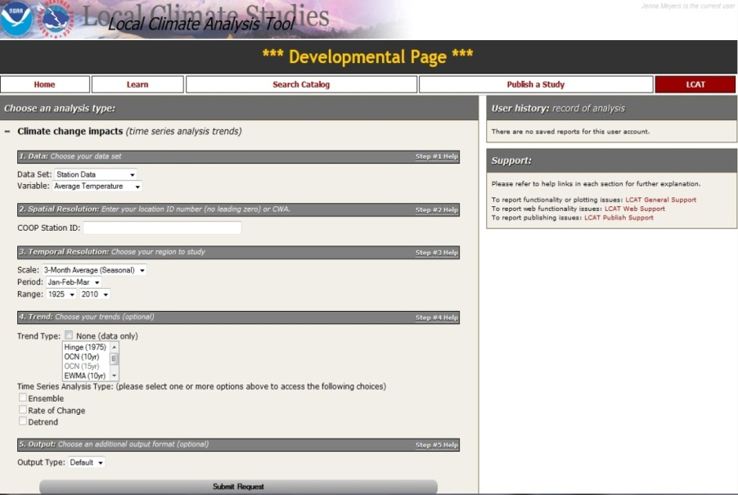
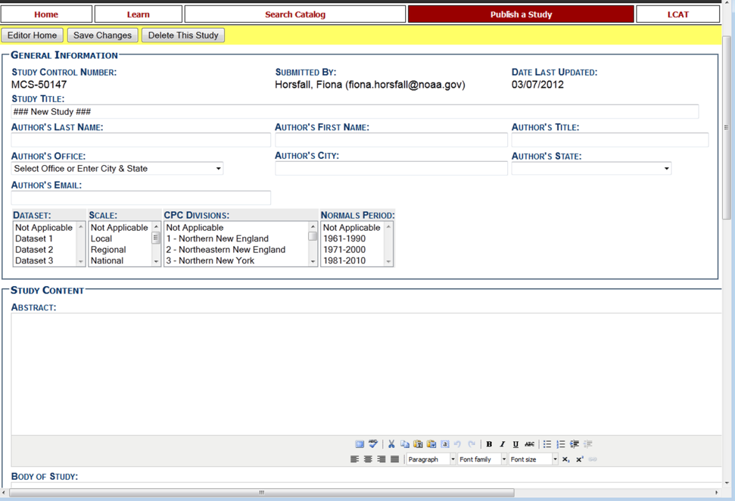
LCAT allows users to define their analysis by selecting
Data (climate division or station)
Time period of interest
Climate variable
Method(s) of analysis
Output format
Climate reports can be saved to contribute to attribution or other studies
LCAT current location:
https://apps.weather.gov/lcat/_dev/index.php?lcatArea=lcat

Slide 8
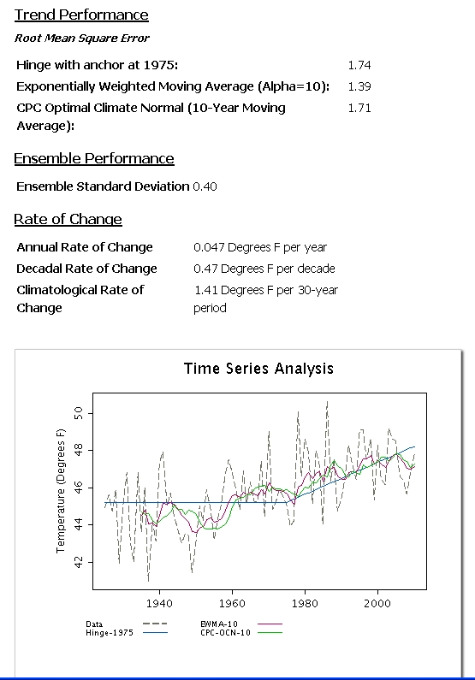
Enabled Studies
Climate Change Impacts
Trend Type
Hinge | EWMA | OCN | Ensemble
Best fit line (Slope = 0) 1950 – 1976 Best fit line 1976 - 2010 | Exponentially Weighted Moving Average | Optimal Climate Normal | Average of all trend values
Selection of Best Practices Case study -- Local Rate of Climate Change
SAT (trend) considered available practices for time series analysis and recommended three trend-fitting techniques
Ensemble mean and variance provide additional information about the uncertainty inherent in the data and methods utilized in the analysis
Development is ongoing and will be in coordination with internal NOAA offices (CPC, ESRL, NCDC) and external partners (state climatologists, RCCs, etc)
Climate Study Reports are generated by LCAT, and include all graphs and tables of the data analysis, along with the variables selected by the user

Slide 9
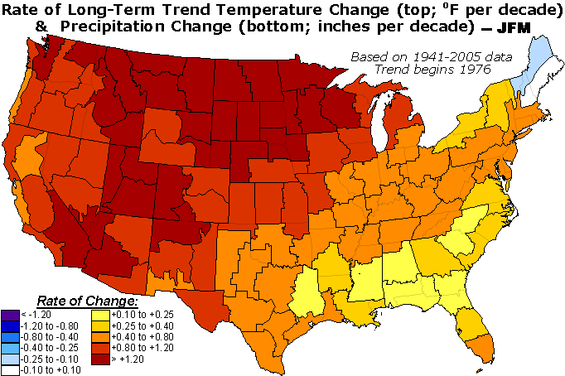
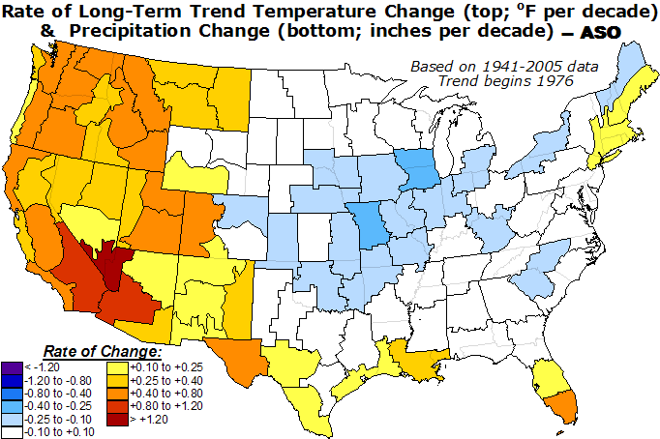
Testing LCAT Best Practices
Climate Division
Stations
(Inches per decade)
http://www.cpc.noaa.gov/trndtext.shtml

Slide 10
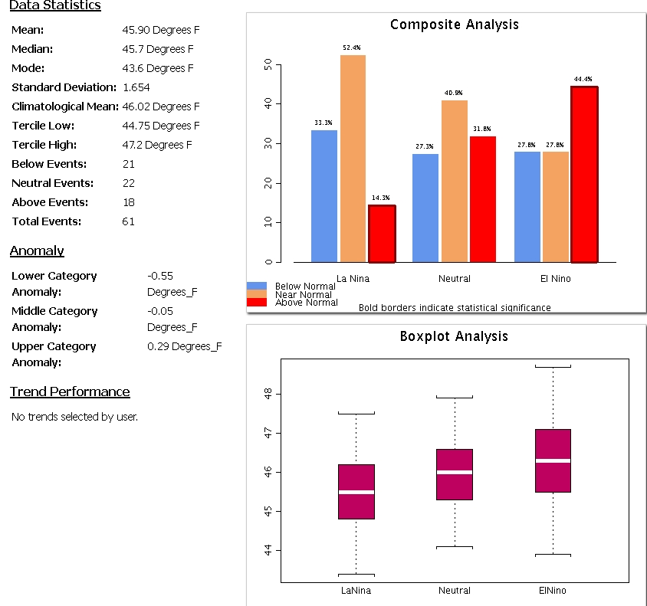
Enabled Studies
Climate Variability Impacts
Identifies is there is a relation between local climate element and climate variability event
Use an analysis of conditional probability or frequencies of occurrence of at least two events together, commonly called composites
Compositing is an alternative method to linear regression commonly used for comparison of two time series, but does not require any underlining distribution assumption of dependent and independent variables

Slide 11
Testing CV Impact Significance
Test of composites statistical significance uses Hyper-Geometric Distribution for possible outcomes of climate variable category (B/A) observed within La Nina or El Nina sample
Helps to identify if there is a relationship between ENSO events and the category (Alternative Hypothesis)
The one-tail test conducted at 90% confidence level for both tails
Probability (P[x])
Probability (P[x])
Left Tail
Right Tail

Slide 12
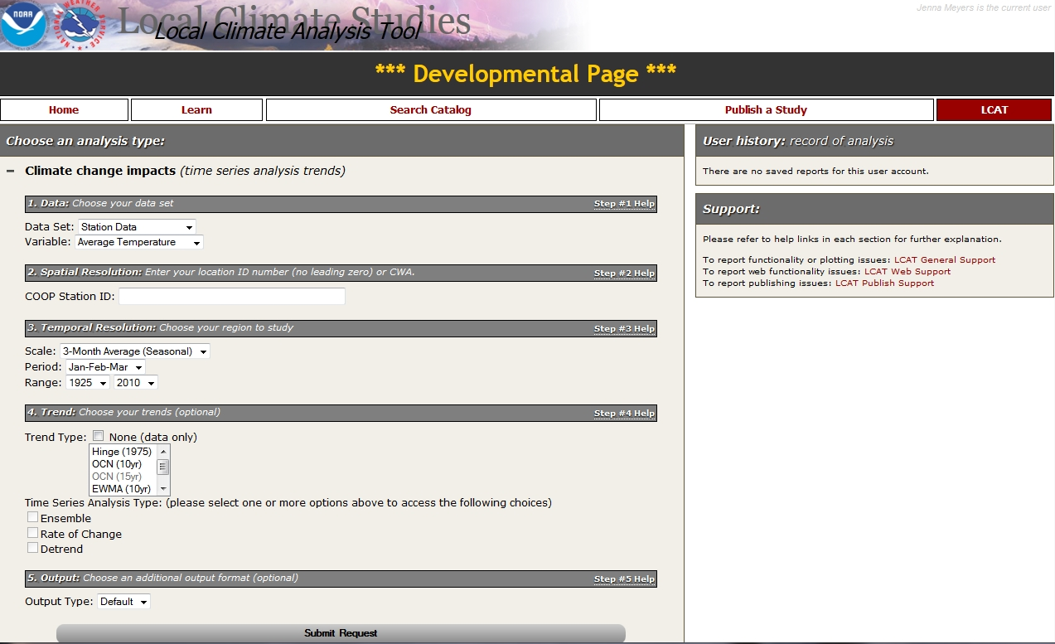
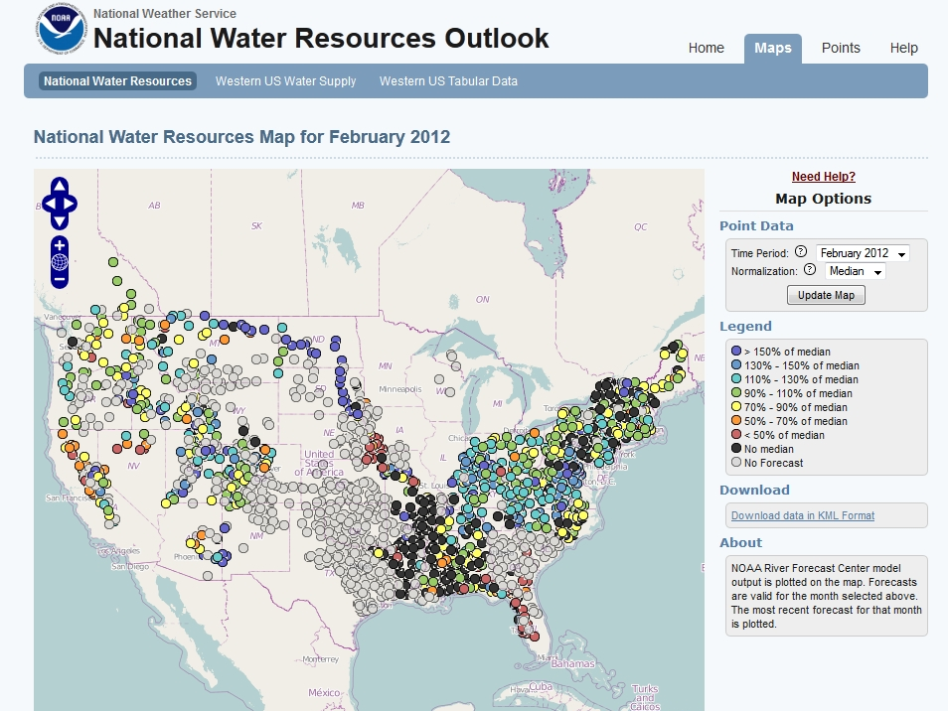
Water Resources Applications
LCAT will include links to relevant external climate analysis tools such as the National Water Resource Outlook webpage

Slide 13
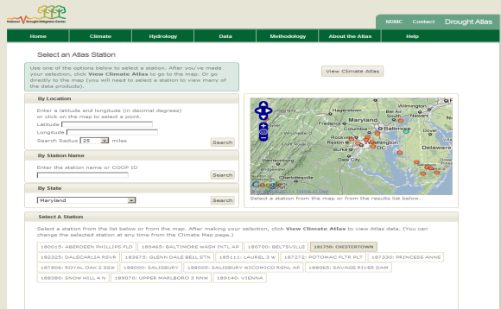
Drought Analysis and Impacts
LCAT will include links to relevant external climate analysis tools such as the Drought Atlas (coming soon)

Slide 14
Currently Under Development
By September 2012
Trend communication between Climate Change & Climate Variability sections
Additional output statistics displayed
Enhancements to help buttons and references
Personalized report labeling for easier reference
Reference maps for Climate Divisions, County Warning Areas, and station locations
Additional output formats available (comma-, space- or tab- delimited, XML, PDF and Excel)
Analog signal years displayed (e.g., years that were La Niña or El Niño)
Additional data sets:
Alaska and Hawaii stations
NCDC Climate Division Data
NOS Sea Level Stations
LCAT FY13 plans
Tuning ONI index capability
Addition of Climate Variability Indices (NAO/AO, SOI, MEI )
Functional link between xmACIS data and LCAT
Additional statistical analysis options (e.g., Multiple linear regression, logistic regression, PCA, etc.)
User defined variable seasons (e.g. 2- , 4-month or 6-month periods)
Increase of spatial options (e.g. county or state wide)
Additional options for definition of climate variable (e.g., critical value)
Multiple signal option combinations (e.g., Negative ONI with Positive AO)
Drought studies (incorporation of drought data)
Trouble Ticketing system implemented
Functionality improvements
Publication process available
Additional data sets:
Pacific Island Data sets
Reanalysis data
Unique data sets

Slide 15
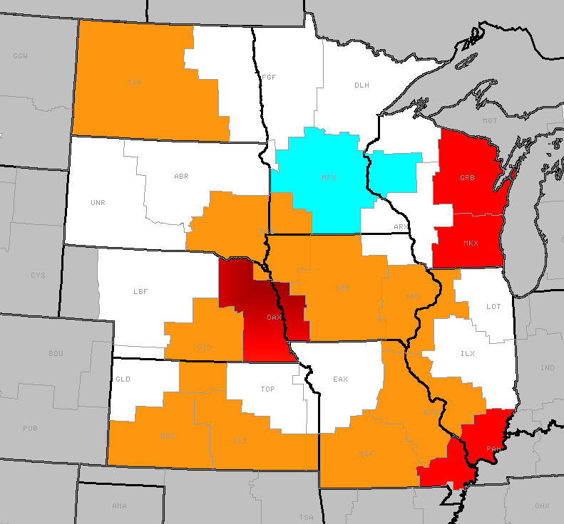
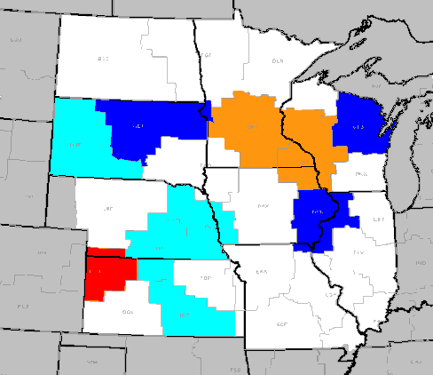
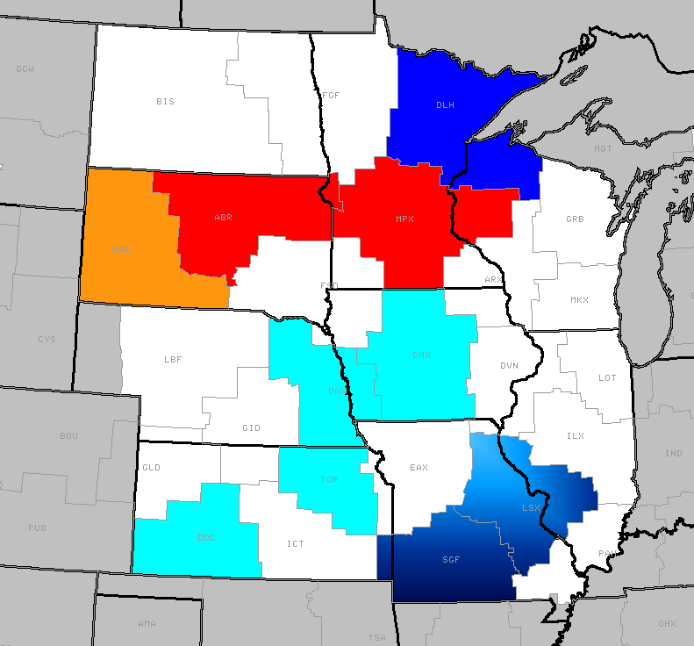
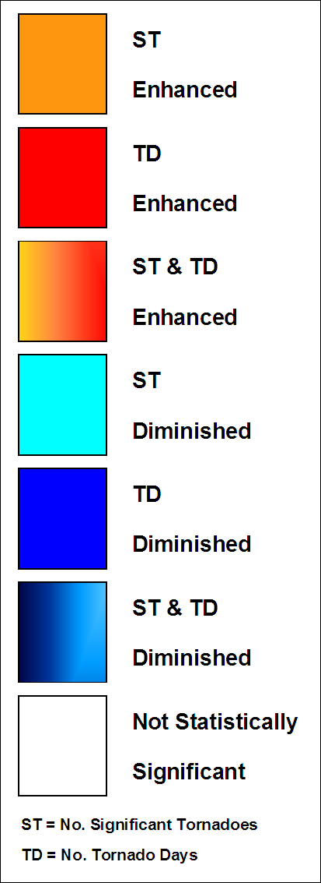
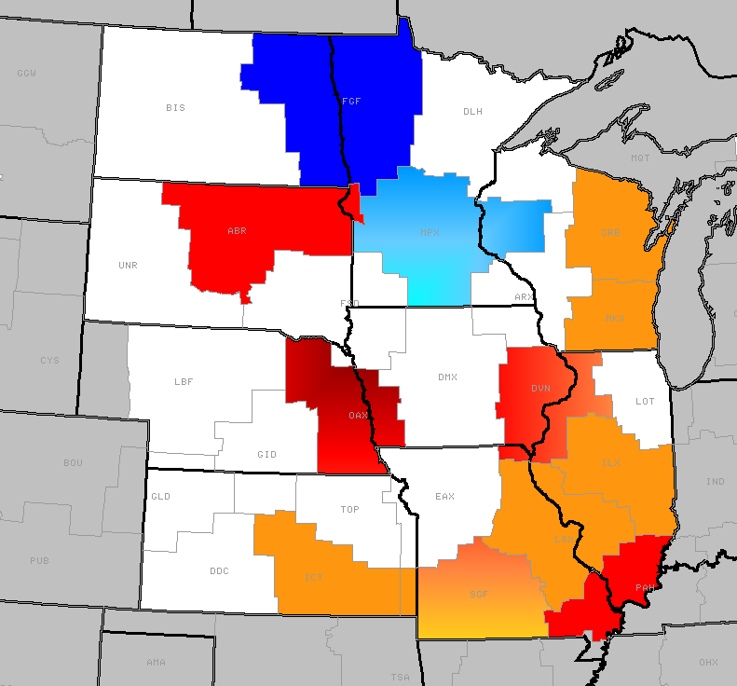
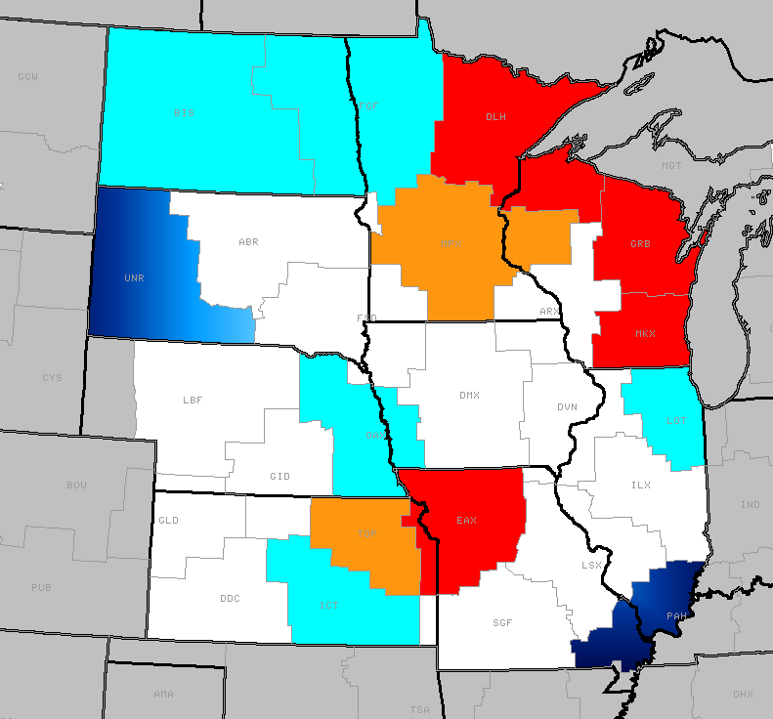
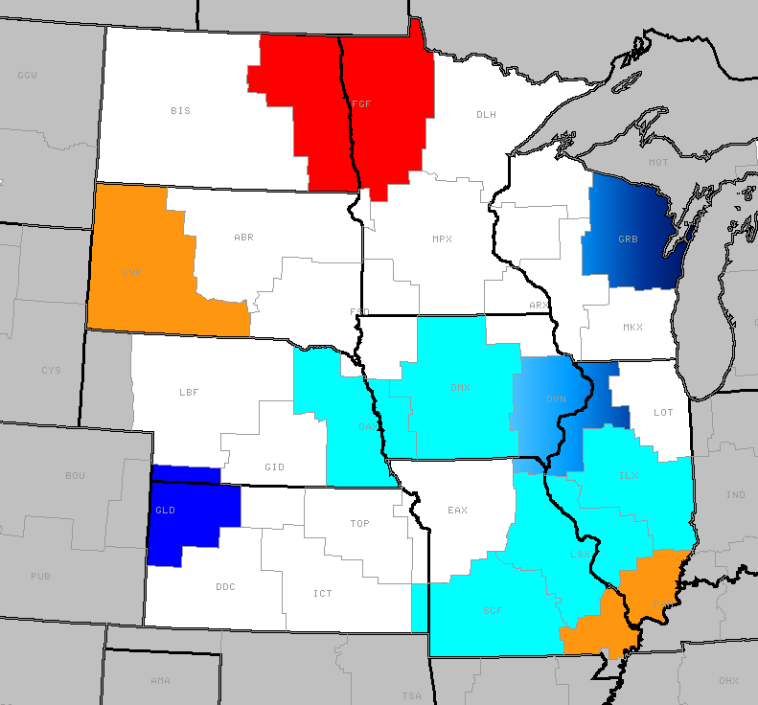
LCAT Future
Incorporation of additional data sets (severe weather, snowfall, number of days with extremes, extreme time series, etc.) will enhance IDSS capabilities by providing integrated environmental services
La Niña
Neutral
El Niño
Yearly
MAMJ

Slide 16
LCAT Future
To answer request to NWS from FEMA/WH
Capability to query database for historical information, trends and relationships to ENSO signals for high impact weather events for local, regional, and national geographical scales
Tornadoes, large hail, high winds (convective and non-convective), winter storms, blizzards, tropical storms and hurricanes, flooding, dust storms
For use prior to and during high impact events

Slide 17
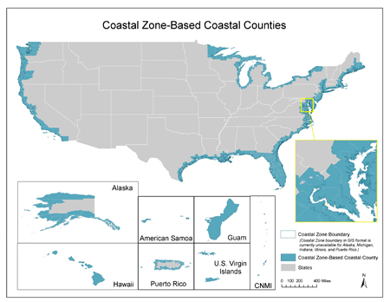
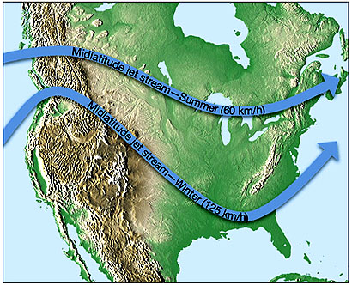
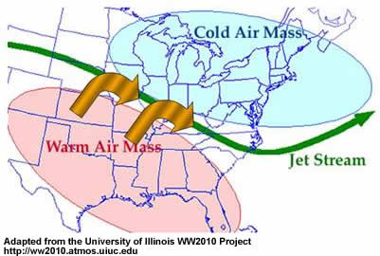
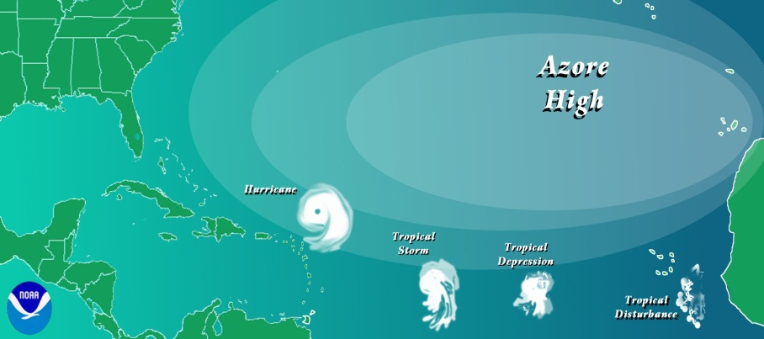
LCAT Future
Water level (tides, etc.) and climate signals for coastal regions
What are water level extremes during El Niño or La Niña events?
Are there seasonal extremes?
Does the AO affect water levels on the NE coast?
Relative humidity, upper air, storminess, lightning, tornadoes, hurricanes, snow, radiation
What is the trend in snowfall in the Pacific NW?
What is the average speed of the midlatitude jet over Kansas during ENSO neutral years?
What is the probability of a greater than average number of hurricanes during a La Niña year?
From NOAA/HRD

Slide 18
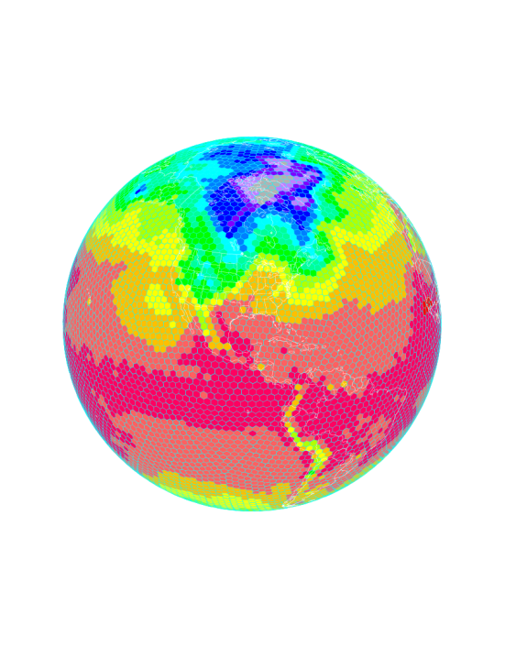
Gridded Data
Reanalysis data – CFSR
Grid point data
Averaging over a region
Model data at grid points and regions
CFSv2, FIM
7 models of the NMME – individual model output and ensemble average
CMIP / IPCC models – AR5

Slide 19
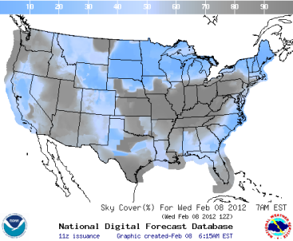
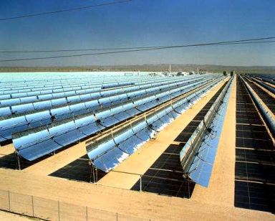
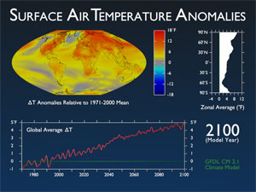
LCAT Future
Data and analyses for energy industry support
What has been the maximum wind speed over the past 30 years?
What is the projection for the next 20-50 years?
What is the average daily cloud cover in a region during an El Niño winter?
What is the average radiation in the North East when the AO is in the negative phase?
Validation/evaluation of climate model output/performance by region
Analysis of regional trends in climate models
Spatial correlations to climate phenomena

Slide 20
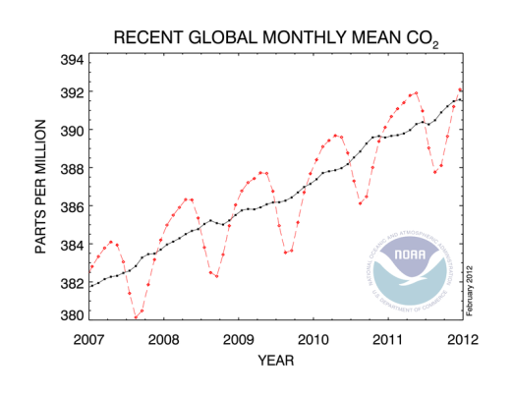
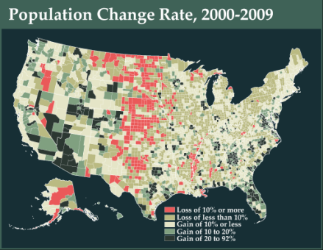
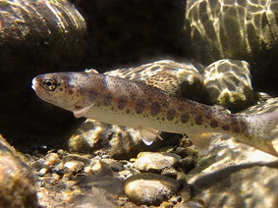
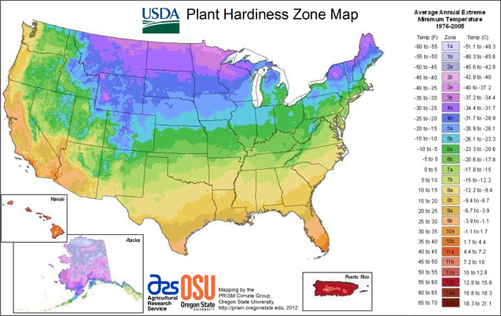
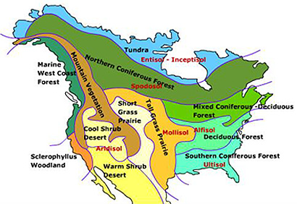
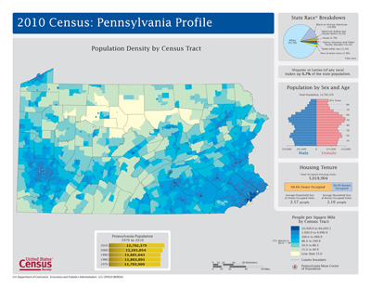
Other Potential Parameters
CO₂ emissions/trends
Satellite data
Biological/physical ocean data
Ecological data for deriving relationships to climate signals (coastal, soil, demographics, vegetation)
NOAA Habitat Blueprint: A framework to improve habitat for fisheries, marine life, and coastal communities

Slide 21
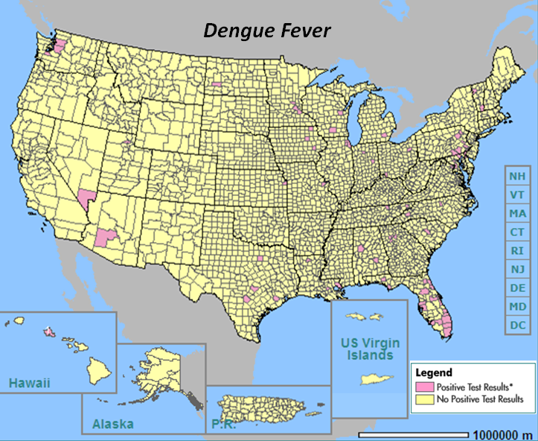
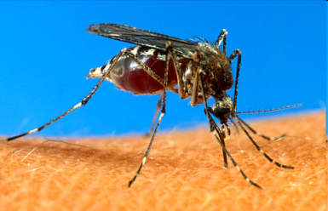
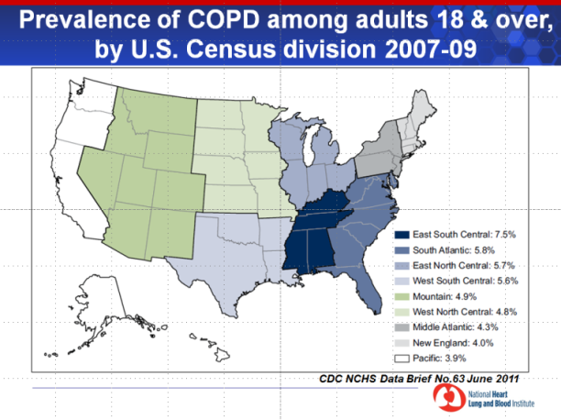
Other Potential Applications
NOAA-CDC Partnership
No-cost means for sharing local climate data with health researchers and decision makers to aid in characterizing climate variability and change impacts on health in local communities
What is the climatology of a region as it pertains to proliferation of a vector to spread Dengue Fever?
If the past winter was warmer than average, what is the probability of a spring drought that will provide a ripe environment for the mosquito carrying the West Nile virus?
Provide temperature, humidity, and air quality analyses to CDC for deriving relationship between climate and incidence of COPD (Chronic Obstructive Pulmonary Disease)
Dengue Fever
Vector + high temperatures, humidity, and low wind speed

Slide 22
Other Potential Partnerships
DOE
NCDC
USGCRP
NOS
Space Weather Program
Marine Weather
Marine Habitats
Fire Weather Program
NWS Corporate Board
Tsunami
NOAA Climate Test Bed

Slide 23
Summary of LCAT Strategic Steps
Purpose | Function | Needed Data | Methods
Support for Weather-Ready Nation - Climate Linkages | Analysis of extreme meteorological and hydrological events | NCDC: Hail, lightening, tornado, height of storm cells, severe storm damages (1995/1950 – present) NCDC: CFS reanalysis and forecast data (local globe-wide) WRCC: extension to ACIS extreme data series | Trends, composites, regressions (linear, logistics)
Improving meteorological services | Validation of past meteorological forecasts | NCDC: NWS severe weather warning data base | Validation techniques: skill scores, sample comparison tests, correlation
Supporting Climate Goals | Drought Studies | NCDC: extension to Drought – ACIS and drought indices | Sample selection/ statistical comparisons.
DOE user needs | Regional/local model analysis, validations | NCDC: CFS reanalysis and forecast data (local globe-wide), NMME model data sources | Earth System Grid Federation Protocols, Open sources coding capabilities, Model validation methods
CDC user needs | Regional/local analysis of climate related health problems | Health data (TBD) | Correlations
Marine and Fisheries | Regional/local data | Marine/fisheries/habitat data | TBD

Slide 24
LCAT Operational Deployment Plan
Activity/Milestone | Scope summary | Responsible | Date
1. LCAT upgrade in response to beta-test | Navigation, data, methods, help support, | OCWWS/CSD & contractors | 09/30/12
2. Define final scope of LCAT operational deployment – phase I | Proposal, coordination, description of LCAT – phase I, solution on LCAT external/internal only utility | IWT, CSD, OST, CSPMs | 10/15/12
3. Transition of LCAT from Apps server to NIDS host | Request, approval, upload of software, technical work, tests | CSD, CSD contractors, MDL, NIDS | 11/30/12
4. Operational LCAT test completed | Benchmarking LCAT results, quality control, SATs approval | OCWWS/CSD & contractors, IWT, SATs | 12/31/12
5. Documentation of LCAT operational routines | Document of Computational routines, Document of Web Architecture, O&M guidance, | OCWWS/CSD & contractors, SATs | 01/15/13
6. Developing LCAT training | Modules: Use of data, Time Series Analysis, Trends in Climate, Methods for Climate Variability Impacts | CSD | 01/31/13
7. OSIP Gate 4 | Documentation, O&M staff support, ownership solution, etc. | CSD, CSD contractors, MDL, IWT | 02/15/13
8. Operational Deployment | Announcement to the fields, outreach support (fact sheets, talking points, etc.) | CSD, MDL, Regional CSPMs | 03/01/13

