Slide 1
LAPS in AWIPS II
Paul Schultz
presentation for two audiences
RITT
20 October 2010
and
LAPS Users’ Workshop
26 October 2010

Slide 2
History of LAPS in AWIPS
Integral component of AWIPS since inception (mid 1990s)
  61 x 61 x 21, Δx=10km, centered on WFO
Support to WFO users has not been up to same standards as other components of AWIPS
  Last update in 2002
Usage of LAPS very consistent at some offices, not at all in others
  Terrain issues were a big turn-off for WR

Slide 3
Current status in AWIPS
LAPStools (found on Tools menu)
  Allows the user to resize and relocate the grid, and change the execution frequency
  Provides convenient access to what-got-in reports
    Shows data sets used in analyses, blacklisted data
Small number of WFO users initializing local models
  Not a very convenient process
    Move data in/out of LDAD
  “Hot start” option giving mixed results
  Thanks to Bob Rozumalski (COMET) for making this practical in the forecast office

Slide 4
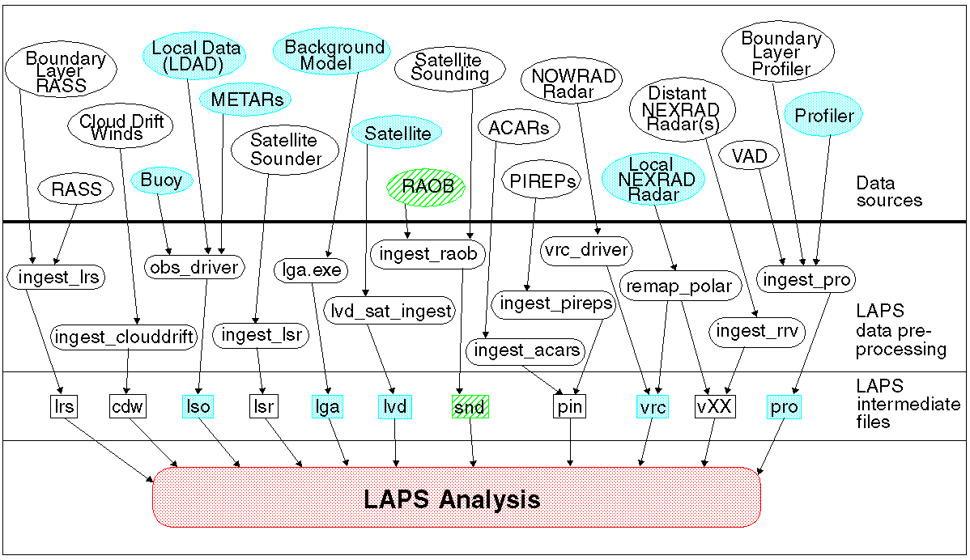
Data sources in AWIPS

Slide 5
What’s missing?
GPS vapor
  First release of AWIPS II
Doppler velocity
  Efficiency issues

Slide 6
First release of AWIPS II (next year)
Orders from APO: replicate what’s on AWIPS
  Permitted exception: new version of LAPS
    Thank you Pablo Santos!
  Done, mostly
New local database: EDEX
  Simple reformatters make EDEX data look like old AWIPS data (netCDF)

Slide 7
AWIPS II basics
Better hardware
Java-based display (CAVE)
  Distinction among display scales is diminished
Service-oriented architecture and migration to Open Geospatial Consortium standards
  Redundant servers for satellite, radar, grids, obs
  Registry/repository conventions
    Being developed jointly by FAA and NWS
  Which data sets should be locally cached?
    All data are cached in old AWIPS
Thin Client

Slide 8
Implications for LAPS
EDEX presents development issues
  Raytheon wants to make it OCG compliant, make it act like a web service. But when?
  Avoid (more) throwaway code
Opportunities
  Easy to get data sets not stored locally
    Reg/rep makes things automatic
  Faster turnaround, more frequent updates
    Faster hardware, more efficient data handling

Slide 9
AWIPS II Thin Client
Primary users: Incident METeorologists
  NWS forecasters on site at fires and other emergencies
Laptop computers powerful enough already
  PADS project
Web services reduce data requirements
  Specify areal subsets
  Minimizes comms requirements

Slide 10
Requirements and desirable features
Downscaler
  Support wildfire incident management
  Urban chemical release or smoke
    GTAS project, link with HYSPLIT
  Grid increments down to 10 m (!)
  New multigrid approach offers much promise
    Eventually replace hotstart
GUI (LAPStools)
  Support local modeling, ensembles, verification

