Slide 1
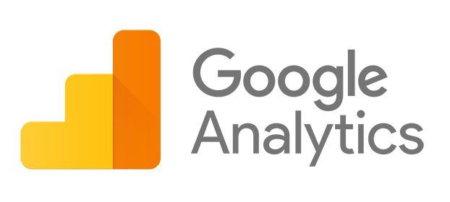
Noel “Shad” Keene
WFO Medford, OR
Who cares about our web presence?
What data?
Data Studio Reports
Enhancing IDSS
80/20 Rule
Notes:
Google Analytics is simply a tool to objectively quantify the reach of our web presence. Its value within our agency is closely linked to the value of our web presence. If our web pages are an important medium for communicating our observations, forecasts, watches and warnings, then it follows that we’d want to try to measure the effectiveness of this communication method.
I’m a vocal proponent of our web pages. I believe they have both internal an external utility. Internally, we create weather and climate-related tools and platforms for collaboration. Externally, we have the unique opportunity to communicate directly with public and partners on content we control, without the filter of 3rd party platforms that may or may not share our exact mission and goals.
Since GA is connected to the value of our web presence, I’ll first try to highlight the value of our web pages, both quantitatively and qualitatively.
Here’s what I’m going to discuss today

Slide 2
90 million annual web communications with partner agencies
Notes:
Google Analytics is simply a tool to objectively quantify the reach of our web presence. Its value within our agency is closely linked to the value of our web presence. If our web pages are an important medium for communicating our observations, forecasts, watches and warnings, then it follows that we’d want to try to measure the effectiveness of this communication method.
I’m a vocal proponent of our web pages. I believe they have both internal an external utility. Internally, we create weather and climate-related tools and platforms for collaboration. Externally, we have the unique opportunity to communicate directly with public and partners on content we control, without the filter of 3rd party platforms that may or may not share our exact mission and goals.
Since GA is connected to the value of our web presence, I’ll first try to highlight the value of our web pages, both quantitatively and qualitatively.

Slide 3
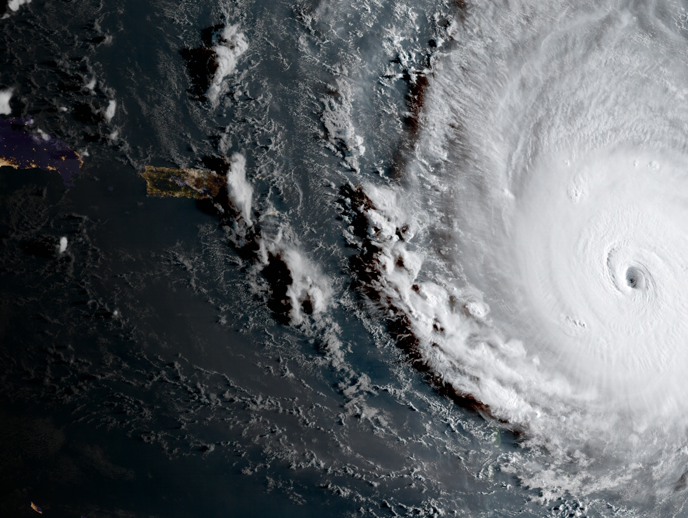
XX million
900
hits
per
minute
Ahead of and during Hurricane Irma Landfall
5-10 Sep
(XX communications per minute)
Source: NOAA
Notes:
In the 6 days before Hurricane Irma made landfall in Florida, there were over 6 and a half million web page visits from partner agencies.
Core partners were actively seeking weather information at a rate of 900 times per minute.
The partners looking most at our web pages during this time included the Navy, FAA, Army, the VA, the State of Florida, and the US Coast Guard.
The US Coast Guard viewed NWS and NOAA web pages 55,000 times in the 6 days ahead for Irma’s landfall.

Slide 4
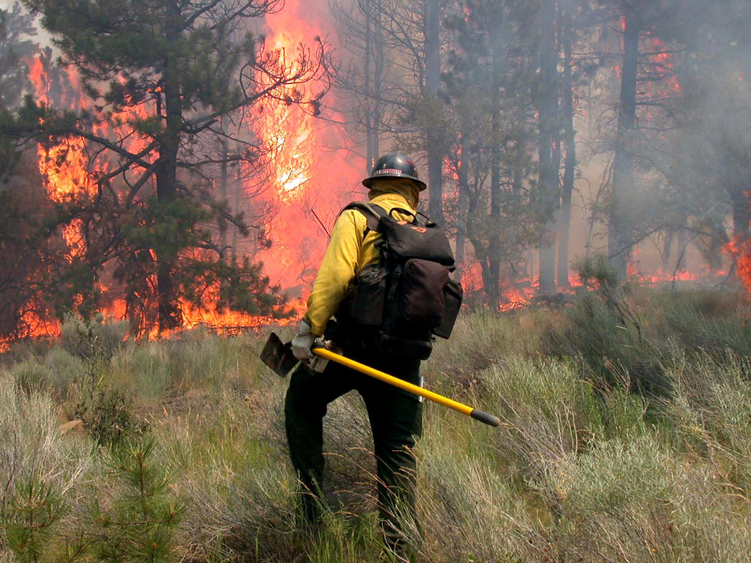
Brett Smith Intelligence Specialist Fremont Winema National Forest
Notes:
Now some qualitative measurements for the value of our web presence. I gave Brett Smith a call a few weeks ago to check with him on our web pages. I’ve never talked to him before about this, but he’s a weather-savvy partner, so I thought he might have some insight. Here’s what he said.
During the offseason, Brett comes into his office in the morning and opens up 6 websites immediately. One of them is the NWS Medford home page. His routine is to look up multiple point-and-click forecasts, sometimes viewing the hourly weather graphs. He reads the forecast discussions regularly.
During fire season, Brett’s usage of the web presence increases. He keeps an eye on observations via the detailed hazards viewer website. Sometimes the information he finds on our web presence prompts him to make a phone call to the office for additional details.

Slide 5
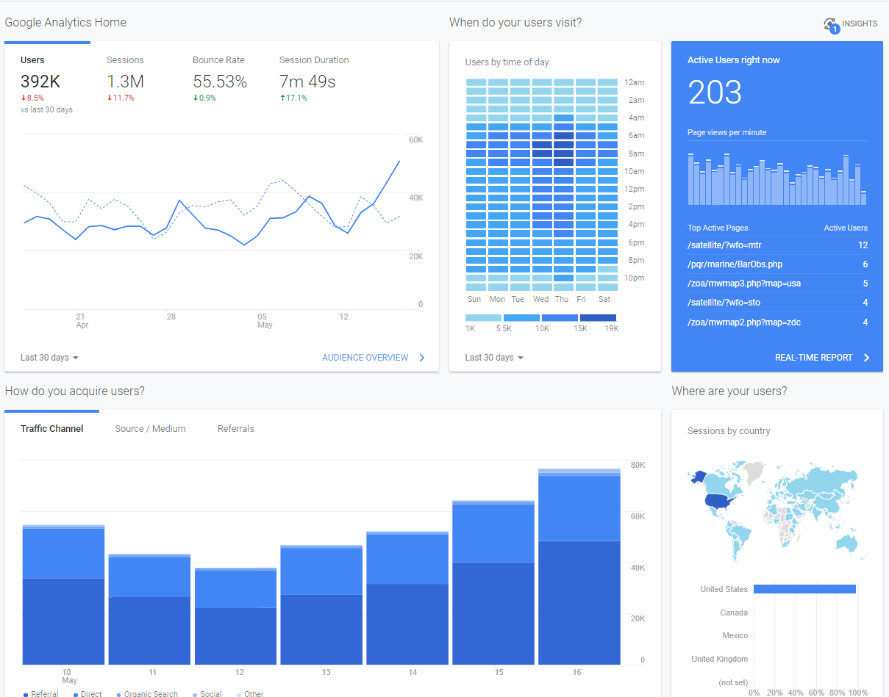
How do I view the data?
Email me. noel.keene@noaa.gov
Notes:
Simple…
So lets’ take a look at the data. I’m going to dig into real-time data today

Slide 6
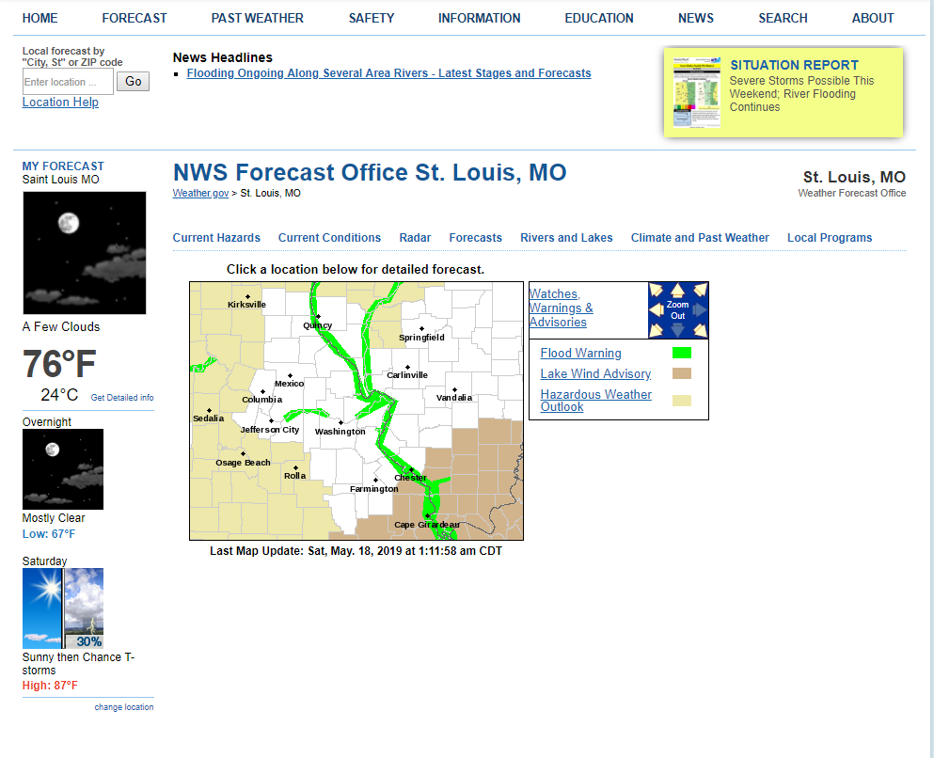

Slide 7
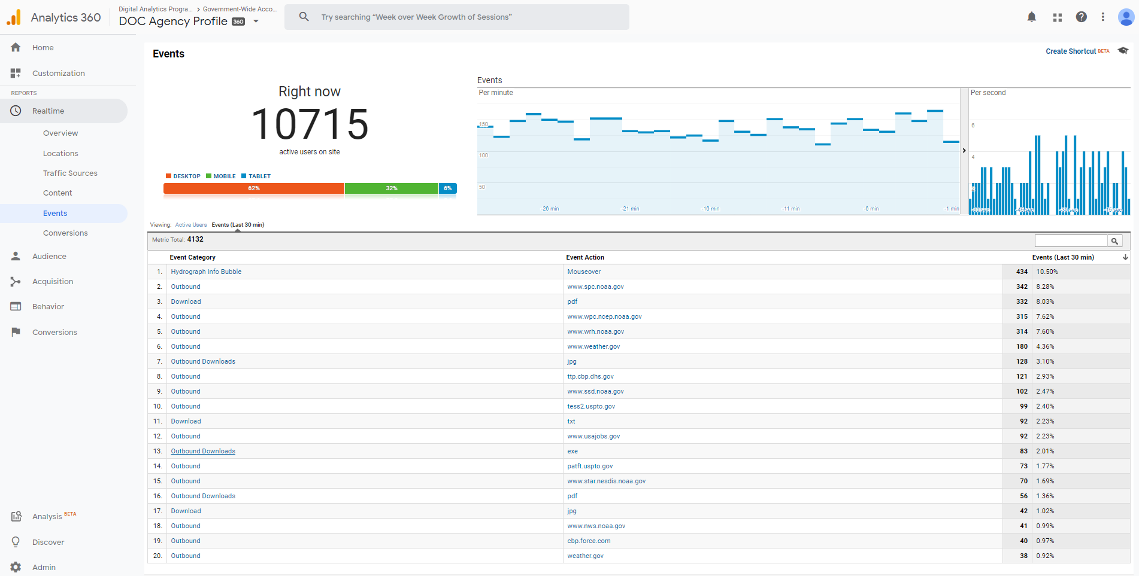
Real-time data: 2am EDT 5/18/2019
Notes:
Real time data…then to events

Slide 8
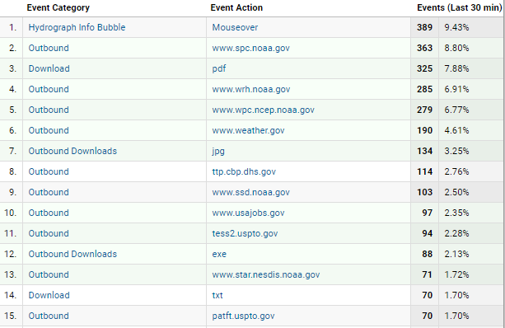
Real-time data: 2am EDT 5/18/2019
Notes:
Then to download…pdf

Slide 9
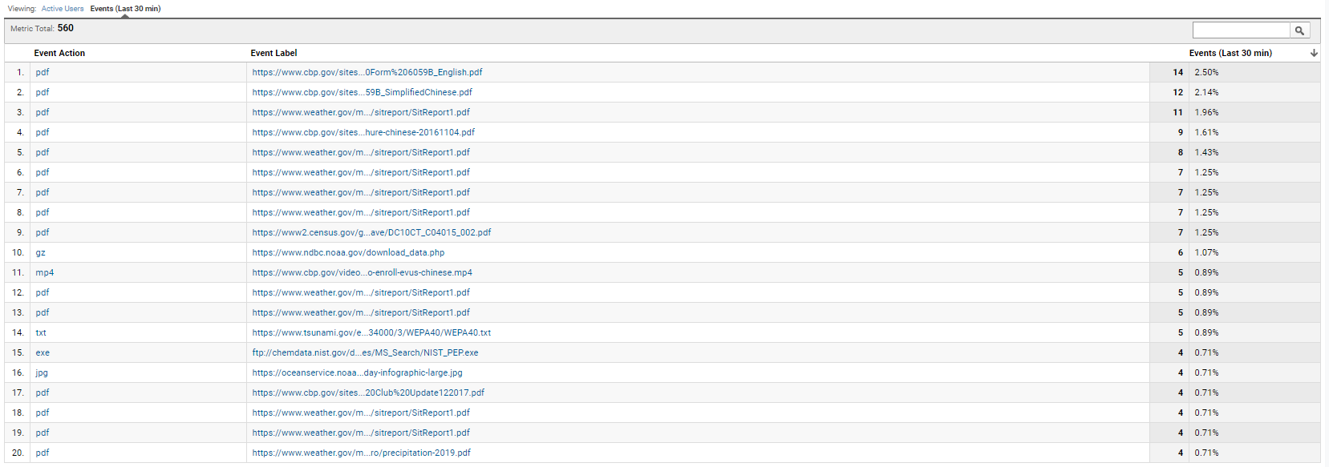
Real-time data: 2am EDT 5/18/2019

Slide 10
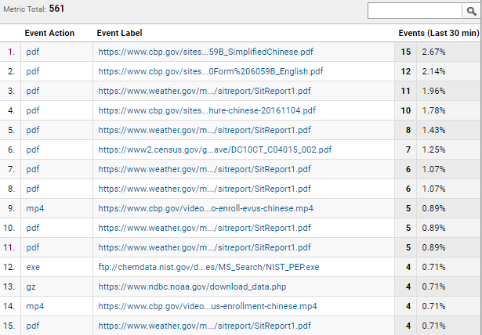
Situation Reports: EAX, ICT, TOP, LSX

Slide 11
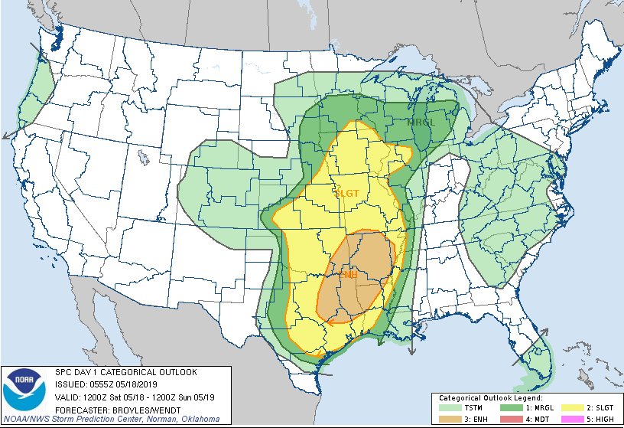
EAX
TOP
LSX
ICT
LZK

Slide 12
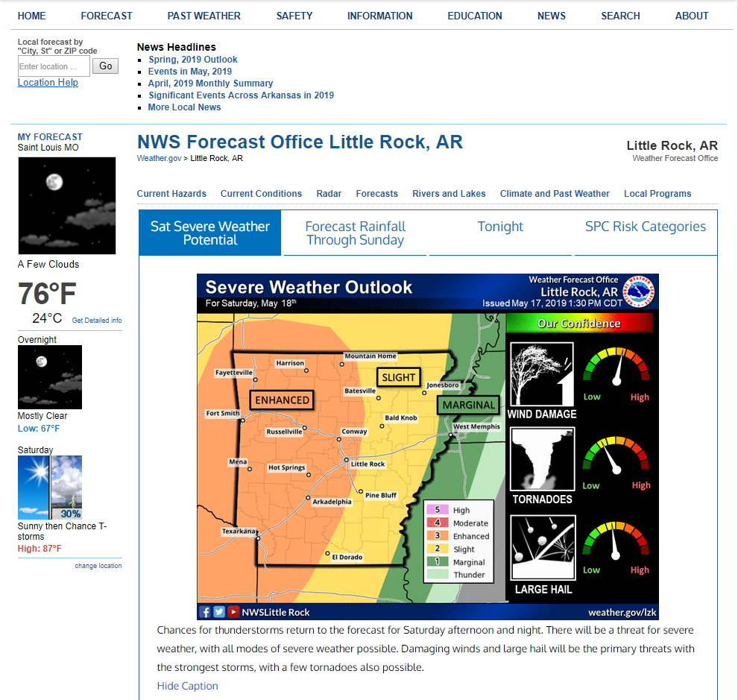

Slide 13
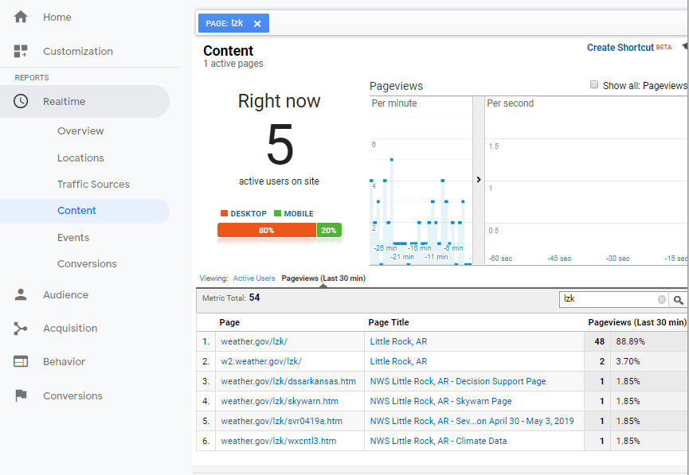

Slide 14
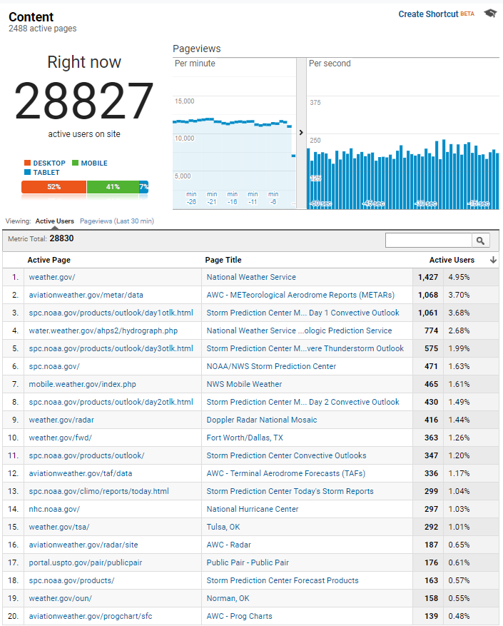
Real-time data: 3pm EDT 5/18/2019

Slide 15
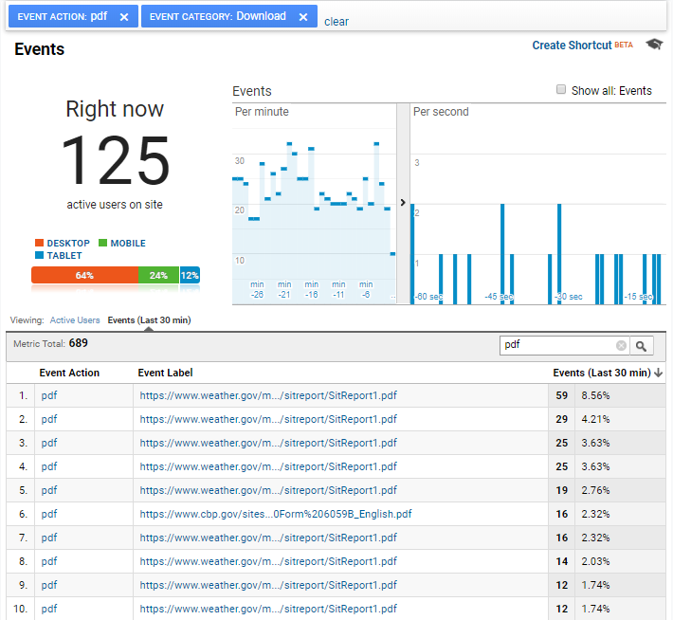
Notes:
Next…some summary statistics about that day.

Slide 16
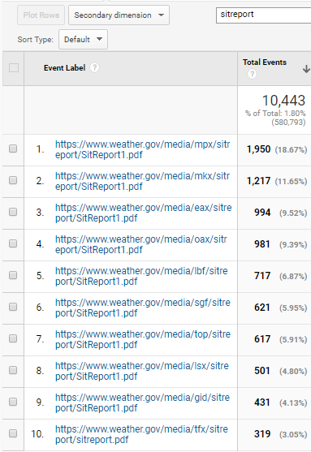
Total Situation Report Downloads May 17 2019

Slide 17
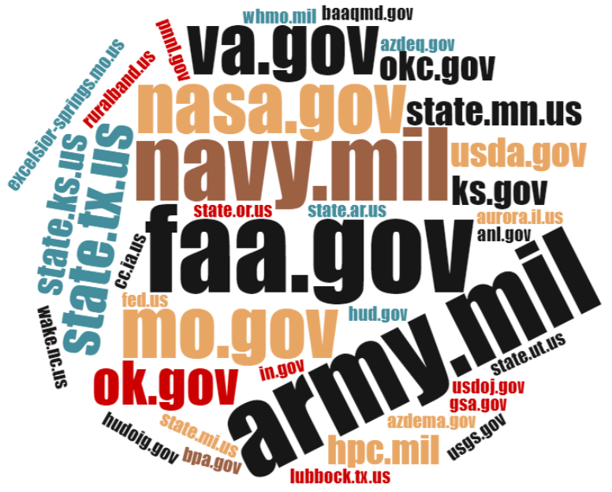
Most frequent SPC
partner
visitors May
17-21
2019
315,000
Total
Pageviews

Slide 18
So how do I view data easily and share this information?
Notes:
SPC data studio…May 17-21
Quick glimpse at pageviews, partner agencies, devices, and internal NOAA usage of products
--Where’s HREF viewer…advertised enough?
Data studio is great for the big picture and if for details when you have hundreds of thousands of visitors per month. However, when you have millions of visitors like SPC, and you want to dig into what partner agencies are visiting that site the most, I recommend unsampled reports.

Slide 19
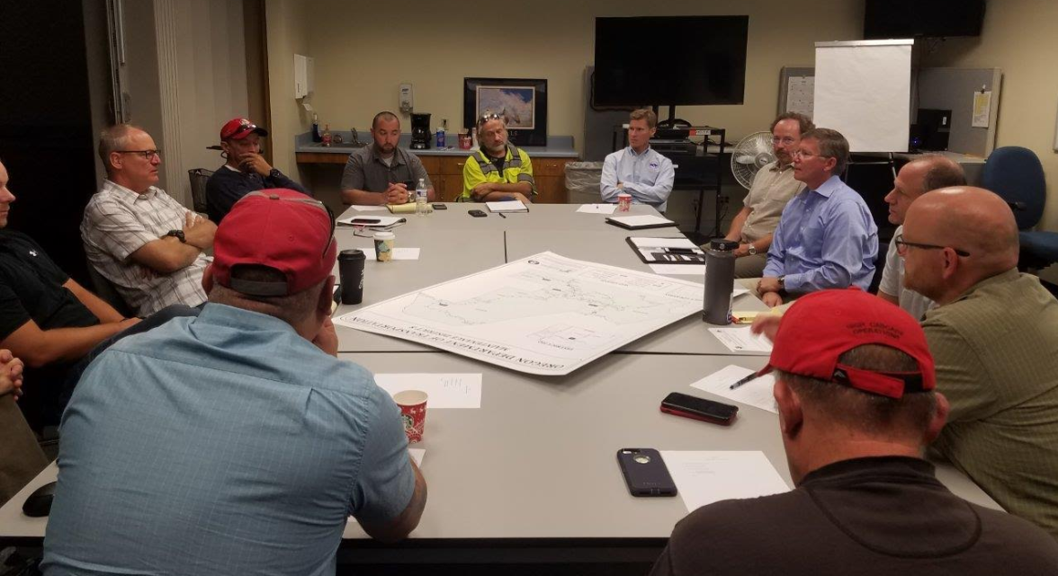
Oregon DOT/Caltrans
Service Advancement
Mobile-friendly web page to better enable weather-related decision-making
Is it effective?
Notes:
Building relationships:
Thoughts on service advancements to DOT partner. Approached them with various options including webinars, conference calls, and a tailored website.
They chose website.
So we built it. It’s really cutting edge—mobile-friendly, intuitive, full graphics suite. Michelle McAuley, now at the Anchorage WFO, did the heavy coding for much of the website, while myself and our ITO Ken Sargeant assisted.
I used Google Tag Manager to track every click possible on the website. Pageviews are important, but the metrics I’m always most interested in are ones that measure engagement with the website.
One part of the website we built was a milepost map.

Slide 20
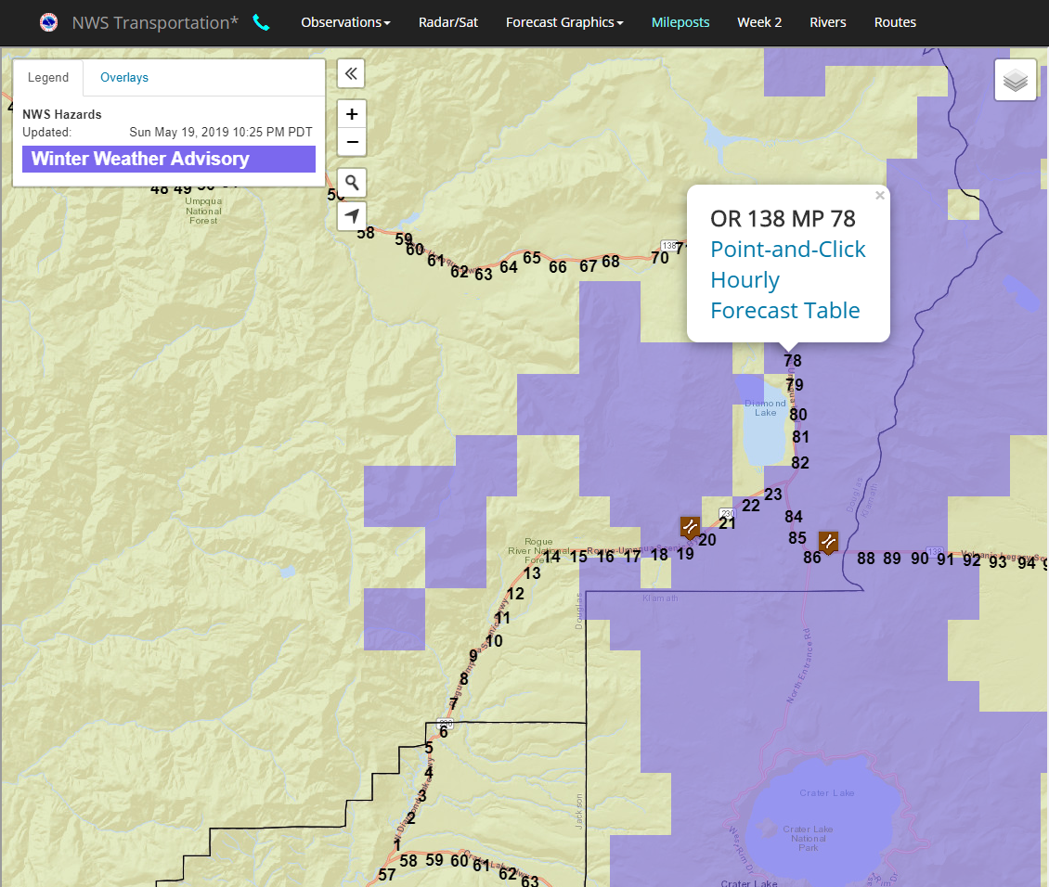
Milepost map clicks tripled
Notes:
Something we learned as we worked with ODOT and Caltrans is how much they rely on mile markers for locations.
It was painful to watch the users hunt and peck for specific points on roadways or open an array of bookmarks to find the point forecasts they were looking for. So we wanted to make it quicker for them.
We developed an interactive milepost marker map that integrates multiple ways of viewing point forecast data…along with current hazards.
I was ready to scrap this feature after the first year b/c of lackluster metrics.
But my colleagues insisted we keep it, and we did some very intentional one on one outreach with transportation partners this year, and we went through the website and how to use it.
After evaluating the usage this year, we observed that clicks on the milepost map tripled compared to last year. We’re now more confident in the utility of this service…we just need to make sure the users are aware of it.

Slide 21
Notes:
Note about marketing. Every web-based service you offer needs to be marketed or your metrics will mean very little.
This should not be considered a chore. Every partner I’ve ever met is very pleased when you offer a tailored service for them that they can access 24/7, and it’s a good reason to go out and meet new partners and learn about them.
IDSS-focused web pages and partnership building complement each other.

Slide 22
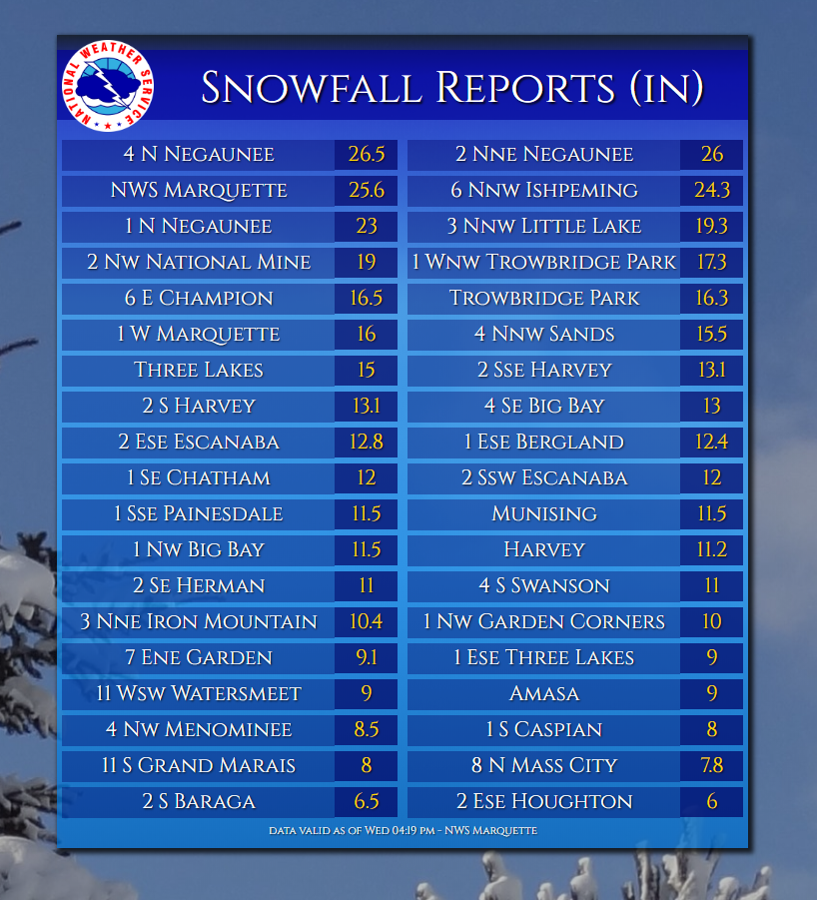
Accelerate effective communication of weather forecasts and
warnings to decision makers.
Accelerate effective communication of weather forecasts
and warnings to decision makers.
NOAA Hurricane Website User
Experience Study from a Public Perspective
Notes:
Google Analytics can also help us become more efficient and effective with internal websites. Drew Peterson from Monterey Weather Forecast Office has created incredible graphic-generating software that highlights climate and forecast data with appealing and engaging imagery. Drew’s application is a single page application, so there’s some nuances that were required to track usage of his website. We worked it out, and he created a post on the Google Analytics Vlab Forum entitled “Event Tracking Analytics for Single Page Applications”. Visit the Google Analytics Vlab community, do a quick search for “Single Page Application”, and you’ll see the post.
GA has helped Drew identify the most- and least-used graphics as well as the offices that use his service the most. He plans on improving those graphics that are used the most, gathering feedback from offices that are frequent visitors, and marketing the graphics he thinks will be helpful but folks may not be aware of. In addition, analytics data proved that his application was being used extensively, and this helped him receive a regional Cline Award.

Slide 23
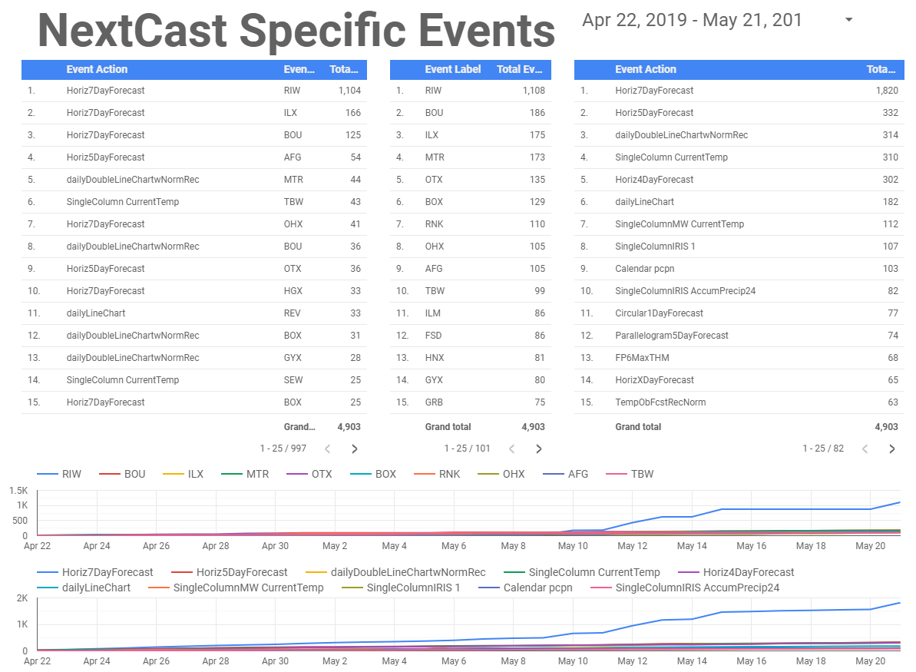
Accelerate effective communication of weather forecasts and
warnings to decision makers.
NOAA Hurricane Website User
Experience Study from a Public Perspective
Notes:
Here Drew has created an awesome Data Studio report that tracks which graphics are used most, by who, and even graphs the changes in these two variables.

Slide 24
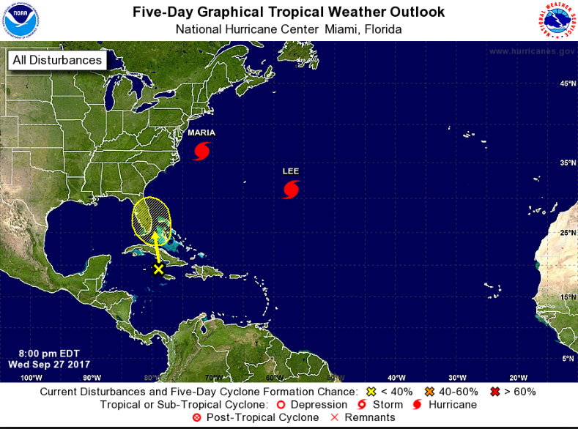
Accelerate effective communication of weather forecasts and
warnings to decision makers.
NOAA Hurricane Website User
Experience Study from a Public Perspective
Notes:
Last but not least, one of the more exciting uses of Google Analytics data involves our tropical weather websites, like NHC, CPHC, and the Southern and Eastern Region’s tropical web pages.
Jessica Fieuex and Jessica Schauer are involved in a study that collects qualitative and quantitative data, including social science research and Google Analytics, to help improve our tropical weather web presence, including the NHC home page.

Slide 25
Accelerate effective communication of weather forecasts and
warnings to decision makers.
https://www.hoyes.com/blog/the-80-20-rule-of-money-management/
NOAA Hurricane Website User
Experience Study from a Public Perspective
Notes:
Like many things in life, 20% of our efforts on the web get 80% of the results we desire.
Google Analytics lets me identify the web pages or portions of web pages that users engage with the most. I try to focus on these, and I either remove or at least spend less time on parts of the page that get the least results.

Slide 26
Final Thoughts
Ask questions about the data, then answer
Market your work
Use Data Studio
Share and Learn
Focus on effectiveness/efficiency (80/20)
Our digital real estate is priceless
Notes:
If you don’t have specific questions that you want the data to answer, the data can be overwhelming. You’ll likely discover new questions and insights along the way, but at least have a few questions to guide you.
You have to show the user and teach them. How many times has someone told you about something in an email and it didn’t stick…but when they showed you, it clicked and you now use their product or service. Plus, it’s a great reason to meet with partners and build relationships.
Data Studio reports are great. They save time and allow for sharing and collaboration.
Join the Vlab Google Analytics community. There’s over 100 members, and no question goes unanswered.
80/20
We often use 3rd party platforms like FB and Twitter to communicate. This is necessary and extremely valuable for certain audiences and in certain situations. However…

