Slide 1
Iris, Impacts Catalog, and iNWS
An update on
project progress

Slide 2
Changes since the last VLab forum
We’ve begun our transition to the Integrated Dissemination Program.
We’ve continued to make changes to the program architecture to support future enhancements.
We’re continuing to work with the Impacts Catalog Integrated Working Team to refine requirements for the FY16 beta test period.

Slide 3
Integrated Dissemination Program
Databases have been moved and several applications are now running.
IDP system administrators have been very helpful throughout the process.
A weekly performance review is required for Ben Kyger each Wednesday.
In general, IDP base software is frozen on RHEL6 supported versions, but exceptions can be made, if justified.

Slide 4
Integrated Dissemination Program
We are currently in the migration phase of our project, which will conclude August 1st.
All software must be redesigned to fit new architecture.
All requirements must be documented and test cases written.
Latest indications are that the project will reach operational status in the November to December time frame.

Slide 5
System changes since the last Vlab
The iNWS user interface has been re-written in Javascript, abandoning the obsolete PHP-Symfony version current used.
Observational data is now stored in Postgresql as JSON, allowing us to decode new elements as needed without changing the database schema.
We continue to work toward a consolidated, map based Iris interface similar to EDD.
Continued work on the Alert Monitor component of the Alert Monitor interface.

Slide 6
Impacts Catalog beta requirements
Support for Aviation Weather Center.
Impacts will have a severity level assignment.
Opening of AWIPS firewalls to Iris framework.
Contacts will be unique and have both permission and assignment restrictions.

Slide 7
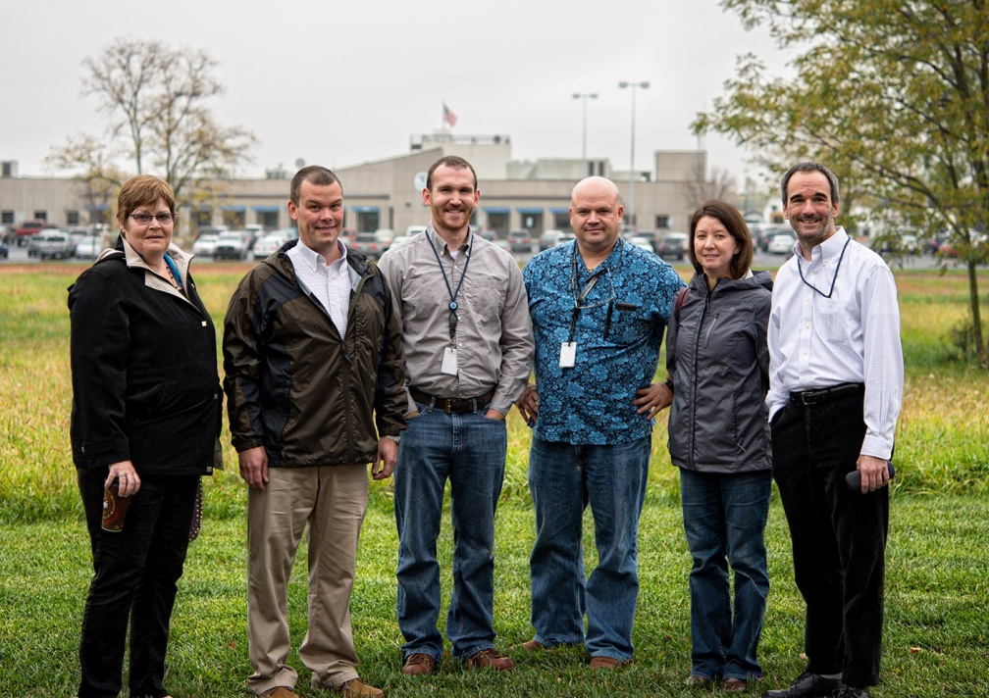
Challenges
We are still trying to solidify staffing levels for the project. Currently, most of the Iris team are NRAP members.

Slide 8
Challenges
Integration of two mature projects with different user bases, and a component with new requirements requires careful analysis.
Governance still lacking in various areas.
For final operational capability, we will need to process large amounts of data quickly.

