Slide 1
The Iris Project at Five Years: How a Grassroots Rapid Prototyping Project has Grown to Support NWS Operational Needs

Slide 2
Where did Iris come from?
Iris grew from a series of separate, but related projects during the period 2008 to 2010.
Developers saw a need to standardize a framework to provide consistent data storage and georeferencing capacity for contact, impact, event, and communications data used by the NWS.
The Iris team has always been virtual: field offices, regional offices, and now headquarters.

Slide 3
What can Iris do?
Manage all contacts for an office, including NWS specific data.
Display all observations in an are of concern, rank them in anyway needed, display criteria alerts, and directly create LSR text products from observations.
Generate storm reports is any format desired by clicking on a map.
Provide a heads up display for situational awareness use mashing together warnings, reports, and contacts on a map.
Drives iNWS to alert customers to warnings, and powers Wireless Emergency Alerts to provide cell phone alerts to the public.
Full impact management capabilities are now in development.

Slide 4
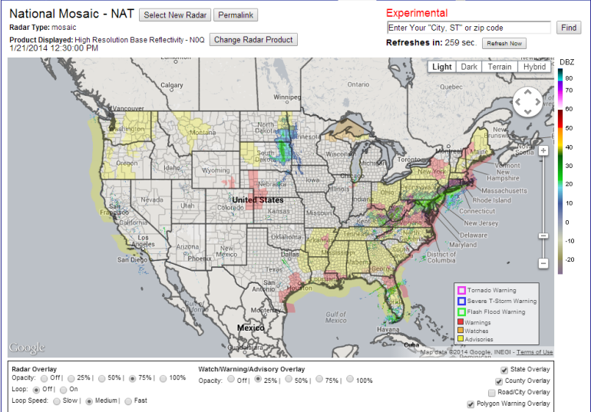
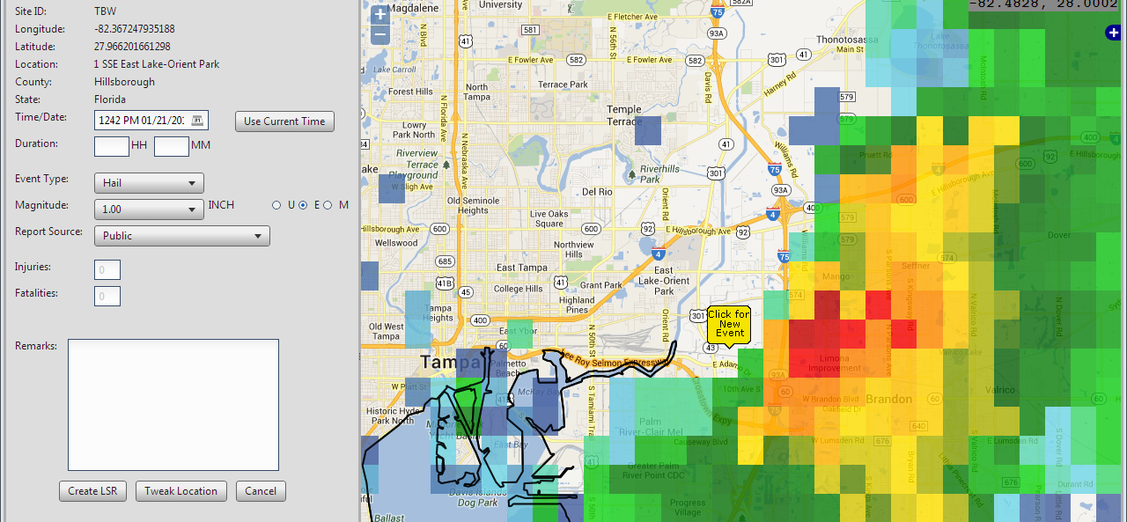
IRIS

Slide 5
So, what is Iris?
At the core, Iris is a PostGIS enabled Postgresql database.
Wrapped around the database is the Iris framework, providing methods for storing and retrieving the stored information via web services.
Using the framework are clients like the Iris Web Interface, iNWS, and others.

Slide 6
Iris and the Virtual Lab
The Iris team heavily uses the Virtual Lab Redmine and Jenkins development tools.
The Iris Web application actually opens directly to the Redmine ticketing system to allow users to open tickets (works great!)
All source code is managed by the Virtual Lab git repository.
Framework builds and Java documentation is automatically generated upon commit.

Slide 7
Let’s have a look: http://iris-devweb.crh.noaa.gov/index.html?wfo=arx https://collaborate3.nws.noaa.gov/projects/iris?jump=welcome

