Slide 1
RITT Forum
Nov 16, 2011

Slide 2
Overview
Introduction
History of IHIS
Demo
Design for National Database
Requirements
Next Steps and Future work

Slide 3
Funding and Resources
National Weather Service – OS&T (Office of Science and Technology)
GSD DDF (Global Systems Division Discretionary Director) and Base Funds
CWB (Central Weather Bureau) Taiwan
COMET – University of Southern Florida
Southern Region -- NWSWarn

Slide 4
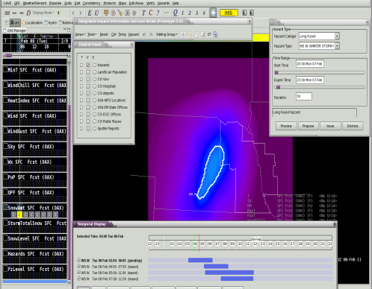
Collaborations
NWS National Centers
NCEP Development Team
NWS Partners
BOU Office
NWSWarn
AWIPS II
Extended
Collaboration
Data Delivery
Thin Client
Verification
AWIPS II
Central
Weather
Bureau
Taiwan
RENCI
Raytheon
SSWIM
Social Science Woven
Into Meteorology
MDL
Meteorological Development Lab
Iris / iNWS
University of Wisconsin
NSSL
National Severe Storms Lab
COMET

Slide 5
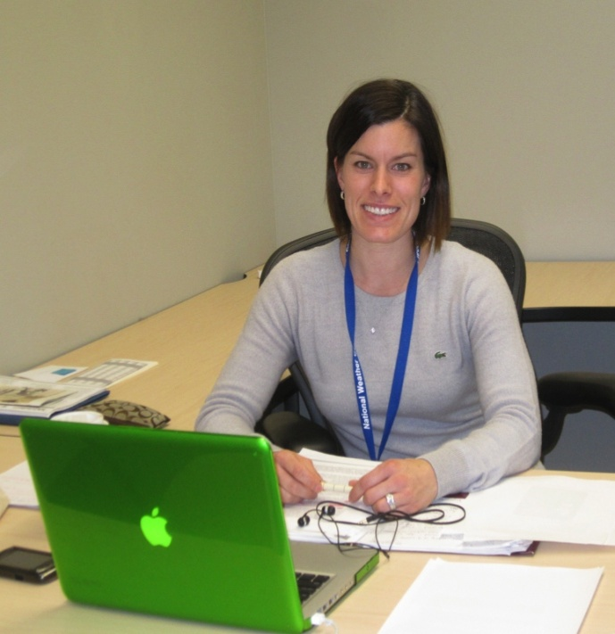
Social Science Partner Research
Social Science Woven into Meteorology (SSWIM)
SSWIM brought on board 2009
Preliminary Results from Current Research shared at AMS 2011
Today, provide a brief overview of the social science component and share several practical applications for the IHIS prototype design.
Jen Spinney, Researcher carrying out social science component of project
Notes:
My name is Jen Spinney and I’m here today as a representative of SSWIM, Social Science Woven into Meteorology, to share with you all details of the exciting work we are doing in collaboration with Tracy Hansen and her team at the Global Systems Division on the development of the Integrated Hazards Information Services, or IHIS.
SSWIM was brought on board in 2009 as collaborators to enhance the development of this set of services. Earlier phases of the IHIS project where SSWIM was involved included a workshop in Boulder, Colorado followed by a handful of interviews by a social scientist with weather forecasters and software developers. The results of these interviews were presented at last year’s AMS meeting in Atlanta.
I’m trained as a cultural anthropologist and was hired in October of 2010 to lead the next phase of the IHIS project’s social science component. Today I’ll share a little bit about the social science component of the project and share with you several practical applications for IHIS design based on results from the research undertaken in Central Texas, Missouri and Kansas.
55

Slide 6
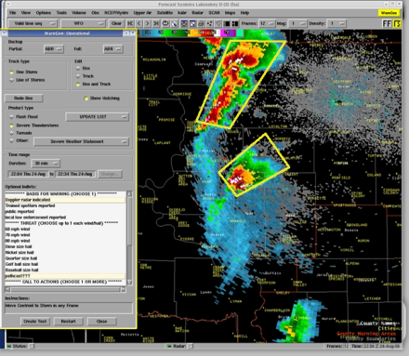
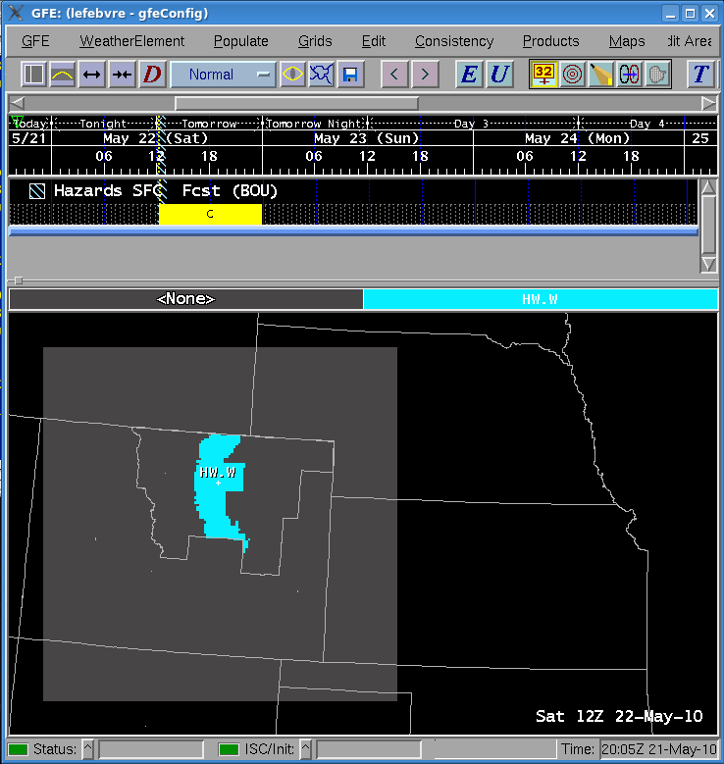
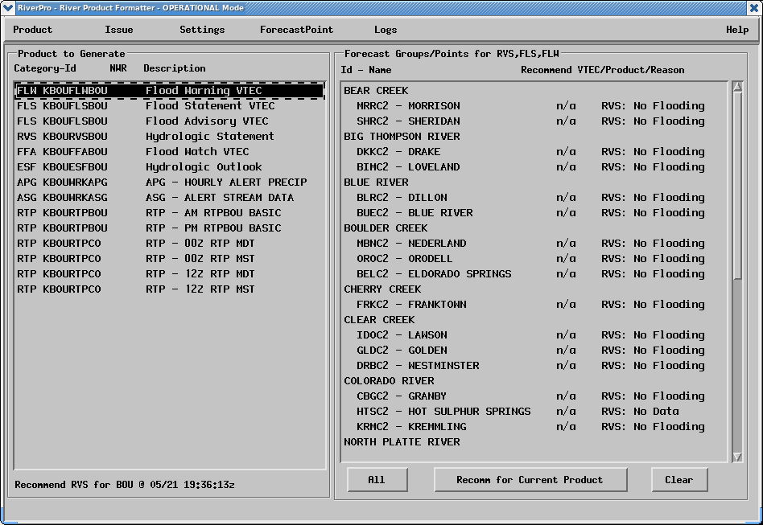
Purpose -- Integrate Hazard Tools
Phase 1
WARNGEN
(< 1 hour)
GHG
(Hours-Days)
IHIS
IHIS
RiverPro
(Days)
6

Slide 7
Purpose -- Integrate Hazard Tools
Phase 2
WARNGEN
(< 1 hour)
GHG
(Hours-Days)
IHIS
RiverPro
(Days)
NMAP
(National)
7

Slide 8
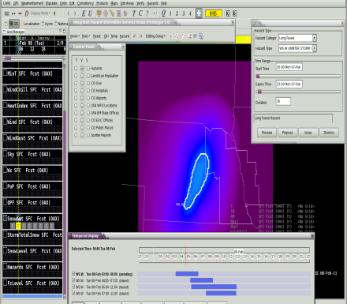
Purpose -- Two-way Communication
Phase 3
AWIPS II CAVE -- Forecasters
Web -- Partners:
EM's, Broadcasters
Spotters, Publics
Hazards
Impacts
8
IHIS serves as a vehicle for social science
(RENCI / SSWIM) research into
Partner Requirements to be realized by NWS

Slide 9
Purpose -- Two-way Communication
Phase 3
AWIPS II CAVE -- Forecasters
Web -- Partners:
EM's, Broadcasters
Spotters, Publics
National
“Cloud”
9
IHIS serves as a vehicle for social science
(RENCI / SSWIM) research into
Partner Requirements to be realized by NWS

Slide 10
Iterative Feedback Process
“Build a little / Test a little”
Prototype
Demo
Sessions
Feedback
Incorporated into next iteration
User
10

Slide 11
IHIS Project Portal : integratedhazards.noaa.gov

Slide 12
History
2004 OSIP Project / Next Generation Warning Tool team
Telecons for Concept and Requirements discussions
2008 Workshop Norman OK, 130 attendees http://www.weather.gov/warningworkshop
50% forecasters / program managers
50% partners / FEMA / EM / Accuweather
2009 Integrated Hazard Information Services Workshop hosted by GSD, 70 attendees http://fxa.noaa.gov/NGWT/NGWT_Workshop.html
Forecasters / partners / developers / social scientists
35-page report and set of requirements
Initial User Interface designed for prototyping
Listserver established
2004 OSIP Project / Next Generation Warning Tool team
Telecons for Concept and Requirements discussions
2008 Workshop Norman OK, 130 attendees http://www.weather.gov/warningworkshop
50% forecasters / program managers
50% partners / FEMA / EM / Accuweather
2009 Integrated Hazard Information Services Workshop hosted by GSD, 70 attendees http://fxa.noaa.gov/NGWT/NGWT_Workshop.html
Forecasters / partners / developers / social scientists
35-page report and set of requirements
Initial User Interface designed for prototyping
Listserver established

Slide 13
History
2010 Prototyping
Web-based short-fused TOR
Allowed for quick and broad forecaster feedback to refine requirements and user interface
Looking ahead to two-way communication
Developed capabilities and algorithms for AWIPS II CAVE

Slide 14
History
2011 Prototyping – Jan - Sept
AWIPS II CAVE Long and Short-fused
Utilization of PGEN drawing tools
GIS data – hospitals, Iris spotter reports, Census
Design and some development for “Live Data” and storage in Iris database
Preliminary Hydro requirements
Web-based prototype (prior to May)
IWT Workshop – Hydro/Partners – (June, Fargo, ND)

Slide 15
Demo

Slide 16
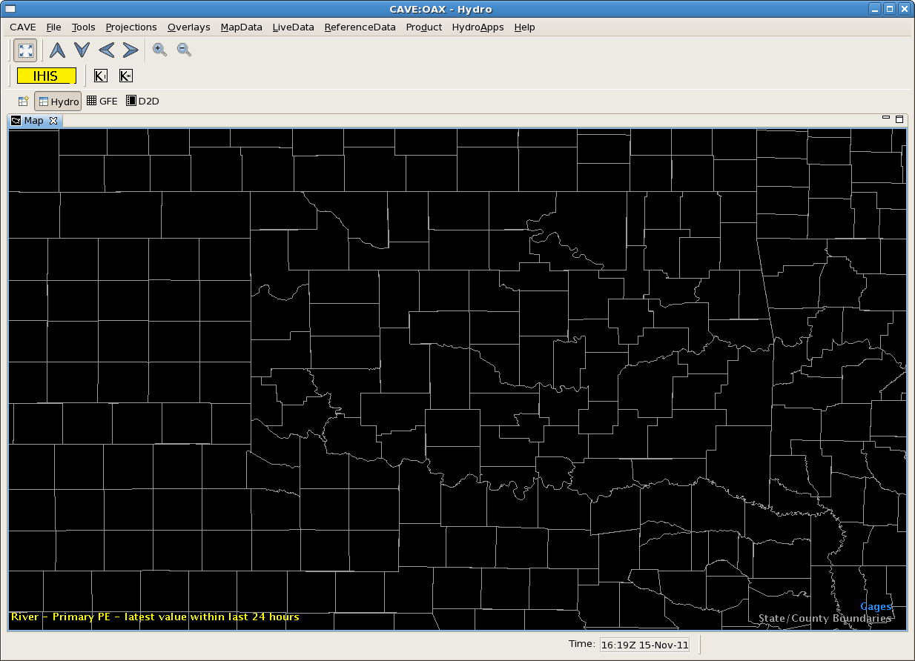

Slide 17
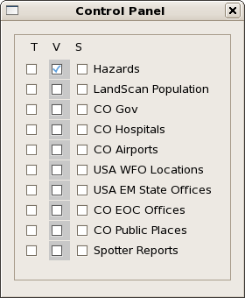

Slide 18
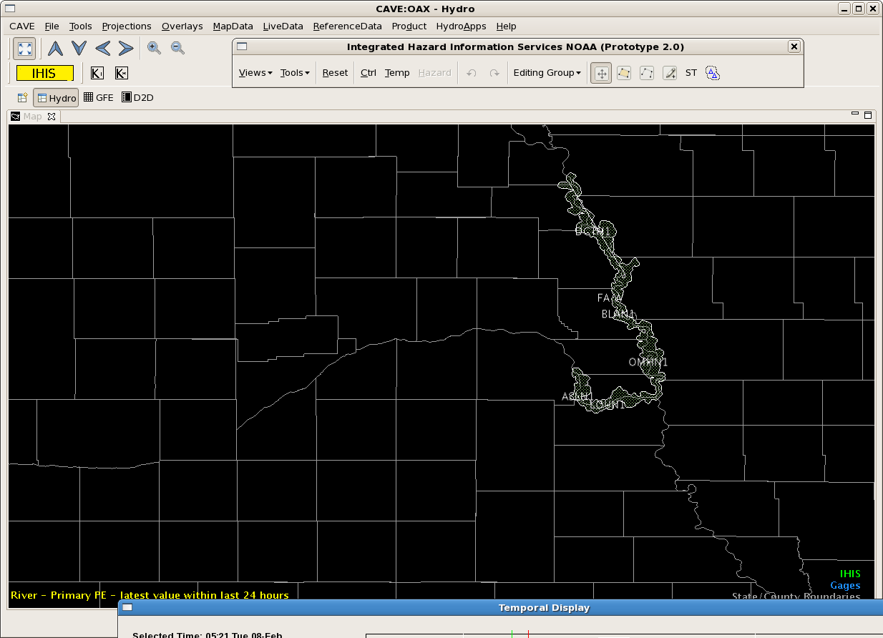

Slide 19
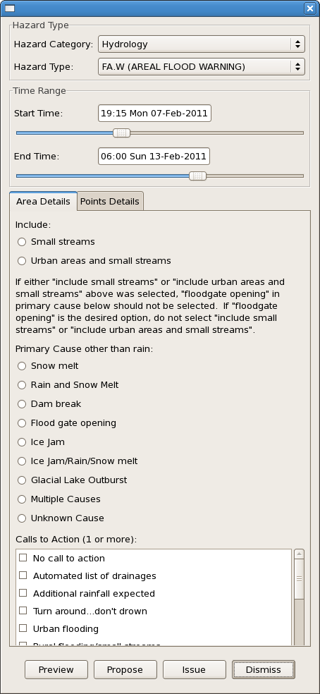

Slide 20
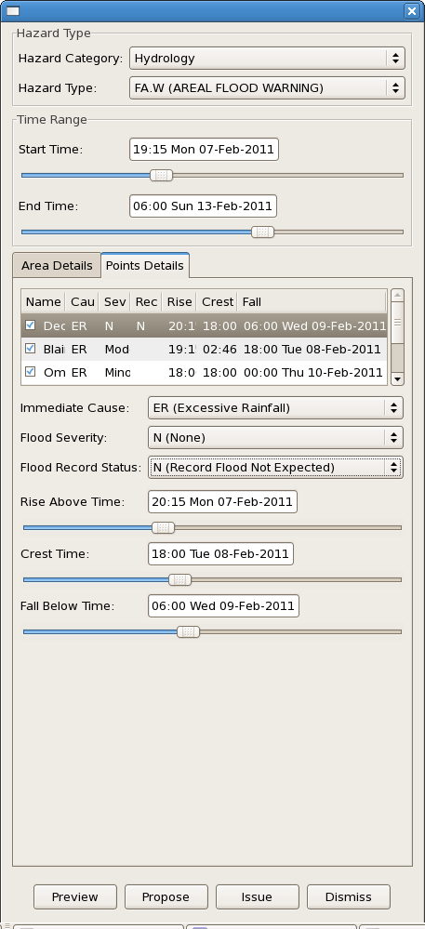

Slide 21
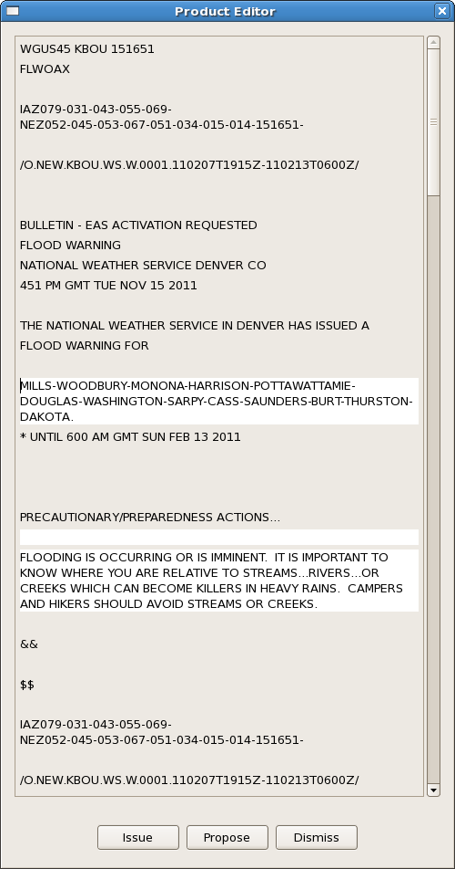

Slide 22
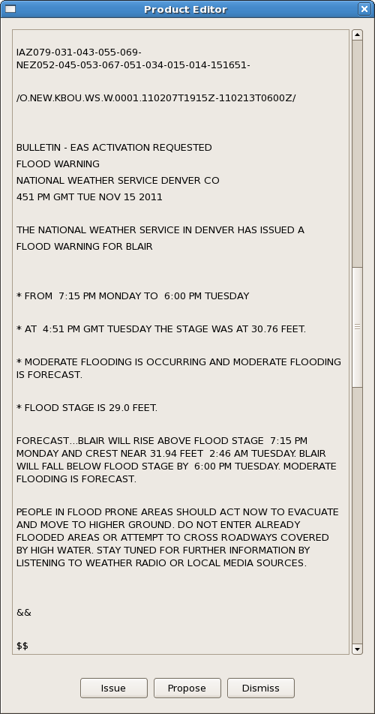

Slide 24
IHIS Plug-in
Java / SWT
Toolbar Dialog (TB)
Hazard
Information
Dialog – (HID)
Control
Panel
Dialog
(CP)
Spatial Display (SD)
Abstract Viz Resource
Invokes PGEN drawing tools
Product Editor
Dialog -- (PE)
Select By
Area
Dialog
MB3
context
menu
Temporal Display Dialog (TD)
IHIS Layer (IL) -- Java/Python
Time Management, Selected Time, Current Time
List of Event Dictionaries, Selected Hazard,
Data Access, GIS and other data, hazard data access,
Configuration and Views, Data Transformation
Configuration and
Views
Hazard Data
(Canned)
Control Panel
Dialog -- (CP)
Tom

Slide 25
Design for National Database

Slide 26
Integrated Hazard Information Services
Moving from Product-Centric to Information-Centric Hazard Information
Hazard information gathered across perspectives in diverse ways and then converted to and stored in a common format
If hazard information is stored only in local EDEX, still need to ingest text products and merge hazard information from neighboring sites

Slide 27
IHIS – Local EDEX Solution
VTECDecoder
(VTECTableUtil)
SBN
Transient
WAN
Local Site EDEX
IHIS Hazard
Creation:
Grids, Polygons,
Points, Paths
(Drawn or Calculated) ->
Local Hazard Database
request
HazardDict Database
Local
Hazard
Database
Proposed VTEC Database
Issued VTEC Database
reply
Neighboring
AWIPS Site
Product Generation
SBN

Slide 28
IHIS – Local EDEX Solution
National Disbributed
Database
IHIS Hazard
Creation:
Grids, Polygons,
Points, Paths
(Drawn or Calculated) ->
HazardDict Database
Proposed VTEC Database
Issued VTEC Database
Product Generation
SBN

Slide 29
Comments
National Distributed Database would eliminate need for Ingesting and Merging from neighboring sites
Legacy products can still be generated, but the system is no longer product-centric.
The “information” is the hazard and can be generated in multiple forms – text, graphics, cell phones, radio, etc.
Even longer-term solution would alter VTEC from being product-centric to being information-centric
Many challenges with Performance and Security that need to be explored.

Slide 30
Requirements Analysis
Where are we now?

Slide 31
Requirements Analysis
Overview and rough estimates:
Many features have been identified and are described
on the Wiki “Design Concepts” page
Prototyping has
“Touched on” ~60% of requirements
Provided a good launching point for gathering functional requirements and IOC design
Yet only covers ~20% of the functionality
Some additional features would benefit from prototyping...

Slide 32
Next Steps and Future Work

Slide 33
Current Work - 2011
2011 Prototyping
Hydro Prototype Pathway
“Live Data” VTEC processing and local storage
IHIS Workshop – Sept 27-29
Focused on Phase 1 – AWIPS II Forecaster Tools
Engaged User community in gathering requirements and define user interfaces
Focused on Hydro plus advancements in Short-fused, Long-fused
Defining Initial Operating Capabilities

Slide 34
Future Work Ideas
-- Consulting with RTS on production development
-- Prototyping and requirements refining
Phase 1
Framework for Recommenders and Text Products
Short-fused NWSWarn and NSSL PHI improved warning area definition
Long-fused Interaction with GFE grids, Hurricane Warning
Iris Database – working with Iris team on storage formats, security, authentication
Common data access for forecasters – GIS info, maps, data, models, grids
Phase 2 – National Center requirements

Slide 35
Project Time Line
RTS Production Coding in Collaboration with GSD
Scheduled to begin Jan 2012, but may slip if OAX not transitioned by then.
GSD prototyping / requirements-gathering in 2012
Selected Phase 1 capabilities
Begin Phase 2?
Phase 1 Target Completion: July 2013.
There may be incremental releases for evaluation before that time.

Slide 36
Forecaster of the Future

Slide 37
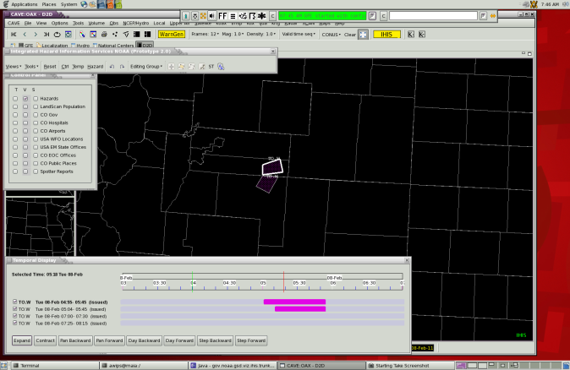
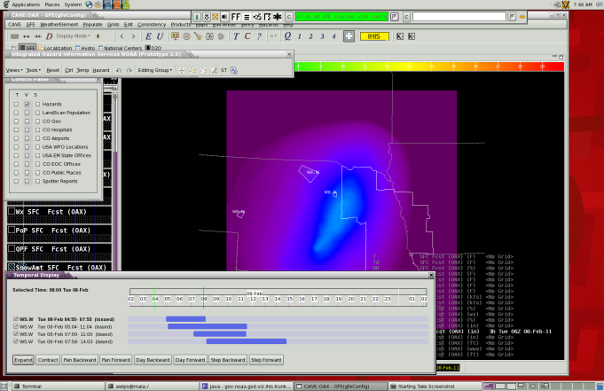
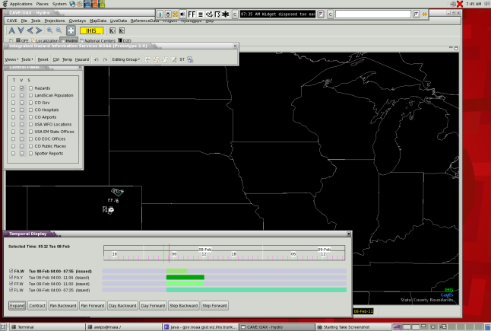
IHIS across perspectives
First step toward integrating AWIPS Applications
Common Data Access
Common Tools – iTools, Recommenders,
Text Products
Collaboration
Real-time
Data Sharing
National Data “Cloud”

Slide 38
APPENDIX

Slide 39
Wiki Tour
Common Interface / IhisProject: https://collaborate.nws.noaa.gov/trac/ci/wiki/IhisProject
Requirements and Design Concepts
Summary of operational requirements from OSIP document
Technical and Functional requirements corresponding to operational requirements
Being continually refined through prototyping
Architecture and Design Options
Hydro Requirements

Slide 40
Wiki Tour
Feature Requests
Instructions on joining the listserver
Notes from forecaster feedback sessions and resulting tasks completed
Task Tracking
Developer's Page
Software set-up and maintenance notes

Slide 41
PGEN Drawing Tools in IHIS

Slide 42
What is PGEN?
AWIPS II NCEP Product Generator CAVE Plug-in
Integrates NAWIPS drawing capabilities into CAVE.
Supports NCEP drawing requirements for outlooks, surface analysis, and general annotation
Provides a rich palette of drawing tools
Plug-in being refactored for extensibility and reusability

Slide 43
PGEN
IHIS
NCEP
Perspective
Manager
User selects PGEN Button
D2D/GFEHydro
Perspective
User selects IHIS Button
Creates
Creates
NCMapEditor
PGEN Palette
Abstract
Editor
Creates
Contains
AbstractPgen
Tool
Creates
Contains
Future
AbstractModal
Tool??
Contains
PgenResource
Contains
PgenResource
Data
SpatialDisplay
Resource
SpatialDisplay
ResourceData
Contains
PGEN Classes Used By Both PGEN and IHIS
Abstract
Element
Containter
Display
Element
Factory
Layer
DECollection
Drawable
Element
Drawable
Element
Factory
AttrDlg
Product
OpenGL

