Slide 1


Different Kinds of Time
Expert Challenges in Coordinating Messaging with Partners and Publics
Jen Henderson, Julie Demuth, Heather Lazrus, Rebecca Morss, and Jamie Vickery
Notes:
Main take away: time is taken for granted in our conversations and activities around warnings and is has important connections to vulnerability

Slide 2
outline
Dynamics and Theories of Time
Chronological Time
Examples from Case
Kairological Time
Next Steps

Slide 3
motivation

Slide 4
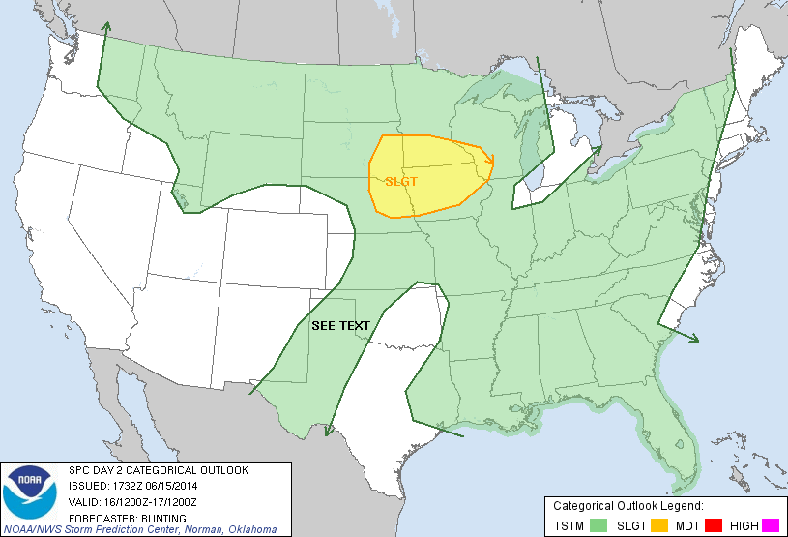
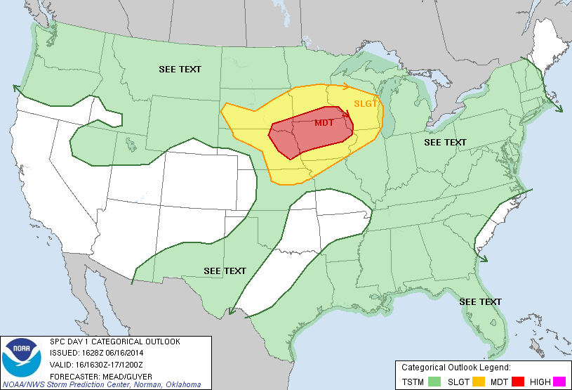
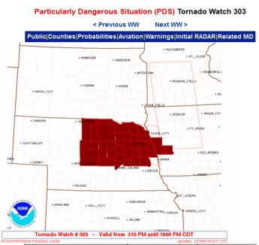
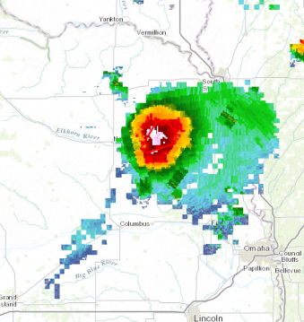
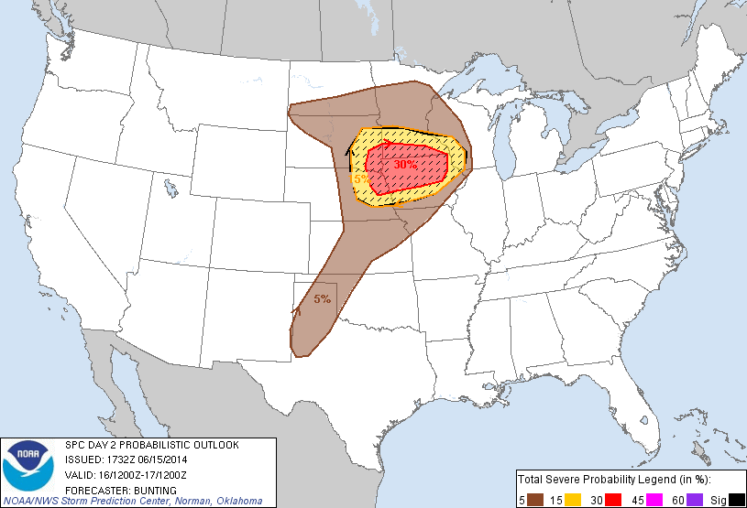
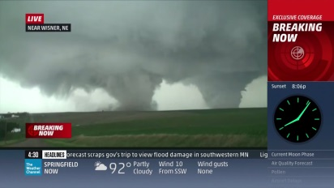
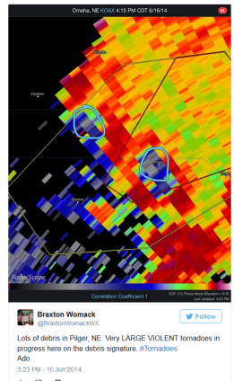
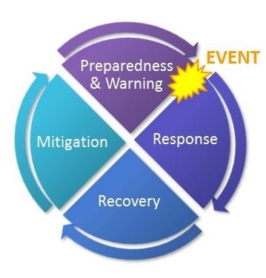
Dynamic information
Multiple pieces of information, changing and evolving in time
1 day before event
2+ days before event
Day of event
Notes:
Information about threats changes as certainty and uncertainty about an upcoming event evolves. The modalities, languages, and visualization of that information are dynamic, as well. Not all types of information will be understood or resonate with all people.

Slide 5
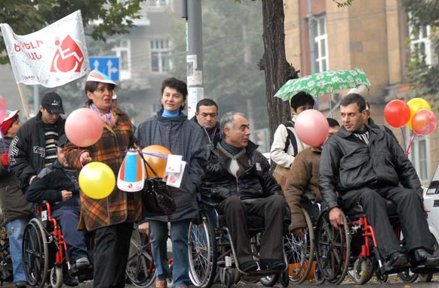
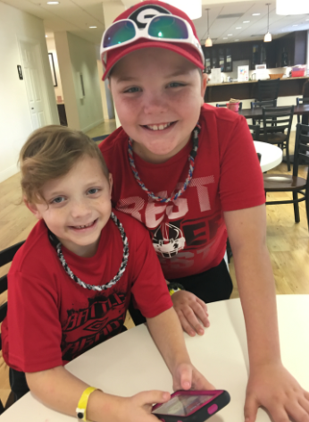
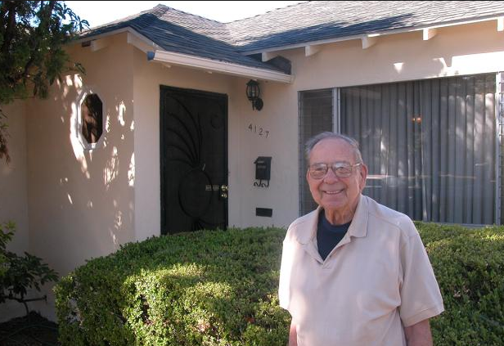
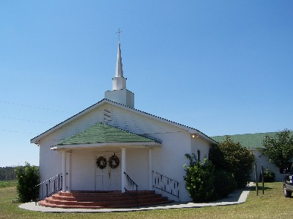
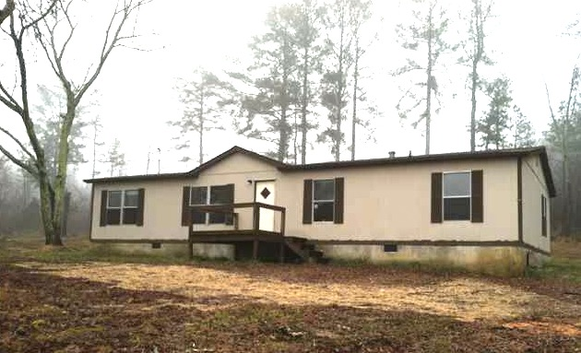
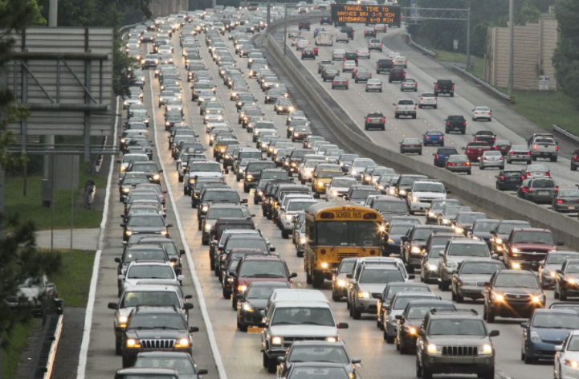
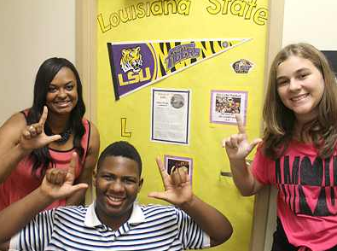
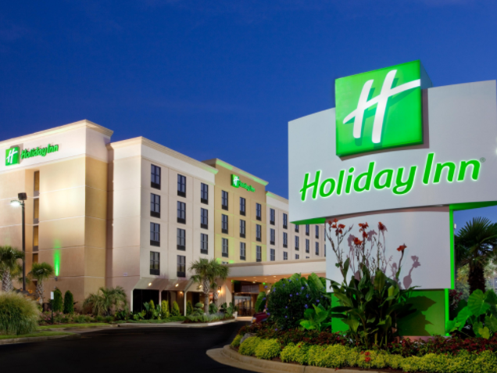
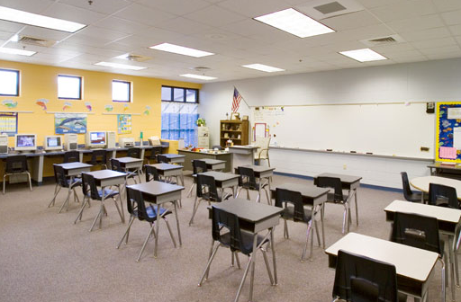
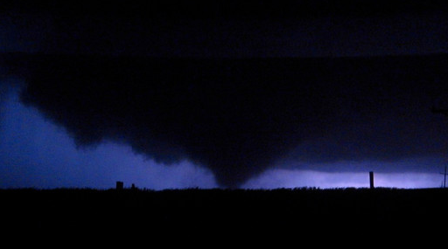
Dynamic Vulnerabilities
Multiple elements of life, changing and evolving in time
Demographics and Ability
Familiarity and Access
Location and Movement
Notes:
Vulnerability is layered, complex, and emergent. And vulnerability is not just about the characteristics of the people but the dimensions of experience that we all have: travel, varied locations, and familiarity with places or access to resources. These are likewise evolving over time and rarely the same every day.

Slide 6
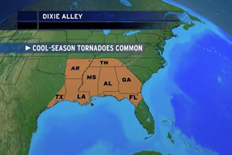
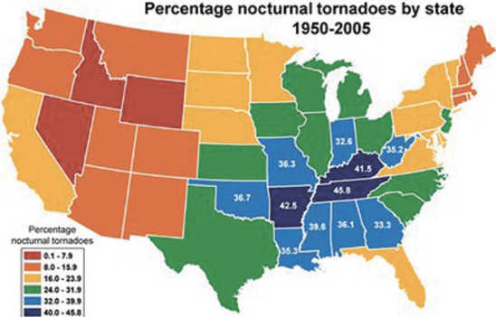
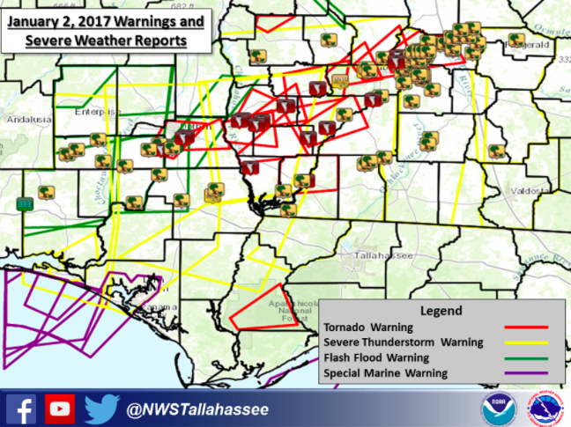
Dynamic Storms
Multiple types of weather, changing and evolving in time
Seasonality
Diurnal / Nocturnal
Type of Threat
Notes:
Then we have the weather itself. It’s continually changing (as you all well know) and different threats can emerge at unexpected times and unexpected ways. Or the expectation may be there but the evolution of the atmosphere may be known until just before the threat develops.

Slide 7
Time in weather Prediction
Timeliness of….
      prediction and detection of threats by professionals
      communications within and between offices
      information dissemination & feedback on public requests
      support services & decision making for partners
      possible actions by different publics
Time is dynamic and important but often taken for granted.
Notes:
One taken for granted term that is important to all of these dynamics is time itself. Timeliness of …..

Slide 8
Theories of Time
Time Perceptions
Individualized orientations toward time vary (e.g. past / present / future)
Time is deployed through values placed on chronology, duration, pace of life, coordination of activities, economics, etc.
Expressions of time as expectation, anticipation, and surprise.
                (Levine, 1998; O Murchadha, 2013; Stolarski et al, 2014)
Notes:
Not surprisingly, in the social sciences community (and in physical sciences, like, quantum physics), there are several theories of time, how it is perceived, how it operates, how it is expressed.

Slide 9

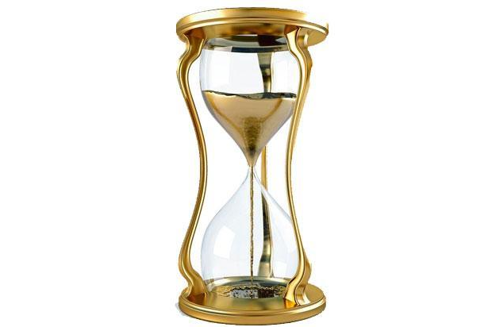
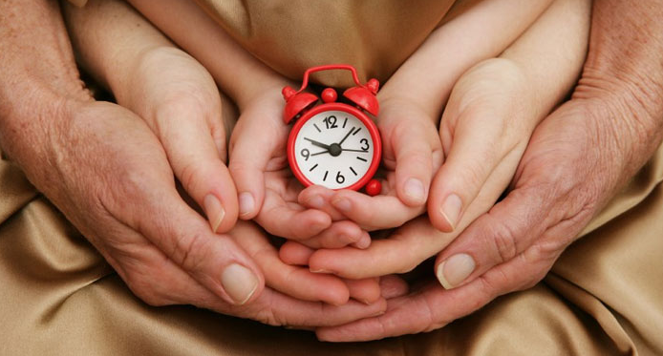
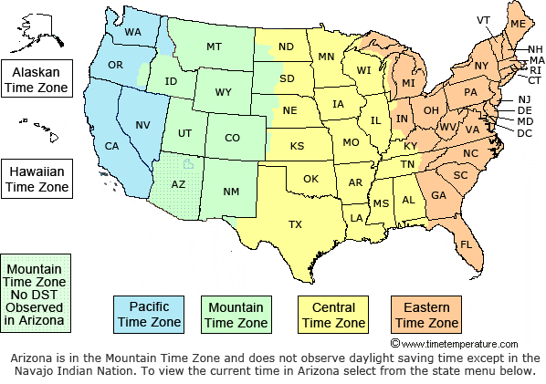
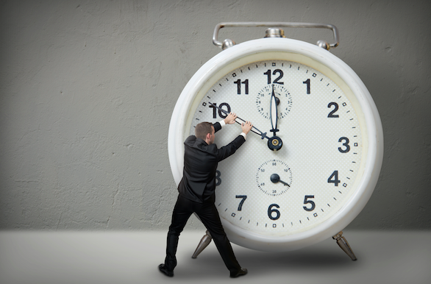



Slide 10
Theories of Time
Time Perceptions
Individualized orientations toward time vary (e.g. past / present / future)
Time is deployed through values placed on chronology, duration, pace of life, coordination of activities, economics, etc.
Expressions of time as expectation, anticipation, and surprise
                (Levine, 1998; Zimbardo, 2010; O Murchadha, 2013)
Notes:
For my purposes today, I’m looking at how time is valued and deployed in a forecast, with a specific examination on chronology, which I think is a very common human—and expert focused—orientation toward time. It involves things like coordination of activities and dispersing of information. Though there are many other interesting ways to think about time, that I’ll mention shortly.

Slide 11
Chronological Time
“A quantitative concept of time. …an account of what happened during a particular period.” O Murchadha, 2013
Notes:
I’d like to demonstrate a primary concept of time in the forecast office through chronological time, which is defined this way. To show chronological time, I’ll focus on activities of coordination, which assumes a common understanding of time, but also the ways groups or individuals organize that time toward their needs.

Slide 12
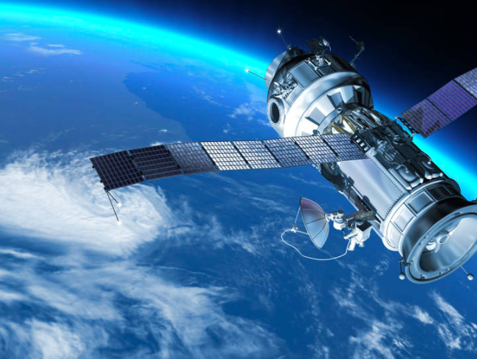
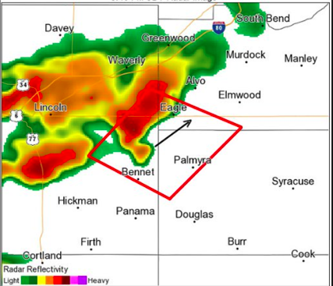
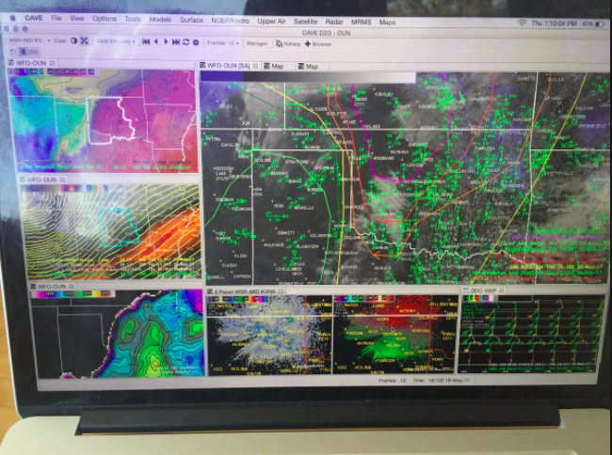
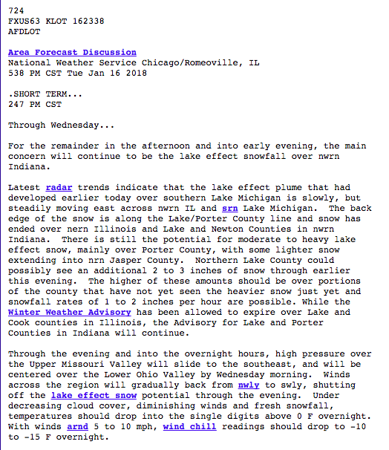
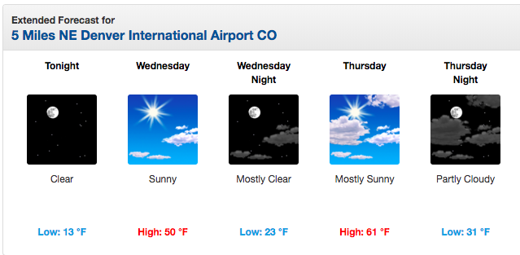
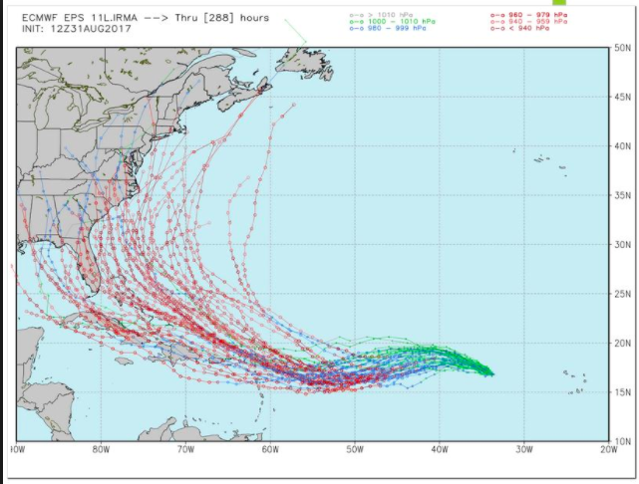
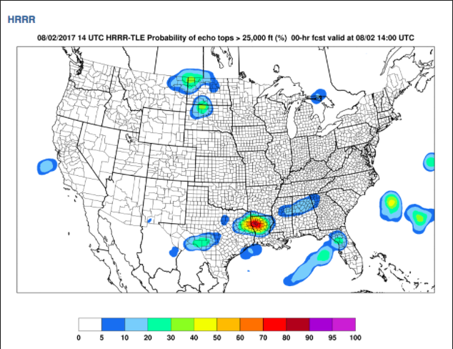
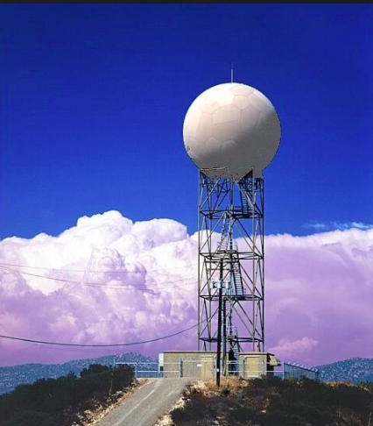

Slide 13
methods

Slide 14
Case study
”Case studies are indispensable to meteorology. By describing how the weather evolved during a specific event, case studies can be integral to improving weather forecasts and can reveal mesoscale phenomena that were previously undiscovered.” --David Schultz, Finnish Meteorological Institute, Helsinki, Finland
Notes:
Much like meteorological case studies of single tornadoes, hurricanes, or flooding events
Allows for in-depth exploration of a particular phenomenon and its impacts
Helps researchers characterize and theorize elements of the disaster
How to research and write effective case studies in meteorology. (2010). Electronic J. Severe Storms Meteor., 5 (2), 1–18.

Slide 15
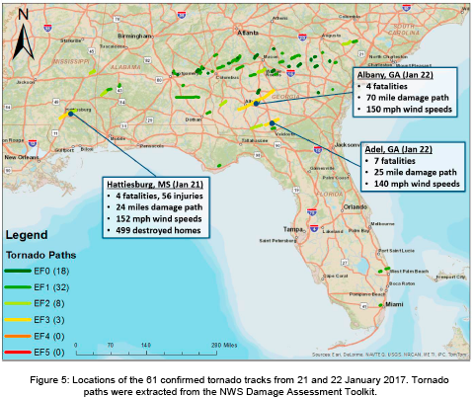
January 21-22, 2017
Albany & Adel, GA
Jan. 21: Adel, GA: 3:45 am EF 3 killed 11 in mobile homes and tracked 25 miles
Jan. 22: Albany, GA: 3:20 pm EF 3 killed 5 people and tracked 71 miles, 1.25 miles wide at times
Deadliest Outbreak in 17 years
4 Significant Tornadoes Killed 16 people
3 Rounds of Severe Weather: Friday, Saturday Sunday
Increasing Severity from Enhanced to High Risk
First High Risk in U.S. since June 2014
Second Tornado Emergency Use for FO
Notes:
Today I’ll explore the idea of time through a case study of cool season tornadoes that affected communities in Adel and Albany Georgia in late January. “Keith Seillman of Peachtree, not know how instability of one event will affect the next” and it was over a weekend, radars were down.
Here’s a quick summary of the event. These highlight some of the most salient points from the point of view of the forecast offices in which I conducted interviews.

Slide 16
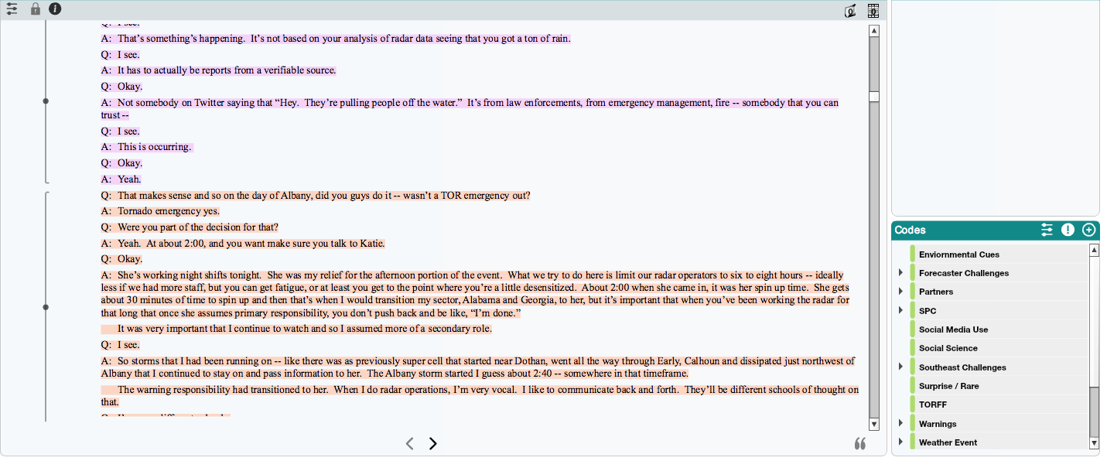
Qualitative Data
Interviews conducted with 16 local NWS, 1 emergency manager, & 2 broadcast media; analyzed Facebook feeds for NWS and broadcasters
Audio recorded, transcribed, and inductively coded with Dedoose software
Notes:
Just a quick note about my methods. And here’s a screen capture of the software that allows me to read over transcripts and code passages for interesting ideas, themes, etc., that are emergent in the data. This is also where notions of time become visible.

Slide 17
Preliminary Results

Slide 18
#1: Logistical time
(organization of complex operations)
SPC outlooks coordinate local (consistency?)
“I set that up years ago where if it’s a lower end threat [e.g. marginal], you email a briefing packet. If it’s a significant event [e.g. moderate], you do a webinar.
When they get their webinar invite in their email, they know that we mean business….And we ultimately did do [a briefing] the Friday before the event. …” (F 7)
Use logistics to convey severity
Notes:
Yet a challenge of what I’m calling logistics time, an expression of coordination, arose. Here, you see that the types of information distribution are tightly coupled with SPC outlook categories. Webinars, an important aspect of communication with partners, however, is only triggered by moderate risk on SPC. And keeping up with briefings in general is a challenge when you’re also fielding phone calls, keeping up usual forecast products, and issuing warnings / monitoring reports. The second quote is also referring to interoffice and state coordination, an aspect of time I didn’t explore in this study (but it merits attention).

Slide 19
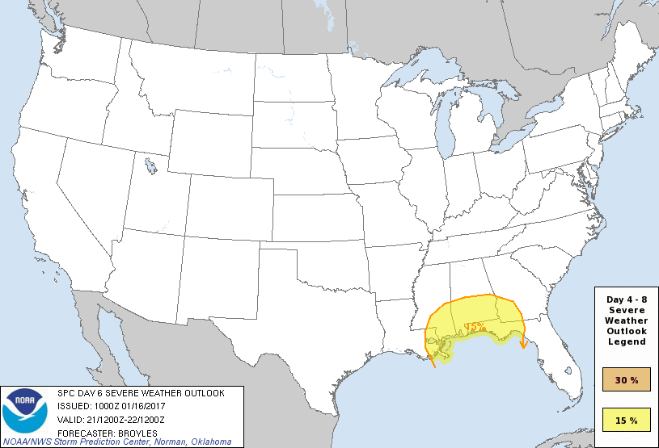
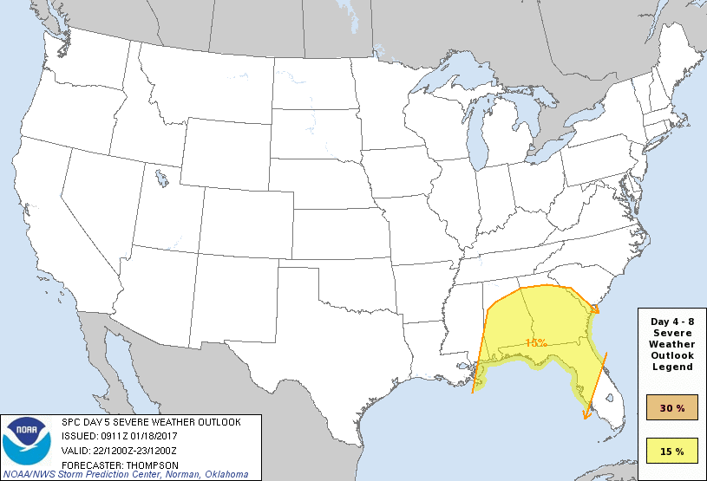
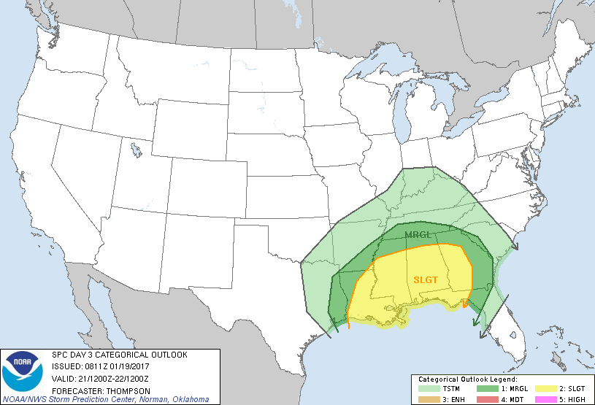
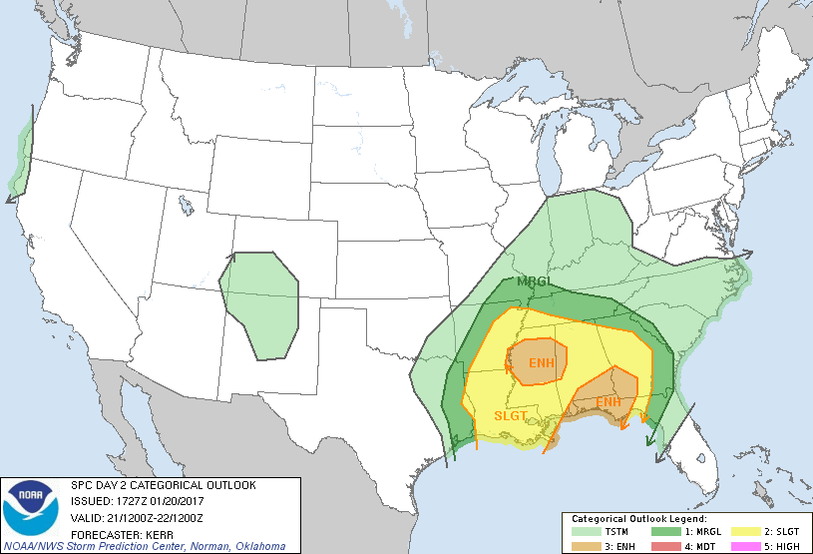
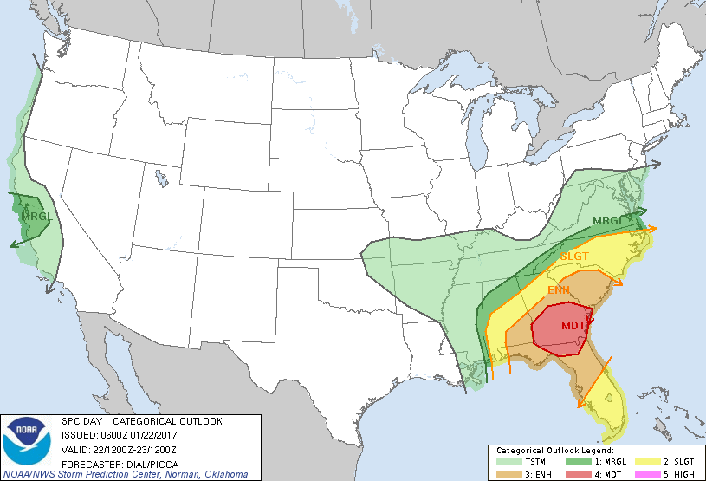
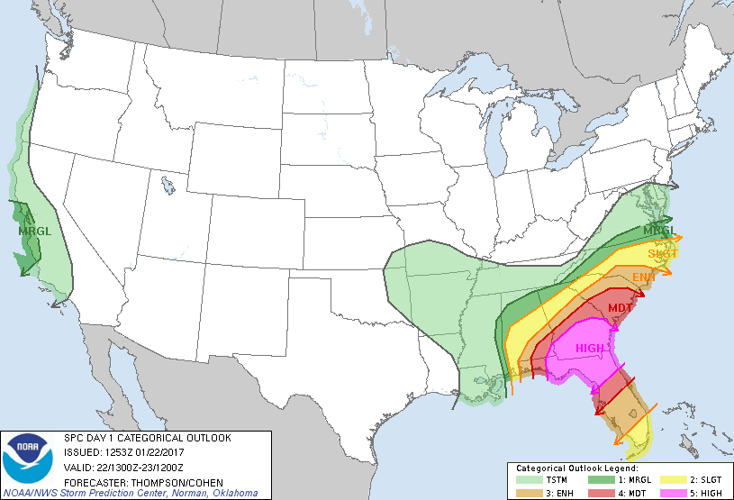
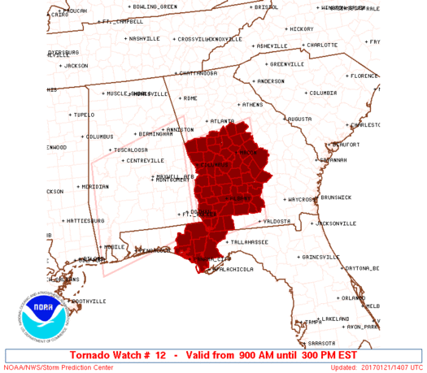
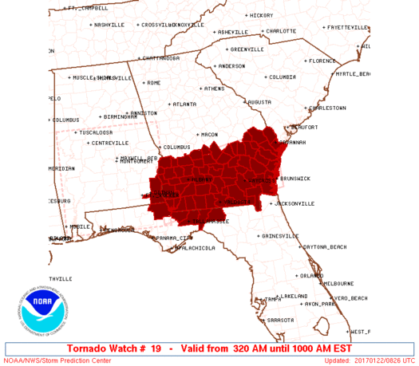
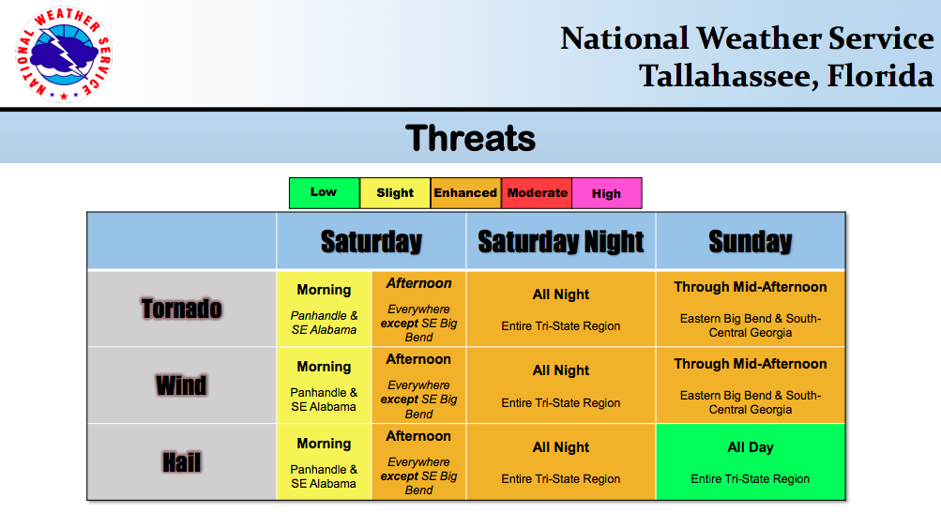
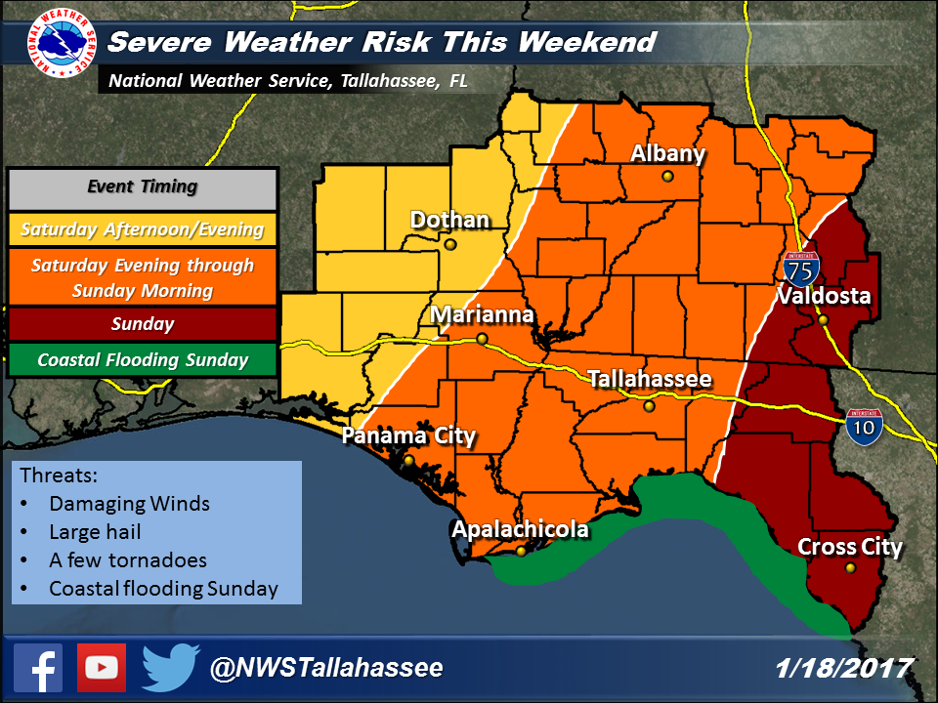
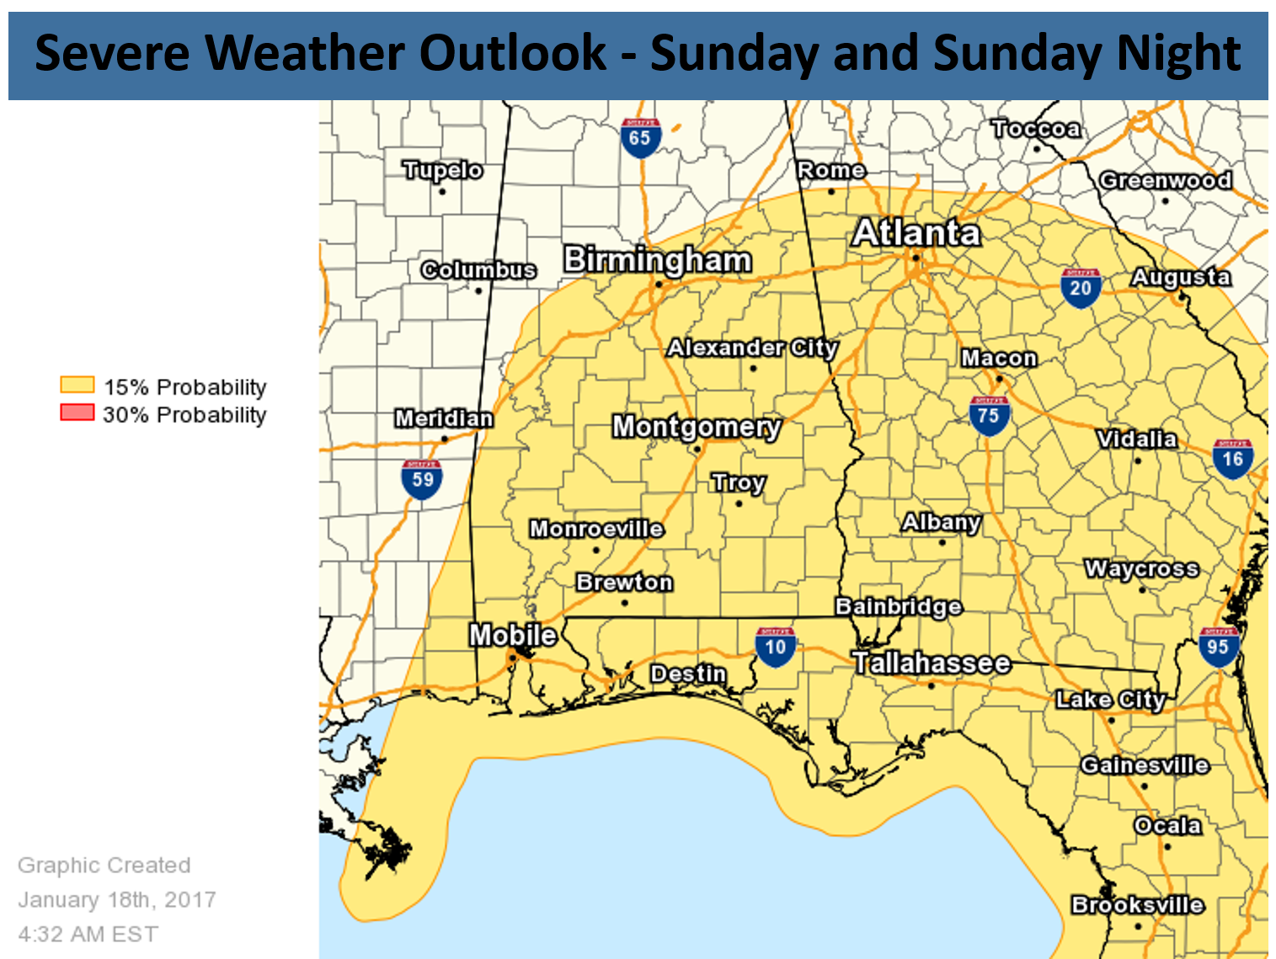
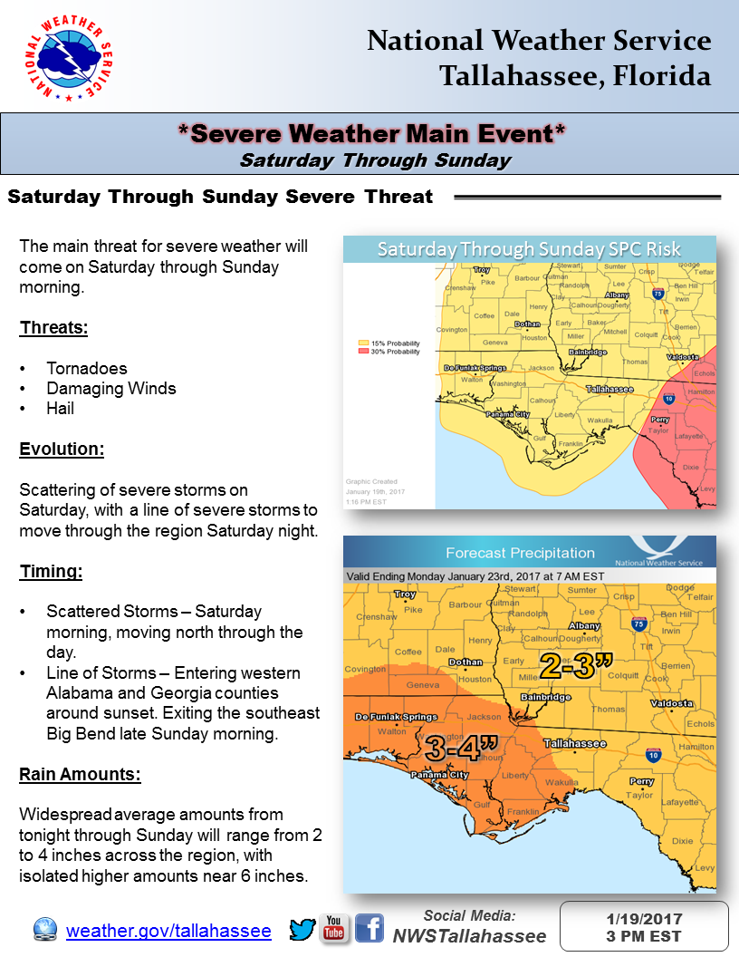
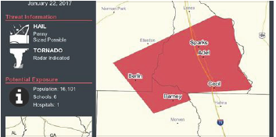
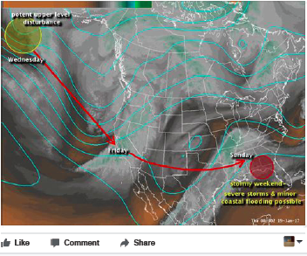
Event Timeline
Wednesday
Thursday
Friday
Saturday
Sunday
T-storms
Svr T-storms
Svr & Tor
Adel Tor
Albany Tor
SPC Timeline
High 9 am EST / PDS noon
Day 6: Slight
Day 5: Slight
Marginal / Slight
Enhanced
Moderate
watch
watch
NWS Timeline
Webinar
Warnings
Warnings
Facebook
Twitter
Twitter
AFD
Email EM head’s up
Website
Phone Calls
Website
Email briefings
Facebook
Email briefings
Phone Calls
Phone Calls
Verification Calls
Website
Facebook
Visit Mobile Homes
EM Timeline
Phone calls to WCM
Request Webinar
Webinar
Call WCM
Move Assets
Respond to Events
Notes:
Here is a chart that breaks down some of the chronology of time in terms of coordinating information exchange. You can see from this chart that for the NWS office I talked to, the SPC is a primary driver of coordination. Their issuing of SPC outlooks shapes the deployment of different information streams and those then shape and are shaped by EM needs. For example, each level of SPC threat corresponds at this FO to a particular type of information that is sent to EMS. That same information is posted on Facebook and Twitter, though the details of the information is tailored primarily to EM concerns (sequence of events, impacts, etc). On Facebook, members of the public could then ask questions about the information and the office often addressed those questions directly.

Slide 20
Logistical time Assumptions
SPC time cascades to EM
”…if we’re going into a weekend and they’re getting information at 3:00pm, then it’s a little late because at 5:00 [EMs] are out the door and the phones are off for the weekends. So we learned that lead time is quite important, especially if we’re going to do a webinar on the potential significant event.”
“I mean, they knew that it was coming because we had the email briefings out for several days before the webinar, but it was eye opening to know all the pieces that need to fall in place on their end heading into a weekend: having resources ready to go the bodies ready to dispatch to handle, not only preparation, but response.” (F 2)
Use partners’ need to shape logistics
(IDSS?)
Notes:
Here you see that the multiple assumptions about time coming into conflict.

Slide 21
Event Timeline
Wednesday
Thursday
Friday
Saturday
Sunday
T-storms
Svr T-storms
Svr & Tor
Adel Tor
Albany Tor
SPC Timeline
High 9 am EST / PDS noon
Day 6: Slight
Day 5: Slight
Marginal / Slight
Enhanced
Moderate
watch
watch
NWS Timeline
Webinar
Warnings
Warnings
Facebook
Twitter
Twitter
AFD
Email EM head’s up
Website
Phone Calls
Website
Email briefings
Facebook
Email briefings
Phone Calls
Phone Calls
Verification Calls
Website
Facebook
Visit Mobile Homes
EM Timeline
Phone calls to WCM
Request Webinar
Webinar
Call WCM
Move Assets
Respond to Events
Notes:
To look at a particular example of a coordination challenge, note the request and attendance of a webinar. The email briefings had been out for a few days, updating partners on information about the changing dynamics of rounds of storms and when / where they would occur.

Slide 22
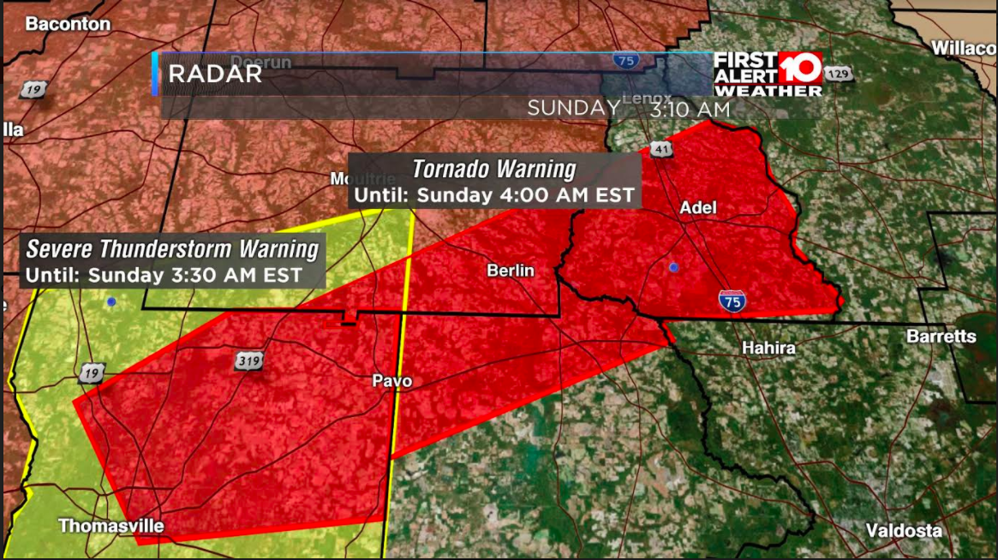
#2: Communication time
(visual and textual messages)
Notes:
Here’s an example of coordination sent to me by a broadcaster I interviewed that shows coordination expressed as what I’m calling procedural time, related to the order of activities via policies and procedures. As you can see here, there is a warning with a 45 minute lead time for Adel that moves outside the watch area (in pink). This area was quickly added to a watch by SPC—and I want to emphasize this isn’t about criticizing or blaming—but about noting how time is understood, practiced, and may intersect with vulnerabilities.

Slide 23
Communication time assumptions
SPC shapes public message
“It’s 2:55 am and there’s still not a tornado watch [for Adel] issued by the Weather Service…. Thomas County is under the watch, but you go one county over… there’s not a watch. 3:18 am. So right after that warning went out, the Storm Prediction Center or the Weather Service said, all right. All the way from Dothan, Alabama down to Tallahassee to Savannah, you guys are under a watch.” (F 4)
“So that [lack of watch] concerned me because, you know, some people don’t take it as seriously if they’re not under a watch because why would you? If you’re not under a tornado watch, you don’t have to watch out for the conditions.” (F 6)
Communication as absence of awareness
(vulnerability?)
Notes:
From that interview, explaining what the person saw in this example. Underlying assumptions here suggest something “missed” in the forecast process or a problem that’s not clearly explained in information disseminated with the graphics.

Slide 24




Communication time
(Trust and preparation)
Communication as disruption of familiarity
(loss of social capital?)
Notes:
Finally, communication time is about conveying a message outside the expert group to their public. It’s how we usually think about time related to when messaging goes out and how people are able to act on it. This office followed a protocol of not posting warnings on FB because it’s difficult to know if the post is current. However, notification of moving warnings to Twitter happened as events were unfolding. This office did a fantastic job keeping their FB page up to date and answering questions. At this moment, however, several people felt unable to access information through channels they were familiar with.

Slide 25













Event Timeline
Wednesday
Thursday
Friday
Saturday
Sunday
T-strorms
Svr T-storms
Svr & Tor
Adel Tor
Albany Tor
SPC Timeline
High 9 am EST / PDS noon
Day 6: Slight
Day 5: Slight
Marginal / Slight
Enhanced
Moderate
watch
watch
Broadcast Timeline
Facebook SPC
Facebook Live
TV First Alert
TV First Alert
SPC Upgrade
Warnings
Facebook Live
Facebook Live
Wall to Wall Coverage
TV First Alert
Facebook Live
NWS Timeline
Notes:
An interesting omission in communication is that between the NWS and broadcast community in this area. There’s not much direct information or contact between the two. Yet, the broadcasters were sending out SPC and WFO information as it was sent to them. They were adding in other mechanisms like FB live and TV first alerts to update and highlight risks.

Slide 26
Communication time
(relationship)
Communication reveals loss of partnership
“We don’t need to contact the NWS. We have the SPC to issue Outlooks and we use those. But of course we do forward warnings from the NWS and information about tornadoes. But largely, we’re doing our own meteorology and assessing the situation for our viewers.” (F 13)
Learning context of the public
Notes:
So perhaps another kind of time we might consider is relationship time, or the time it takes to build relationships before events occur and unfold. I would count most IWT and IDSS activities as falling into this category of time. It may even underpin other forms of time.

Slide 27
Kairological time
experiential
“a qualitative concept of time…the opportune time to do something, the right time to act.” (O Murchadha, 2013)

Slide 28

“Kairos is all about finding the opportune time to engage another. … As the saying goes, timing is everything.” (Newbold 2013)
…"what is said [or done] must conform to both audience and occasion.” (Poulakos 1983)
“…taking advantage of the timeliness and appropriateness of a situation, the term also implies being knowledgeable of and involved in the environment where the situation is taking place in order to benefit fully from seizing the opportune moment.” (Hess 2011)
Notes:
http://thevisualcommunicationguy.com/2013/08/07/5-concepts-you-need-to-understand-to-communicate-persuasively/ Rhetoric Soderlund, 2011 Scott (2006) argues that Kairos was extended indefinitely in the wake of 9/11

Slide 29






Slide 30
Example
Safe place as a expression of “situated” opportunity
…”I can’t think of anything people can do in a mobile home [at 3 am in a rural area]; there’s no safe place. You’ve got to have some system where the people in the mobile home parks will be able to get out [in time] and get to a neighbor that has more significant structure, get to family..” (F 15)

Slide 31


Next steps
Kairological Time
°Cultural systems
Progression of Vulnerability, Wisner et al, 2004
Notes:
“No safe place” for people in a mobile home is really about time to leave and find better shelter. So place is an expression of time.

Slide 32
Thank you!
References
Hess, Aaron (2011). "Critical-Rhetorical Ethnography: Rethinking the place and Process of Rhetoric." Communication Studies. 62 (2): 127-152.
Levine, Robert (1998). A Geography Of Time: The Temporal Misadventures of a Social Psychologist. Basic Books, 280 pp.
Newbold. (2013). “5 Concepts You Need to Understand to Communicate Persuasively: Ethos, Pathos, Logos, Kairos, Topos.” http://thevisualcommunicationguy.com/2013/08/07/5-concepts-you-need-to-understand-to-communicate-persuasively/
O Murchadha, Felix (2013). The Time of Revolution: Kairos and Chronos in Heidegger. Bloomsbury Academic, 256 pp.
Poulakos, John (1983). "Toward a Sophistic Definition of Rhetoric." Philosophy and Rhetoric. 16 (1): 35–48.
Schultz, D. M., 2010: How to research and write effective case studies in meteorology. Electronic J. Severe Storms Meteor., 5 (2), 1–18.
Stolarski, M., Matthews, G., Postek, S. et al. “How We Feel is a Matter of Time: Relationships Between Time Perspectives and Mood. Journal of Happiness Studies (2014) 15: 809-827.

