Slide 1
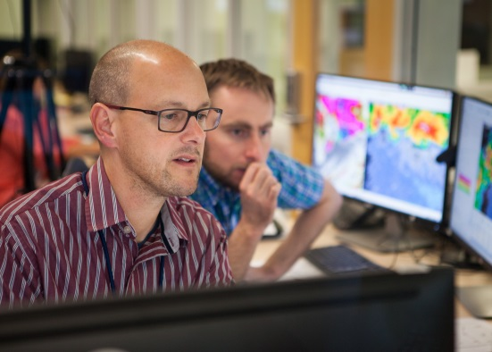
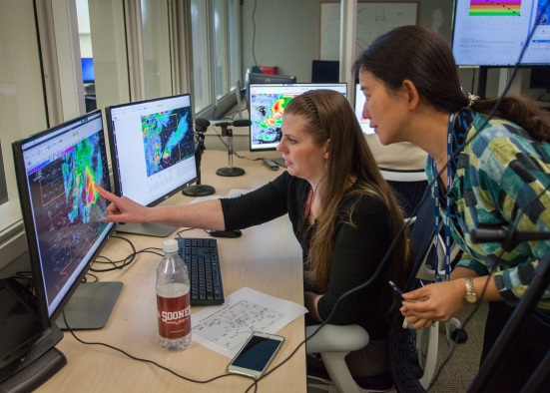
Hazard Services- Probabilistic Hazard Information (HS-PHI) VLAB FORUM (SEPTEMBER 2017)
Greg Stumpf
CIMMS / NWS-MDL, Norman, OK
Tracy L. Hansen
ESRL / GSD, Boulder, CO
With: Alyssa Bates, Chris Golden,
Yujun Guo, Joe James, Jim LaDue,
Chen Ling, Kevin Manross, Tiffany Meyer
Notes:
‹#›

Slide 2
Outline
Background
USWRP Grant
Team Composition
Development Process
Hazardous Weather Testbed Experiment
Preliminary Findings
Looking ahead

Slide 3
BACKGROUND: FACETs and PHI
Forecasting A Continuum of Environmental Threats
A next-generation severe weather watch and warning framework that is modern, flexible, and designed to communicate clear and simple hazardous weather information to serve the public.
Probabilistic Hazard Information (PHI)
Rapidly-updating probabilistic hazard grids.
PHI can be used to provide custom user-specific products that can be tailored to adapt to a variety of needs – for example, providing longer lead times, at lower confidence, for more vulnerable populations with a lower tolerance for risk.

Slide 4
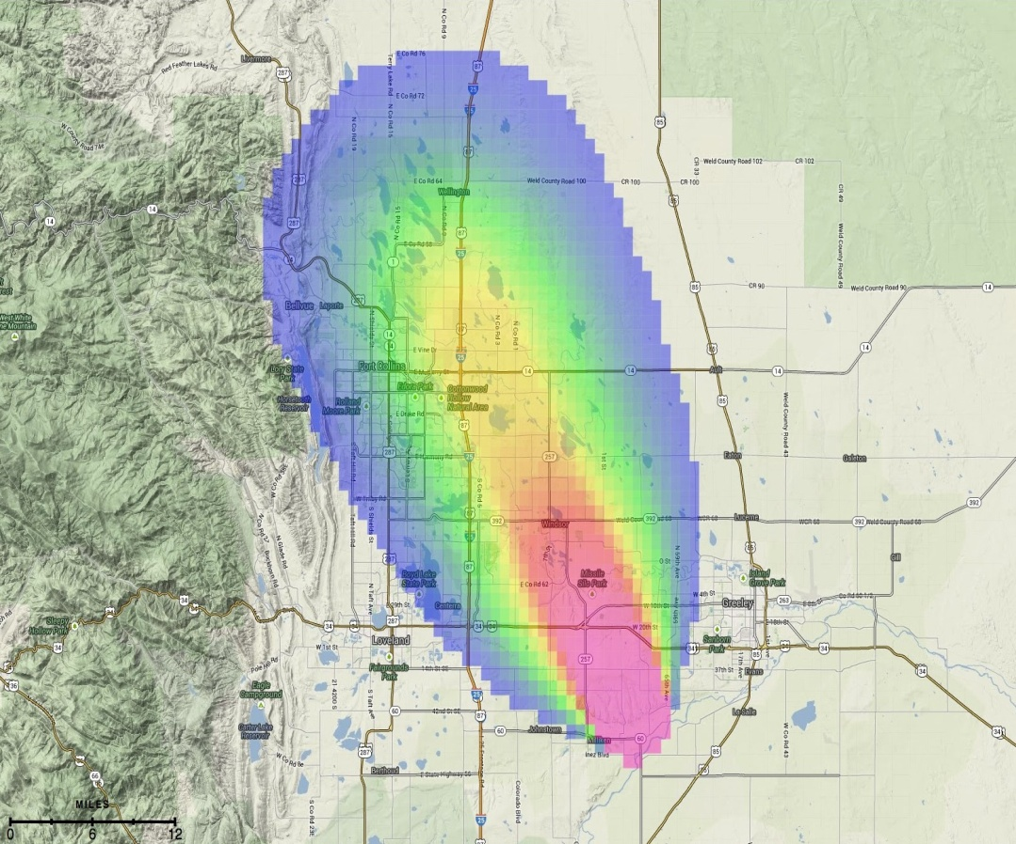
Adaptive warnings from PHI
30-Minute Threat: Tornado Probability
Valid 11:00 a.m. - 11:30 a.m. MDT
_{Last updated: 6 minutes ago}
Evolution from product-centric to information-centric paradigm:
Probabilistic Hazard Information (PHI): forecasters convey threat probability on grids using a new threat management tool.
_{Proximity Alert}
Legacy products (warnings/watches) result from pre-determined thresholds applied to binary decision-making.
Opens the door for new products and services – such as low-probability longer lead time warnings for high risk users who have greater tolerance to high false alarm ratios.
_{Legacy Warning}

Slide 5
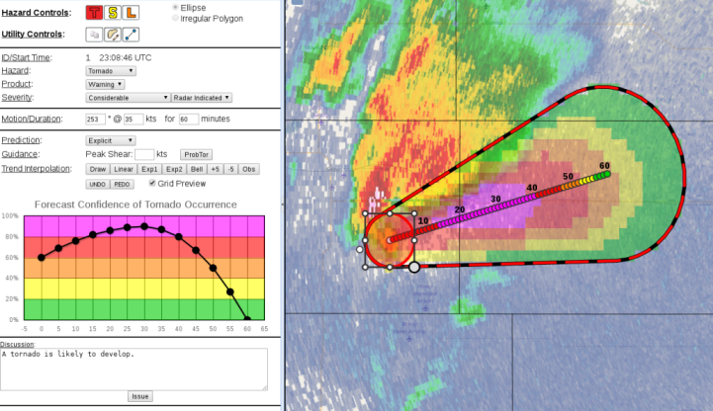
PHI Evaluation History in the Hazardous Weather Testbed (HWT)
PHI Tool Evolution:
First NSSL PHI prototype tests using Warning Decision Support System II (WDSSII), tested in 2007, 2008.
Second modern NSSL PHI Prototype using a web browser-based design, tested in 2014, 2015, 2016.
Look and feel based on AWIPS2 Hazard Services
Integrated user component with Emergency Managers and TV broadcasters using the Enhanced Data Display (EDD) to display custom products derived from PHI.
USWRP Grant: Developed initial capability in AWIPS2 experimental Hazard Services – PHI (HS-PHI) using PHI Prototype as a guide, first tested in 2016.

Slide 6
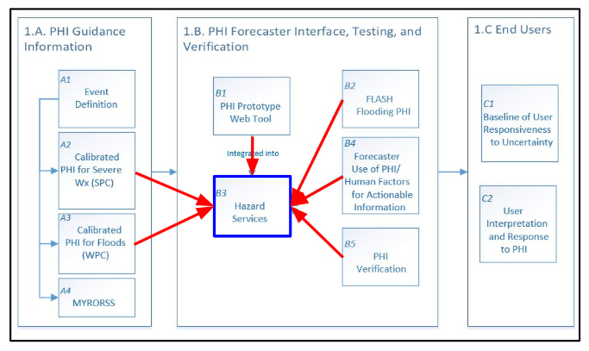
USWRP Grant: Probability Of What? (POW)
RL6 by end of Year 3 (1 June 2018)
Operational readiness will follow

Slide 7
Cross-Organizational Team
MDL -- Experimental Design coordinator, Product Owner writing Functional Tests and prioritizing tasks. Conduit between PHI Prototype and PHI into Hazard Services / AWIPS / Operations. PHI visionary.
GSD -- Software design and development, integration with AWIPS, Hazard Services concepts, and VLab.
Forecasters -- Trying new paradigm, input from operation perspective, feedback on improving software, concepts, and process, O2R
NSSL -- FACETs concept and collaborations, IT support, Hazardous Weather Testbed facility, overall management of the grant / funding, future funding
WDTD -- Development of the Training including future operational use and best practices
University of Akron -- Human Factors

Slide 8
Year 2 Process (2016-2017)
Throughout:
Weekly Design and Planning meetings with entire team
Development and Testing at GSD
Use of Virtual Lab Development Services
May: Set up single machine Test Environment at GSD
Sept: Set up dual machine Test Environment at GSD
Major shift in Team dynamics and progress:
Oct-Feb: Coding and Testing against Detailed Functional Tests using WebEx so developers could watch HWT in action
Mar-April: HWT with continued improvements in off weeks

Slide 9
HS-PHI software developments in Year 2
The 2015 version of NSSL PHI Prototype was the Year 2 benchmark.
New functionality added for Year 2:
Convective Recommender
Processes ProbSevere detections into Hazard Services – PHI objects.
Workflow for editing objects including adjusting of the motion vector
Levels of Automation
Forecasters can create manual objects.
Forecasters can assume partial or full control of automated objects.
New object drawing tools: ellipses, rotation, resizing
Ending objects
PHI output grids
Warning Decision Discussion (timestamped entries)

Slide 10
PHI in AWIPS2/Hazard Services (HS-PHI)

Slide 11
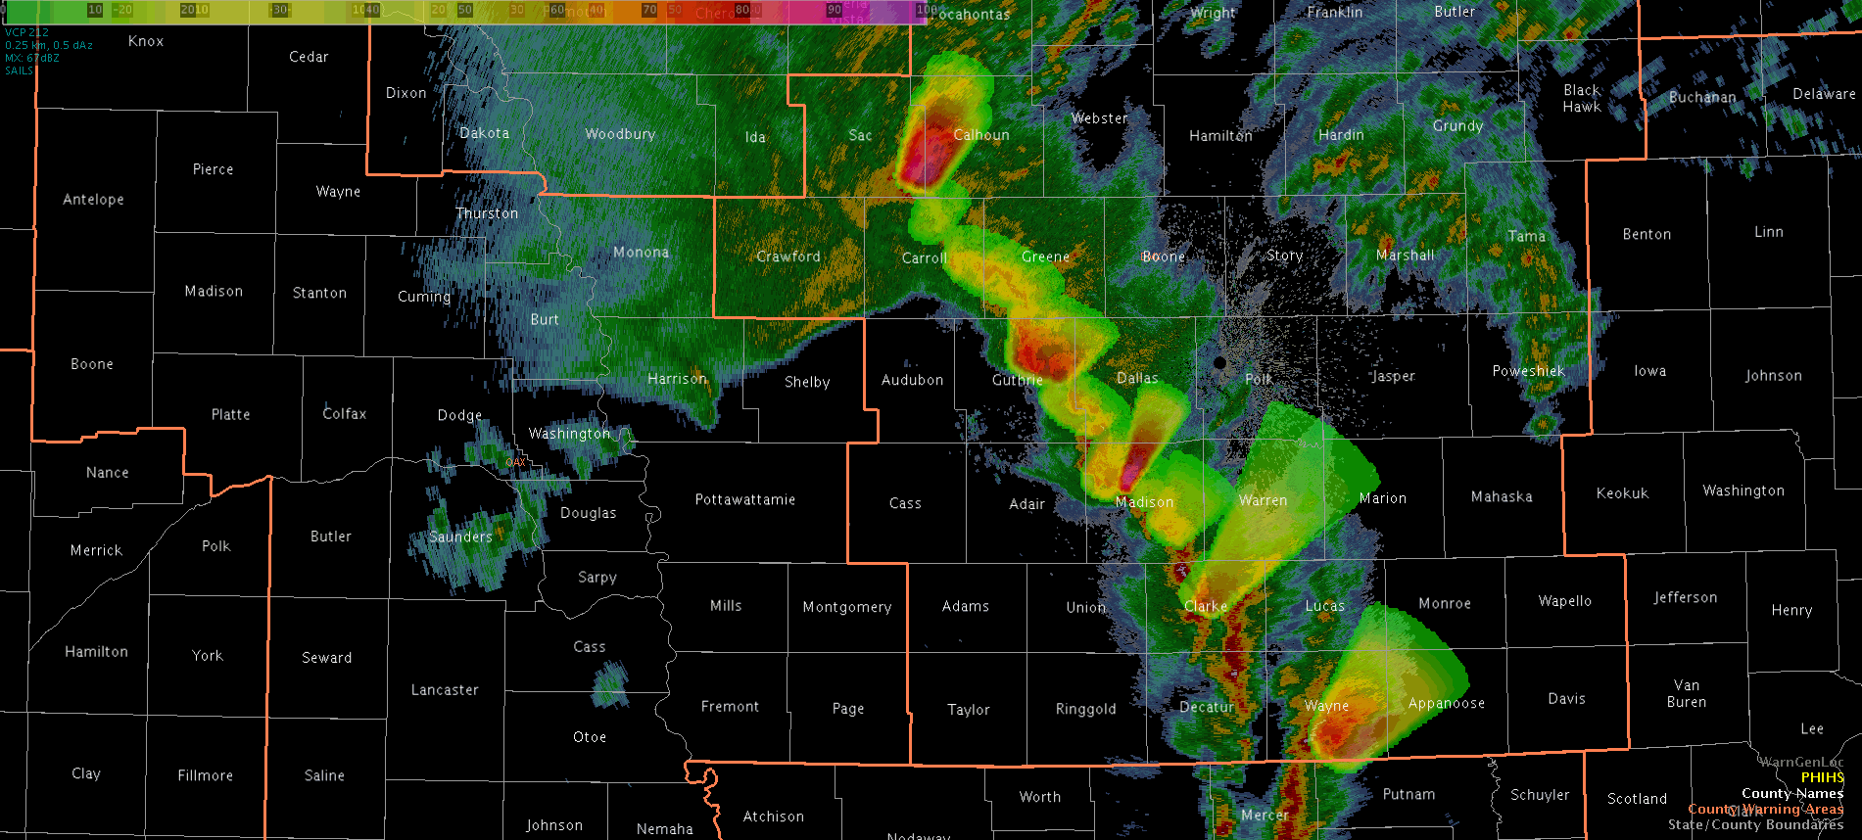
PHI Output Grids in AWIPS2

Slide 12
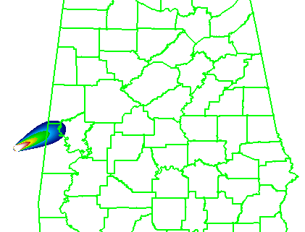
HS-PHI HWT Experiment Objectives
Technology: Evaluate HS-PHI components and performance so that the software can be improved before operational implementation.
Human Factors: Measure forecaster workload using HS-PHI, including ease of use and graphical design.
Methodology: Assess how forecasters adopt and evolve their current warning methodology into the HS-PHI environment, including evaluating the human-machine mix with automated ProbSevere guidance.
Conceptology: Collect and analyze data on forecasters’ thoughts on the paradigm change from deterministic warning products to probabilistic hazard information.
_{“Threats-In-Motion (TIM)”}

Slide 13
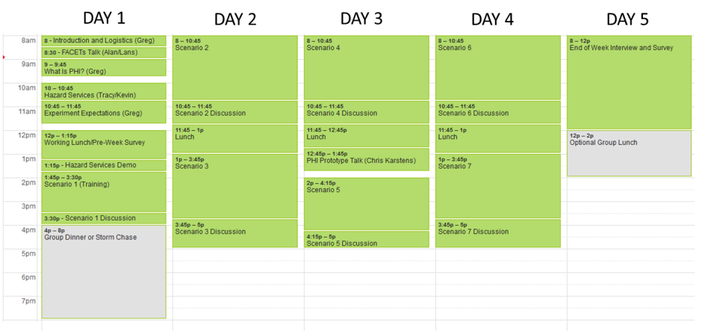
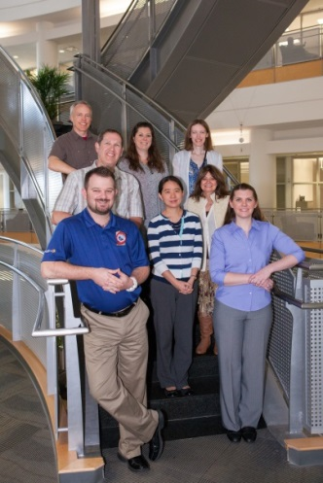
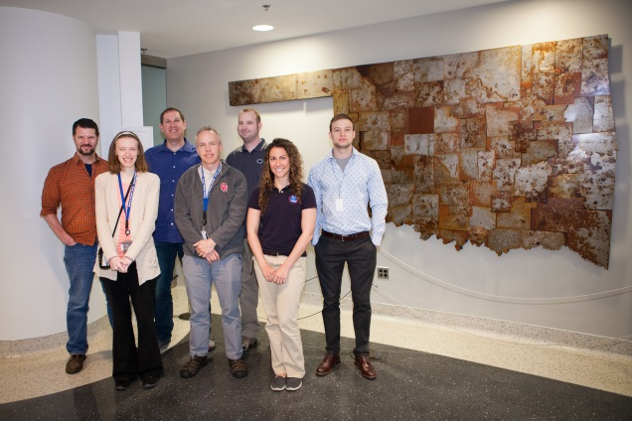
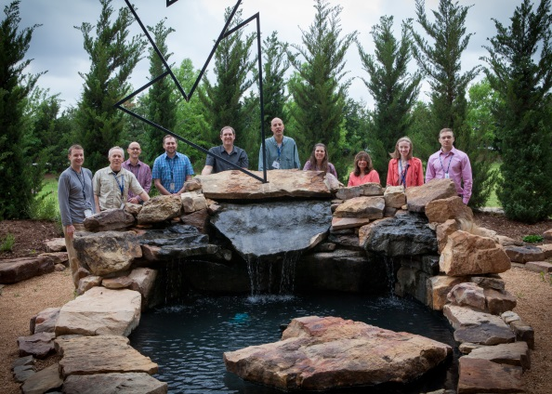
HS-PHI 2017 HWT Experiment
Training materials hosted by Virtual Lab Collaboration Services
2017 Operations Weeks:
Shakedown: 20 – 24 Feb (1 forecaster)
Week 1: 20 - 24 Mar (2 forecasters)
Week 2: 3 – 7 Apr (2 forecasters)
Week 3: 17 – 21 Apr (2 forecasters)

Slide 14
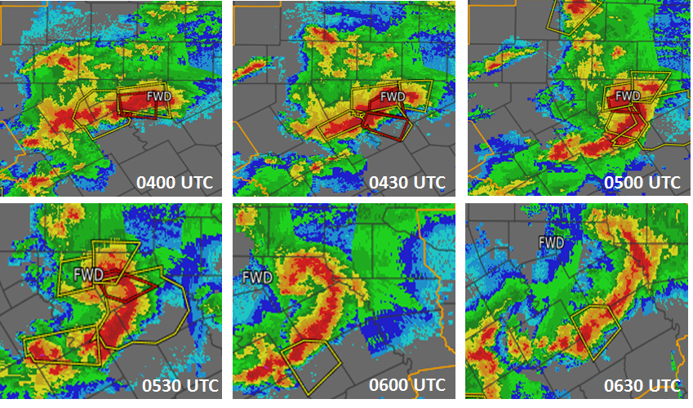
2017 Displaced Real-Time Scenarios
Isolated marginally severe storm
Provide forecasters with basic concepts of PHI
Developing supercell
For continued practice with PHI and object nudging.
Merging/splitting supercells
Dealing with many events in very close proximity
Quasi-Linear Convective System Tornadoes
Multiple-scale PHI
Low-Shear Summer Southeast Microbursts
Random slow motion
Upscale growth to squall line
Merging objects to larger objects
Mature supercells
To study issues with cross-forecast area collaboration
_{CWA 1}
_{CWA 2}

Slide 15
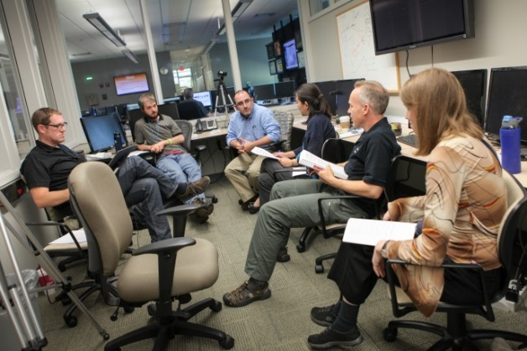
Human Factors Data Collection
Pre-operations survey
Internal probability thresholds, ProbSevere use, WFO warning team composition, forecasters’ ideas for warning improvement
Live video of forecasters, desktops, and group discussions
Discussions during events with meteorologists, developers, trainers, and human factors scientists
Post-event survey/discussion (60 minutes each)
NASA Task Load Index (TLX) Mental Workload Survey
Mental Demand, Physical Demand, Temporal Demand, Performance, Effort, Frustration
Confidence Survey
End-of-Week Discussion (Friday)
Post-Study Usability Survey
Long Interview touching on the four main objectives
Technology, Human Factors, Methodology, Conceptology

Slide 16
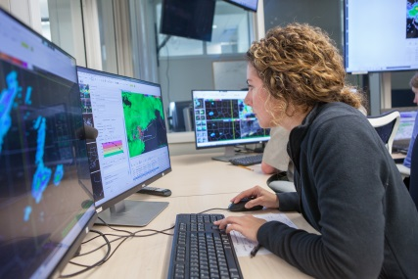
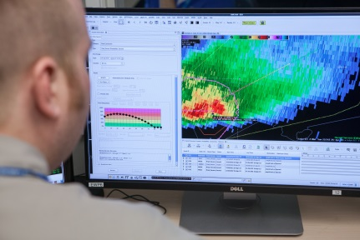
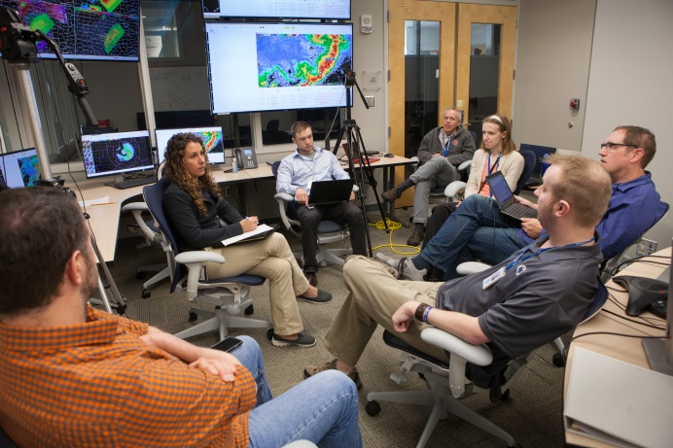
Forecaster contributions
Visiting forecasters provided suggestions to improve the software.
These suggestions are triaged to determine if they can be:
Incorporated into HS-PHI directly
Incorporated into both the PHI Prototype and HS-PHI
Require proof-of-concept testing in the PHI Prototype first.
Forecasters helping to formulate operational best practices – WDTD integration.

Slide 17
Year 2 Preliminary Findings
New systematic software releases and virtual functional testing resulted in better progress and more stable platform than in Year 1.
Forecasters completed all required scenarios without major software interruptions.
Cross-WFO collaboration and object handoff will require significant analysis
OAR Office of Weather and Air Quality (OWAQ) HWT Proposal not accepted – will pursue other means of funding.
Software performance issues continue to impact the forecaster experience and need to be addressed.

Slide 18
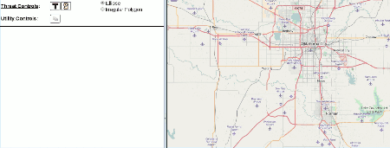
Year 3 Development – Finish 2015 Prototype Capabilities
Address performance issues and stability
Hazard Services Registry implementation results in slow-downs
Need to incorporate the latest improvements
If necessary, explore alternative solutions
Buffering of commands for quicker responsiveness
PHI requires intense user interaction with hazard objects which warrants performance analysis and optimization
More robust error handling
Continue to refine functionality
Ownership of hazard objects and locking
Redraw polygon
Respond to user interface suggestions from forecasters

Slide 19
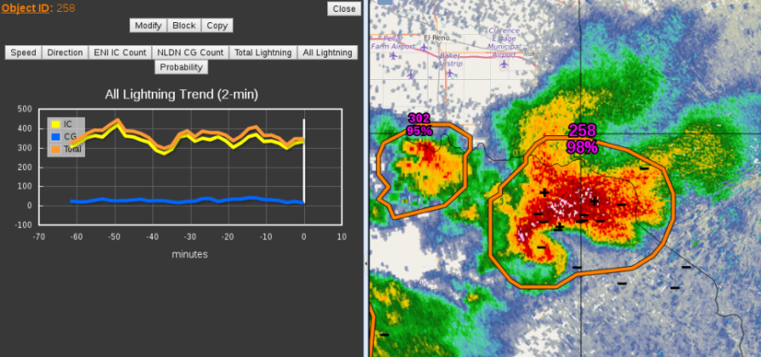
Year 3 Development – New Functionality
Begin development of new functionality, including new items IDed by HS-PHI HWT tests, and those vetted by the PHI Prototype in 2016-2017.
Candidates at the top of the list are:
Lightning PHI
Warning product output (with VTEC, etc.)
Deterministic Threats-In-Motion (TIM) polygons
Storm Longevity

Slide 20
Year 3 Timeline
_{May}
_{June}
_{July}
_{Aug}
_{Sept}
_{Oct}
_{Nov}
_{Dec}
_{Jan}
_{Feb}
_{Mar}
_{Apr}
_{May}
_{Report to NWS}
_{Plan Year 3 Tasking}
Establish full GSD Test Platform
_{Code Sprint in Boulder}
Initial Set of Functional Tests
_{Final Set of Functional Tests}
_{2018 HWT}
_{Proposals for Year 4+ funding}
Continual Design, Development, and Testing -- Details TBD
_{Wrap-up to RL6}
Bi-weekly Collaboration calls with WPC / SPC

Slide 21
Path to operations after the USWRP: Year 4+
JTTI Proposal pending (software to RL7)
Complete development of 2016-2017 Prototype functionality
HWT spring experiments to include users (EMs, etc.)
Addition of new science as developed in companion JTTI proposal:
New plume model
New storm object ID and tracking model
Improved probabilistic guidance
New products informed by PHI Prototype
Policy and paradigm shift to make FACETs operational

