Slide 1
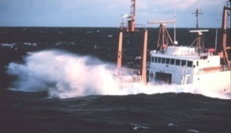
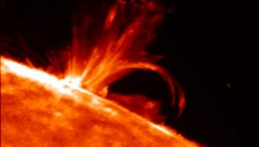
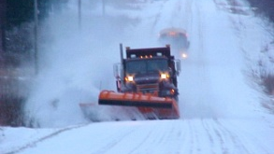
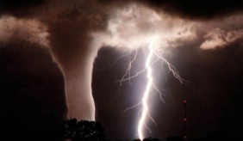
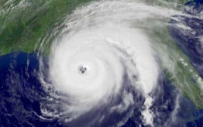
Hydrometeorological Prediction Center
2012 Review and R2O Activities
Wallace Hogsett
Science and Operations Officer
with contributions from HPC: Jim Hoke, David Novak, Mark Klein, Keith Brill, Chris Bailey, Dan Petersen, Faye Barthold, Tom Workoff, Patrick Burke, Mike Bodner, Tony Fracasso, Jim Cisco
2012 Research in Transition Team (RITT) – December 2012

Slide 2
Outline
Overview of HPC Product Suite
Review of FY12 performance metrics (GPRA)
Use of EMC guidance in support of HPC operations
QPF, Winter weather, Medium Range, MetWatch
R2O activities via the Hydrometeorological Testbed at HPC
Notes:
*

Slide 3
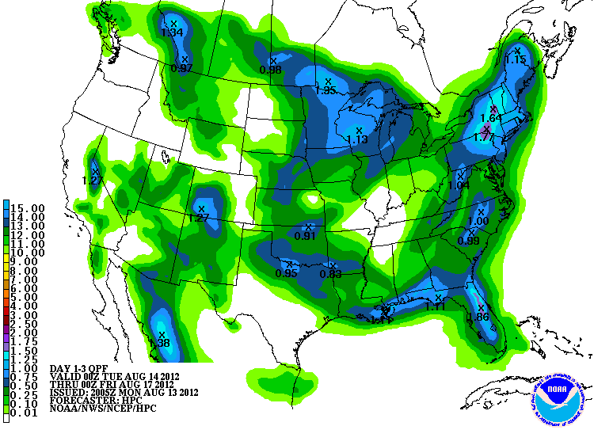
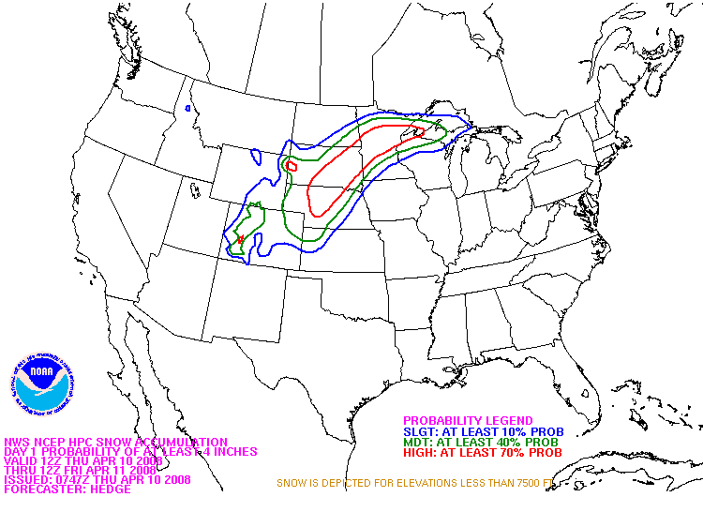
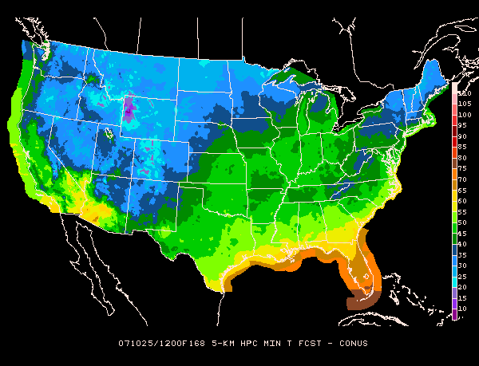
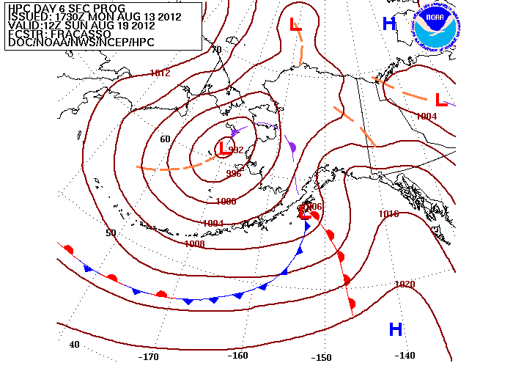
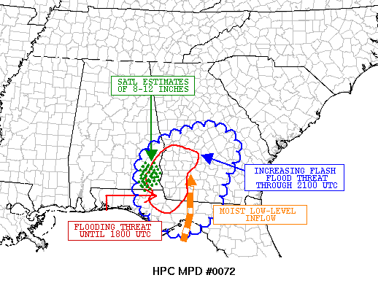
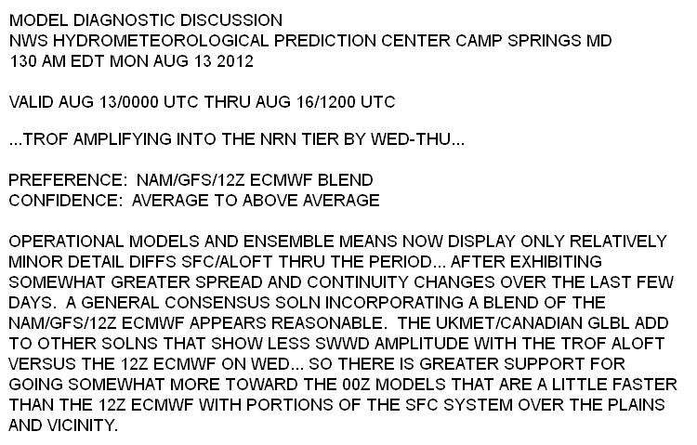
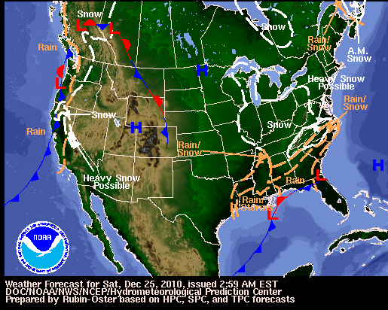
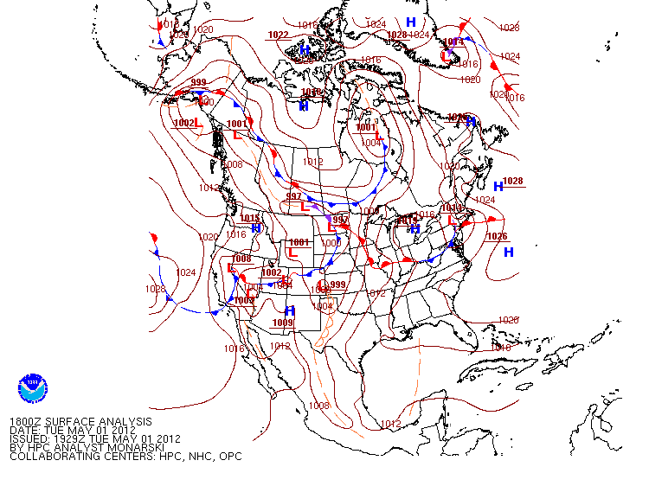
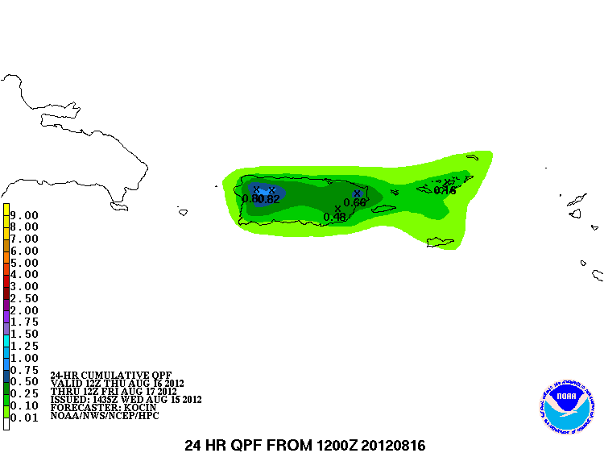
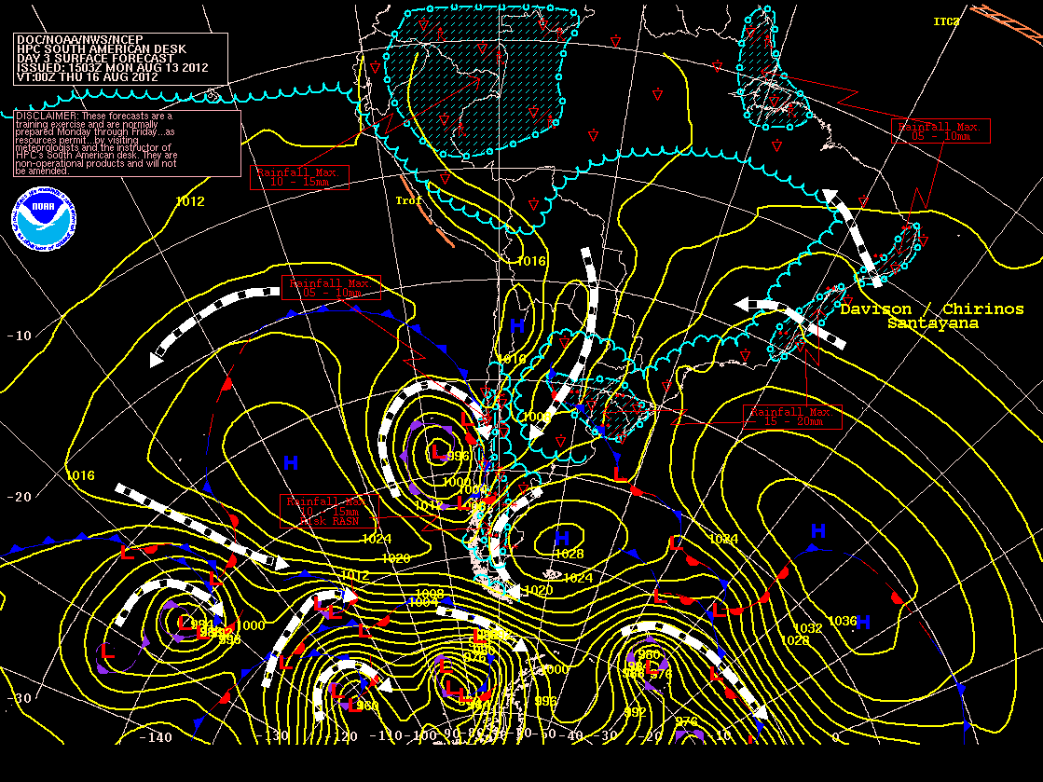
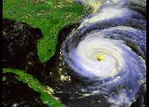
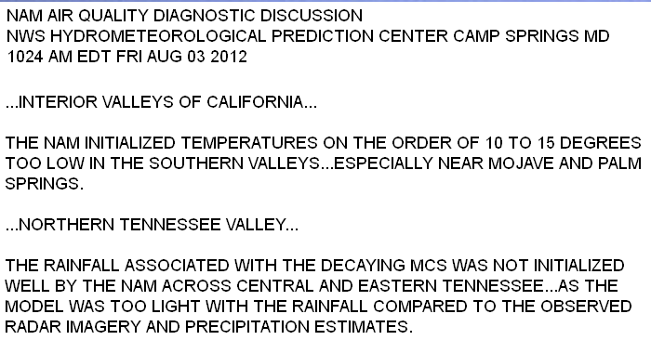
HPC Operational Desks
QPF
Winter Weather
Medium Range
Alaska Med. Range
NEW
Met Watch
Model Diagnostics
Short Range
Surface Analysis
DISCONTINUED
Puerto Rico QPF
International
Tropical
Air Quality

Slide 4
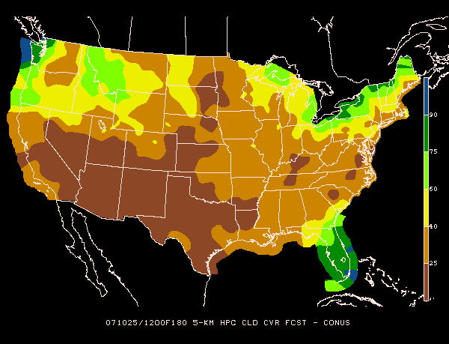
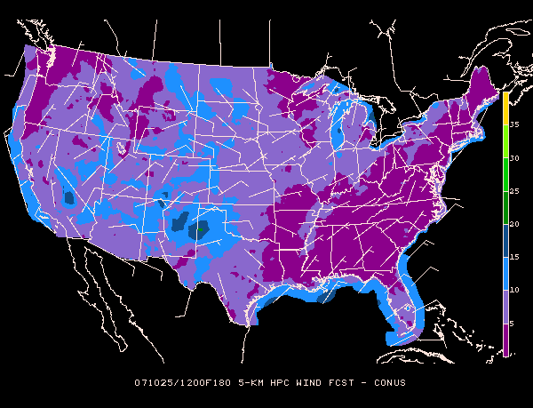
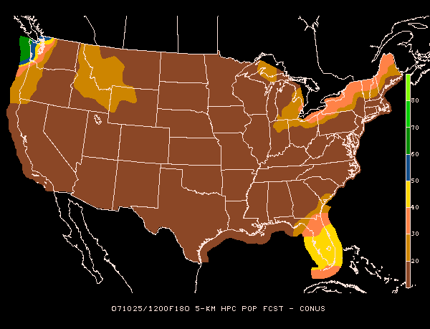
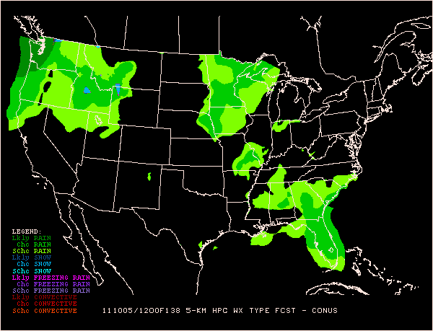
HPC Forecast Process
Forecaster evaluation of ensemble guidance
(ex., NCEP, MDL, CMC, NAEFS, ECMWF, UKMET, FNMOC)
PAST
Forecaster in the loop
Subjective “model of the day”
Manual product generation
Extensive manual edits
TARGET
Forecaster over the loop
Subjective “most likely outcome”
Automated grid generation (spatial consistency)
Limited manual edits
Forecaster weighting of ensemble guidance
Automated grid generation
Forecaster adjustment of grids

Slide 5
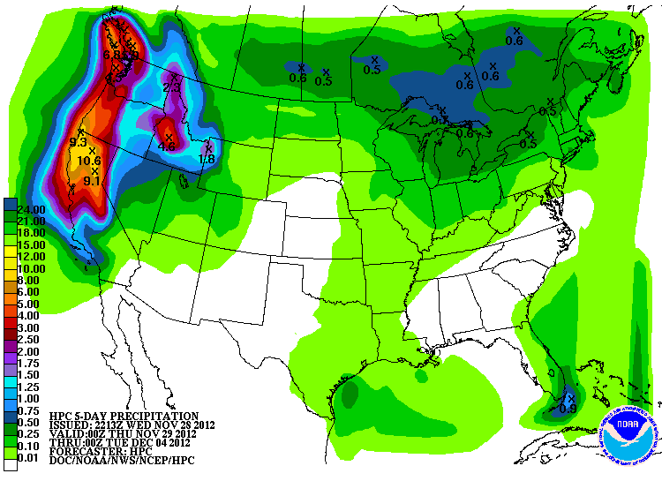
QPF

Slide 6
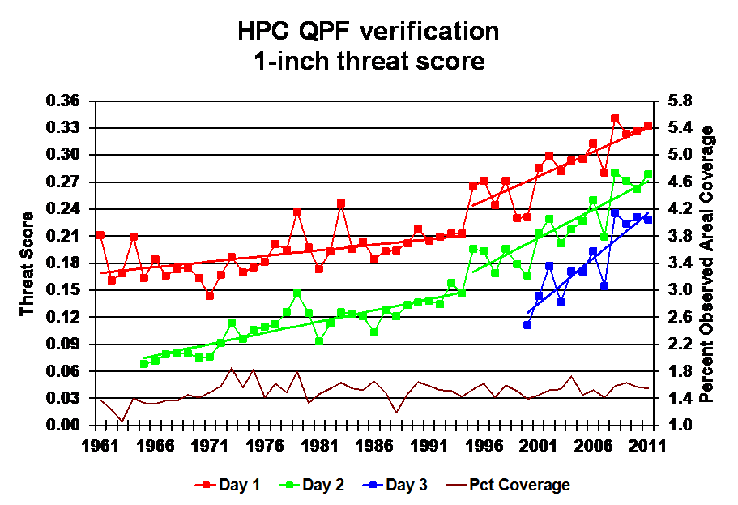
Long-Term Verification
2012 GPRA Goal: 0.31
6
Notes:
*

Slide 7
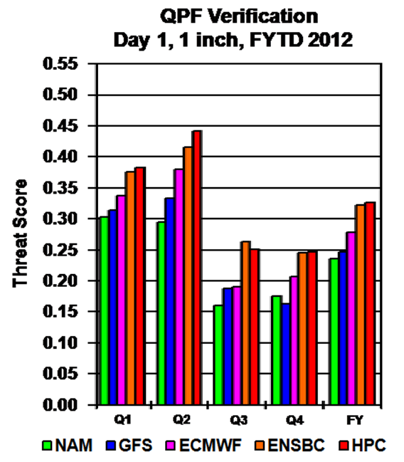
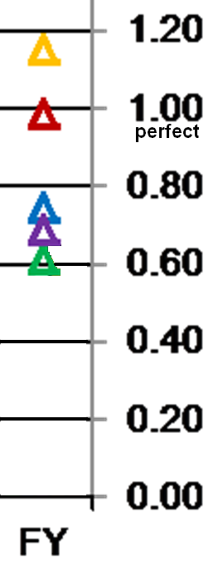
2012 HPC Verification
Achieved 2012 GPRA goal
HPC’s internal bias-corrected ensemble (ENSBC) technique performs well at Day 1.
In general, ECMWF>GFS>NAM
Cool season skill (Q1 - Q2) is notably better than the warm season skill (Q3 – Q4)
Freq Bias
GPRA Goal: 0.31
Notes:
*

Slide 8
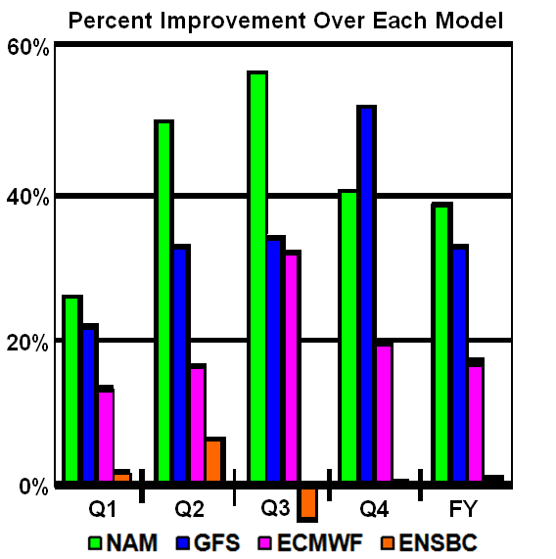
Day 1: Percent Improvement
HPC adds value to the NAM, GFS, and ECMWF
More value is added during the more difficult warm season
ENSBC is based on EMC guidance suite
FY2012
9
Notes:
*

Slide 9
High-Impact Events
Landfalling “TCs” presented two of the most visible QPF hazards of 2012.
Sandy
Isaac
HPC contributions:
Skillful and value-added QPFs
Decision Support Services (DSS)
Media, NOAA coordination
9
Notes:
*

Slide 10
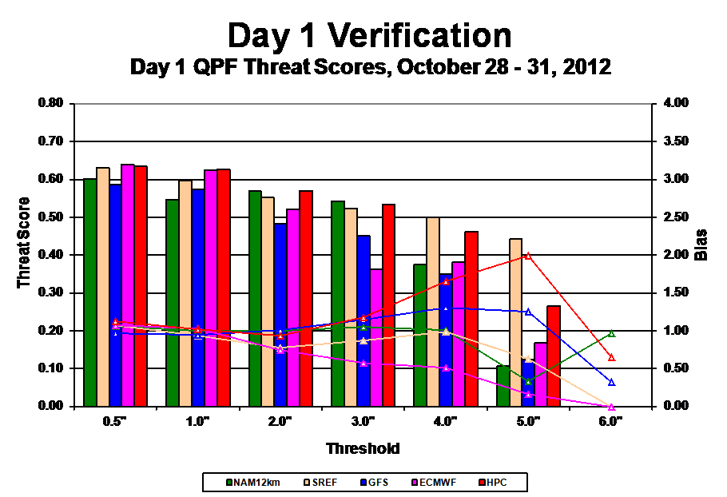
High-Impact Events: Sandy
Skillful and nearly unbiased Day 1 1” forecasts
Goal
- perfect
Notes:
*

Slide 11
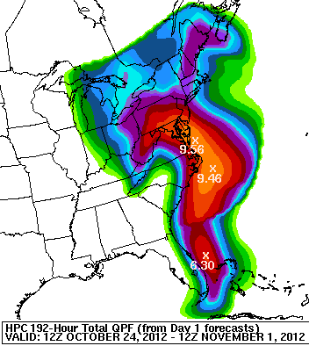
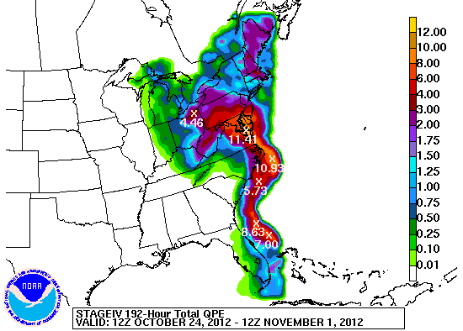
Day 1 QPFs - Sandy
Forecast
Observed

Slide 12
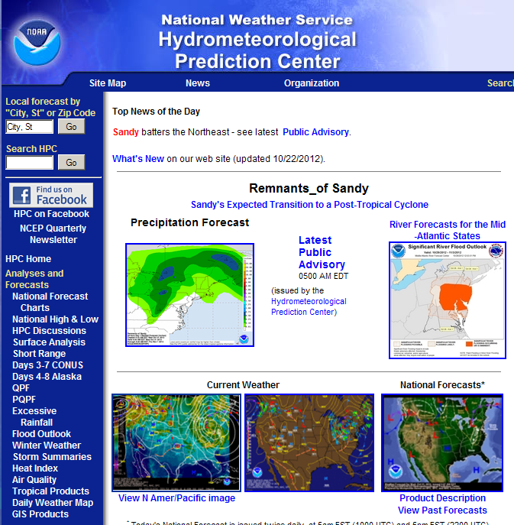
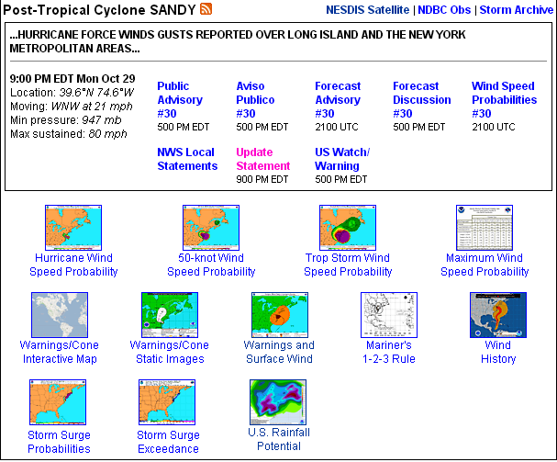
Decision Support: Sandy
Internal DSS: NOC, FEMA, Regions, WFOs
External DSS: Media (CNN, Univision, etc.)
Flexible web presence, with Sandy-specific products highlighted on HPC homepage
HPC QPF linked on NHC webpage
HPC Public Advisories linked on NWS homepage after landfall
Heavy snow mentioned in advisory for the first time
*
Notes:
*

Slide 13
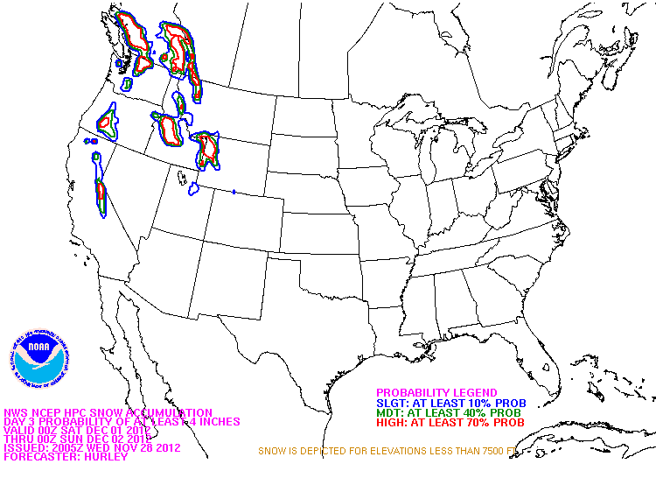
Winter Weather

Slide 14
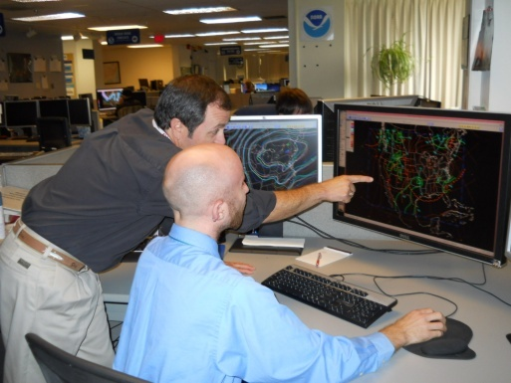
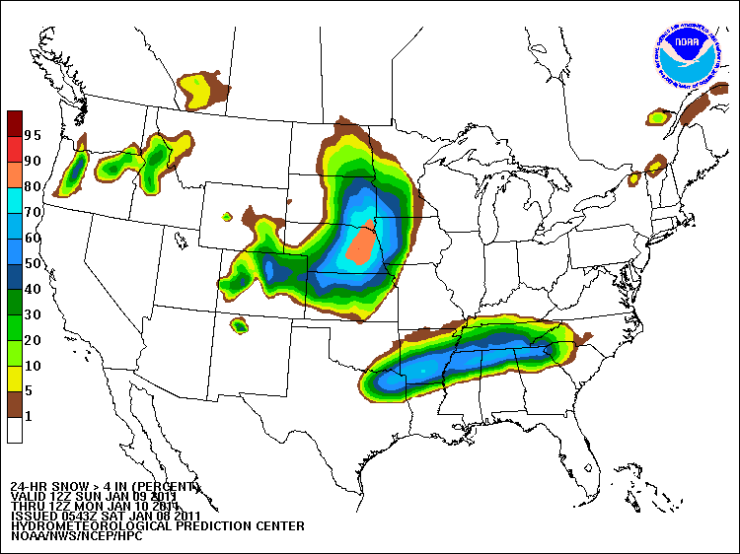
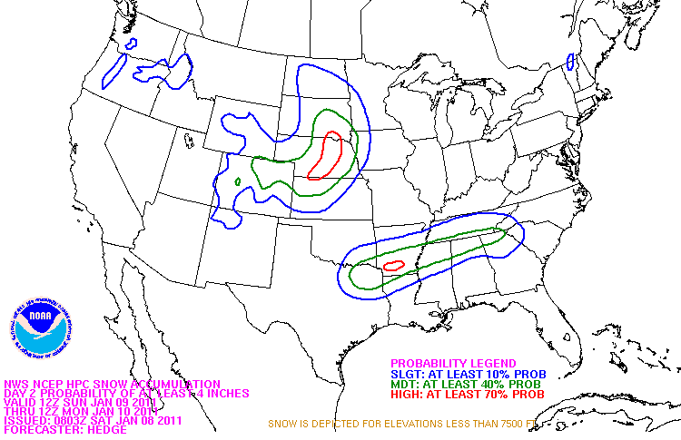
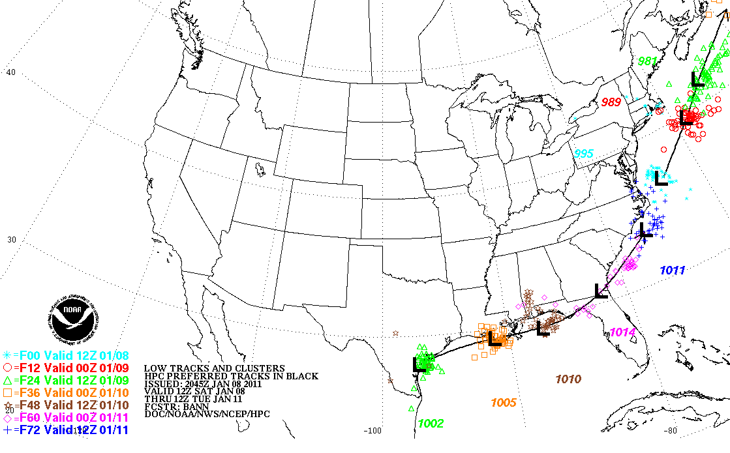
HPC’s Winter Weather Products and Services
Internal NWS collaboration
24 & 48 h probabilities for:
-Snow/Sleet/Freezing Rain
-Probabilities computed from deterministic forecast and ensemble spread
Track forecasts for surface lows
associated w/ significant winter weather
Heavy Snow and Ice Discussion
Notes:
14

Slide 15
HPC Deterministic Snowfall Forecast
2011-12 Day One Snow Threat Score East of the Rockies
Better
Final forecasts are outperformed by the Automated Ensemble
Automated Ensemble : NAM + GFS + ECMWF + SREF members + GEFS members

Slide 16
HPC Deterministic Snowfall Forecast
2011-12 Day Three Snow Threat Score East of the Rockies
Better
Final forecasts outperform the Automated Ensemble for all thresholds
Automated Ensemble : NAM + GFS + ECMWF + SREF members + GEFS members

Slide 17
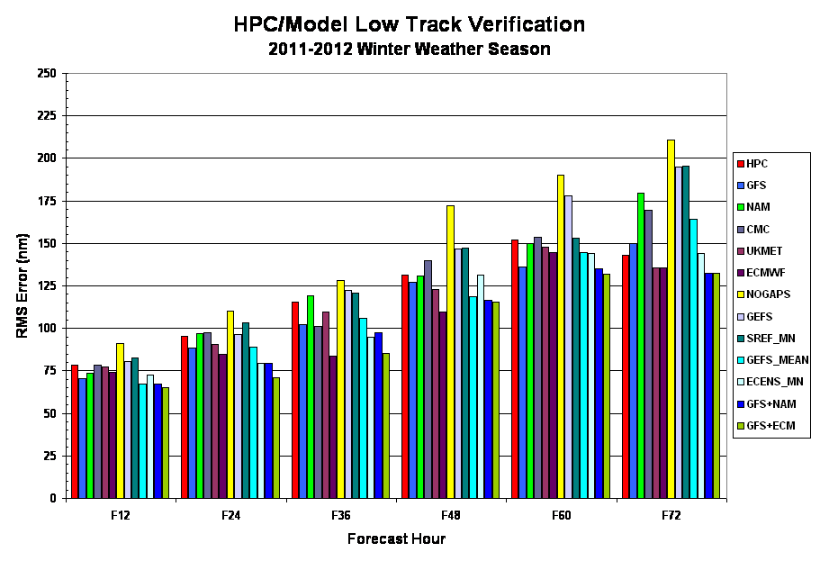
2011-12 Verification of HPC low tracks (position at each forecast hour)
Lowest errors: blend of the GFS&ECMWF
17
Notes:
17

Slide 18
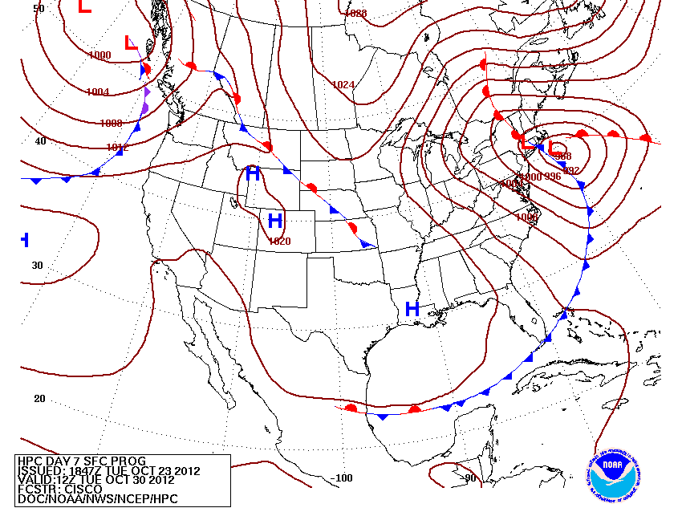
Medium Range

Slide 19
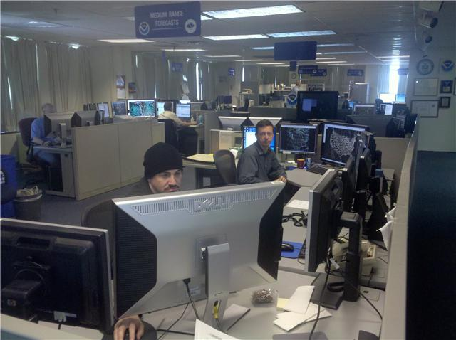
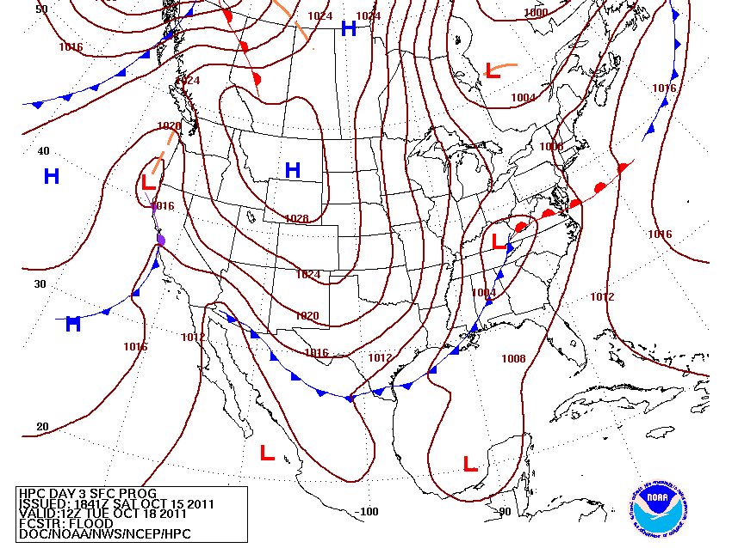
Twice-Daily Medium-Range Grids -- An Enhanced Resource for the Field Offices
Previously once-daily suite for CONUS and Alaska
- Not sufficient for WFO/RFC needs
- Grids were often ‘old’ when needed
- Only available for collaboration 9 hours
Alaska Desk
Temp / PoPs
HPC rearranged staffing to provide twice-daily suite for CONUS, while keeping once-daily for Alaska
More-current forecasts
Improved accuracy
Available for collaboration 18 hours
Implemented Dec 18, 2012
Pressure/Fronts

Slide 20
3-7 day forecasts valid at Sandy landfall
9 Days Prior to Landfall:
“…A LARGE, SPRAWLING HYBRID LOW IS DRAWN TOWARD THE MID ATLANTIC COAST BY THE END OF DAY 7. MUCH REMAINS TO BE SORTED OUT, BUT THE POTENTIAL IMPACT IS IMPRESSIVE.”
CISCO
7 Days Prior to Landfall:
“…BESIDES THE WIND, THE OTHER SENSIBLE WEATHER THREAT IS HEAVY RAINS, WITH HEAVY SNOWS POSSIBLE ON THE SOUTHWEST SIDE OF THE HYBRID CIRCULATION…”
CISCO
xxxxxx

Slide 21
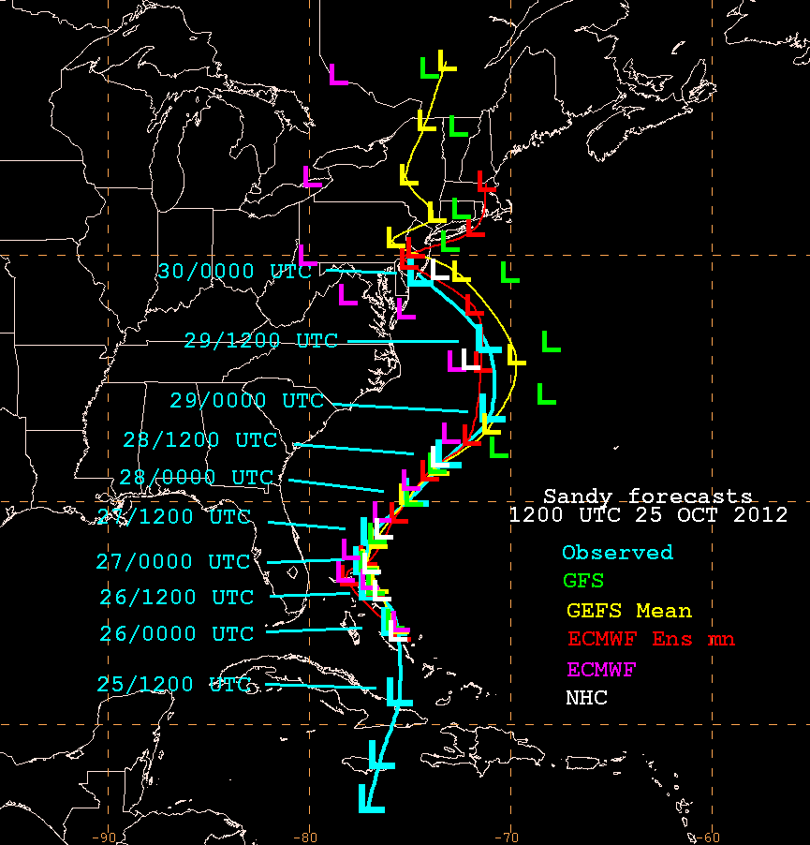
Use of Ensembles - Sandy
Deterministic GFS and ECMWF forecasts diverged 5 days prior to landfall.
However, consistency between their ensemble means gave forecasters confidence in the ensemble solutions.

Slide 22
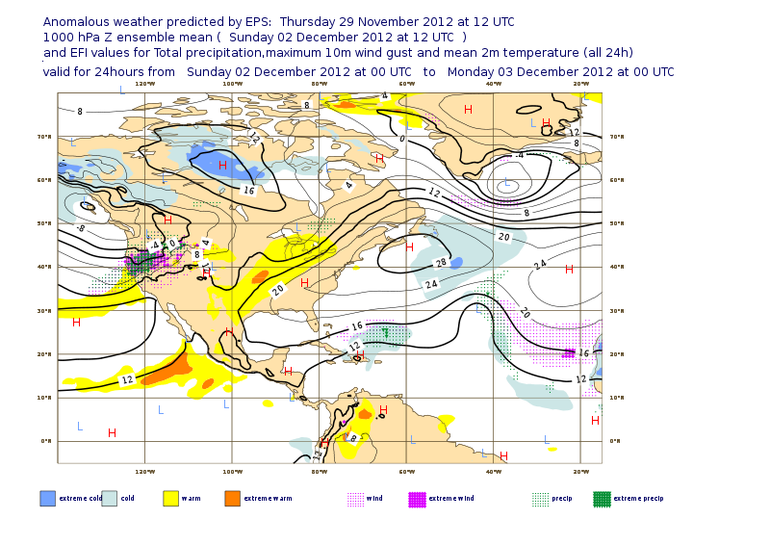
Ensemble-Derived Products
ECMWF Extreme Forecast Index (EFI)
Need tools that condense ensemble data into actionable information.
Mean, spread
Extreme Forecast Index
This topic is increasingly relevant as data volume increases.
Extreme Warmth
Extreme QPF/Wind

Slide 23
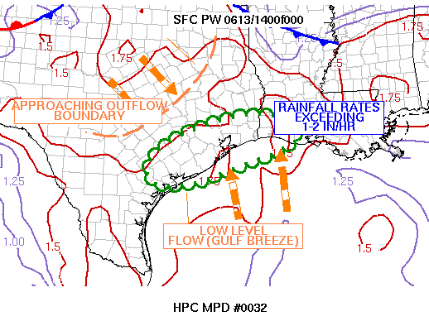
MetWatch

Slide 24
MetWatch Background
HPC will provide a product similar to SPC Mesoscale Convective Discussions (MCD) focusing on heavy rainfall.
The goal is to provide enhanced situational awareness of potential flash flood events (1-6 hrs).
Requirement: high-resolution ensemble system capable of skillful and reliable short-term heavy rainfall forecasts. SSEO, SSEF, etc.
MESOSCALE PRECIPITATION DISCUSSION 0032
NWS HYDROMETEOROLOGICAL PREDICTION CENTER CAMP SPRINGS MD
1216 PM EDT WED JUN 13 2012
AREAS AFFECTED...SOUTHEAST TEXAS...SOUTHWST LOUISIANA
CONCERNING...HEAVY RAINFALL...FLASH FLOODING POSSIBLE
VALID 131600Z - 132000Z
...SLOW MOVING CONVECTION WITH POTENTIALLY EXCESSIVE RAINFALL AMOUNTS ACROSS COASTAL AREAS IN SOUTHEAST TEXAS AND WESTERN LOUISIANA...
COMPOSITE RADAR LOOPS SHOW REGENERATING CONVECTIVE CLUSTERS ALONG THE GULF BREEZE BOUNDARY ACROSS COASTAL PORTIONS OF SOUTHEAST TEXAS...EAST OF VICTORIA...AND SOUTHWEST LOUISIANA. THESE CELLS ARE AIDED BY THE STRENGTHENING DIURNAL DESTABILIZATION...WITH THE LATEST SPC MESOANALYSIS INDICATING SURFACE-BASED CAPES BETWEEEN 3,000-4,000 J/KG...COINCIDENT WITH THE RICH...DEEP MOIST ENVIRONMENT WITH SURFACE DEWPOINTS IN THE MID 70S...K INDICES IN THE MID TO UPPER 30S...AND PWATS BETWEEN 1.75 AND 2.00 PER THE LATEST GPS AND 12Z UPPER AIR ANALYSIS.
...HURLEY.. 06/13/2012
ATTN...WFO...LCH...HGX...CRP...EWX... LAT...LON 28399668 28419704 28719735 29229718 29779637 30179525 30429385 30219268 29789250 29519279 29159377 28839481 28499573 28399668
27
Notes:
*

Slide 25
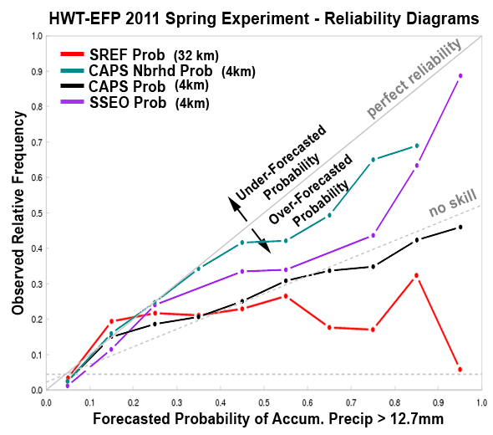
Benefits of High-Resolution
High-resolution SSEF system provides more skillful and reliable precipitation forecasts than the operational SREF.
**note 32km SREF used here
CAPS Nbrhd
SSEO
CAPS
SREF
Figure courtesy of DTC
*
25
Notes:
*

Slide 26
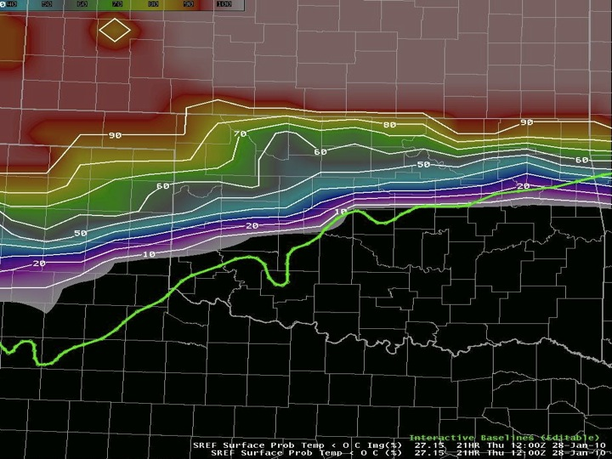
Ensemble Reliability
24h SREF freezing line forecast outside the envelope.
SREF example demonstrates a broader issue with ensemble prediction systems (EPSs).
Probabilistic forecasts only as good as the underlying EPS.
SREF probs of T<0C
Verifying freezing line
Figure courtesy of Patrick Burke (HPC) and Bill Leatham (UMASS-Lowell)
26
Notes:
*

Slide 27
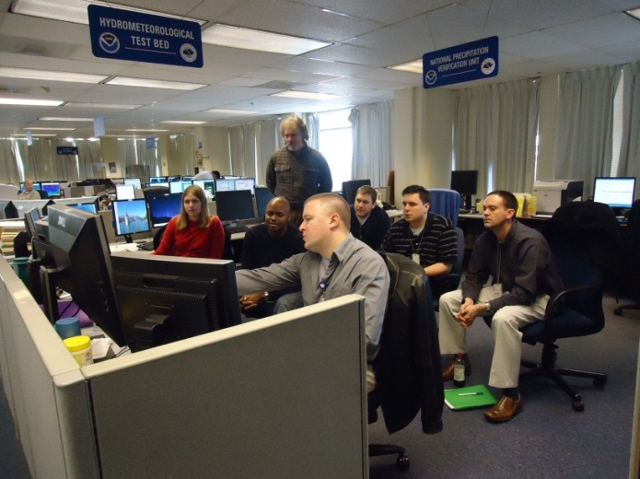
Hydrometeorological Testbed (HMT) at HPC

Slide 28
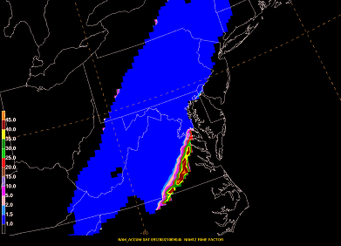
HMT-HPC Focus and Methods
Focus: Improve and extend prediction of heavy precipitation
Approach:
Improve understanding of heavy precipitation phenomena
Improve application of high-resolution and ensemble guidance
Real-Time Collaborative Experiments
Test New Datasets
Develop New Tools/Techniques
Train Forecasters & Researchers
Warm-Season Winter Weather Atmospheric River
Snow
Sleet
28

Slide 29
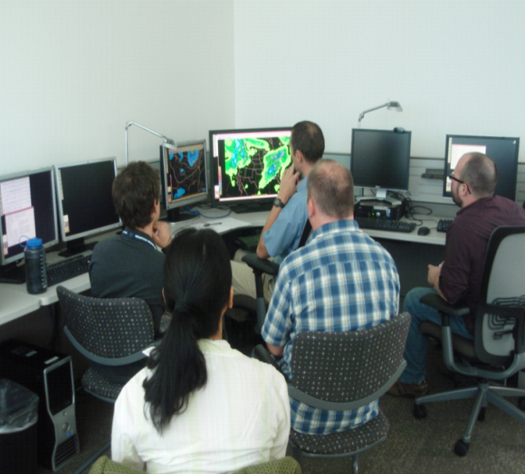
2012 Atmospheric Rivers Retrospective Experiment
Hosted 17 forecasters, researchers, and model developers at HPC
Used 8 past cases over the 2008-2011 time period
Verified using RFC precip analysis and HMT AR Observatories
GOALS
Does the HMT-ensemble, multi-model ensemble, and reforecasting dataset improve extreme precipitation forecasts?
What are the strengths & weaknesses of current model guidance?
How can forecasters add value to extreme precipitation forecasts?
29

Slide 30
2013 WWx Experiment Plans
Featured Datasets
Provider | Model | Resolution | Forecast Hours | Notes
EMC | SREF (21 members) | 16 km | 87 | Operational SREF
EMC | NAM | 12 km (parent) 4 km (nest) | 84 60 | Operational NAM; includes 12 km parent model and 4 km nest
HPC | Autoensemble (28 members) | 32 km | 72 | Composed of 21 SREF members, GEFS mean (2), ECMWF mean, and deterministic NAM, GFS, CMC, and ECMWF
AFWA | WRF (10 members) | 20 km | 144 | UKMET boundary and initial conditions
AFWA | WRF (10 members) | 4 km | 72 | Multi-physics, multi-initial condition convection-allowing ensemble
EMC | NAM | 12 km (parent) | 84 | New snow accumulation algorithm based on modified SLR technique (rime factor)
Experimental Operational
* all other operational guidance will also be available to the participants

Slide 31
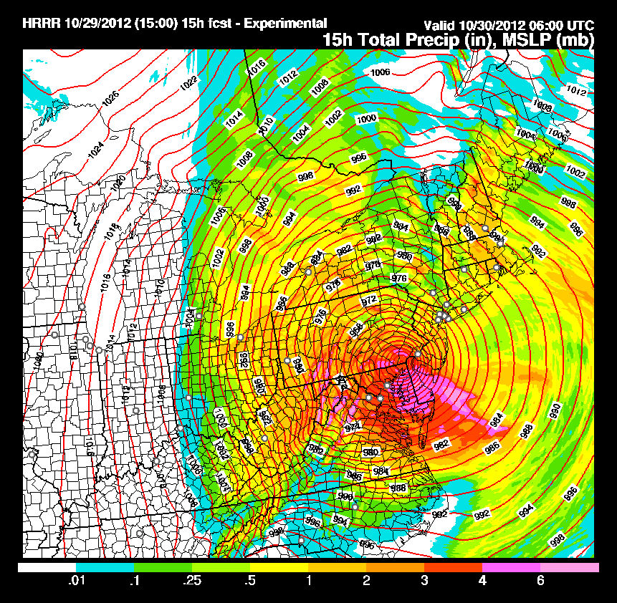
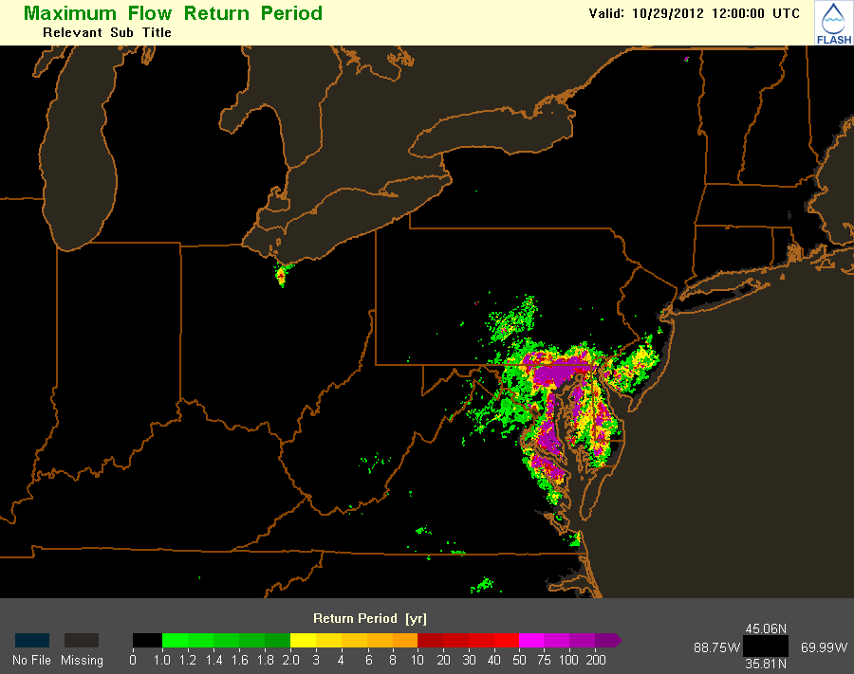
FY13 Heavy Rainfall and Flash Flood Experiment
Meteorology
Zero to 12 h probabilistic rainfall forecasts
Satellite Nowcast
MDL Nowcast
HRRR
Hydrology
QPE
River Stages
Flash Flood Guidance
FLASH hydrologic model
Probabilistic Flash Flood threat product
HRRR 15 h precip
FLASH Return Frequency
31

Slide 32
HPC “Wish List”
In addition to the high-quality and constantly improving EMC guidance suite, HPC would like to see:
Storm-scale ensemble forecast (SSEF) system
Initially for short-term QPF
Formalized Storm-scale Ensemble of Opportunity (SSEO)
Improved reliability of probabilistic QPFs (SREF/GEFS)
Improved snowfall forecasts (microphysics, land use)
Ensemble-derived products: e.g., EFI, improved clusters
New datasets and tools are tested and operationalized through the Hydrometeorological Testbed at HPC

