Slide 1
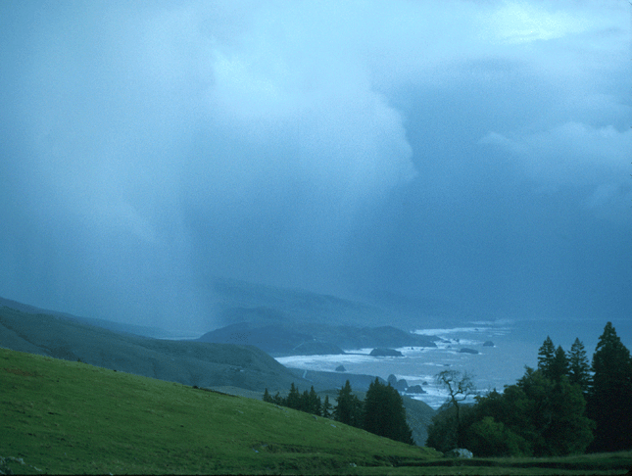
Hydrometeorology Testbed West (HMT-West) Overview
Allen White¹, Rob Cifelli¹, Dave Reynolds^{1,2},
Lynn Johnson^{1,3}, Ligia Bernardet^{1,2}, Kelly Mahoney^{1,2},
Dave Novak⁴, Kirk Holub¹,and Rich Lataitis¹
¹NOAA Earth System Research Laboratory, Boulder, CO
²Cooperative Institute for Research in Environmental Sciences, U. of Colorado, Boulder, CO
³Cooperative Institute for Research in the Atmosphere, Colorado State U., Ft. Collins, CO
⁴NOAA National Weather Service Weather Prediction Center, College Park, MD
VLab Forum, 20 May 2015

Slide 2

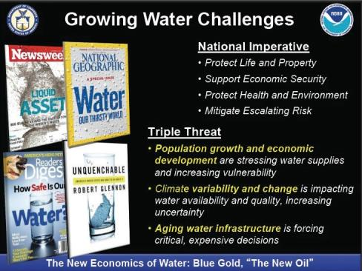
Water is One of NOAA’s Five
Grand Science Challenges
An Interagency Planning Workshop on Water Cycle Science for NOAA recommended several goals that HMT addresses and called for increased support and for coordination with other agencies.
http://nrc.noaa.gov/CouncilProducts/WhitePapers.aspx
Examples of several key drivers for improved understanding and prediction of the water cycle. (Courtesy Don Cline)
2

Slide 3
High level finding and recommendation from CA’s Drought Service Assessment:
HLF 3: NOAA's Habitat Blueprint and Hydrometeorological Testbed (HMT) are examples of successful NOAA models for intra-agency and interagency collaboration, and for engaging with the research community.
Recommendation HLF 3a: NOAA should expand the scope of the Hydrometeorological Testbed (HMT) in partnership with water resources agencies and other science organizations to promote “forecast-based reservoir operations,” scope and develop the needed forecast methods, and develop relevant decision support models in order to enhance California’s ability to mitigate potential drought impacts.
3

Slide 4
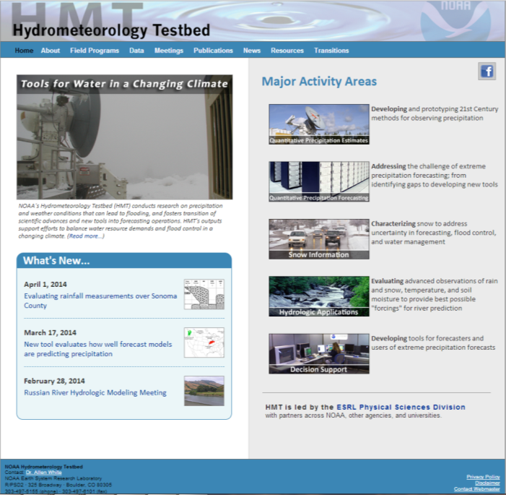
hmt.noaa.gov
New!
New items
posted 2-4 times
per month
4

Slide 5
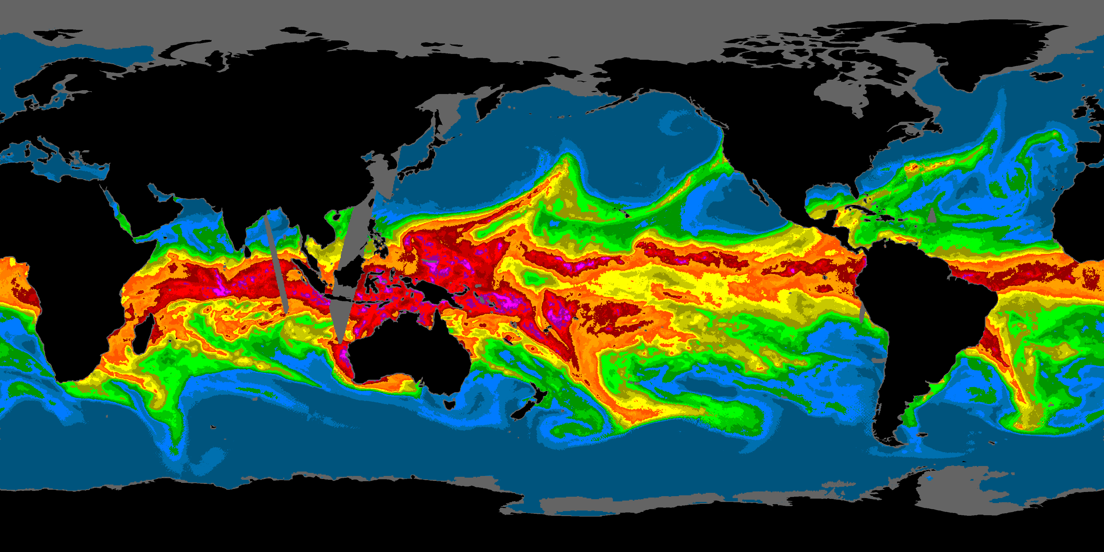
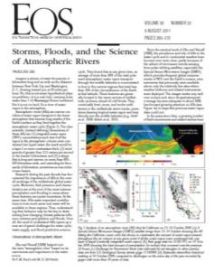
HMT-West Research has Identified Atmospheric Rivers (ARs) as the Primary Meteorological Cause of
Extreme Precipitation & Flooding on U.S. West Coast
Ralph, F.M., and M.D. Dettinger, 2011: Storms, Floods and the Science of Atmospheric Rivers. EOS, Transactions, Amer. Geophys. Union., 92, 265-266.
1
2
3
4
5
6
7
IWV (g cm⁻²)
Atmospheric River Information Page: http://www.esrl.noaa.gov/psd/atmrivers/
“On average, about 30-50% of annual precipitation in the west coast states occurs in just a few AR events.”
“A strong AR transports an amount of water vapor roughly equivalent to 7.5–15 times the average flow of liquid water at the mouth of the Mississippi River.”
5

Slide 6
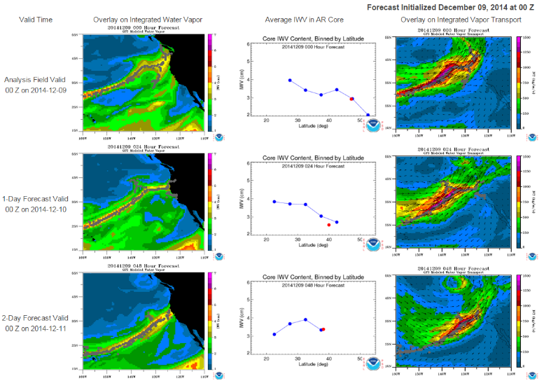
HMT AR Detection Tool
GFS analysis time out to 7-day forecast
IWV (left)
IVT (right)
http://www.esrl.noaa.gov/psd/psd2/coastal/satres/data/html/ar_detect_gfs.php
6

Slide 7
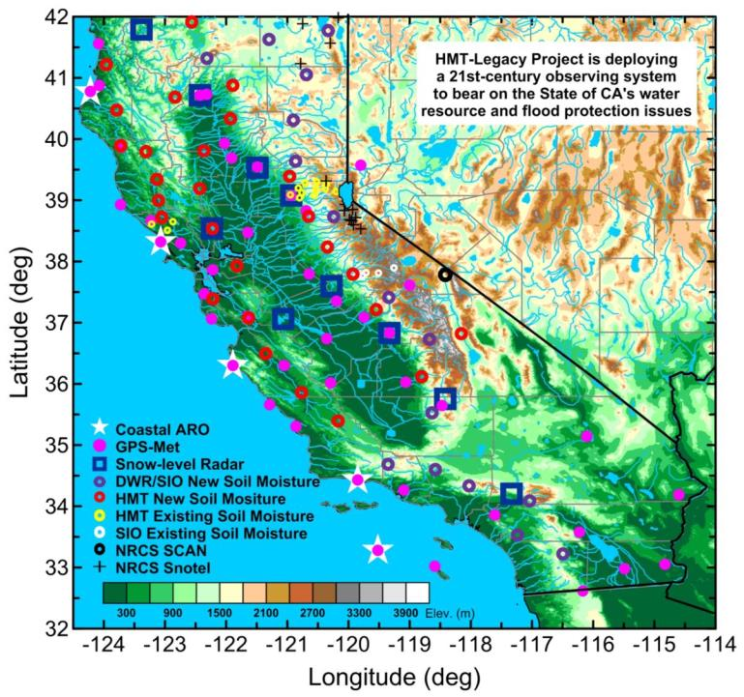
✓
HMT-West Legacy Project in California is implementing key land-based sensors
Jun. 2015
✓
✓
✓
Mar. 2013
✓
✓
Snow-level radars
✓
An AR-focused long-term observing network is being installed in CA as part of a MOA between CA-DWR, NOAA and Scripps Inst. of Oceanography
Installed 2008-2015
100 field sites
See White et al. (JTech, 2013)
Atmospheric
River
Observatories
(AROs)
✓
✓
✓
Fall 2015
✓
Jul. 2015
7

Slide 8
HMT-Legacy Network Instrument Function
Land-based GPS Sensor – measure the fuel (water vapor content) carried by the winds as the storm makes landfall.
Wind Profilers – measure the rate at which the fuel is being supplied to generate heavy rain (fuel rate)
Snow-level Radar (S-band profilers) – measure the depth of the atmosphere warmer than freezing. Deeper this layer more moisture is available and the higher the elevation snow will fall in the mtns. Higher snow level more runoff will occur.
Soil Moisture Sensor – measure the moisture content of the soil and calibrate that to field capacity to determine runoff potential.
8

Slide 9
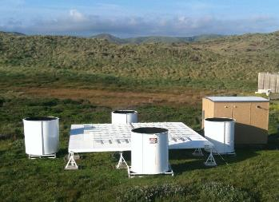
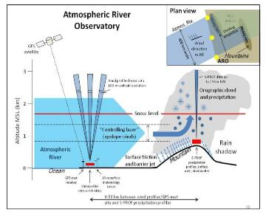
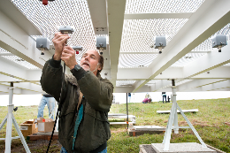
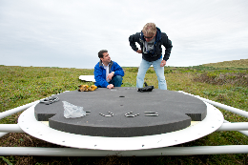
Atmospheric River Observatories Fill Largest Single Monitoring Gap
¼-scale 449-MHz wind profiler
Radio acoustic sounding system
10-m surface met. tower
GPS receiver
Photo by Clark King, PSD
Photos by Florence Low, CA-DWR
9

Slide 10
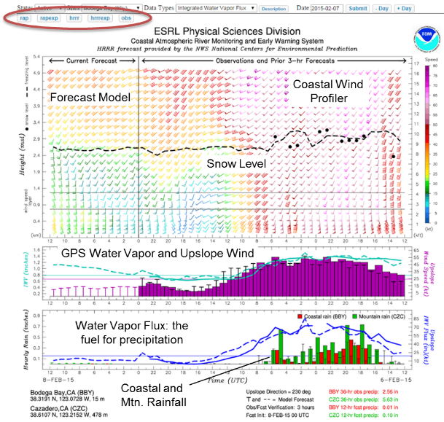
HMT Real-time Upslope Water Vapor Flux Tool Display
Now uses HRRR and RAP forecast models
Providing forecasters with the critical observations to determine how ARs are impacting the area and how model forecasts are portraying the AR conditions and orographic precipitation enhancement.
10

Slide 11
CA-DWR and U.S. DOE are jointly supporting a coastal network of seven atmospheric river observatories. This “picket fence” will provide the first line of defense for winter storms that pound the West Coast each year. This network will be completed this year. UNAVCO/NOAA-GSD is providing real-time GPS-Met data across these West Coast States.
11

Slide 12
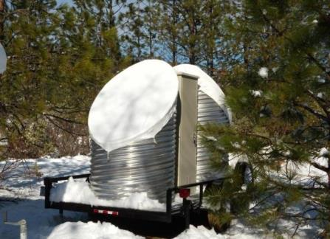
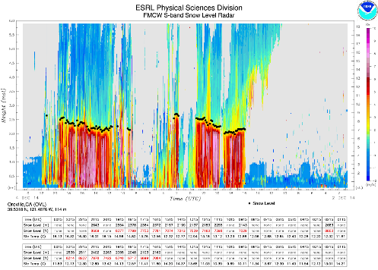
Colfax, CA
Elev. 636 m
Snow-level Radar
Provides proxy snow-level height during precipitation events
Utilizes proven FMCW technology to substantially lower cost
Uses the patented ESRL automated snow-level detection algorithm proven in nationwide field experiments
Less than 8’ diameter footprint
Low-power requiring minimal infrastructure
Photo by P. Johnston
Snow level
12

Slide 13
HMT Future Work (FY15)
Finish HMT-Legacy observing system deployments in CA, OR, WA
Continue 2nd MOU with CA-DWR
  Observing network O&M funding
  Network optimization studies
  SF Bay modeling project
Publish research on HMT-SEPS in North Carolina
  Role of ARs in the East vs West
  Precipitation microphysics
Carry out MOU with SCWA
  Forecast Informed Reservoir Operations
  Improved QPE for the Russian River Basin
  Additional rain gauge/soil moisture sites
  Benefits analysis
Analyze CalWater 2 data (Jan-Feb 2015 )
Coordinate with NMFS on Russian River Habitat Blueprint projects
Implement AWIPS-2 in house
13

Slide 14
Backup slides

Slide 15
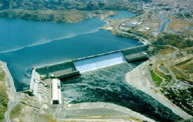




Why Improve QPF?
Improving the amount, type, location and timing of quantitative precipitation forecasts (QPF) and probabilistic quantitative precipitation forecasts (PQPF) are key elements to enhance the information content and reliability of these forecasts.
Who needs accurate and reliable QPFs?
Water Resource Managers
Transportation
Public
Emergency Management
Agriculture

Slide 16
Benefit of Expanded Observation Networks Recent Past and Near Future
Allowed us to begin a climate record of land-falling AR magnitude, duration, relationship to flooding, seasonality.
Allowed us to define the spatial and temporal resolution needed to monitor extreme rainfall events
Allowed us to define the critical observations that we need to properly model extreme events - gaps
Test beds have provided the scientific credibility needed to bridge the research to operations gap - Sustainability – not just a research project…
Expand capability to all areas in the west.

Slide 17
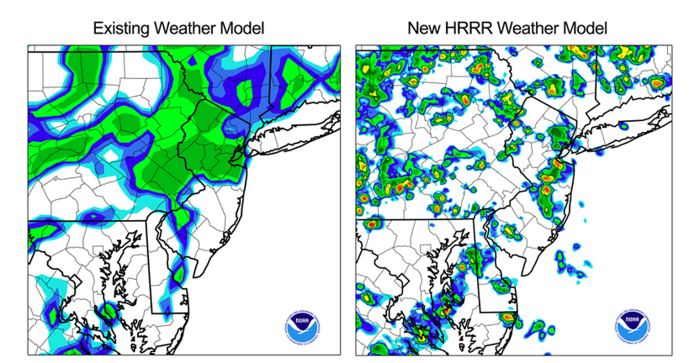
HRRR is Operational
NOAA ESRL/GSD’s High Resolution Rapid Refresh model now at NCEP

Slide 18
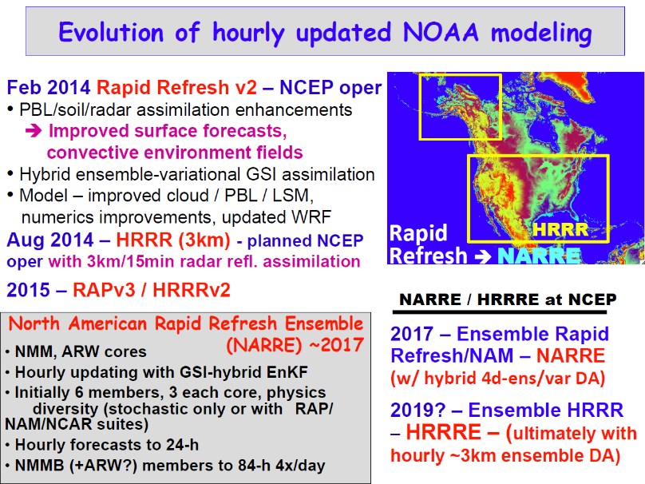

Slide 19
HMT/Riverside Technology implemented the NOAA RDHM into CHPS to demonstrate flash flood potential for NWS WFO-Monterey

Slide 20
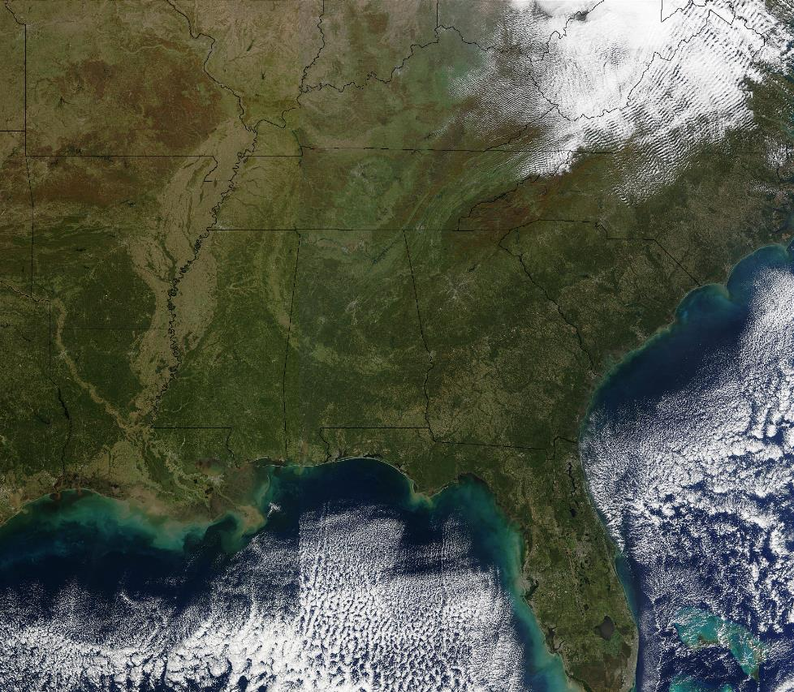
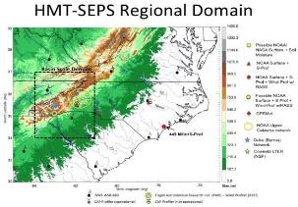
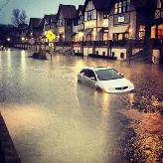
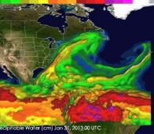
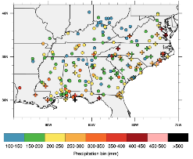
HMT-Southeast Pilot Study
NOAA Vlab Webinar
20 May 2015

Slide 21
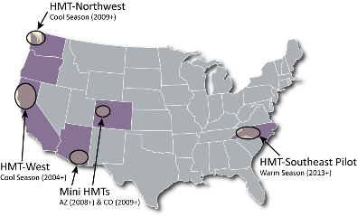
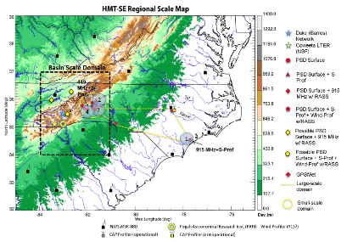
NOAA’s Hydrometeorology Testbed – Southeast
HMT-Southeast: Two parts
  Pilot study (deployment) in western North Carolina (Spring 2013 – Fall 2014)
  Operationally-oriented research on extreme precipitation and forecast challenge identification
HMT-Southeast Pilot Study map
HMT’s regional projects

Slide 22

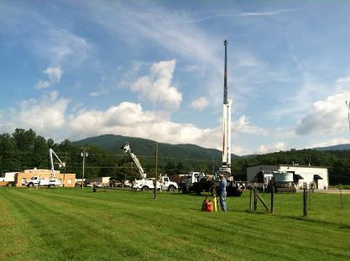
HMT-Southeast Pilot Study (“HMT-SEPS”)
Spring 2013 – Fall 2014 in western NC
QPE evaluations largely focused in western NC (but some instrumentation in central and eastern NC), QPF improvement goals region-wide
NOAA provided instrumentation and leveraged additional assets from NASA ground validation campaign, IPHEx
PSD team:
    Rob Cifelli: Project lead
    Kelly Mahoney: Lead Scientist
    Ellen Sukovich: QPF lead
    Ben Moore: Research associate
“Pilot study”: Long-term plan, vision was never solidified; if value is demonstrated, we allowed that we could consider expanding, prolonging (provided external support could be garnered)
Old Fort, NC instrument installation (Aug 2013)

Slide 23
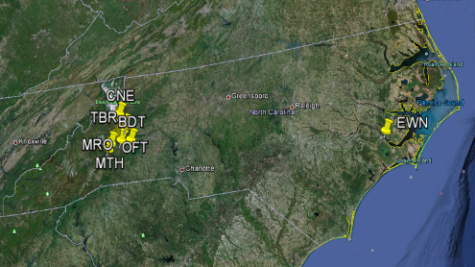

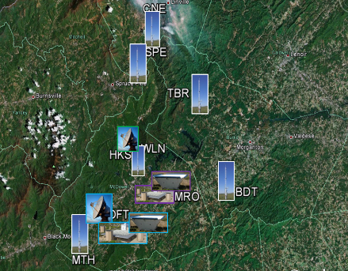

HMT-SEPS instrument deployment
NOAA’s HMT-SEPS deployment: 4 profiler sites and 6 surface meteorology sites
Additional NASA precipitation gauge and disdrometer at each surface site
Restoration of/upgrades to existing NC Div. of Air Quality Clayton, NC and Charlotte, NC wind profilers.
Incorporation of new profiler in RTP at US EPA’s campus.
Site Name | Site ID | Elev (m) | 449 | 915 | RASS | S-band | Met | Soil Moisture | Parsivel
Brindletown | BDT | 355 |  |  |  |  | X | X | X
Crossnore | CNE | 1008 |  |  |  |  | X | X | X
Hankins | HKS | 379 |  |  |  | X | X |  | X
Marion | MRO | 384 |  | X | X |  | X |  | X
Crooked Creek | (MTH) | 519 |  |  |  |  | X | X | X
New Bern | EWN | 3 | X |  |  | X | X |  | X
Old Fort | OFT | 421 | X |  | X | X | X |  | X
Spruce Pine | SPE | 833 |  |  |  |  | X | X | X
Table Rock | TBR | 356 |  |  |  |  | X | X | X
Woodlawn | WLN | 523 |  |  |  |  | X | X | X
All data and observations were available in real-time (as well as for archived download) at:
http://www.esrl.noaa.gov/psd/data/obs/datadisplay/index.php?ProjectID=7

Slide 24
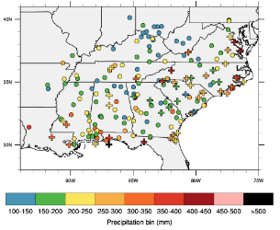

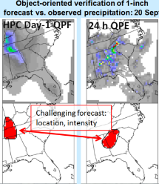
HMT-SE Research Themes
Research topics not regionally-bound to western NC
Major research projects/themes:
    The Climatology of Southeast US Extreme Precipitation Events (Lead by ESRL PSD, B. Moore et al. 2015, MWR)
    Southeast US QPF error climatology (Efforts ongoing at ESRL PSD, North Carolina State University; Baxter et al. 2014)
    Case studies of heavy precipitation events (e.g., July 2013 western NC flash flood - Efforts ongoing at ESRL PSD and NCAR)
    Heavy precipitation processes and the relevance of "atmospheric rivers" to heavy SE precipitation (Efforts ongoing at ESRL PSD)
    Bulk microphysical characteristics of NC precipitation observed with disdrometers and vertically pointing precipitation profilers; assess performance of default NEXRAD rainfall algorithms. (Efforts ongoing at ESRL PSD)
    Performance assessment of radar, gauge, and multi-sensor QPE in the upper Catawba river basin (ESRL PSD, OHD - ongoing)
Extreme precipitation event climatology
Extreme precipitation event case studies
QPF verification

Slide 25
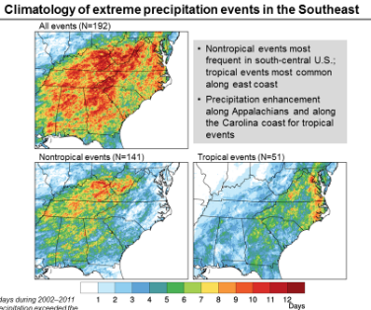
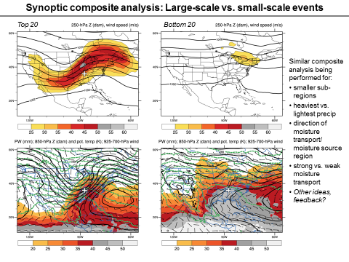
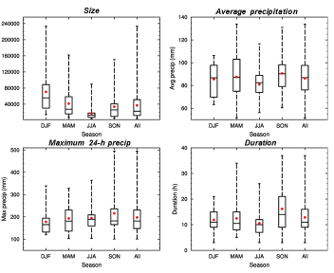
HMT-SE Research Themes: Extreme event climatology example
Motivation:
Large regional variability in event types, seasonality, environmental characteristics, and forecast skill
How well do we understand specific event types, associated forecast errors?
Construct an “extreme precipitation climatology”
Extreme precipitation event climatology
  Moore, B. J., K. Mahoney, E. Sukovich, R. Cifelli, and T. Hamill, 2015: Climatology and environmental characteristics of extreme precipitation events in the Southeastern United States. Mon. Wea. Rev.

Slide 26
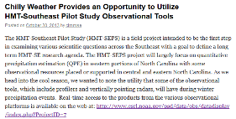
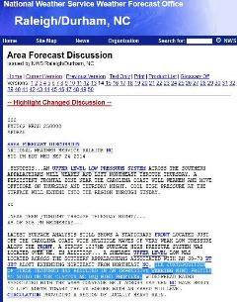
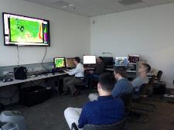
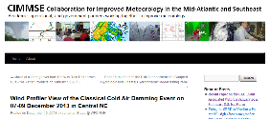
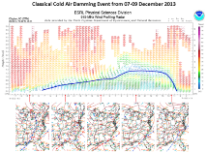
HMT-SEPS achievements:
Research to Operations/Applications
Periodic large-audience community webinars provided forecaster training, community updates:
  June 2012; July 2013; November 2013; July 2014
National Weather Service Area Forecast Discussions mention HMT observations 75+ times in 15 months
Forecast experiment participation: NCEP Weather Prediction Center (WPC) Flash Flood and Intense Rainfall experiments, Winter Weather Experiment
NWS office visits, meetings, presentations: Raleigh, NC; Greenville-Spartanburg, SC
Informal, event-based dialogues between NWS forecasters and HMT-PSD staff to help with interpretation of HMT observations, collaborate on HMT research topics using real-time cases

Slide 27
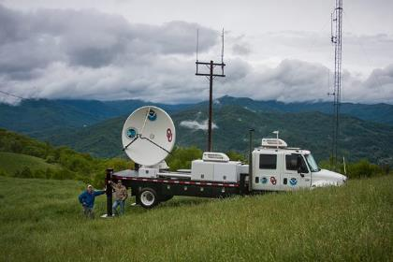
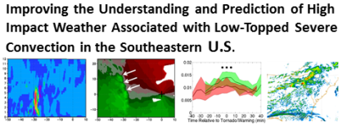
HMT-SEPS leveraged projects
NASA Integrated Precipitation and Hydrology Experiment (IPHEx)
Verification of quantitative precipitation reforecasts over the Southeast United States (Baxter et al. 2014)
USWRP CSTAR project with NC State: “Improving Understanding and Prediction of High Impact Weather Associated with Low-Topped Severe Convection in the Southeastern U.S.”
QPE validation: in collaboration OHD, NESDIS, NSSL, NCDC, CPC, CSU-CIRA
  “CMORPH and GPM Level3 Algorithms Development” (P.I. Xie; NESDIS GOES-R support)
  “Data Fusion and Applications” (P.I. Zhang; NESDIS GOES-R support)
  “Development of a regional system for QPE” (CSU-CIRA Ph.D. thesis)

Slide 28
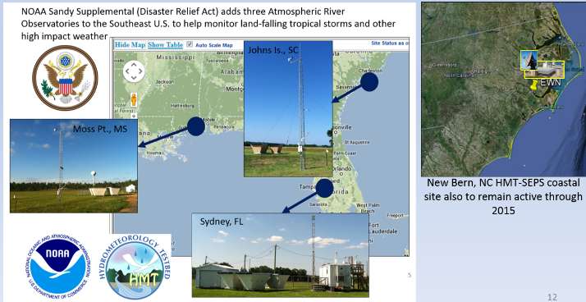
HMT-Southeast Now
HMT-SEPS deployment officially concluded in November 2014 (instruments were removed)
Sandy Supplemental funding supporting some new and ongoing Atmospheric River Observatories (AROs) through 2015
Sandy Supplemental funding (+ NOAA PSD support) allowing for continued research
Plans for several more manuscripts; presentations; forecast experiment participation

Slide 29
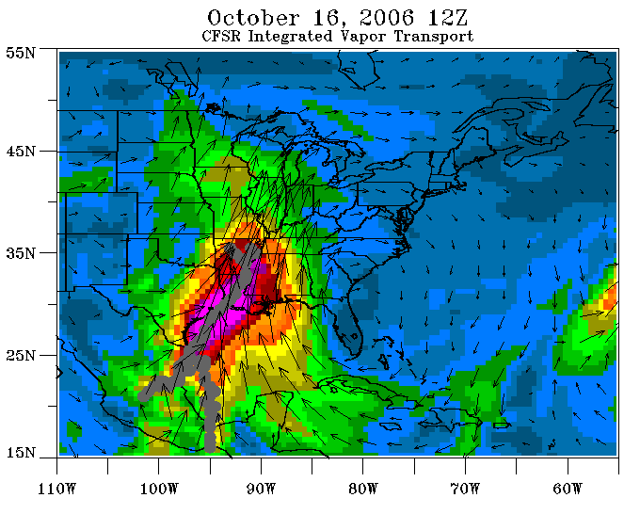
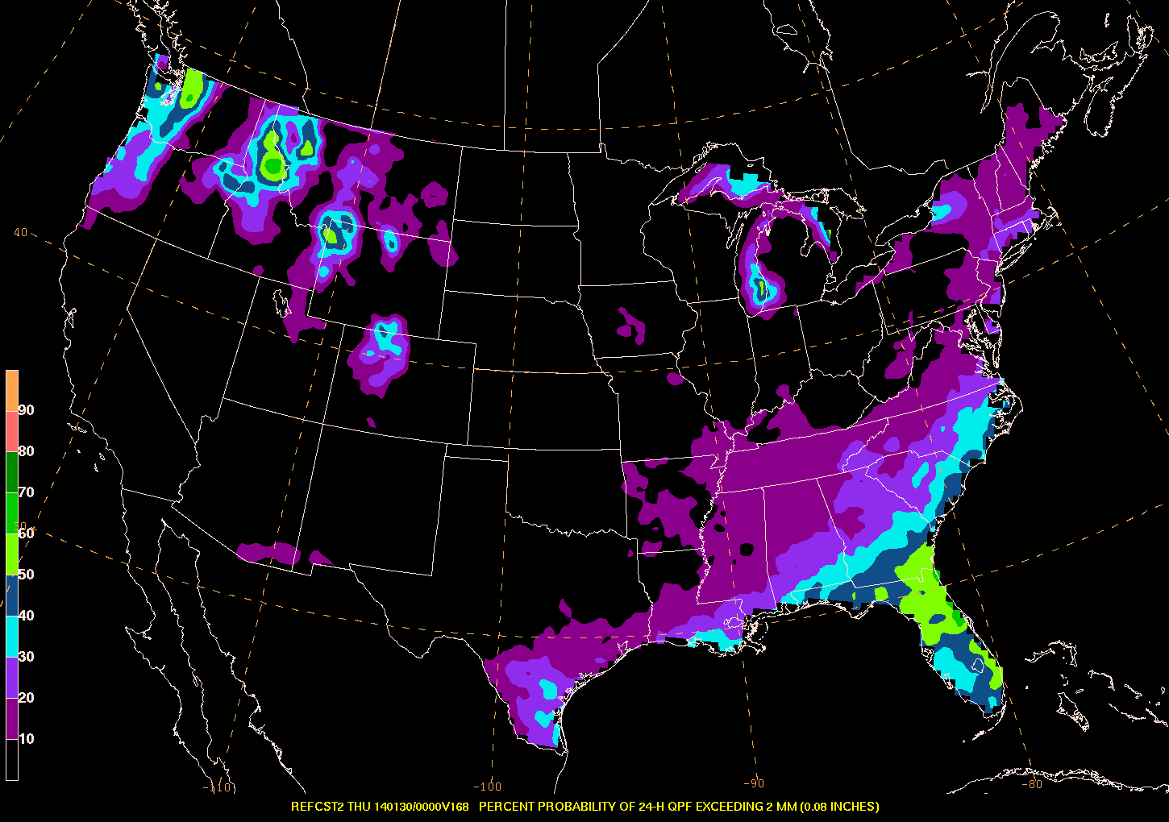
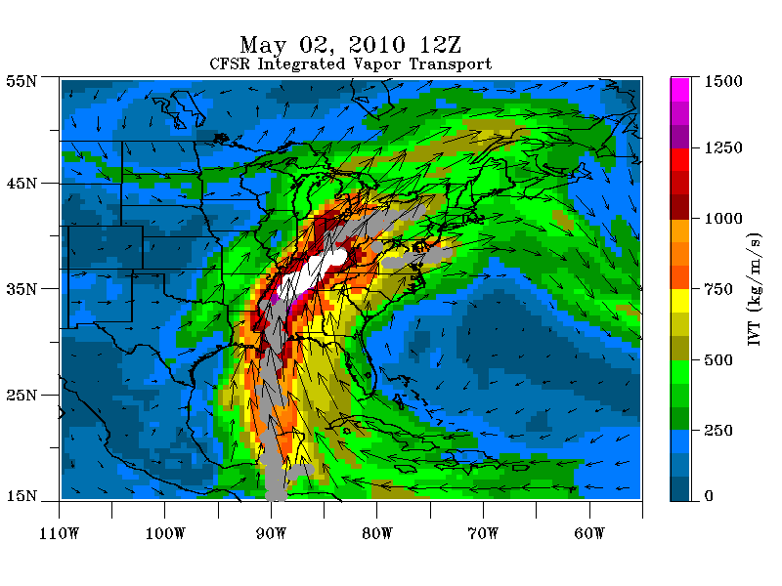
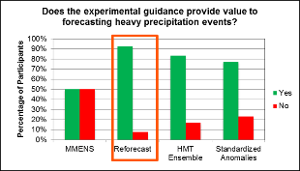
HMT-Southeast Now
Sandy Supplemental funding (+ PSD support) is allowing for continued research focused on:
  Identify contribution of ARs to extreme precipitation in SE
  Case study analysis on extreme precipitation events, flood risk
  Evaluation of GEFS reforecasts for extreme precipitation event types
Future of HMT-SE?
  Despite successful pilot study, interesting science challenges, and an engaged and enthusiastic operations/applications community, current funding and staffing realities dictate project spin-down
Relevance of ARs in eastern US heavy precip?
HMT-WPC uses Hamill et al. reforecast dataset in forecast experiments
Reforecast PQPF

Slide 30
Backup slides

Slide 31
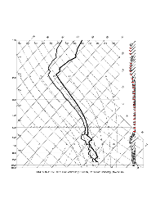
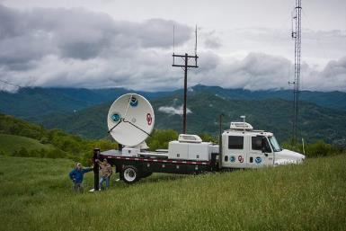
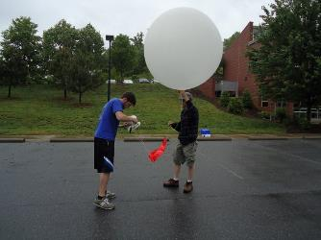
HMT-SE collaborations and external partnerships
HMT WPC (Weather Prediction Center), NSSL/OU, NOAA Hazardous Weather Testbed (HWT) for Flash Flood and Intense Rainfall (FFaIR) experiment
QPE validation: in collaboration OHD, NESDIS, NSSL, NCDC, CPC, others
NC-Division of Air Quality and HMT repair and upgrade of Clayton, NC and Charlotte, NC profilers
US EPA: Profiler assistance, data
North Carolina State University: NCSU graduate and undergraduate student support for QPF error research
UNCA – IOP soundings
NASA, Duke University, NCSU, CSTAR/USWRP, UNCA, NCAR, WPC, NSSL, NWS Eastern and Southern Region Headquarters, NWS WFOs, RFCs, …

Slide 32


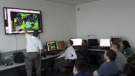

The R2O Spectrum
EXTERNALLY FUNDED PARTNERS
-NGGPS
-OAR R2O
-HMT/HWT
-Others
HMT-PSD Development Group
Interactive Experiments
HMT-WPC
RESEARCH TO OPERATIONS
NGGPS Liaison
Vice Workoff
Sarah Perfater
WPC Development and Training Branch

Slide 33
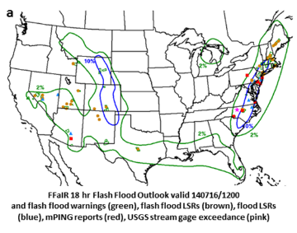
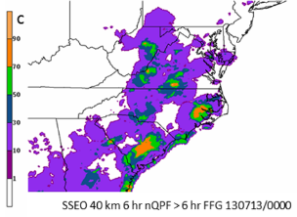
Flash Flood and Intense Rainfall Experiment
July 7-25, 2014
23 participants: operations, research, and academia
Daily Activities
  18 hr CONUS probabilistic flash flood
  outlook (18-12 UTC)
  6 hr event-driven probabilistic flash flood
  forecasts (18-00 UTC and 00-06 UTC)
    Collaboration with HWT-Hydro experiment
  Subjective evaluation exercises
Key datasets and findings:
  Flash Flood Observation Database
  Effective probabilistic guidance
    (hi-res ensembles paired with FFG)

Slide 34


2015 Winter Weather Experiment
12 January – 13 February 2015
28 participants: operations, research, and academia
Daily Activities
  24 hr deterministic snowfall forecast
  Day 4-7 probabilistic winter precipitation,
  heavy snow and freezing rain forecasts
    Daily webinar to interested NWSFOs
  Subjective evaluation exercises
Key datasets and findings:
  Microphysics-based parameters
  (rime factor, percent of frozen precipitation)
  provide value to the forecaster.
  Day 4-7 winter weather products effective;
  well received

Slide 35
Upcoming Activities
2015 FFaIR: July 6-25 at WPC
Focus: 1) Use of additional hydrologic parameters
2) Expanding probabilistic Flash Flood forecasts to Day 2
3) Communication of uncertainty
NGGPS Funded Partner Projects
Bosart and Keyser, SUNY Albany, "An Investigation of the Skill of Week Two Extreme Temperature and Precipitation Forecasts at the NCEP-WPC“
Colle and Chang, Stony Brook University, "Validation of Significant Weather Features and Processes in Operational Models Using a Cyclone Relative Approach."
HMT Competition
Tentative decisions made. To be announced soon.

Slide 36


Key FY16 R2O Thrust
Establishing and Improving Probabilistic Services
-Particular focus on the forecaster and tools
Flash Flood and Intense Rainfall Experiment
Winter Weather Experiment
Medium Range Experiment?
RESEARCH TO OPERATIONS
NWS Hydrology Program
NWS Winter Wx Program
NWS Public Program
Day 8, 9, and 10 forecasts?

Slide 37
Challenges and Opportunities
Explosion of competitive funding avenues
-New experience for HMT-WPC.
Sustaining sufficient infrastructure
-Increasing project management, IT, and data management complexity
-Need to acquire/develop these skillsets
Flash Flood and Intense Rainfall Experiment
Winter Weather Experiment
Medium Range Experiment?
-Lots of momentum and expanding community support
-Building community support
-Needs community focus
NWS strategic direction, but insufficient investment and focus to date

Slide 38

Thank you!

