Slide 1

Hurricane Forecast Improvement Project (HFIP): Where do we stand after 4 years?
Research and Innovation Transition Team (RITT)
Fred Toepfer—HFIP Project Manager
May 15, 2013

Slide 2


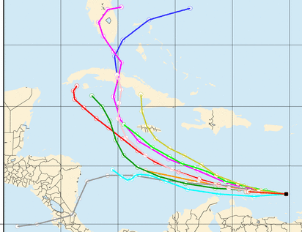
HFIP OVERVIEW
10-year program with ambitious
forecast improvement goals
Designed and run by NOAA
with non-NOAA collaborators
Began in fiscal year 2009
Focus on improving numerical
weather prediction model
forecast guidance provided to
the National Hurricane Center
Notes:
Slide provided by Ed Rappaport

Slide 3
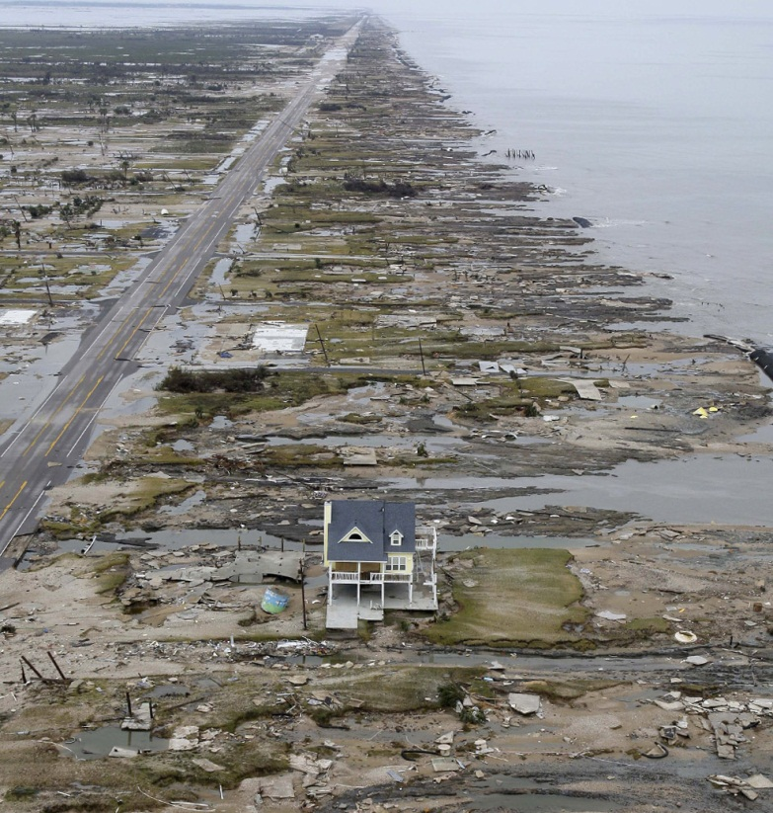
Drivers for a HFIP Program
Lives: More than 50% of U.S. population lives within 50 miles of coast;
Number of people at risk increasing along coast
and inland; 180 million people visit the coast
annually
  Property: Value of coastal infrastructure and
  economy rising… now > $3 trillion; annual U.S.
  tropical-cyclone-related damage losses
  averaged about $10 billion circa 2008;
  averaged losses double about every ten years
Forecasts: Hurricane track forecasts have
improved greatly; intensity forecasts have not
Research: Tropical cyclone research has been
under-resourced and not well-coordinated within the meteorological community
Courtesy: Ed Rappaport
There is a great need and potential for substantial improvements above and beyond current research efforts in hurricane forecasting.
Bolivar peninsula after Ike (2008)

Slide 4
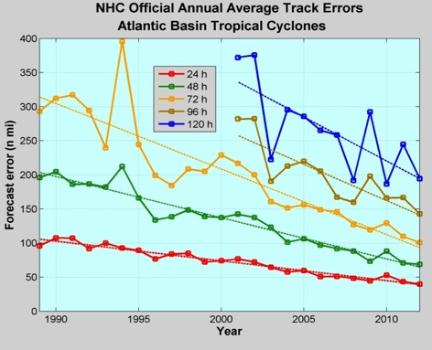
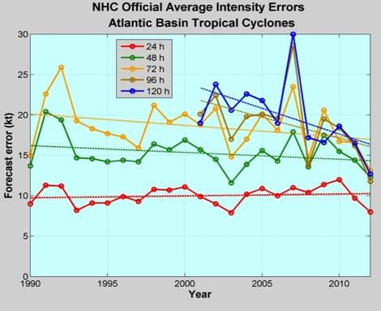
Good – track forecast improvements
Operational Forecast Performance
Not so Good – Modest intensity gains
Some intensity gains since 2008, especially at >48 h
Errors cut in half over past 15 years
10-year improvement - As accurate at 48 hours as we were at 24 hours in 2000
24-48h intensity forecast off by 1 category
Off by 2 categories perhaps 5-10% of time
http://www.nhc.noaa.gov/verification/verify5.shtml Courtesy of Frank Marks
Notes:
Images from: http://www.nhc.noaa.gov/verification/verify5.shtml

Slide 5
HFIP Scope
Improve hurricane forecast system/global forecast system to reduce error in intensity and track
Make better use of existing observing systems; define requirements for future systems to enhance research and operations capabilities and impacts
  Does not include acquisition or operation of operational observing systems
Expand and improve forecaster tools and applications to add value to model guidance
Notes:
Much of the improvement in tropical cyclone forecasting is attributed to advances in regional and global NWP modeling systems. These advances are mainly the result of: improvements in observations; data assimilation techniques; improved model physics in global forecast systems and high resolution regional models; the development of ensemble-based model guidance; and significant investments in supercomputing at operational NWP centers.
The HFIP Portfolio has 3 major components that describe WHAT needs to be done to achieve our goals.
Model improvements
Focuses on the strategies to optimize new and existing observing system and platforms for BOTH modeling and direct use by the forecasters
More tools and applications beyond traditional models and direct obs into the forecasters suite of tools

Slide 6
The HFIP Project –
Vision/Goals
Vision
  Organize the hurricane community to dramatically improve numerical forecast guidance to NHC in 5-10 years
Goals
  Reduce numerical forecast errors in track and intensity by 20% in 5 years, 50% in 10 years
  Extend forecasts to 7 days
  Increase probability of detecting rapid intensification at day 1 to 90% and 60% at day 5

Slide 7
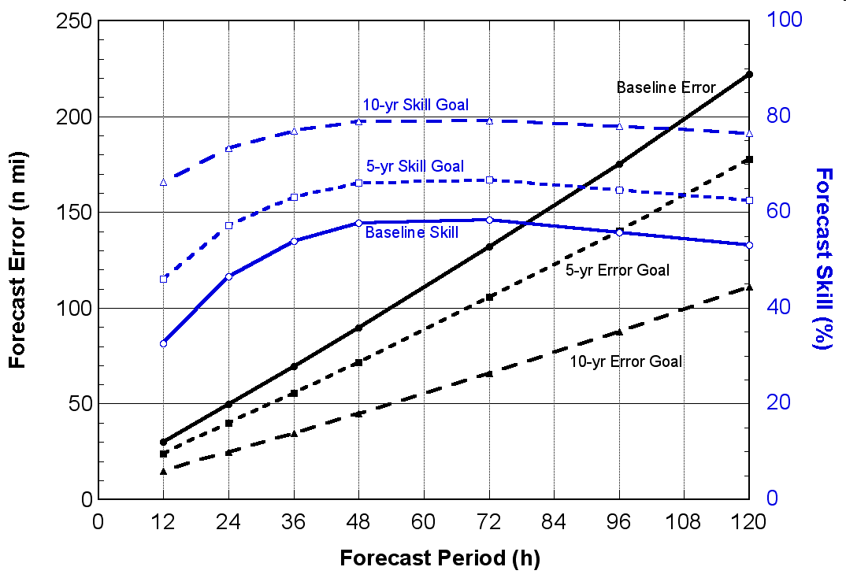
HFIP Baselines and Goals:
Track

Slide 8
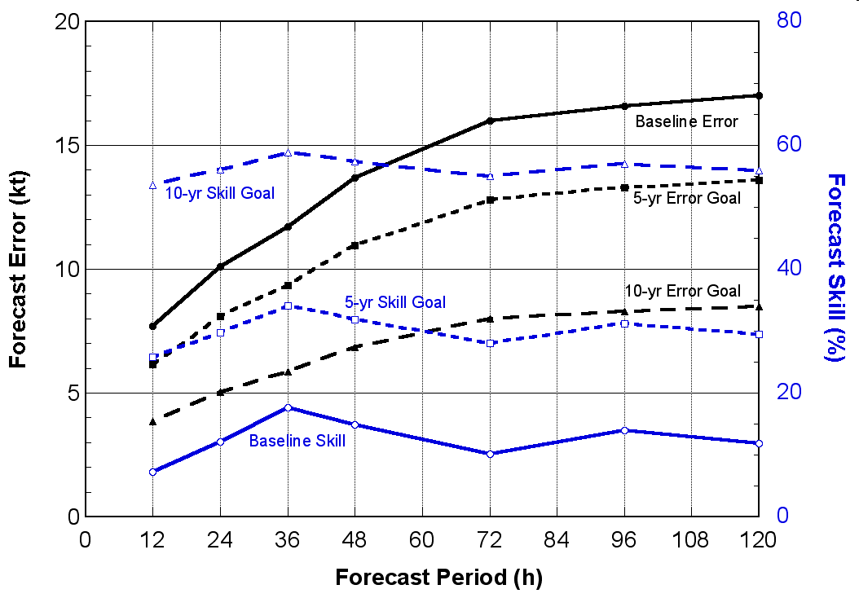
HFIP Baselines and Goals:
Intensity
8

Slide 9
HFIP Charter and Leadership
HFIP Charter signed August 1, 2007
Hurricane Executive Oversight Board
  Jointly chaired by AA for National Weather Services and AA for Oceanic and Atmospheric Research
  Cross-NOAA Membership
HFIP Management
  Project Manager: Fred Toepfer, NWS/OST
  Development Manager: Robert Gall, UCAR
  Research Lead: Frank Marks, OAR/AOML/HRD
  Operations Lead: Ed Rappaport, NWS/NHC

Slide 10
Technical Team Leadership
2013
FY 2013 Strategic Planning Teams
FY 2013 Teams | FY 2013 Team Leads
1. HFIP Model Strategy | Vijay Tallapragada, Stan Benjamin
2. Model Physics | Young Kwon, Jian-Wen Bao
3. Data Assimilation/Initialization | John Derber, Xuguang.Wang
4. Ensemble Development | Jeff Whitaker, Jiayi Peng
5. Post Processing and Verification Development Team | Mark DeMaria, David Zelinski, Tim Marchok
6. Societal Impacts | Jennifer Sprague, Rick Knabb
FY 2013 Tiger Teams
FY 2013 Teams | Strategic Team | FY2013 Team Leads
1. Web Page Design | 5 | Paula McCaslin, Thiago Quirino
2. 3 KM Physics Package | 2 | Joe Cione, Chan Kieu
3. Regional Hybrid DA System | 3 | John Derber, Jeff Whitaker
4 Use of Satellite Data in Hurricane Initialization | 3 | Xiaolei Zoa, John Knaff, Emily Liu
5. Stream 1.5 and Demo System Implementation | 1 | James Franklin, Barb Brown
6. Recon Data Impact Tiger Team. | 1 | James Franklin (NHC), Vijay Tallapragada (EMC)

Slide 11
Federal Funded Opportunity
Current Grants

Slide 12
HFIP Scientific Review Committee
The SRC provides feedback and guidance contributing to the cohesion of near-term (next year or two) and longer range strategies for improving hurricane forecasts
Being outside of the daily project functioning, the SRC provides a broader assessment of HFIP progress and future approaches
  Review and suggest possible changes to annual HFIP plans
  Review proceeding year accomplishments
  Review the long term HFIP model system development and observing strategy plans
  Review the objectives and makeup of the demonstration system each season
Organizational meeting 4th Quarter 2012
2 day review held 26 and 27 February, 2013.

Slide 13
HFIP Scientific Review Committee Membership
Name Organization Area of Expertise Term of Service
Mike Montgomery NPS TC dynamics 3 years
Dave Nolan Miami TC regional models 3 years
Gary Barnes UH/Manoa TC structure 3 years
Jim Price Woods Hole Coupled models 2 years
Bob Hart FSU TC environment interaction 2 years
Jim Goerss NRL Monterey Global models/ensembles 2 years

Slide 14
HFIP Overall Strategy
Use global models at as high a resolution as possible to forecast track out to 7 days
Use regional models at 1-3 km resolution to predict inner core structure to meet intensity goals out to 5 days including rapid intensification
Hybrid DA for both regional and global using as much satellite and aircraft data as possible
Both regional and global models run as ensembles
Statistical post processing of model output to further increase forecast skill

Slide 15
Real-time Experimental Guidance
Stream 1.5
Real-time experimental guidance made available to NHC in real-time
  Called Stream 1.5 “experimental operations”
  Verification evaluation of candidates completed by NCAR
  NHC evaluate results and selects which models will be included as Stream 1.5
  Includes both experimental new and projected future capabilities of current system
Typically runs August 1 through October 15
www.hfip.org to access results

Slide 16

HFIP dedicated HPC for development/demonstration
NOAA Jet system
 | Install Date | Total Cores | Performance (Tflops) | Storage (Tbytes)
Phase 1 (Njet) | Aug 2009 | 3184 | 35.6 | 350
Phase 2 (Tjet) | Sep 2010 | 10600 | 113.0 | 416
Phase 3 (Ujet) | Nov 2011 | 16648 | 182.0 | 1166
Phase 4 (Sjet) | Aug 2012 | 22088 | 272.0 | 1613
“Jet” system performance in 2012 peaks at 272 Tflops
Current Operations Computing peaks at 74 Tflops
Components of the operational system that contribute to hurricane forecasts 26%
HFIP computer provided 10 times more compute
16
Notes:
If the Jet system had received a Linpack benchmark for this month's install, we would rank around 65th on the list with 265 teraflops.

Slide 17
Progress and Accomplishments
5-year Performance Goals Exceeded or Within Reach
  New Hybrid DA Systems went operational in the GFS in May 2012: track forecasts exceeded the 5-yr and approached the 10-yr goal. Among the best dynamical models for hurricane track prediction, beating ECMWF most lead times.
  A third nest was added to operational HWRF allowing an inner core resolution of 3 km. This and other changes led to a 20% improvement in both track and intensity forecasts over previous year.
  Real-time confirmation of the impact of radar data on intensity forecasts from the operational HWRF: Improvement Additional 10%-20% out to 72 hours; independently verified with similar results from AOML using experimental HWRF.

Slide 18
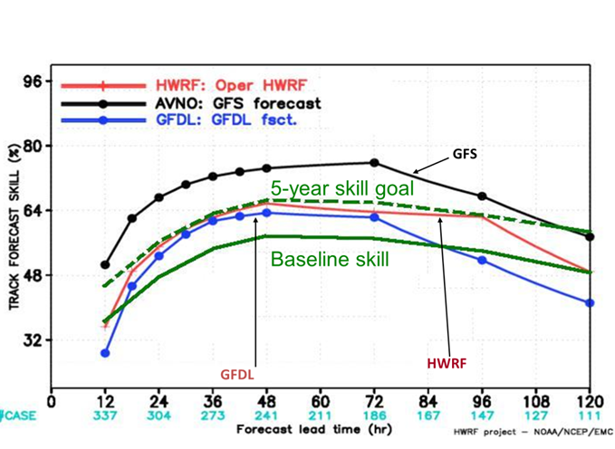
Operational GFS Track Forecasts in CY12
Exceed the 5-year Goal
Track Skill for NCEP Operational models

Slide 19
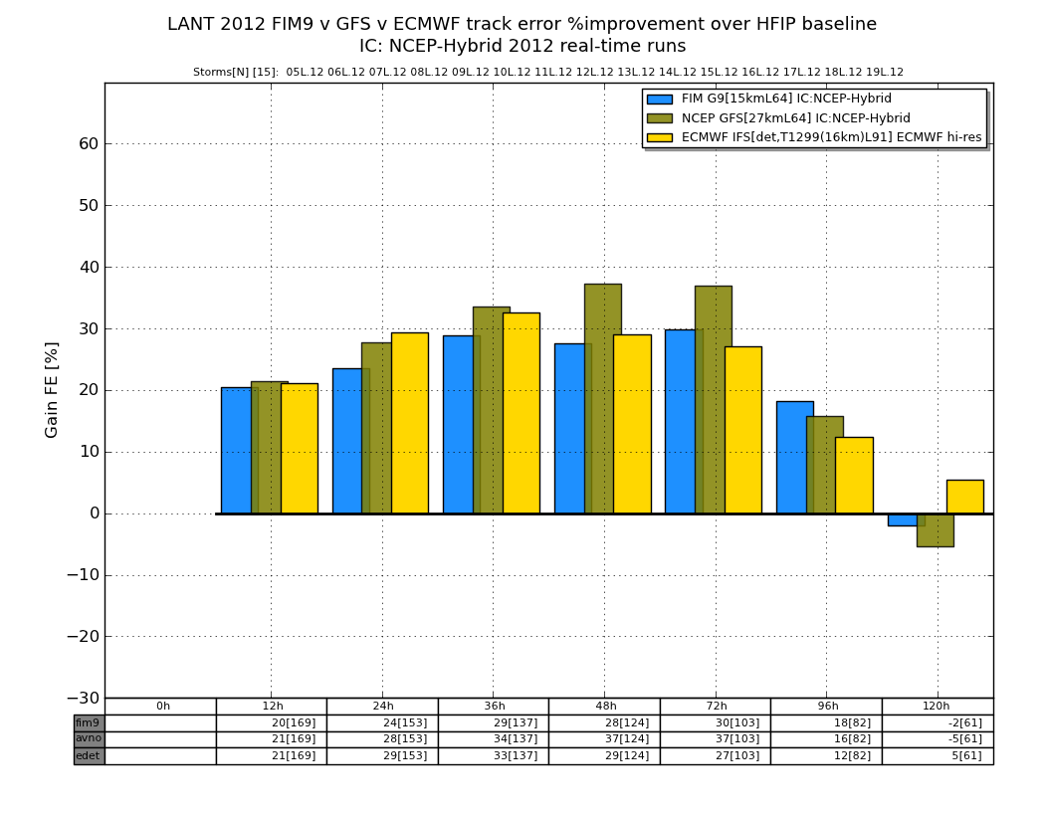
Global Model Track Error 2012
(% Improvement over HFIP baseline)
GFS
FIM
ECMWF

Slide 20
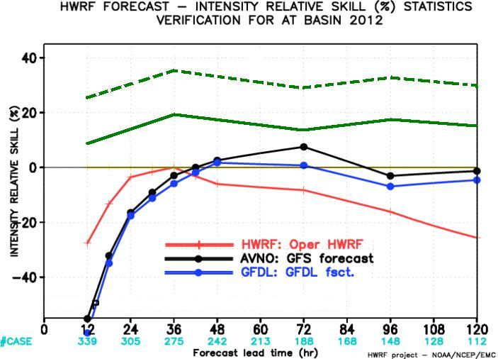
Comparison of 2012 NCEP
Operational Models to the 5 Year HFIP
Goal: Intensity
HFIP 5 year Goal
Baseline skill
GFS
GFDL
HWRF

Slide 21
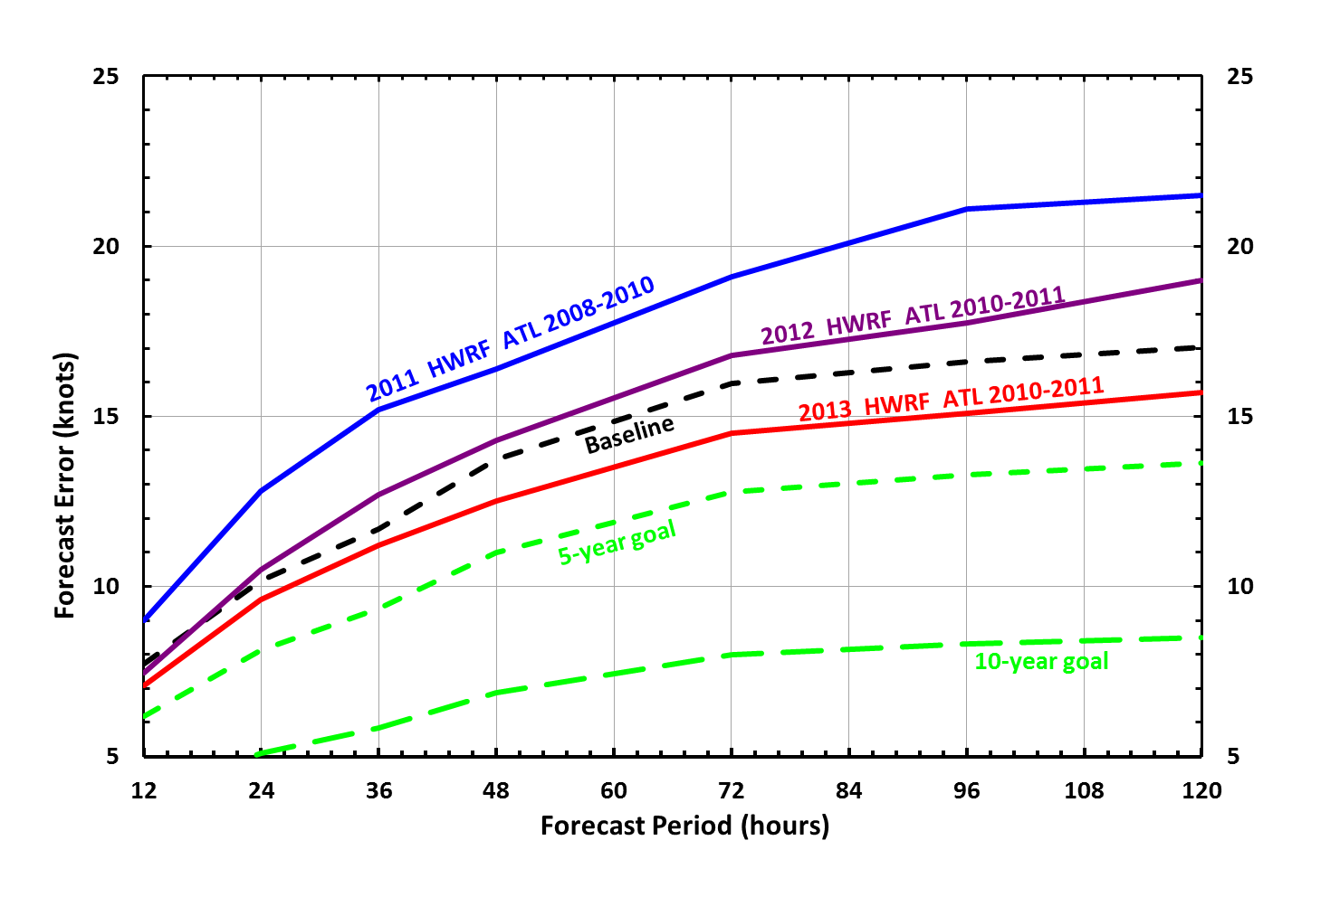
HWRF Intensity ATL Basin
Cumulative Forecast Improvements

Slide 22
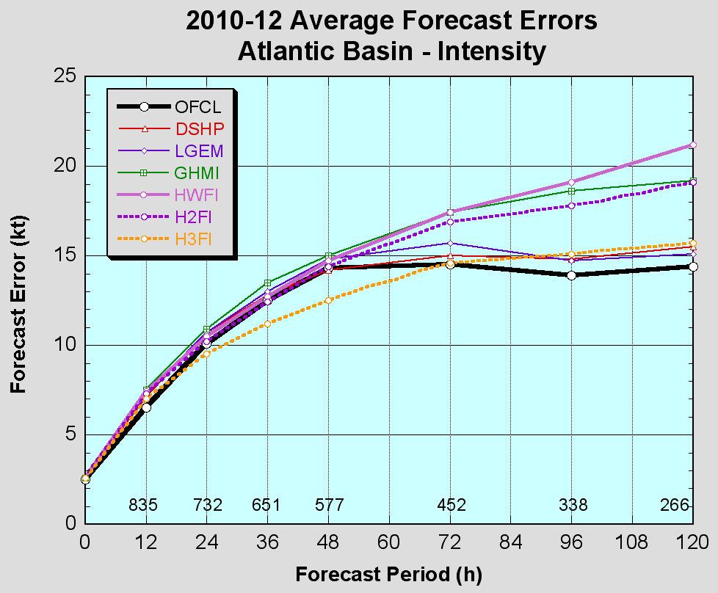
2013 Operational HWRF (H3FI) upgrade Retrospective Testing

Slide 23
Progress and Accomplishments(cont.)
Other Development Areas:
  A real-time product for potential genesis using the HFIP global ensembles was demonstrated
  Experimental 7-day model guidance
  Next generation hurricane storm surge model demonstrated. A forecast for hurricane Sandy made 36 hours before landfall showed surprising skill in forecasting the surge in New York City and along the New Jersey coast.
  Statistical Post processing and products development
  Operational HWRF Development Process initiated

Slide 24
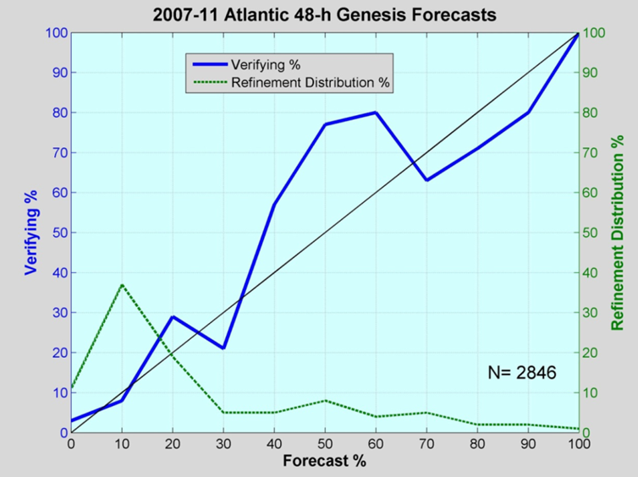
NHC Operational Genesis Forecasts
greatly under predicts around 50% probability
slightly
over predicts
above 70% probability
Refinement distribution indicates the percentage of times the forecast falls in a particular category. So for example forecasts of 50% probability of formation occur about 10% of the time
good for
Lower
probabilities

Slide 25
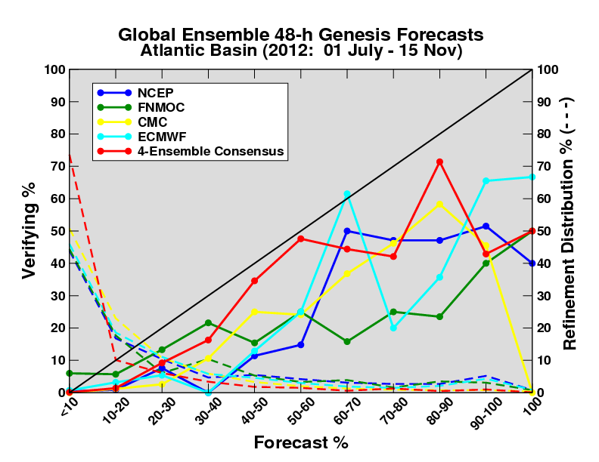
Verification of model genesis for operational global models
All models have a bias towards over-prediction, caused by both false alarms as well as genesis occurring in the forecast long (>>48h) before observed genesis.
4-ensemble consensus close to reliable up through 50-60%.

Slide 26
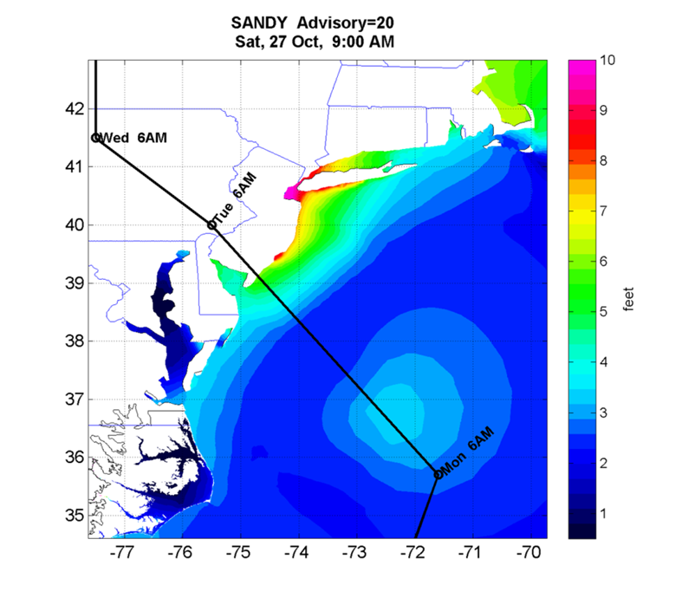
HFIP Working With Hurricane Surge Models
Maximum storm surge forecast for Hurricane Sandy from the ADCIRC storm surge model made 36 hours before landfall. Sandy’s track is shown in black

Slide 27
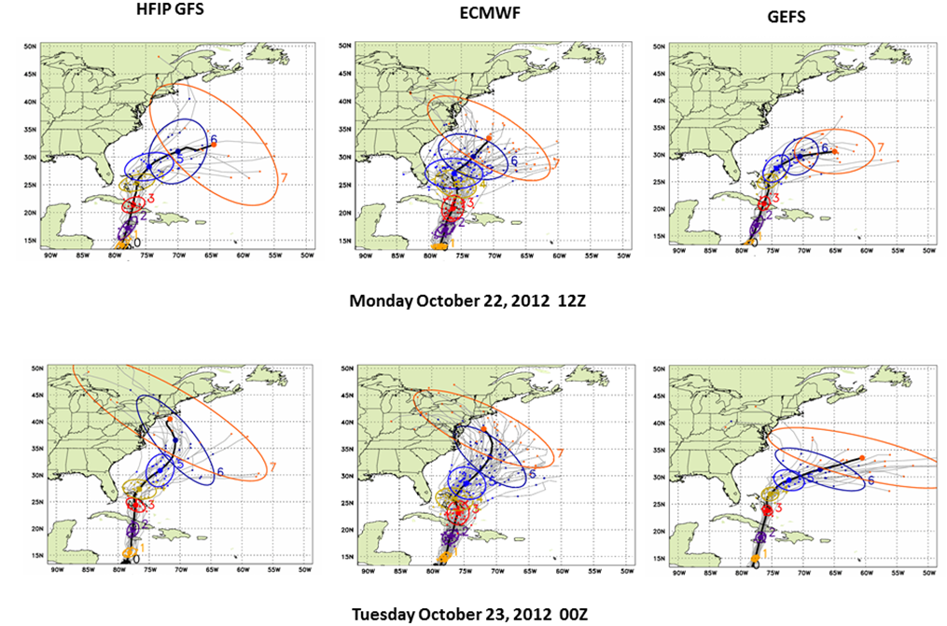
HFIP GFS Ensemble 7day
Forecast for Hurricane Sandy

Slide 28
Statistical Post Processing
Statistical Post Processing can add skill to dynamical forecasts.
There are a number of techniques based on ensembles or individual models.
One method is shown in the following figure
  From the FSU Multi-Model Ensemble (MMEN) which forms a weighted mean of the many global and regional models run both operationally and by HFIP in real time.

Slide 29
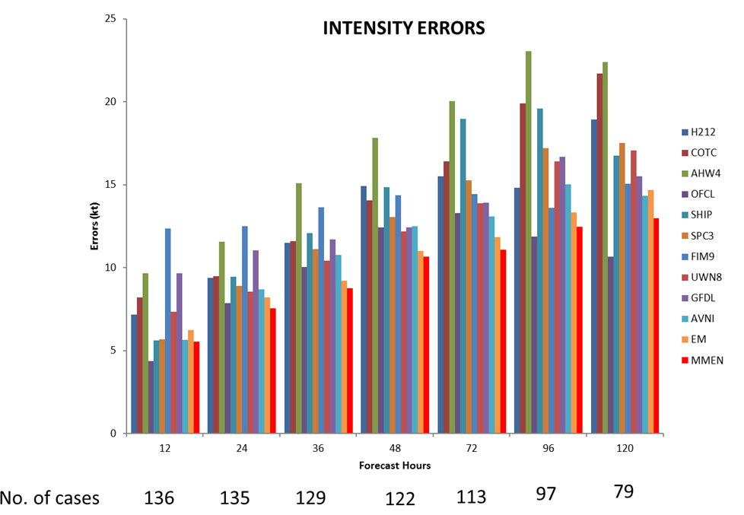
2012 all storms

Slide 30
Operational HWRF Development Process
AOML
Development
  Init/DA
  Physics
  Dynamics
GFDL
Development
  Physics
  Initialization
  Ocean Coupling
NHC
  Diagnostics
  Ops Evaluation
  Recommendation
Implementation
HWRF
GFDL
MMM
Development
  Init/DA
  Physics
  Dynamics
HWRF CR
  Dynamic cores
  Physics Packages
  Initialization Schemes
  Data Assimilation
  Single & Multi- Model Ensembles
  Post Processing
EMC
Versions of
Ops Code
AHW
EMC
Testing/ Eval/
Implementation
  Physics
  Initialization
  Diagnostics
  Op Support
NCO
Operational Code
Operational Runs
NRL
Development
  Init/DA
  Physics
  Dynamics
COAMPS-TC
Ops
Code
Ops
Code
Research / Development
EMC
HWRF Model Development
  Init/DA
  Physics
  Dynamics
  Ocean Coupling
HWRF
Outcome
Reach HFIP Goals on Intensity
DTC
Code Maintenance
TCMT
Testing and Evaluation
Enabling Infrastructure
Academic Research Community
Research
Development
JCSDA
Satellite DA

Slide 31

HWRF

Slide 32
Advanced Next Generation High-Resolution Physics for Operational HWRF
  Develop the next generation physics appropriate for 1-3 km resolutions
Comprehensive use of aircraft and buoy observations to improve model physics, special flight modules to obtain targeted observations in data void regions
Advanced air-sea-wave coupled system with sea-spray parameterization
Meso-SAS convection scheme for high-resolution grids, Higher moment microphysics and advanced Radiation
TKE based PBL schemes for more accurate representation of horizontal and vertical mixing
NOAH LSM for improved representation of land surface processes
Holistic approach in the design of high-resolution physics appropriate for hurricane conditions
Planned Real-time High-Resolution Physics experiments for 2013 Hurricane Season
HFIP Stream 2.0 | 3km Physics Package
Control | FY13 HWRF
PBL | MYJ
Radiation | RRTMG
Micro-Physics | Thompson
Convection | Meso-SAS
Land Surface | NOAH LSM
Ocean | HYCOM
Waves | Sea-Spray parameterization and coupling to Wave Watch III

Slide 33
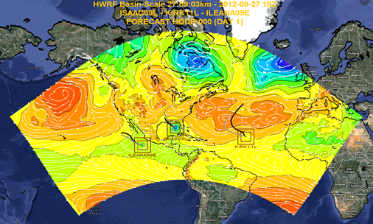
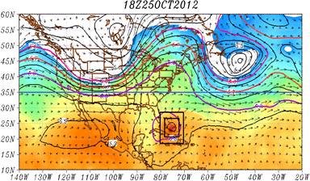
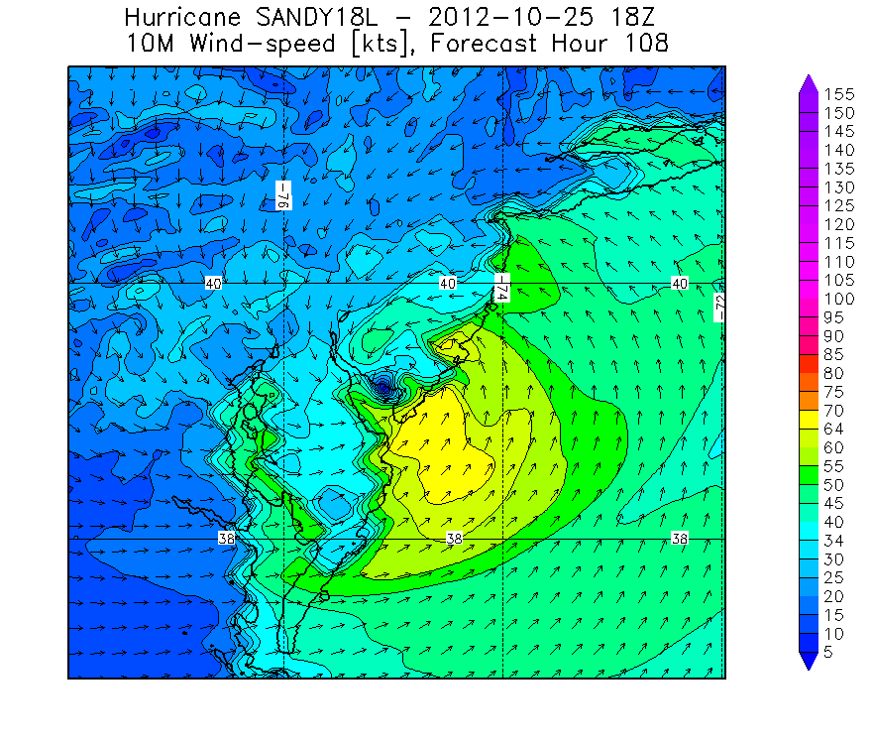
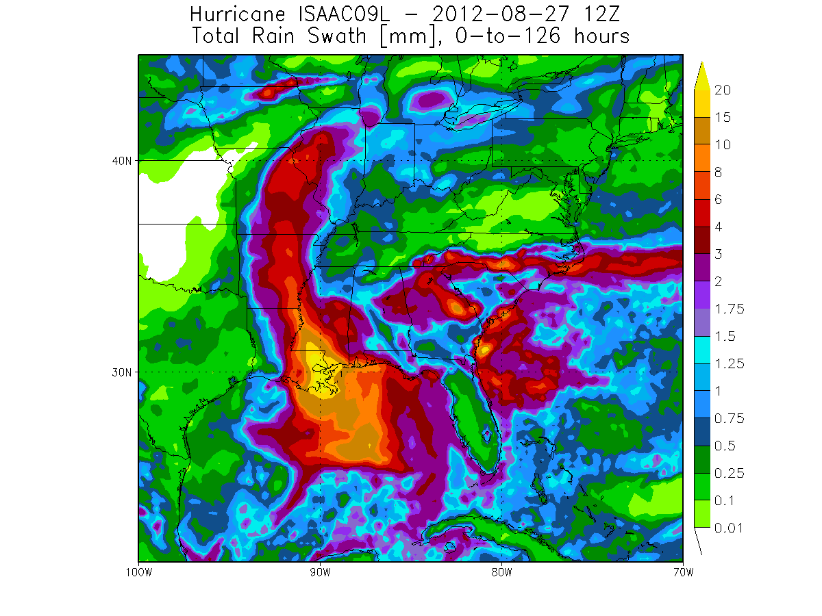
Future advancements for Operational HWRF
Improved Scale Interactions and Improved Track and Size Forecasts
Basin-Scale HWRF: Real-time Multi-nested 3km predictions
Comprehensive large-scale/vortex-scale interactions in a unified framework, with high-resolution hurricane forecast guidance

Slide 34
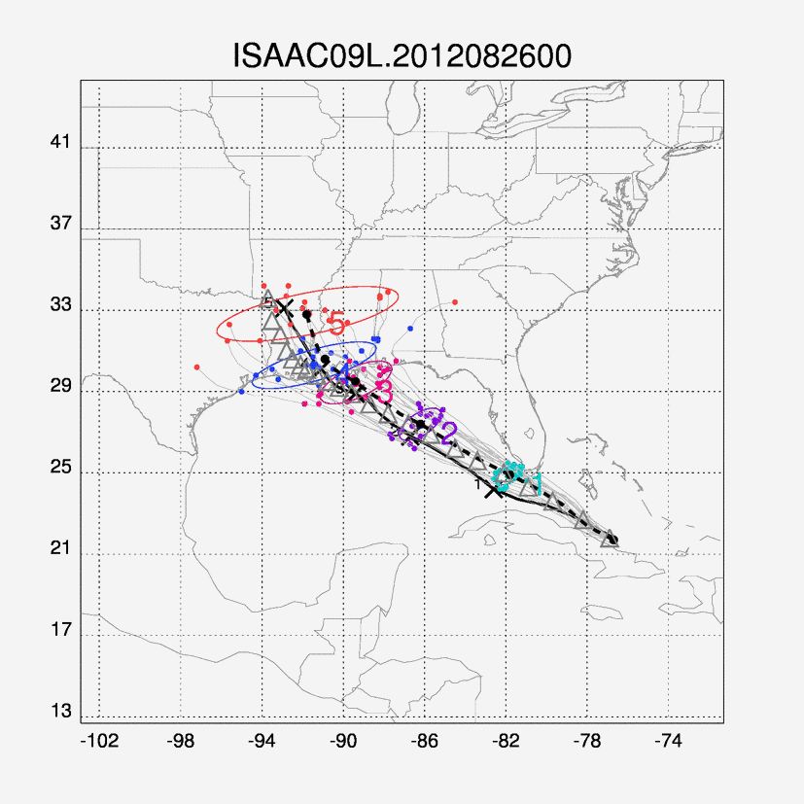
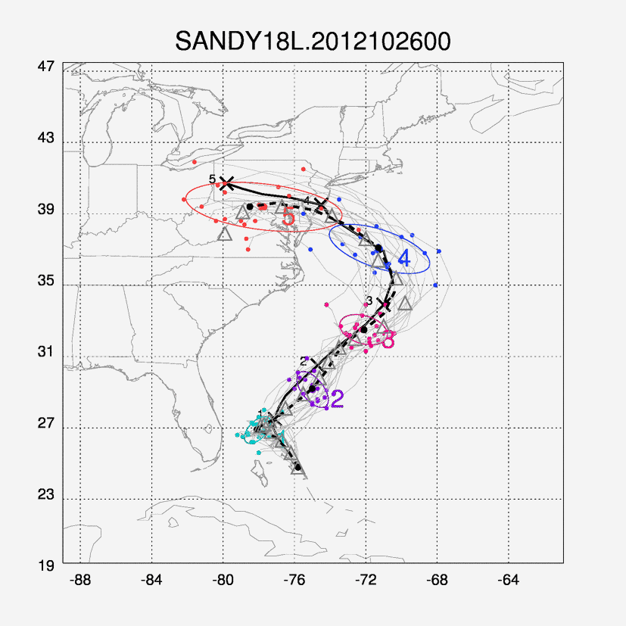
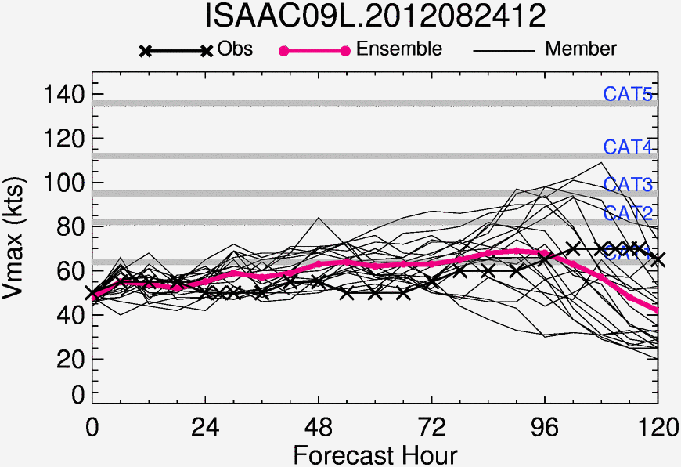
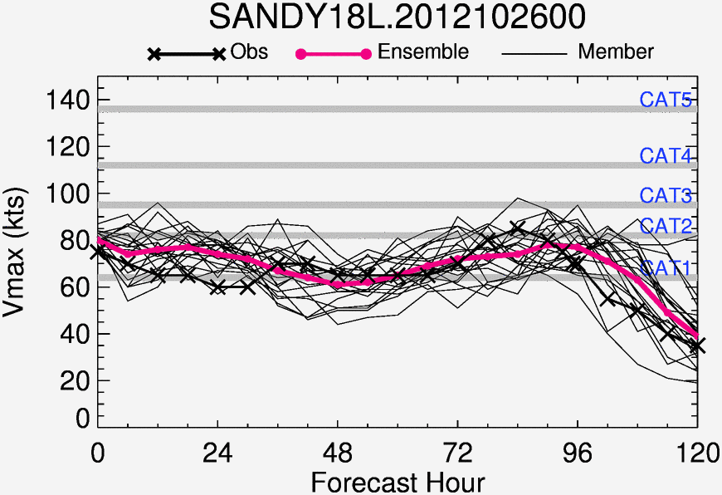
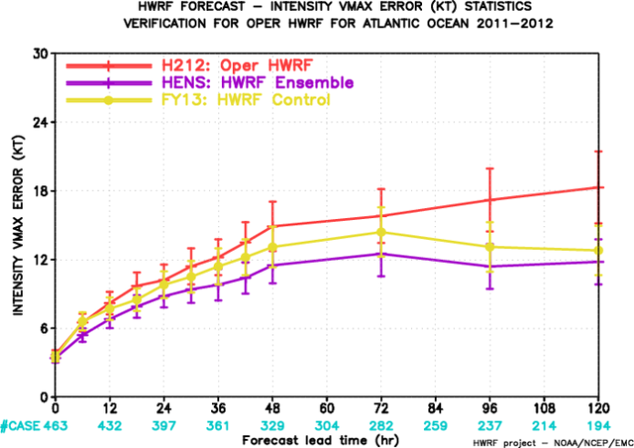
High-Resolution HWRF Ensembles for Real-Time HFIP Stream 1.5 Demo during 2013 Hurricane Season
Hurricane Ensemble Prediction System based on Stochastic Convective Trigger (vortex scale) and GEFS ETR initial conditions (large-scale) perturbations
Based on latest FY2013 HWRF configuration (fully coupled system)
Further improvements to track and intensity forecast skill
High-Resolution Probabilistic Prediction Capability using NMME System (HWRF and COAMPS-TC)

Slide 35
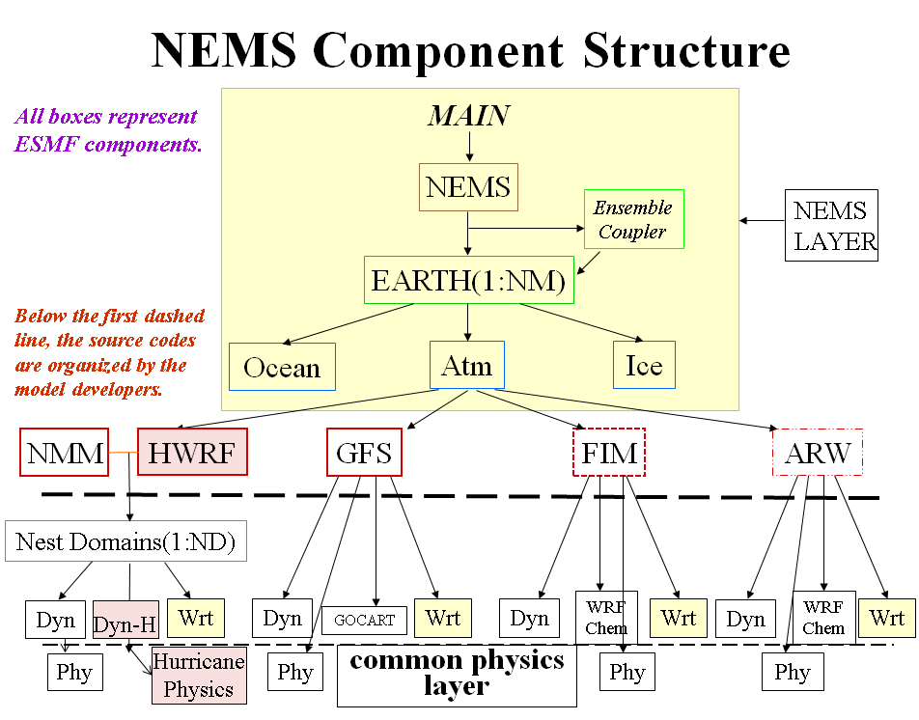
Transitioning HWRF to NMM-B/NEMS Framework
Why NEMS/NMM-B?
Concept of Unified NOAA Modeling Framework
Seamless expansion of current “storm-centric” approach to “global-to-local-scale” approach for hurricane prediction
Take advantage of “in-house” expertise
Three-Tier Developmental Path:
  (a) put HWRF in NEMS Framework
  (b) Adopt NMM-B nests for hurricanes
  (c) Global-to-local scale modeling system for hurricanes
3-year strategy for transitioning HWRF to NMM-B/NEMS framework:
Transition existing operational HWRF capabilities
Transition basin-scale system with multiple moveable nests
Global-to-local scale modeling system for hurricanes in NMM-B global framework
Resource requirements:
Apart from computing resources, estimated human resources are of the order of 8 FTE for three years (includes transition and T&E) and sustained efforts then after.
Dual development strategy:
  Continue annual upgrades for HWRF until we have a stable, reliable and skillful hurricane model in NMM-B/NEMS framework
  Requires extensive independent T&E setup specific to NMM-B/NEMS workflow

Slide 36
Impact of Radar Data

Slide 37
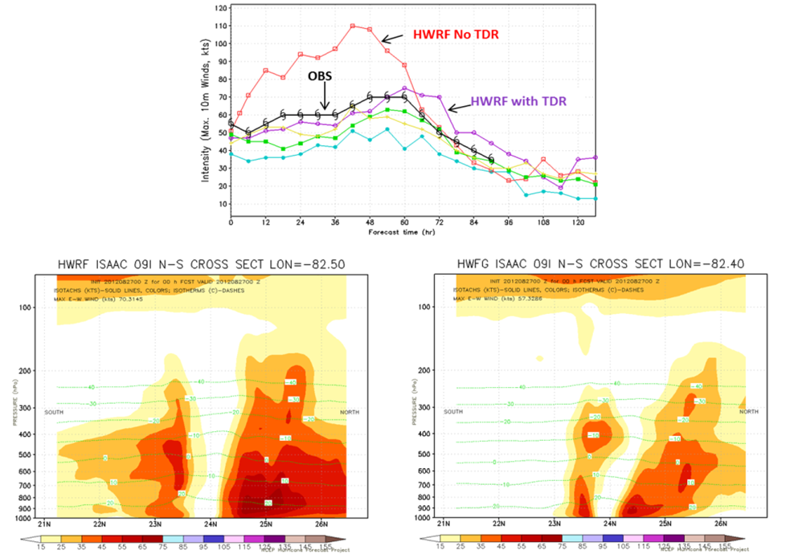
Hurricane Isaac with and without
Tail Doppler Radar Data

Slide 38
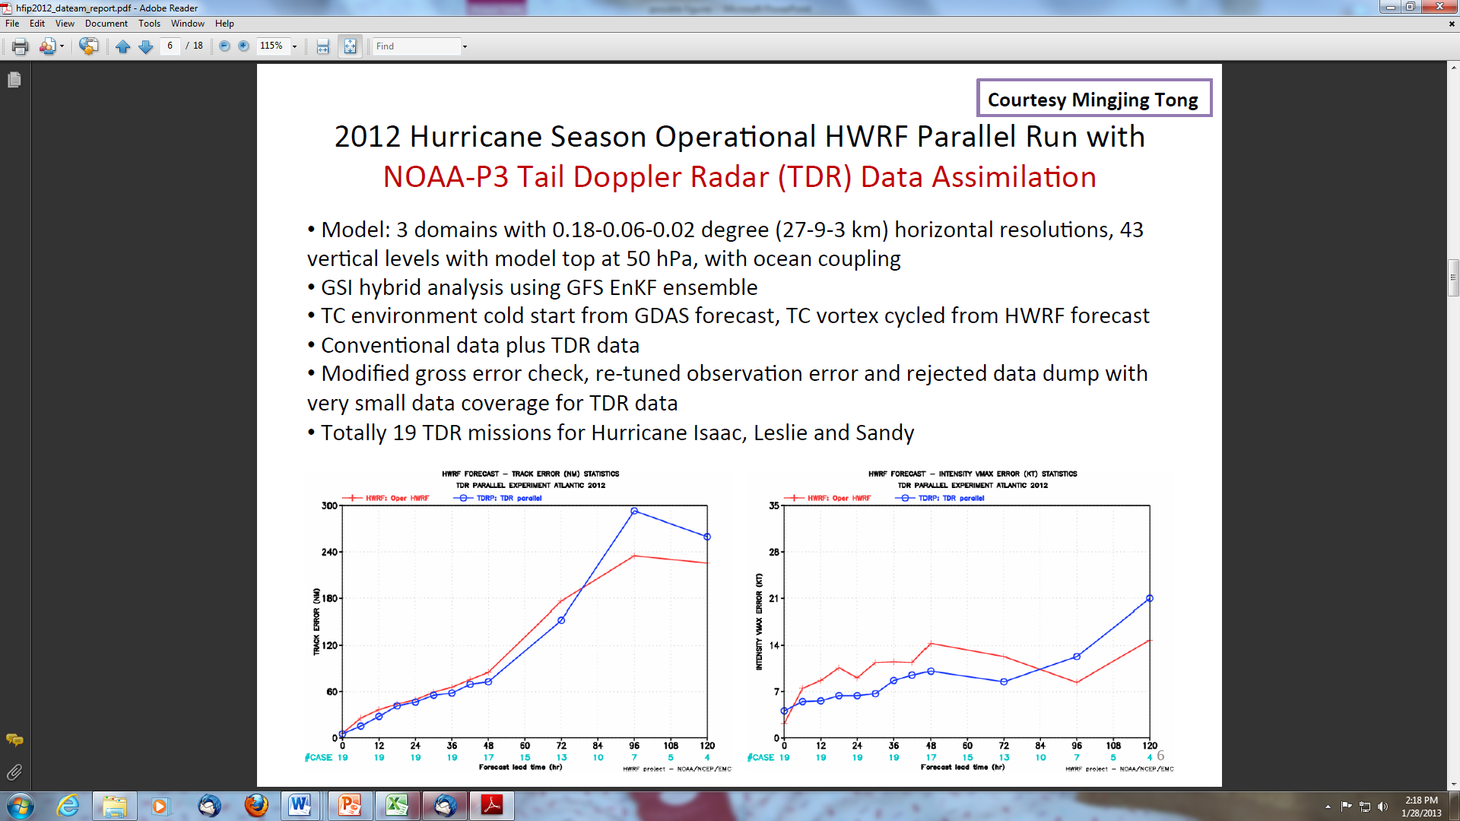
Impact of TDR Data In Operational HWRF
Track Error
Intensity Error
Without TDR
Without TDR
With TDR
With TDR

Slide 39
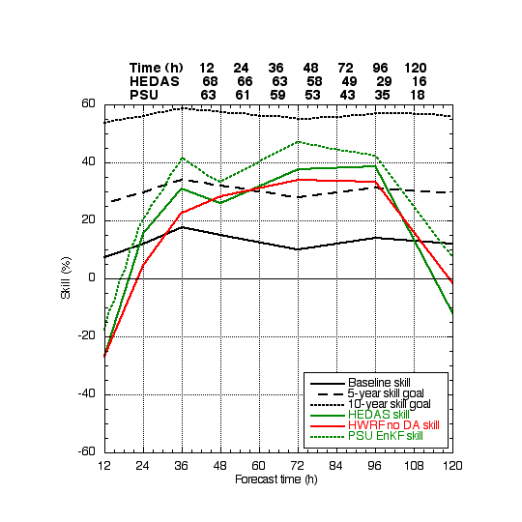
Impact of Aircraft Data
(% improvement over Baseline (Skill))
All cases with radar data from 2008-2010 for ATL basin
Notes:
Impact of P3 tail Doppler radar data on intensity statistics from the HRD/EMC 27/9/3 HWRF using HEDAS and the PSU ARW using an EnKF data assimilation system. All cases with radar data from 2008-2010 are included.

Slide 40
Better Use of Satellite Data

Slide 41
Satellite Data
The hurricane initialization problem
HFIP has shown that high resolution data taken near the hurricane core and its near environment can significantly improve Intensity Forecasts.
  This is particularly true for high resolution wind data (Tail Doppler Radar, TDR)
  Flight level, dropsonde and SFMR surface wind data also important
Currently available only when aircraft are within the Hurricane
  Roughly only 10% of hurricane NWP initialization times
  This is about 30% when storms are near the US coast
Only other option for inner core data is Satellite data
  Lower horizontal and vertical resolution than TDR
Hurricane core is a highly challenging environment for satellite measurements
  Heavy precipitation
  Often completely overcast
  Sharp gradients of cloudy and clear areas (e.g. eye wall) enhance probability of correlated errors and are often of the same horizontal scale as satellite footprints

Slide 42
Satellite Data
Data Sources and Challenges
Goes Atmospheric Motion Vectors (AMV)
  Height assignment is crude and significantly impacts data quality
  Hourly time resolution may be useful with emerging 4-D hybrid assimilation
  Probably the easiest to implement
  Available all the time
Scatterometer Surface Winds
  From polar orbiters, not always available
  Relatively easy to implement
Microwave (MW) Sounders
  From polar orbiters, not always available
  Problems in heavy rain areas (absorption and scattering)
  Some development required
IR Sounders
  Higher horizontal and vertical resolution than MW sounders
  Works well in cloud free areas and above highest clouds
  Much of hurricane region has significant clouds
  HFIP has been working on use of this data in cloudy regions
  This is a very difficult problem and will require considerable development

Slide 43


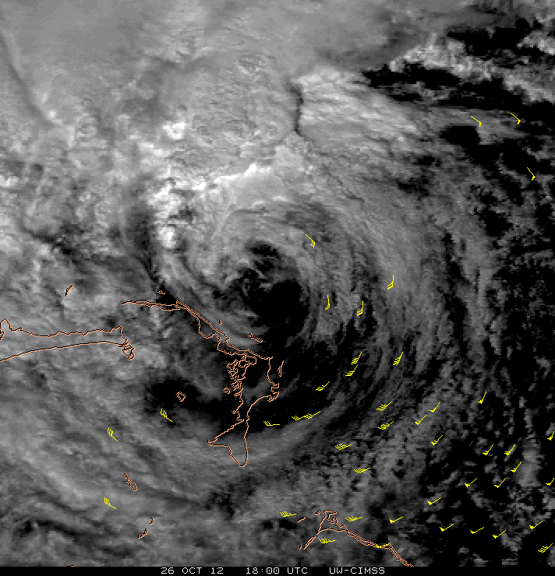
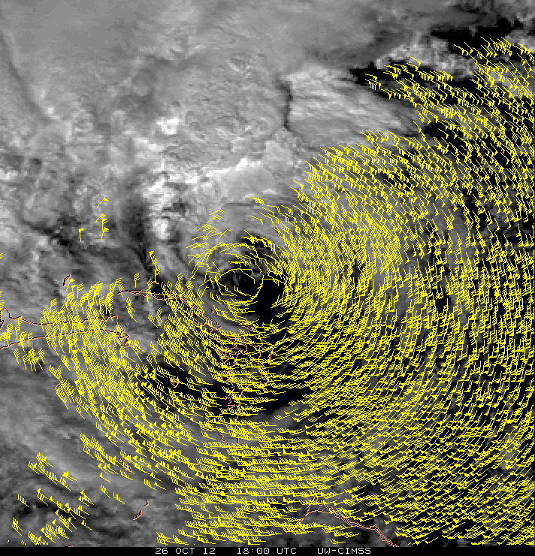
Atmospheric Motion Vectors from GOES-R
Proxy: AMVs from special GOES-14 super-rapid-scan ops during Hurricane Sandy
Low-Level (700-950 hPa) Vectors from VIS
AMVs from 15-min images (routine GOES sampling) AMVs from 1-min images (meso GOES-R sampling)
1800 UTC 26 Oct, 2012
C. Velden (CIMSS)

Slide 44
Next Steps

Slide 45
HFIP Priorities
2013 - 2016
Operational Impact
Continued development and demonstration of the Experimental Numerical Forecast System (real-time) during hurricane season on HFIP Boulder Jet System
Determine the benefit from standard reconnaissance data (flight level, dropsondes, SFMR) and the addition of Doppler Radar
Demonstrate Impact of Multi-model ensembles for Track and Intensity
Research and Development
Best use of limited TDR flights operationally
Improve use of Satellite data in hurricane DA
HWRF Physics
HWRF GSI hybrid DA
  Basin scale HWRF
  High resolution inner domain/vortex scale
Technical Advancements
Convert HWRF to NMM and optimize code for application of accelerator technologies

Slide 46

Questions?

Slide 47
Backup Slides

Slide 48
Recent HWRF Results

Slide 49
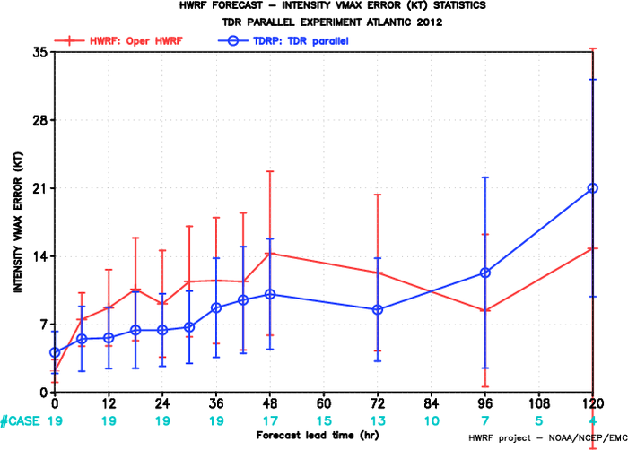
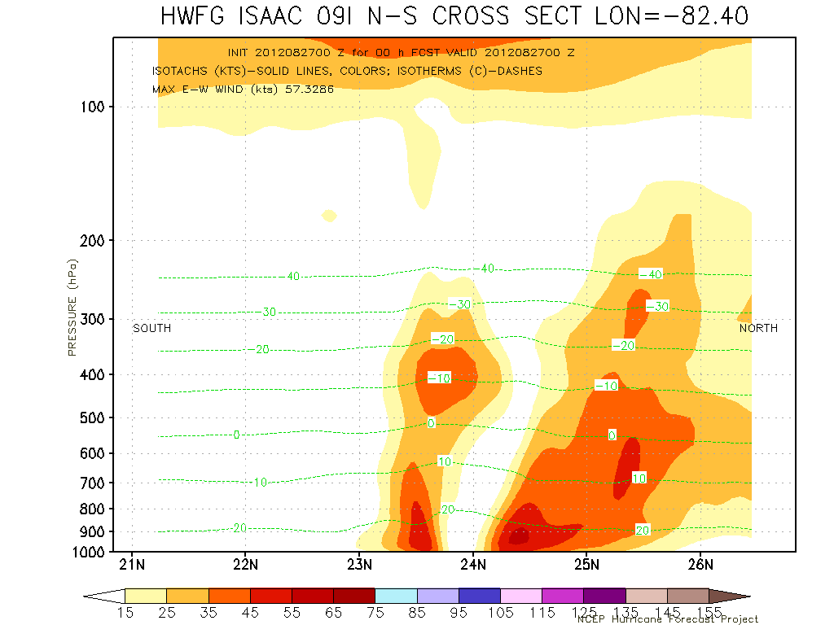
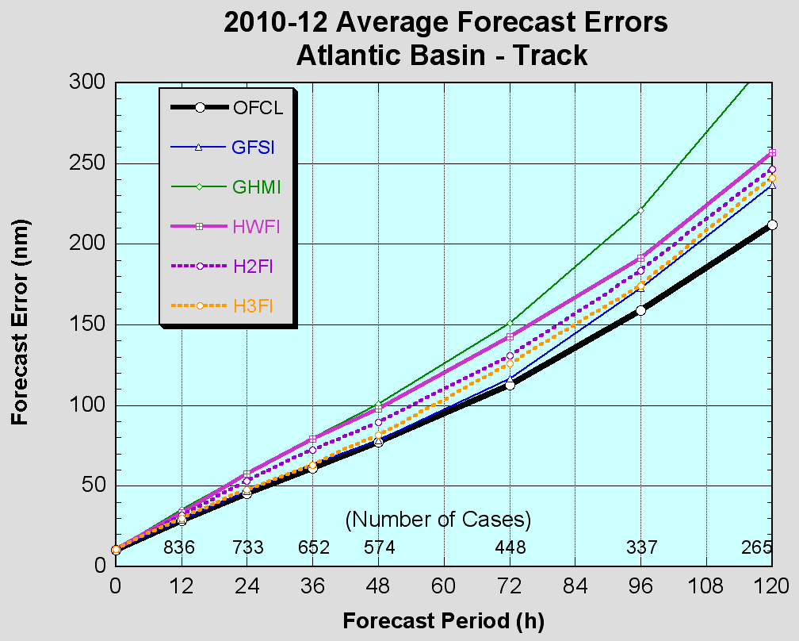
Further advancements to FY13 HWRF for improved track, intensity and structure forecasts
Advanced High resolution (3km)Triple Nested HWRF for 2013 Hurricane Season to be implemented on WCOSS
Implementation of One-Way Hybrid Global EnKF-Regional 3DVAR GSI DA
Improved vortex initialization, nest motion algorithm and nesting techniques
Improved physics and air-sea interactions
Improved product quality and enhanced synthetic satellite imagery
Track Skill comparable to GFS, Intensity Skill superior to Official forecasts and statistical models
One-way hybrid GSI for HWRF using GFS EnKF ensembles
Accurate representation of vortex tilt
Intensity Errors
OPER HWRF
HWRG TDR
FY13 HWRF

Slide 50
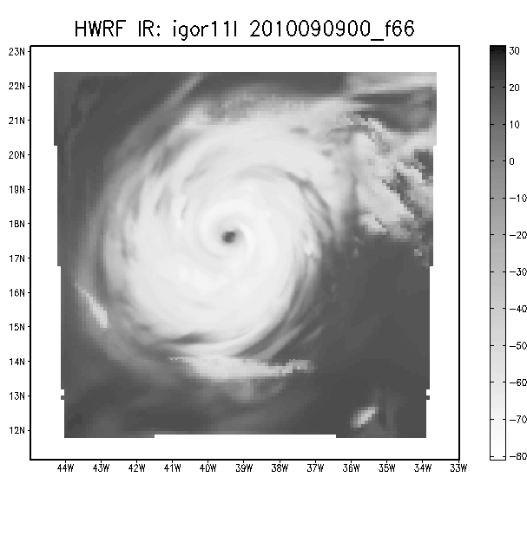
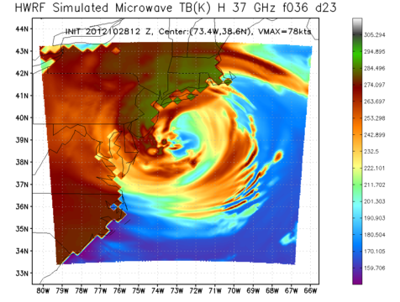
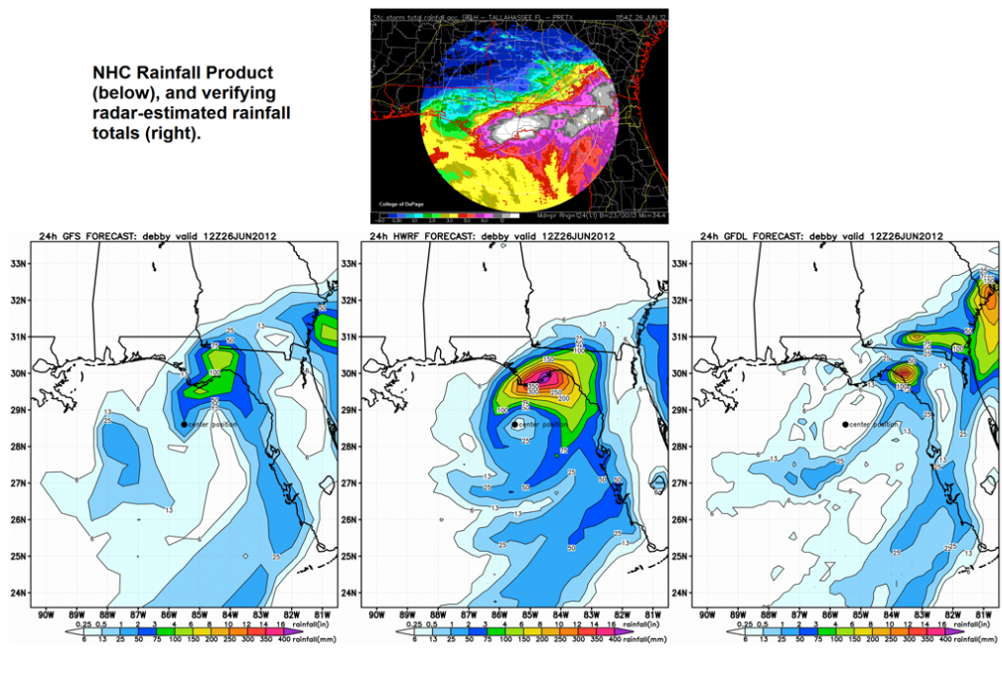
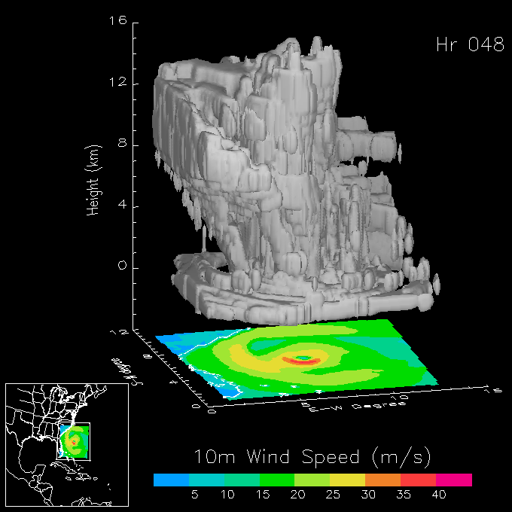
Advanced Real-Time Products from Operational HWRF
High-Resolution synthetic satellite imagery (IR and Microwave)
High temporal resolution track, intensity and structure forecasts
Advanced inner core and large-scale diagnostics
Swaths for maximum wind and rainfall, SHIPS predictors, 24-hr QPF, TPW, OHC, SST cooling
Advanced verification tools to make use of all available observations (aircraft recon, TDR, AXBTs, buoy data and remote sensing satellite data)
Research quality forecasts for real-time operations
GFS
HWRF
GFDL

Slide 51
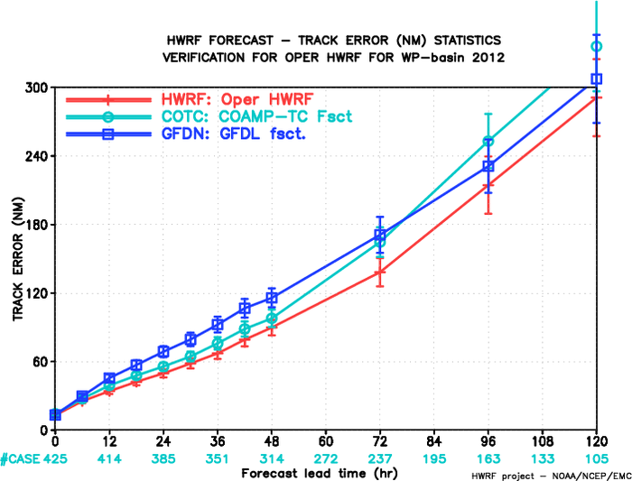
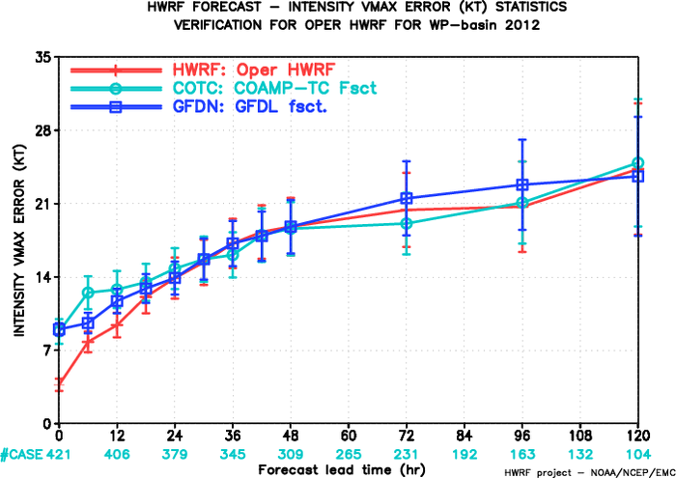
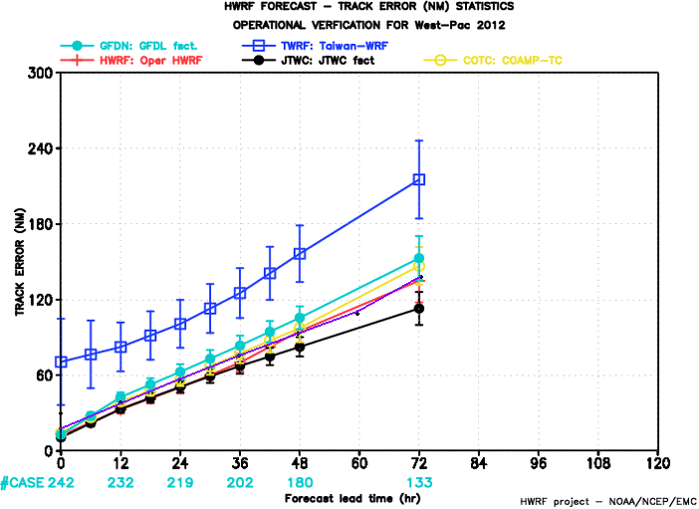
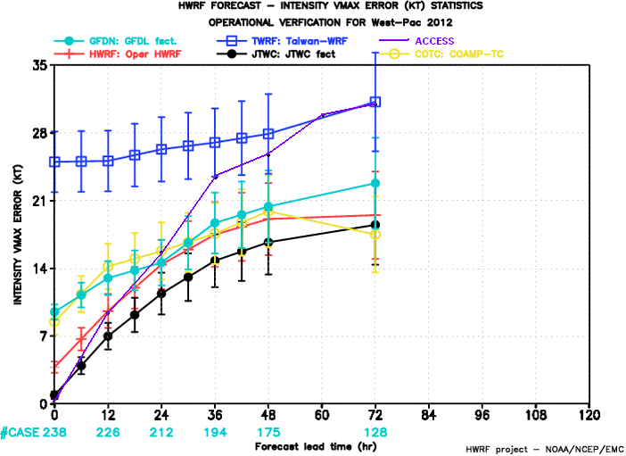
HWRF in the Western Pacific Basin in support of JTWC Operations (supported by HFIP)
HFIP’s collaborations with JTWC to extend our emerging capabilities to other critical operational centers.
For the first time, starting with 2012 typhoon season, EMC HWRF Team is delivering real-time guidance to JTWC forecasters for Western Pacific Typhoons using dedicated reservations on HFIP computing. Products delivered directly to JTWC and through EMC HWRF website.
85% on-time delivery of forecasts in a quasi-operational setting.
FY12 HWRF for WPAC basin demonstrated superior forecast skill compared to other regional model guidance from FNMOC and other international agencies operating in that region.
We will continue providing real-time guidance to JTWC, CPHC and NWS Pacific Region for 2013 season using upgraded FY13 HWRF.
West-Pac HWRF compared to Navy Models (COAMPS-TC and GFDN)
track
intensity
West-Pac HWRF compared to other operational regional models (TWRF-Taiwan and ACCESS-TC, Australia
track
intensity

Slide 52
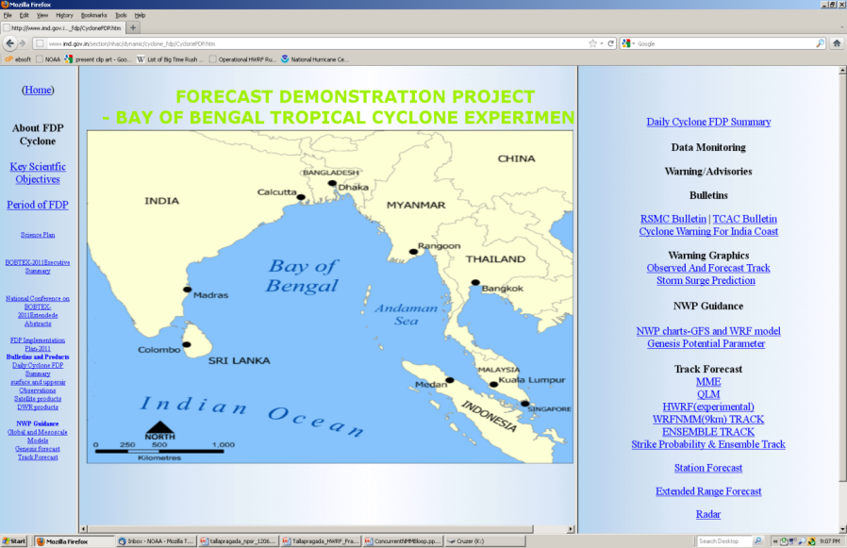
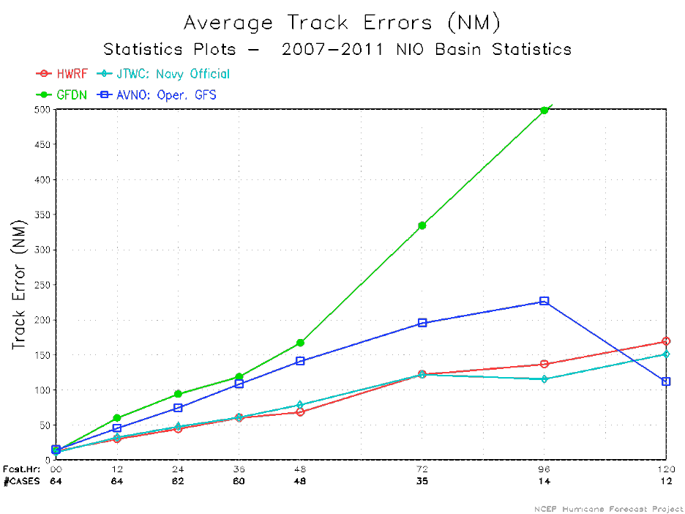
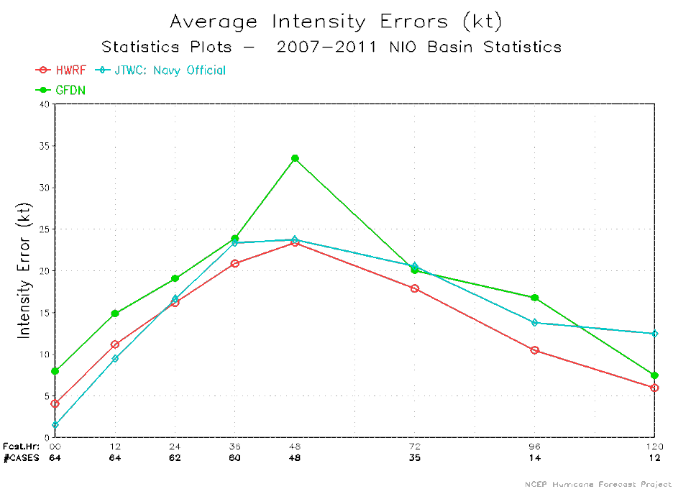
Expanding the scope of operational HWRF for World Oceanic Basins through International Collaborations
HWRF operational in India for Tropical Cyclone Forecasts for the North Indian Ocean through support from Indo-US Science and Technology Forum and NOAA-MoES bilateral MoU and IA. Two IMD scientists to visit EMC this summer
HWRF implemented at Shanghai Typhoon Institute, China for Western Pacific basin. STI sending a visiting scientist to EMC in May.
HWRF implemented in Vietnam for Western Pacific basin
HWRF will be implemented in Taiwan for real-time applications in 2013
Oman expressed interest in HWRF for applications in the Arabian Sea
Operational implementation of HWRF by India Meteorological Department
HWRF
GFDN
GFS
JTWC
HWRF
GFDN
JTWC
Track
Intensity

Slide 53
Science Review Committee

Slide 54
HFIP Scientific Review Committee:
Recommendations*
Revisit Intensity Goals
  Present intensity goals are unreachable and/or impossible; reduction of the largest error (e.g., 90th percentile) error values may be more meaningful
  Consider metrics for defining size and shape of storm, and/or accuracy of the precipitation field structure
Improve HFIP Model Physics and Initialization
  Broaden capabilities in HWRF for idealized simulations
  Improve model physics and vortex initialization focusing on microphysics, boundary layer structure, and turbulent mixing -- not ocean and air-sea coupled modeling
  Develop a self-consistent, flow-dependent data assimilation system
Further Integrate the HFIP and HWRF Efforts with Community
  Initiate a visiting scientist program at NOAA laboratories
  Be open minded, accept criticism, and willing to restructure modeling frameworks if necessary
* Response in development

Slide 55
Appropriation History
(2009-2014)
 | FY09 | FY10 | FY11 | FY12 | FY13 | FY14 (PB)
WCOSS PAC (HFIP | 6.000M | 3.000M | 3.000M | 4.000M | 2.000M | 4.000M
NWS ORF | *15.040*M | *14.040M | *14.044M | *14.044M *8.540M Due to NWS reprogramming | * **14.044M | * **14.044M
OAR ORF | 6.100M | 6.100M | 6.100M | 6.000M | 5.800M | 5.800M
TOTAL | $*27.140M | $*23.140M | $*23.144M | $*18.540M | $*22.040M | *24.044M
** OMB Restored NOAA and DOC proposed reductions

Slide 56
NHC Endorsement
NHC has reviewed the performance of the proposed HWRF implementation for 2013. The model has been extensively tested on a three-year sample of cases with very impressive results. For Atlantic basin track, the HWRF is improved by ~5-15% and now appears competitive with the GFS. For intensity, the model reduces errors by ~15%, has demonstrated skill greater than that of the NHC official forecast and greater than that of the statistical models. These are remarkable results and Rick has asked me to relay NHC's strong endorsement for implementation of the upgraded HWRF for the 2013 season.
Congratulations on a tremendous effort. NHC is eager to see the new model in operations as soon as possible.
-- James Franklin

Slide 57
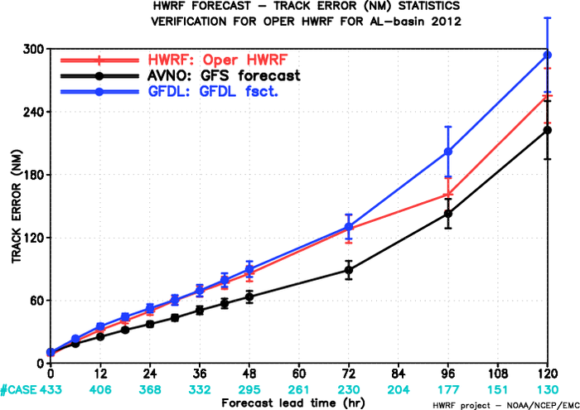
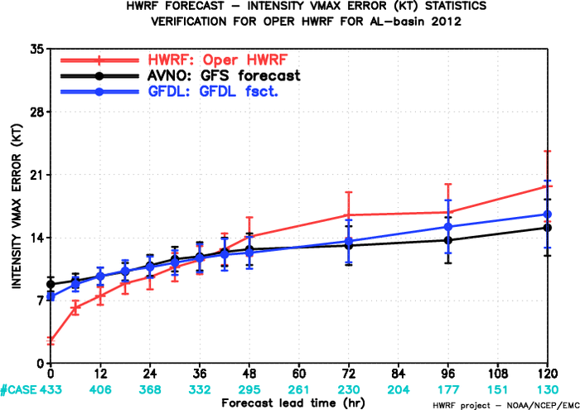
FY2012 Implementation of High-Resolution 3km Triple-Nested HWRF – Major Step towards improved forecasts
For the first time, a high-resolution hurricane model operating at cloud-permitting 3km resolution implemented into NCEP operational system
This upgrade is a result of multi-agency efforts supported by HFIP
  EMC: Computational efficiency, nest motion algorithm, physics improvements, 3km initialization and pre-implementation T&E
  HRD/AOML: nest motion algorithm, PBL upgrades, interpolation for initialization,
  DTC/NCAR: code management and repository, MPI profiling. Operational HWRF modeling system in the community framework supported by DTC since 2010.
  ESRL: Physics sensitivity tests
  URI: 1D ocean coupling in East Pac
  GFDL: Knowledge sharing, joint T&E
  NHC: Diagnostics and evaluation of the HWRF pre-implementation tests and real-time guidance
2011 HWRF 96hr FCST errors
2012 HWRF 96hr FCST errors
2011 HWRF 96hr FCST errors
2012 HWRF 96hr FCST errors
Notes:
57

Slide 58
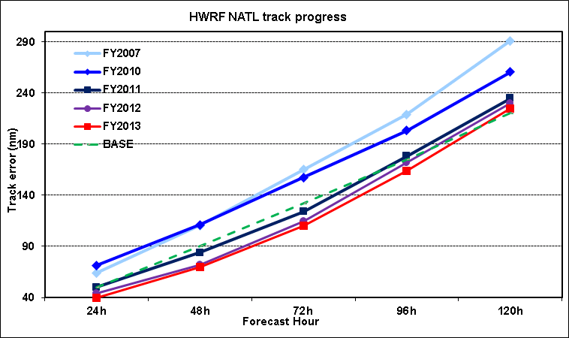
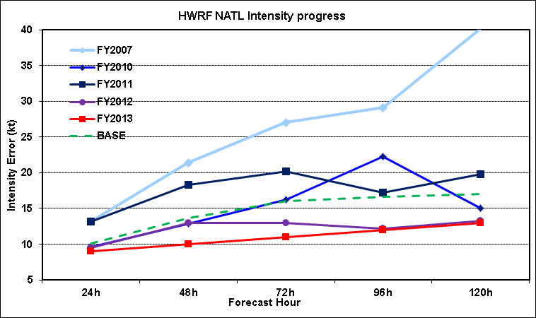
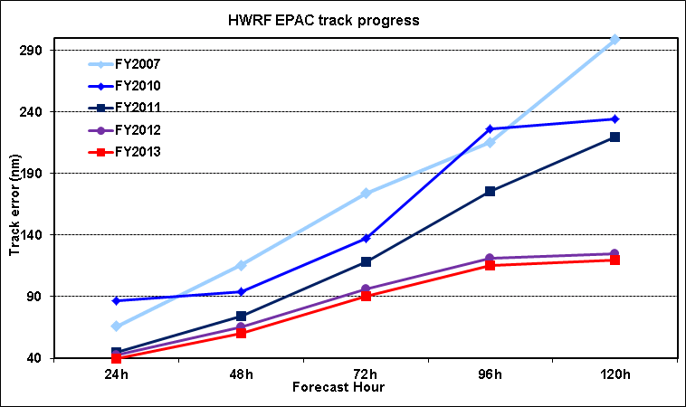

Progress of Operational HWRF To-Date

