Slide 1


Global Systems Division’s Web Services
Jebb Stewart
NOAA/ESRL/GSD
Affiliated with Colorado State University
Cooperative Institute for Research in the Atmosphere (CIRA)
December 15th, 2010
Earth System Research Laboratory
Global Systems Division
Technology Outreach Branch

Slide 2
Agenda
NextGen Background
Architecture - OGC Web Services
Capability Evaluation 2010
Impacts

Slide 3
NextGen Weather Data Cube Fundamental Concepts
An integrated and nationally consistent common weather picture for observation, analysis, and forecast data available to all system users
“Network Enabled” - available, secured, real-time, useful information
“Virtual” repository with no single physical database or computer
Conceptually unified source distributed among multiple physical locations and suppliers, of which NOAA is the primary data supplier
Direct integration of weather information into operational decision making processes

Slide 4
NextGen IT Team
GSD
Lynn Sherretz – NextGen Program Manager
Sher Schranz – Assistant NextGen Program Manager
Chris MacDermaid – NextGen IT Technical Coordinator
Michael Leon – FAA NextGen IT Technical Lead
Jebb Stewart – NWS NextGen IT Technical Lead
Steve Ennis Jim Frimel
Paul Hamer Patrick Hildreth
Shannon Johnston Bob Lipschutz
Adam Mabrouk Glen Pankow
James Schroeter Jeff Smith
MarySue Schultz Mike Turpin
GSD is involved in both FAA NNEW and NWS NextGen Programs.

Slide 5
Architecture Background
OGC (Open Geospatial Consortium)
  International industry consortium
  Standards developed in a consensus process
  Geoprocessing applications interoperable
  SOA (Service Oriented Architecture)
      Lots of disparate weather tracking / forecast systems
      Need to make services interoperable
      Consolidates systems/data from NOAA/FAA/DoD
      Efficient data delivery

Slide 6
Data Delivery Services
OGC-capable/compliant
Web Feature Service (WFS)
Web Coverage Service (WCS)
Web Mapping Service (WMS)
Sensor Observation Service (SOS)
Registry/Repository (RegRep)

Slide 7
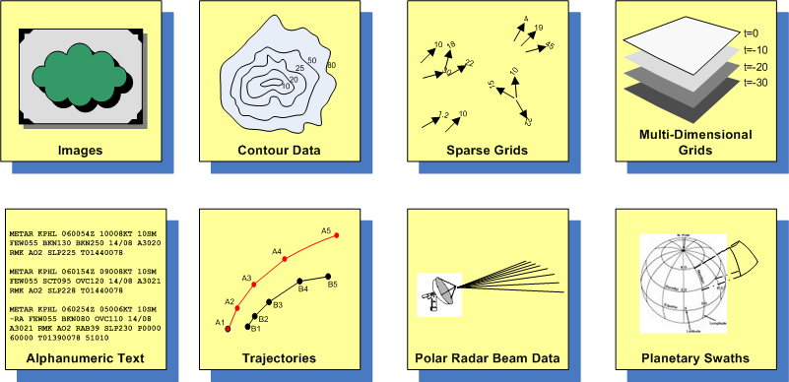
Common Weather Data Types
and Service Mapping
WMS
WFS
WCS
WCS
WFS
WFS
WCS
WCS

Slide 8
WFS Reference Implementation
MIT/Lincoln Labs
Non-gridded data (METAR, MDCR,TAF)
Java, PL/SQL
Data stored in XML in Oracle
Requests made with SOAP client API
  GetCapabilities
  DescribeFeatureType
  GetFeature
  WFS-T – XML format WXXM (Weather Information Exchange Model)
WXXM, the Weather Data Model, is a UML-based structural definition for the exchange of information by users of and contributors to the 4-D Wx Data Cube. It was designed by Eurocontrol, in partnership with NNEW.

Slide 9
WFS Development
GSD is exploring open source implementations without licensing costs or restrictions
  GeoServer (http://www.geoserver.org)
  Deegree (http://www.deegree.org)
Data stored in PostGIS, other storage formats are possible
Both implement versions 1.0 and 1.1 of WFS Specification
WFS Specification requires at least GML, doesn’t prevent serving other formats.

Slide 10
WFS TAF Response
<avwx:TAF
xmlns:wfs="http://www.opengis.net/wfs/2.0" xmlns:xsi="http://www.w3.org/2001/XMLSchema-instance" xmlns:wx="http://www.eurocontrol.int/wx/1.1" xmlns:gml="http://www.opengis.net/gml/3.2" xmlns:om="http://www.opengis.net/om/1.0/gml32" xmlns:xlin="http://www.w3.org/1999/xlink" xmlns:avwx="http://www.eurocontrol.int/avwx/1.1">
<avwx:rawText>TAF
KDEN 150439Z 1505/1524 18009KT P6SM SCT060 BKN200
FM150600 21008KT P6SM SCT140
FM151600 07008KT P6SM FEW080 SCT140
FM160200 15009KT P6SM BKN080</avwx:rawText>
<avwx:aerodromeWxForecast>
<wx:Forecast gml:id="KDEN_02">
<om:samplingTime>
<gml:TimePeriod gml:id="KDEN_03">
<gml:beginPosition>2010-09-15T05:00:00Z</gml:beginPosition>
<gml:endPosition>2010-09-16T00:00:00Z</gml:endPosition>
</gml:TimePeriod>
</om:samplingTime>
<om:procedure xlink:href="urn:fdc:faa.gov:System:Forecast:Weather:01234" xmlns:xlink="xlink"/>
<om:observedProperty xlink:href="http://www.eurocontrol.int/ont/avwx/1.1/wx.owl#AerodromeWx" xmlns:xlink="xlink"/>
<om:featureOfInterest xlink:href="#KDEN_04" xmlns:xlink="xlink"/>
<om:result>
<wx:WxFeatureCollection gml:id="KDEN_06">
<wx:featureMember>
<avwx:AerodromeWx gml:id="KDEN_07">
<avwx:windDirection uom="deg">180</avwx:windDirection>
<avwx:horizontalVisibility>
<avwx:HorizontalVisibility gml:id="KDEN_8">
<avwx:prevailingVisibility uom="SM">6</avwx:prevailingVisibility>
</avwx:HorizontalVisibility>
</avwx:horizontalVisibility>
<avwx:windSpeed uom="kt">9</avwx:windSpeed>

Slide 11
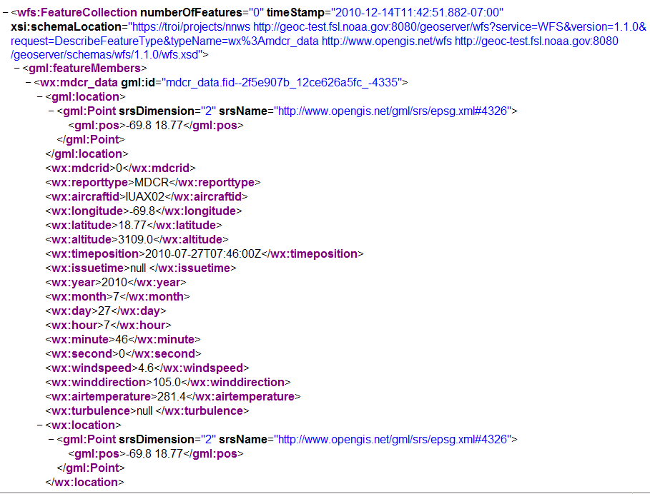
GeoServer MDCR GML Response

Slide 12
WCS Reference Implementation
NCAR/RAL
Gridded datasets (satellite, reflectivity, models)
Java using ServiceMix (FUSE), NetCDF
Developed by NCAR/RAL
Format is NetCDF
Like IDV, Java NetCDF tools for manipulation and display
Data in backing flat file store as-is
Coordinate Reference System (CRS) handled transparently
Requests made with SOAP client API
  GetCapabilities
  DescribeCoverage
  GetCoverage

Slide 13
WMS Reference Implementation
NcWMS
Georeferenced Images
Java using Tomcat, NetCDF
Developed by Reading e-Science Centre at the University of Reading, UK.
Output Formats: JPEG, GIF, PNG, KMZ.
CRS handled transparently
Requests made with SOAP client API or Key Value Pairs
  GetCapabilities
  GetMap
  GetFeatureInfo (Optional Implementation from Specification)

Slide 14
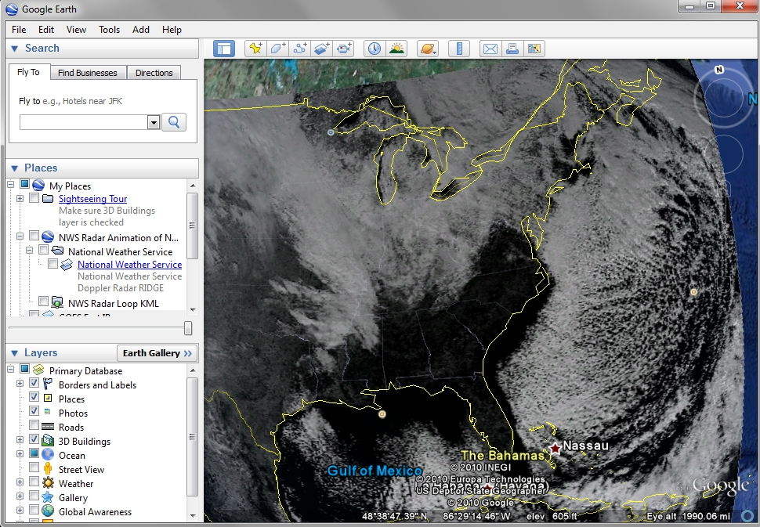
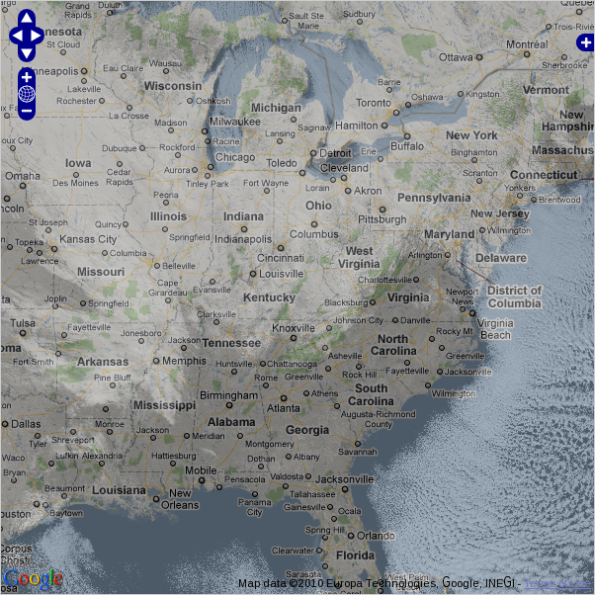
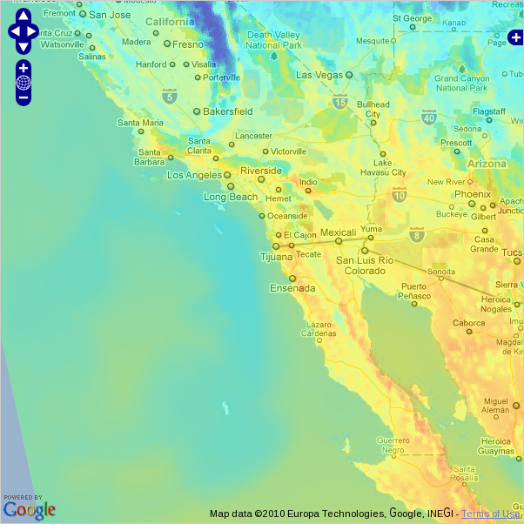
WMS Examples
GOES EAST Visible - Google Earth
NAM 12 Surface Temperature
Open Layers
Overlaid on Google Maps
GOES EAST Visible
Open Layers
Overlaid on Google Maps

Slide 15
SOS Reference Implementation
Deegree
Observation and Sensor data (METAR, TAF, Sensor Information)
Java, Implements 1.0 Specification
Uses Observations & Measurements (O&M) data model and Sensor Model Language (SensorML). Generic model that uses attributes to describe data.
Requests made with SOAP client API or Key Value Pairs
  GetCapabilities
  DescribeSensor
  GetObservation
  GetFeatureOfInterest (Optional)

Slide 16
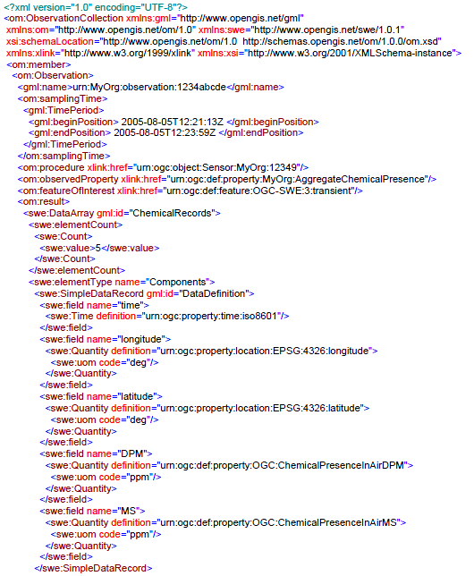
SOS Examples – 1 of 2

Slide 17
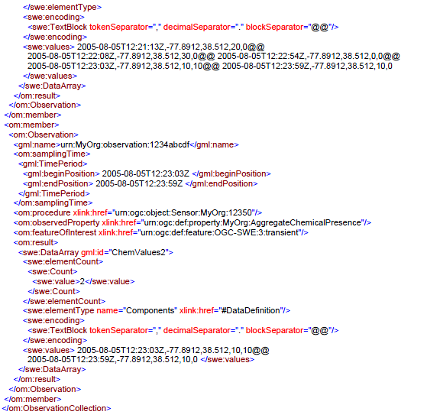
SOS Examples – 2 of 2

Slide 18
Testing Portal
  Provides functional tests and performance monitoring of the WFS and WCS at ESRL.
  Functional tests can be run individually or as a entire suite.
  Provides detailed information on test(s) success or failure
  Provides capability to submit ad hoc requests
  Provides continuous, automated performance monitoring of the OGC Web Services

Slide 19
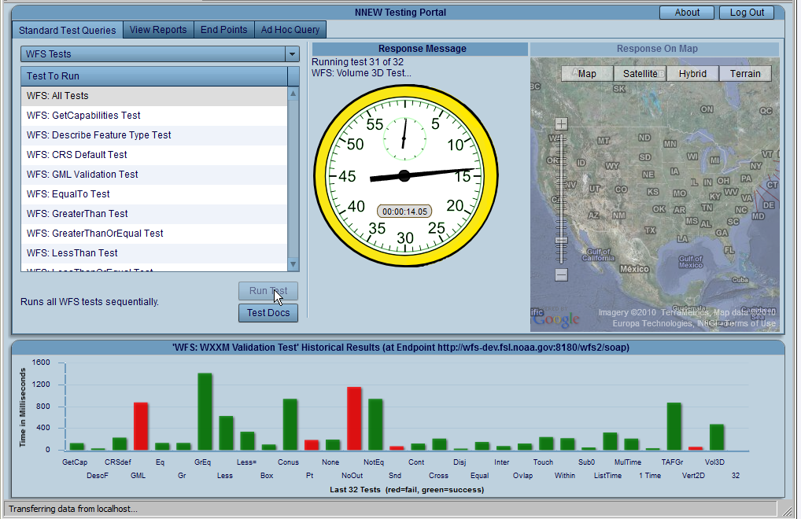
Testing Portal Example

Slide 20
Reg/Rep Implementation
Data catalog of metadata
  endpoint
  dataset
Searchable
Commercial product (but uses PostgreSQL)
RI’s interface with RegRep
Administration UI
Federated capability

Slide 21
NextGen 4-D Weather Data Cube
Capability Evaluation
Capability Evaluation (CE) at the William J. Hughes Technical Center (WJHTC) September, 2010
Participants:
  Meteorological Development Laboratory (MDL)
  Global Science Division (GSD)
  Aviation Weather Center (AWC)
  National Severe Storms Laboratory (NSSL)
  National Center for Atmospheric Research (NCAR)
  Massachusetts Institute of Technology / Lincoln Laboratory (MIT/LL)
  WJHTC – Radar and Mosaic Processor (RAMP)
  WJHTC – Regional Automated Weather Observing System Data Acquisition Service Provider (RASP)

Slide 22
NextGen 4-D Weather Data Cube
Capability Evaluation
Continued
  GSD ran the following services running during the FY 2010 Capability Evaluation
    MIT/LL WFSRI
    NCAR/RAL WCSRI
    Reg/Rep
    Testing Portal

Slide 23
Impacts
By using standardized data models and specifications, any client that understands these services can use data.
Improves collaboration and interoperability.
Tools/Utilities Easily combine data from different services
Specifications support sub-setting and data filtering allowing consumers to grab only the data they need.
Specifications support ability to re-project data into different CRS
Services will provide Publish/Subscribe mechanisms allowing consumer to maintain most recent data

Slide 24
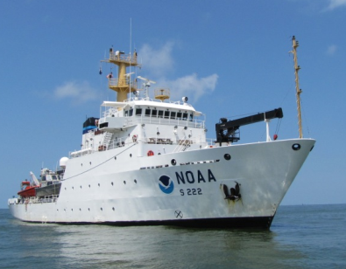

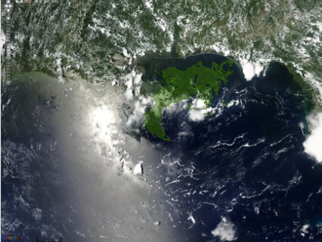
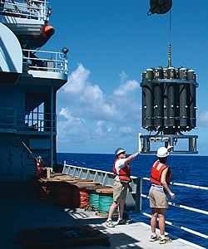
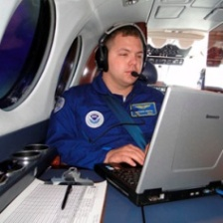

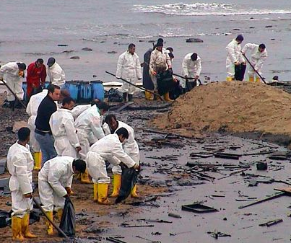

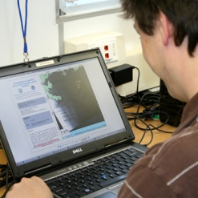
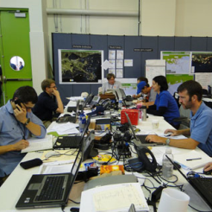
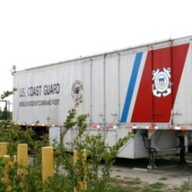
Integrating Data Access to Address
an Ecological Disaster
NOAA Observing Systems
Collection & Process
All Source Observing Systems
Data Assembly Center
(e.g. OR&R, NDBC, NODC)
Calibration
Validation
QA/QC
Metadata
VerifiedData Streams
Joint Analysis Group
Protecting Living Marine Resources
Research Community
Assimilation, Integration & Visualization
Decision Support Tools
Archive & Stewardship
Interagency Management
OR&R
NIC
ICC
Data Centers &
Centers of Data
Russell H. Beard
DEEPWATER HORIZON Data and Information Management – “Lessons Learned”, August 11, 2010

Slide 25
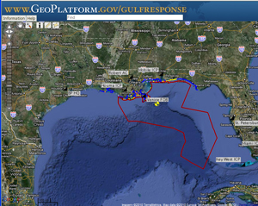
Deepwater Horizon
GeoPlatform.gov is a one-stop shop for detailed near-real-time information and data about the response to the Deepwater Horizon/BP oil spill.
NOAA’s response has been immediate and sustained, strategic and scientific.
From day one, NOAA has been tracking every aspect of this spill: where the oil is going on the surface and under the sea, and what the consequences are to coastal communities, wildlife and the marine environment. We are bringing all scientific methods to this task:
* Satellites in space
* Planes in the air
* Boats on the water
* Gliders below the surface
* Scientists on the ground
http://www.noaa.gov/sciencemissions/bpoilspill.html

Slide 26
  Questions?
  Email: Jebb.Q.Stewart@noaa.gov

