Slide 1
National Weather Service
NWS GIS Enterprise Viewer
Overview
Kari Sheets
Geographic Information Systems (GIS) Team Lead
Office of Dissemination
vLab Seminar
July 24, 2019

Slide 2
Briefing Purpose – Informational
Briefing purpose is to:
To provide a high level overview of the plans for the NWS Enterprise Viewer for which the need was validated as CaRDS 16-037

Slide 3
Background of Mission Need or Requirement
CaRDS 16-037
MDC validated CaRDS request in November 2017
A common web design to display and disseminate map-based graphics and text information would allow NWS partners and the public to more seamlessly access information across multiple CWAs. This will improve DSS in states and localities that span multiple CWAs. In addition, users would not have to learn how to navigate several different web designs to find the products they need to make decisions.
While the initial effort may be substantial, establishing a common design and code base for the display of map-based graphics and related text information will ultimately reduce the work required to design and maintain sites to support different NWS products and services. Display of future products and services could be planned to fit the common web design when possible.

Slide 4
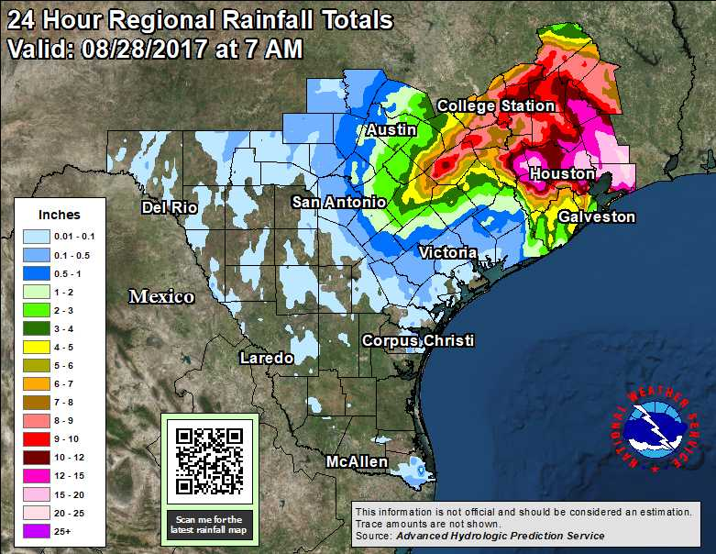
Hurricane Supplemental:
Scalable National Web-Based GIS Viewer / CaRDS 16-037
Background of Mission Need or Requirement
Improve public access, end user experience and Decision Support Services (DSS) in states and localities that span multiple County Watch Areas (CWAs)
Provide a reliably consistent and common design and software code base to display GIS map-based graphics and related text information
Provide consistent and reliable display and data access for flood inundation mapping, excessive rainfall products, and quantitative precipitation forecasts

Slide 5
Background of Mission Need or Requirement
The GIS D2O team (June 2017-Nov 2018) identified at least 30 NWS websites which provide geospatial data and information. Each site has been developed independently.
Additionally through the NOAA esri ELA independent arcgis online (AGOL) sites are being developed by individuals, offices and regions for IDSS purposes with little to no consistency in design or approach.
The DIS GIS team and NWS GIS D2O team documented and validated the technical and functional requirements based on the functionality of the existing websites and shared these requirements in the CaRDS system as well as with AFS policy teams.
The provision of data in GIS formats is separate from this CaRDS request, but also managed by the Dissemination Office and was worked on by the D2O team
The NWS GIS D2O has been reinstitued and real time virtual training will be held July 30-Aug 1. The plan is to record these trainings for those not able to participate. If you are interested in joining the D2O team email Kari.sheets@noaa.gov for more information.

Slide 6
Strategic Alignment
A single code base for NWS web based GIS contributes to 2 of the “5 Key Ways Forward” for evolving NWS:
1) Better Serving Partners by providing key IDSS information as GIS web services so NWS IDSS staff can brief using NWS tools while also providing the data so it can be efficiently integrated into the GIS or common operating pictures of our partners.
2) Improve consistency of NWS forecast & product display and dissemination in support of IDSS through a collaborative R2O process that makes best use of technology, reduces duplication, and ensures consistency of IDSS experience across the NWS’ 11 service areas.

Slide 7
Timeline
What it does: Displays NWS IDSS data across multiple County Warning Areas and other geographies
What we need to do: Develop a common code base focusing on large precipitation events (inundation, QPE, etc) of national interest
GIS Viewer | FY 2019 |  |  |  | FY 2020
 | Q1 | Q2 | Q3 | Q4 | Q1 | Q2 | Q3 | Q4
Planning
Development
Quality Assurance
Implementation

Slide 8
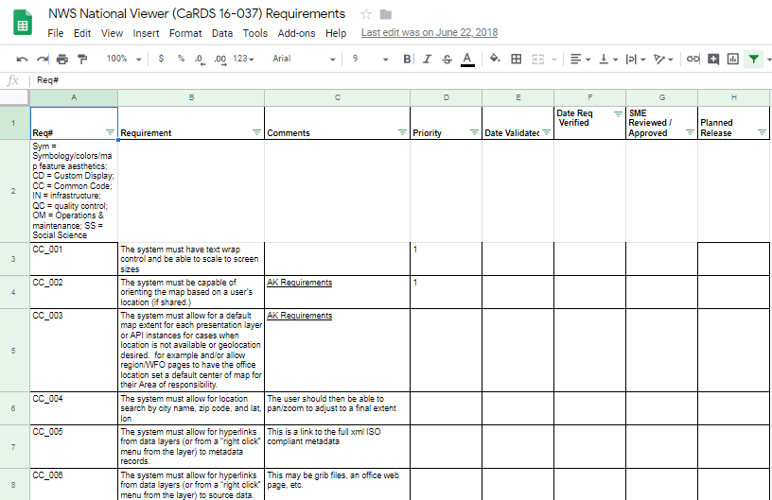
Requirements Documentation
https://docs.google.com/spreadsheets/d/14fatfg6C28MGQKAv06u2UqIc3nVPvUZYrvZrVhGkFqs/edit?usp=sharing
268 requirements

Slide 9
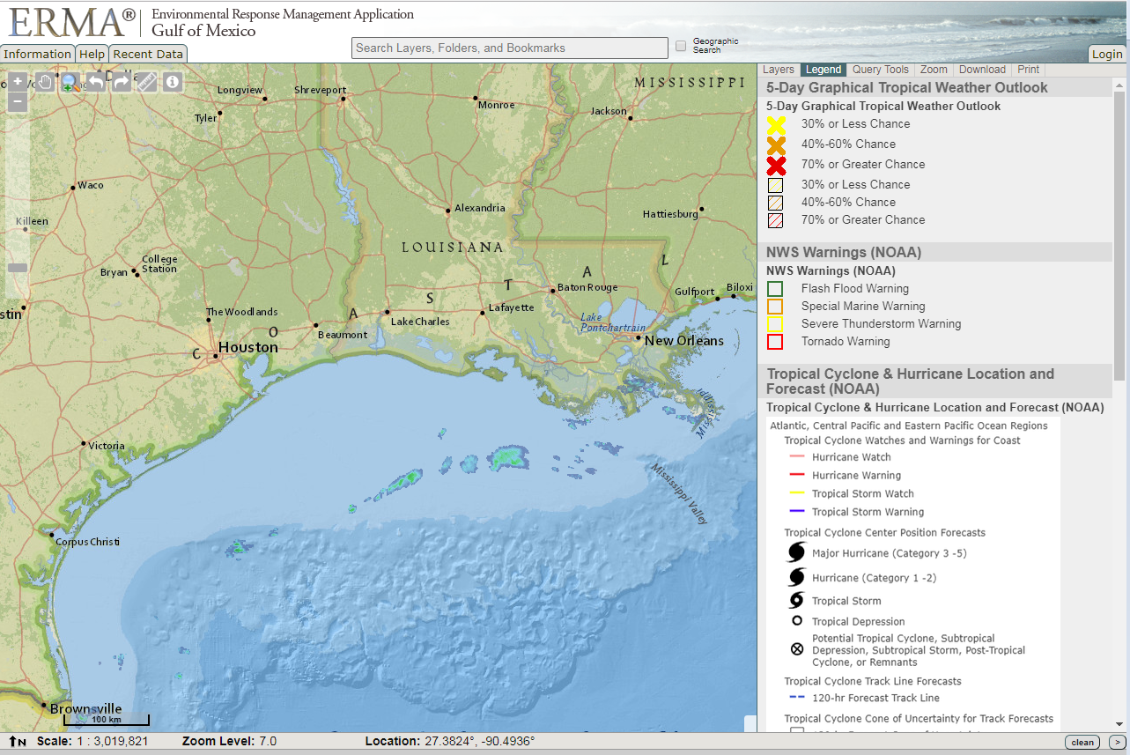
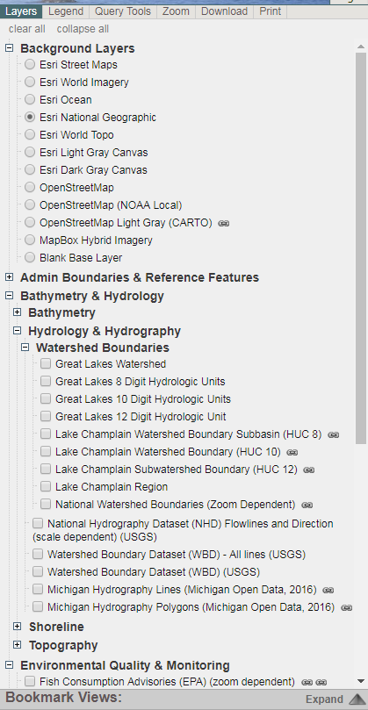
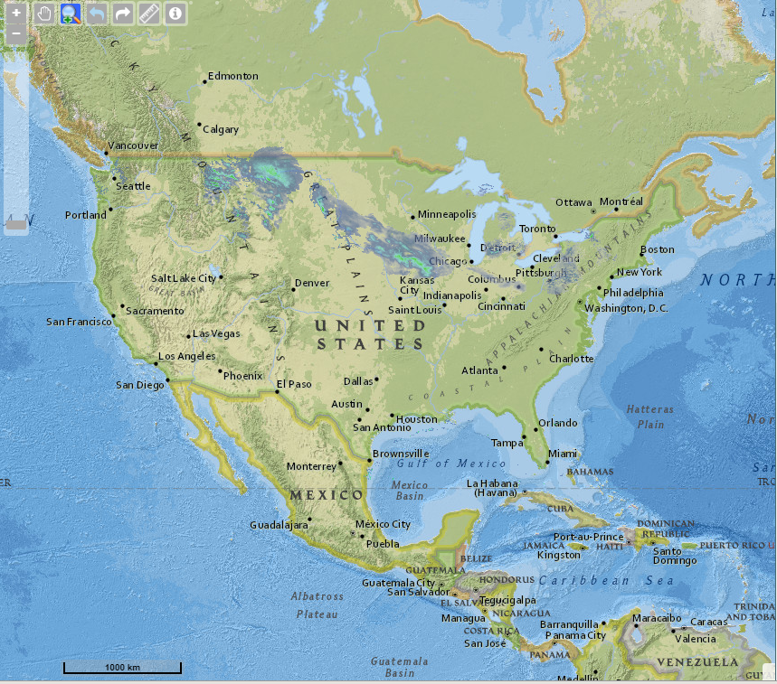
NWS Enterprise Viewer MOCK-UP
NWS Enterprise Viewer
Critical NWS Function - Time Slider
MOCK-UP
Basic Web Based Map Functions:
Pan, Zoom
GetInfo
Selectable Data Layers

Slide 10
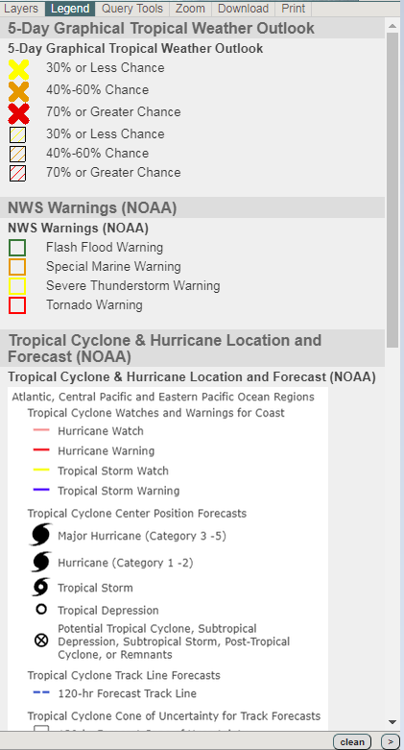
NWS Enterprise Viewer Mock-Up
NWS Enterprise Viewer
MOCK-UP
Basic Web Based Map Functions:
Legend
Notes:
Every map needs a legend, but when managing screen space, you need to be able to use the same portion of the screen for multiple purposes, so the legend and the table of contents is interchangeable by 1 click

Slide 11
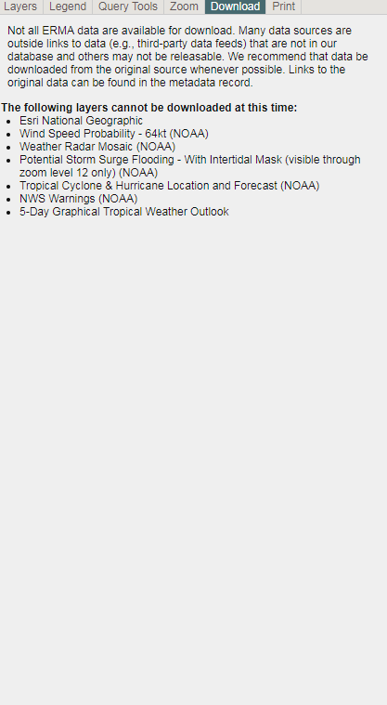
NWS Enterprise Viewer Mock-Up
NWS Enterprise Viewer
MOCK-UP
User Requested Functionality:
download shapefiles of data layers when allowable by data provider
Notes:
Occasionally our partners and customers want to be able to download the map data, so the application will have download functionality.

Slide 12
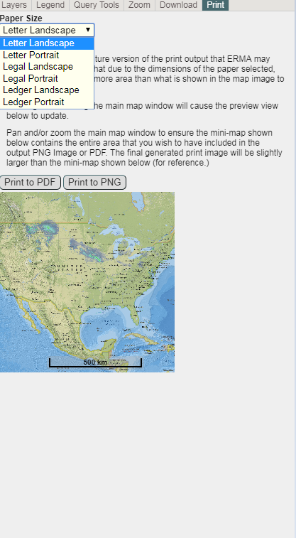
NWS Enterprise Viewer Mock-Up
NWS Enterprise Viewer
MOCK-UP
User Requested Functionality:
Print to image or pdf for use in briefings and papers
Notes:
Another very useful option when providing IDSS is to be able to print (or create an image) of the screen in a presentation format. This functionality will also be included

Slide 13
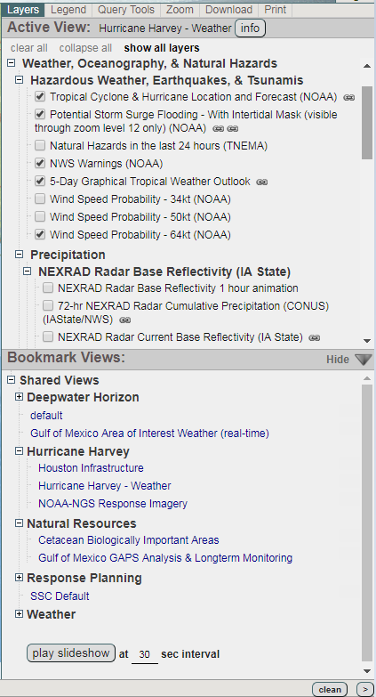
NWS Enterprise Viewer Mock-Up
NWS Enterprise Viewer
MOCK-UP
User Requested Functionality:
“bookmarks” for sets of layers in 1 click
Notes:
Back to the table of contents. Especially in IDSS, it can be helpful to treat a web GIS as more of a slideshow with preset map content. Some applications call this bookmarks. In this example (from the NOS ERMA application) you click on this arrow to reveal the bookmarks.
Now you see several options for picking preset maps with 1 click.
When talking to a map, sometimes you don’t need to see the legend or table of contents, so when you click on arrows like these from EDD you can hide the information pane.

Slide 14
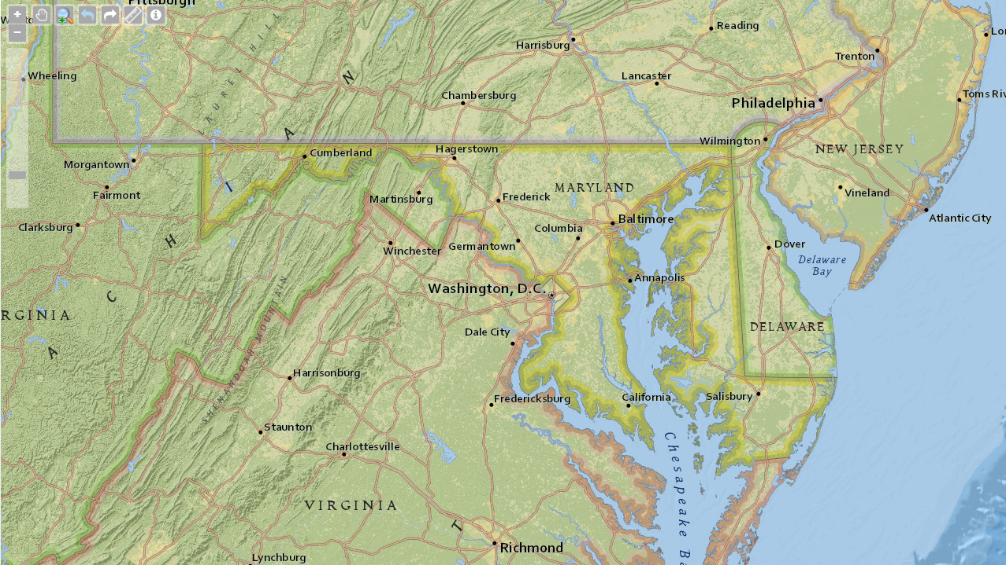
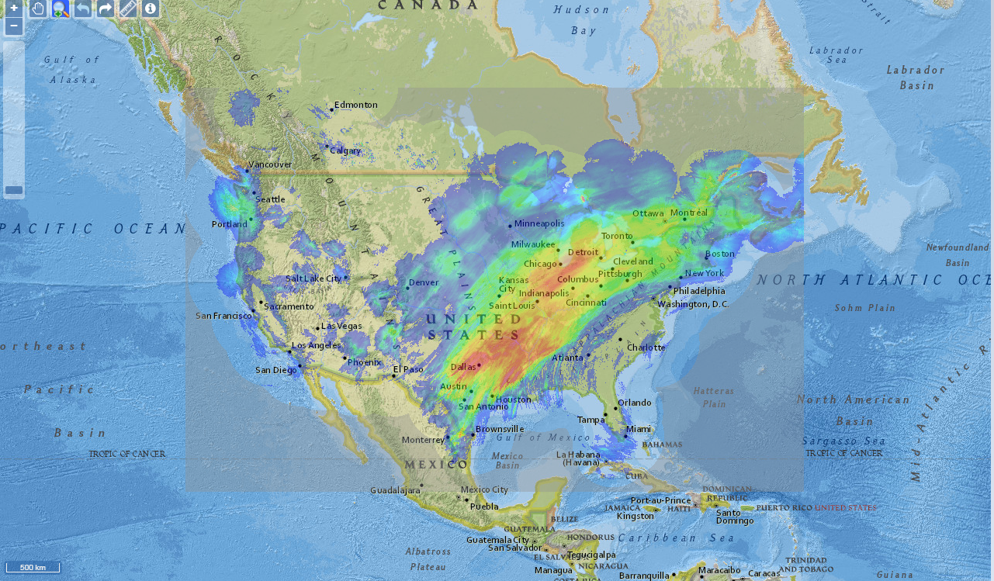
NWS Enterprise Viewer Mock-Up
NWS Enterprise Viewer
MOCK-UP
User Requested Functionality:
hide the “navigation panel”
Notes:
And the pane can be re-exposed with a click of the reverse arrows.

Slide 15
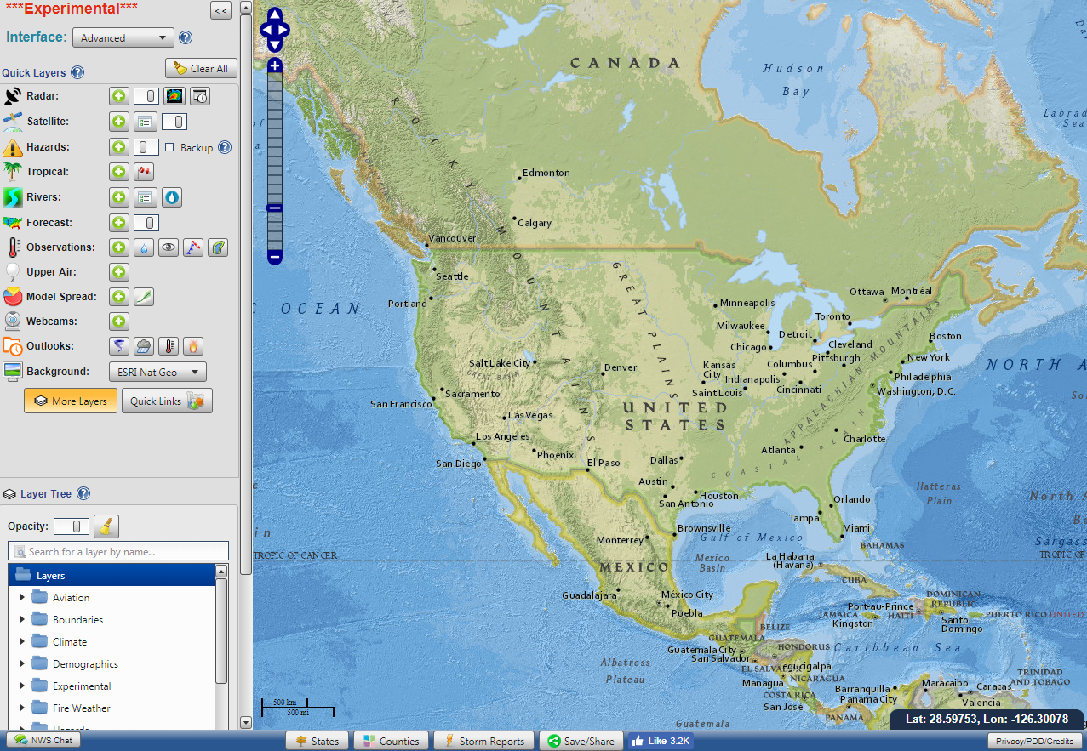
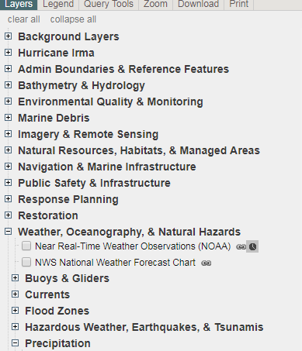
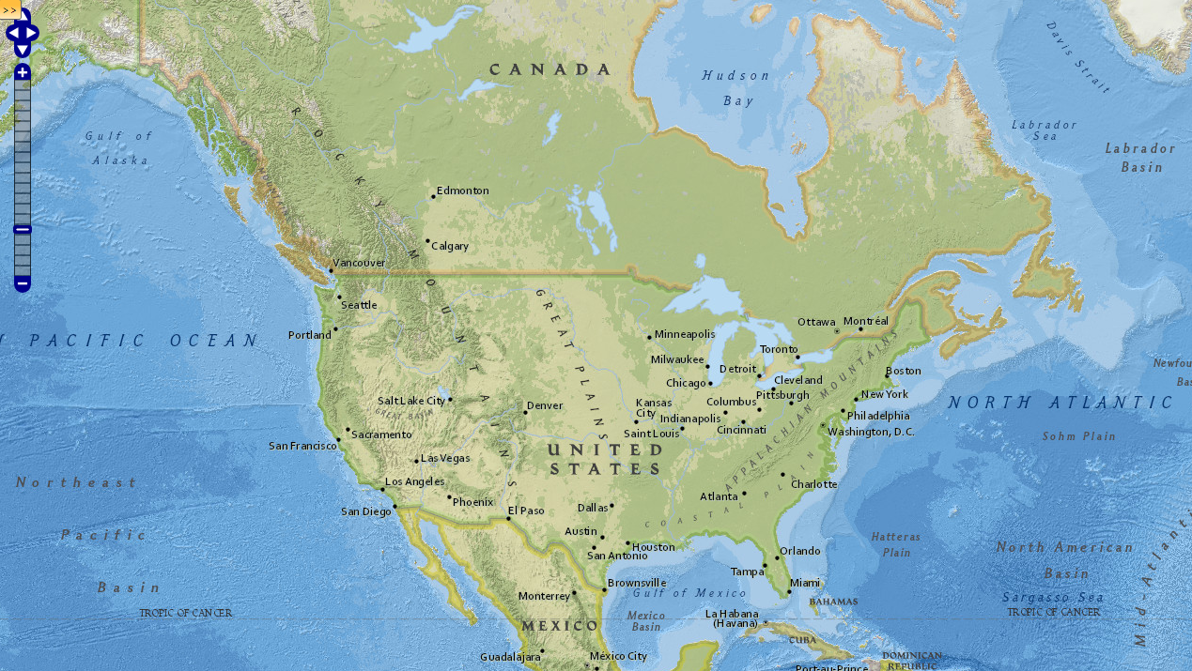
NWS Enterprise Viewer Mock-Up
NWS Enterprise Viewer
MOCK-UP
User Requested Functionality:
search for data layers not default in the “presentation layer”
Notes:
To be able access to all available data in the database, we’ll have a button to allow for full access to the folder structure. Like this button from EDD.
At the top of the map there is a search box which can be used to search for data based on keywords or you can click the box and do a geographic search based on location
To be able access to all available data in the database, we’ll have a button to allow for full access to the folder structure. Like this.

Slide 16
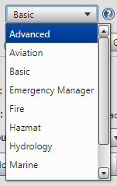
NWS Enterprise Viewer Mock-Up
NWS Enterprise Viewer
MOCK-UP
User Requested Functionality:
jump from one “presentation layer” to another
Notes:
Additionally there will be a way to navigate from skin or interface to interface like this drop down menu.

Slide 17
NWS Enterprise Viewer Mock-Up
Mock-Up of Viewer
NWS Enterprise Viewer
MOCK-UP
Basic Web Based Map Functionality:
search for presentation layer data or search for location
Notes:
Another search or navigation feature that will be implemented, you can think of this like our location based forecast search on weather.gov In this design the search bar would have a toggle to switch between content searches and geographic searches.
Finally, weather maps also need the ability for you to see data over time, so a time slider capability will be included similar to this one from the NOS nowCOAST application

Slide 18
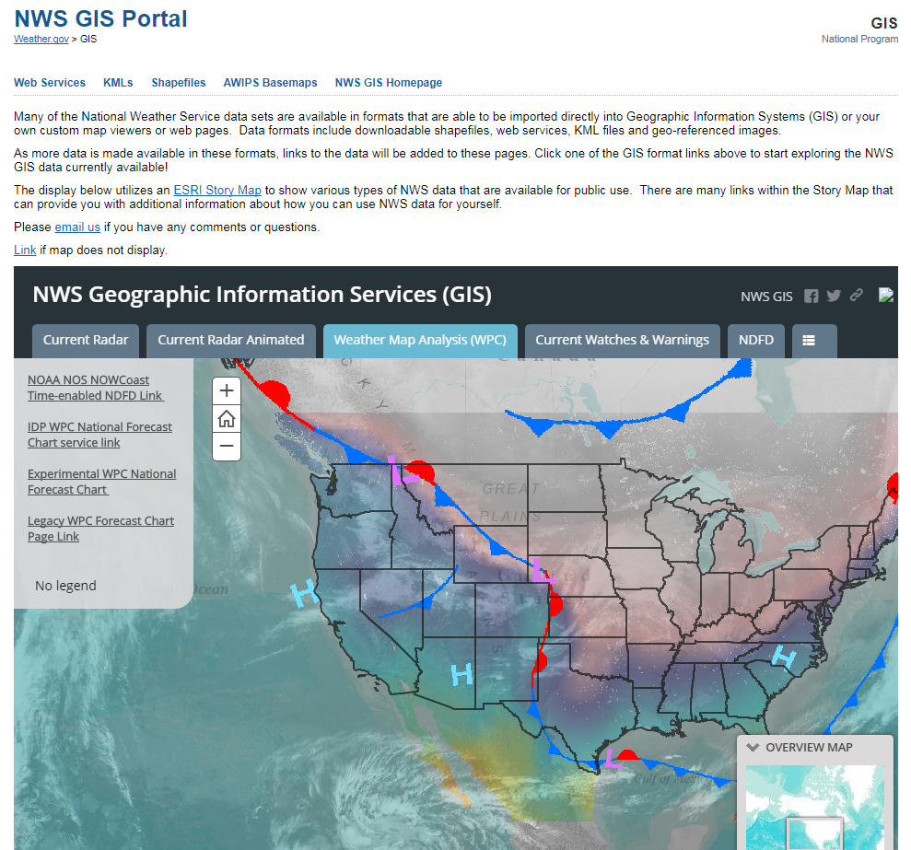
Similarities with existing tools
Common Look & Feel w/customized skins
potentially with tabbed navigation similar to interim NWS GIS page

Slide 19
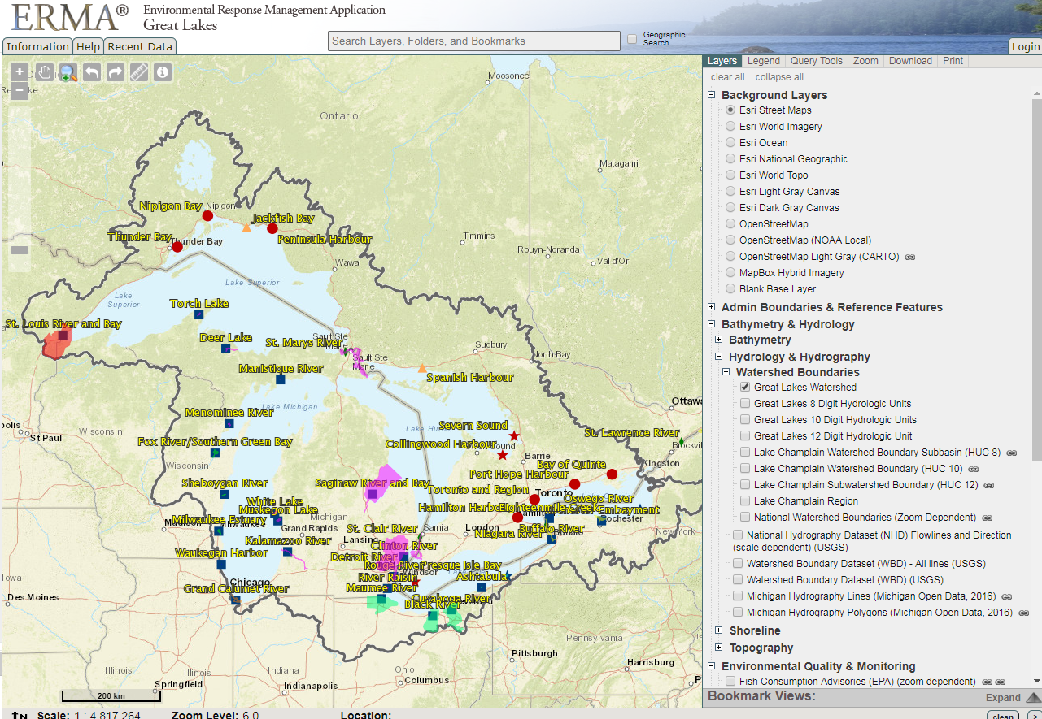
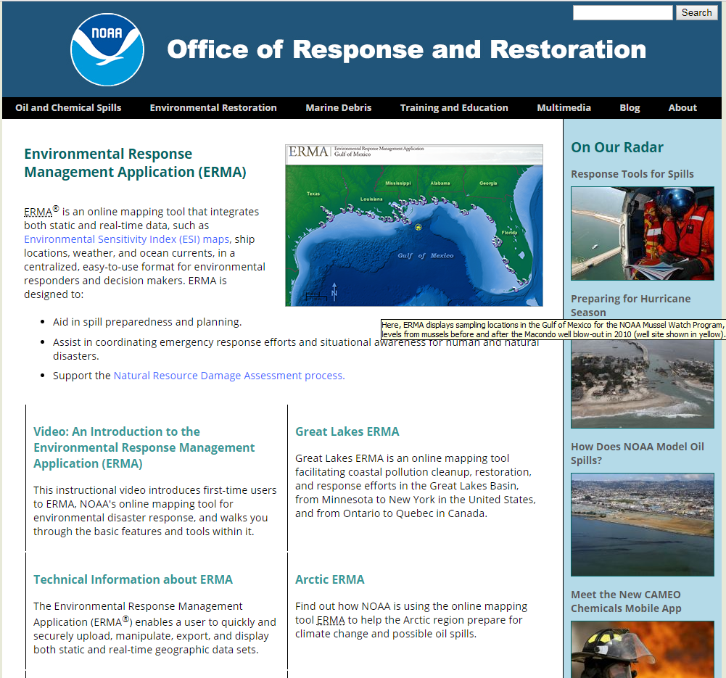
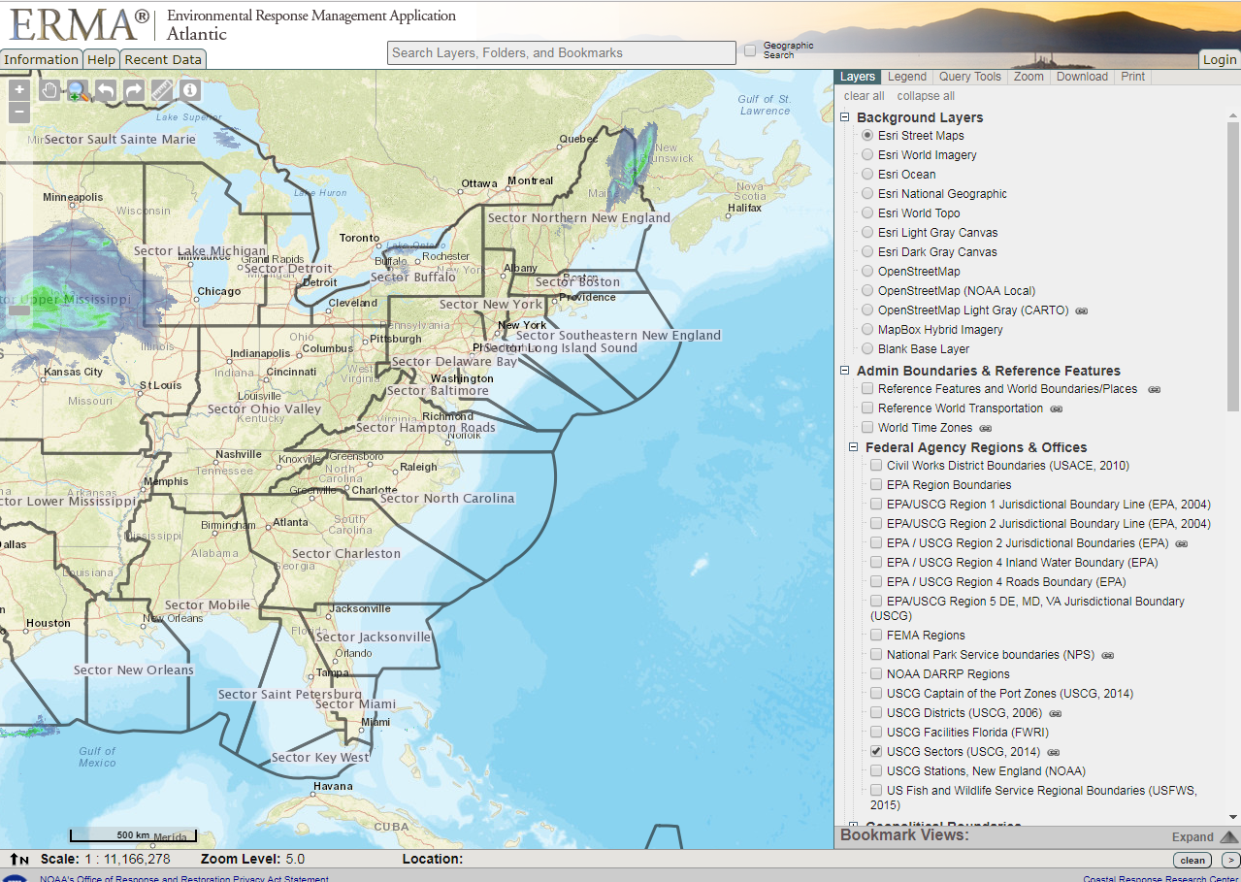
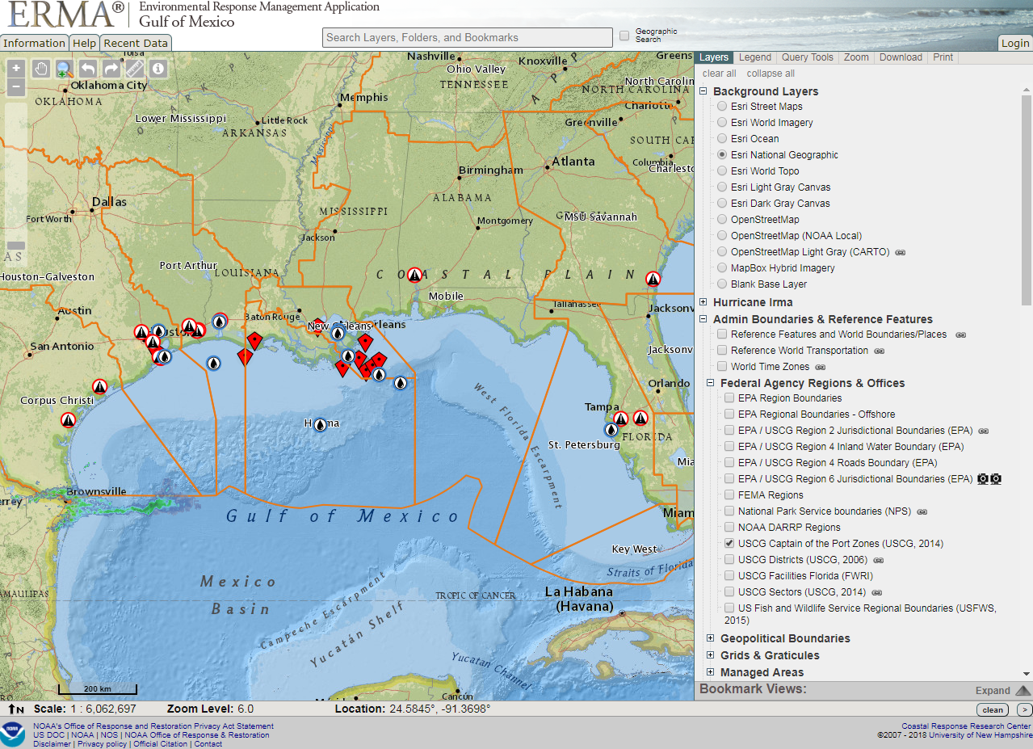
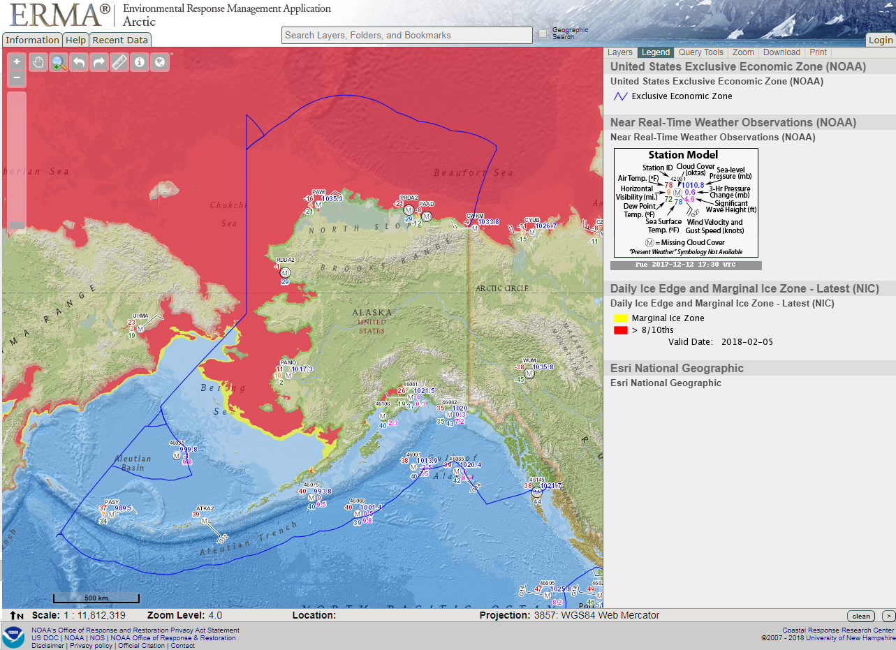
Similarities with existing tools
Common Look & Feel w/customized presentation layers
similar to NOS ERMA application

Slide 20
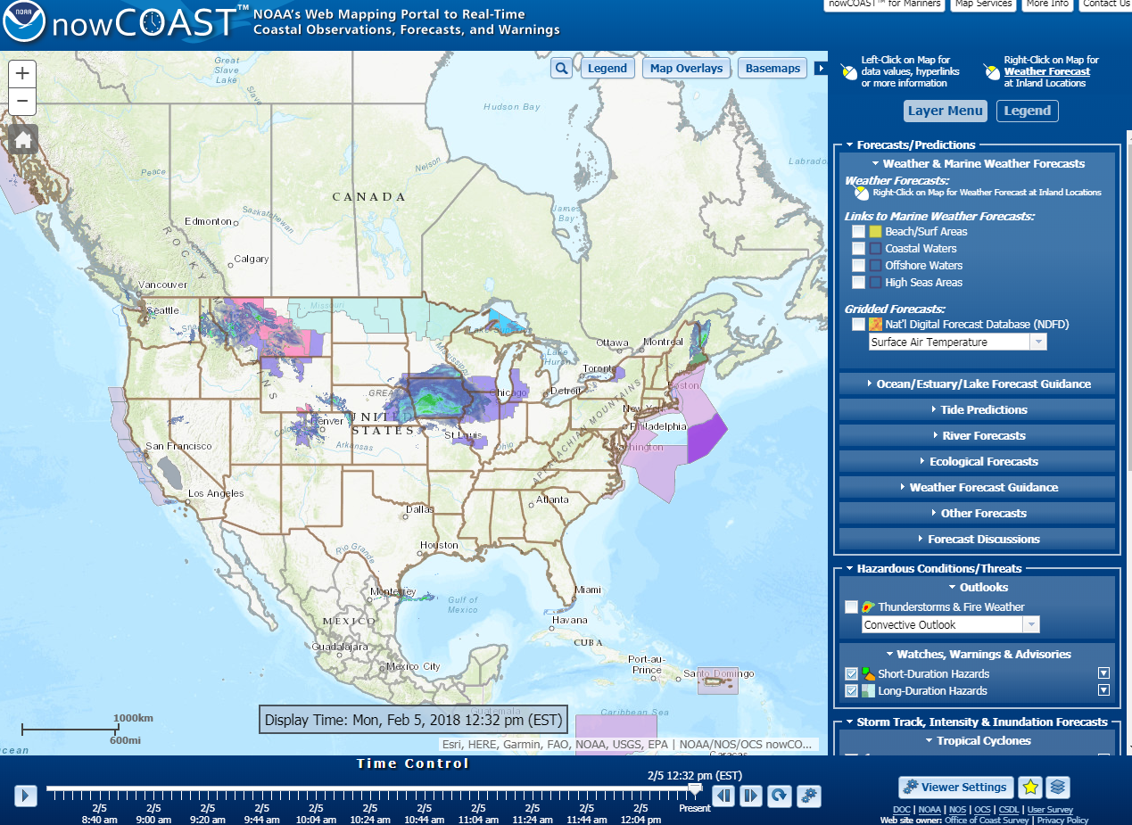
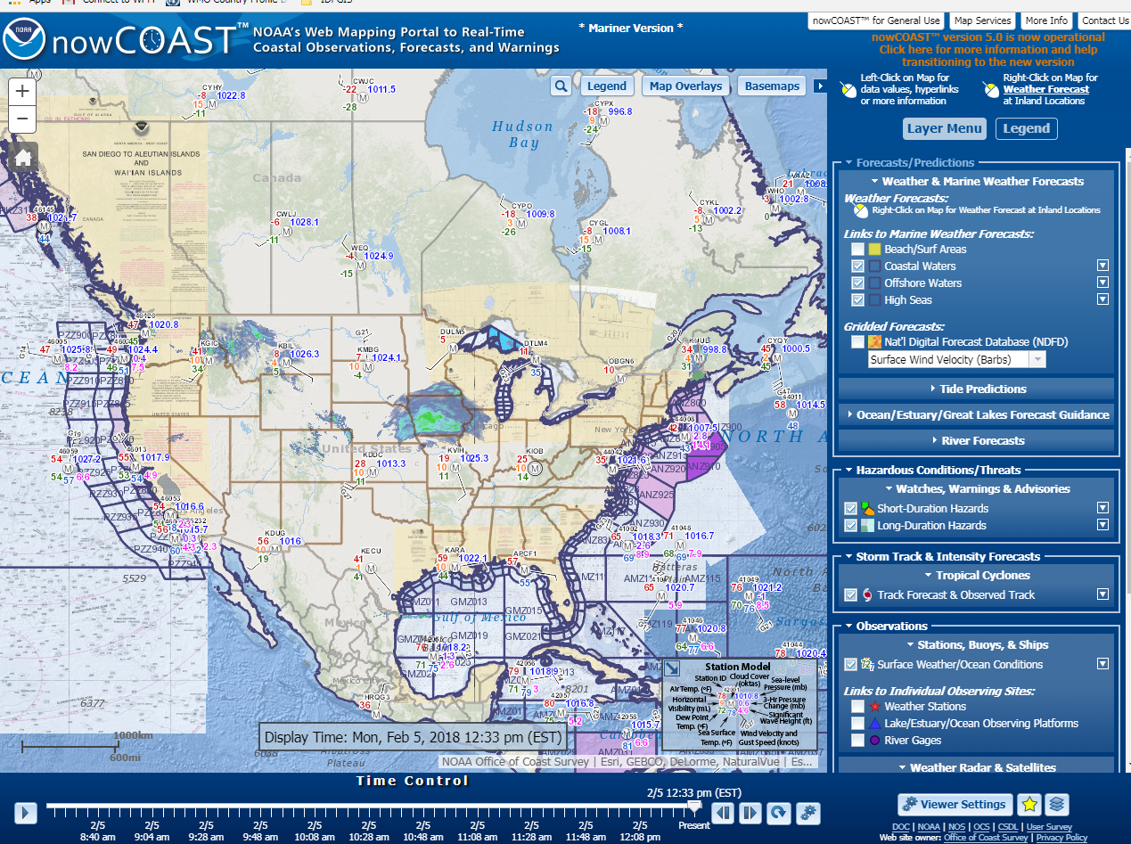
Similarities with existing tools
Common Look & Feel w/customized presentation layers
similar to NOS nowCOAST
General Use
Mariner Version

Slide 21
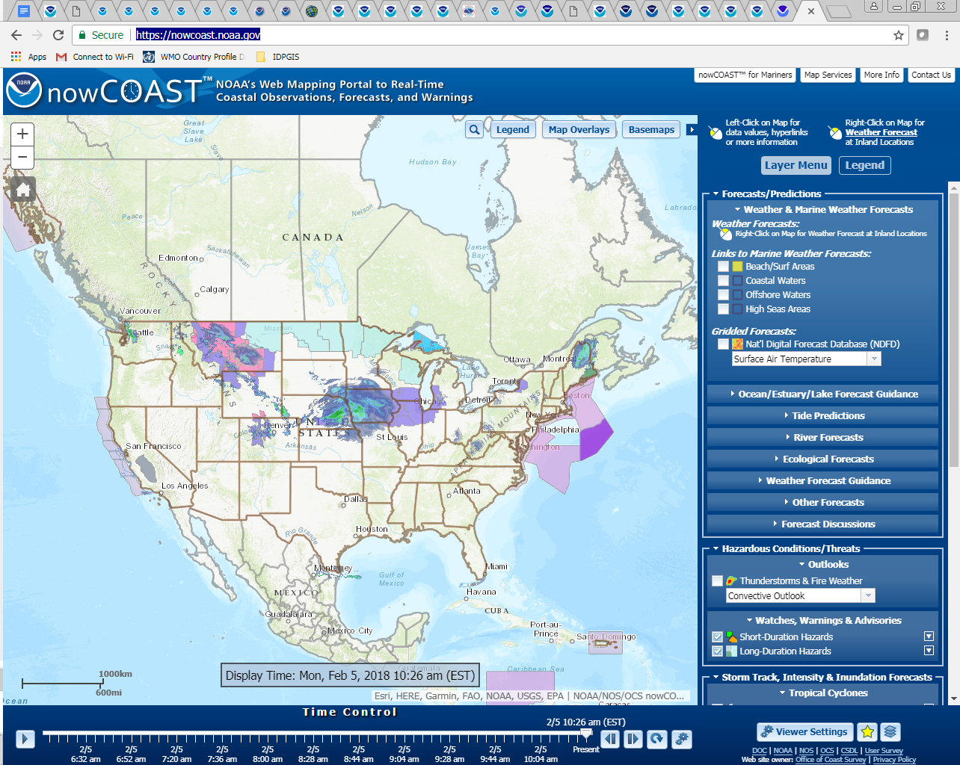
Similarities with existing tools
Key Functionality from current applications
time slider NOS nowCOAST

Slide 22
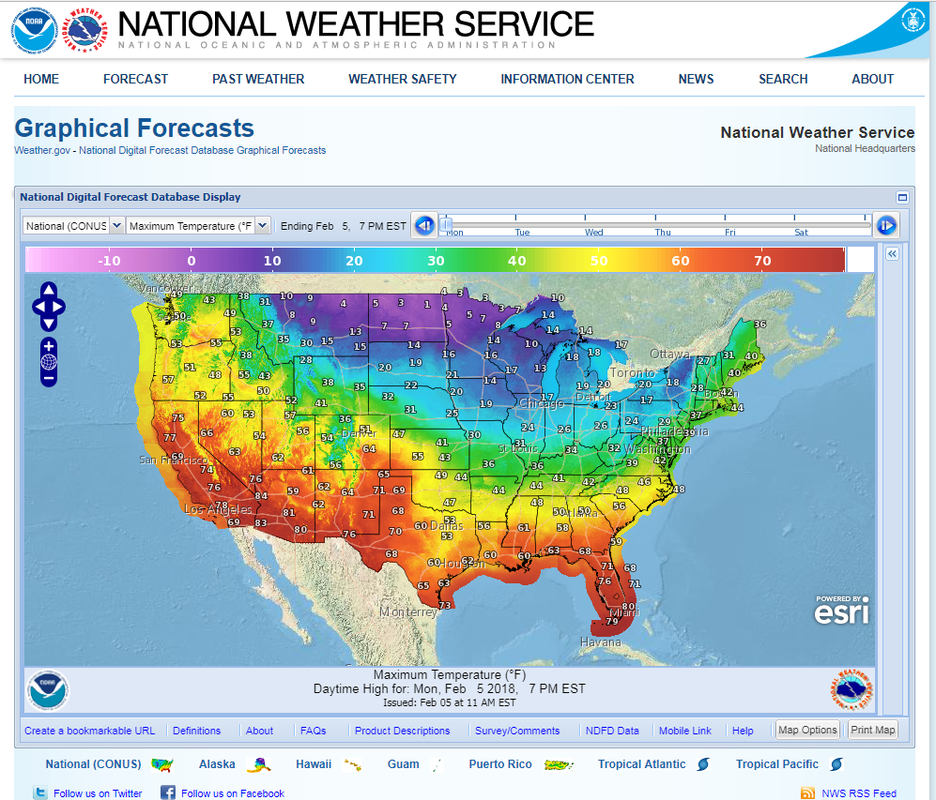
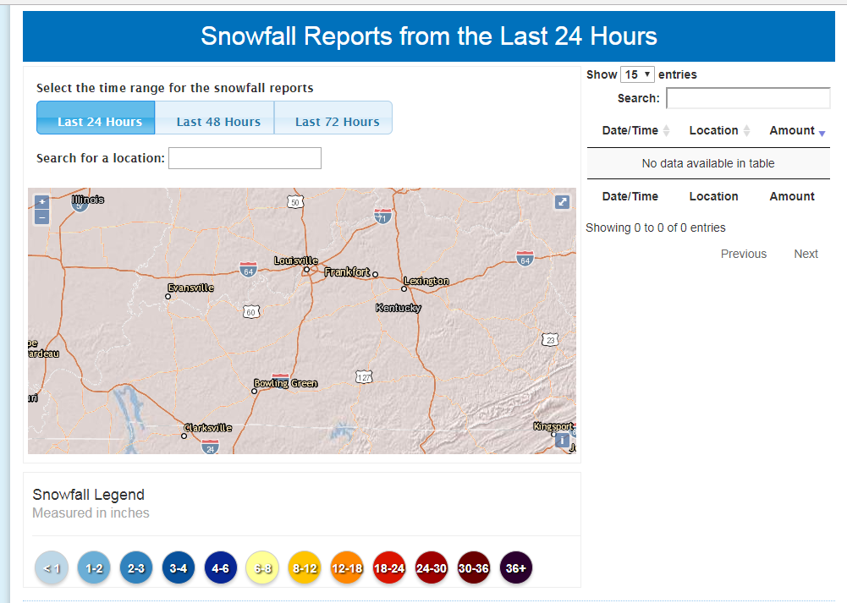
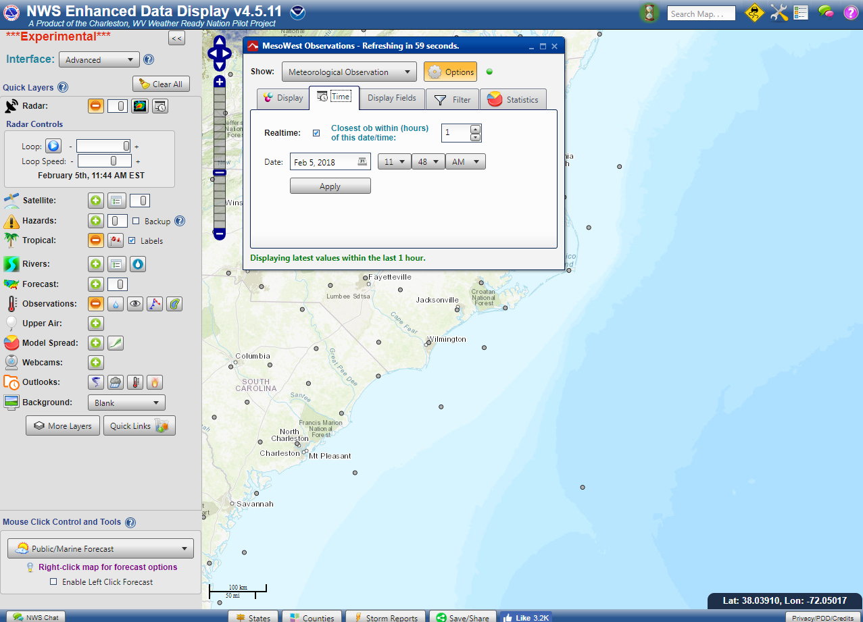
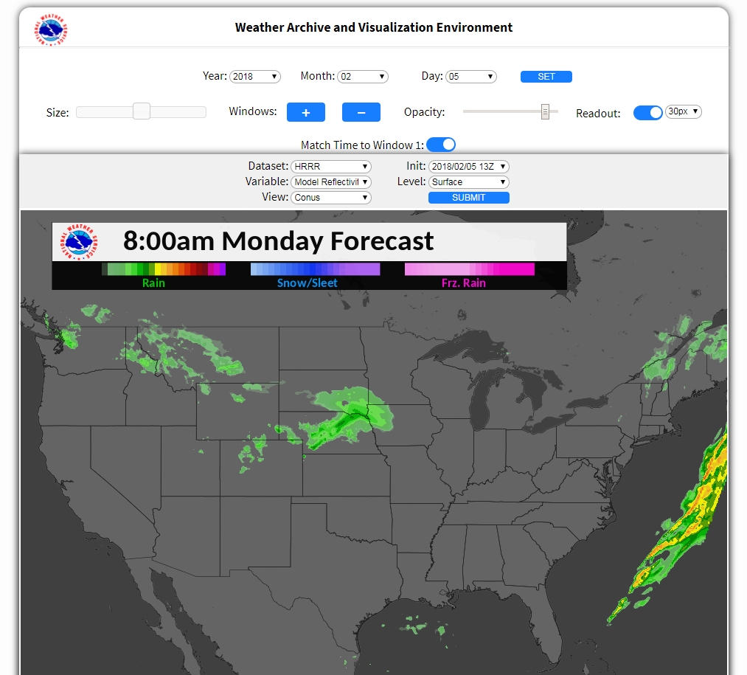
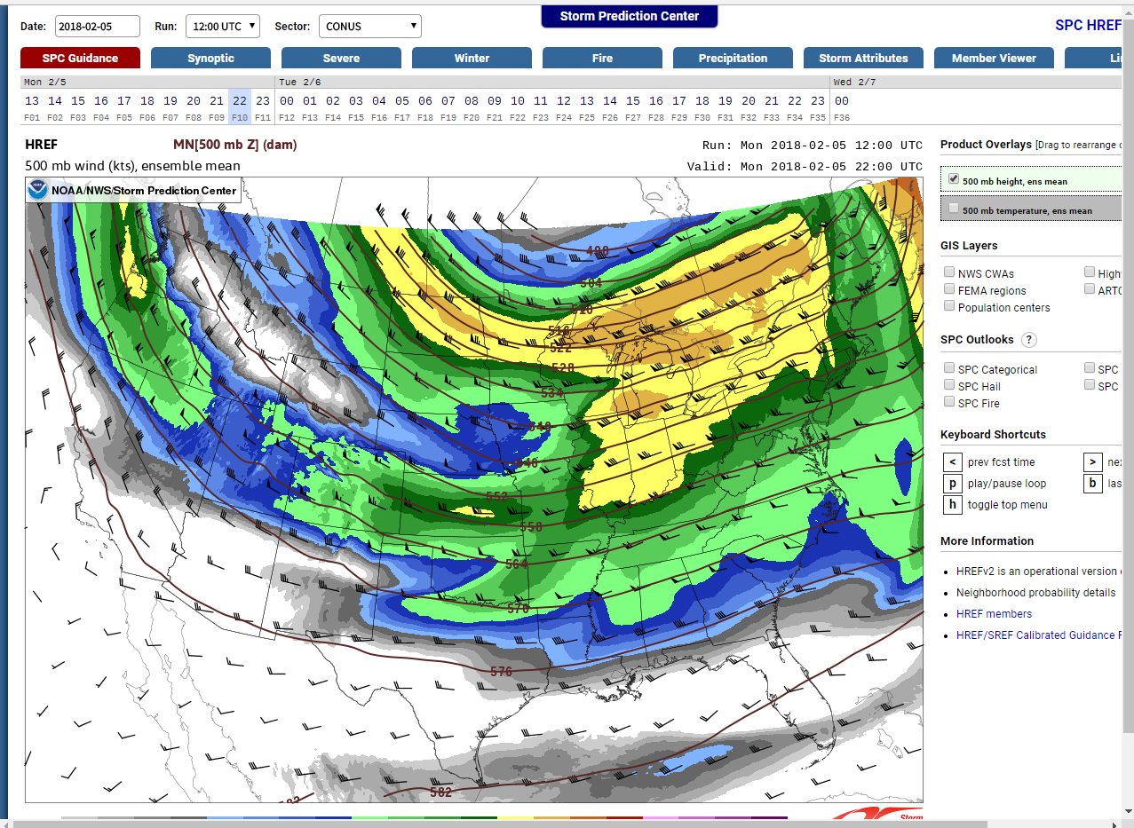
Similarities with existing tools
Key Functionality from current applications - Display Data by Valid Time
EDD, NDFD, WAVE, SPC Viewer, Snowfall Reports

Slide 23
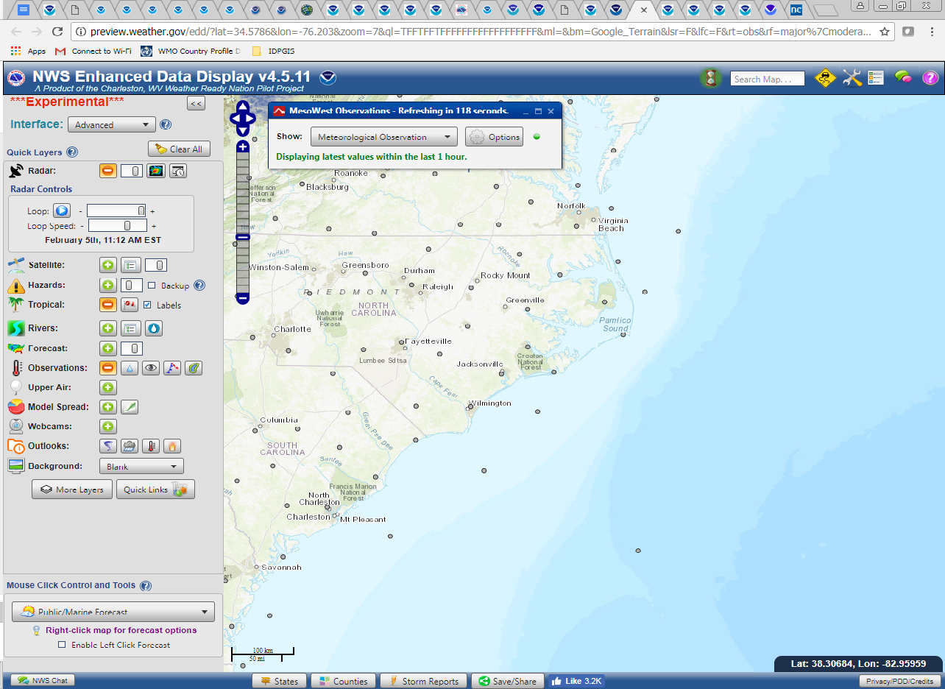
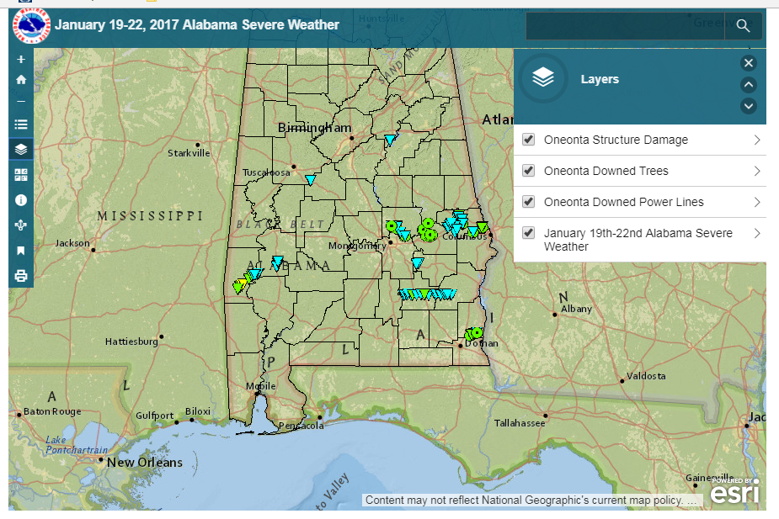
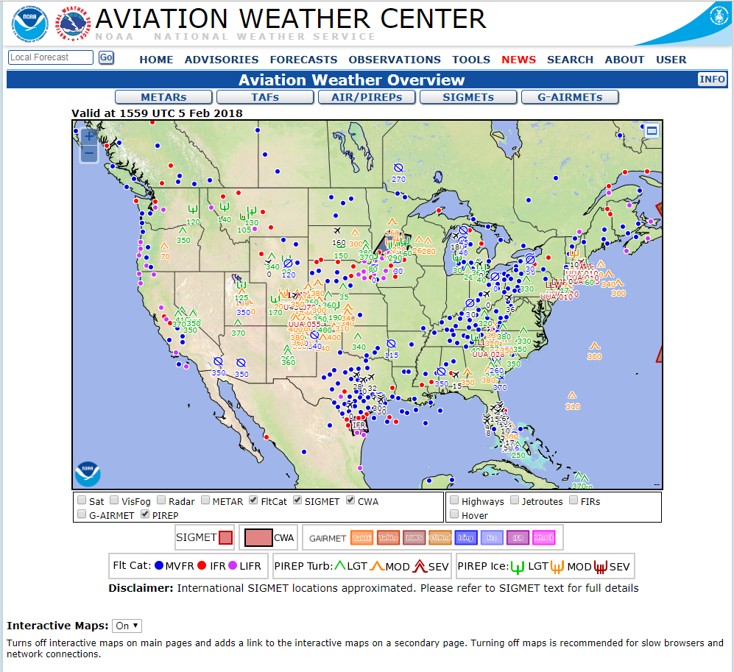
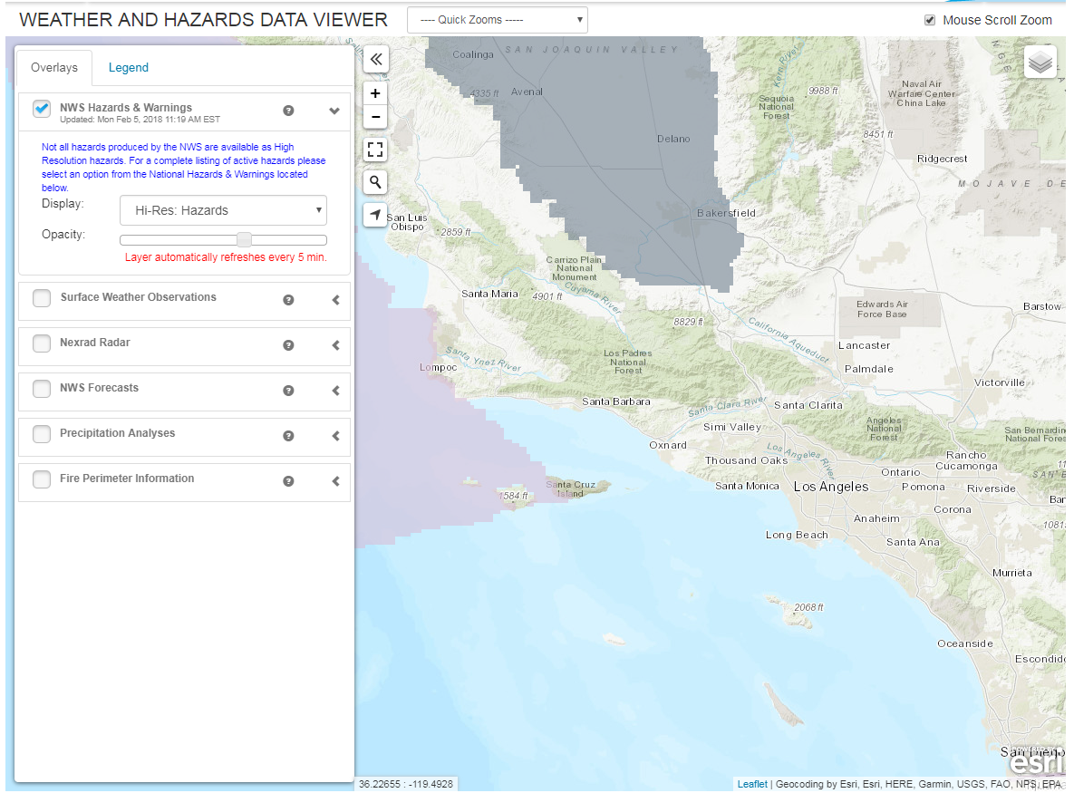
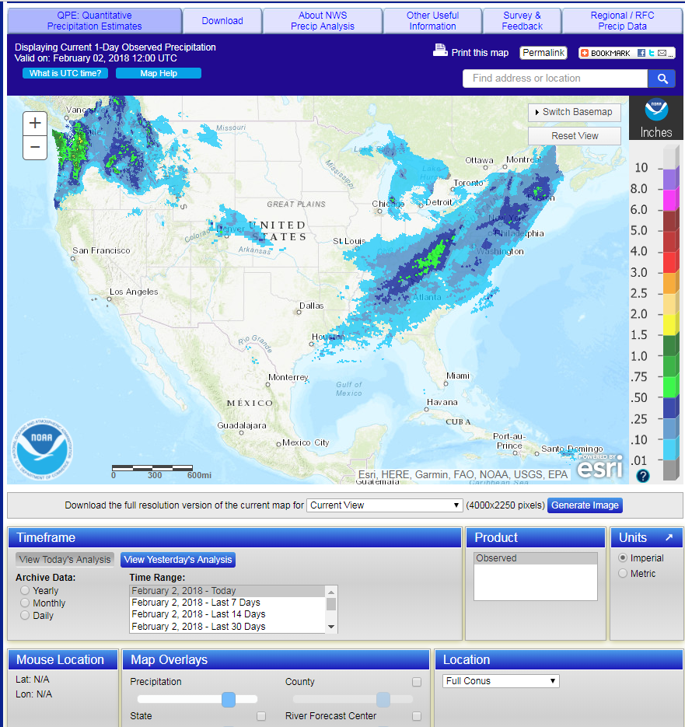
Similarities with existing tools
Key Functionality from current applications - Selectable, Concurrent Layers
EDD, Severe Weather Event Maps, SPC Viewer, Aviation Weather Overview, AHPS

Slide 24
BACKUP

Slide 25
Interested in participating in devleoping the NWS Enterprise GIS Viewer with 30% of your time over the next 18 months as part of the Development to Operations (D2O) Team?
Email Kari.sheets@noaa.gov and andrea.hardy@noaa.gov for more information.
Questions?

Slide 26
Benefits
The NWS benefits from an interactive web-based common map interface, such as the one being described in the following ways:
Consistency for IDSS mission and partners
Availability & Reliability
supported by NWS 24/7/365 operational teams
real-time data ingest ensures data updates as NWS releases new products
Experience
“Look & Feel” is similar between service areas and geographic regions of the NWS
Leverages, & when possible provides access to, NWS data in international geospatial data standards (Open Geospatial Consortium - OGC)
Flexible
Allows for tailoring of content to service areas and regions
Allows data being displayed (layers) to be selected “on-the-fly”
Consistency for NWS O&M staff
Common code and content form the “back-end” for “skins” customized for service areas = only 1 thing to maintain and monitor
Streamlines training (internal & external) since both the the front and back-end will be consistent web map experiences across the NWS

Slide 27
Success Criteria
Collaborative development for updates
NWS staff request & contribute functional updates rather than building something else to achieve their goals (less silos/”one-offs”)
Usage Statistics
Meet or exceed current usage of “silo” applications via Google web stats or other NWS web monitoring tools
User Feedback
Positive Feedback (including requests for additional functionality) will show that mission need is being met
Feedback from Weather Enterprise, other customers, and NWS staff

