Slide 1
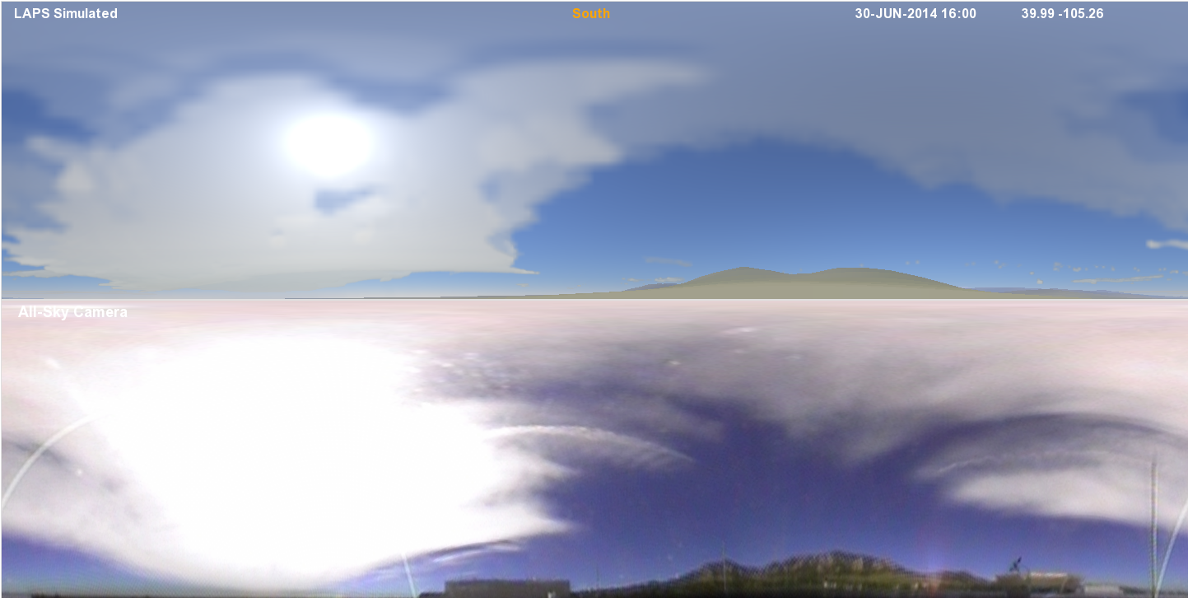

NOWCASTING WITH THE LOCAL ANALYSIS AND PREDICTION SYSTEM (LAPS)
Zoltan Toth,
Yuanfu Xie, Steve Albers¹, Hongli Jiang¹, and Craig Hartsough²
Global Systems Division
NOAA/OAR/ESRL
¹ CIRA at GSD
² CIRES at GSD
Acknowledgements:
Drs. Steve Koch &
Louis Uccellini
VLAB Seminar – 30 June, 2014 – 16:00 UTC CLOUD IMAGE
Notes:
Updated Jan 27 2056 UTC

Slide 2
OUTLINE / SUMMARY
LAPS history & user base
  1989 – 2011 – multi-pass Barnes analysis
  2012 – Multiscale variational approach
  Used operationally by 20+ US, private, international agencies
Qualities of LAPS
  Fidelity to reality (observations)
  Consistency between situational awareness & NWP analyses
  Nowcast (forecast) skill
  Speed – Low latency, high frequency, high resolution
Drivers for change in use of LAPS
  Need for more coordination, cloud computing, WRN
VLab path to Nowcasting with LAPS
  Monitoring
    2.5 km / 15-min frequency CONUS & OCONUS 2/3D analysis
  Nowcasting
    For high impact events – Relocatable domain
    1km/5-15 min freq. 3D analysis, 1hr freq. 3-6 hr WRF forecast
  Approach
    Run on IDP server; Test off-line, in Testbeds, OPG
    Engage with broader DA / user communities – LAPS Workshop, User Group

Slide 3
HISTORY OF LAPS
Wind analysis & radar remapping (V, Z) 1989
Cloud analysis / Hotstart 1991
  Major innovation – 150+ citations
T-LAPS - Terminal-LAPS at 40 ITWS/FAA sites 1992
  Major advancement
  5-min update at 2km, 20+ years ahead of national guidance
O-LAPS – System adapted at OU / CAPS 1990s
K-LAPS - Technology transfer to KMA 1990s
Cloud analysis / hot start elements in other systems 1995-2005
  ADAS, RUC, etc
LAPS operationally used at NWS WFOs (AWIPS) ~1995
New 2DVar surface analysis – multiscale STMAS 2004
NOAA Tech Transfer Awards 2005, 2008
Variational LAPS based on STMAS => AWIPS-ll 2013
Multiscale approach in hybrid GSI & other systems 2013 - 2014
Variational LAPS transitioned to FAA operations 2012 - 2015

Slide 4
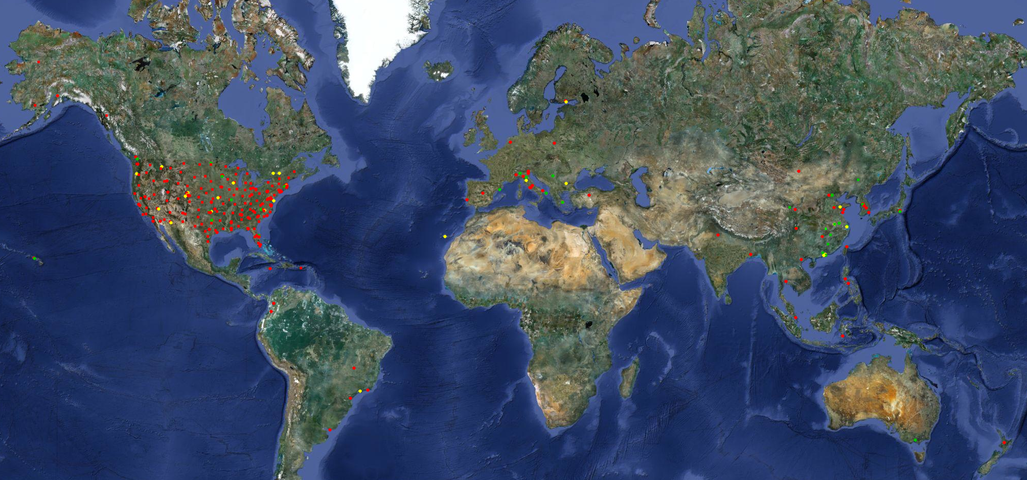
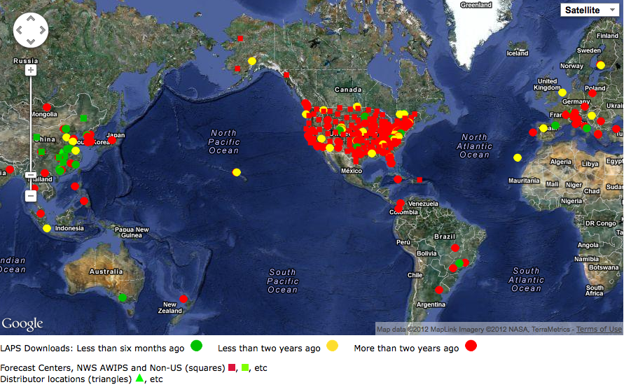
LAPS USER BASE
Courtesy Steve Albers
Private Sector
  Weather Decision Tech., Hydro Meteo,
  Precision Wind, Vaisala, Telvent
International agencies (10+ countries)
  KMA, CMA, CWB, Finland (FMI), Italy, Spain
  BoM (Australia), Canary Islands, HKO
  Greece, Serbia, Nanjing Inst. of Met.
NOAA
  ~120 WFOs (via AWIPS), ARL, NESDIS
Other US Agencies
  DHS, DoD, FAA, CA DWR, GA Air Qual.
Academia
  Univ of HI, Athens, Arizona, CIRA, UND, McGill

Slide 5
SOME KEY LAPS PARTNERS
Institute | Role | Contributions
IHR, CMA | LAPS POC in China | Satellite data, cloud analysis
FMI, Finland | LAPS POC in Europe | Cloud and Arctic apps
KMA | User, developer | Typhoon apps, parallelization, nowcasting
CMA and IUM | User, developer | MICAPS
Univ. Belgrade | User, developer | Dual-polarization radar
Vaisala US | User, developer | Lightning DA
NOAA ESRL | Central repository, main developer | Terrain following, cloud, parallelization, balance
NOAA WFOs | Principal users | Feedback on LAPS
CWB, Taiwan | User, developer | Typhoon, satellite data
FAA, US | User | Nowcasting
Toyota Racing | User, developer | Cloud analysis
Army Research Laboratory | User, developer | Nowcasting, balance

Slide 6
LAPS QUALITIES
Fidelity to reality (observations)
  Due to use of Laplacian (instead of recursive) filter
    Only gradients (not values) used from background near observations
Consistency between situational awareness & nowcasting tools
  Situational awareness analysis is used to initialize NWP nowcast/forecast model
    After scales / features not resolved by model filtered out
Nowcasting skill
  Due to fidelity to observations
    Significantly higher ETS for 0-3 hr reflectivity
Speed
  18-times faster than GSI
    Due to multi-scale formulation
    Low latency, high update frequency, high resolution

Slide 7
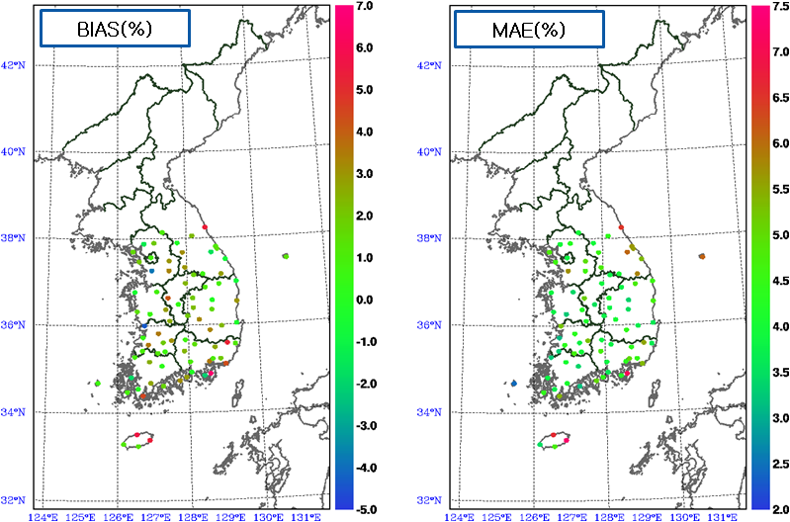
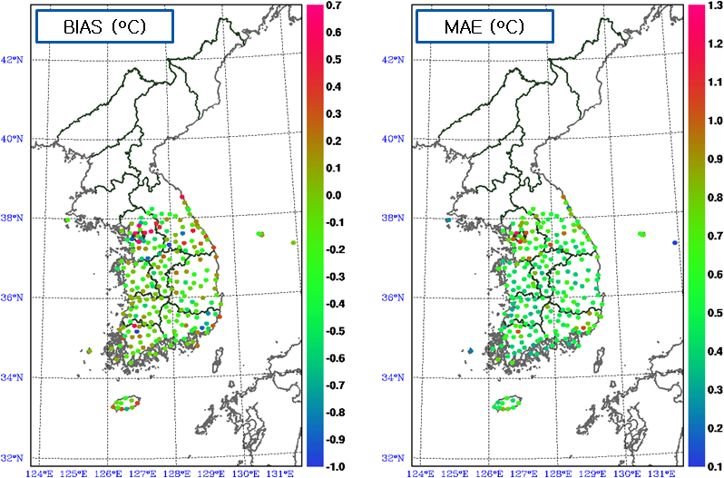
FIT TO INDEPENDENT OBSERVARIONS - KMA
2009.1.1 ∼ 12. 31 HOURLY ANALYSIS – 2 Million + INDEPENDENT OBSERVATIONS
2m RH
1.7%
4.4%
10m Wind Speed
0.2 m/s
2m Temp
-0.11 C
0.56 C
Courtesy YongHee Lee

Slide 8
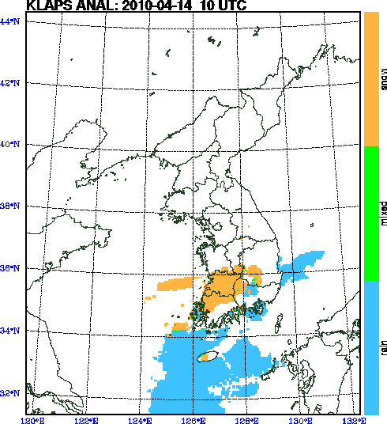
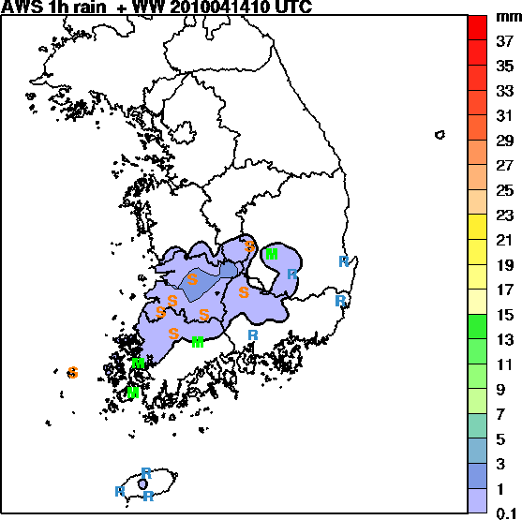
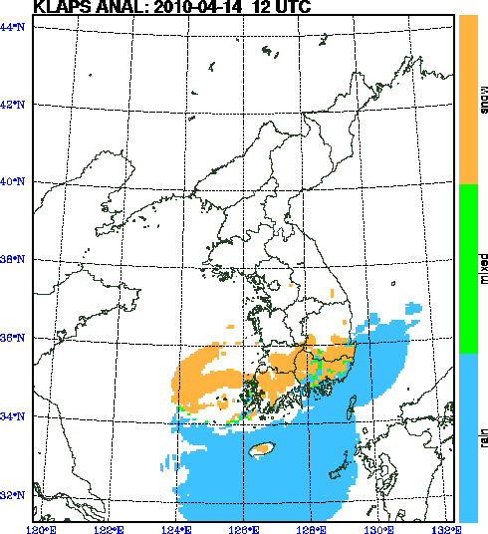
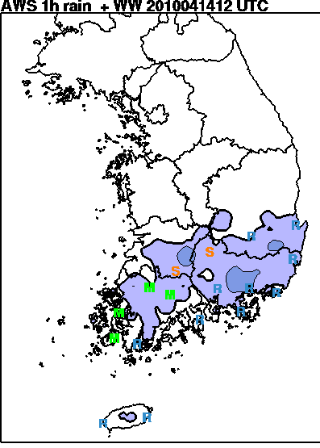
PRECIPITATION TYPE ANALYSIS - KMA
  Based on wet bulb temp & thicknesses
    Relationship tuned
  Analyzed precip type at 76 sites with independent obs
    Matches independent observations 90% of time
Courtesy YongHee Lee

Slide 9
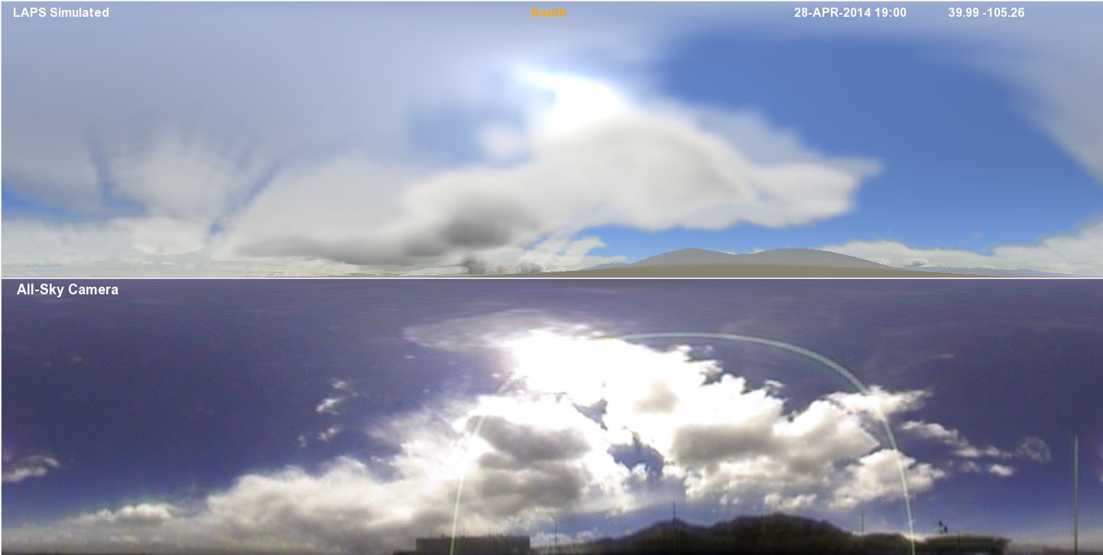
3D 1 km CLOUD ANALYSIS
Courtesy Steve Albers
Unique feature of LAPS, critical for WOF, Nextgen, etc
Clouds as seen from top of DSRC building in Boulder by LAPS ANALYSIS
ALLSKY CAMERA
19:00UTC Apr 28, 2014

Slide 10
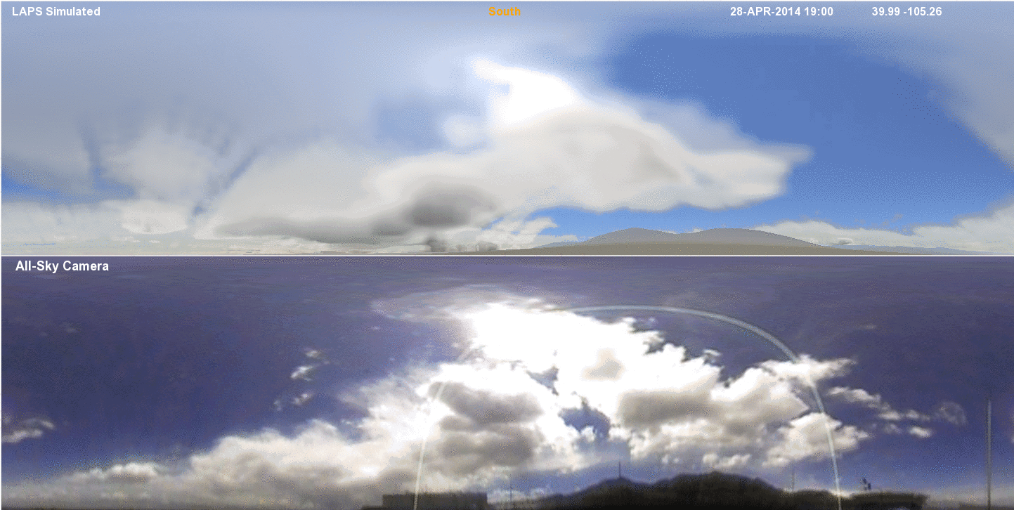
3D 1 km CLOUD ANALYSIS - LOOP
Courtesy Steve Albers
Unique feature of LAPS, critical for WOF, Nextgen, etc
Clouds as seen from top of DSRC building in Boulder by LAPS ANALYSIS
ALLSKY CAMERA
19:00-21:00 UTC Apr 28, 2014, 15-min frequency

Slide 11
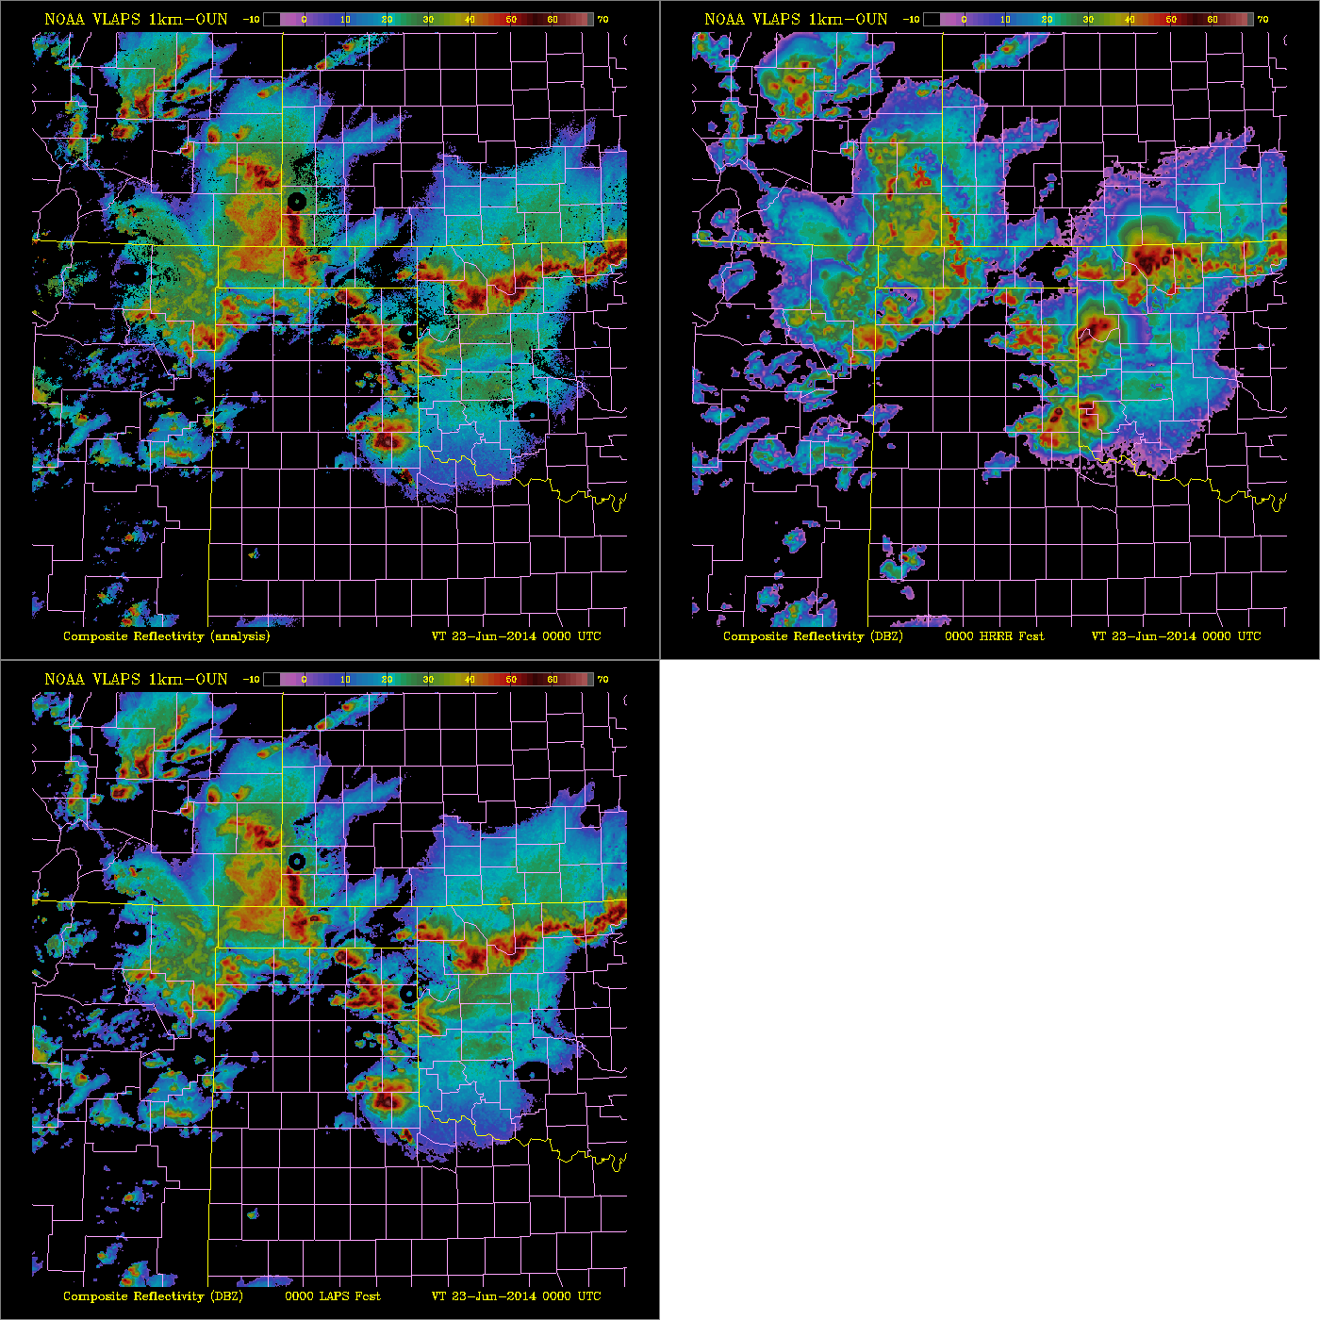
Reflectivity Initialization
RADAR MOSAIC
HRRR ANALYSIS
COMPARISON OF
LAPS RADAR MOSAIC WITH
LAPS & HRRR
COMPOSITE REFLECTIVITY ANALYSIS
0000 UTC, 23 June, 2014
LAPS ANALYSIS

Slide 12
CONSISTENCY BETWEEN MONITORING & NOWCASTING
High fidelity to reality for monitoring
  Capture all scales / phenomena resolved on grid
    2D LAPS analysis
    NDFD project making 2D & 3D LAPS analyses consistent
Initialize WRF ARW model w 3D LAPS analysis
  After filtering out scales/physics not resolved by WRF
Inconsistency between
  Initial model state & analysis used for monitoring
    May render numerical guidance for nowcasting suspect

Slide 13
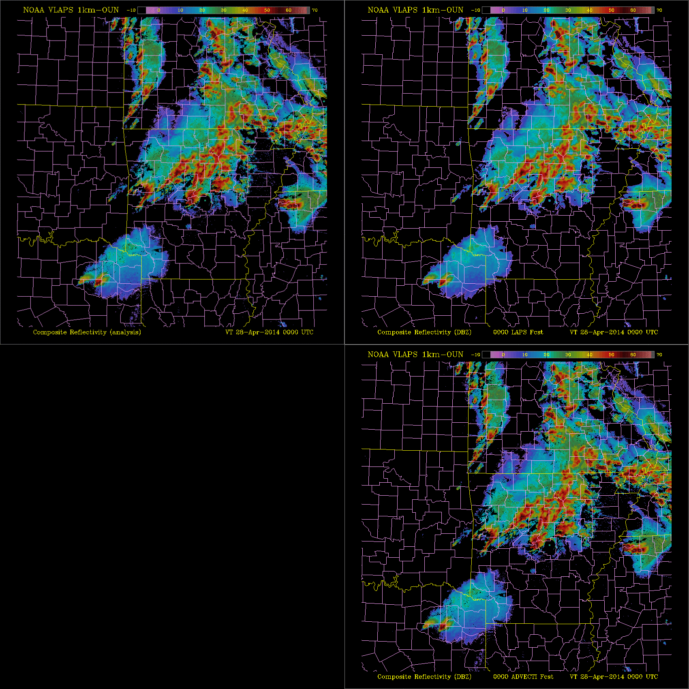

RADAR REFLECTIVITY FOR MAYFLOWER, AR TORNADO
00:00 – 03:00 UTC
April 28, 2014
15-min frequency loop
Radar Mosaic
LAPS-initialized WRF forecast
Touchdown at
00:34 UTC
28 April, 2014
HR-initialized WRF forecast
Advection-based nowcasting

Slide 14
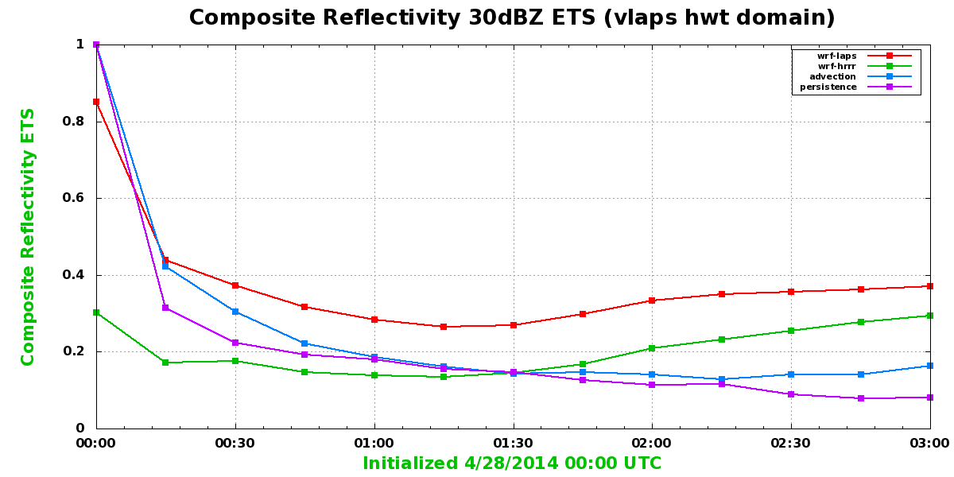
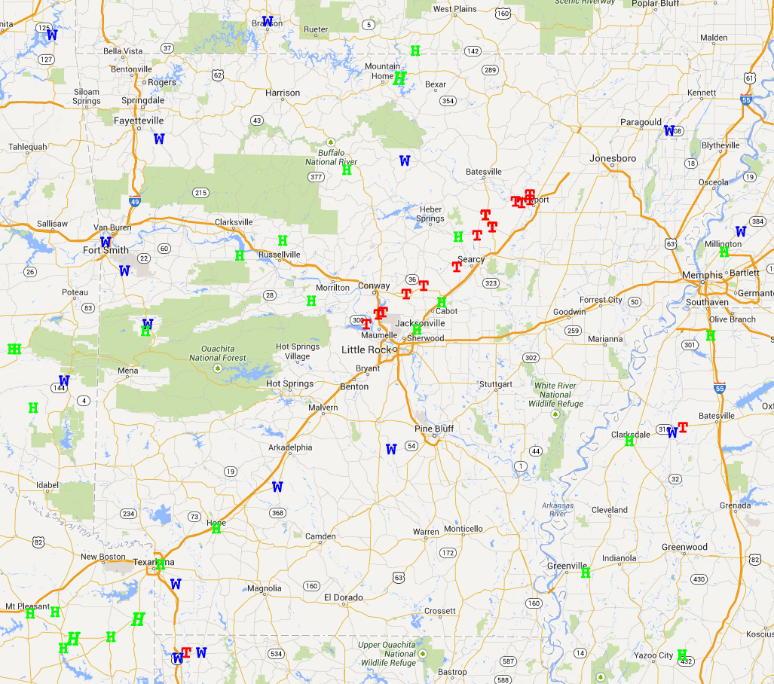
MAYFLOWER, AR TORNADO
Advection
LAPS
HR
Persistence
0.3-0.4 ETS score for LAPS Nowcasting
Ranking / scores consistent with 7-day mean results

Slide 15
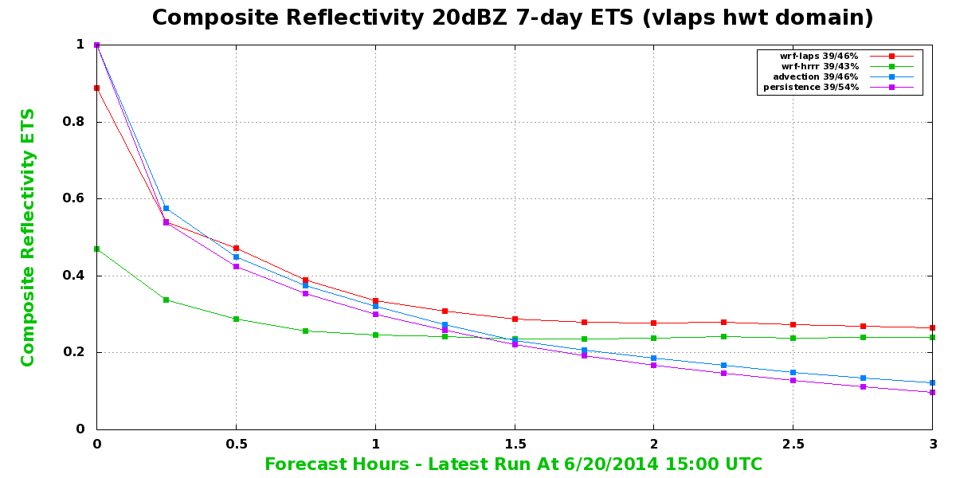
NOWCASTING SKILL

Slide 16
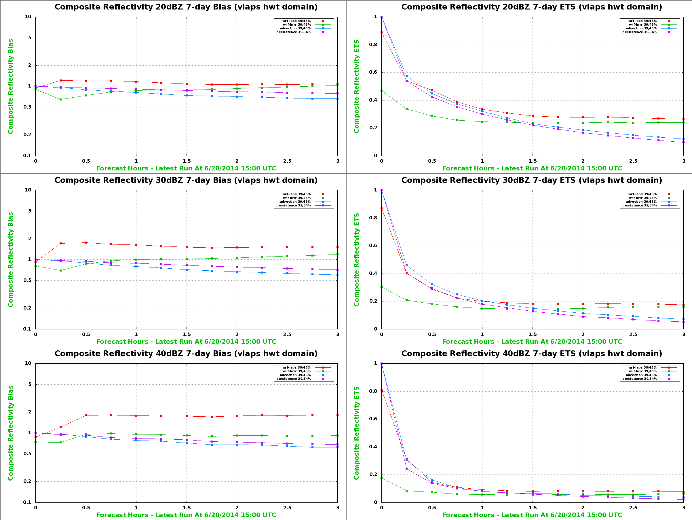
LAPS COMPARED TO GSI

Slide 17
LAPS COMPUTATIONAL EFFICIENCY
Comparison with GSI by T. Schlatter, LAPS vs RAP (uses GSI)
Configuration
  Observations - Comparable types / amount
  Resolution
    LAPS – 12 km, 41 levels
    RAP – 13 km, 50 levels
  Domain
    LAPS – CONUS
    RAP – North America (3.5 times larger
  Execution time
    LAPS – 4 min on single Zeus processor
    RAP – 5 mins on 64 Jet processors
Considering all these factors:
  LAPS is about 18 times more efficient computationally
    Due to use of multi-grid minimization algorithm

Slide 18
KEY FEATURES OF VARIATIONAL LAPS
FEATURE | METHOD | BENEFIT | SOURCE / REFERENCE
Variational Draws close to obs. | 3DVAR and future 4DVAR Laplacian filter | Balance, remote obs. Use for monitoring/nowc. | 3DVAR/4DVAR literature
Multiscale in space | Multigrid, Incorporate successively finer scales | Multiscale analysis | Briggs (2003), Xie et al. 2005, 2011. Li, et al 2008
Multiscale in time | Multigrid in time as well. Control variables at multiple time levels | 4-dimensional extension of 3dvar. Take advantage of temporal information | Xie et al 2011
Choice of control variables | U and V | Best use of obs, efficient and avoid boundary issue | Xie and MacDonald 2011
Preconditioning minimization of cost function | In observational terms | efficiency | VLAPS surface document for MIT LL
Diabetic initialization (“hot start”) | Dynamical, Physical & microphysical constraints | WoF, situation awareness and convective initiations | In progress
Nonlinear minimization | Nonlinear minimization algorithm and nonlinear 3-4 DVAR formulation | Without tangent linear, faster convergence and better minimizer | Fletcher R 1987, Xie and Byrd 1999
Thinning of observations | To nearest grid-points | Scale, terrain, & flow dependent; improved condition number | New version of surface LAPS
Object oriented design | Fortran 2003 | Maintenance, collaboration, and portability | BAMS in preparation

Slide 19
RECENT LAPS PUBLICATIONS
Cimini D., E. Campos, R. Ware, S. Albers, G. Giuliani, J. Oreamuno, P. Joe, S. Koch, S. Cober, E. R. Westwater 2011: Thermodynamic Atmospheric Profiling during the 2010 Winter Olympics Using Ground-based Microwave Radiometry, IEEE Trans. Geosci. Rem. Sens., accepted, DOI 10.1109/TGRS.2011.2154337.
Marquis, M., S. C. Albers and E. C. Weatherhead, 2011: For Better Integration, Improve the Forecast. Solar Today, 25, 52-53.
Xie, Y. F., and A. E. MacDonald, 2011: Selection of Momentum Variables for a Three-Dimensional Variational Analysis. Pure and Applied Geophysics, DOI 10.1007/s00024-011-0374-3.
Xie, Y. F., S. Koch, J. McGinley, S. Albers, P. Beringer, M. Wolfson, and M. Chan, 2011: A Space-Time Multiscale Analysis System: A Sequential Variational Analysis Approach. Monthly Weather Review, 139, 1224-1240.
Toth, Z., S. Albers, Y. Xie, 2012: Analysis of finescale weather phenomena. Bull. Amer. Meteor. Soc., 93 (3), ES35–ES38, doi:10.1175/BAMS-D-11-00148.1
Toth, Z., M. Tew, D. Birkenheuer, S. Albers, Y. Xie, and B. Motta. 2013: Multi-scale data assimilation and forecasting. BAMS, Multiscale Data Assimilation and Forecasting. Bull. Amer. Meteor. Soc., 95, ES30–ES33.
Jiang, H., S. Albers, Y. Xie, I. Jankov, Z. Toth, M. Scotten, J. Picca, G. Stumpf, D. Kingfield, D. Birkenheuer, and Brian Motta, 2014: Real-time Applications of the Variational Version of the Local Analysis and Prediction System (LAPS). BAMS, under review.
Xie, Y., S. Albers, H. Jiang, and Z Toth, 2014: A New Variational Version of the Local Analysis and Prediction System (LAPS). Draft, available upon request.
Toth, Z., Y. Xie and co-authors: Community Data Assimilation Development. Draft, available upon request.

Slide 20
USE OF LAPS IN NWS
AWIPS Operational Requirements (2009)
  3D LAPS analysis needed “to properly assimilate an increasing number of data sources into [the forecasters’] decision making process”
  Single 3/4D gridded data
    Synthesis of all observational information
    From which all products can be derived
WFO application areas - NWS LAPS survey & AWIPS requirements
  Monitoring
    Severe weather & convective potential
    Pre-storm & near-storm environments - 3D thermodynamic & kinematic analysis
    Frontal / wind / synoptic forcing analysis
    Winter weather / melting layer / mixed precipitation
    Ongoing monitoring of current conditions
    Moisture / temperature analysis / trends
    Aviation forecasting – low level windshear
    Coastal forecasting – intrusion of marine layers
  “Local high resolution model initialization” – Nowcasting
    LAPS GUI does not support this in AWIPS

Slide 21
DEFAULT LAPS CONFIGURATIONS ON AWIPS
2009
  10 km, 1-hr frequency WFO domain 3D analysis
  Schedule driven
  Serves single WFO
  Runs on AWIPS
2014
  2.5km, 1-hr (?) frequency WFO domain 3D analysis
  Schedule driven
  Serves single WFO
  Runs on AWIPS-ll
Future configuration – How should we design?

Slide 22
DRIVERS FOR CHANGE IN NWS USE OF LAPS
Desire for more coordinated forecast process
  WFOs work together to cover evolving high impact events
  Close LAPS user – developer loop
Government directive to reduce # of data centers
  Servers or “thin clients” at WFOs?
Cloud computing
  Reassess where LAPS & AWIPS runs
    Local machine or central / cloud facility?
Weather Ready Nation (WRN)
  Digital guidance needed for decision making support

Slide 23
PROPOSED CONFIGURATION FOR
LAPS ANALYSIS & NOWCASTING (LAN)
Analysis for monitoring
  2.5 km, 15-min frequency CONUS 3D analysis
  Schedule driven
  Serves all WFOs – Coordination made easier
Nowcasting
  On demand, for selected high impact events
  Serves group of WFOs coordinating event response
    1km 15-min freq., relocatable domain 3D analysis
    1km 1-hr freq. 6-hr forecast
Platform
  Run on NWS central IDP servers
    Space, data access, cpu, etc offered for testing

Slide 24
“LOCAL” IN LAPS
NWP strongly constrained by CPU
  Must sacrifice resolution on global / CONUS scales
  Can run more sophisticated applications regionally
LAPS example
  ~20-year advantage over high impact areas
    2 km local guidance in 1994
      Terminal LAPS (T-LAPS – ITWS) for FAA
    3km CONUS guidance in 2014?
      HR implementation scheduled at NCEP
Need for finer resolutions never goes away
  Do not wait until global / CONUS solution possible
  Run finer resolution regional applications for
    Tornadoes (WoF), flash flood, urban events, etc

Slide 25
LAPS ANALYSIS & NOWCASTING (LAN)
Forecasters’ role
  Analysis
    Local (WFO) QC of obs. for CONUS analysis
  Nowcasting
    Groups of WFOs / NCEP Service Centers
      Request application
      Define regional domain
      Define non-default setup
Can serve needs of other agencies - consistency
  FAA – Nowcasting for CIWS (with MIT Lincoln Lab)
  USAF – Range Standardization and Automation
  SF Public Utility Commission, SF Bay Area Consortium

Slide 26
NWS R2O
NOAA and
Other Federal
R&D
NWS
Field
Innovation
Private Sector and Universities
NWS Operations
GSD
R&D Sources
FDSE, AWIPS
R2O Infrastructure
Vaisala, intl partners, etc
After Stephan Smith

Slide 27
KEY PARTNERSHIPS
MRMS
  N-LAPS to use extensive radar QC etc from MRMS
  MRMS to use microphysics analysis, precip over orography, & radar – gage relationships from LAPS
FACETS
  Role of LAN in end-to-end probabilistic warning
    Gridded probabilistic warning guidance
SOOs from WFOs and Service Centers
  Contribute to design / development / testing
    FDSE – Boise, Boulder; GOES-R 1-min scans, NUCAPS soundings, etc
Training Division
  Link with WRF Environmental Modeling System (EMS)
    WRF model for WFO use
      Bob Rozumalski et al

Slide 28
Analysis
LAPS
Nowcasting
After Lans Rothfusz

Slide 29
WHAT DISTINGUISHES DATA ASSIMILATION SCHEMES?
Scientific aspects
  Collection of methods based on 10-20 choices
    Variational or ensemble filter, interpolation, minimization algorithm, QC, etc
  Assembled to accomplish objectives in targeted appls.
Software engineering realization
  Process oriented design
    Traditional, “hardwired” approach for particular application
    Hard to modify / generalize
  Object oriented design
    Best suited for
      Wide range of applications
      Distributed development

Slide 30
COMMUNITY DEVELOPMENT
Mature US data assimilation systems
  GSI, WRFDA, LAPS, DART, NAVDAS, etc – in their separate repositories
    Only ideas exchanged – independent software development
    Algorithms must be recoded & retested
      Waste of national resources
Concept of Community Data Assimilation Repository (CDAR)
  Agree upon use of Object Oriented Software Design principles (OOSD)
  Share DA techniques with community
    Techniques from GSI, LAPS, etc available for direct use
      Developers exchange software – Accelerated advances in DA
      Users configure their DA according to their needs
        Improved DA applications
    Concept paper ready for community review (BAMS)
Operational Centers
  Configure and test subsets of CDAR to meet their needs for various applications
    Benefit from faster development and range of techniques
  National leveraging
    Links with JCSDA, ESMF, NUOPC, DTC - Integrated development
Gradual adoption of OOSD
  Newly developed methods adhere to OOSD
    Other elements made compliant when changes required

Slide 31
COMMUNITY DATA ASSIMILATION REPOSITORY (CDAR)
CDAR
C
B
B
C
C
B
C
D
A
A
E
A
B
A
SYSTEM 3
SYSTEM 4
A
C
B
E
B
E
D
A
C
D
GSI
LAPS

Slide 32
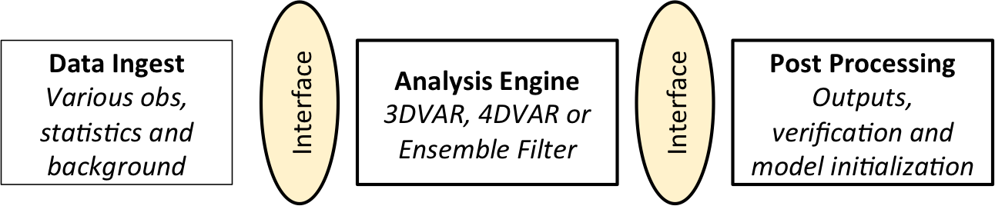
DA - OBJECT ORIENTED DESIGN

Slide 33
IDP
Web
Farm
AWIPS
WCOSS
TRL 9
  LAPS in Central Development
  & Testing Environment –
  climbing the “pyramid”
  via VLab
Operational
Testing Environments
TRL 8
VLab Centralized Development/Prototyping and Testing Environments (CDTE)
VLab Communities, Code Repositories, Project and Software Management Tools
TRL 3
VLab Project Repository
Partner Agency Projects
NOAA Projects
CSTAR Projects
NWS HQ Projects
NWS Field Projects
NCEP Projects
UCAR Projects

Slide 34
FIRST / NEXT STEPS
LAPS project started in vLab
  LAPS repository established (under GIT)
  vLab seminar on LAPS Nowcasting
  Distributed development
Close user – developer loop
  3rd LAPS User Workshop – October 21-23, 2014
  Form LAPS User Group to steer process
  Links with MRMS, FACETS, etc
Test of concept
  LAPS Analysis / Nowcasting on IDP central servers
    2.5km 15-min frequency 2/3D CONUS analysis
    1km 15-min freq. 3D analysis & 1-hr freq 3-6 hr forecast
      On demand relocatable domain for high impact events
NOAA Testbeds
  Testing / development in
    HWT, HMT – Flash Flood / Winter Weather, AWT
Operational Proving Ground
  End-to-end evaluation

Slide 35
NOWCASTING VISION
Build on existing capabilities
  LAPS 3D analysis, WRF ARW, MRMS
Pathfinding approach – What can we do today?
  Plan in context of FACETS
  Work with partners on concept / operations
    Serve needs of field to respond to high impact events
      Fire weather, severe weather, incident response, etc
    On demand, flexible, quick response
      Observationally driven analysis for monitoring
      Forecast consistent w analysis for nowcasting
  LAPS designed & developed to fill these needs

Slide 36
CONCLUSIONS
Objective
  Best nowcasting system attainable now for WRN
    Will use whatever techniques provide desired features / best metrics
Community effort
  We engage in VLab
  Invite others to join
    Inclusive effort – LAPS & broader community
Readiness
  Necessary tools are there today
  Use what’s available now – Improve later

Slide 37
OUTLINE / SUMMARY
LAPS history & user base
  1989 – 2011 – multi-pass Barnes analysis
  2012 – Multiscale variational approach
  Used operationally by 20+ US, private, international agencies
Qualities of LAPS
  Fidelity to reality (observations)
  Consistency between situational awareness & NWP analyses
  Nowcast (forecast) skill
  Speed – Low latency, high frequency, high resolution
Drivers for change in use of LAPS
  Need for more coordination, cloud computing, WRN
VLab path to Nowcasting with LAPS
  Monitoring
    2.5 km / 15-min frequency CONUS & OCONUS 2/3D analysis
  Nowcasting
    For high impact events – Relocatable domain
    1km/5-15 min freq. 3D analysis, 1hr freq. 3-6 hr WRF forecast
  Approach
    Run on IDP server; Test off-line, in Testbeds, OPG
    Engage with broader DA / user communities – LAPS Workshop, User Group

Slide 38
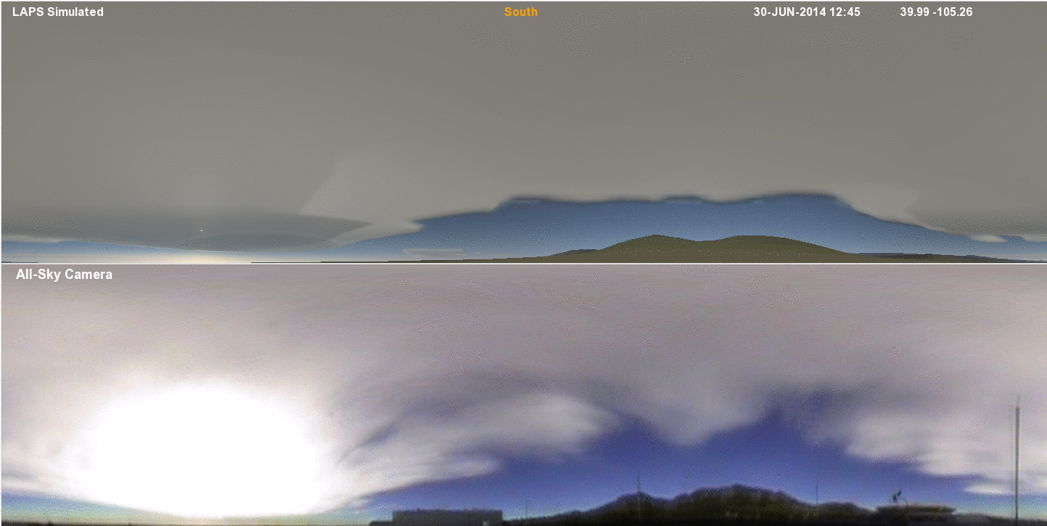
3D 500 m CLOUD ANALYSIS - LOOP
Courtesy Steve Albers
Unique feature of LAPS, critical for WOF, Nextgen, etc
Clouds as seen from top of DSRC building in Boulder by LAPS ANALYSIS
ALLSKY CAMERA
12:45-16:00 UTC June 30, 2014, 15-min frequency

Slide 39
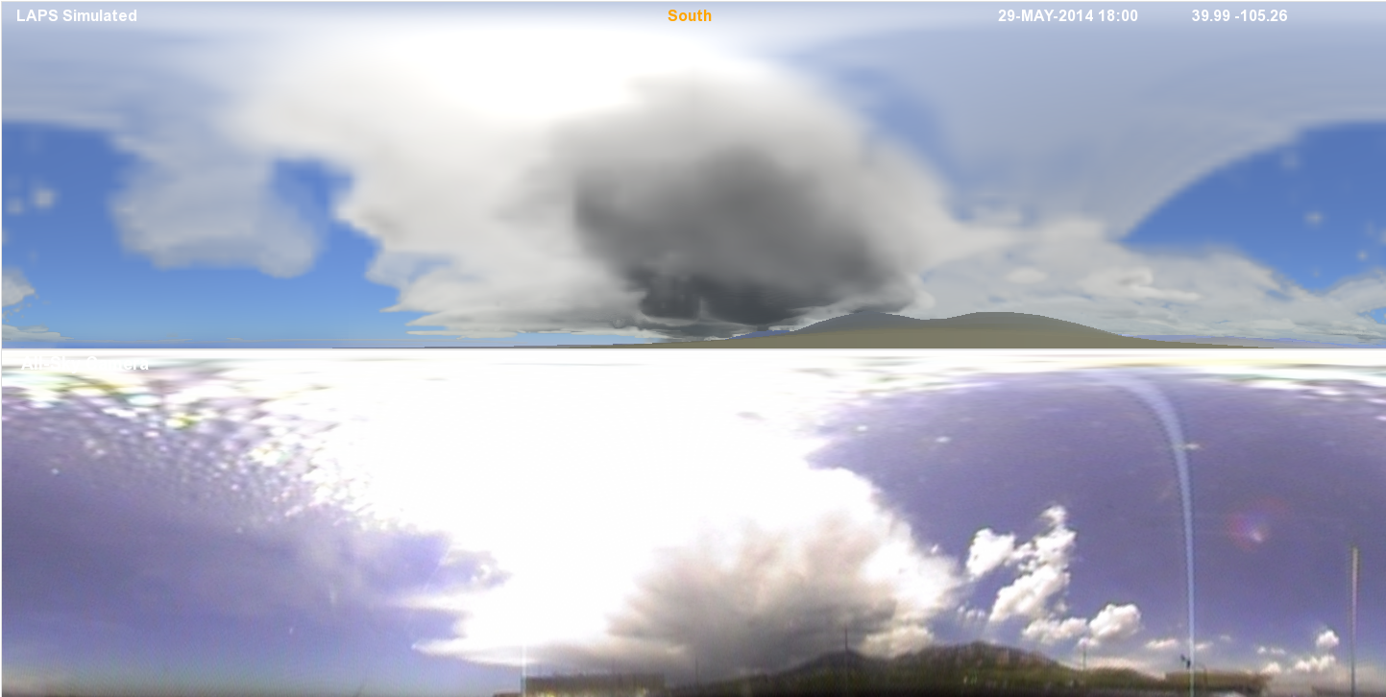
3D 500 m CLOUD ANALYSIS
Courtesy Steve Albers
Unique feature of LAPS, critical for WOF, Nextgen, etc
Clouds as seen from top of DSRC building in Boulder by LAPS ANALYSIS
ALLSKY CAMERA
18:00UTC May 29, 2014

Slide 40
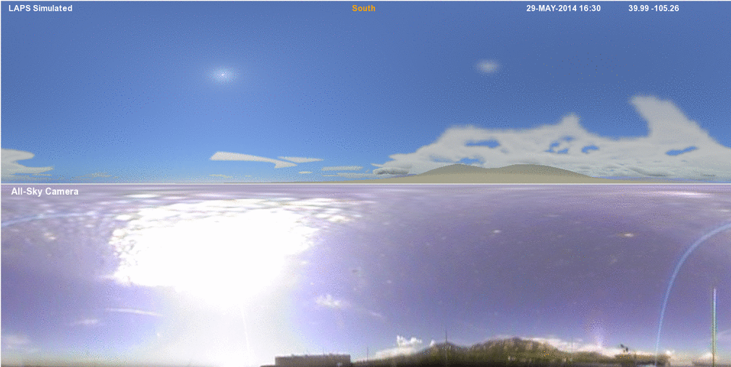
3D 500 m CLOUD ANALYSIS - LOOP
Courtesy Steve Albers
Unique feature of LAPS, critical for WOF, Nextgen, etc
Clouds as seen from top of DSRC building in Boulder by LAPS ANALYSIS
ALLSKY CAMERA
16:30-19:45 UTC May 29, 2014, 15-min frequency

Slide 41
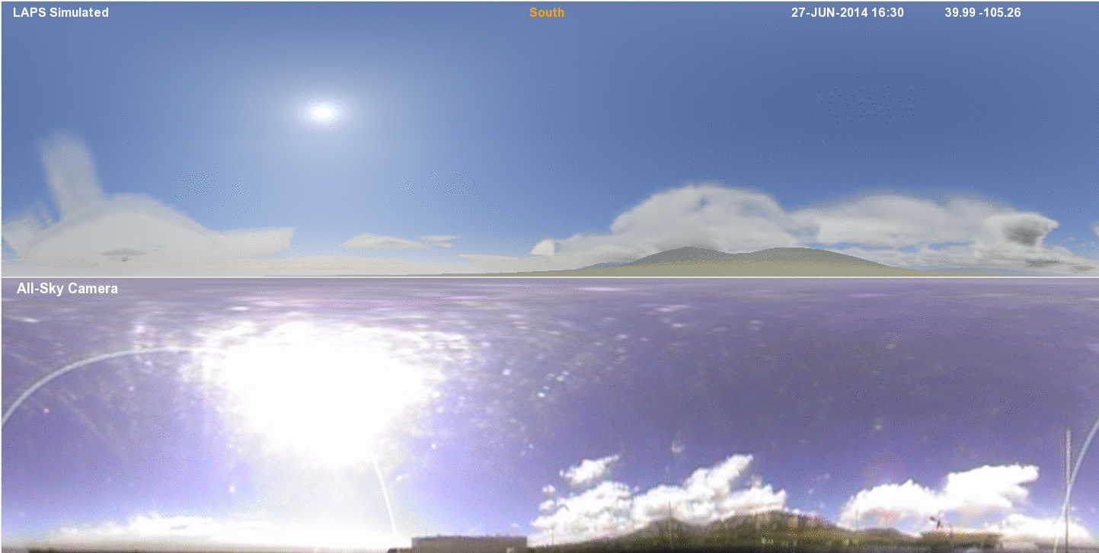
3D 500 m CLOUD ANALYSIS - LOOP
Courtesy Steve Albers
Unique feature of LAPS, critical for WOF, Nextgen, etc
Clouds as seen from top of DSRC building in Boulder by LAPS ANALYSIS
ALLSKY CAMERA
16:30-18:45 UTC June 27, 2014, 15-min frequency

Slide 42
BACKGROUND

Slide 43
GSD DA TECHNIQUES
RUC (1994) – RAP (2013) – HRRR (2014?)
  CONUS scale applications, 60 / 13 / 3 km, 15 hrs & beyond
    NCEP operations
  GSI-hybrid, radar etc data added to GSI-hybrid, DFI for imposing balance
LAPS (early 1990s)
  Local / regional applications, 2/1/0.5 km, 0-3 hrs, nowcasting
    NWS WFO operations
  Multiscale variational approach
GSD internal assessment (Schlatter 2013)
  Value in both approaches
    Continue both development path
    DTC should distribute LAPS
Global cloud analysis
  LAPS & HRRR groups work together on 4DVar approach
    For initialization of NIM, MPAS, NMMb

Slide 44
4DVAR CLOUD ANALYSIS

Slide 45
MULTISCALE DATA ASSIMILATION
Scales of phenomena to capture
  Planetary, synoptic, sub-synoptic, meso, convective
    Factor of ~1000
Localized observations
  Reflect motions on all (multiple) scales
DA challenge
  How to extract observational info on multiple scales?
    How to spatially spread observational info?

Slide 46
Multigrid Approach
Long waves
Short waves
Solve a sequence of 3-4DVARs with proper balance constraints
A Space–Time Multiscale Analysis System: A Sequential Variational Analysis Approach. Xie, et al., 2011 MWR
Hayden, and Purser, 1995: J. Appl. Meteor. also shows a 3DVAR is equivalent to one LAPS pass.
Ackn.: Koch & Uccellini

Slide 47
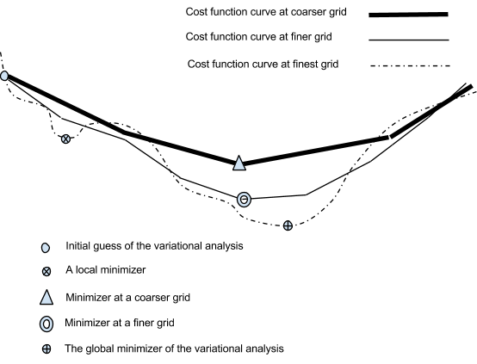
SINGLE VS MULTI - SCALE MINIMIZATION
Background
Multi-scale approach:
More accurate estimate of minimum
Order(s) of magnitudes faster
Minimum after
LONG
+ MEDIUM
+ SHORT
scale iteration
Minimum with single scale approach –
Not well posed problem

Slide 48
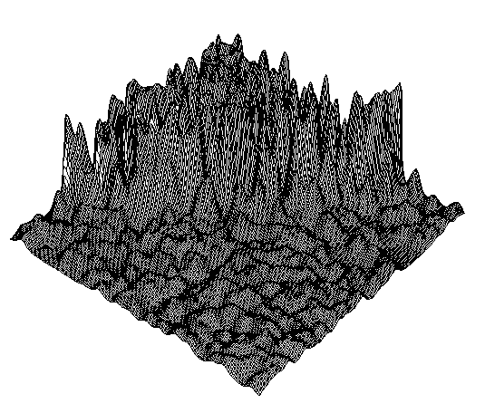
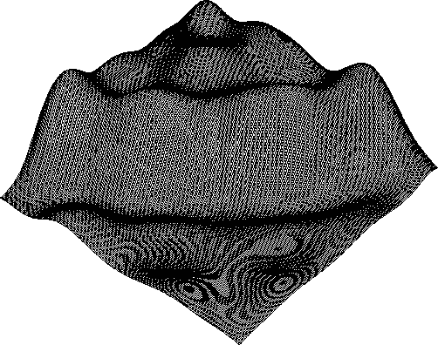
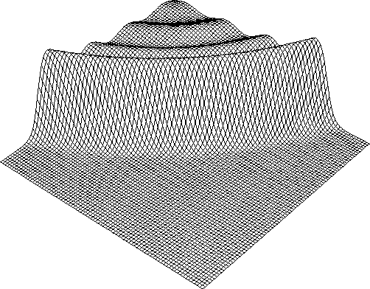
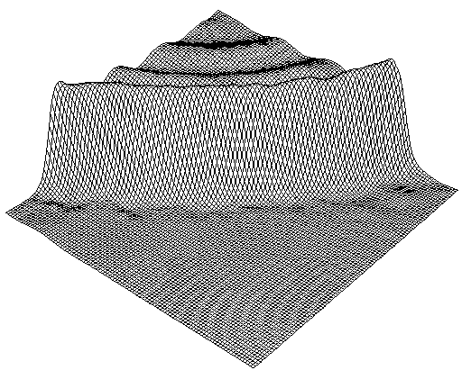
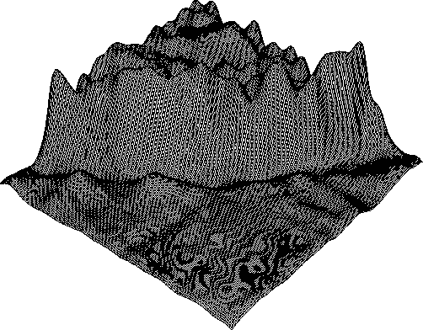
OSSE EXPERIMENTS
DENSE OBSERVATIONAL NETWORK
3DVAR with
short-scale
correlations
3DVAR with
long-scale
correlations
Truth
vLAPS
3DVAR with medium-scale correlations
Multiscale
approach - Both
large & fine scales captured

Slide 49
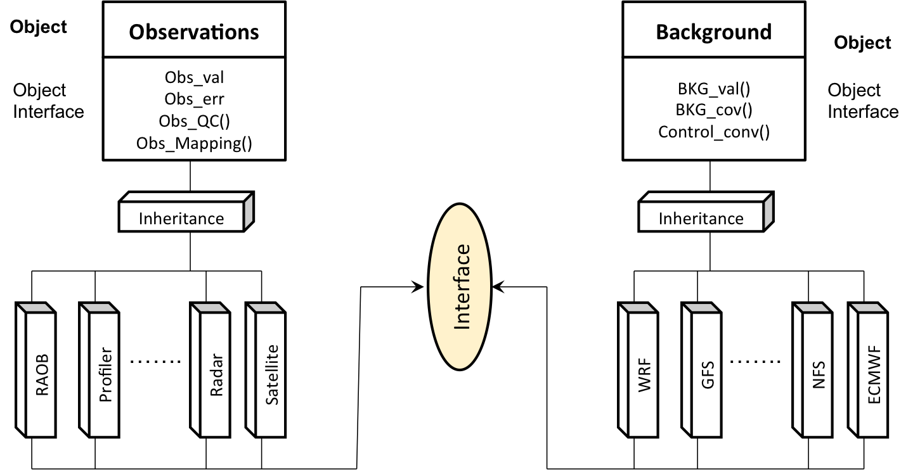
DA – DATA INGEST

Slide 50
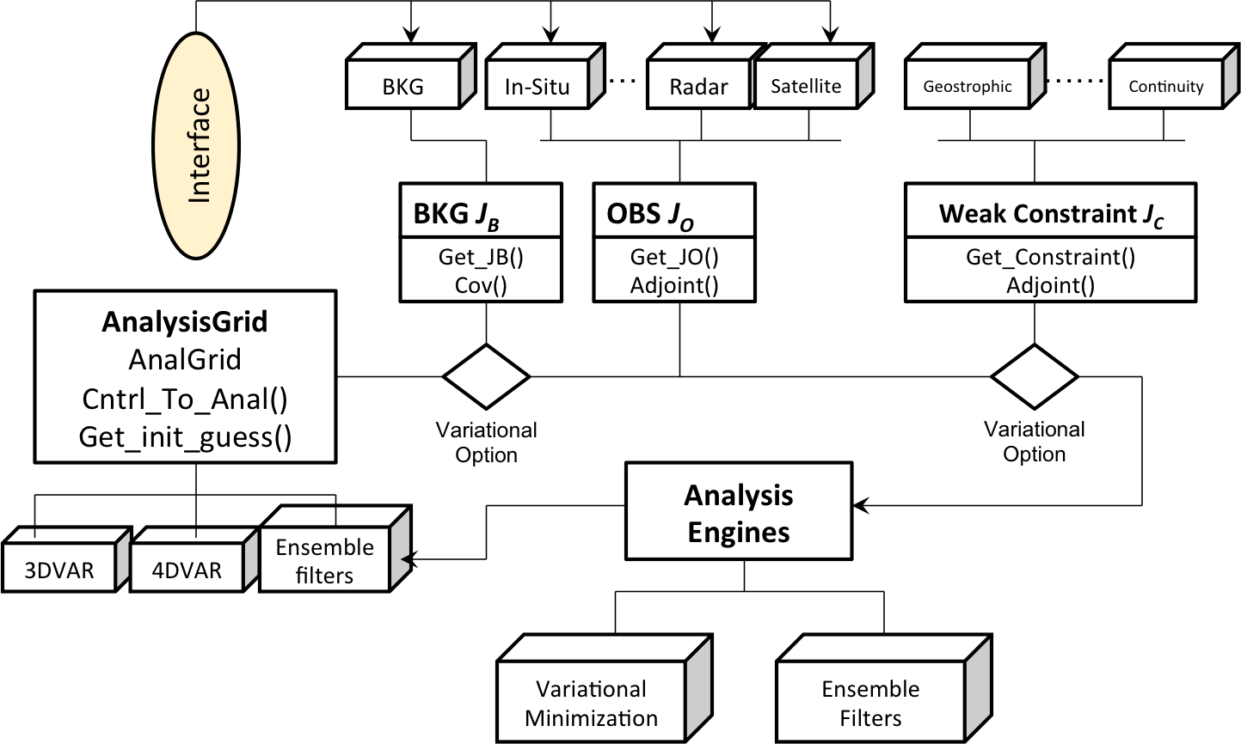
DA ENGINE

Slide 51
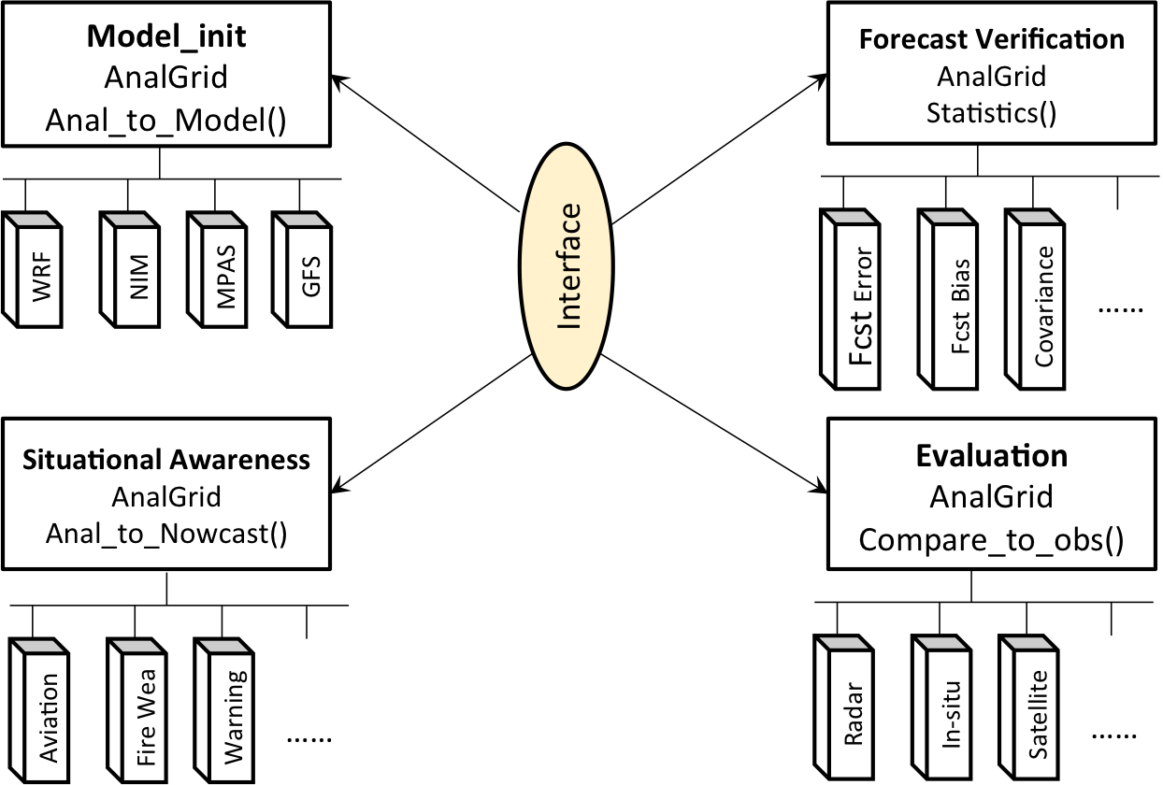
DA – POST-PROCESSING

Slide 52
LAPS BACKGROUND
“Traditional LAPS”
  Multiscale Barnes analysis used 1989-2012
I joined GSD in 2009
  Caretaker, not inventor
  Saw value, great scientists, dedicated group
Renewal of LAPS
  Reconnect with community
    2 LAPS User Workshops (2010, 2012)
    Active partnership with KMA, CMA, CWB, FMI, etc
  Upgrade with state-of-the-art techniques
    Variational multiscale approach based on STMAS (Xie et al) – “variational LAPS”

Slide 53
LAPS IN AWIPS-ll – FY13 COMPLETED TASKS
Ongoing support of LAPS in AWIPS II; Annual delivery of upgraded code to NWS
Direct data ingest from the EDEX database to remove reliance on AWIPS-I data space & capture more data
Datasets modified were:
METAR data
Background forecast
Maritime data
Aircraft Observations
Profiler data
ACARS data
RAOB data
Basic LAPS GUI and short user guide to allow forecasters to:
Determine which observations were used by the analyses
Re-define the LAPS analysis domain, including:
Center latitude and longitude of the LAPS grid
Grid resolution (in km)
Number of gridpoints
Delivery of LAPS, including reading data from EDEX database, and LAPS GUI is targeted for build 14.4.1 in July 2014.

Slide 54
LAPS IN AWIPS-ll – FY14 ONGOING TASKS
Ongoing support of LAPS in AWIPS II; Annual delivery of upgraded code to NWS
Ingest satellite data directly from the EDEX database to remove reliance on AWIPS-I data space (ongoing).
Pull metadata for background models directly from EDEX database –
    This will allow ingestion of higher resolution background forecasts (ongoing)
Other tasks (priority / scope being finalized):
Direct ingest of radar data from the EDEX database – more data vertically
Further enhancements to LAPS GUI as requested by AWIPS-II users

Slide 55
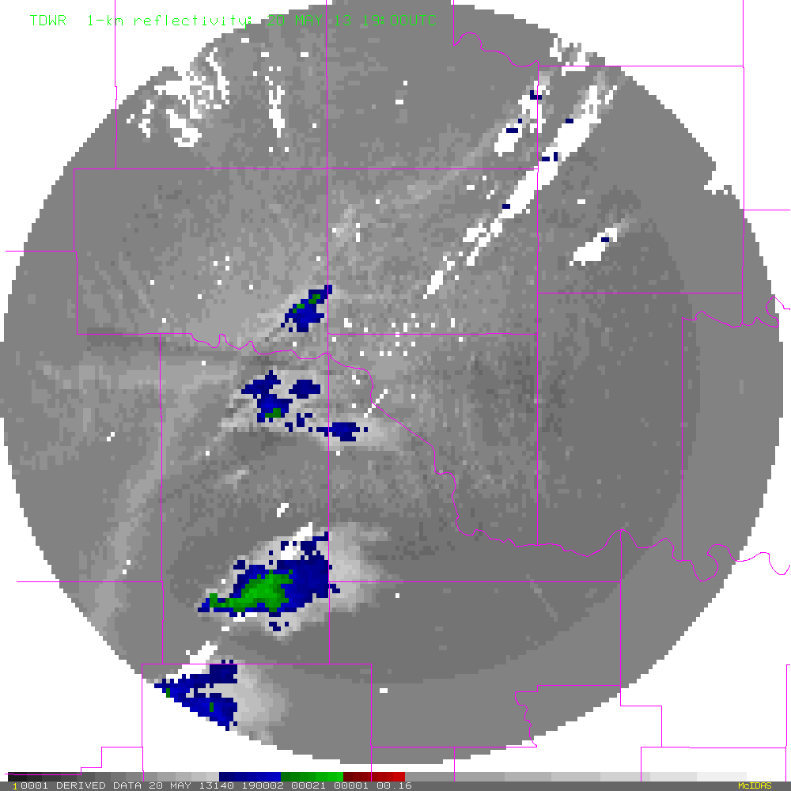
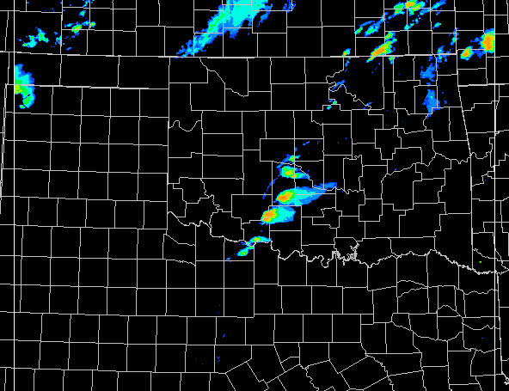
vLAPS 1-km Forecast for Moore Tornado
vLAPS 2 h forecast initialized at 1900 UTC, 5 min intervals
Touch down at 19:56 UTC, dissipated around 20:35 UTC
TDWR LAPS Composite Reflectivity forecast
(B. Rabin)

Slide 56
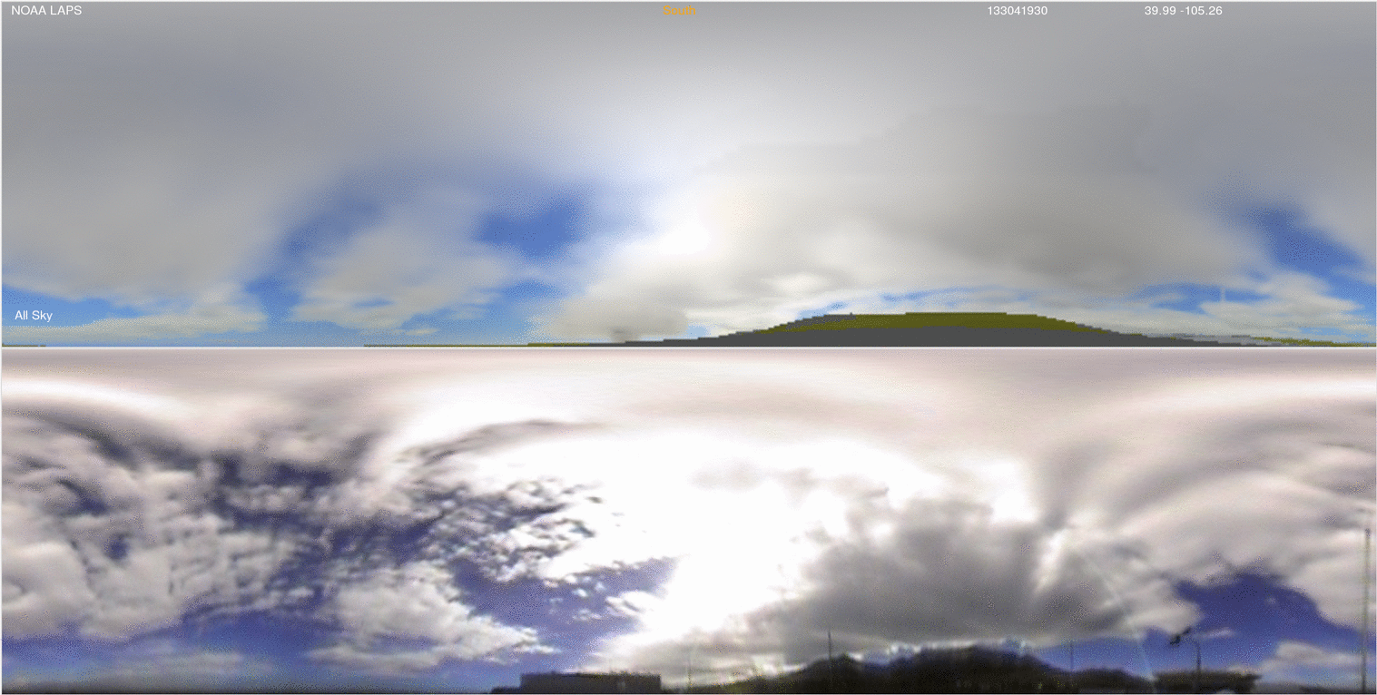
3D 1 km CLOUD ANALYSIS LOOP
Courtesy Steve Albers
Unique feature of LAPS, critical for WOF, Nextgen, etc
Clouds as seen from top of DSRC building in Boulder by LAPS ANALYSIS
19:30-21:15 UTC Oct 31, 2013, 15-min frequency
ALLSKY CAMERA

Slide 57

WINDSOR, CO TORNADO SIMULATION generated from 3-D cloud analysis
Cylindrical all-sky image forecast initialized at 1700 UTC 2008 05 22
1.7 km resolution LAPS, 1-min output frequency, out to 17 minutes
SOUTH
Courtesy Steve Albers
Loop starts ~45 mins before tornadic winds touched ground.
Supercell approaching from South

Slide 58
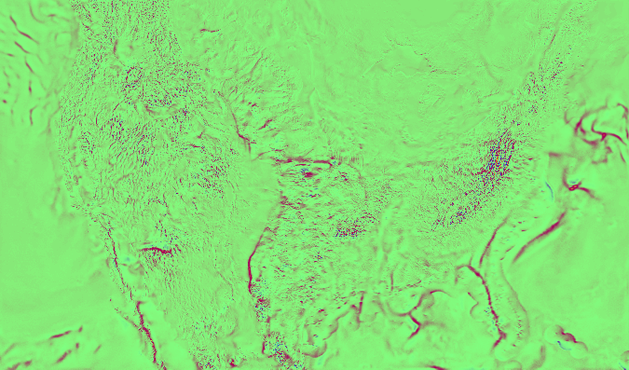
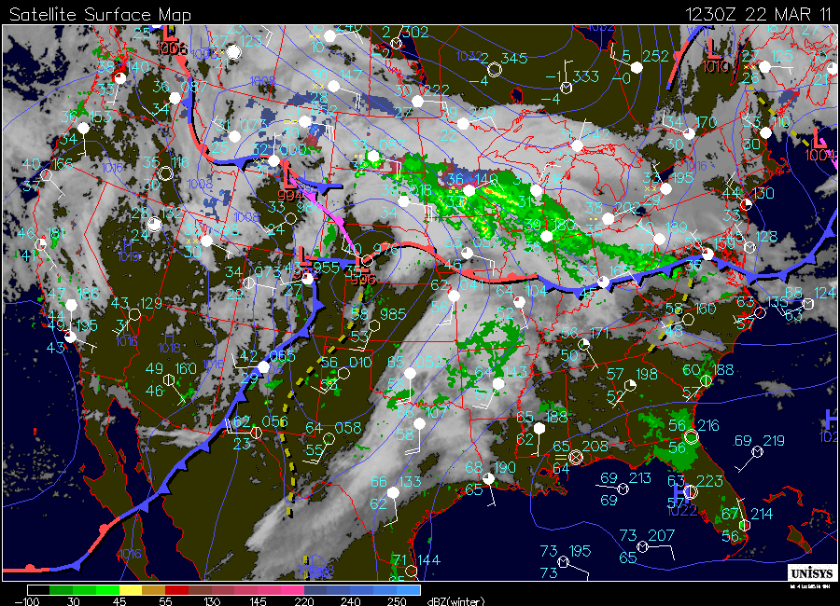
vLAPS DIVERGENCE ANALYSIS
Continental US
(note the frontal boundaries indicated in the inset)
24-hr Loop for Mar. 23, 2011

Slide 59
BACKGROUND - 2

Slide 60
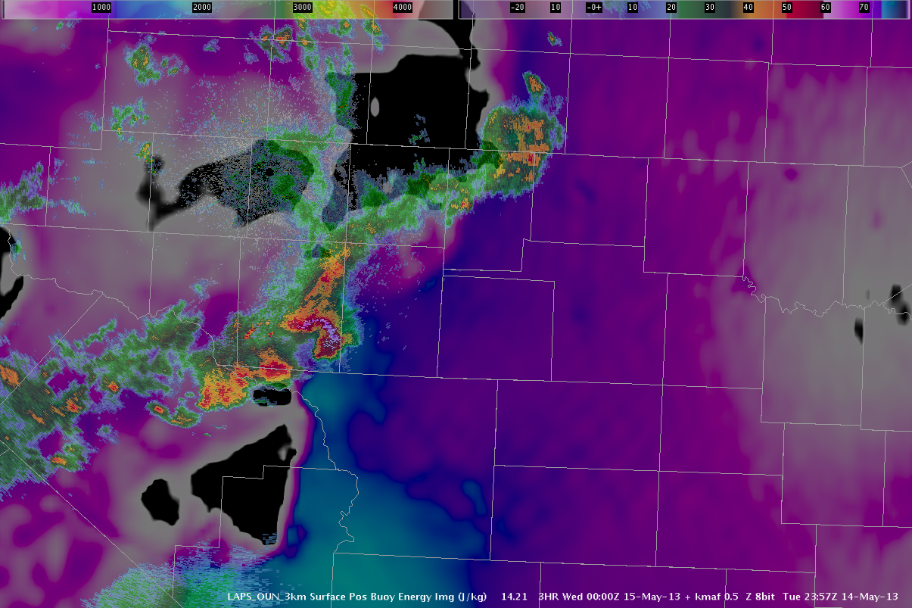
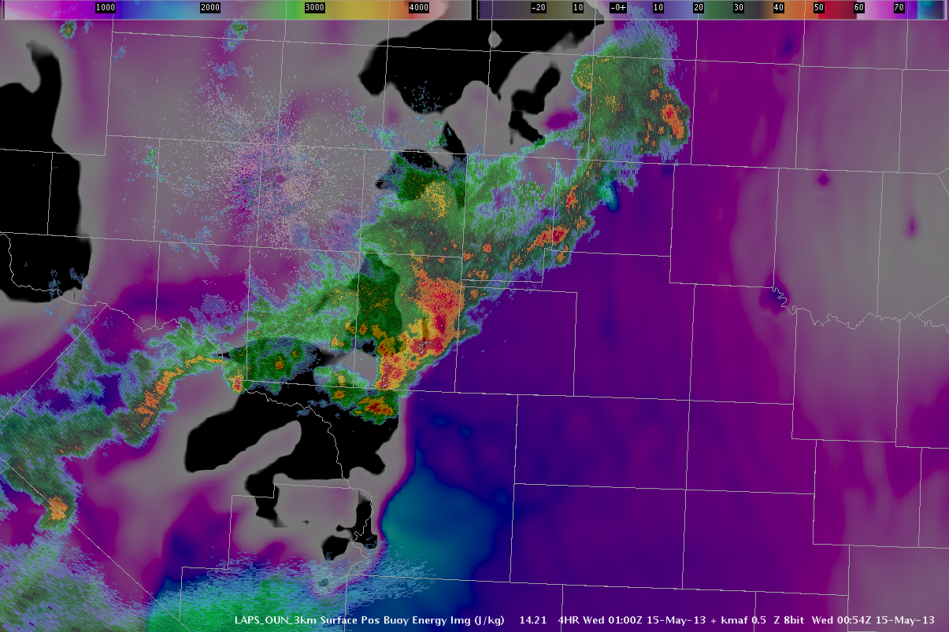
EWP 2013 Real-time blog posted on 13 May 2013
``LAPS again. Higher CAPE, bow echo. Lower CAPE, bye bye bow echo.’’
“In my opinion, the LAPS surface-based CAPE product was one of the stars of the day.
Consistently, storms lived and died based on entering and exiting the higher CAPE values which extended north and northeast from the Big Bend area for most of the day. Lower left image shows the LAPS surface-based CAPE at 00Z, and the radar at the same time…. Note that the storm is still in the tongue of 1000+ J/kg of CAPE as noted on LAPS. One hour later, the storm is exiting and entering a less favorable instability regime. And predictably, it starts to weaken.
00Z 01Z
Any questions?
LAPS nailed it.”
(courtesy of Chris Leonardi WFO RLX)

Slide 61
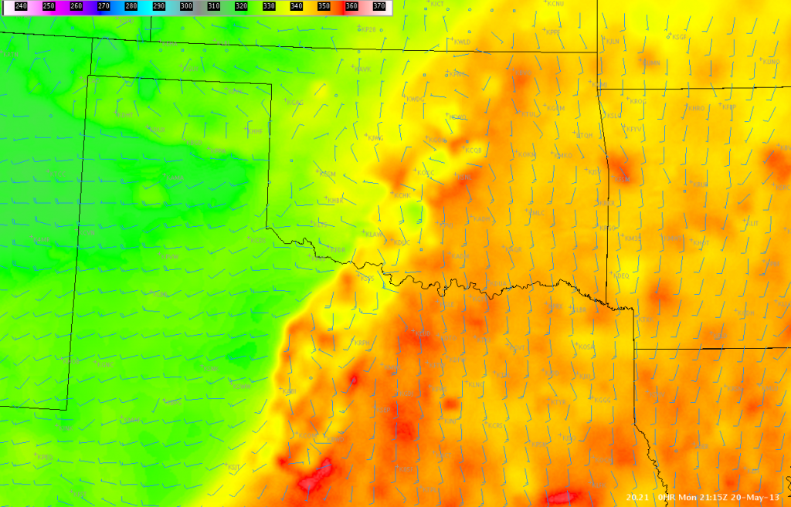
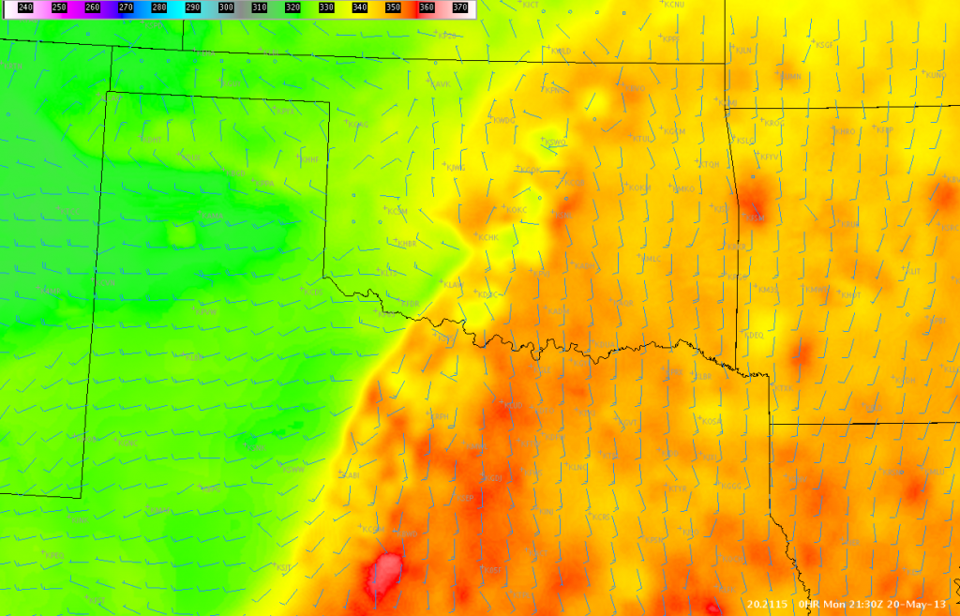
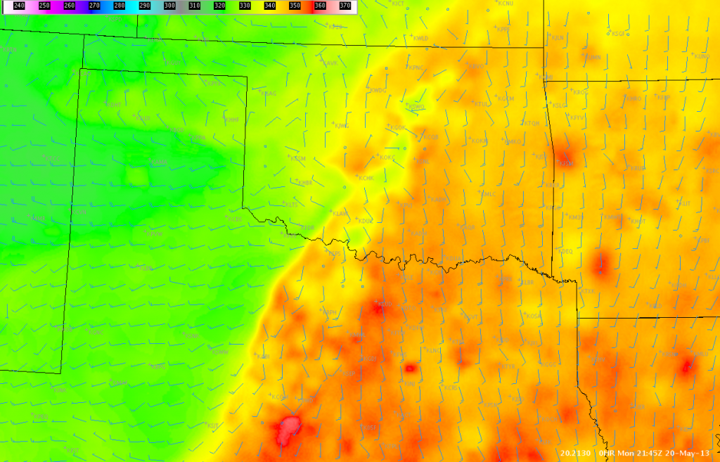
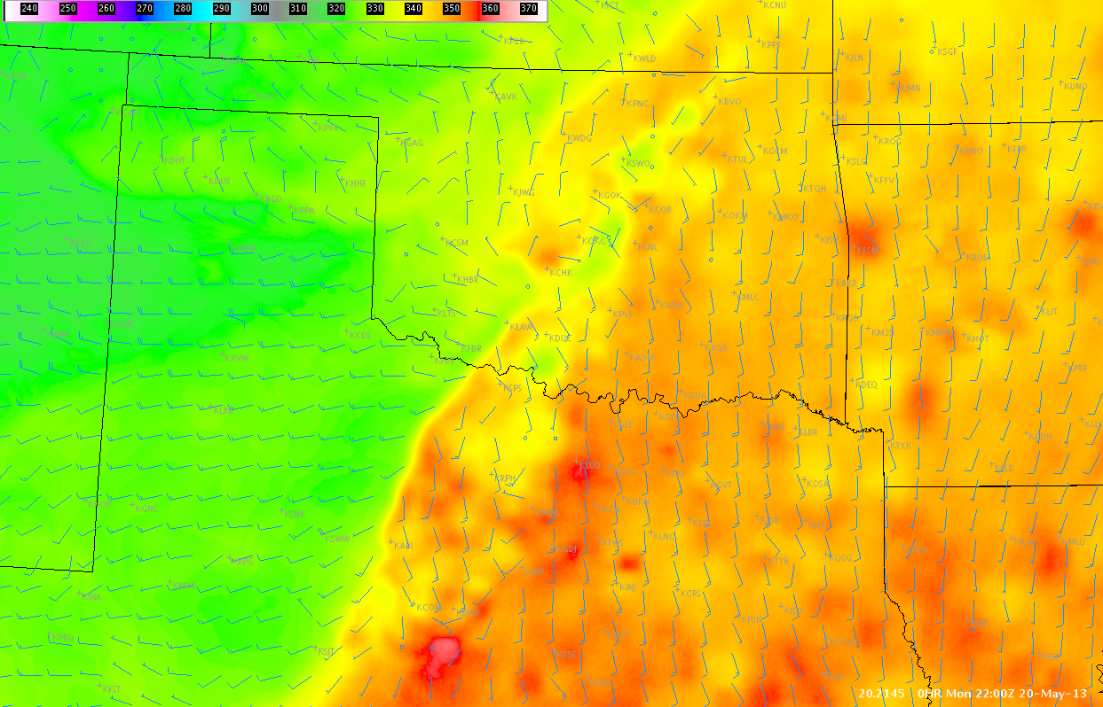
After Moore Tornado Real-time Blog Posted 20 May 2013
LAPS Observations and Determining Future Storm Development…
“Just a quick post about observations of the LAPS theta-e field this afternoon. It was interesting to see the near stationary aspect of the θ_{e} boundary in assoc/w the dryline to our south across portions of north Texas this afternoon. This suggests that continued development is possible late this afternoon especially across northern Texas, where the gradients have been sustained and have even increased lately. However, notice that the gradients have decreased generally across much of Oklahoma where convection and related effects (rain cooled air, cloud shield) have helped to stabilize the environment.”
2115UTC
2130UTC
“The 15-minute temporal resolution of the product can be very useful for diagnosing locations of continued convection especially in rapidly developing convective situations.” (courtesy of G. Garfield)
2145UTC
2200UTC
Surface θ_{e} (K, shades) and wind vector

Slide 62
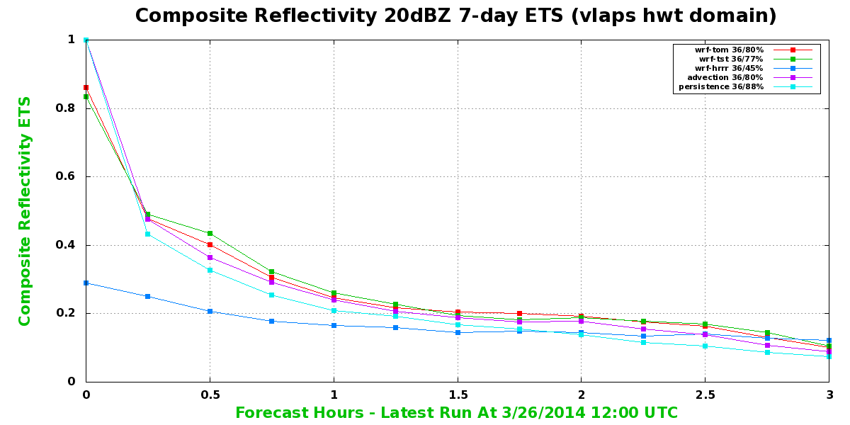
vLAPS vs PERSISTENCE & HR (7-days)
Quality of very short range forecast is indicator of analysis quality
Advection
LAPS
Persistence
HR
Courtesy Steve Albers

Slide 63
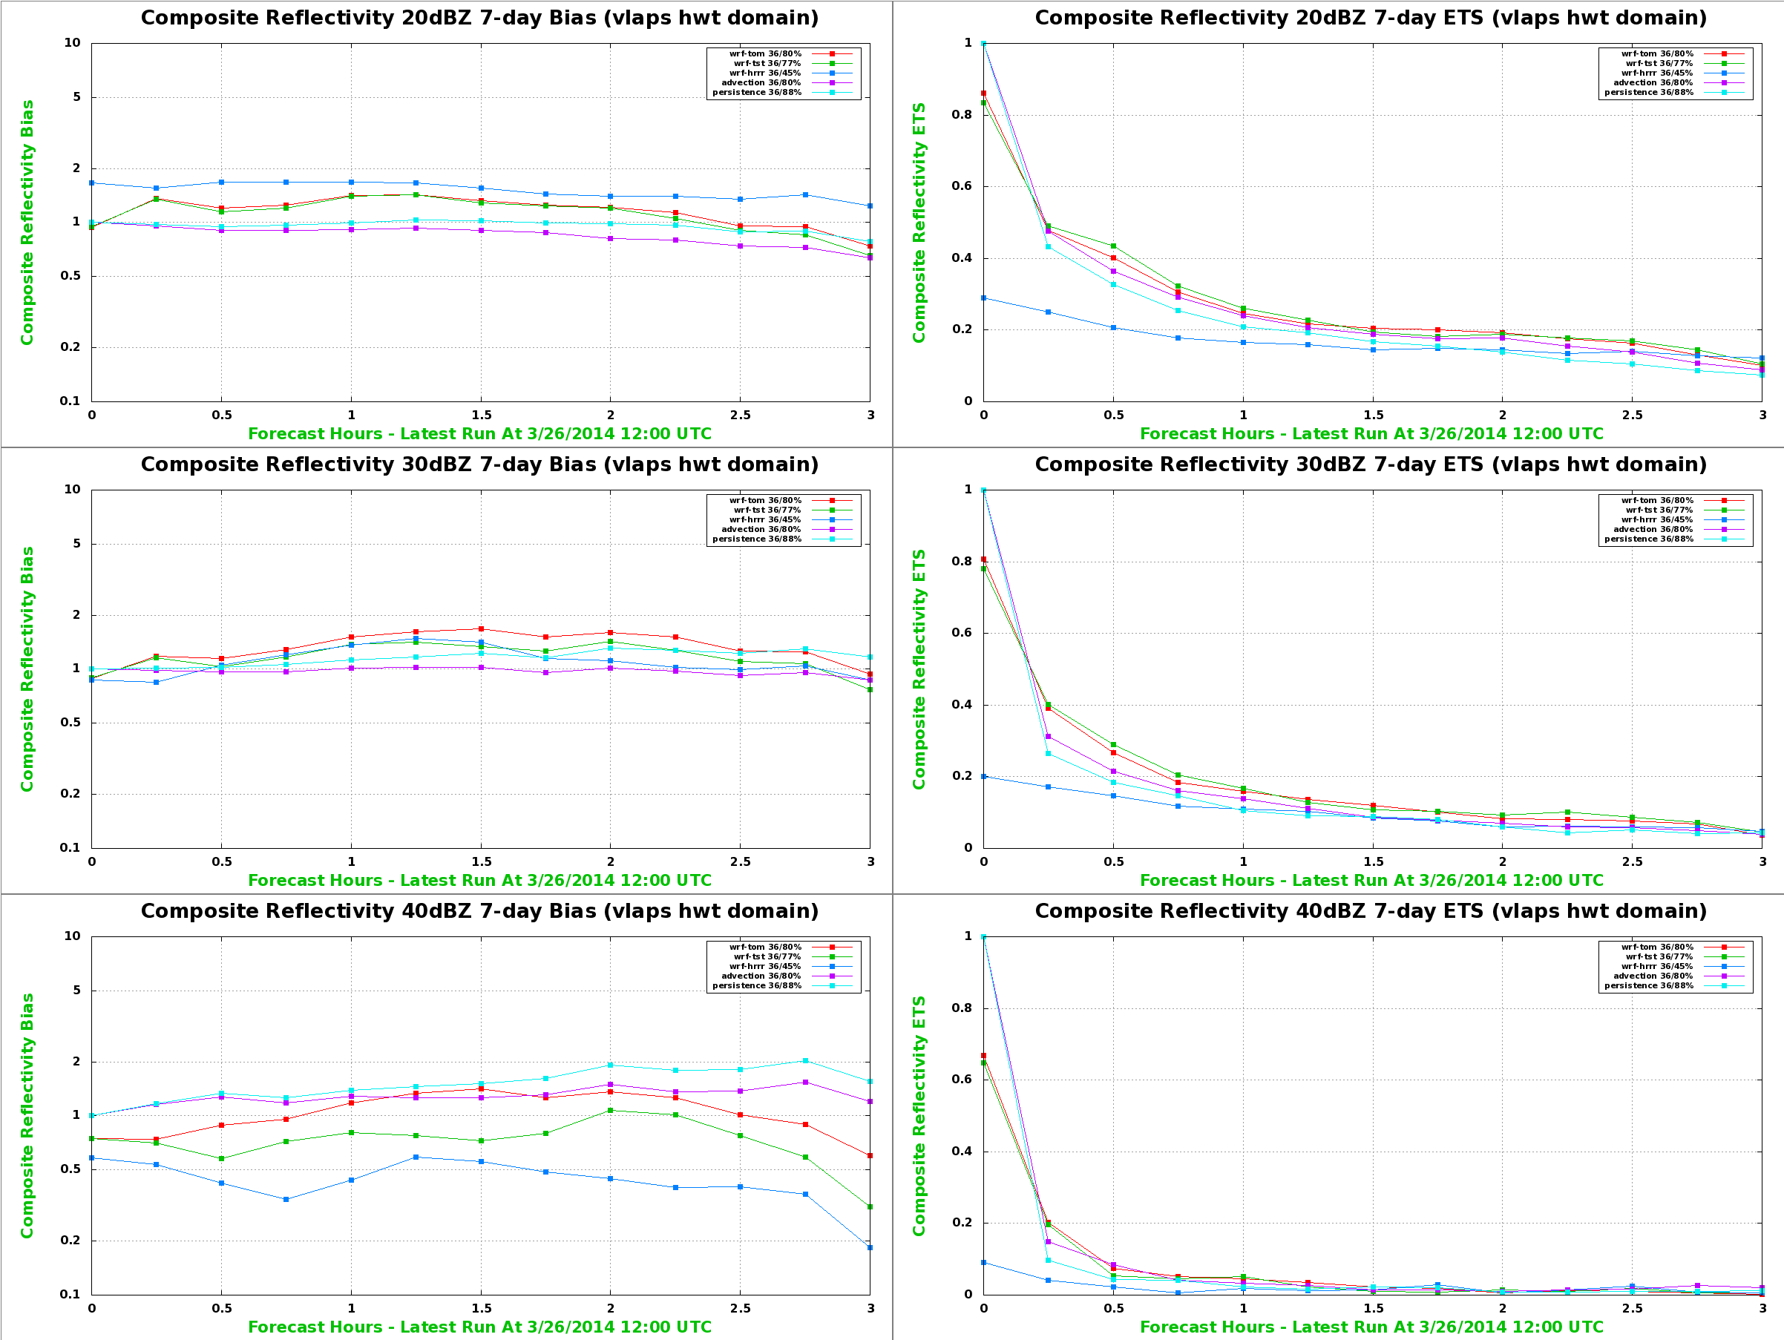
7-DAY MEAN RADAR COMPOSITE REFLECTIVITY SCORES
BIAS
EQUITABLE THREAT SCORE

Slide 64
LAPS IN VLAB
Resources offered in VLab / on IDP Server Farm
  Space, data access, cpu, potential SOO participation
LAPS repository established in VLab
  Recommended revision control tool (GIT) used
VLab Forum
  LAPS briefing scheduled for 18 June
LAPS group excited about what VLab offers
  Community / distributed development at new level
VLab LAPS project in planning phase
  Seeking input, identifying / developing links, etc

Slide 65
LAPS IN CDTE
Central Development and Testing Environment
  Climbing the “pyramid” of CDTE via VLab
GSD / community
  Development and off-line testing
NOAA Testbeds
  Testing / development in
    HWT, HMT – Flash Flood / Winter Weather, AWT
  Forecaster control
    Configuration – choice of events, domain, etc
    Local Quality Control of observations
Operational Proving Ground
  End-to-end evaluation
Potential implementation
  Operations on IDP Server Farm

Slide 66
NOWCASTING WITH THE LOCAL ANALYSIS AND PREDICTION SYSTEM (LAPS)
Zoltan Toth,
Yuanfu Xie, Steve Albers¹, Hongli Jiang¹, and Craig Hartsough²
Global Systems Division
NOAA/OAR/ESRL
¹ CIRA at GSD
² CIRES at GSD
Acknowledgements:
Drs. Steve Koch &
Louis Uccellini
VLAB Seminar – 30 June, 2014
Notes:
Updated Jan 27 2056 UTC

