Slide 1
ForecastBuilder Experiment in Central Region
A Project From the CR-GMAT
(Central Region Grid Methodology Advisory Team)

Slide 2
GMAT (Grid Methodology Advisory Team)
Formed in 8/2008 with an 80% to 20% mix of NWSEO forecasters and management team members (SOO/ITO)
Answers to CR Headquarters through the SSD (Science Services Division)
Goals/Charter
Promote the development of science-based techniques and tools for GFE
Review and recommend policy for creating gridded forecast for Central Region
Team values:
Trust
Continuous communication with the field
Surveys
Webinars
Feedback forms
VLAB (lately)
Rapid responses to issues
Strong working relationships with CR SSD and CR NWSEO

Slide 4
The development of ForecastBuilder
Since the GMAT inception the team looked to standardize and improve the creation of the SnowAmt, IceAccum, and Wx grids. Surveys revealed that there were many disparate ways that offices were creating these grids - some with questionable science leading to consistency issues both internally and externally.
Late in 2015, based on our previous projects, the team felt that the time was right to fully take on these elements.
It quickly became clear that the SnowAmt, IceAccum, and Wx grids have major dependencies and connections with many other forecast elements. Accordingly, producing consistent, quality forecast grids required a comprehensive, science based, approach.

Slide 5
The GMAT saw a need to work together both regionally and nationally to produce a gridded forecasting approach that:
Is structured, systematic, and scientifically grounded
Replicable from Office to Office and Forecaster to Forecaster
Creates SnowAmt, IceAccum, and Wx grids in the same way
Fills the regional policy gap between the ESTF periods and the implemented day 4-7 forecast practice

Slide 6
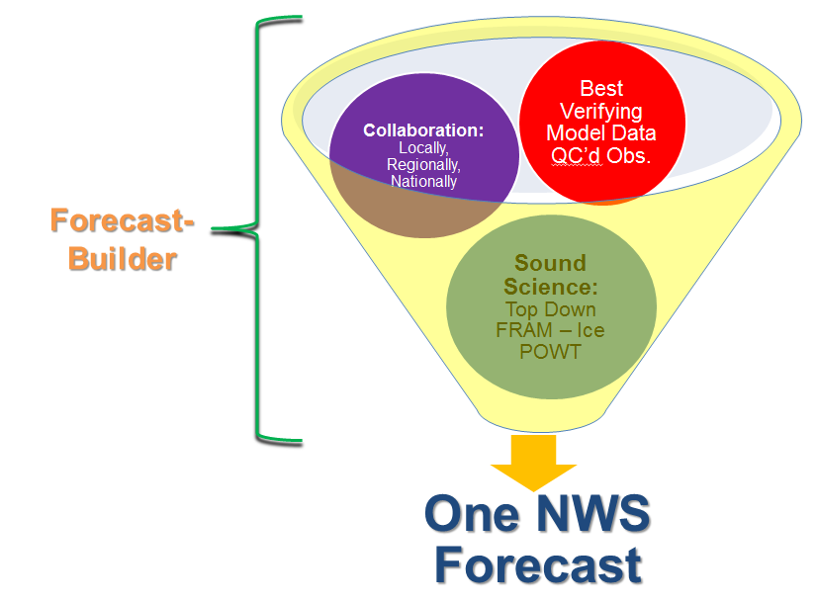
Result
Accordingly, the CRGMAT, with support from CR SSD and CR NWSEO, developed a standard procedure for producing the Wx, Snow and Ice grids.
CRGMAT created the ForecastBuilder program, including its supporting components, to meet our team’s goals for forecast grid creation in the region.
The GMAT strives to bolster the ForecastBuilder’s effectiveness, use, and adoption throughout the region and now beyond.

Slide 7
CRGMAT’s Answer - ForecastBuilder Procedure
A new GFE procedure which employs a streamlined and systematic methodology for developing the forecast
Provides a strong initialization scheme based on well verifying blended models. This also results in a consistent, common starting point
Also incorporates observations
CRON based version provided for the initialization
Employs sound science to derive SnowAmt, IceAccum, and Wx grids - ensuring internal consistency
Greatly facilitates creating the Wx grid
Fast process
Robust and comprehensive
Responsive to forecast changes

Slide 8
Developed and tested by the field forecasters - those on the “front lines”
Robust and flexible procedure with the support of regional developers responsive to the field
Ideally this approach would become the national delivery mechanism for the NBM - maintaining the WFO forecaster as the ‘driver’ of the official NWS forecast and its message

Slide 10
ForecastBuilder was developed in collaboration with:
Upper Mississippi Valley SOO community
National SmartInit Team
NBM Wx Grid Team
CR Consistency Team
CR NWSEO
CRH Management

Slide 11
Immediate Benefits For Forecasters
Allows forecasters to spend more time on:
IDSS - especially in high impact situations
Situational Awareness / Meteorological Analysis
The forecast problem(s) of the day
Training / Professional Development
Improved grid consistency by starting from a consistent and seamless database
Forecaster remains in control of grids (i.e. over the loop) and the message those grids convey - remain a key decision maker in a national to local collaborative process

Slide 12
Immediate Benefits For Forecasters (continued)
Future training is focused and streamlined
Automatically ensures the meteorological forecast integrity of the database
An approach which allows forecasters to share experiences, science and techniques to all offices
This process will allow for improvements to be instantly spread to all offices
For grids - much easier to back up another office, or when settling into another office

Slide 13
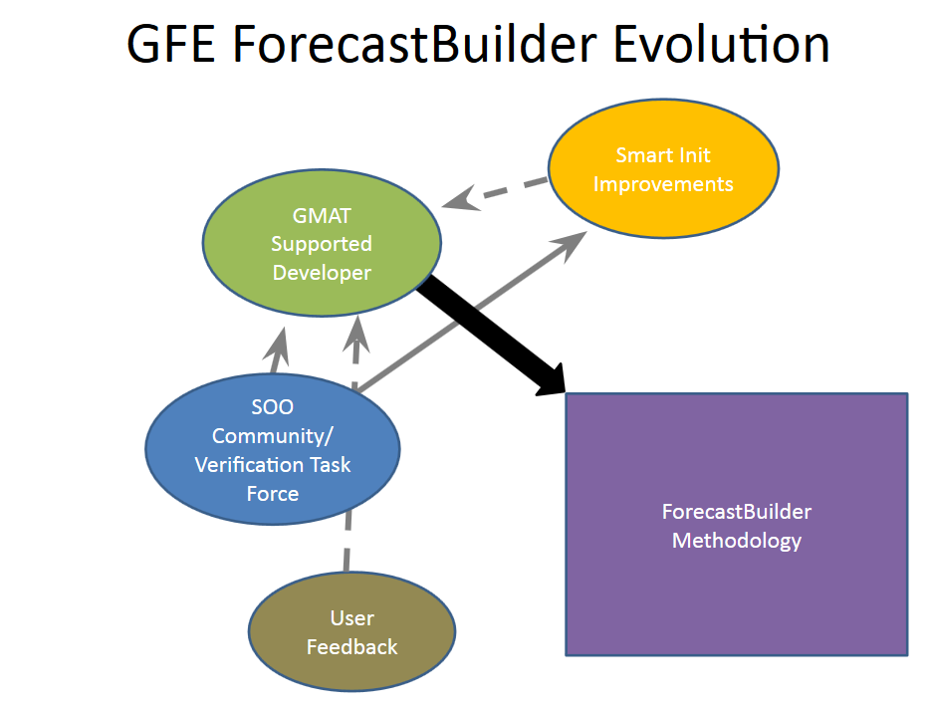
The ForecastBuilder Methodology is designed to evolve and improve with new techniques and scientific findings.
The developers will be responsive to all feedback and suggestions.
This will be maintained by the CRGMAT and become a means of science sharing resulting in a standard GFE methodology that ‘grows’.

Slide 14
ForecastBuilder Methodology
Foundation Grids
Temps
Td/RH
Wind/WindGust
Sky
PoP
QPF
SnowRatio
Wx Grid
Completely Derived (No editing needed)
Non-
Precipitation Types
(F, FR, BS, T, Etc.)
Precip Types, Accumulation Grids, Integrity Checks
Completely Derived (no editing needed)
Top Down Grids
MaxTwAloft
ProbIcePresent
ProbRefreezeSleet
RoadTemp
Items in Yellow Initialized and can be Edited

Slide 15
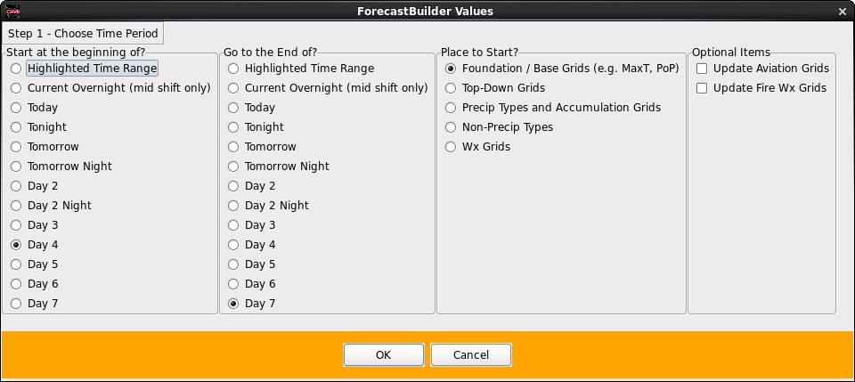
First Step - Choose A Time Period To Work On
Other options
Jump ahead (e.g. happy with the foundation grids)
Can also update Aviation and/or FireWx Grids

Slide 16
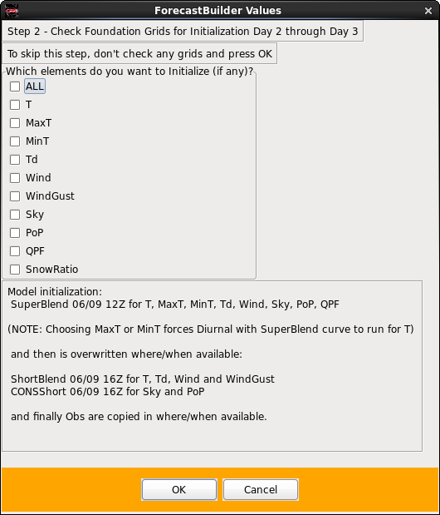
Step 2 - Most Important - Update Foundation Grids
Ability to initialize grids with best verifying data sets over the long term, and blend in the Obs
Forecasters should spend 90-95% of their total grid editing and collaboration time with these key grids
Seek “targets of opportunity” for modification, in a collaborative manner

Slide 17
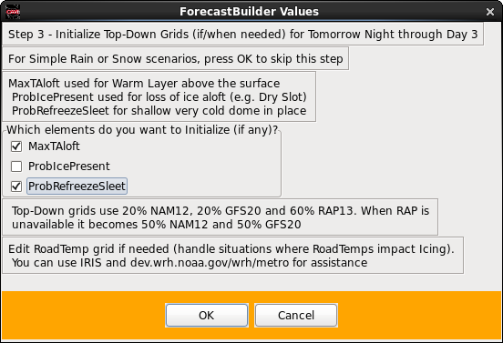
Step 3 - Update Top Down Grids
Only inspect for:
Freezing Rain
Sleet
Rain with a deep cold isothermal layer (e.g. 1C up to 2000 ft).
This step will be skipped if coldest hourly temp in the forecast time range is > 40F
Models incorporated (those that have good vertical resolution in AWIPS): NAM, GFS, RAP
Reference top-down training

Slide 18
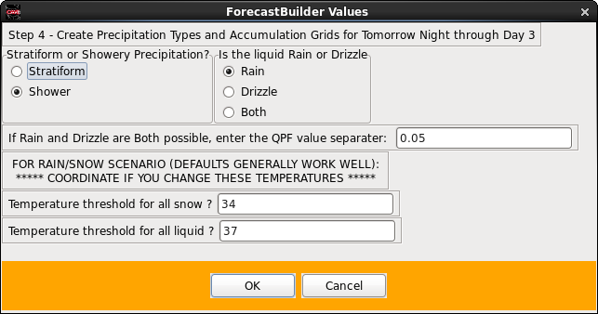
Step 4 - Precip Types, Snow/Ice and Integrity Checks
Background science and statistics will generate probabilities of precipitation types and the SnowAmt/ IceAccum grids
If you don’t like the output, collaboratively change either Foundation or Top-Down grids. Remember this is the One NWS forecast
Integrity checks along with updates to ApparentT, Td/RH also occur at this time

Slide 19
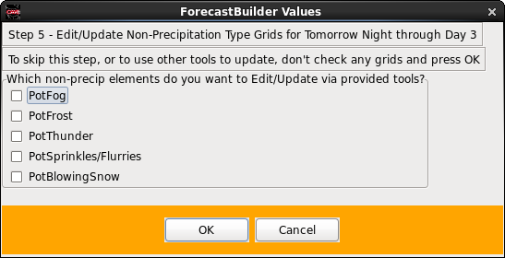
Step 5 - Non-Precipitation Types
Tools provided to help you produce non- precipitation types
Science-based study results incorporated - such as for BlowingSnow
One area where field- driven improvements are anticipated through more science, technology and empirical infusion

Slide 20
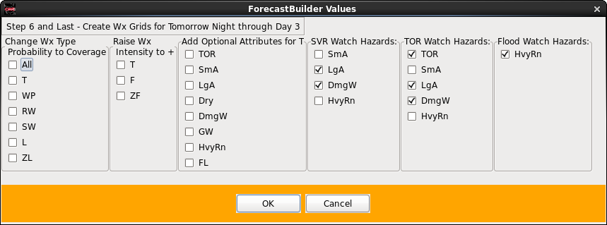
Step 6 - Update Wx Grids
95% or more of the time these defaults are fine
Automatically brings in convective watches to enhance the Wx grids
Wx intensities are derived from QPF/SnowAmt
Adds a level of flexibility/control before the Wx grid is created

Slide 21
Training and Support Provided
ForecastBuilder employs the most current peer-reviewed scientific techniques via:
SnowRatio
The FRAM Ice Accumulation Model (produced by Kris Sanders and Brian Barjenbruch @ TOP)
The Top-Down approach for forecasting precipitation type
Operational deployment videos on:
ForecastBuilder usage
Ways to improve upon a consensus initialization
Winter weather training via:
Job sheets
A WES2 GFE Simulation, when GFE becomes available on the WES2 (unknown)
Real-time support 24-7:
VLAB
CRGMAT - NWS Chat Room
CR - ROC - for forecast collaboration assistance

Slide 22
ForecastBuilder Process
Period 2 - day 7 initialized at 0530Z and 1730Z with SuperBlend by ForecastBuilder_CRON for the ‘foundation grids’ T, MaxT, MinT, Td, Wind, Sky, PoP. Additionally: WindGust, QPF, SnowRatio, MaxTAloft, ProbRefreezeSleet, SnowAmt and IceAccum through day 3.
Collaborate and modify, as needed, all foundation grids
Use ForecastBuilder to produce SnowAmt and IceAccum, which incorporates the FRAM model for IceAccum
Testbed offices (a cluster of 10 WFOs) adjusted the Top Down grids and created the Wx grids via ForecastBuilder
Other WFOs joined in during the experiment

Slide 23
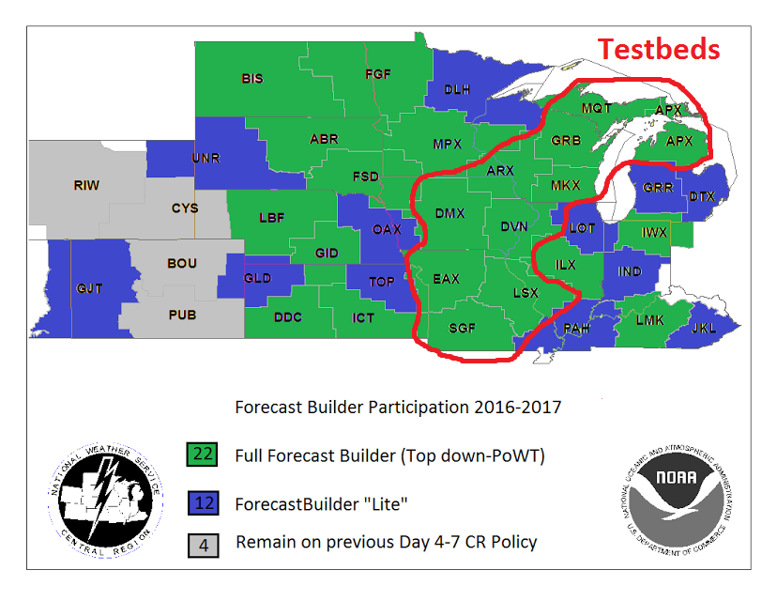
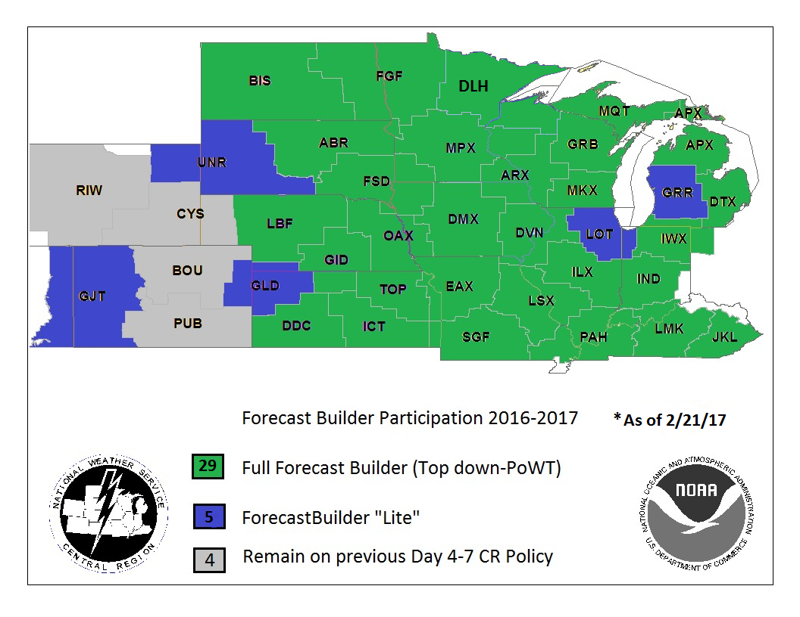
Testbed Offices - CR ForecastBuilder Usage
Late 2016
Spring 2017

Slide 24
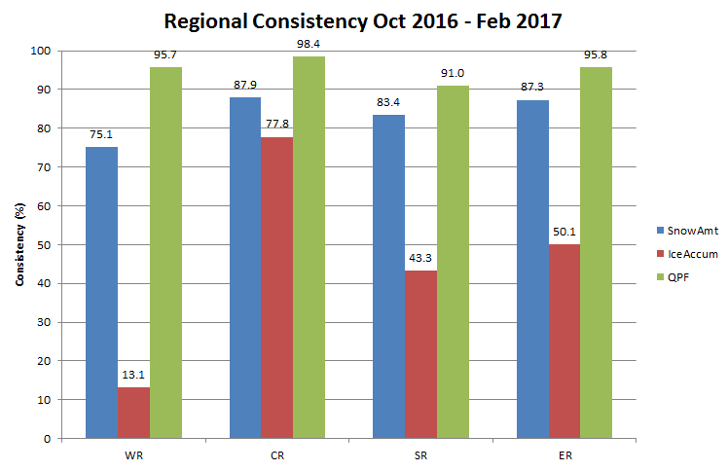

Slide 25
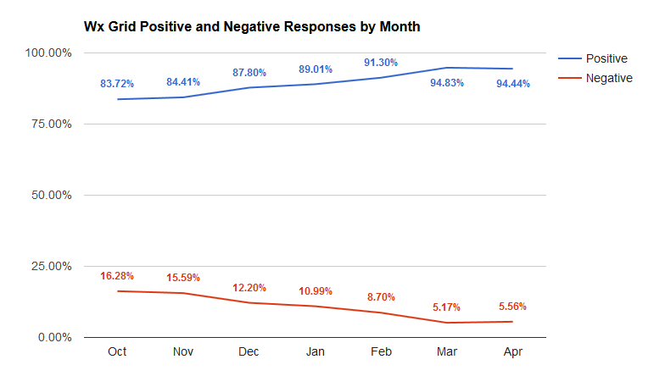
Wx Grids - Forecaster Satisfaction

Slide 26
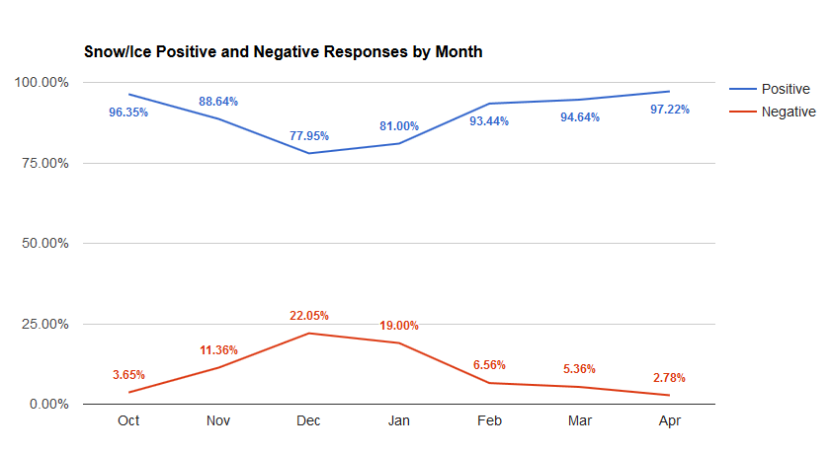
Snow/Ice Grids - Forecaster Satisfaction

Slide 27
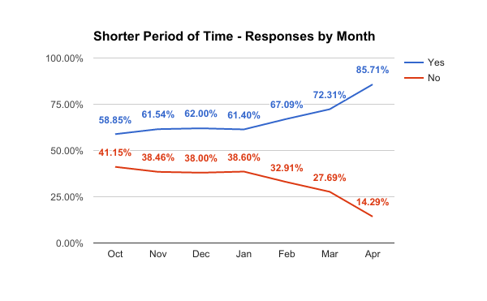
Was the Forecast Created in a Shorter
Amount of Time Using ForecastBuilder?

Slide 28
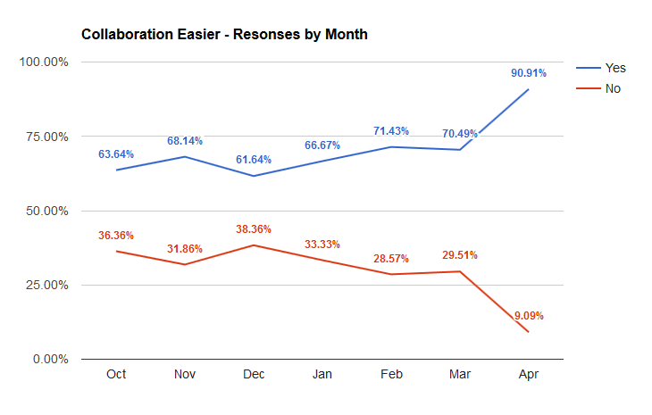
Was Collaboration Easier?

Slide 29
ForecastBuilder’s Future
CR to use NationalBlend as starting point in ForecastBuilder Q4 FY17 - Q1 FY18
Gradually roll back support of Regional Blends. FY18
Start with NBMRegBlend, CONSMOS, BCCONSMOS
Possibly incorporate WR Impact Grids idea
ESTF (Enhanced Short Term Forecast) with ForecastBuilder FY18
Possible 6 hour Grid Population to align with TAF times.
“Finalize” grid updater built into FB to smoothly and effortlessly update dependent grids across the Public/Fire Wx/Aviation/Marine realms Q1 FY17 - Q1 FY18
Completed for Public (Q1 FY17) and Aviation (Q2 FY17)

Slide 30
Where we are heading (cont)
Target of Opportunity “Finder” Q3 - Q4 FY 17
Fire Wx Grid Creation within ForecastBuilder Q3 FY17 - Q1 FY18
Ensure AutoWSW is running CR-wide Q1 FY18
Encourage further expansion of ForecastBuilder beyond CR Q2 FY17 - FY18

Slide 31
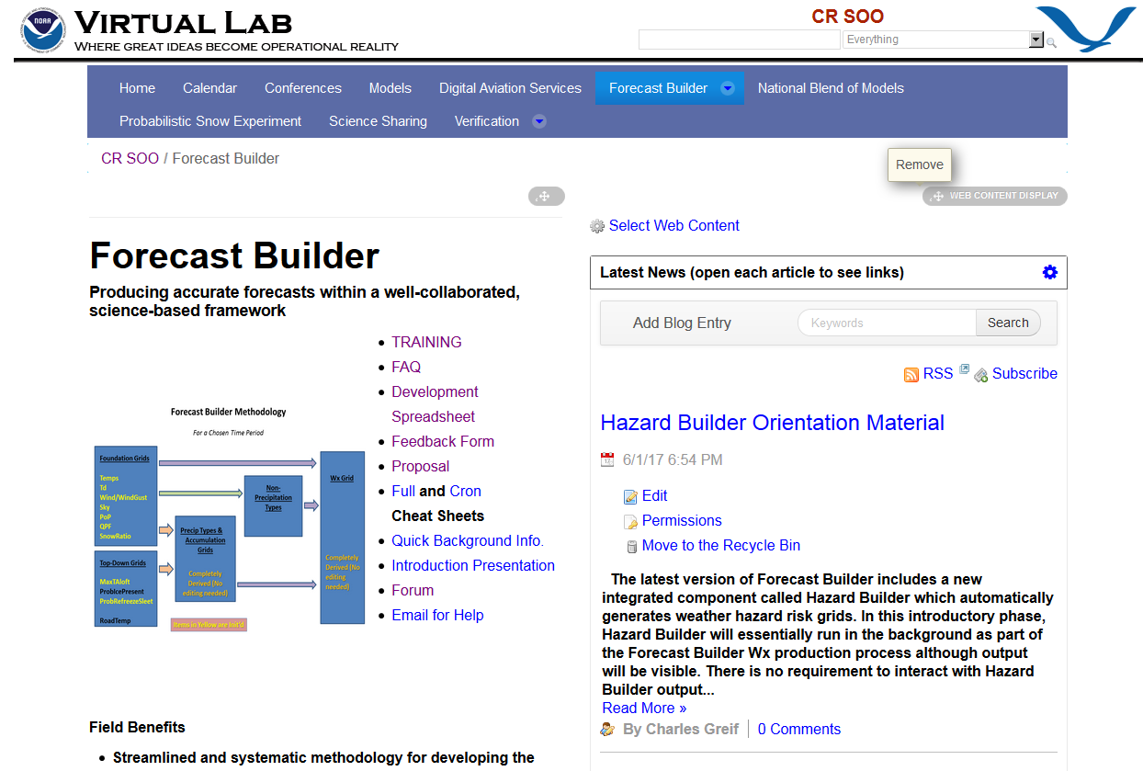

Slide 32
