Slide 1
The Freezing Rain Accumulation Model (FRAM)
Operational Utility, Application Tips, and Ongoing Research

Slide 2
Important Definitions/Abbreviations
FRAM – Freezing Rain Accumulation Model
ILR – Ice to liquid ratio
Differences in ice measurement
ASOS Measures This
1” Diameter of ice
1” Radius of ice
1” of flat ice
0.5”
1”
1”
0.5”
Elevated Horizontal Surface
FRAM Predicts This

Slide 3
What is the FRAM?
A statistical method to predict ILR
Based on 1255 hours of actual freezing rain observations
ILR is strongly correlated to measurable meteorological conditions
Why does the FRAM work?

Slide 4
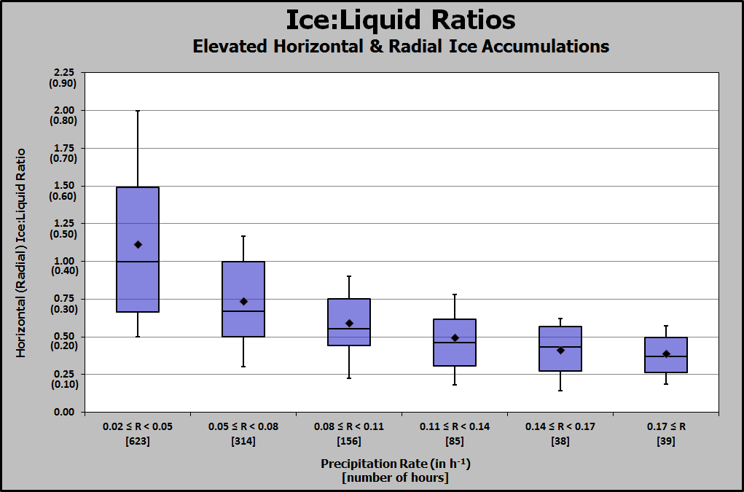
Precipitation Rate
Strongest correlation to ILR
As precipitation rate INCREASES
ILR DECREASES

Slide 5
Precipitation Rate – Why?
Rain drops are warm
To freeze, heat must be removed
Heat removal takes time
At greater precipitation rates, water does not have time to freeze to the surface before additional water is added
Excess water runs off

Slide 6
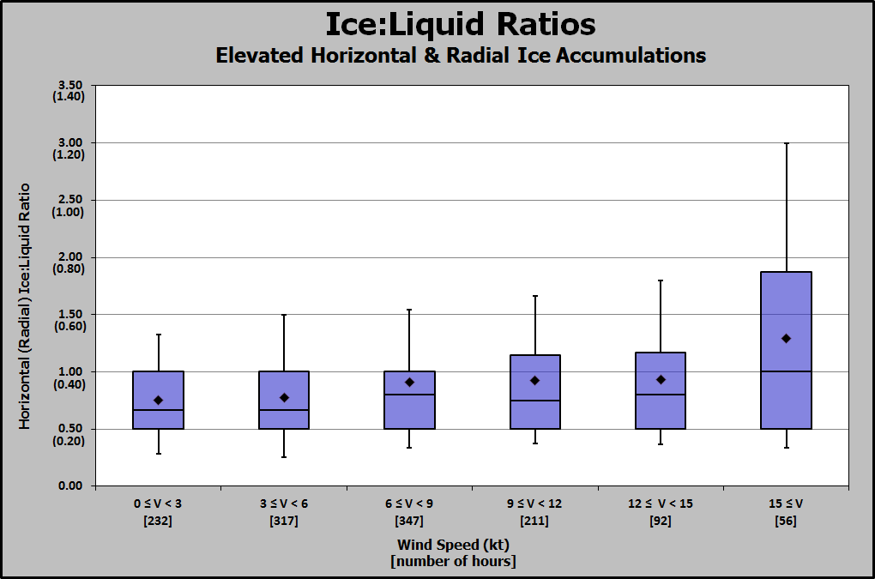
Wind Speed
As wind speed INCREASES
ILR INCREASES

Slide 7
Wind Speed – Why?
Increased wind leads to increased horizontal moisture flux (2)
Greater chance of a drop contacting the surface
1
2
Strong (cold) wind removes heat from the surface, promoting quicker freezing
Rain drops are warm
To freeze, heat must be removed
Wind is an effective mover of heat

Slide 8
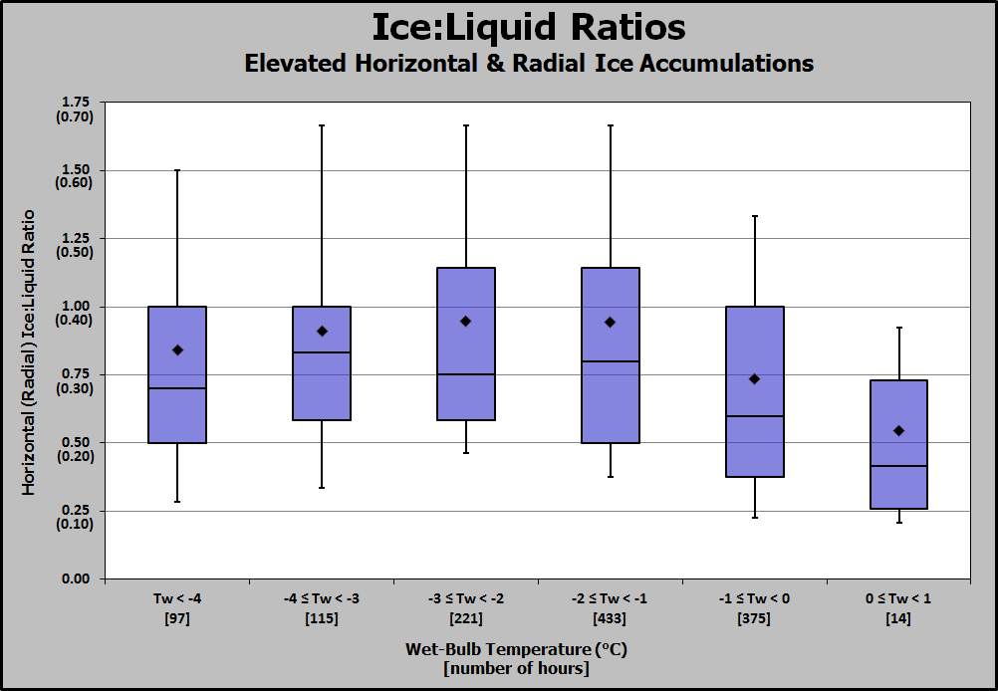
Wet-Bulb Temperature
As wet-bulb temperature decreases toward -2° C (28° F)
ILR INCREASES

Slide 9
Wet-Bulb Temperature – Why?
Colder near-surface air typically relates to colder freezing surfaces, promoting quicker freezing
Rain drops are warm
To freeze, heat must be removed
Why wet-bulb instead of air temperature?
Wet-bulb helps account for evaporative cooling toward saturation.
The air-liquid interface along the edge of a raindrop is saturated. Microscale temperature approaches wet-bulb
Works especially well in presence of wind

Slide 10
Freezing Rain & Temperature
An important finding:
Freezing rain commonly occurs with air temperature warmer than freezing
BUT
Freezing rain rarely occurs with wet-bulb temperature warmer than freezing

Slide 11
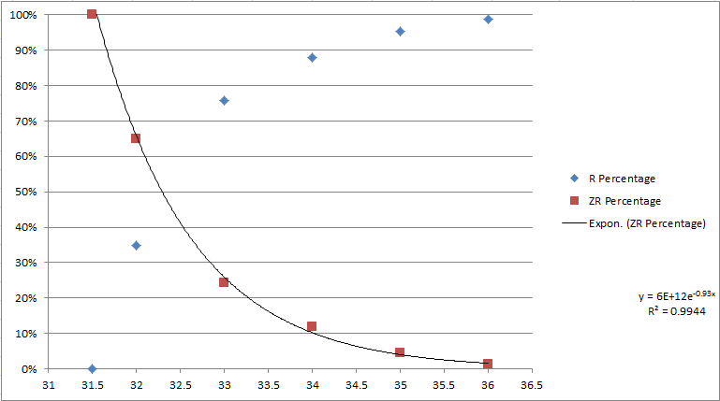
Freezing Rain & Temperature
Probability of Rain vs Freezing Rain Precipitation Type
(if wet-bulb temperature is ≤ 32 °F)
While possible at a temperature > 32 °F, freezing rain is not guaranteed with wet-bulb ≤ 32 °F
% Probability of Freezing Rain
% Probability of Rain

Slide 12
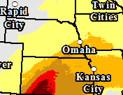
The FRAM
Precipitation Rate
Wet-bulb Temperature
Wind Speed
FRAM
Binned Multivariate Statistical Analysis
Ice Forecast

Slide 13
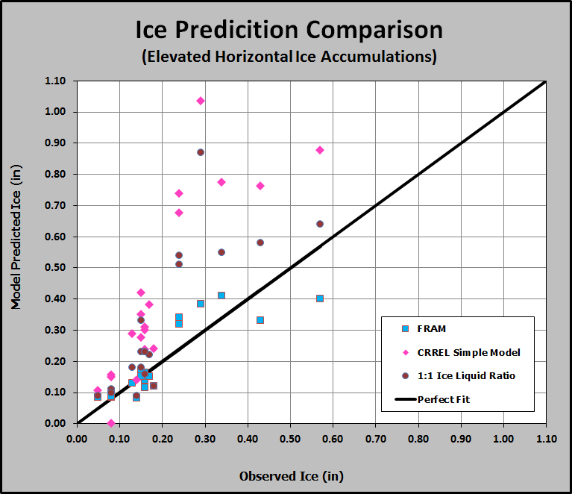
FRAM Performance
For freezing rain events at least 3 hours in duration:
FRAM outperformed existing methods 85% of the time
FRAM had a mean absolute error of 0.05”
Perfect Forecast
FRAM had a bias of less than 0.01”

Slide 14
FRAM Performance
Bottom line: FRAM is a skillful tool… …but is it statistical predictive perfection?
NO
FRAM forecasts the most statistically likely ILR
In reality, there is a range of possible outcomes

Slide 15
FRAM Application Tips
There are situations for which the statistical prediction can be improved upon
Near-freezing conditions
Droplet size and temperature
Elevation variations
Diurnal trends
Differing air and accretion surface temperature

Slide 16
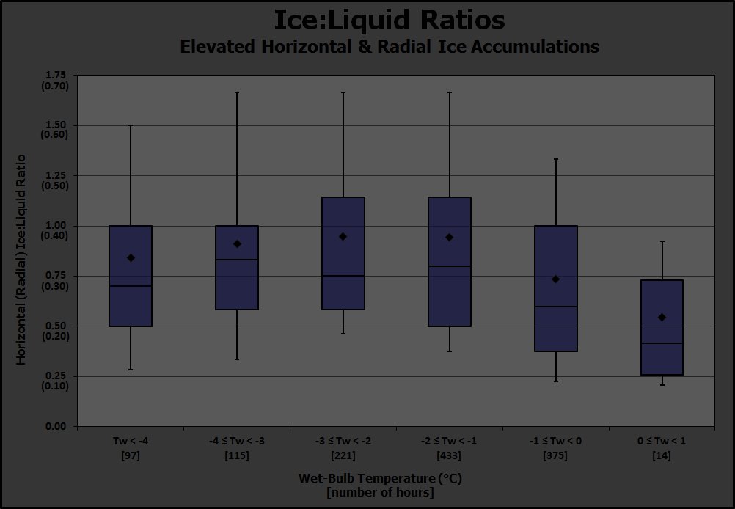
FRAM Application Tips
Near-freezing conditions
Recall that icing efficiency decreases as Tw approaches freezing
If combined with
Heavy precip rates, or
Warm temperature aloft
then ILR is likely to decrease to near the bottom of the box-and-whiskers

Slide 17
FRAM Application Tips
Droplet Size & Temperature Variations
Deeper or warmer warm layer aloft
Warmer drops
Just-warm-enough warm layer aloft
Cooler drops
Larger drop size
Warmer drops
Smaller drop size
Cooler drops
Extreme ILR possible (>3:1)
Super-cooled droplets (fog/drizzle)
Freeze-on-contact

Slide 18
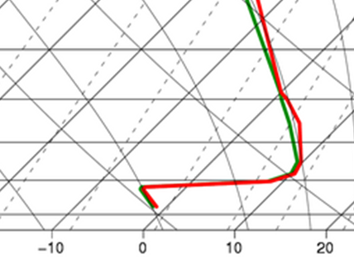
FRAM Application Tips
Elevation Variations
Sharply Warmer with height
In a typical vertical temperature profile for freezing rain:
T decreases with height just above the surface
T increases sharply with height into a warm layer
Icing efficiency can change based on elevation…initially increasing with height, then much less efficient into the warm layer
Colder with height

Slide 19
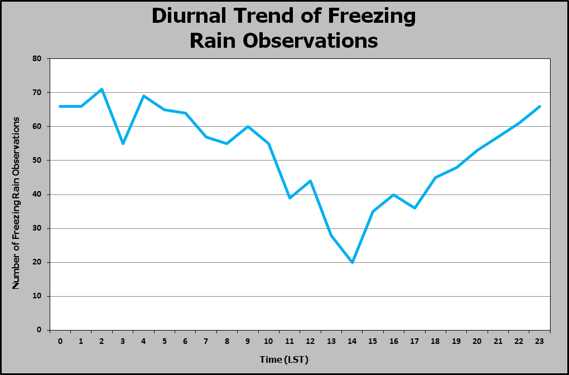
FRAM Application Tips
Diurnal Variations
Minimum in short-wave radiation influx during non-daylight hours is more conducive to freezing rain

Slide 20
FRAM Application Tips
Differing Air & Surface Temperatures
Colder surface more efficiently removes heat from liquid
Promotes a quicker freeze of the liquid mass
Air temperature observations are a good approximation
A sub-freezing surface may accumulate ice with temperatures > freezing
Consider elevation of the surface (impact of ground temperatures)

Slide 21
Ongoing Research & Related Projects
FRAM enhancements
Currently in the process of adding 2 more years of data + vertical temperature component
Increase statistical strength
Incorporate a “drop temperature” component
Improve upon the forecast method

Slide 22
Ongoing Research & Related Projects
Impact Study & Partnership
Goal of better predicting electrical outage impacts before they occur
Working with DOE and related entities
Leveraging a historical outage database in combination with meteorological and physical factors
Valuable for pre-positioning of resources

Slide 23
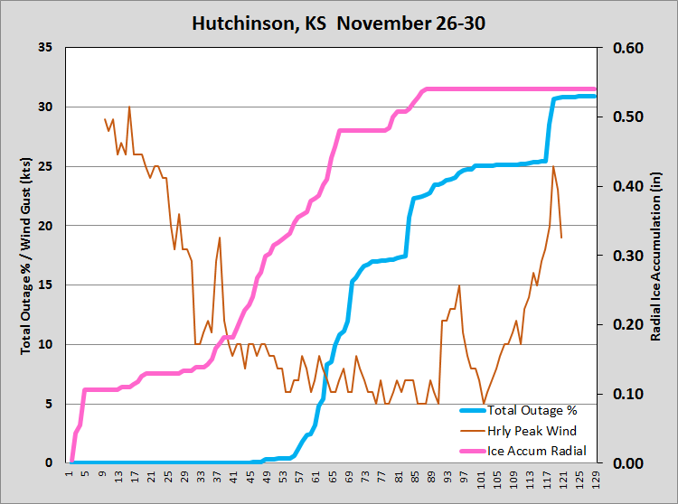
Ongoing Research & Related Projects
Impact Study & Partnership

Slide 24
Ongoing Research & Related Projects
Impact Study & Partnership
Maximum
Impacts
INCREASING
Moderate
Impacts
Minimal Impacts
Ice
Wind
INCREASING
Highly Simplified

Slide 25
Ongoing Research & Related Projects
Other Projects & Partnerships
Weather Prediction Center
National Blend of Models
Forecast Builder
NWS Policy Discussions
Clarity in what type of ice measurement we are forecasting
Discussion of potential future adjustments to ice storm warning criteria (research pending)

Slide 26
Available Tools
GFE Procedure/Smart Tool set
Freezing Rain Accumulation Tool (FRAT)
Available for local download
Will require some local training and practice
A more sophisticated version is included in the Forecast Builder

Slide 27
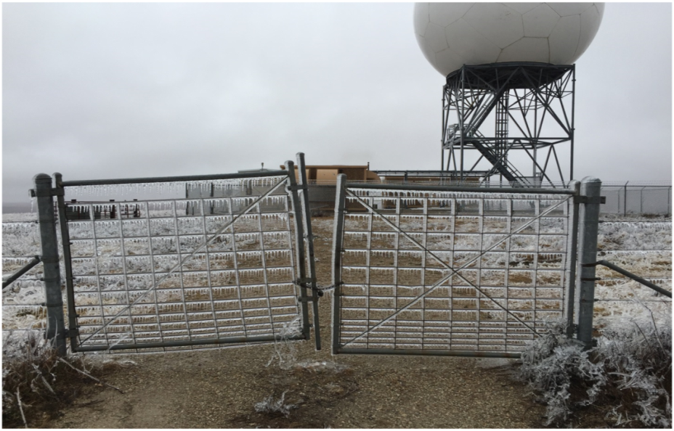
For More Information
VLAB Link for downloading GFE tools
GFE – Apps - CrGfeTools – branches - FRAT
Weather and Forecasting Link

Slide 28
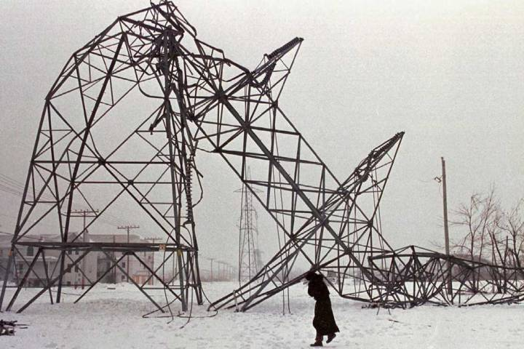
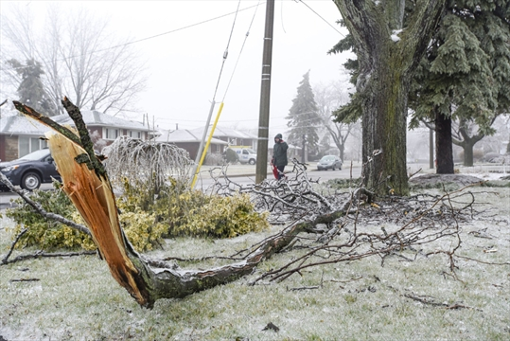
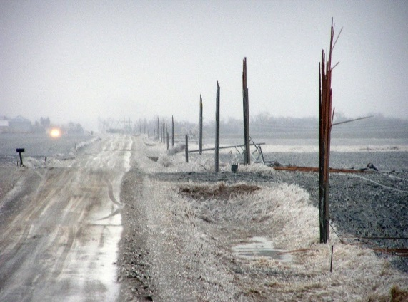
Thank You!
Happy to answer questions…

