Slide 1
Implementation of Forecast Flood Inundation Services To The Nation - An Update
David R. Vallee Director, Service Innovation and Partnership Division NOAA/NWS Office of Water Prediction/National Water Center

Slide 2
Outline
Background on what got us to where we are today
Progress to Date on our FIM Services Implementation for the Nation
Examples of our new Experimental Flood Inundation Services
Where you can access our Experimental National Water Model & Flood Inundation Services
Field office training

Slide 3
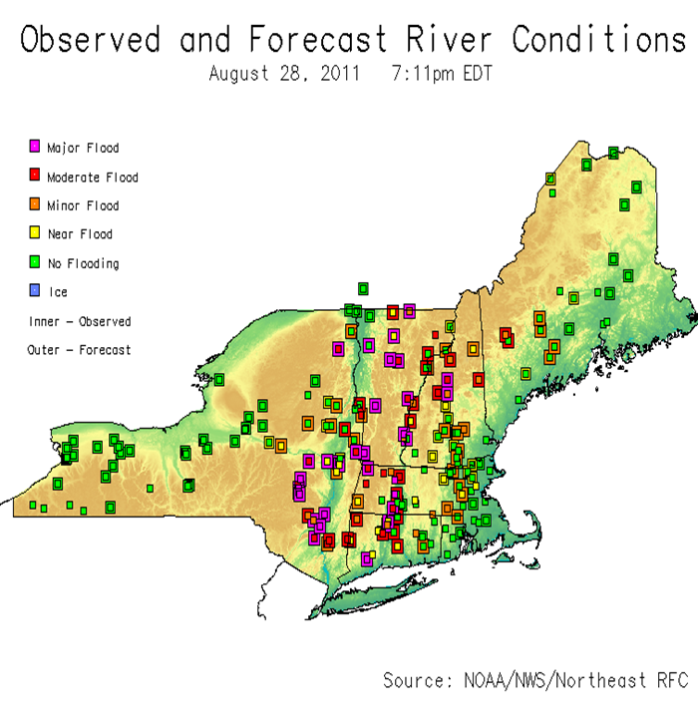
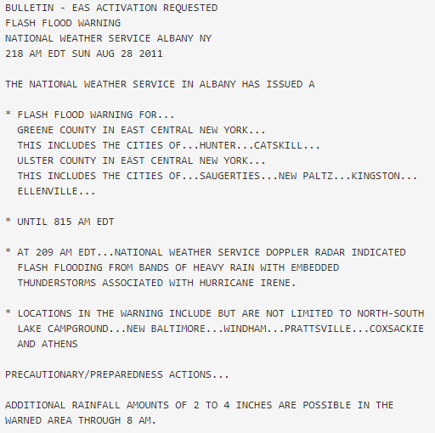
Current Flood Services
Why are we doing this? To fill a significant service gap!
Flood and Flash Flood Watches & Warnings
Providing general information on timing and impact on small streams
Detailed timing and impacts in the vicinity of our river forecast locations
Impact-based Decision Support Briefings, packages and Webinars
Partner feedback
While our current services are tremendously valuable, warnings lack specificity of location, timing and detailed impacts such as potential extent of inundation & duration of flooding
Lead time is critical in preparation
Knowing what roadways, bridges, etc. could be impacted is invaluable

Slide 4
Flood Inundation Mapping Timeline
2017
2019
2021
2023
2026
NWC Summer Institute
Demonstrated continental scale FIM capability using the Height Above Nearest Drainage (HAND) method.
First DOC/NOAA Agency Priority Goal
Near real-time demonstration in Texas.
Completed two tabletop exercises with core stakeholders and emergency responders.
Second DOC/NOAA Agency Priority Goal
Near real-time demonstration in Texas and along the Atlantic Coast.
Completed two tabletop exercises across the Northeast with core stakeholders and emergency responders.
Operational FIM for 10% of U.S. Population
Begin delivery of FIM services and Impact-based Decision Support Services (IDSS).
Leverage cloud-based solution.
Operational FIM for nearly 100% of U.S. Population
Integrated FIM capabilities and services across the U.S.
Total Water Level FIM forecasts along the coasts.

Slide 5
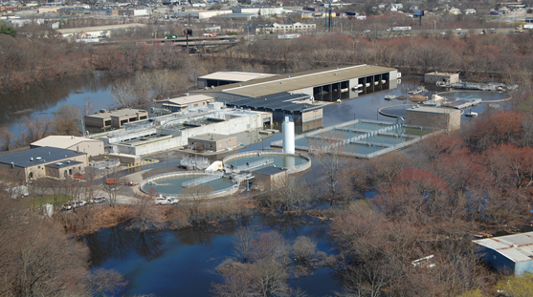
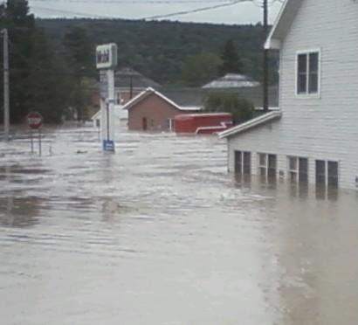
Tabletop Exercises: Key Findings
1. Partners found the combination of the NWS briefings with the FIM Service was a powerful combination to help them understand the impacts - Deliver through web services briefed by a professional forecaster
2. The capabilities provided by these FIM services would be a “game changer” for the emergency management community
- These geospatial services allowed for the creation of a common operating picture
3. Services would be most useful in staging and planning activities in the 1-3 day timeframe
County EM: “Had I had this tool in 2011, we would have had a larger evacuation area established earlier, would have moved emergency assets out of the flood zone, pre-positioned support resources and been able to provide better information to the residents of the affected area.”
4. Depth is tremendously important - as it determines the types of resources needed for the flood fight
West Warwick Wastewater Treatment Facility under siege, morning of April 1st, 2010 as the Pawtuxet River began to recede. Photo: RI ANG
Record flooding along Schoharie Creek in the town of Schoharie on the morning of Sunday, August 28th, 2011. Source: Kait Wood

Slide 6
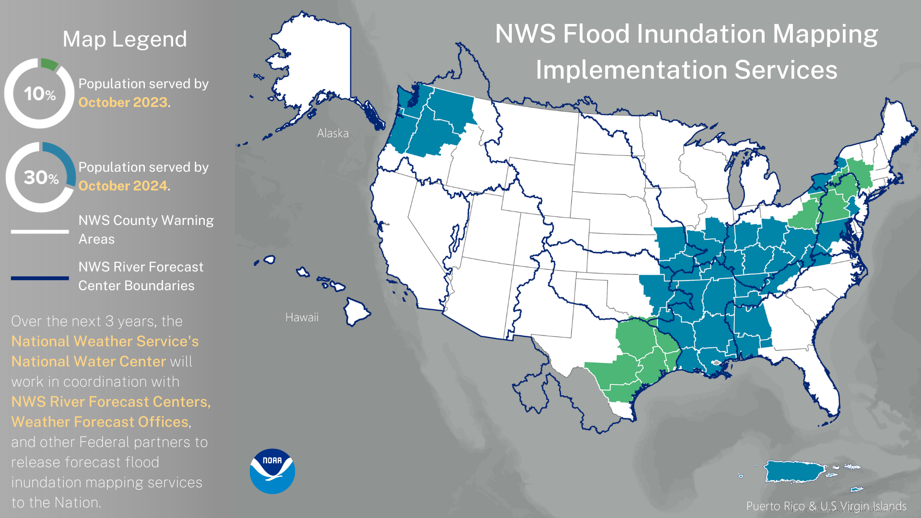
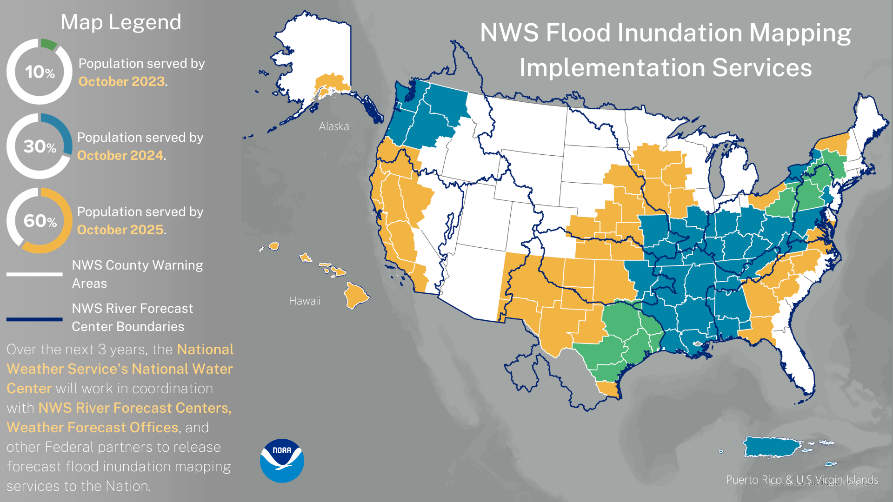
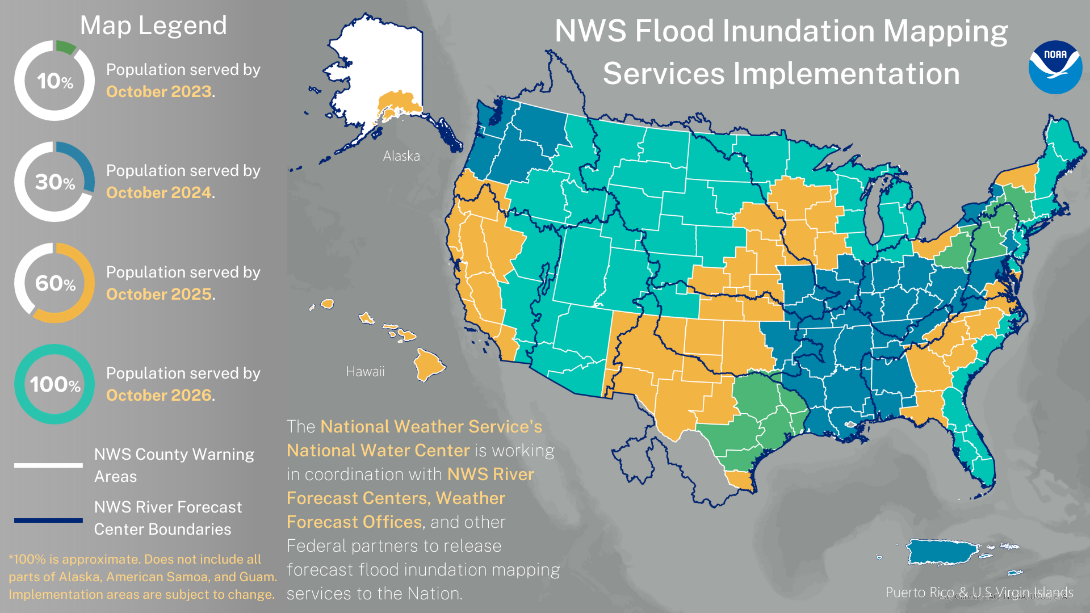
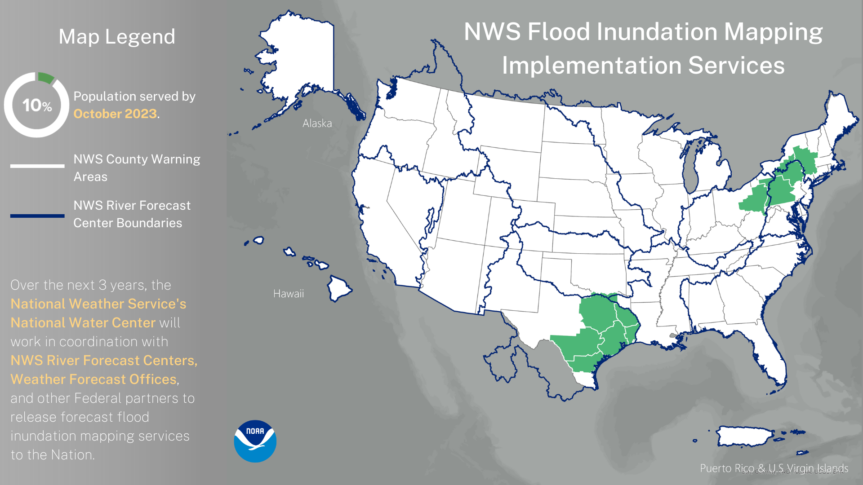
Notes:
Explain the 4 year phased rollout: Training the forecasters, training our partners and evolving the science behind the services

Slide 7
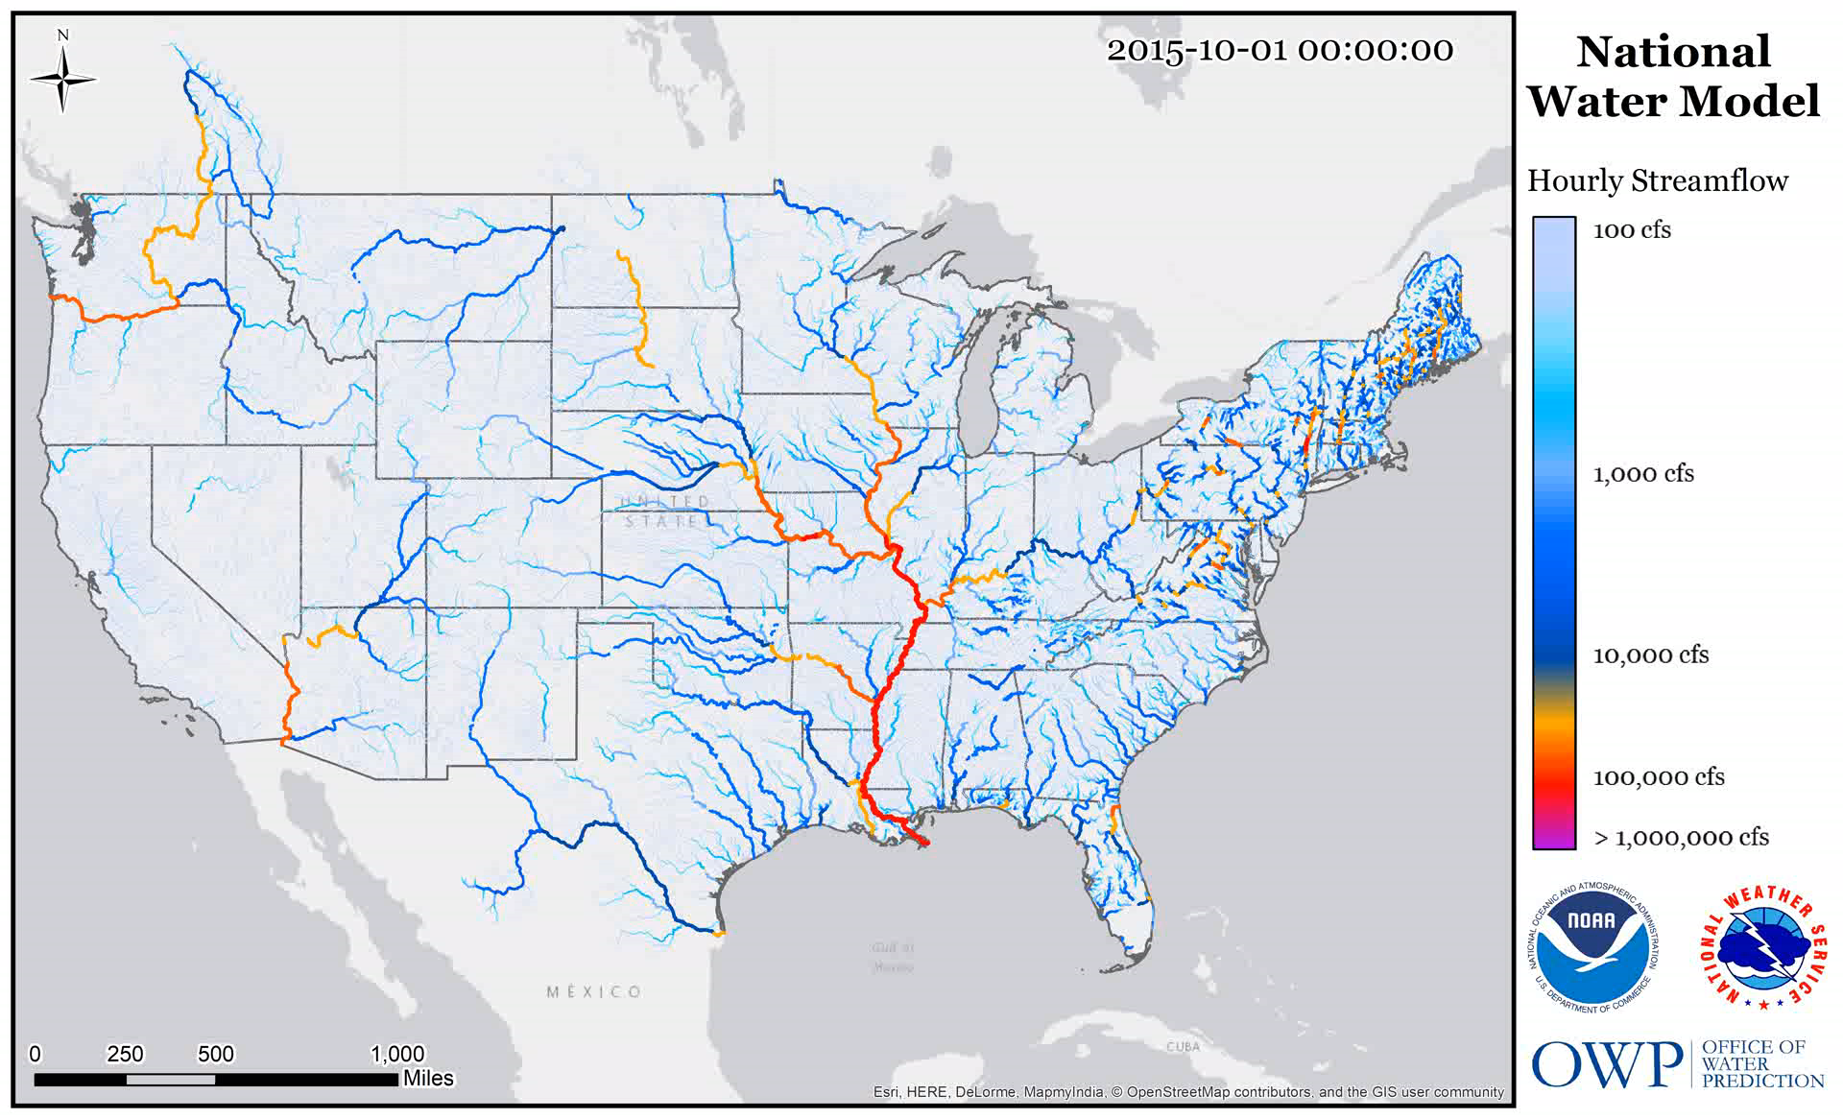
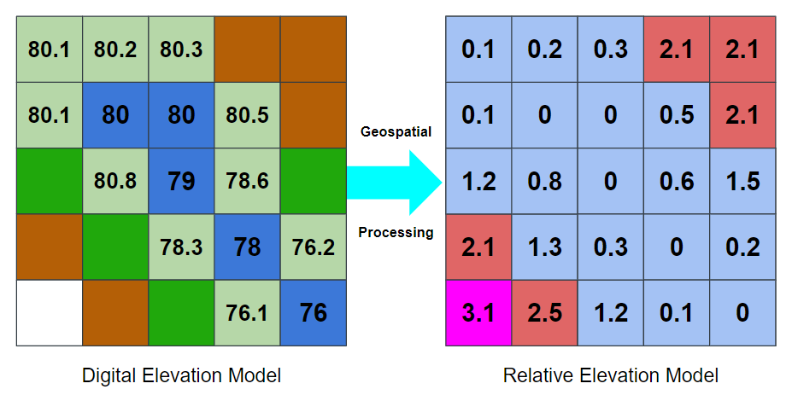
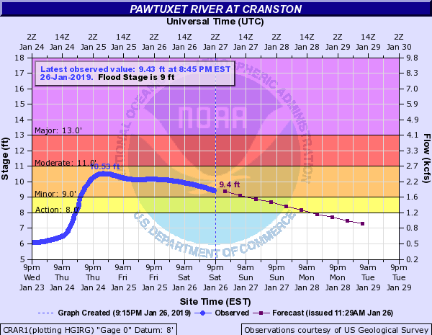
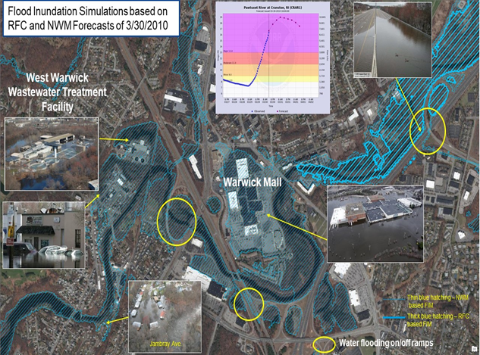
The Method behind FIM Services: Height Above Nearest Drainage (HAND) Deliver Forecast Flood Inundation Services
Height Above Nearest Drainage (HAND)
National Water Model Guidance
Completely automated process with no forecaster engagement – but provides complimentary guidance on ~3.4 million stream miles nationwide, including Puerto Rico and the Virgin Islands, Hawaii, and by the fall - portions of Alaska
River Center Forecasts Forecasters heavily engaged in the forecast production
Replace
Route
Pawtuxet River Valley – West Warwick/Warwick
Height Above Nearest Drainage (HAND)
Flood Inundation Mapping Services
+RAStoFIM & RAStoREM techniques
Notes:
HAND is a geoprocessing technique that converts a Digital Elevation Model (DEM) to a Relative Elevation Model (REM) depicting the elevation of the surrounding terrain above the river to which it drains. It uses a 10m Digital Elevation Model [DEM] produced by the US Geological Survey’s [USGS] 3D Elevation Program [3DEP] and the NHDPlus Hydrography (stream network) dataset produced by the USGS to create a “hydrofabric”. The hydrofabric represents the land surface elevations at the 10m resolution

Slide 8
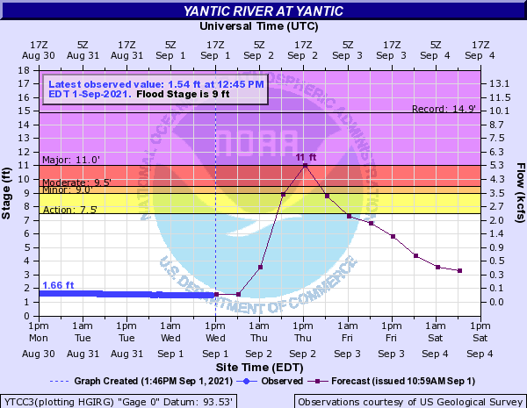
Value of FIM Services - Visualizations to depict impacts
Prototype Forecast Inundation Services Ida, September 1, 2021
Notes:
Creating that common operating picture: moving from a few statements of impact to a neighborhood level depiction of extent and potential impact

Slide 9
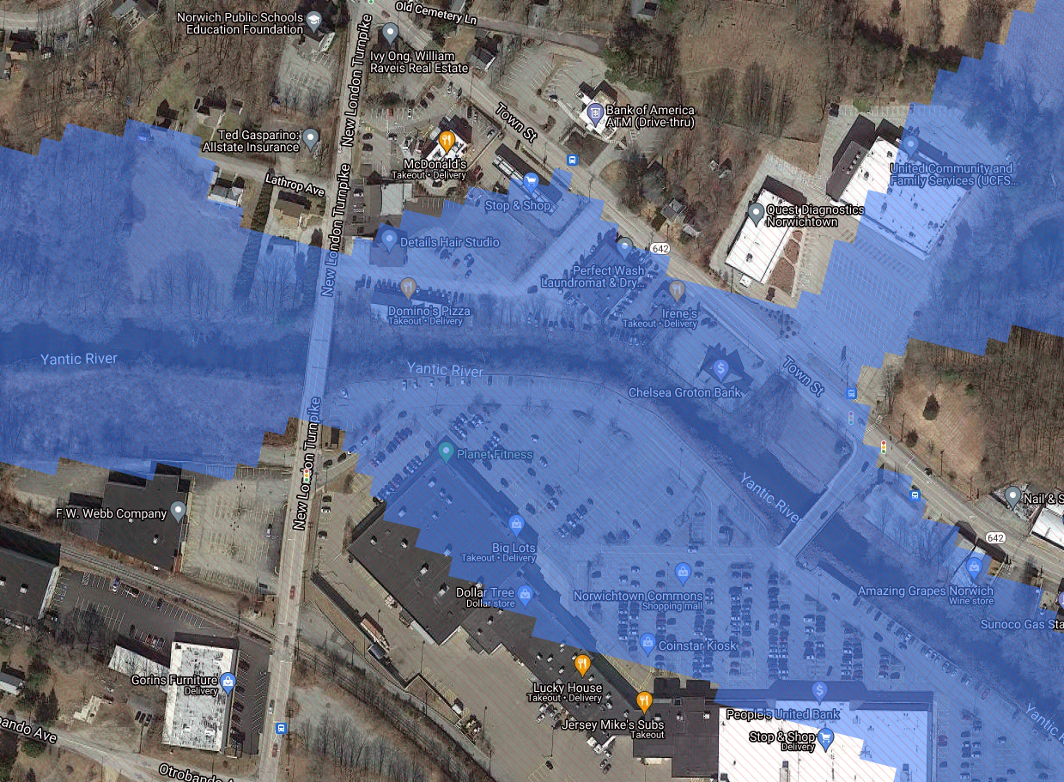
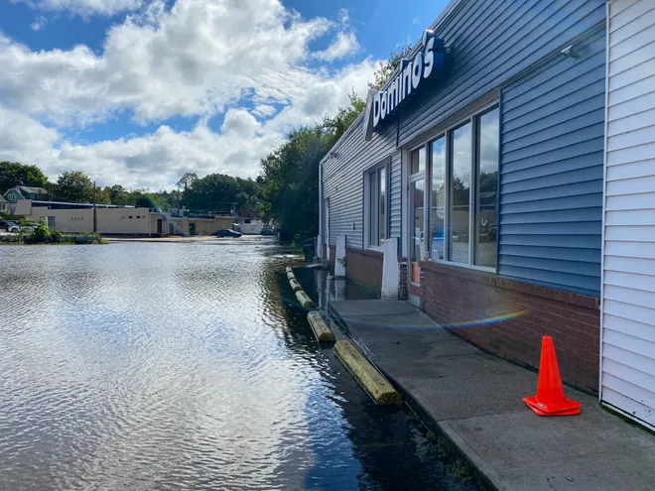
Value of FIM Services - Visualizations to depict impacts
Photo credit: Trevor Ballantyne Norwich Bulletin
Notes:
Creating that common operating picture: moving from a few statements of impact to a neighborhood level depiction of extent and potential impact

Slide 10
Integrating FIM Services into our IDSS
Disclaimer: This experimental map represents the NWS’s best approximation of inundation based upon modeled river discharge
High confidence of inundation in these areas
Yantic River at Yantic, CT
Forecast Crest Height: 11 Feet
Map Height Shown: 11 Feet
FIM Source: RFC FIM 5 Day Max Extent
FIM Type: Dynamic (Depth NOT Included)
FIM Creation Time: Sept 1st, 1 pm
Bridge overtopping not likely
Bridge overtopping not likely
Insert Hydrograph
9/1/2021 @ 1 pm
Notes:
NWC RFC R&R FIM example from 1/9/22

Slide 11
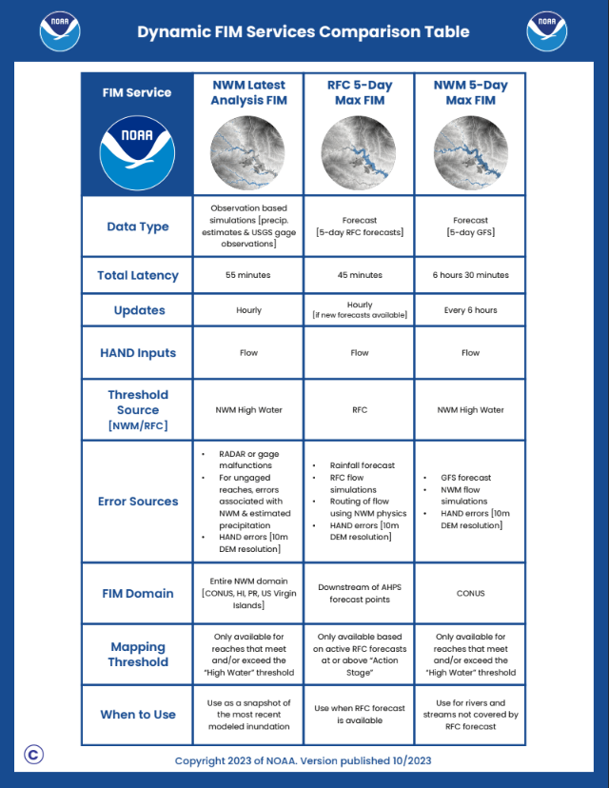
Initial FIM Rollout - National Viewer
Experimental Services - FIM for 10% of the U.S. population
Services available on our NWS National Viewer alongside the existing NWM visualizations
(https://viewer.weather.noaa.gov/water)
High Water Arrival Time, Max High Flow Forecast, & High Water Probability Forecasts
Rapid Onset Flooding Forecasts & Probability Forecasts
Actual services available for ingest into your local GIS systems

Slide 12
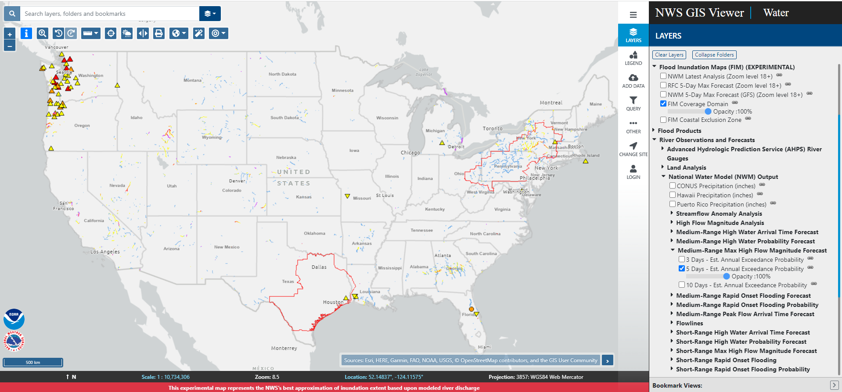
NWM and FIM Services - NWS National Viewer
-
Notes:
Link to Viewer & the QR Code

Slide 13
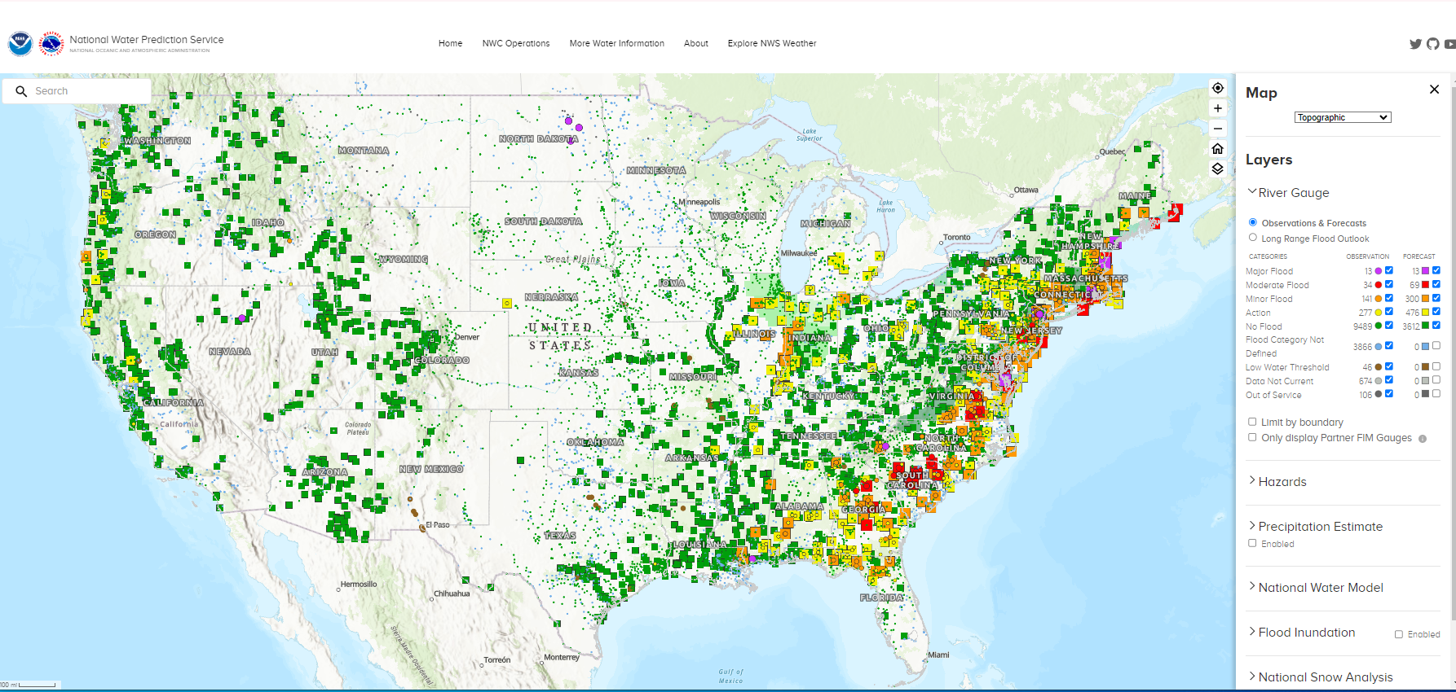
National Hydrologic Prediction System - coming in late March

Slide 14
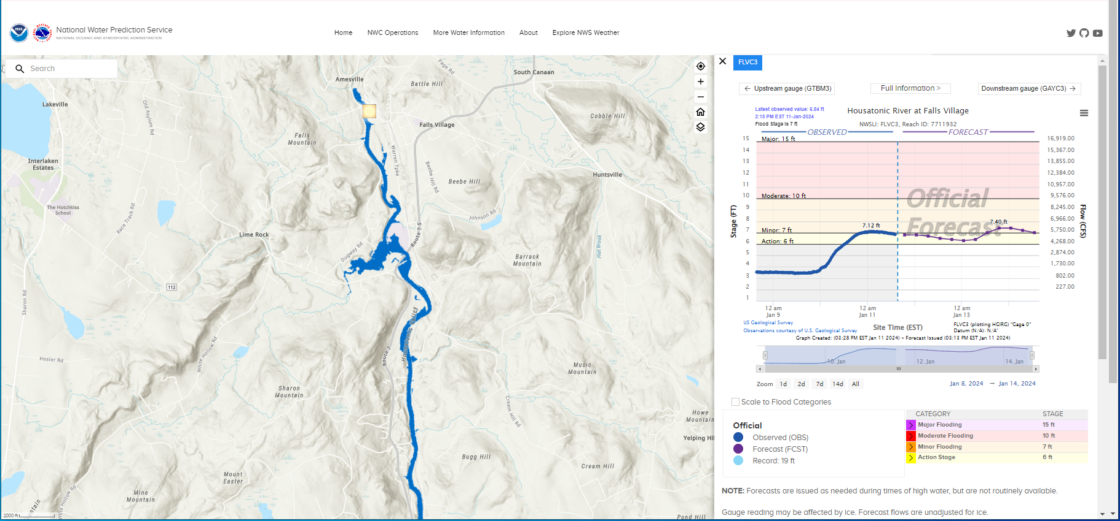
National Hydrologic Prediction System - coming in late March

Slide 15
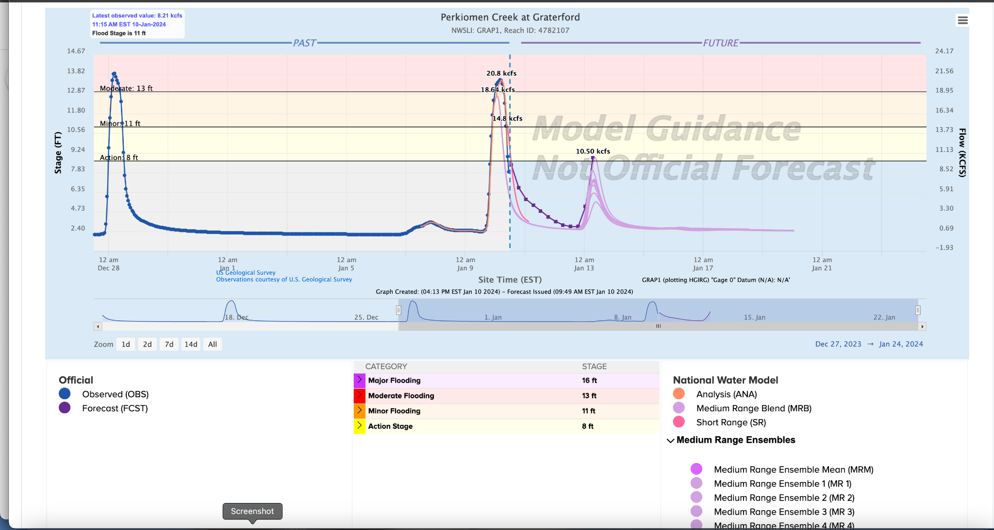
National Hydrologic Prediction System - coming in late March
Example of NWM Guidance for Perkiomen Creek, January 10th, 2024

Slide 16
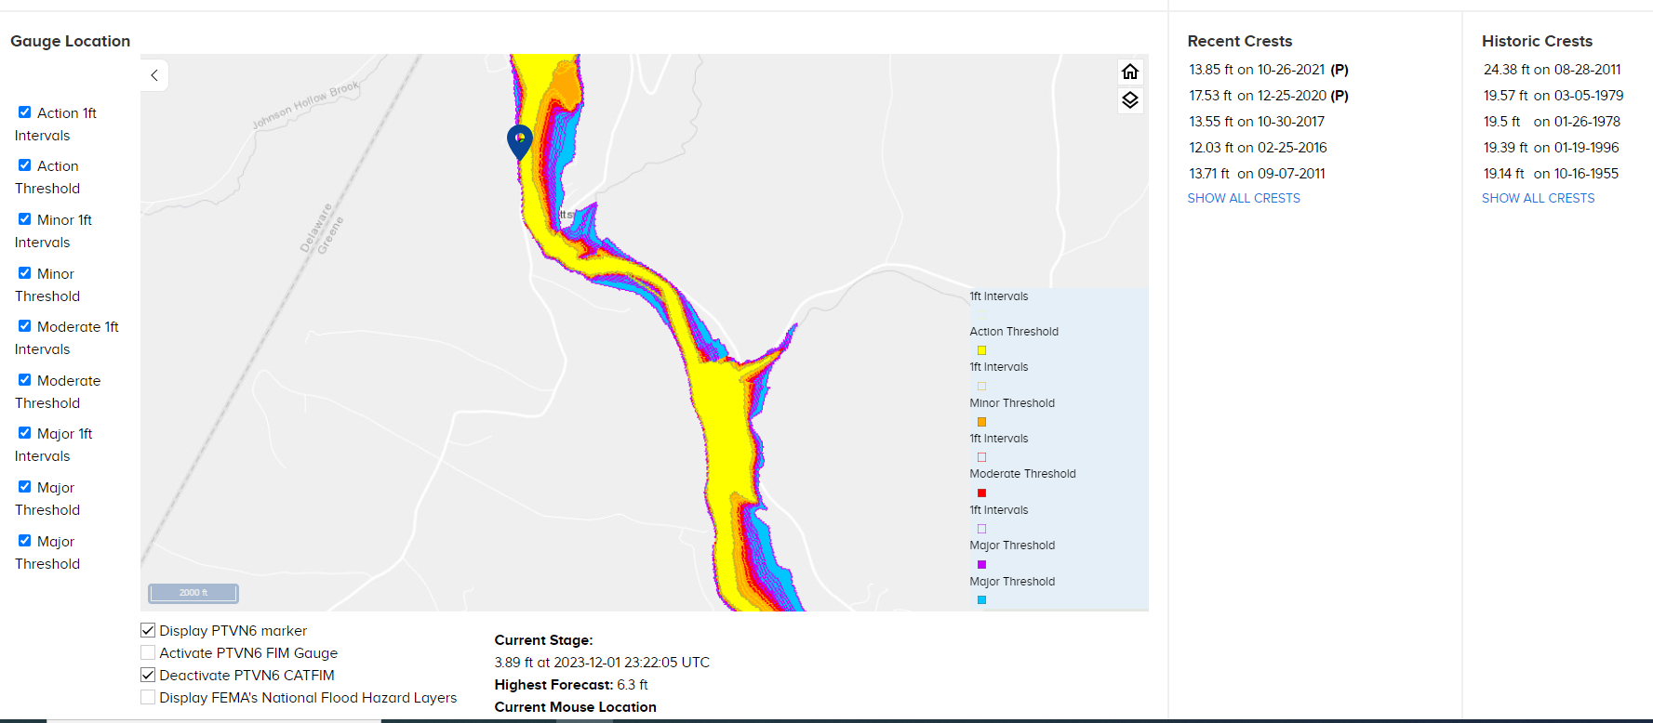
National Hydrologic Prediction System: Categorical FIM

Slide 17
Notes:
Explain the 4 year phased rollout: Training the forecasters, training our partners and evolving the science behind the services

Slide 18
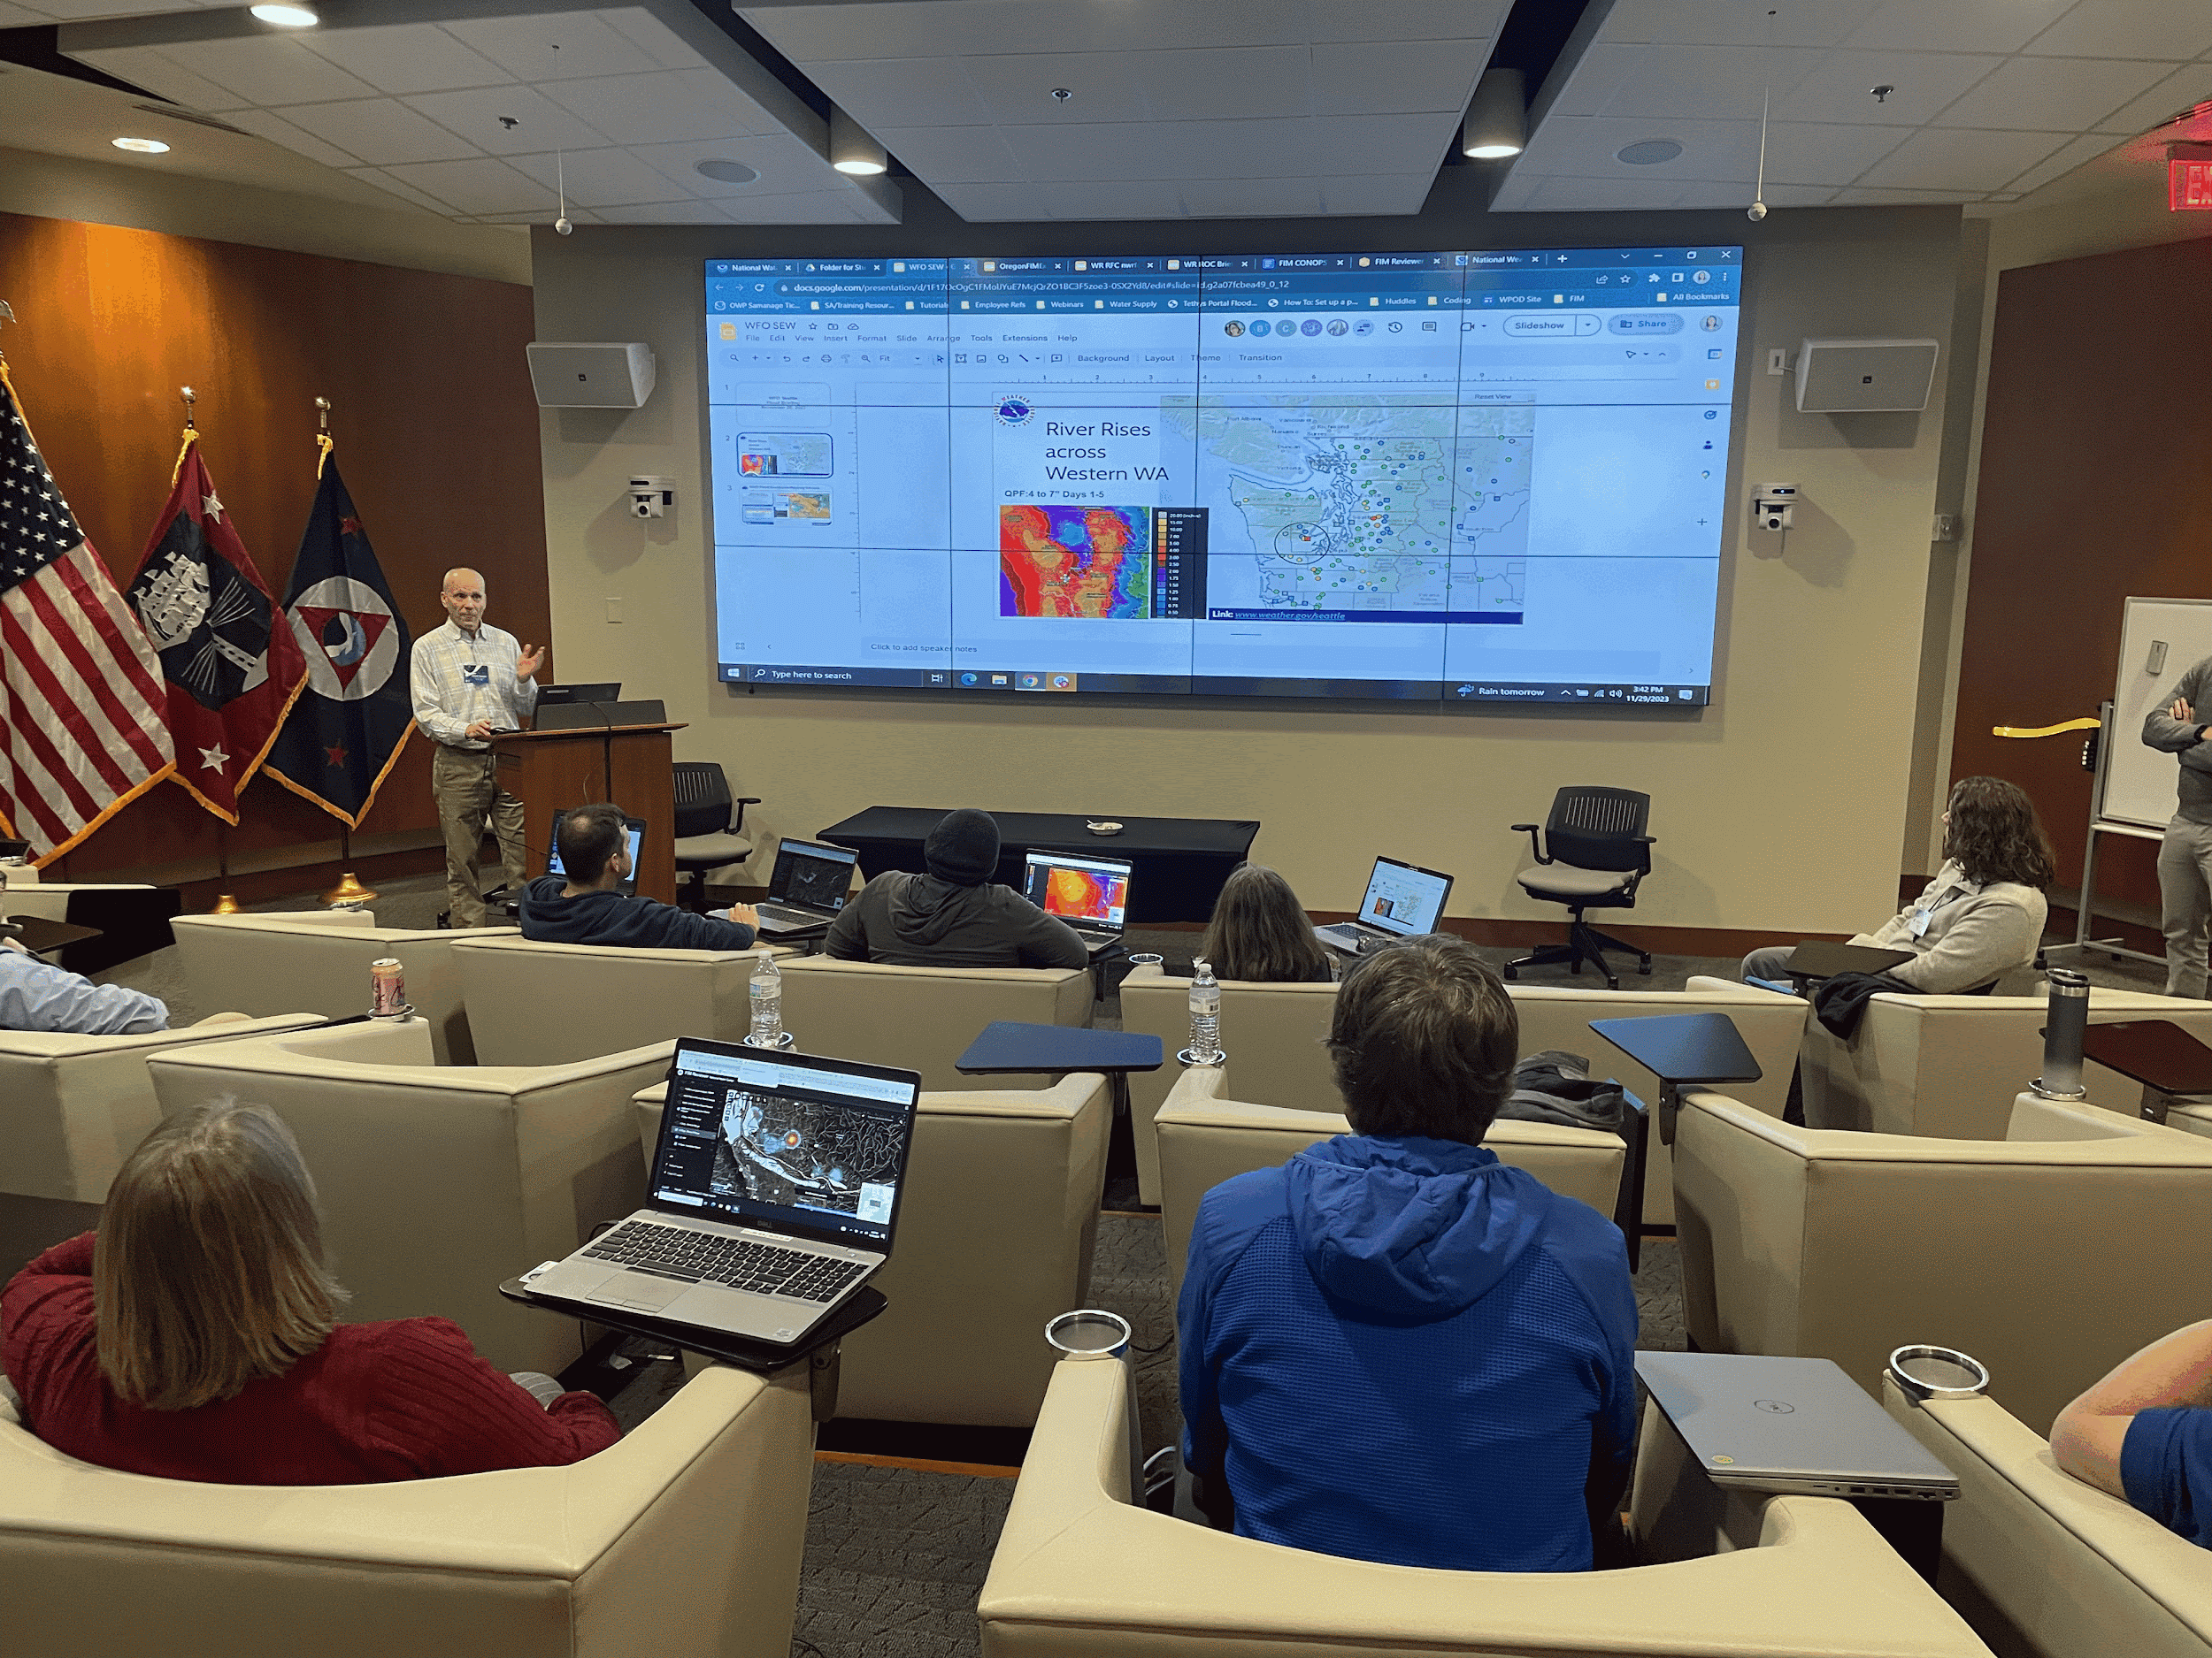
FIM IDSS workshops for field SMEs
Intensive 3 day workshop
2 people per WFO/RFC
Digging into the Science
Exercising the tools
Working actual events and delivering IDSS to partners
Facilitators included SMEs from the 10% offices!
Since November of 2022 we’ve trained:
~ 133 field staff in 52 offices
10 RFCs, 42 WFOs, 4 ROCs, and the NWS NOC!

Slide 19
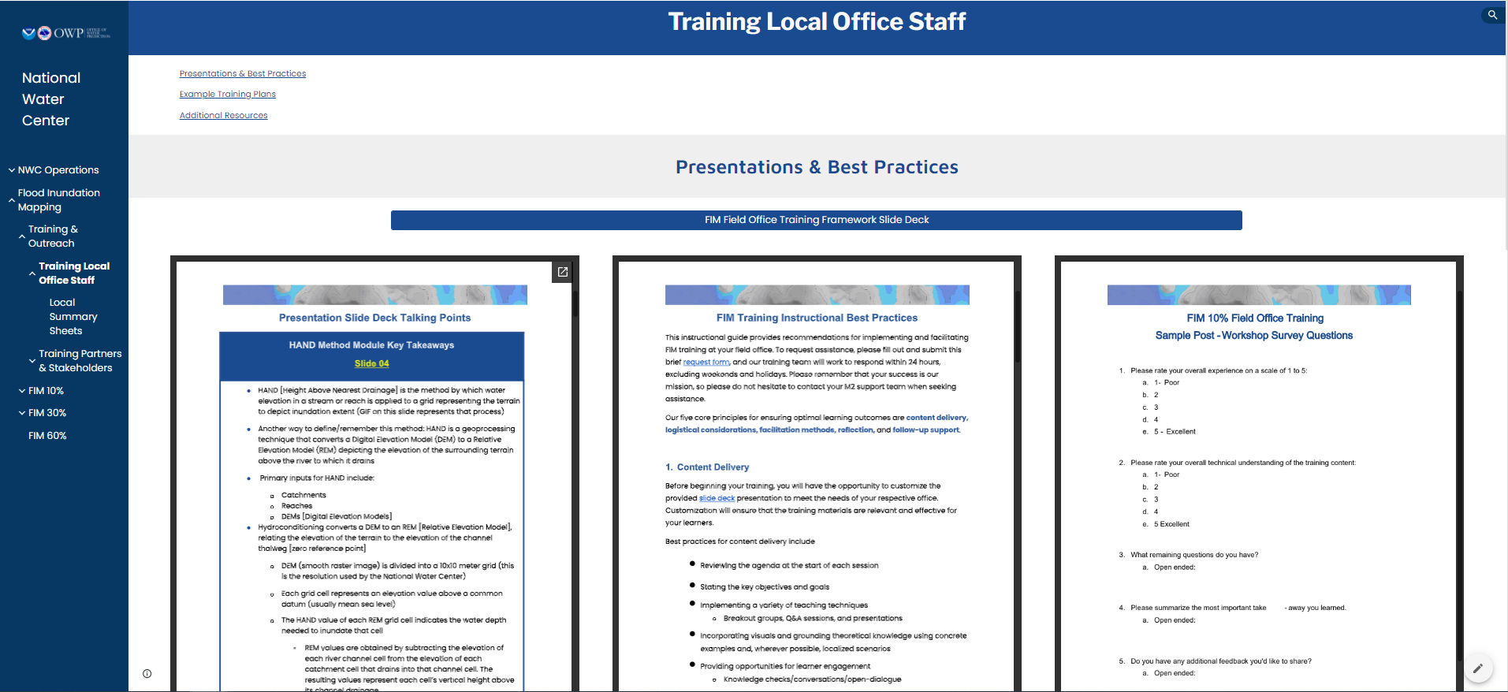
Local Office Training Resources

Slide 20
Partner Training Resources

Slide 21
FIM CONOPS Training Roadmap - Field Office Plan
Activities to executing FIM IDSS deliver by Sept 30th, 2024
Stakeholder Training
Field offices conduct hands-on training sessions and table top exercises for local partners. Complete by August 31, 2024
Rollout
Rollout NWS FIM Services to 30% of the nation by September 30, 2024.
Develop
Update existing materials for prerequisites to the FIM IDSS Workshops. Complete by June 1, 2023.
In-Person Workshops
Host FIM IDSS Workshops for local FIM SMEs for 30% offices. Complete by December 31, 2023.
2023 - Q4
2024 - Q2
2024 - Q4
2023 - Q3
2024 - Q1
2024 - Q3
2025 - Q1
Prerequisites
Office SMEs complete prerequisites by mid September - and attend several webinars leading up to your workshop * November 14-16, 2023 or * November 28-30, 2023
Review
Provide any necessary updates to training via webinars and job sheets. Complete by September 30, 2024.
Local Internal Training
Local FIM SMEs conduct local training sessions for staff. Complete by May 31st, 2024
Disclaimer: Dates for webinars ahead of each workshop TBD - and will be recorded!

Slide 22
Integration into the IMS Prototype

Slide 23
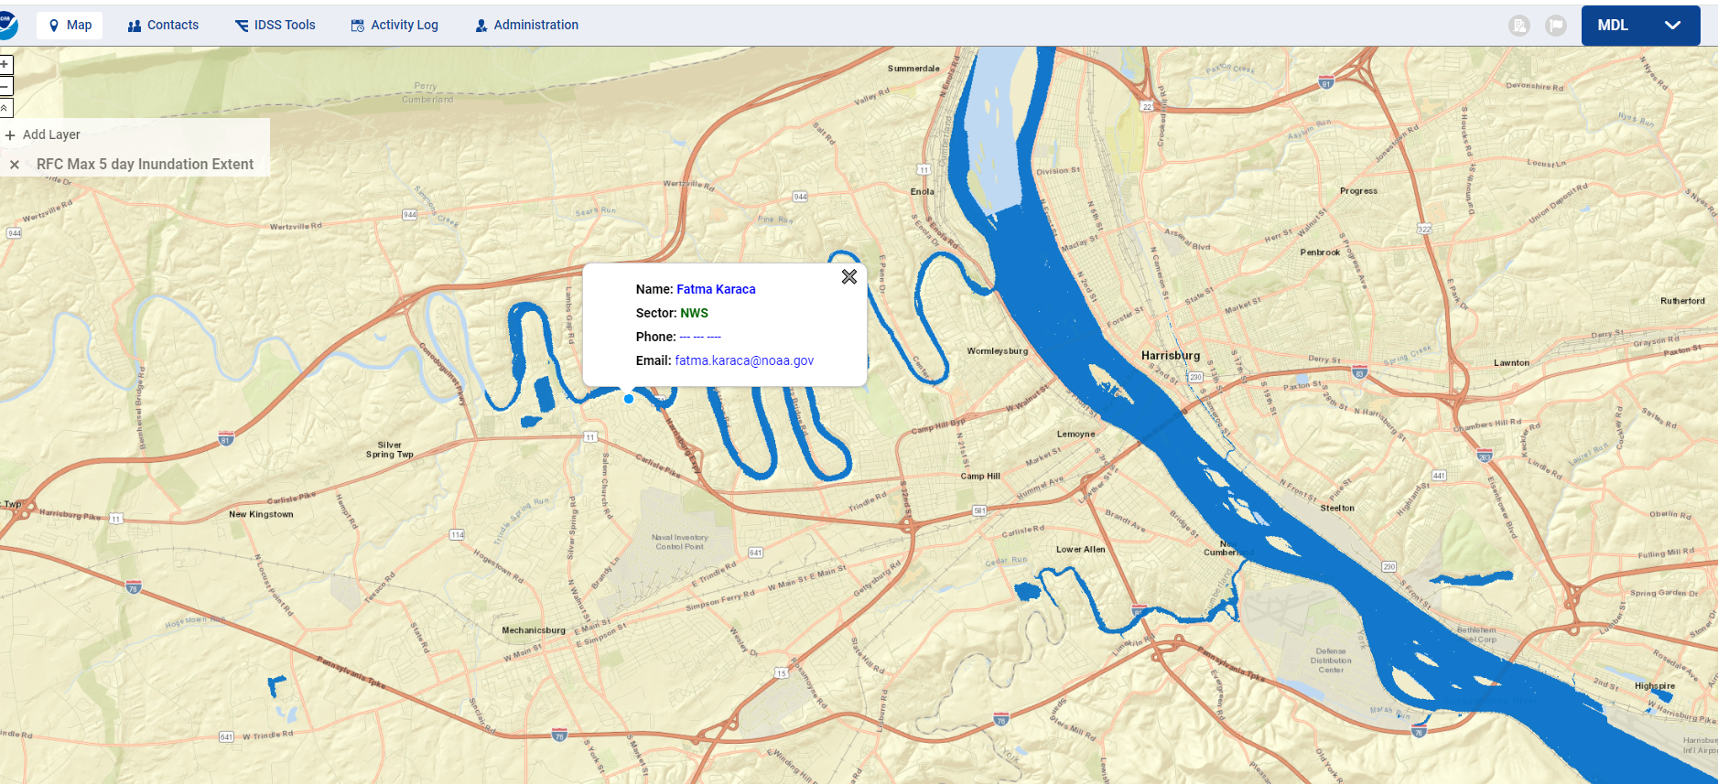
Prototype integration into IMS

Slide 24
Implementation of Forecast Flood Inundation Services To The Nation - An Update
David R. Vallee Director, Service Innovation and Partnership Division NOAA/NWS Office of Water Prediction/National Water Center

