Slide 1
RITT Presentation
Tom LeFebvre
GSD/ESRL
20 November 2013

Slide 2
What is FDSE?
The NWS Weather Ready Nation Roadmap outlines concepts for the future of forecasting in the NWS
Initially labeled Forecaster Decision Support Environment (FDSE), it has been renamed to: Environmental Intelligence Management Capability
Among the major concepts, FDSE is to enhance…
Situational Awareness
Forecast Confidence
Impact-based Decision Support Services (IDSS)

Slide 3
Task Development
GSD proposed a number of tasks to SSDs and three were selected
Forecast Grid Monitor
Short-term Forecast Update Tool
Enhanced Ensemble Capabilities for AWIPS II

Slide 4
Forecast Grid Monitor
Purpose: Situational Awareness
Allow forecasters to better understand the state of the forecast as compared to
Observations
Numerical Guidance Forecasts
Consensus Forecasts

Slide 5
Forecast Grid Monitor
A framework that compares combinations of GFE forecast grids:
Gridded Analyses of Observations:
RTMA
MSAS
“Obs” grids
Gridded Forecasts:
Official, “Fcst”
Downscaled Numerical Guidance Forecasts
Consensus forecasts

Slide 6
Forecast Grid Monitor
How it works
Reads GFE grids (observational and forecast)
Performs some operation to compare grids for the same valid time
Displays the results of that algorithm

Slide 7
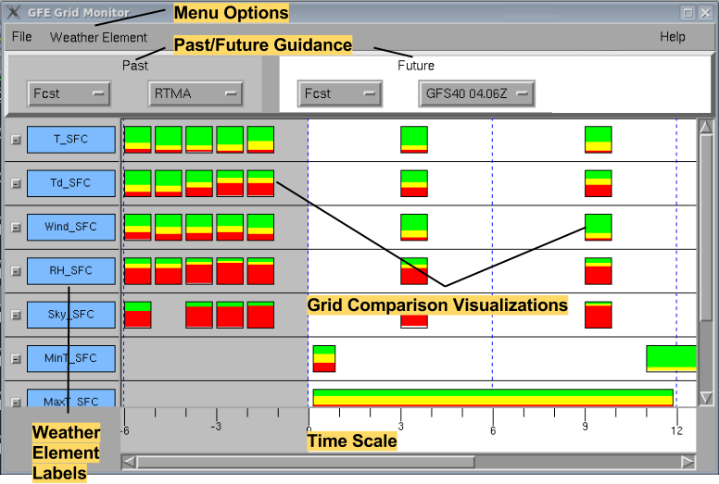
Grid Monitor GUI

Slide 8
Grid Monitor GUI
Menu Options – Add / Remove weather elements
Past / Future Guidance – Sets data sets to compare
Weather Element Labels – Identifies weather element
Time Scale – Time in hours from now
Grid Comparison Visualizations – Graphical representation of the algorithm results

Slide 9
Grid Comparisons
Grid Comparisons are designed to be very flexible
Existing algorithms can be modified
New algorithms can be created
Each algorithm has access to raw data:
Two grids to compare
The Edit Area over which to do the comparison
The rectangle in which to draw/paint
Algorithms can draw:
Graphical Objects
Text

Slide 10
Grid Comparisons
Grid comparison algorithms can be customized for particular weather elements
Users only need to add the algorithm and restart the Grid Monitor (no configuration required)
Each element can use a different comparison algorithm
Seeking ideas for new algorithms

Slide 11
Grid Monitor – Drilling Deeper
Grid Monitor allows forecasters to also investigate comparison details
Histogram – Plots overlaid to reveal bias
Error Histogram – Histogram of error grid
Scatterplot – X vs. Y plot (e.g., Fcst vs. Obs)
Difference Grid – Displays in GFE to show where differences are greatest

Slide 12
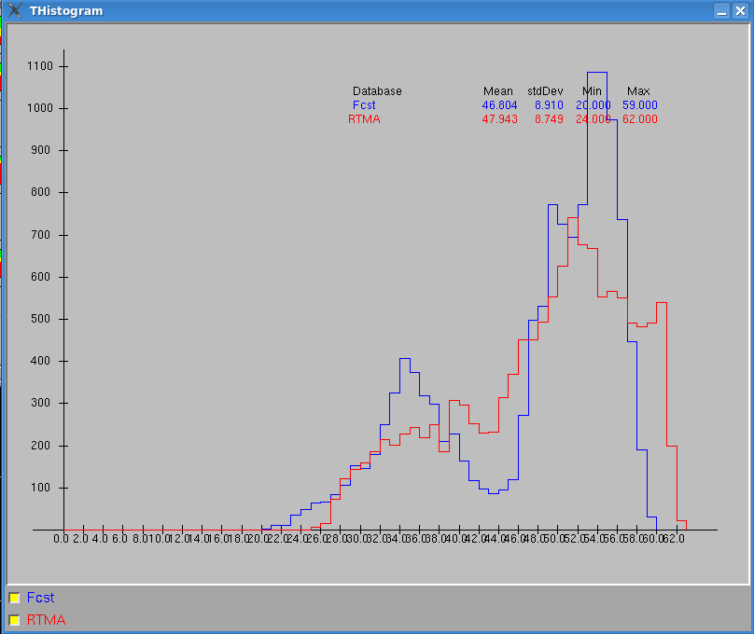
Grid Monitor - Histogram

Slide 13
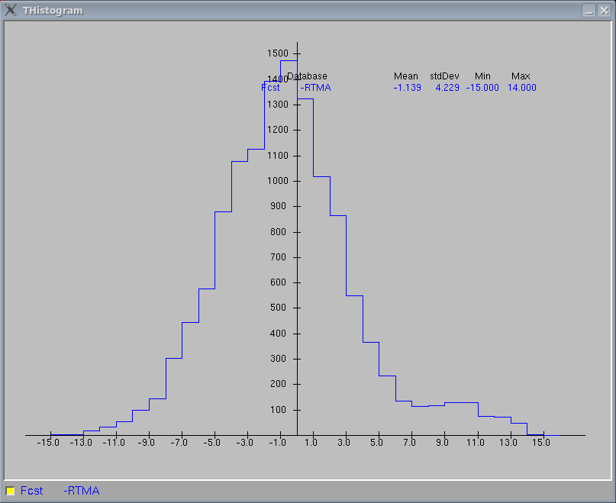
Grid Monitor – Error Histogram

Slide 14
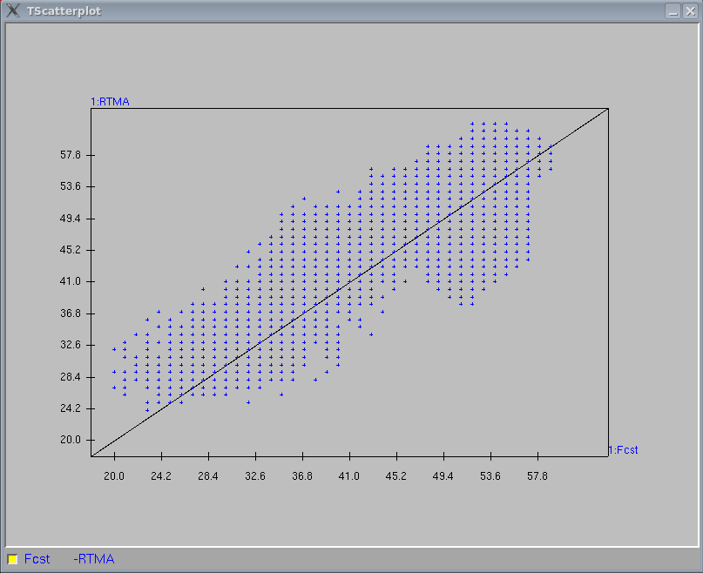
Grid Monitor - Scatterplot

Slide 15
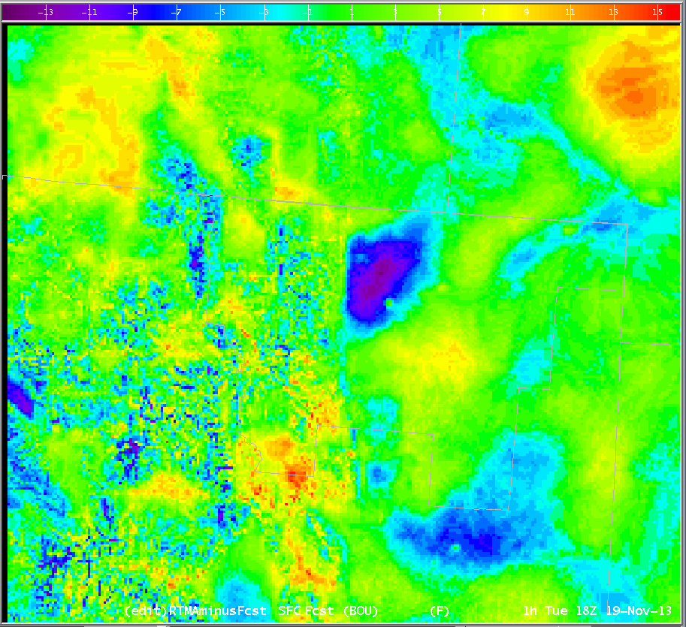
Grid Monitor – Difference Grid

Slide 16
Grid Monitor - Future Work
Currently gathering feedback from some field offices:
Allow for display of single weather element from many sources to view model performance
Display models vertically instead of weather elements
Allow grid comparisons to calculate areas of predicted watch, warning, and advisory criteria
Plot some text summary of grid comparison

Slide 17
Grid Monitor
Thanks for listening!
Questions?
Comments?
Discussion?

