Slide 1
Improving IDSS: Enhancing Forecaster Situational Awareness of Extreme Rainfall Events
Daniel Nietfeld, Richard Grumm, Stanley Czyzyk, Trevor Alcott, Jon Zeitler and Joshua Scheck

Slide 2
Project Overview
Goal:
Validate and deliver a situational awareness tool
Anticipated Result:
Provide improved IDSS for top 1% rainfall events
Notes:
Based on a need identified by previous service assessments, this project was designed and funded by STI to demonstrate a new model for SOO teams to work on projects of regional or national importance.
Scope:
Help forecasters make better predictions of top 1% precipitation events
Validate and deliver at least one operational situational awareness tool based on ensemble predictions of extreme precipitation ingredients.
Expected Benefits:
Improve IDSS to core partners and public.
Remove the element of surprise from top 1% events.
Make risk categorization objective using probabilistic ensembles.
Increase POD for top 1% events.
Overall reduction in loss of life due to top 1% events.

Slide 3
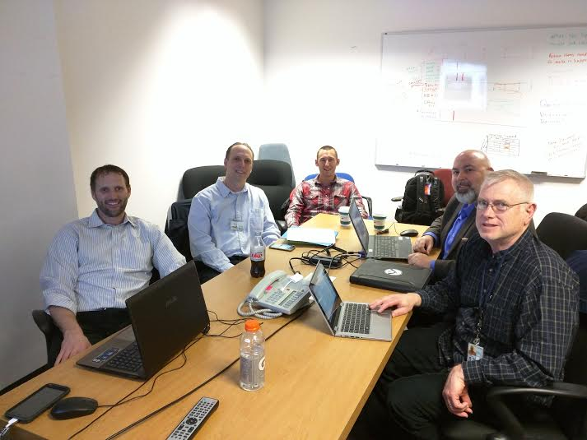
Where we are...
Kelly Mahoney (ESRL PSD), David Gochis (NCAR RAL), and Rob Cifelli (ESRL PSD) → WRF Hydro
Curtis Alexander, Isidora Jankov, Tim Schnieder, and Steve Weygandt from GSD → HRRR RAP Development
Tom LeFebvre, Paul Schultz, and Woody Roberts (GSD) → GFE Situational Awareness Display
Russ Schumacher (CSU) → NOAA 14 (ARI)
Tom Hamill (ESRL PSD) and Tom Galarneau (NCAR MMM) → PQPF & Analogs

Slide 4
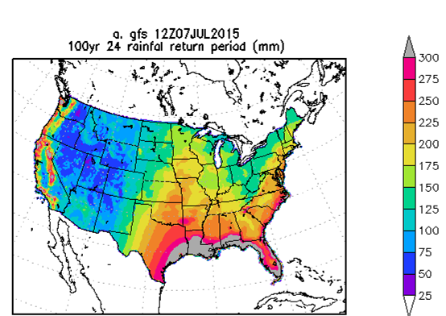
Key Considerations
M-Climate vs. R-Climate
Raw QPF and M-Climate vs. Post-processed QPF and R-Climate
AWIPS II vs. web-based
Experimental datasets
NOAA Atlas-14 limitations
OCONUS needs
NCEP and RFCs also need to be included

Slide 5
Critical Questions
Should GSD be contracted?
Should tool be centrally processed?
What platforms and perspectives should display?
Which framework, GFE or Web based?

Slide 6
Mockup of Situational Awareness Dashboard
HRRR Time lag: last 3 HRRR runs
1 hour exceedances
SSEO: HIRES NMM and ARW
NAM Nest last 2 cycles
3-hour exceedances in AWIPS
SREF MME: Use NAM, SREF, and/or GFS
GEFS: Either GEFS vs M-Climate or
Calibrated GEFS vs R-Climate
6-hour exceedance
National Blender R-Climate
Official R-Climate

Slide 7
A simplistic view...
QPF
How much will fall?
Climatological Significance
Is that a lot?
Significant Rainfall
Return Interval and Coverage
Antecedent Conditions
Terrain, Soil Type, etc.
Soil Moisture and Streamflow
Hydrologic Response
Will it flood?

Slide 8
Fractional Percentages
Display the percentage of 100 year interval precipitation reached by highest QPF data point in domain, including all members.
Notes:
Make image of slide 6 and wash out

Slide 9
Phase 1
Prototype
Contains HRRR Time lag, SSEO, GEFS, NBM, and Official
Color curves consistent with HazSimp
Uses 100 year recurrence interval
National mosaic as provided by Russ Schumacher
CONUS-wide NOAA Atlas-14 not available
Displays exceedance of 100-yr recurrence interval and fractional percentages

Slide 10
Phase 2
IOC
Available via software collaboration portal (SCP)
Still needs to have colors calibrated to probability values
We want to make sure we are appropriately signalling risk
Probability of exceedance thresholds used for OCONUS
Tested via OPG/testbeds
Prototype NCEP solution

Slide 11
Phase 3 (Full Implementation)
Color table thresholds are calibrated
Training and case studies formalized
Color table thresholds are calibrated
Verification and validation
Full NCEP solution implemented

Slide 12
Phase 4
Wishlist items
Centralized post-processing
FFMP and/or FLASH integration
Basin-based alerting
Integration of WRF Hydro
Implement ECMWF and CMC M-Climates (possibly HRRR)
Evolution of calibrated PQPF from GEFS and SREF (HREF/SSEO)

Slide 13
Contractor work
Build GFE/A2 R-climate for NOAA-14 currently on 4km grid
Build GFS/A2 M-Climate for GEFS 1x1 degree grid
GFE SmartInit and procedure development (primarily in Python)
Verification and validation of tool
SCP software maintenance
Notes:
The contractor will be managed by WPC, located in Boulder, housed at the WFO, and down the hall from GSD and PSD. This highlights the team’s emphasis on strong collaboration between NCEP/WFOs/OAR efforts.

Slide 14
Other Team Work
Training on using SA tool in GFE
Training on using NOAA 14 and M-Climate
Case studies across NWS WFO/RFC/WPC
How it can work for YOU!

Slide 15
Paradigm shift in forecasting M-Climate: internal model based climate
Models produce known patterns
Forecasters can recognize these
Models can produce strong signals relative to climatology
Model knows where it has the lift
Where each member produces QPF
In correct pattern get QPF
Ensemble provides probability
M-Climate provides potential for high impact event

Slide 16
Events for 2014/2015 are catalogued
Recent events: 17-18 July 2015 NV-CA
May 2015 flooding rains southern Plains
Ohio Valley events
Western heavy rains December (2014) and January 2015 (December event →)

Slide 17
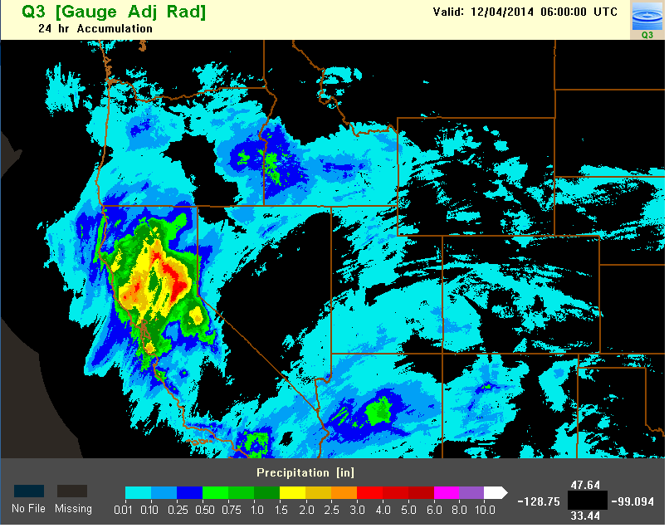
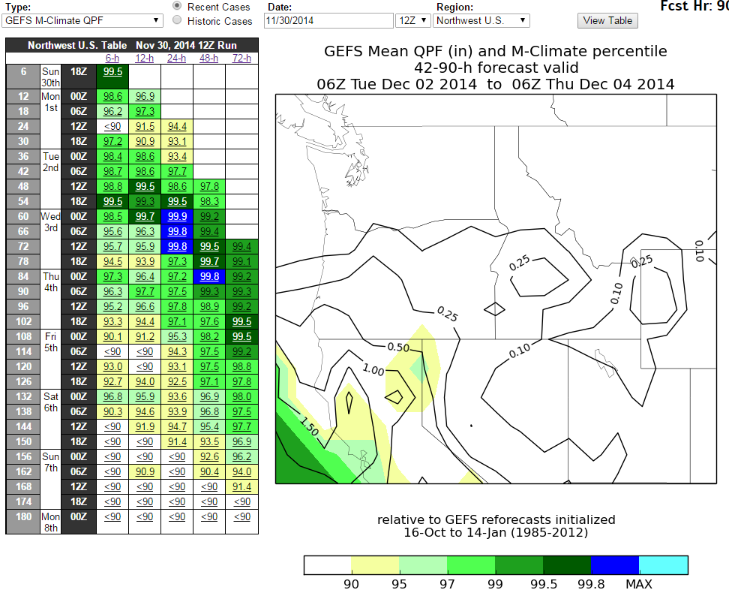
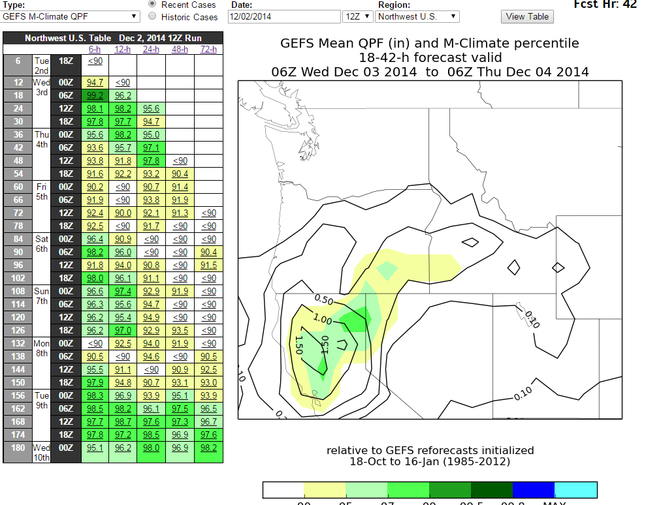

Slide 18
Plains Example
Texas Rainfall 5-6 May
There was a signal for this convective event
Maximum in NMQ Q2 was 10 inches
Resolution matters here
Louisiana Rain
Mesoscale so some signal but not great

Slide 19
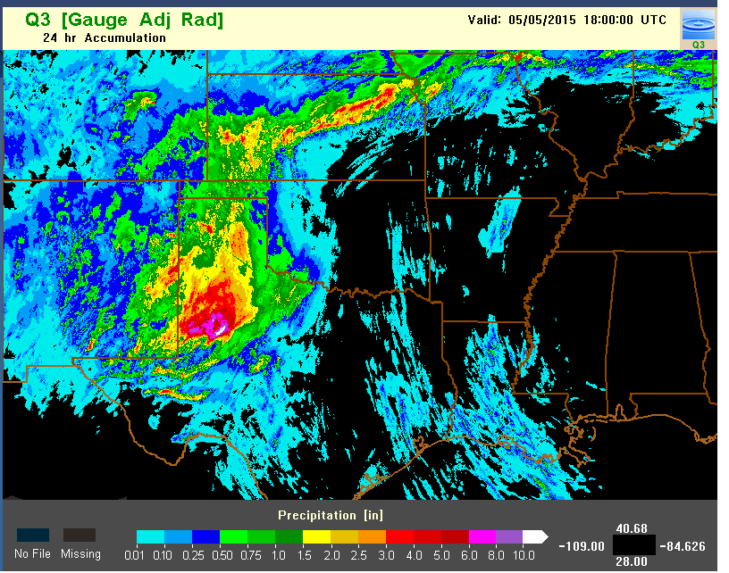
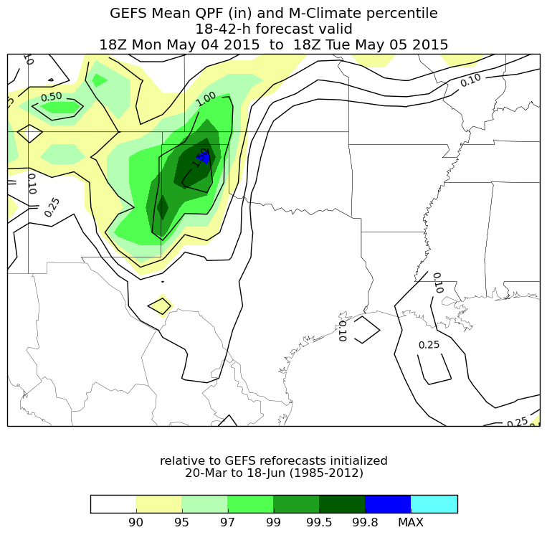
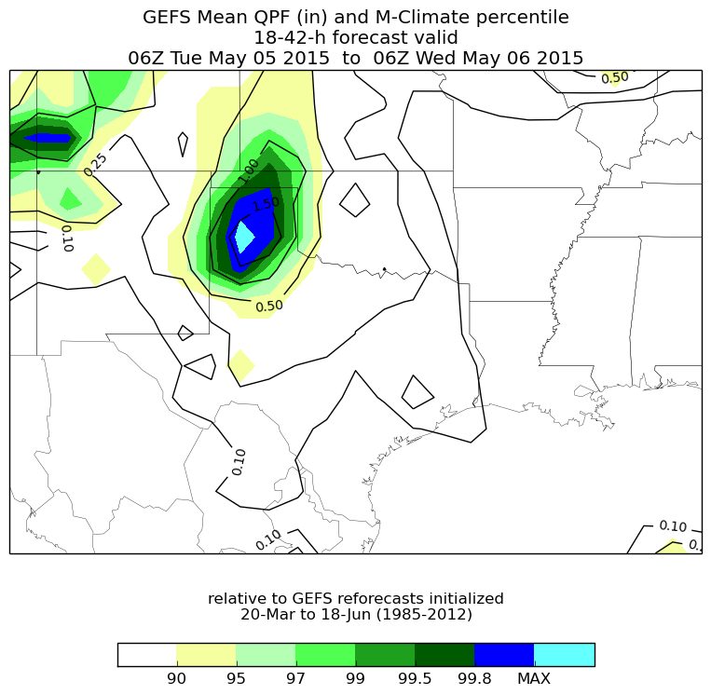

Slide 20
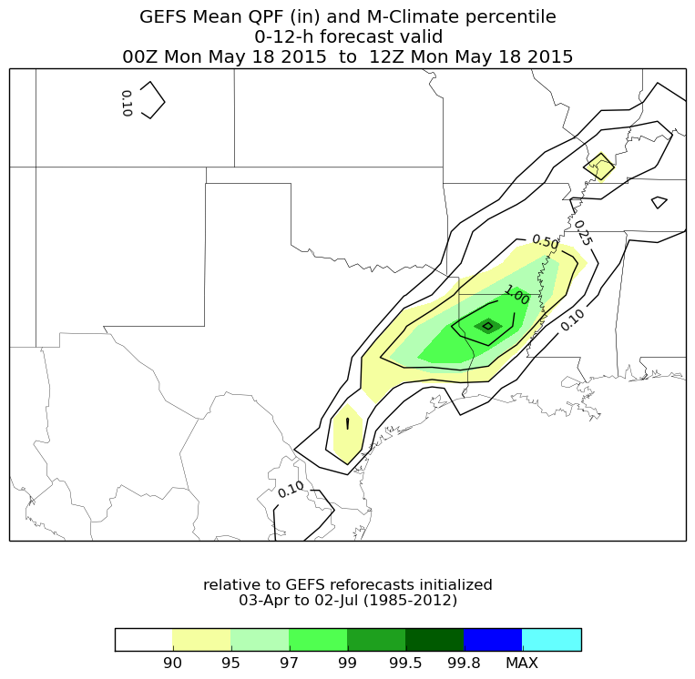
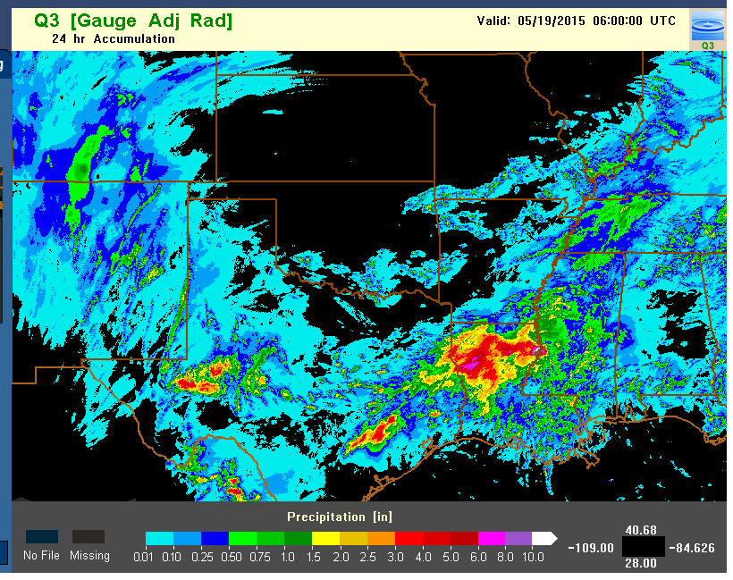

Slide 21
24 May 2015 OK-TX
Big rainfall event
Texas- Oklahoma area
Had some signal in GEFS M-Climate
Why? Good pattern and model had some knowledge of instability and where lift might be
Time to use other tools to help us here

Slide 22
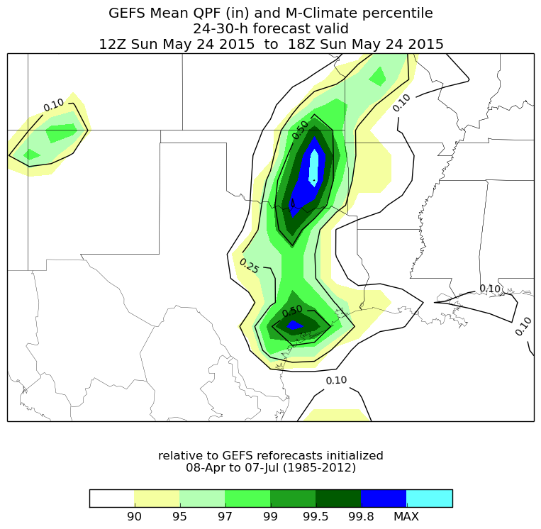
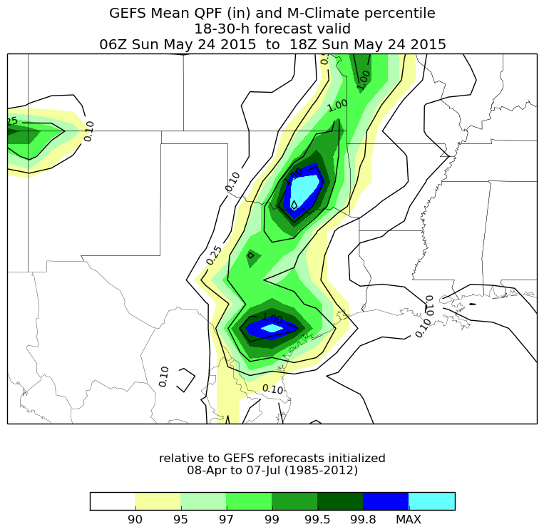
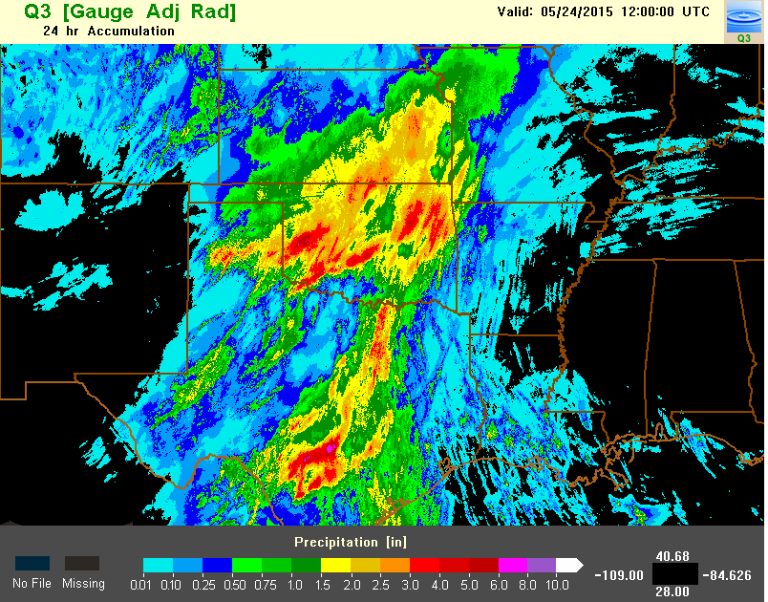

Slide 23
Average Return/Recurrence Intervals: ARI R-Climate: based on some observed dataset
NOAA-14 and NOAA-40 provide us with return periods
Our models and EFS produce forecasts QPF
We can relate the two to identify extreme rainfall
These data lack antecedent condition information
But help us with flood and flood potential issues

Slide 24
24 hour 100 year ARI
ARI on GFS Grid
Mix of NOAA-14 and NOAA-40
We can define forecasts of significant rainfall events.
Other intervals are available.

Slide 25
24 May rainfall and flood case GFS forecasts
Southern Plains ARI
Big rainfall event
24 hour GFS data shown here verse 100 year return periods

Slide 26
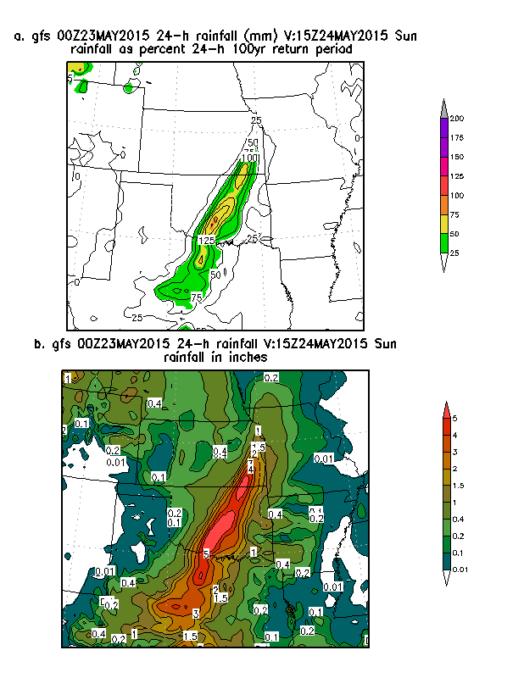
Static Image and Loop

Slide 27
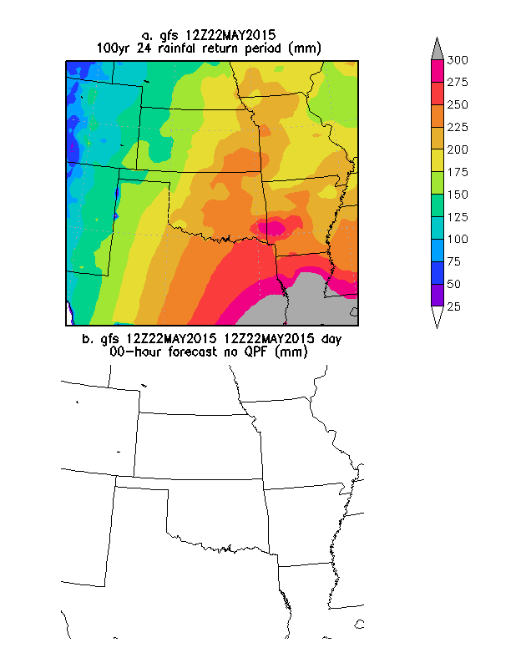
22 1200 and 23 12 Z forecasts

Slide 28
Summary
The GEFS M-Climate helps identify potential big rainfall events
We did this without patterns and pattern recognition
EFS members know & where the lift is or may be.
Clues even in convection
M-Climate and ARI hold out lots of hope for an alert system
Need to build provable case library

Slide 29
Backup Slides

Slide 30
Acronyms and terms
SCP: Software Collaboration Portal
R-Climate is based on NOAA14 and, where not available, NOAA40 data 2 and 100 year return periods.

Slide 31
Some examples using the concepts
Forecast paradigm shift
Recent cases with M-Climate and ARI data

