Slide 1
Weather and Climate Operational Supercomputing System (WCOSS) - An operational perspective
Steven Earle
Lead Production Analyst
NWS/NCEP Central Operations
February 20, 2019

Slide 2
Outline
Introduction to NCEP Central Operations and WCOSS
History of supercomputing at NCEP
Today’s system - WCOSS
Today’s Computers -- WCOSS
Research to operations - Challenges
The future WCOSS

Slide 3
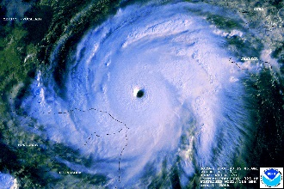
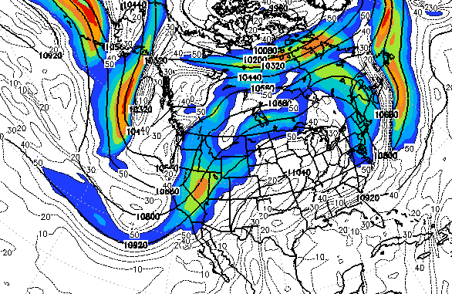
NWS National Centers for Environmental Prediction
Aviation Weather Center Kansas City, MO
Space Weather
Prediction Center
Boulder, CO
Storm Prediction Center
Norman, OK
National Hurricane Center
Miami, FL
NCEP Central Operations
College Park, MD
(Supercomputers in
Reston & Orlando)
Ocean Prediction Center
College Park, MD
Climate Prediction Center
College Park, MD
Environmental
Modeling Center
College Park, MD
Weather Prediction Center
College Park, MD
Mission
NCEP delivers national and global operational weather, water and climate products and services essential to protecting life, property and economic well-being.
Vision
The trusted source for environmental predictions from the sun to the sea, when it matters most.

Slide 4
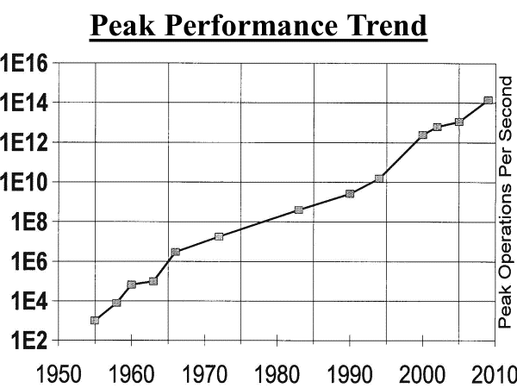
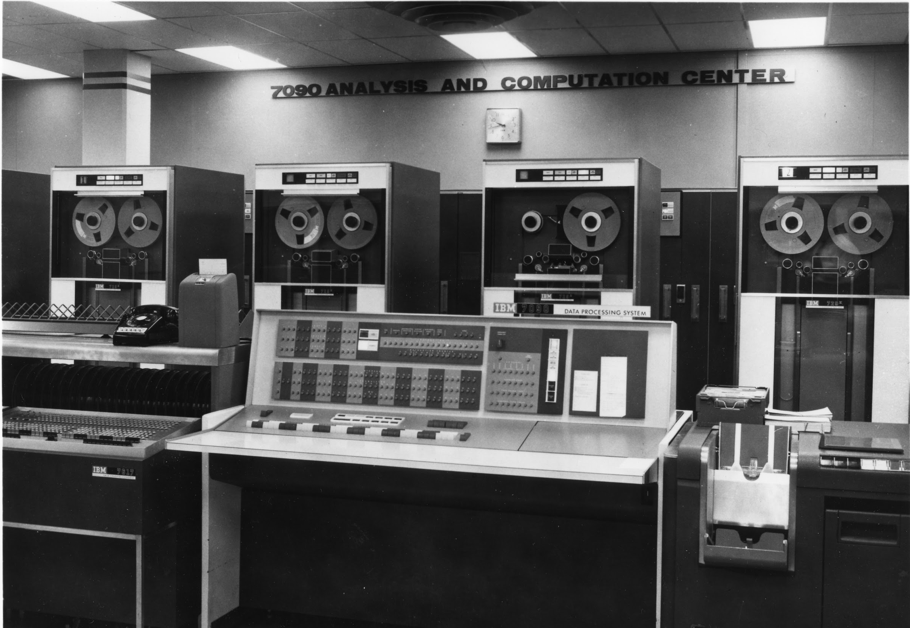
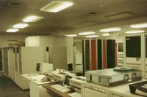
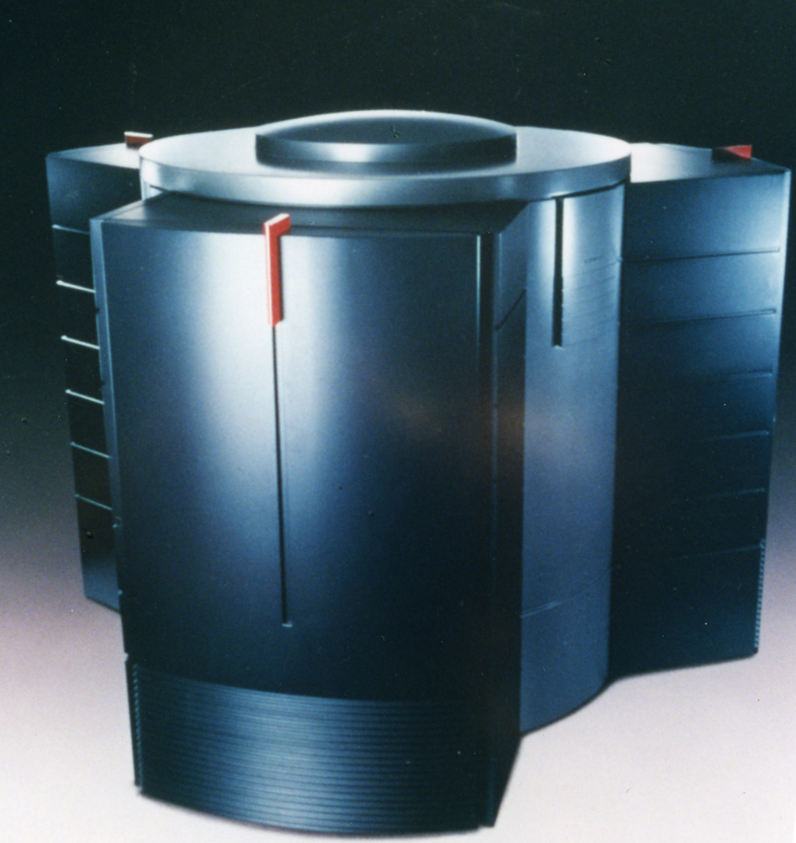
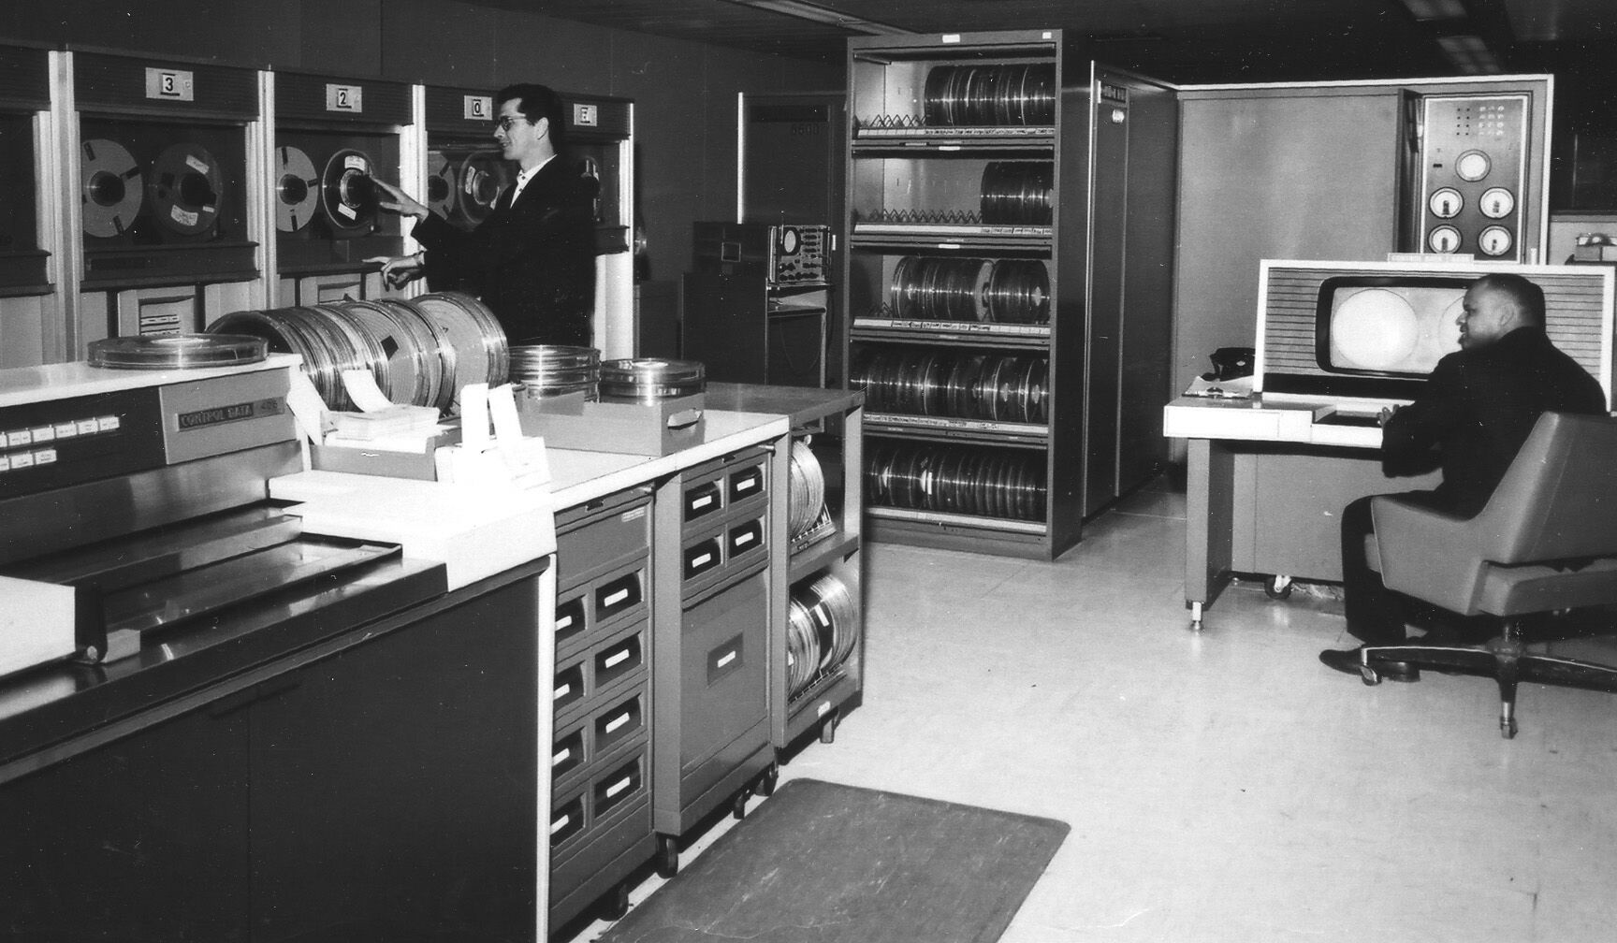
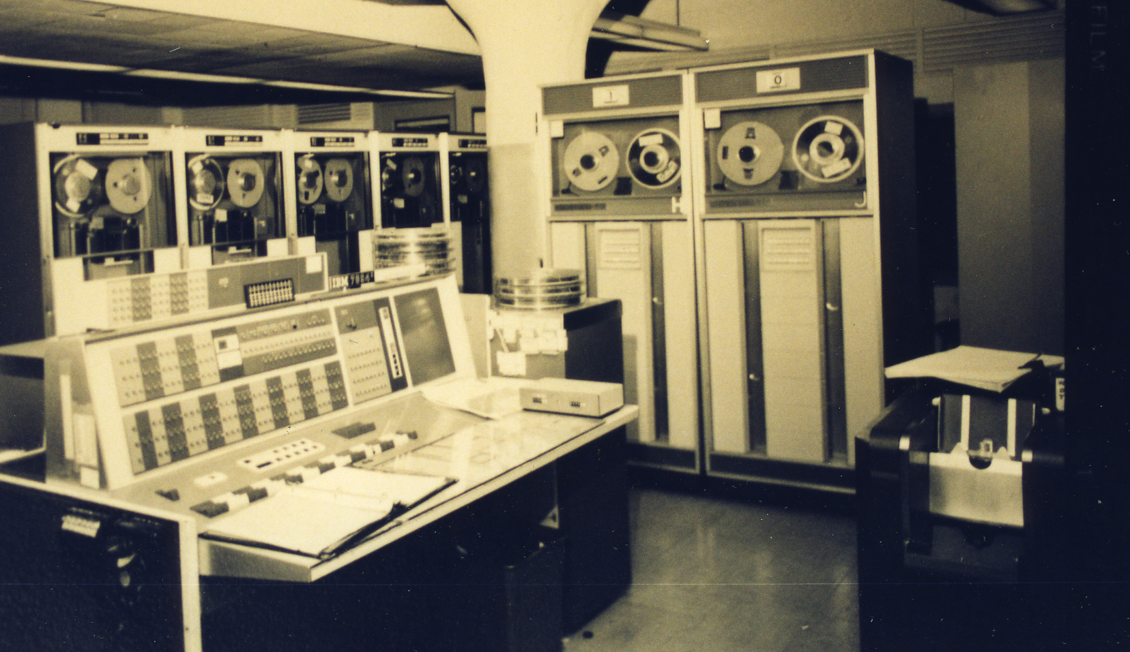
Supercomputing in NCEP
The National Weather Service purchased our first supercomputer in 1955 –
the last of the IBM 701s

Slide 5
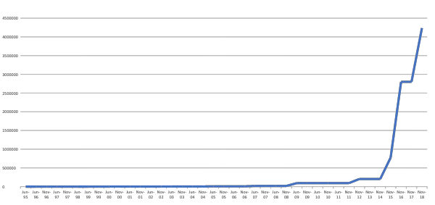
NWS Operational Computing Over the Last 20 Years
WCOSS Contract --IBM
4 upgrades
Crays
2 upgrades
CCS Contract -- IBM
5 upgrades plus initial test system
4.2
Pflops
Performance (Flops)
204
Tflops
3 Gflops
614 Gflops
93 Tflops

Slide 6
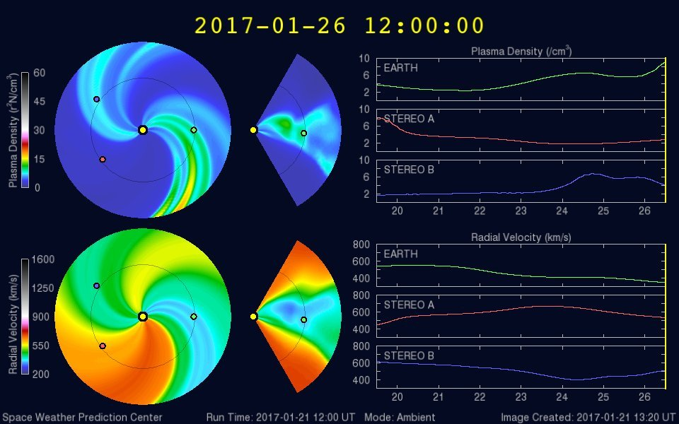
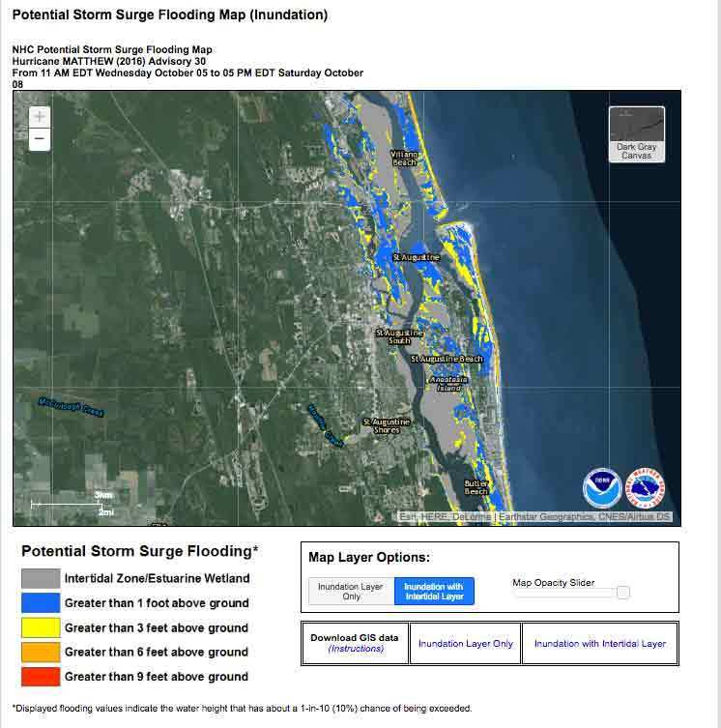
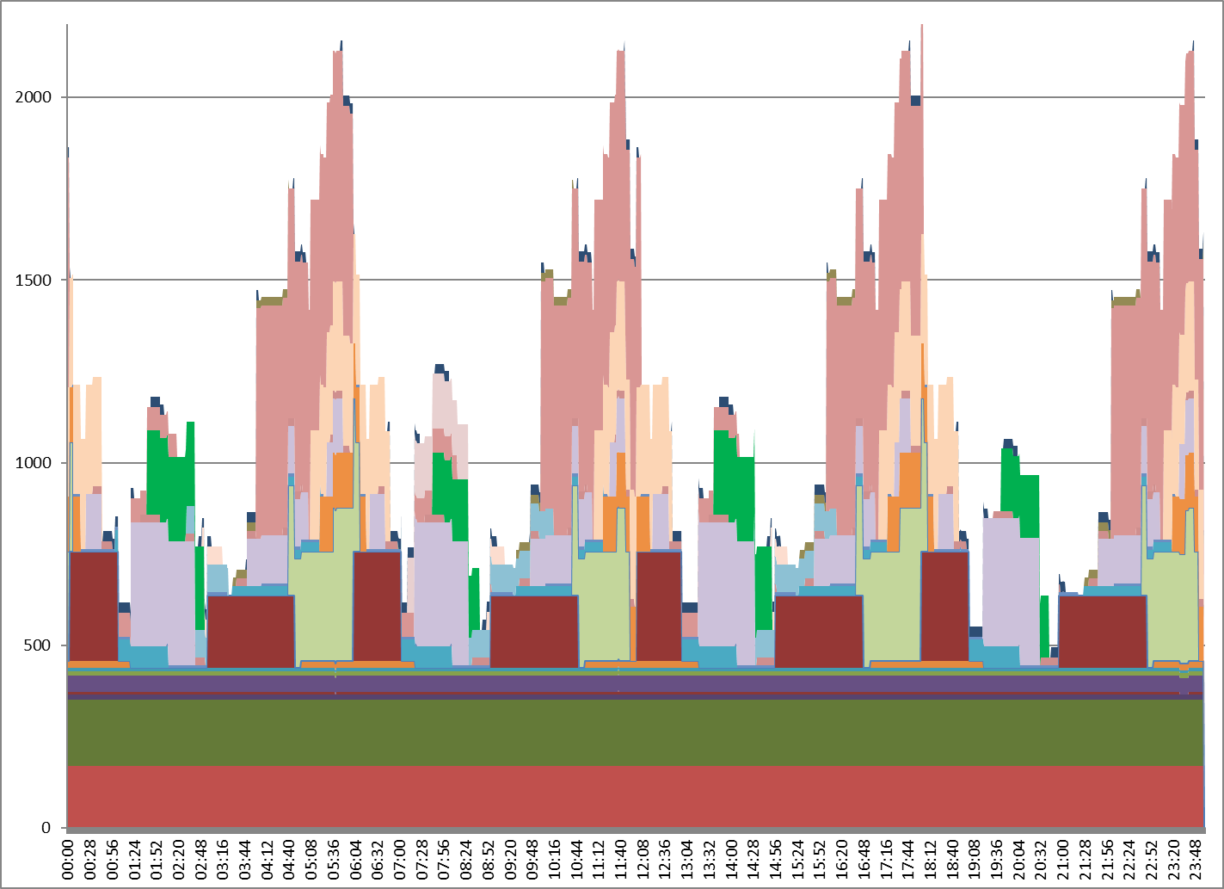
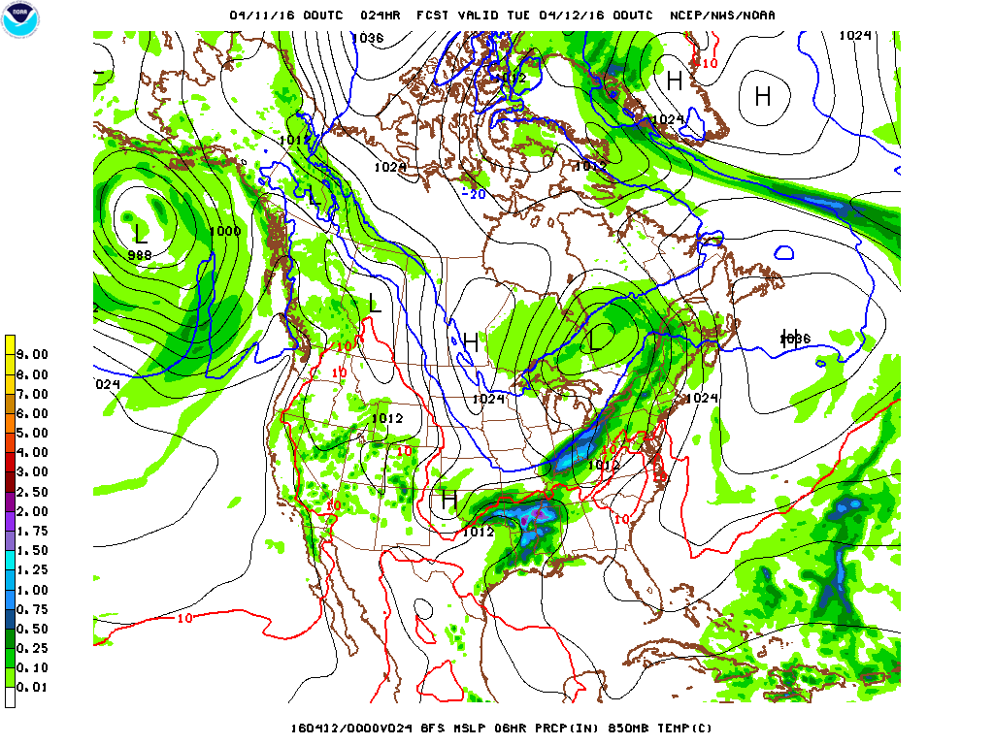
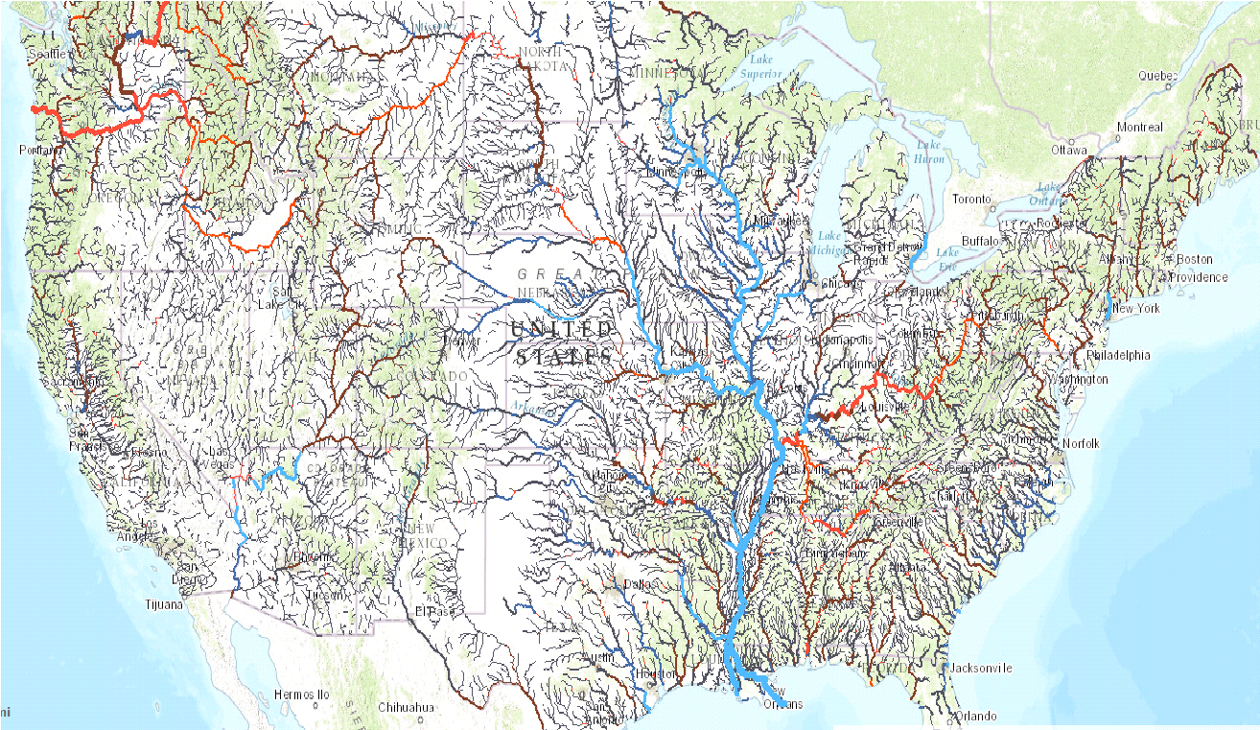
NCEP Production Suite (NPS)
30+ major models and associated applications from across NOAA – air, water and space
24x7 operation. Goal: routine, reliable and consistent product delivery times
HWRF
SREF
Number of Nodes
NAM
GEFS
GFS – Global Forecast System
CFS – Climate Forecast System
NWM – National Water Model
HRRR – High Resolution Rapid Refresh
GEFS – Global Ensemble Forecast System
NAM – North American Model
SREF – Short-Range Ensemble Forecast
HWRF – Hurricane Model
GFS
CFS
NWM
HRRR
Hour (UTC)

Slide 7
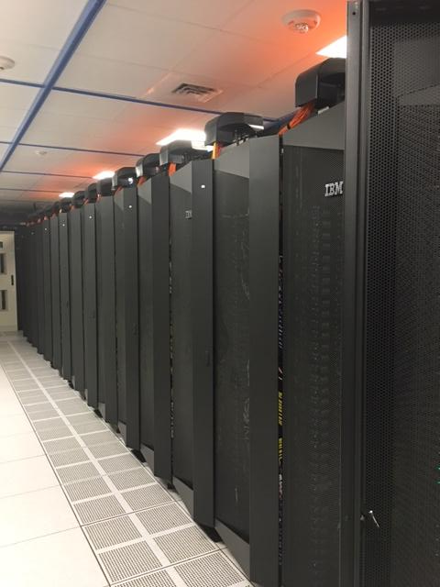
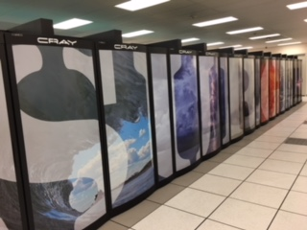
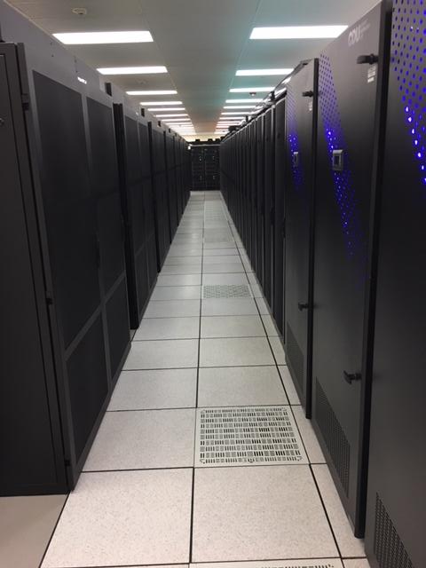
Current Computing -- WCOSS
10 year contract awarded to IBM from 2011 through 2021. Includes initial delivery, three subsequent upgrades.
Supplemental funding from Congress added more compute
2 identical clusters -- Orlando, FL and Reston, VA
Currently 4.2 Pflops, 14 PB disk, 5260 nodes
Heterogeneous system -- Combination of IBM iDataPlex, Cray XC40, and Dell PowerEdge hardware
Chips include Sandy Bridge, Ivy Bridge, Broadwell and Haswell
Simultaneous Production and Development workload – 500+ users
Produces 140 million products/day, distributes over 10 TB of guidance/day

Slide 8
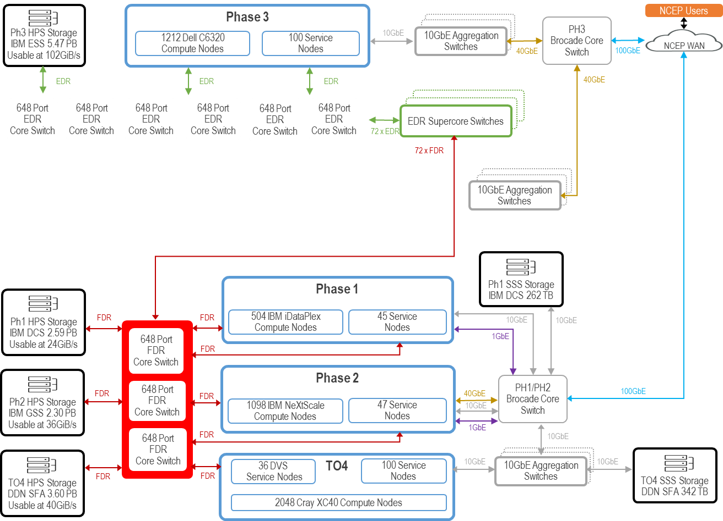
WCOSS Schematic
4948 compute nodes
312 service nodes
Filesystem is GPFS (Spectrum Scale)
DCS
GSS
DDN
ESS
Shared Storage to move data btw machines
Mellanox and Infiniband interconnect
Brocade Switches

Slide 9
WCOSS Schematic – Heterogeneous System
4948 compute nodes
312 service nodes
Filesystem is GPFS (Spectrum Scale)
DCS
GSS
DDN
ESS
Shared Storage to move data btw machines
Mellanox and Infiniband interconnect
Brocade Switches
Dell
Supercore
IBM
Cray

Slide 10
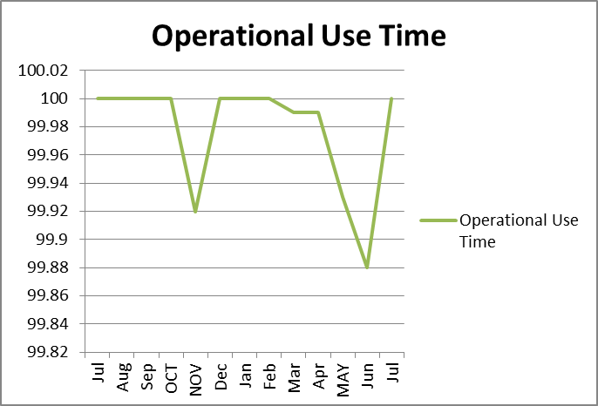
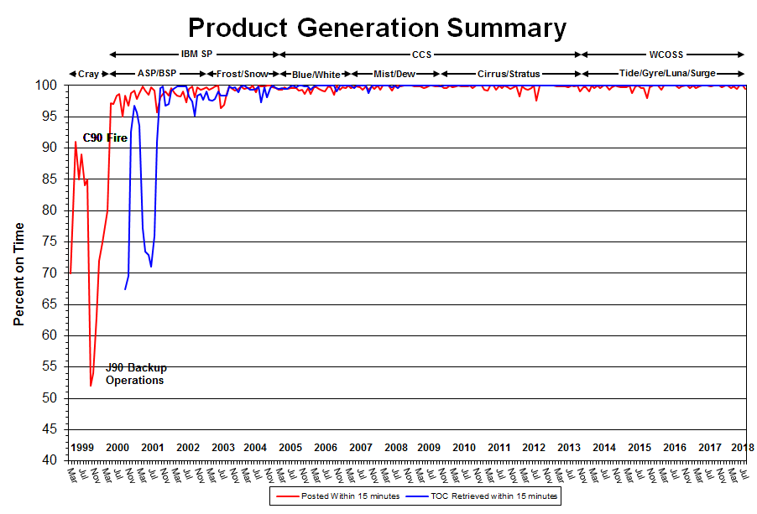
WCOSS -- Providing Operational Resiliency/Reliability
Two Identical Systems – one Production and one Development
Production locked down to NCO and select users
Development machine is open to all users
Switch between systems takes 15 minutes, but models bleed off for a few hours.
Data mirrored between two systems – 40TB per day. Must have that for failovers and development work.
For major maintenance activities, only one system is down. Production remains unaffected.
Performance Requirements
Minimum 99.9% Operational Use Time
Minimum 99.0% On-time Product Generation
Minimum 99.0% Development Use Time
Minimum 99.0% System Availability
Penalties in contract for failing to meet metrics
Three Tier Approach
Tier 1 - Operations Monitoring Branch
Tier 2 - Implementation and Data Services Branch
Tier 3 - Development organization

Slide 11
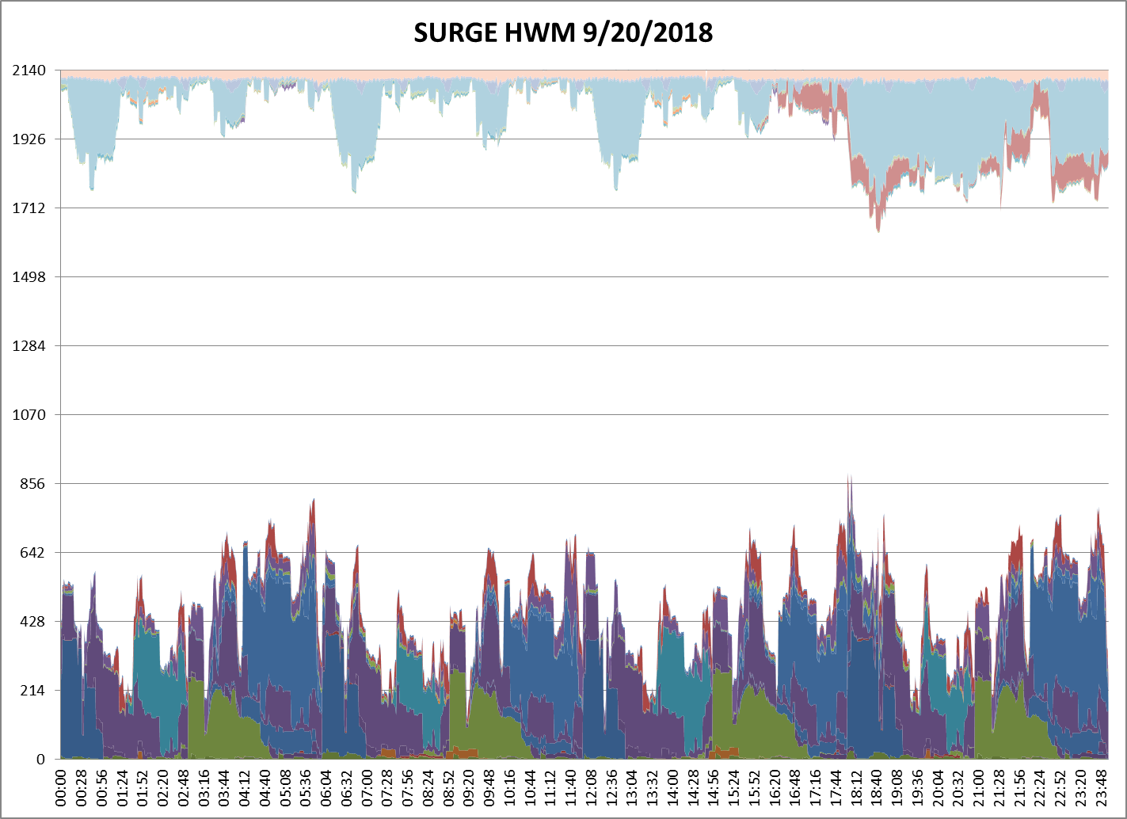
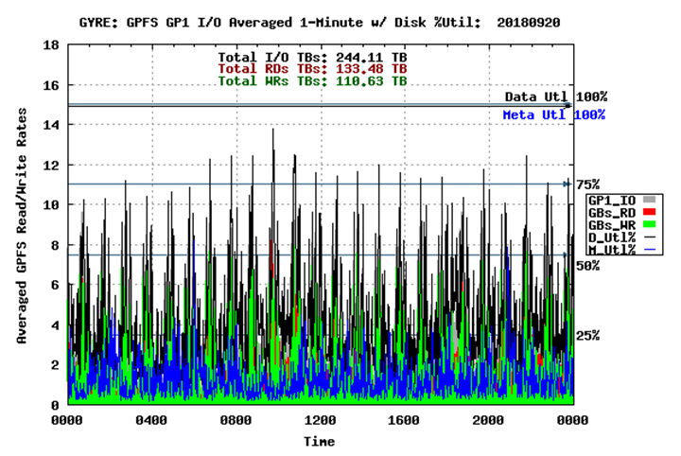
WCOSS – Workload Management
Managing Workload
Parallel and serial workloads
Applications run on only 1 component of the system
Machines have LSF (IBMs and Dells) and ALPS/LSF (Cray) as job schedulers
Priority queues
Run production suite using ecflow. Working to get developers using ecflow.
Use “white space” on production for additional development work
Upgrades have been opportunity to move applications between components of WCOSS
“white space”

Slide 12
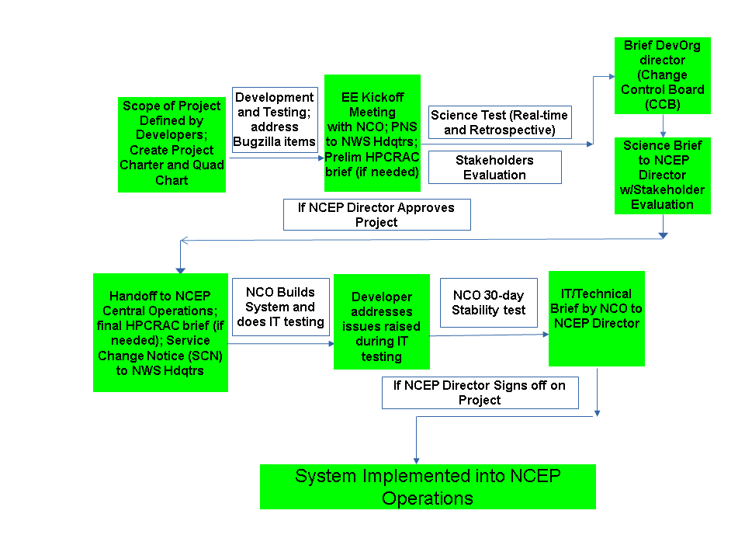
Transition to Operations

Slide 13
R2O Transition Challenges
Two major challenges for transition to operations and back to development:
Different environments
Production Suite Complexity

Slide 14
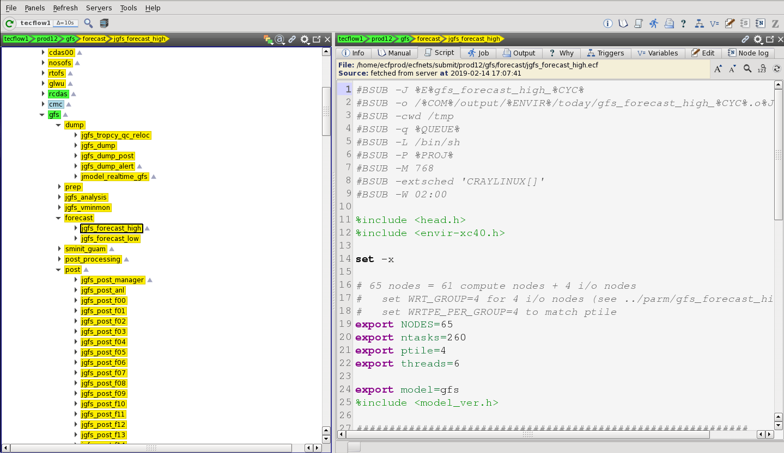
R2O Transition Challenges
Different Environments
Problem - Ops vs Dev
Scheduler - cron vs ecFlow vs rocoto
Workflow - different scripts
System throughput / stability
What can be done?
Environment Equivalence project!
Training underway for development ecFlow
Development workflow will be identical to production workflow
Fairshare scheduling in LSF

Slide 15
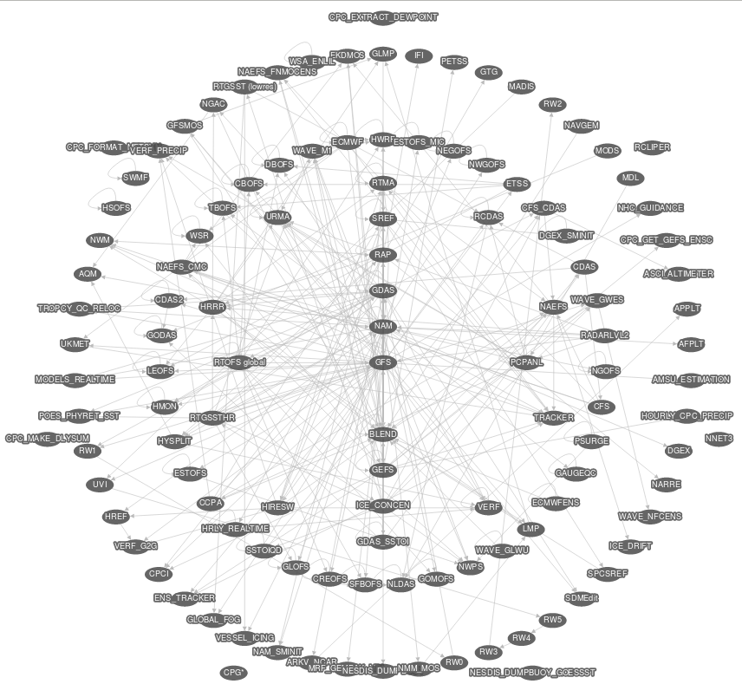
R2O and O2R Transition Challenges
Production Suite Complexity

Slide 16
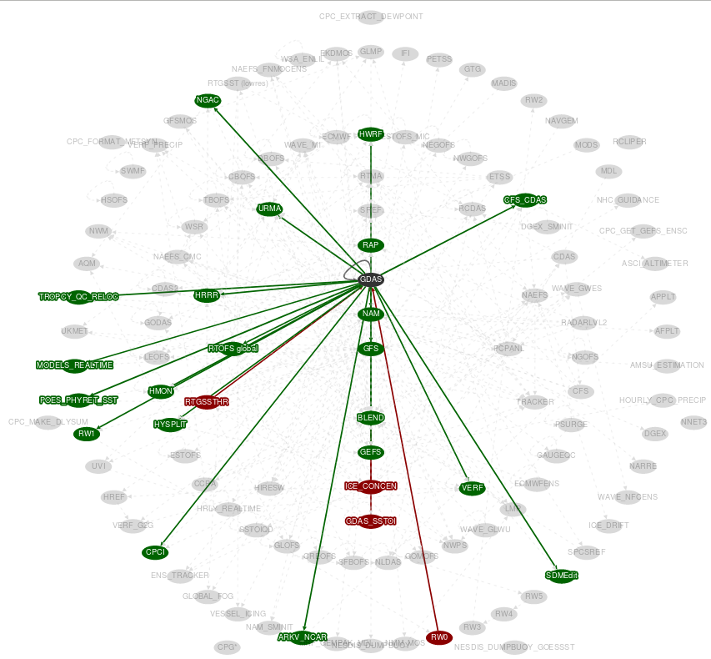
R2O and O2R Transition Challenges
Production Suite Complexity

Slide 17
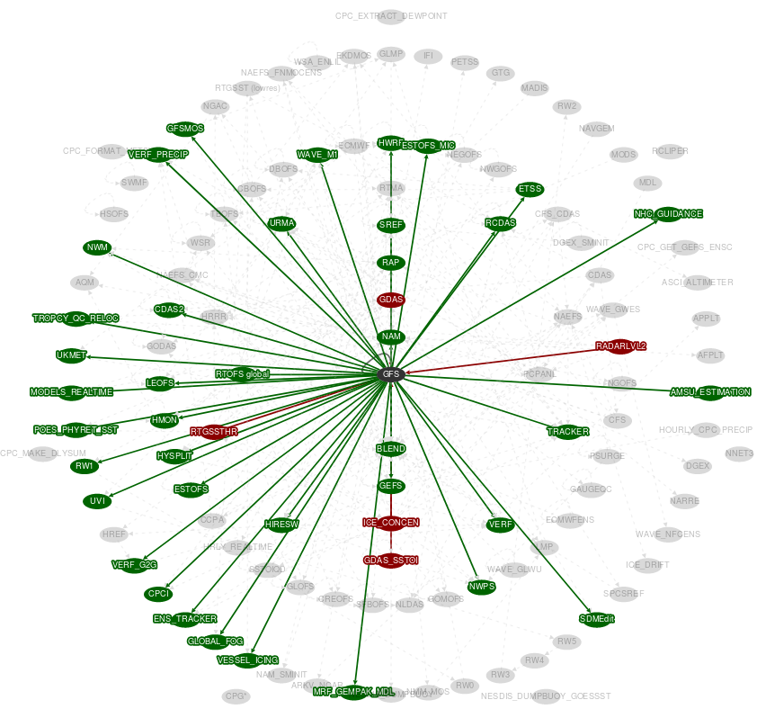
R2O and O2R Transition Challenges
Production Suite Complexity

Slide 18
R2O and O2R Transition Challenges
Production Suite Complexity
Problem - Dependencies
Upgrade GFS → 40+ applications need to be tested and verified
100+ applications; most of which want yearly upgrades
What can be done?
Production Suite Unification!
Not just science unification - technical unification
Include end to end

Slide 19
What comes next...
Working on our next 10-year computing contract
Conducted RFI and met with industry. Next up is RFP
What is the best computing system for our type of workload? Parallel processing versus heavy IO pre/post-processing
Want to foster competition
Potential for Supplemental Funding Bills for HPC from the US Congress
Cloud vs on-premise? Both?

Slide 20
Questions?
WCOSS Components | Phase I | Phase 2 | CRAY | Phase 3 | Totals
Compute NODES | 640 | 1,080 | 2,048 | 1,212 | 4,844
Compute Racks | 8.9 | 15 | 12 | 16.5 | 52
Spare Nodes | 20 | 18 | 30 | 36 | 104
Peak TFs | 208 | 572.3 | 2,045 | 1,412 | 4,237
Cores (Compute and Service) | 9,920 | 25,920 | 50,176 | 36,736 | 122,752
Spare Cores | 320 | 432 | 720 | 2,800 | 4,272
Processor Type | Intel Sandy Bridge | Intel Ivy Bridge | Haswell & Sandy Bridge | Intel Broadwell
Processor Clock Speed | 2.6 Ghz | 2.7 Ghz | 2.6 Ghz | 2.6 Ghz
Cores/node | 16 | 24 | 24 | 28
Service Nodes | 54 | 58 | 100 | 100 | 312
Memory/core | 2 GiB | 2.66 GiB | 2 GiB | 2 GiB
Disk Storage (useable PB) | 2.59 | 2.034 | 3.5 | 5.49 | 14
Shared Storage (TB) | 259 | 266 |  |  | 525
Backup Tape Capacity (TB) | 600 |  |  |  | 600
Interconnect Fabric | Mellanox FDR | Mellanox FDR | Mellanox FDR | EDR Infiniband
Operating System | Red Hat Linux | Red Hat Linux | CRAY and SUSE Linux | Red Hat Linux
Filesystem | GPFS | GPFS | GPFS | GPFS
Workflow Manager | LSF | LSF | LSF/ALPS | LSF
Workflow Scheduler | ecFLOW | ecFLOW | ecFLOW | ecFLOW

