Slide 1
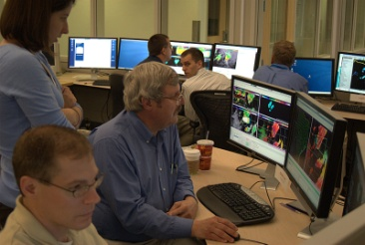
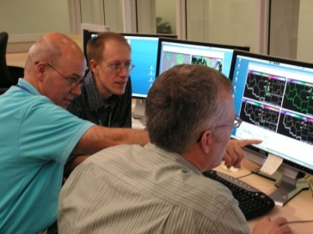
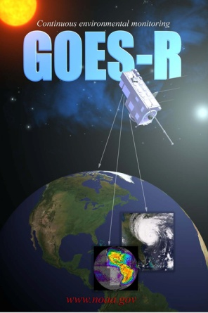
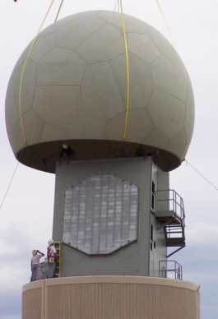
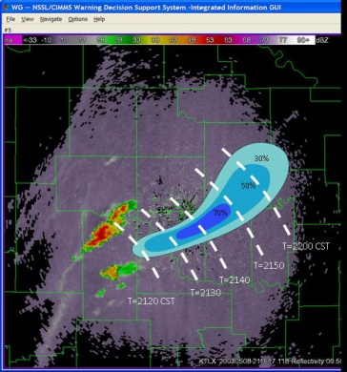
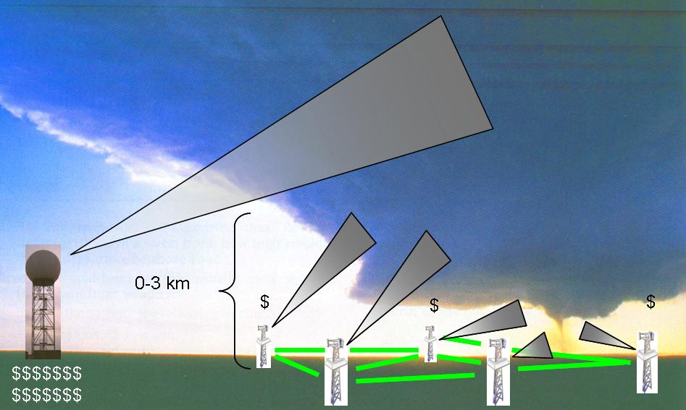
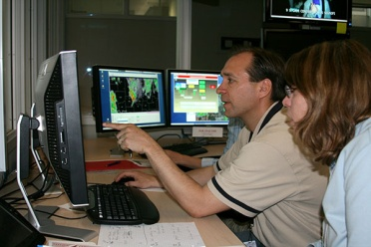
Overview of the NSSL 2012 Experimental Warning Program EWP2012
Greg Stumpf, Travis Smith
Hazardous Weather Testbed
Norman, OK

Slide 2
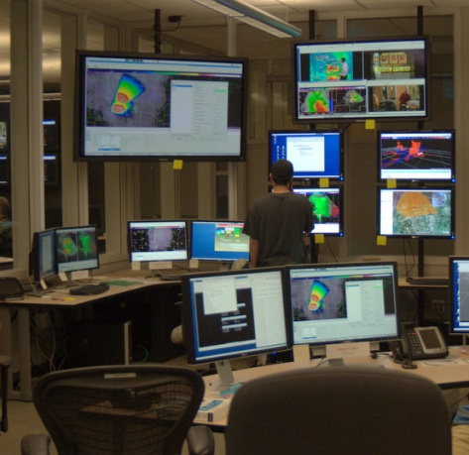
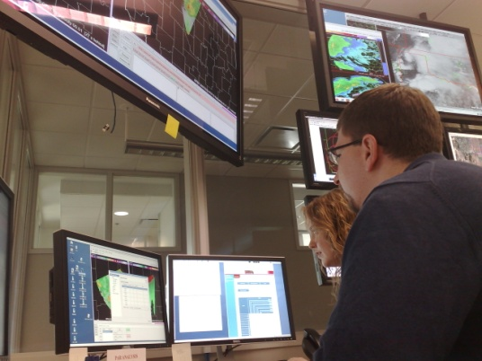
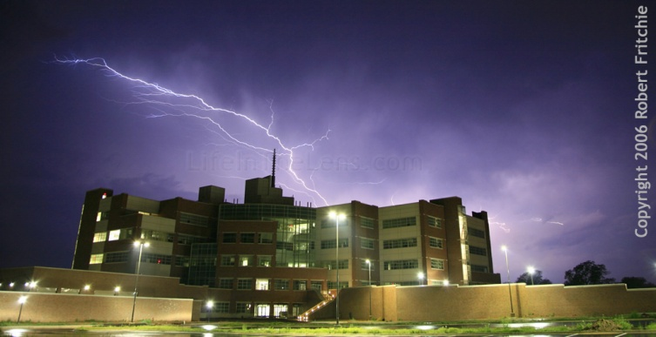
The NOAA Hazardous Weather Testbed
Collaboration
FORECASTERS
RESEARCHERS
DEVELOPERS
TRAINERS
USERS
Evaluation
OBSERVING PLATFORMS
NUMERICAL MODELS
ALGORITHMS
PRODUCTS
SERVICES

Slide 3
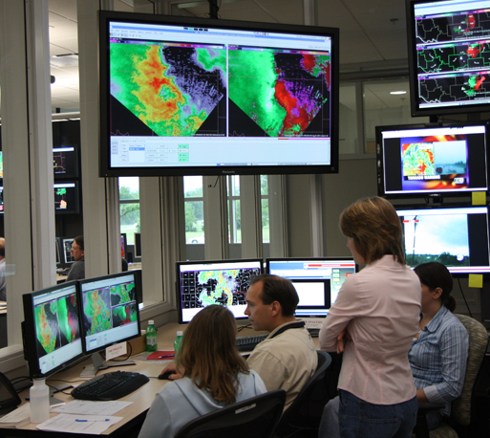
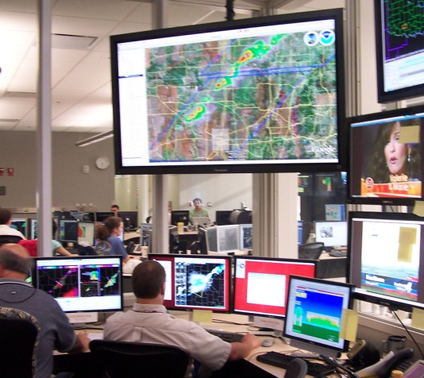
HWT Motivation
Improve understanding of convective weather hazards
More accurate and timely forecasts and warning services
To protect life, body, well-being, productivity, and property.

Slide 4
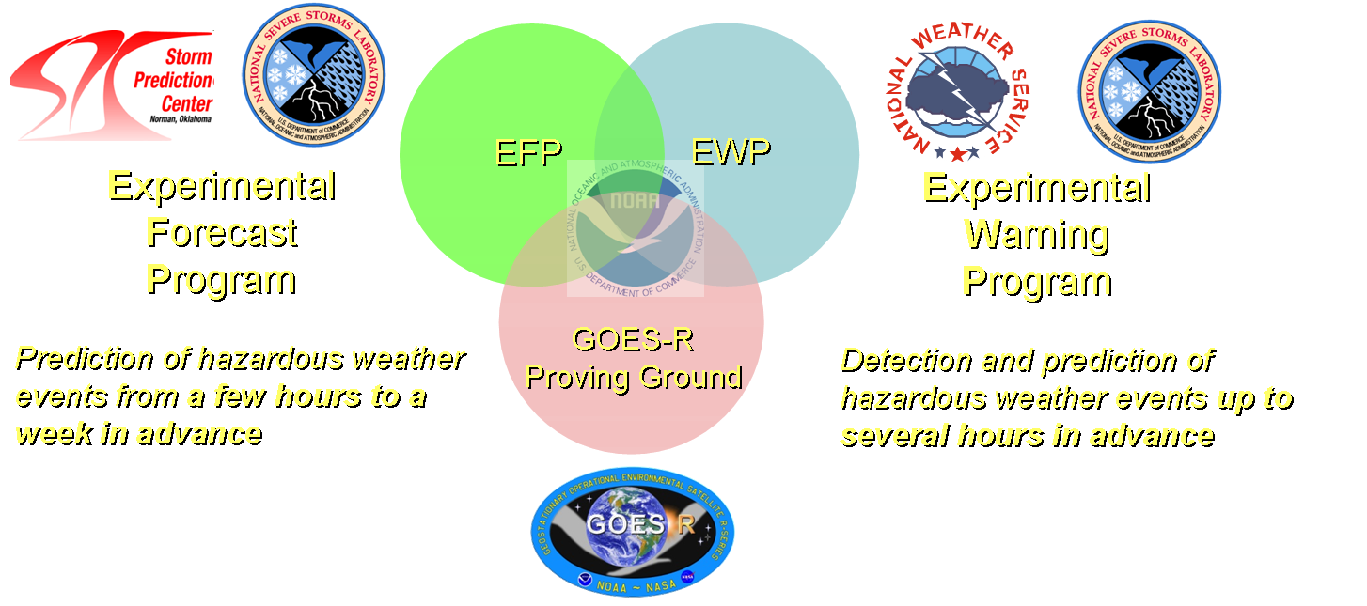
What is the HWT?
Not just a facility…
…but an organization:

Slide 5
HWT Experimental Warning Program (EWP)
Mission: Improve prediction of severe convective weather at the “warning scale” (0-2 hours).
Norman has a large community of researchers, operational meteorologists, students, industry.
But, we serve all National Weather Service WFOs nationwide.

Slide 6
What is tested?
New sensors:
Radar, satellite, lightning, etc.
New Applications/Algorithms:
Multi-sensor integration (MRMS), GOES-R proxies, lightning jump, etc.
New Methodologies:
Best practices, new concepts, products, services
Social Science integration

Slide 7
Former EWP Experiments
2007 - 2011

Slide 8
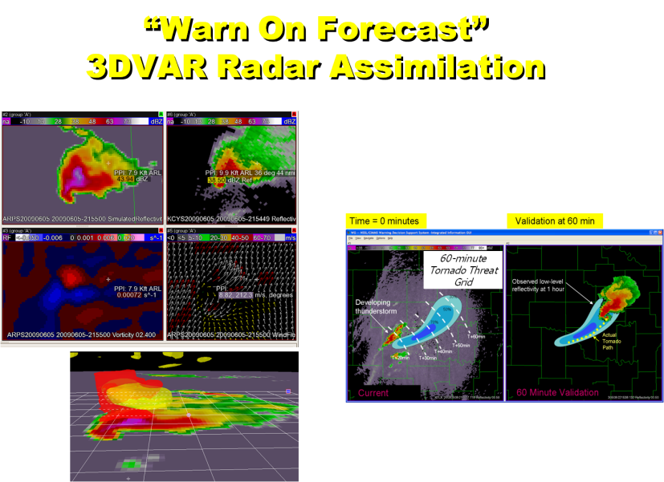
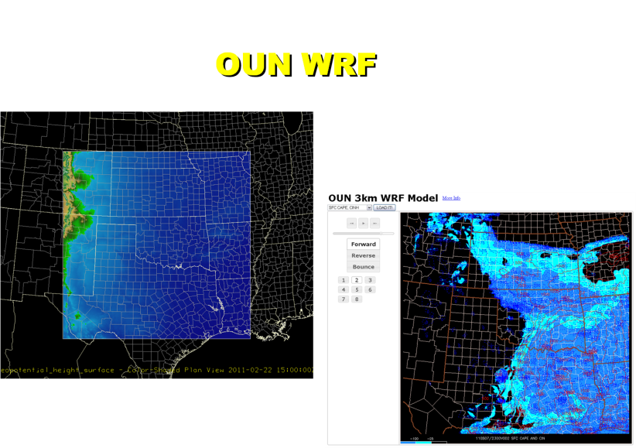
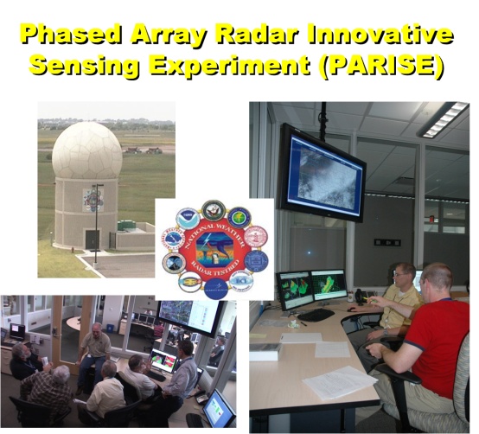
Current EWP Experiments
2012

Slide 9
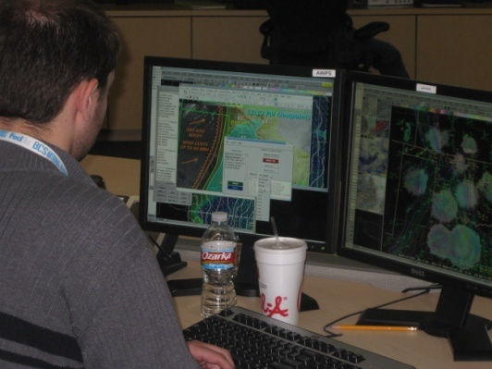
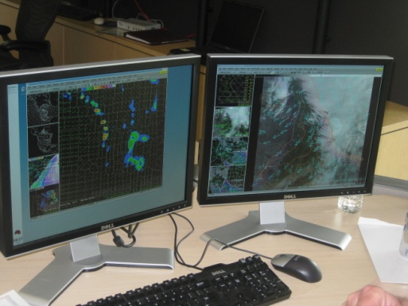
EWP2012 Timeline
Spring Experiment (May, Jun):
GOES-R Satellite
OUN-WRF Local high-resolution modeling
Warn-On-Forecast (WOF) real-time data assimilation
4-6 forecasters per week
Summer Experiment (Jun, Jul, Aug):
Phased Array Radar Innovative Sensing Experiment (PARISE)
2 forecasters per week
Independent of spring experiment
Project still under development
Will have significant component devoted to forecaster decision making and cognitive task analysis

Slide 10
Spring Experiment
5 weeks (7 May, 14 May, 21 May, 4 June, 11 June)
4-6 forecasters per week
Will be evaluating all components simultaneously
Using AWIPS2 for the first time
Get forecasters to think about how products are used in nowcast and warning decision making.
Not necessarily trying to “compete” with warning issuance.

Slide 11
“Warn On Forecast” (WOF)
Today: Warn based on detection and extrapolation
Tomorrow: Warn aided by very high-resolution storm-scale models
30 min ago
Now
30 min from now
60 min from now
30 min ago
Now
30 min from now
60 min from now

Slide 12
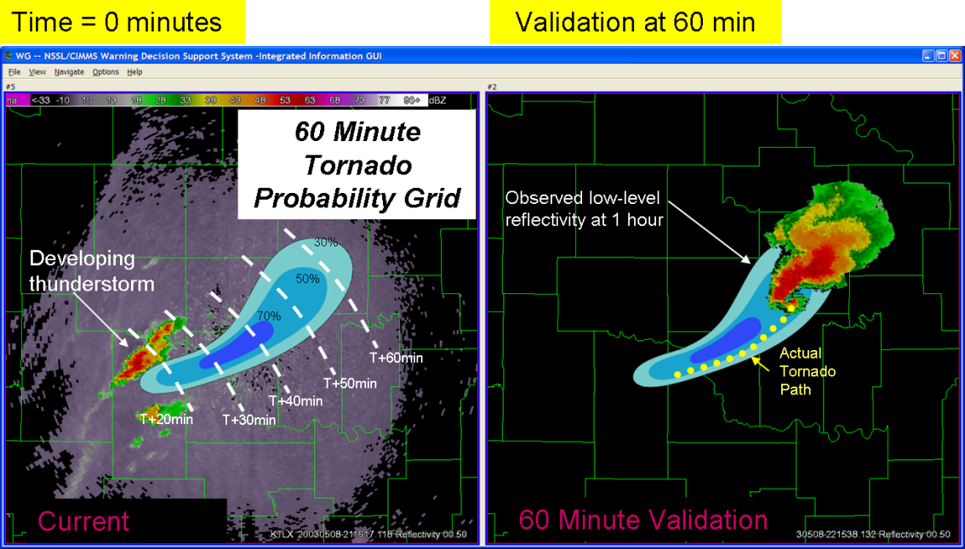
“Warn On Forecast” (WOF)
60-minute
Tornado Threat
Grid

Slide 13
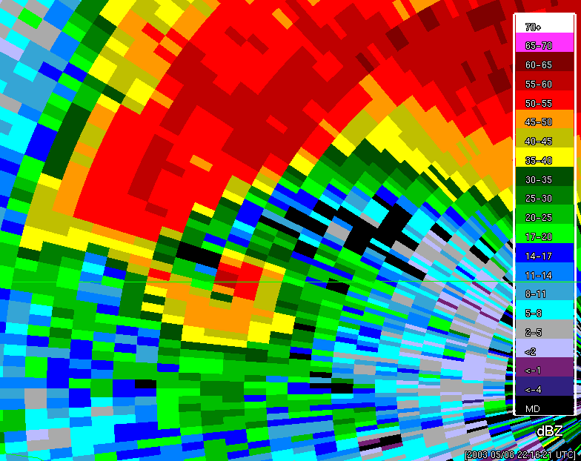
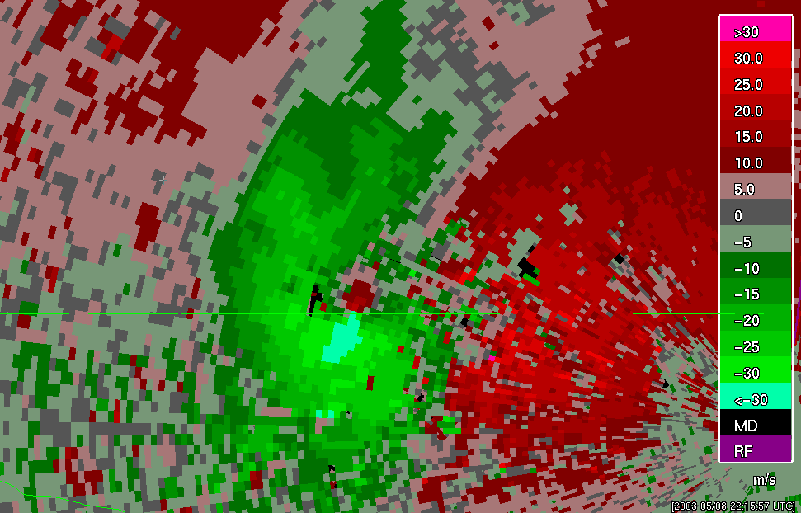
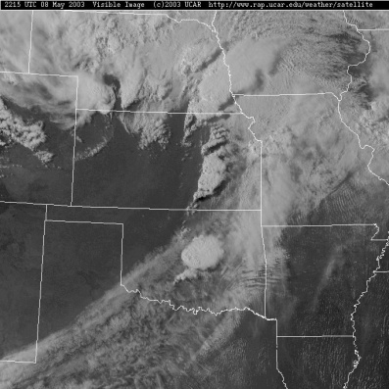
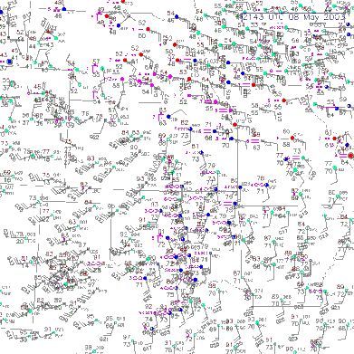
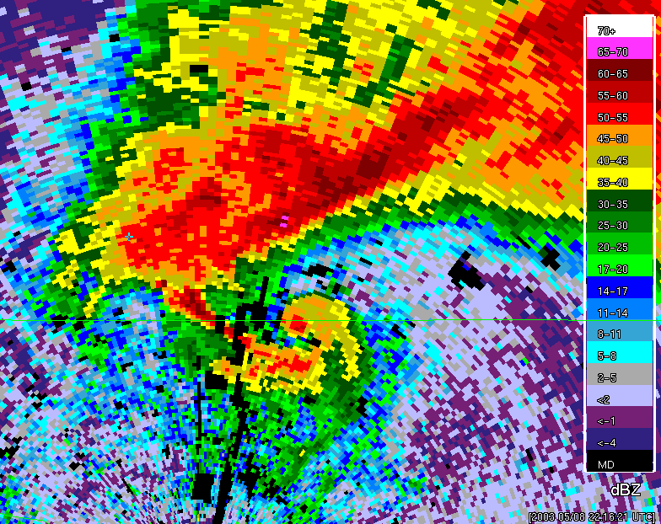
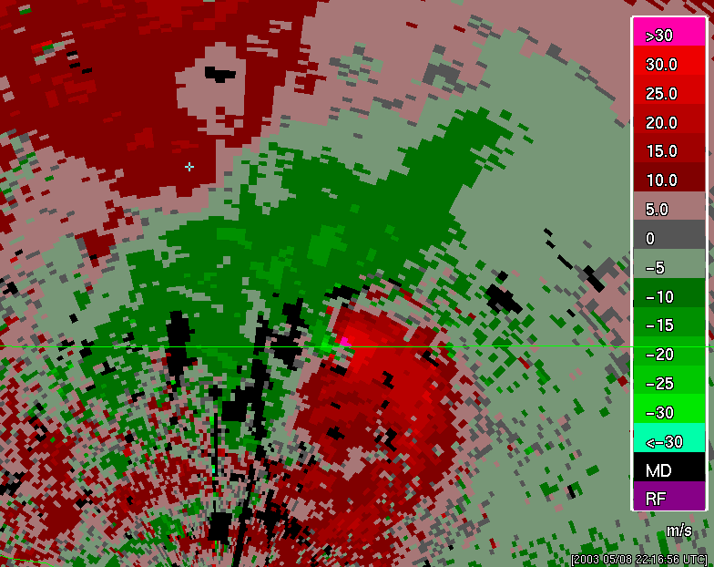
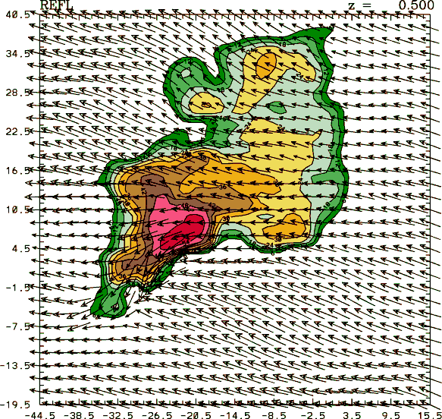
Real-time 3D data assimilation (3DVAR)
The ultimate multi-sensor data integration – data assimilation
Combine multi-sensor data with numerical models, in a physically-realistic manner.
New types of products:
3D wind fields
Simulated Reflectivity
Updraft strength
Vorticity

Slide 14
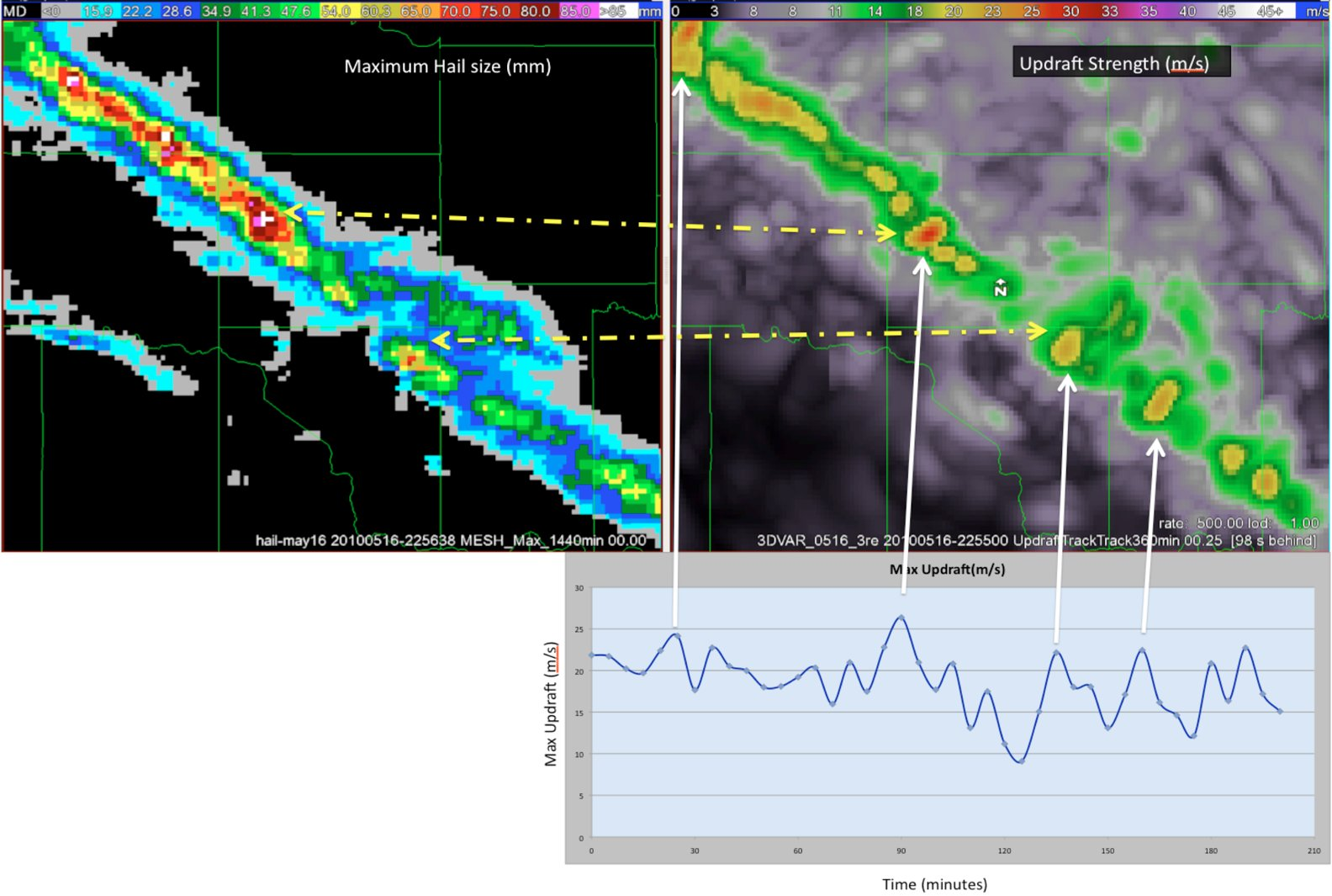
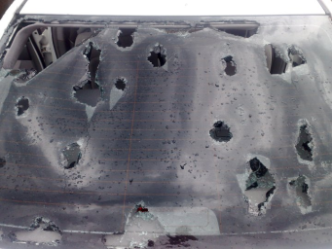
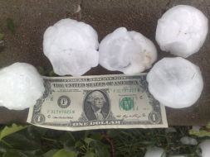
May 16, 2010 Hail Storm / OKC: Hail Size vs. Updraft Intensity

Slide 15
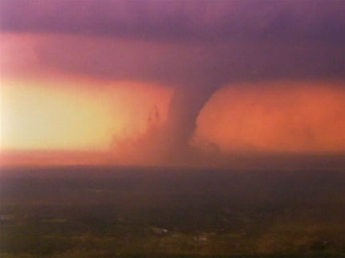
May 10, 2010 Oklahoma Tornadoes: Radar Shear vs. Vorticity
KTLX azimuthal shear track
0-3 km MSL
3DVAR assimilation vorticity track
0-3 km MSL
Norman, OK

Slide 16
OUN WRF
Specs:
3-km grid
Hourly cycle
15 fcst intervals out to 8 h
Products:
Composite Reflectivity
1-km Reflectivity
Instantaneous Updraft Helicity
Maximum Hourly Updraft Helicity
Maximum Hourly Column Hail
10-m Wind Speed

Slide 17
Geostationary Operational
Environmental Satellite – R series
To determine readiness of GOES-R “baseline” and “option-2” products prior to launch of the satellite
Develop training for users
Prepare for display within AWIPS2

Slide 18
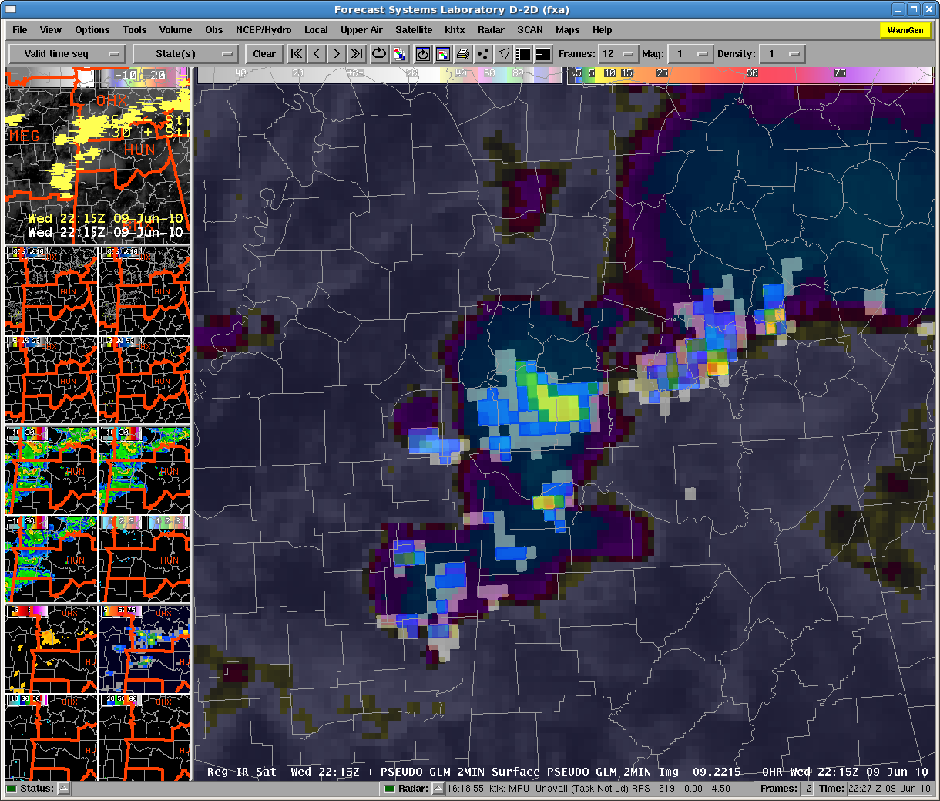
Pseudo-Geostationary Lightning
Mapper (PGLM)

Slide 19
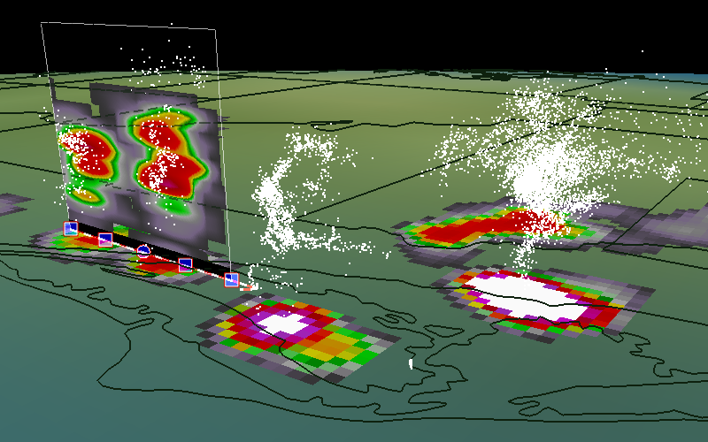
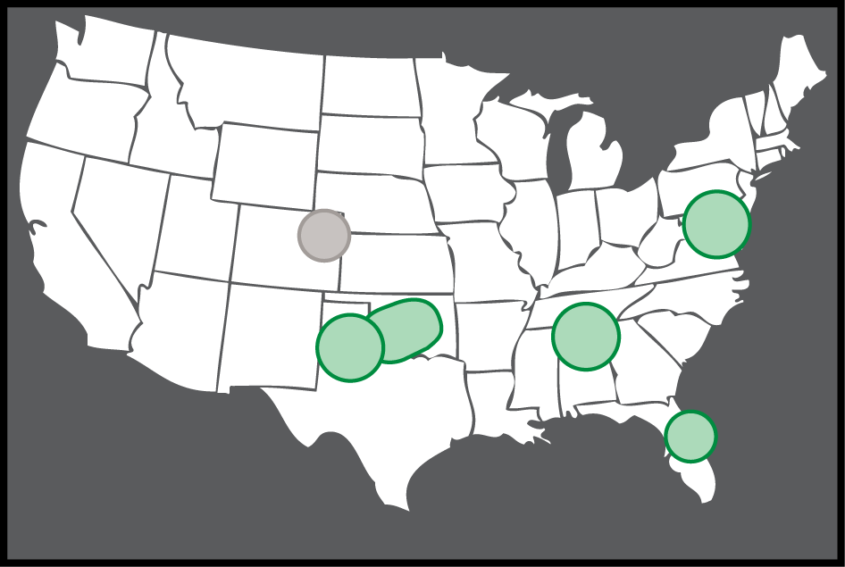
3D Lightning Mapping Array (LMA)
Cloud-to-ground + intra-cloud = total lightning
Used to create PGLM proxy
LMA visualization and attribute extraction (Courtesy: Scott Rudolsky, Florida State University)
LMA Networks

Slide 20
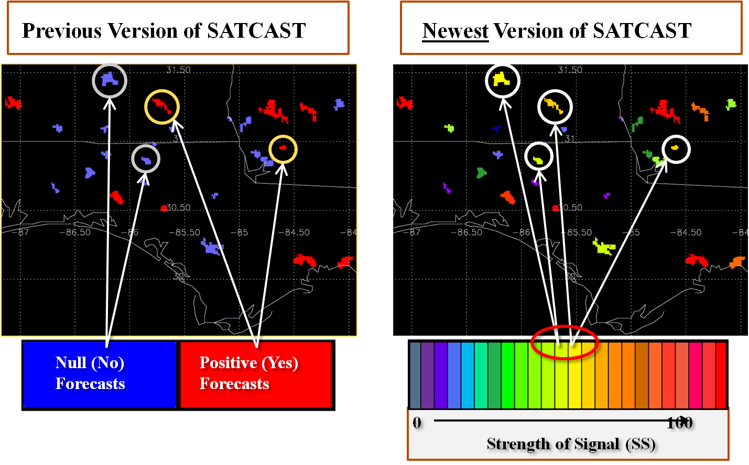
UAH Convective Initiation:
“SATCAST”

Slide 21
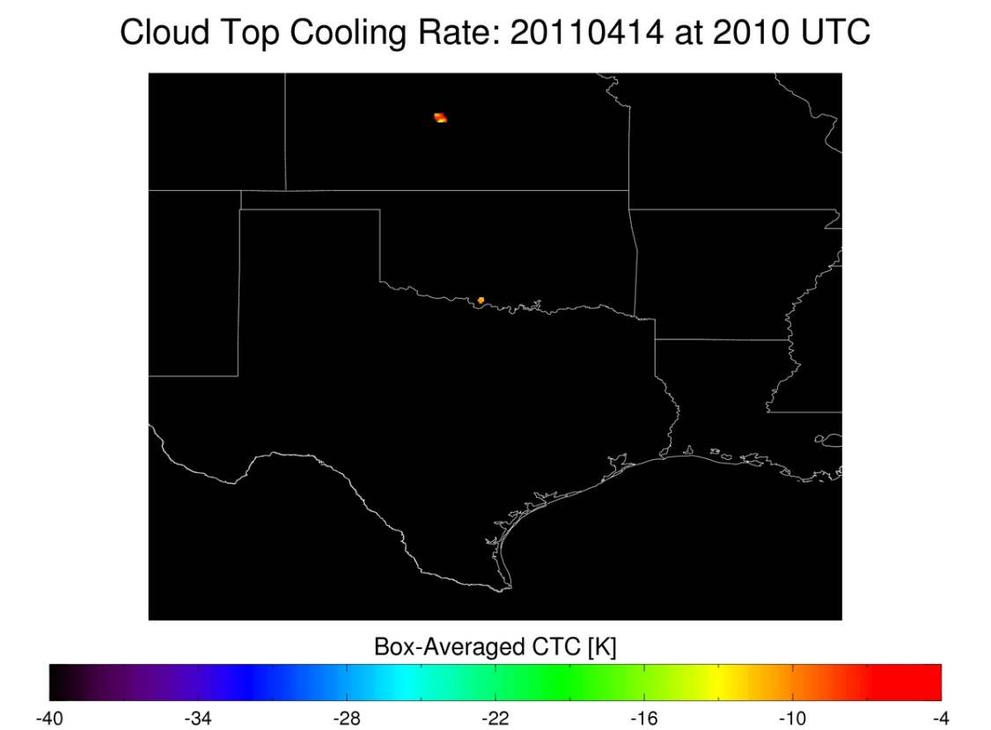
UW Convective Initiation – Cloud Top Cooling:
Detection in Cirrus-covered areas
Thin cirrus above developing convective line prevents detection of vertically growing convective clouds; addition of cloud optical depth allows diagnosis of valid UW-CTC rates

Slide 22
UW Convective Initiation – Cloud Top Cooling:
Relating CTC to Radar/MRMS products
Weak Moderate Strong
UW-CTC UW-CTC UW-CTC
> -10 -10 >= CTC > -20 <= -20

Slide 23
New for EWP in 2012 (Spring Experiment only)
Added an EWP training shift (a 6th day; 8h supernumerary):
Taken at WFO within two weeks prior to travel to Norman
Training materials posted online
WES Virtual Machine Case on DVD, job sheets online
“Flex” shifts
On Tue, Wed, Thu only
Start time between 12pm and 3pm; finish 8 hours later
Time determined at the end of previous day shift
Based on expected timing of severe using Day2 outlook.
Allows for greater flexibility to capture weather events.
EWP2012 Webinars
More later…

Slide 24
Monday Schedule
1200p Convene to NSSL Dev Lab (NWC2820)
1200p Welcome and Introductions
1215p EWP2011 Orientation Briefing
100p Break
115p Convene in HWT Operations Area for on-hands AWIPS2 Familiarization and procedure building
315p Break
345p Real-time warning operations in HWT Operations Area
???p Dinner Break (time chosen based on wx)
715p Fill out feedback survey
745p Day 2 forecast discussion to choose tomorrow’s “flex” shift time
800p Adjourn

Slide 25
Tue-Wed-Thu “Flex” Shift Schedule
Determined at the end of the previous day’s operations shift, based on expected timing of weather
Start time anywhere between 12 – 3pm
Finish 8 hours later
Dinner break time will be based on wx activity
Forecasters fill out feedback surveys 45 minutes before end of shift
Day 2 “flex” shift time decision made in last 15 minutes of current shift.

Slide 26
Friday Schedule
1000am Convene in Dev Lab
1000am-1140am Weekly debrief (Dev Lab)
1140am Break to grab lunch, move to WDTB Conference Room
1200pm-100pm EWP2012 Weekly Webinar (WDTB Conference Room)
100pm Operations End for the week

Slide 27
EWP2012 Weekly Webinars
A summary of that week's experience, presented by the NWS participants.
Each forecaster has 5 minutes to discuss their key takeaway that week.
Audience: WFO/CWSU peers, RHQ, NWHQ, funding agencies.
Facilitated by WDTB (similar to dual-pol "Storm of the Month").
Remainder of the hour will be devoted to Q&A.
Each Friday from 12-1 CDT (1-2 EDT) from the NWC in Norman.

Slide 28
EWP Personnel
Forecasters/Evaluators
Weekly Coordinator (WC)
Webinar Facilitator (WDTB)
Project Scientists
EWP Officers
Travis Smith (co-Team Leader)
David Andra (co-Team Leader)
Greg Stumpf (Operations Coordinator)
Darrel Kingfield (IT Coordinator)

Slide 29
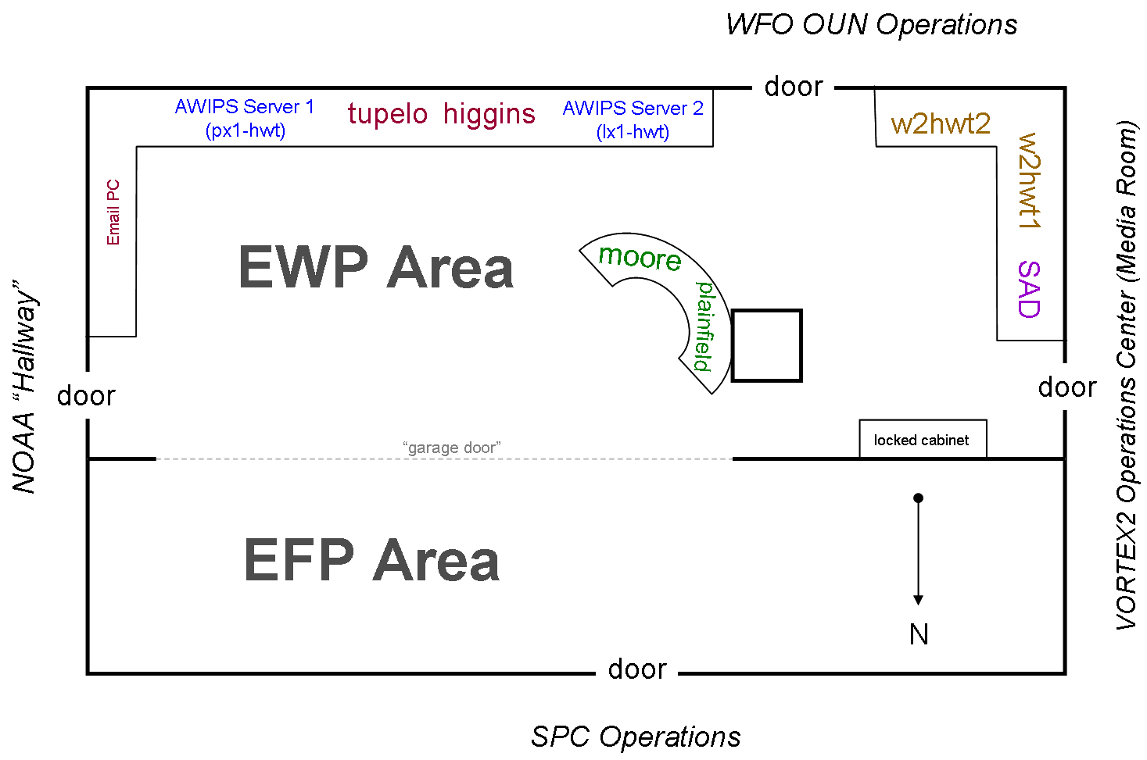
EWP Technology in the HWT
NWS Advanced Weather Interactive Processing System 2 (AWIPS2):
Can emulate any forecast office nationwide
Displays experimental products
Issue experimental warnings
Situational Awareness Display (SAD)
Television feeds
Streaming storm chaser dash cams
etc…

Slide 30
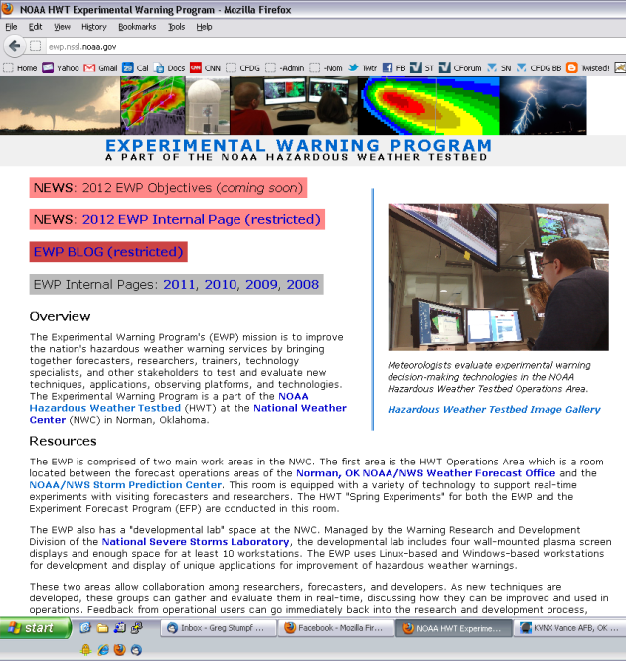
EWP Web Presence
External (public)
http://ewp.nssl.noaa.gov
Content:
General Information about the EWP
Past experiment information
Internal (private)
https://secure.nssl.noaa.gov/projects/ewp2012/
NOAA LDAP user and password
Content:
The EWP Blog
Operations Plans
Training Materials
Schedules (Google Calendar)
Other useful links

