Slide 1
Investigating Collaboration Tools for Sandy Supplemental Project HIWPP
Bonny Strong, ESRL/GSD

Slide 2
Outline
Overview of HIWPP project
Collaboration needs for HIWPP

Slide 3
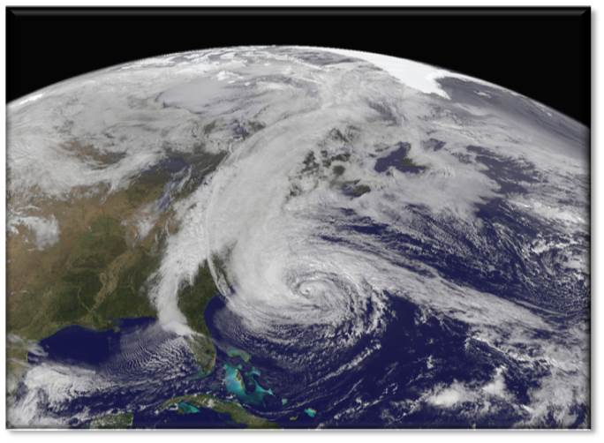
What is HIWPP?
High Impact Weather
Prediction Project
A “Sandy Supplemental”
project
Tim Schneider, ESRL/GSD
HIWPP Project Manager
Hurricane Sandy, October 28, 2012; image captured by GOES-13 satellite.
NASA Earth Observatory image by Robert Simmon

Slide 4
HIWPP Objectives
In an unprecedented way, the Hurricane Sandy Supplemental funding provides an opportunity to bring together the nation’s global weather modeling community and focus them on a common goal:
developing the world’s best
medium-range weather forecast model
by the end of the decade
to improve our time-zero to two-week prediction of nature's most dangerous storms such as hurricanes, floods, and blizzards, over the whole globe.
4

Slide 5
HIWPP Six-Point Strategy
Drive the current generation (hydrostatic) of global NWP models to max performance & resolution (10km-20km), to medium-range and beyond
In parallel, accelerate the development of the next generation (non-hydrostatic) of high-resolution (3km) medium-range global and nested NWP models
Utilize the latest hybrid assimilation techniques (4D-En-Var) and scale-aware physical parameterizations
Migrate models to newer and faster HPC technologies (MPFG/GPU)
Provide new tools to quickly access, visualize, and analyze massive amounts of gridded data
Engage with the weather community for feedback and an open process
5
Notes:
HPC = High Performance Computing
MPFG = Massively Parallel, Fine Grain
GPU = Graphical Processing Unit
4D-En-Var = hybrid Four-Dimensional, Ensemble Kalman Filter, Variational assimilation
Sources:
Image: http://upload.wikimedia.org/wikipedia/commons/b/b0/Titan1.jpg

Slide 6
HIWPP at a Glance
“Just the facts…”
How are we going to do it?
HIWPP is an OAR “Sandy Supplemental” Project
$12.905M
Public Law 113-2, the FY2013 Disaster Assistance Supplemental
Funds expired 30 September 2014
36 months to execute via contracts and grants
12 organizations, coast-to-coast:
AOML; ESRL/GSD; ESRL/PSD; GFDL;
NCEP/CPC; NCEP/EMC;
CICS-P; CIMAS; CIRA; CIRES;
NCAR; NRL
Project is comprised of
5 Subprojects
19 Tasks
Through partnerships…
HIWPP funding can help to unify and focus the NWP community
Building on existing efforts
And enhance & accelerate them
Drive the science to a higher technical readiness level
6

Slide 7
Work Breakdown Structure
High Impact Weather Prediction Project (HIWPP)
Project Manager:
Tim Schneider, ESRL
Business Manager:
Ty Robinson, OWAQ
3.1 Hydrostatic Global Models
POC: S. Benjamin, ESRL
3.5 Test Program
POC: Bonny Strong, ESRL
3.2 Non-Hydrostatic Global Models
POC: J.Whitaker, ESRL
3.1.1 DA/Ens/Stoch Physics
3.5.1 Statistical Post Processing
3.2.1 DA/Ens/Stoch Physics
3.1.2 Parameterization Dev
3.5.2 Visualization via NEIS
3.2.2 Parameterization Dev
3.1.3 GFS
3.5.3 Verification Methods
3.2.3 MPFG/GPU Optimization
3.1.4 FIM
3.5.4 Real Time IT Operations
3.2.4 NIM
3.1.5 NAVGEM
3.2.5 MPAS
3.3 Moving Hurricane Nest
POC: S. Gopalakrishnan, AOML/ V. Tallapragada, NCEP
3.2.6 NMMB
3.4 NMME Expansion
POC: Jin Huang, NCEP
3.2.7 HIRAM
3.2.8 NEPTUNE

Slide 8
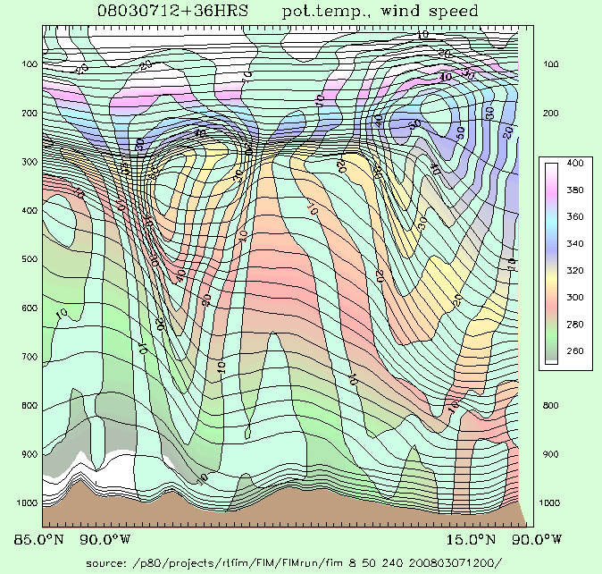
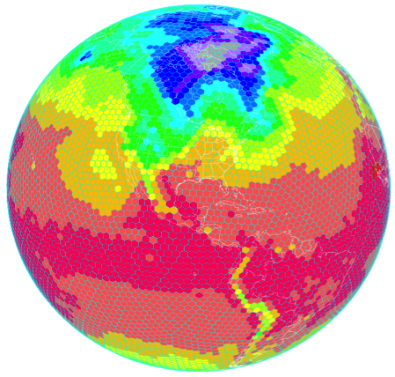
Goal: Hydrostatic Global Models
Improve the current generation of global NWP models
Near-term impact: 1-3 years
Work with three existing models:
GFS; FIM; NAVGEM
Run at higher resolutions
(sub-20km)
Develop and implement scale-aware physical parameterizations
Develop and implement new 4D-En-Var hybrid assimilation techniques
Serves as baseline for the non-hydrostatic models
FIM
Flow-following,
finite-volume
Icosahedral
Model
Temperature at lowest level
8
Notes:
GFS: Global Forecast System
FIM: Flow-following, finite volume Icosahedral Model
NAVGEM: Navy Global Environmental Model
E.g. FIM (http://fim.noaa.gov/)
Two of the 3 unique aspects of the FIM are ones that you can see, for its vertical and horizontal coordinate systems.
- the isentropic-sigma hybrid vertical coordinate, which DOES adapt and generally follow air parcels up and down, and
- the use of the intriguing soccer-ball like icosahedral horizontal grid.

Slide 9
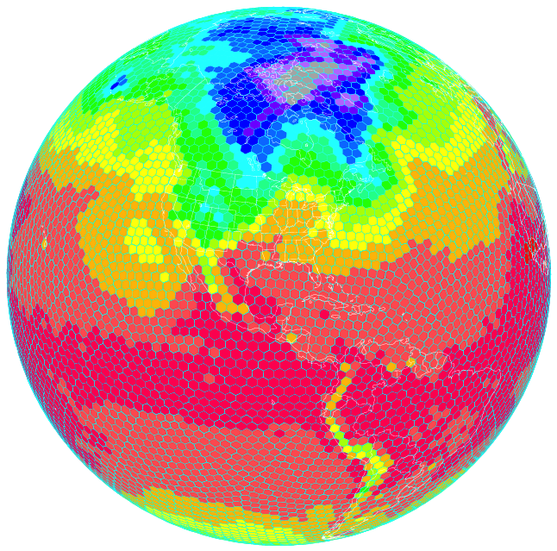
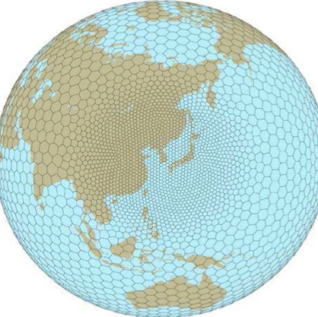
Goal: Non-Hydrostatic Global Models
Next generation of medium-range (0-16 days), global NWP models
By the end of the current decade (2020)
3km resolution; convection and cloud resolving
Thoroughly evaluate and test five existing dynamical cores
NIM
MPAS
NMMB
HiRAM
NEPTUNE
Migrate one or more models to newer and faster Massively-Parallel, Fine-Grain (GPU) HPC technologies
9
Notes:
NIM: Non-Hydrostatic Icosahedral Model
MPAS: Model for Prediction Across Scales
NMMB: Non-Hydrostatic Multi-scale Model
HiRAM: High-Resolution Atmospheric Model
NEPTUNE: Navy Non-Hydrostatic Prediction System

Slide 10
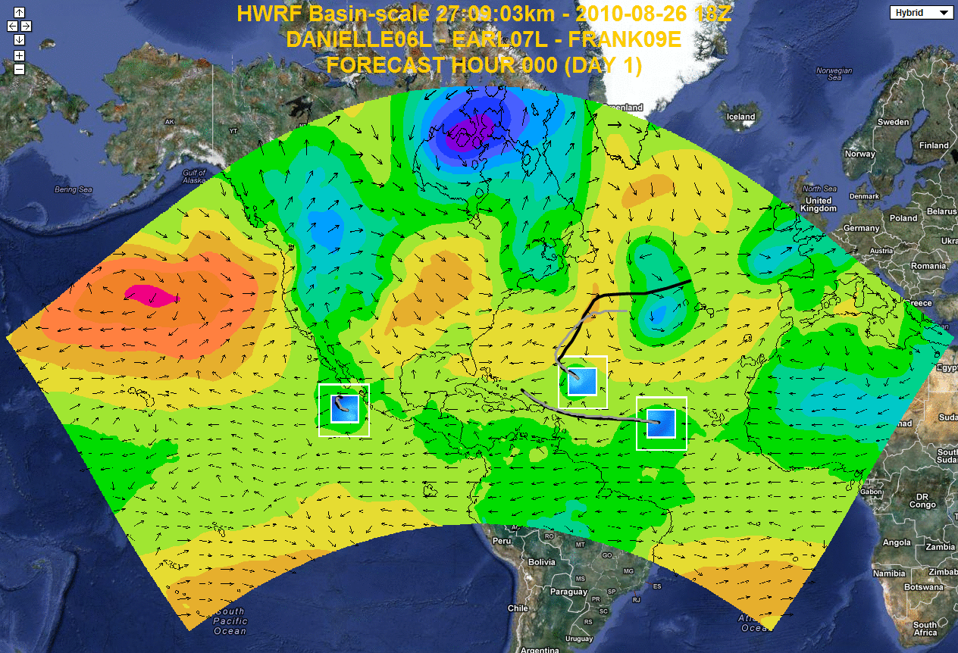
Goals: Moving Hurricane Nests and Seamless Long-range Weather Forecasts
Moving Hurricane Nest:
NMME Expansion:
Integrate HWRF into NMMB
fully two-way interactive moving nested, multi scale, non-hydrostatic modeling system using NMMB/NEMS framework
Options to test HWRF nests in NMMB/NEMS framework with initial and boundary conditions from other models
Proof of concept of global tropical cyclone model with multiple moveable nests placed around all tropical systems in the world and an open process
Evaluate & establish the predictive capability of hurricanes & other high-impact weather events out to several months
Leveraging activity to build a seamless suite of medium- to long-range weather forecasts
10
Notes:
Sources:
Image (AOML): https://storm.aoml.noaa.gov/realtime

Slide 11
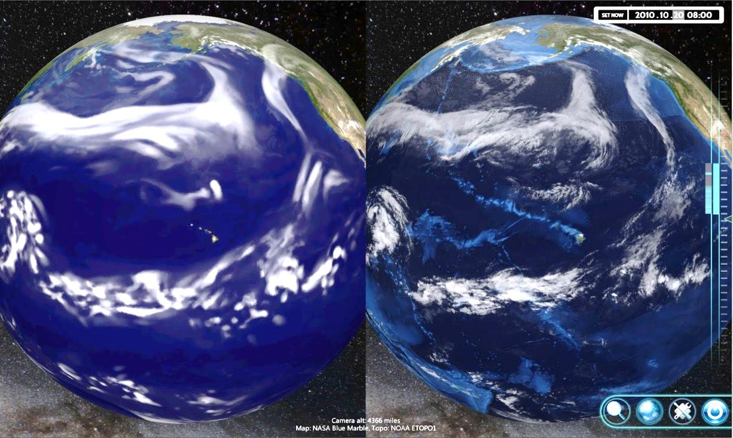
Goal: Test Program
Real time IT Operations:
Getting data where it needs to be; when it needs to be there
Building tools for Open Data Initiative
Statistical Post-Processing:
Statistical post-processing of high-resolution HIWPP deterministic models and of coarser-resolution ensembles
NOAA Earth Information System (NEIS):
A new tools to quickly access and visualize massive amounts of gridded data
Verification:
Consistent and uniform assessments across all of the models
11
Notes:
Sources:
Image: http://www.esrl.noaa.gov/neis/

Slide 12
Test Program: Statistical Post-Processing
Investigation of experimental statistical post-processing techniques
Inputs: HIWPP research models and available operational model data, both deterministic and ensemble
Output: “best” model estimate

Slide 13
NOAA Earth Information System
(NEIS) -The Concept
NOAA Earth Information System (NEIS) is a framework of layered services designed to help NOAA’s mission areas by facilitating the discovery, access, integration, and under-standing of all NOAA (past, present, and future).
Framework provides the capability to answer questions that require data from different data sources regardless of format or location.
NEIS - http://neis.noaa.gov/

Slide 14
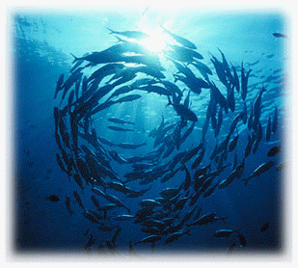
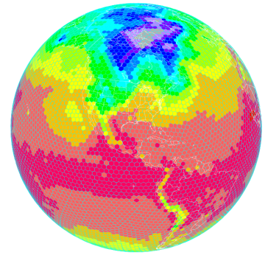
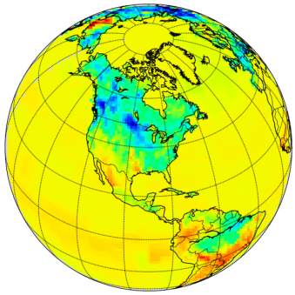
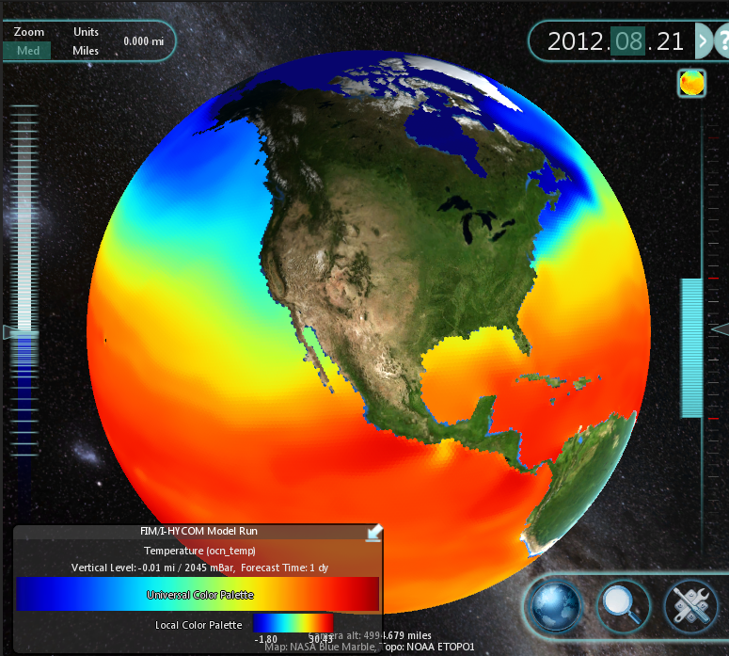
Impacts
Physical
Chemical
Biological
Framework built towards
standards, not data.
Important Because:
NOAA and other data ready for action. Services model facilitates agile response to events. Services can be combined or reused quickly, upgraded or modified independently.
Any data available through framework can be operated on or combined with other data. Integrated standardized formats and access.
New and existing systems have access to wide variety of NOAA data. Any new data added, easily incorporated with minimal to no changes required.
NEIS - http://neis.noaa.gov/

Slide 15
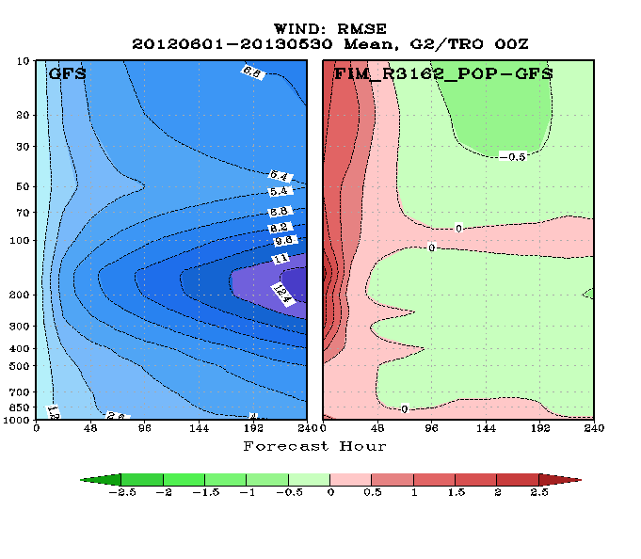
Verification System
Building on existing systems at ESRL/GSD and NCEP/EMC
Developing new methods and observations for verifying global precipitation
Collaborative effort between ESRL/GSD and NCEP/EMC

Slide 16
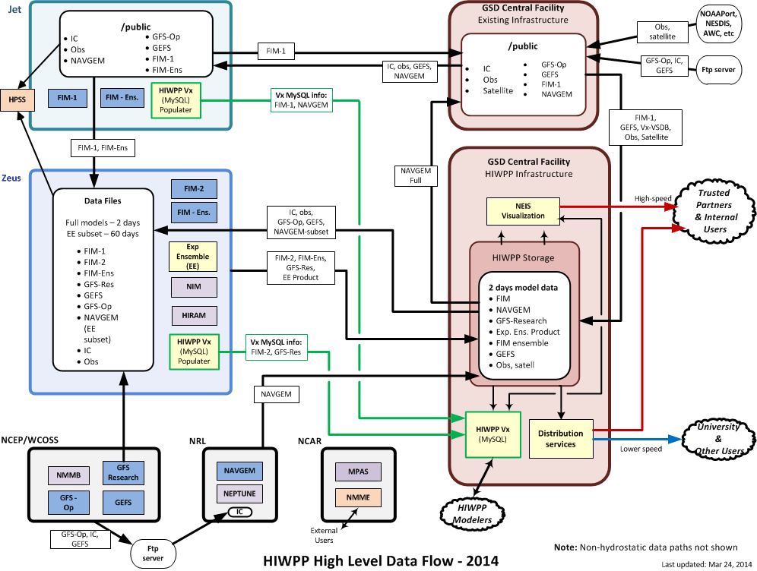
Real-time Operations: Data Flow Diagram
Notes:
Blue boxes - hydrostatic models
Purple boxes - non-hydrostatic models
Yellow boxes – components developed for HIWPP
Green lines - verification

Slide 17
HIWPP Open Data Initiative
AMS
Forecast Improvement Group
Key recommendations include:
“Support active collaboration between public, private, and academic sectors with models particularly in their final stages of development”
Real-time Research
HIWPP will support such collaboration through its
Open Data Initiative
From http://www2.ametsoc.org/cwce/

Slide 18
HIWPP Open Data Initiative
Provides an opportunity to engage in the development of the next generation of global medium-range weather models, and help to improve them
Two components of HIWPP research will be made available to interested users:
NEIS advanced visualization tool with data access
Real-time model output, including
High resolution hydrostatic models: FIM, GFS, NAVGEM
Experimental ensembles
Statistical post-processing output
Encourage users to provide feedback for model developers
Available January 12, 2015
For announcements on access: hiwpp.noaa.gov/engage.html
Notes:
For Unidata
- Overview of HIWPP - plans, goals
- The table of the Work Breakdown Structure diagram, which would show all the pieces and provide some names of the players which the committee members will probably know.
- A slide about the trusted partners program - what it is, how it would work.
- A table of the data to be made available and the volumes expected
- Something about how we see Unidata participating in this
- a liason with the University community
- a source of the data for the community
- ?
I'm not sure if we could do a quick TerraViz demo or maybe play one of the canned videos that Eric and Julien have, but it could whet their appetite.

Slide 19
Collaboration
Collaboration is key for this project
Large project
Geographically and organizationally diverse
Many interconnected work elements
Areas of collaboration:
Project coordination
Project management
Software development
Open Data Initiative

Slide 20
Project Coordination and Information Sharing Collaboration amongst team members
Share info such as
Project plan
Presentations
Other key documents
Team members and contact info
Milestones and status
Research results
Coordination
Meetings
Reports
Model intercomparison information

Slide 21
Project Management Collaboration between management and team
Tracking milestones
Tracking issues and actions
Gantt charts

Slide 22
Open Data Initiative Collaboration with public
User authentication
User instructions, documentation, and support
User feedback

Slide 23
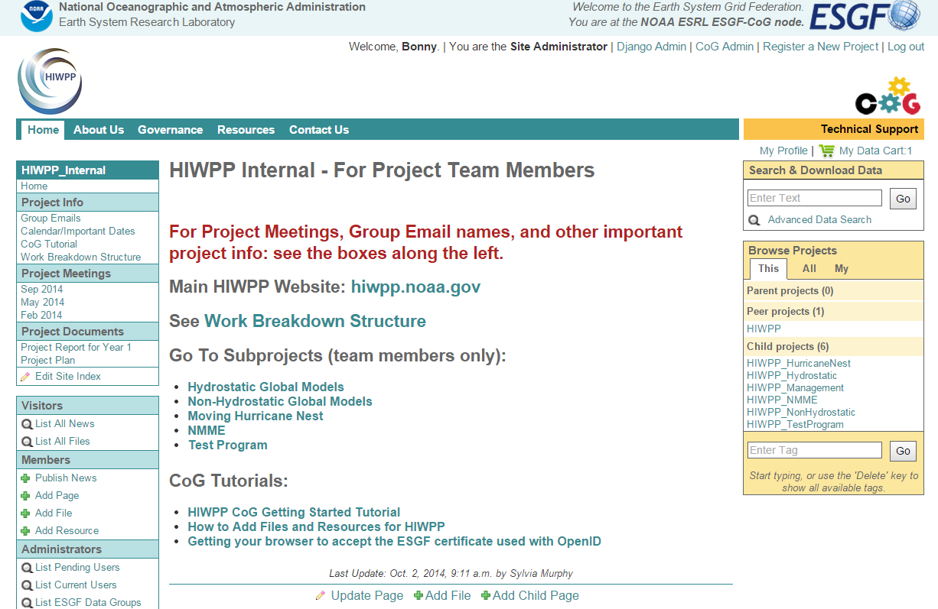
Collaboration Tools – CoG
CoG (Community of Governance)
Initially used in the project based on modelers experience using it for DCMIP
NOAA’s NESII team, headed by Cecelia DeLuca, has worked with HIWPP to develop new features
Has worked well for project coordination internally
http://cog-esgf.esrl.noaa.gov/projects/hiwpp_internal/

Slide 24
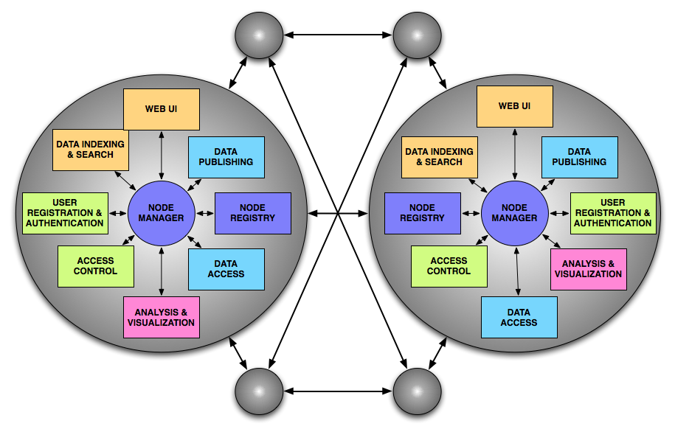
Collaboration Tools – ESGF
ESGF (Earth System Grid Federation)
Mechanism for user authentication with OpenID
Serving HIWPP real-time data through a THREDDS service in the ESGF network
Mechanism for metadata
https://www.earthsystemgrid.org/home.htm

Slide 25
Collaboration Tools – VLab
Became aware of VLab following seminar by Ken Sperrow at ESRL
For HIWPP:
Project management tools
Software development tools
Shared development between ESRL/GSD and NCEP/EMC
Forums for user feedback
HIWPP needs to support users outside NOAA
Partners in project
Public for Open Data Initiative
Integration of CoG/ESGF and VLab features?
OpenID

Slide 26
More Information:
Email:
Timothy.Schneider@noaa.gov
or
Bonny.Strong@noaa.gov
On the Web:
http://hiwpp.noaa.gov/
26

Slide 27
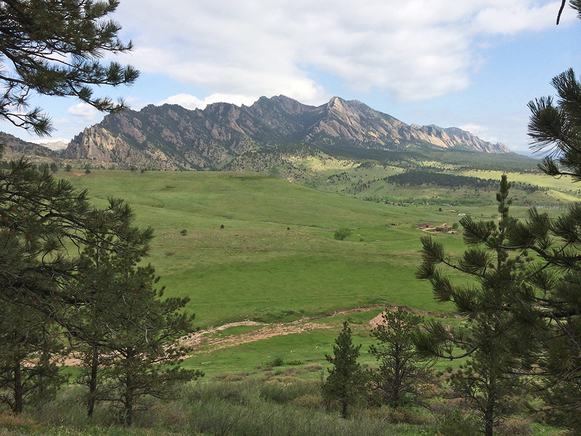
Questions?
Thank You!
27

Slide 28
Additional SLides

Slide 29
Structure: HIWPP Partnerships
Organization | Role/ Expertise | Notes
NOAA OAR/Laboratories | Applied R&D expertise (model development, high resolution nesting, physics, statistical post-processing, new data assimilation); verification; HIWPP data & visualization infrastructure; R2O | AOML, ESRL/GSD, ESRL/PSD, GFDL
NOAA NWS/NCEP | Operational numerical weather prediction and model development (GFS, NMMB, NAEFS, physics, data assimilation); verification, R2O | EMC; CPC
NOAA Cooperative Institutes | Academic and applied R&D in partnership with NOAA labs and centers | CICS-P, CIMAS, CIRA, CIRES
NSF/UCAR | R&D model development of non-hydrostatic model (MPAS); NMME data system | NCAR
Navy | R&D and operational modeling with NAVGEM (hydrostatic) & NUMA/NEPTUNE (non-hydrostatic) | NRL
Weather Enterprise | Interface with public perceptions and commercial needs, and academia; evaluation and feedback | HIWPP Open Data Users, AMS community (FIG)
29

Slide 30
Quick Dive: HIWPP Hydrostatic Models
Model | Agency | Resolution (at 40° Lat.) | Initial Output Freq. & Resolution |  | Vertical Levels | NEMS ready | Initial Condit. | Notes
FIM Flow-following, finite-volume Icosahedral Model | ESRL/GSD | 15km to 16day (10 km in future) | 1 hr | 1/8° | 64 | Y | GFS T1534 | Icosahedral grid; isentropic sigma vertical coordinates; finite volume core GFS 2012 (w/updates) physics;
GFS Global Forecast System | NCEP | 13km to 10 days 27km to 16 days | 1 hr (0-12 hrs) 3 hrs (12+ hrs) | 1/4° | 64 | Y | GFS T1534 | Spectral core (spherical harmonic basis functions w/transformation to a Gaussian grid); vertical sigma pressure hybrid coordinate; GFS 2014 physics;
NAVGEM Navy Global Environmental Model | Navy | 25km | 3 hrs | 1/4° | 64 | N | GFS T1534 | semi-Lagrangian, semi-implicit core; vertical sigma pressure hybrid coordinate ; NAVGEM physics package
30

Slide 31
Quick Dive: HIWPP Non-Hydrostatic Models
Model | Organization | Characteristics
HiRAM High Resolution Atmospheric Model | GFDL | Finite-volume dynamical core on a cubed-sphere grid. Developed as a global climate model, with capability to simulate statistics of tropical storms; parameterized convection helps the resolved scale convection, parameterization of shallow convection by Bretherton et. al. (2004)
MPAS Model for Prediction Across Scales | NCAR | Comprised of geophysical fluid-flow solvers that use spherical centroidal Voronoi tesselations (nominally hexagons) to tile the globe and C-grid staggering of the prognostic variables; supports non-uniform horizontal meshes and/or nests; terrain following height coordinate or hybrid coordinate relaxed at constant height. Advanced WRF physics package
NEPTUNE Navy Environmental Prediction sysTem Utilizing NUMA corE | Navy | Based on NUMA (Non‐hydrostatic Unified Model for the Atmosphere), a spectral element/discontinuous Galerkin dynamical core; uses cubed-sphere grid; adaptive mesh refinement under development
NIM Non-hydrostatic Icosahedral Model | ESRL/GSD | Multi-scale model based on 3D finite-volume solver. Vertical coordinate system is physical heights. GFS and WRF physics options. Evolving from the FIM, NIM was designed for and is currently being tested on massively parallel fine grain computers (GPU)
NMMB Non-hydrostatic Multi-Model on B-Grid | NCEP | Based on NEMS framework; global versions uses lat-long grid. Horizontal differencing preserves properties of differential operators and conserves energy and enstrophy; 1-way and 2-way nesting supported; WRF NMM’s physics
31

Slide 32
Key HIWPP Milestones
Test Program: New hardware purchased, installed, and tested | 6/30/14
Hydrostatic Global Models: Real-time research high-resolution runs of hydrostatic models begin; real-time cycling of 4D-En-Var begins; initial verification system in place | 10/1/14
Non-Hydrostatic Global Models: Idealized test cases for non-hydrostatic models are completed | 10/1/14
Test Program: NEIS (visualization) version 1 completed including Experimental Ensemble output; real-time data distribution system to Trusted Partners in place | 10/1/14
Moving Hurricane Nests: Preliminary tests of hurricane nests within a research version of NMMB completed | 12/30/14
NMME Expansion: Evaluations of NMME-based hurricane seasonal outlook completed | 1/31/15
Test Program: Advanced verification system with new capabilities completed | 3/30/15
Hydrostatic Global Models: Report on hydrostatic real-time test results submitted to journal | 9/30/15
NMME Expansion: Evaluation of NMME-based severe weather environmental factors completed | 9/30/15
Test Program: NEIS version 2 completed | 9/30/15
Non-Hydrostatic Global Models: Completion of retrospective forecasts for non-hydrostatic models and report on all testing results. Selection of 1-2 models for porting to MPFG | 10/30/15
Moving Hurricane Nests: Near real-time demo of multi-nested NMMB/NEMS model for hurricanes and report | 12/30/15
Non-Hydrostatic Global Models: Optimization of code for selected non-hydrostatic model/s on new MPFG system completed; ready for runs on new system in March 2016 | 3/30/16
32

