Slide 1
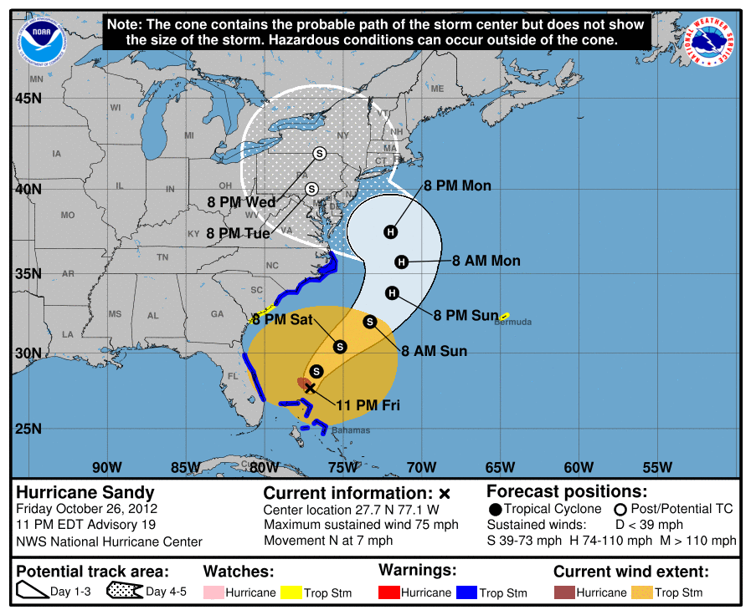
Cone of Uncertainty
Social and Behavioral Science Research
October 16, 2020

Slide 2
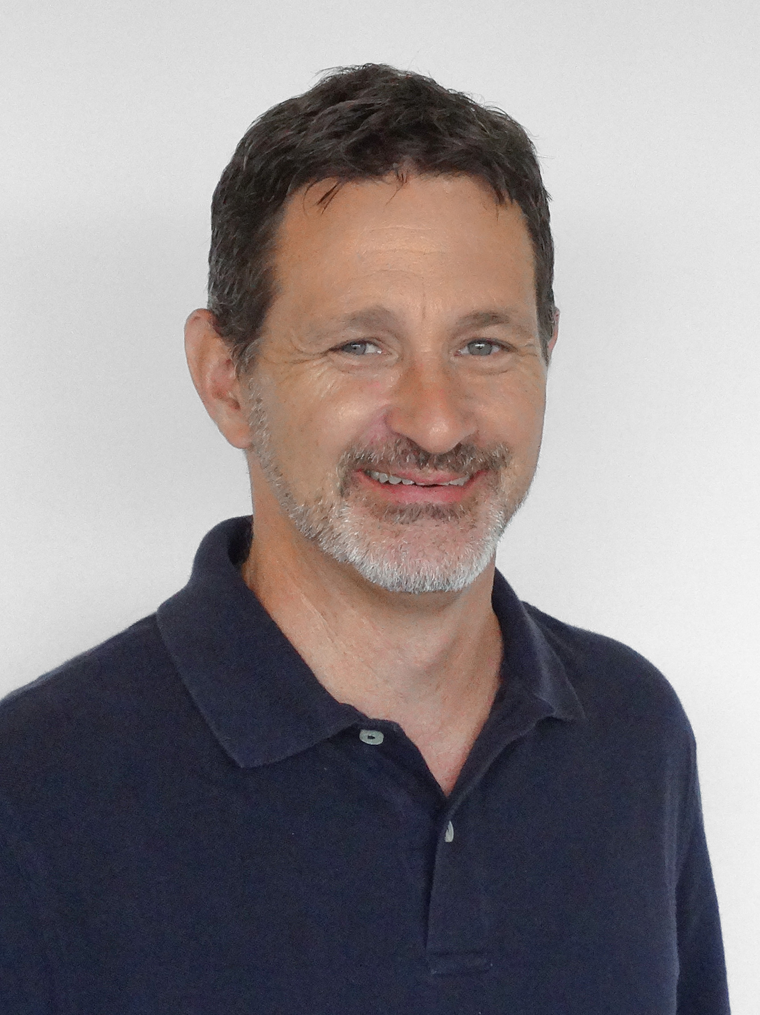
Research Team
Linda Girardi
Dr. Lou Nadeau
Jennifer Sharp
Dr. Betty Morrow
Dr. Jeff Lazo

Slide 3
What Is the Cone Graphic?
Represents the probable track of the center of a tropical cyclone.
Formed by enclosing the area swept out by a set of circles (not shown) along the forecast track (at 12, 24, 36 hours, etc.).
The size of each circle is set so that two-thirds of historical official forecast errors over a 5-year sample fall within the circle.

Slide 4
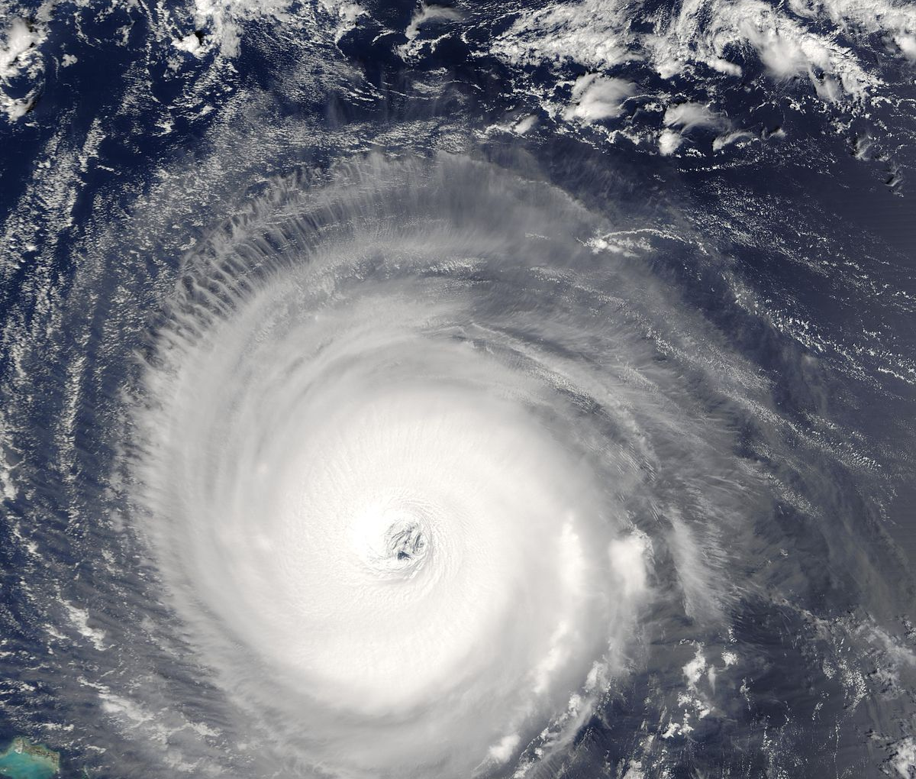
Study Purposes
How do people interpret (or misinterpret) the Cone of Uncertainty graphic?
How integral is the Cone Graphic to international partners’ decision-making?
How much do important economic sectors rely on the Cone Graphic for operational decision-making?
Does the Cone Graphic meet these users’ and stakeholders’ needs?
Notes:
We’re here today to share our findings from a research project focused on NHC’s tropical cyclone forecast track graphic, commonly referred to as the cone of uncertainty. The Cone graphic has come under scrutiny in recent years with many studies pointing to misunderstandings about what the visualization represents. Specifically, our research had four key objectives.

Slide 5
Approach
Approach | Purpose | Study Group | Final Report
Literature review | Understand interpretations of the Cone Graphic, implications for decision-making, and ideas for enhancements. | Members of the public Public officials, emergency managers Broadcasters | April 2019
Interviews | Understand how the Cone Graphic is used in decision-making and whether it serves operational and stakeholder communication needs. | International meteorologists in Bermuda, Canada, Cuba, Jamaica, Mexico, and Netherlands | July 2020
Survey | Understand interpretation, use, and implications for decision-making by lesser-studied but economically significant sectors. | Decision-makers in tourism/recreation, energy/utilities, marine, and transportation sectors | September 2020
Notes:
The research was conducted in three phases.

Slide 6
Literature Review
Notes:
The work began with a comprehensive literature review to review recent and important studies related to the Cone Graphic. We reviewed nearly 60 reports and studies, most of which were published in the last several years.

Slide 7
Factors Influencing Public Decision-Making
May not influence evacuation decisions on its own
TV and radio broadcasts
Public officials
Internet and social media
NOAA Cone Graphic
Past experiences
NOAA watches and Warnings
Decision-making
Friends and family
NHC website
Worldviews
NOAA text discussions and other products
Notes:
The literature showed that people consult many different sources of information when making hurricane preparation and response decisions. The Cone Graphic is the most well-known and pervasive (and sometimes the only) NOAA product they access. However, despite being the most familiar NOAA product to the public, it may not have a major impact on their decision to evacuate. One reason is because the graphic doesn’t provide the types of information that are most likely to influence decision-making, such as the size of the storm or potential impacts.

Slide 8
Literature Review
Misunderstanding | Implication
Seeing the cone as an impact visualization | Believing you are “safe” if located outside of the cone or “doomed” if inside the cone.
Equating the cone to storm size or intensity | Believing the hurricane is growing in size or strength as it approaches land.
Focusing on the forecast track | Not recognizing that landfall/impacts could occur at adjacent locations. Loss of interest in a hurricane when a track shifts away from a person’s location. Not recognizing that a storm’s present track could change in the future.
Notes:
Another reason is that the graphic can be confusing to people and cause them to misinterpret it. Some common misinterpretations focus on equating the cone feature as an impact visualization, so you are safe if you are outside of the cone but doomed if inside.; equating the cone to storm size or intensity; and focusing on the track not recognizing that impacts can occur at adjacent locations. People can also anchor to the first track they see, losing interest if that track shifts away from them or not recognizing the track could change in the future.

Slide 9
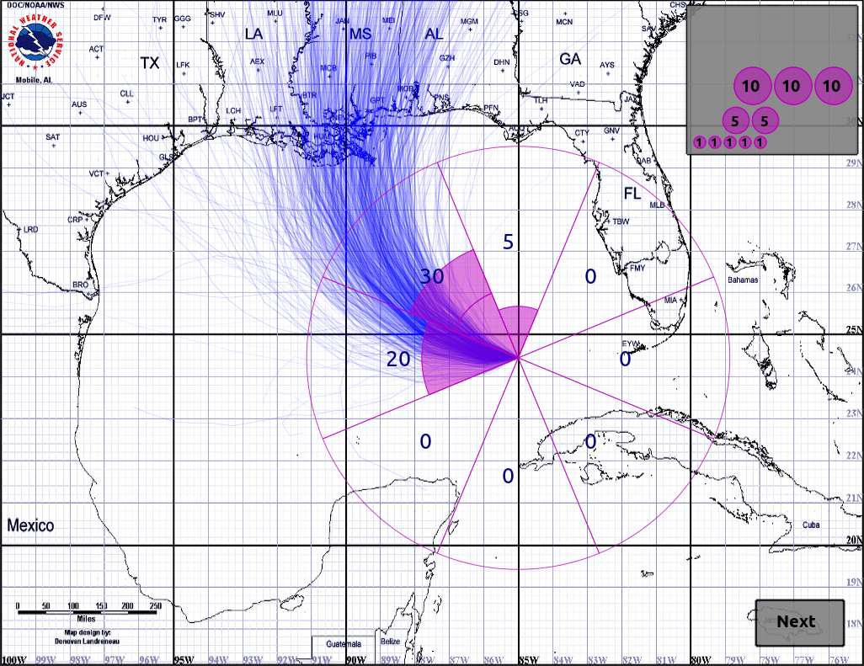
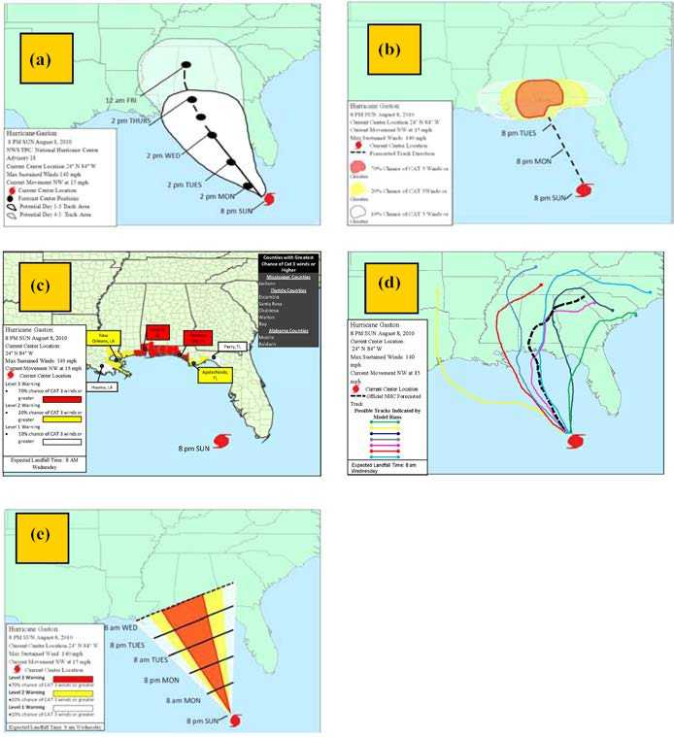
Visualizations
Source: Cox, J., House, D., and Lindell, M. (2013). Visualizing Uncertainty in Predicted Hurricane Tracks. International Journal for Uncertainty Quantification, 3(2): 143–156.
Source: Radford, L., Senkbeil, J.S., and Rockman, M. (2013). Suggestions for Alternative Tropical Cyclone Warning Graphics in the USA. Disaster Prevention and Management: An International Journal, 22(3): 192–209. https://www.emeraldinsight.com/doi/abs/10.1108/DPM-06-2012-0064
Source: Liu, L., Boone, A.P., Ruginski, I.T., Padilla, L., Hegarty, M., Creem-Regehr, S.H., Thompson, W.B., Yuksel, C., and House, D.H. (2017). Uncertainty Visualization by Representative Sampling from Prediction Ensembles. IEEE Transactions on Visualization and Computer Graphics, 23(9): 2165–2178. https://doi.org/10.1109/TVCG.2016.2607204
Notes:
Researchers have been experimenting with alternative ways to depict the Cone Graphic. While some of these visualization have shown promise in reducing common misconceptions with the current graphic, they have, in some cases, introduced other issues—for example, the animated icon display (indicated by an arrow) reduced the tendency for study respondents to confound the graphic with storm size, but respondents mistakenly believed the animation was showing the passage of time. A common finding among many of the studies is the need for any alternative visualization to be simple and communicative. Most respondents that participated in the study of the five visualizations on the right said they wanted to glean everything they need from the graphic in 20 seconds or less.

Slide 10
Interviews with International Meteorologists

Slide 11
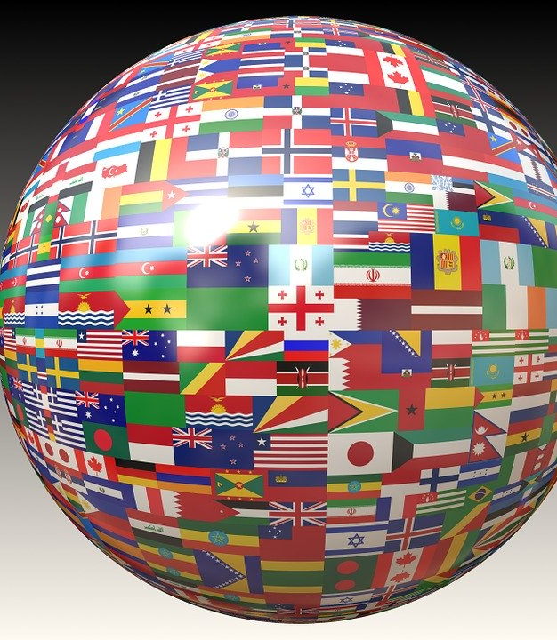
Participants
Bermuda Weather Service
Canadian Hurricane Centre
Cuba National Forecast Center of the Institute of Meteorology
Meteorological Service of Jamaica, Weather Branch
National Meteorological Service of Mexico
Royal Netherlands Meteorological Institute (serving Bonaire, Saba, and St. Eustatius)
Notes:
Following the literature review, we conducted interviews with meteorologists in six nations or territories to understand how integral the Cone is to international partners’ decision-making, as well as whether the graphic serves their operational and stakeholder communication needs. We also asked for suggestions on how the graphic might be improved to better meet their needs.

Slide 12
Strengths and Weaknesses
Positives
Negatives
Very familiar to audiences
Provides important first-view, possible track movements, high-level overview
Can help people assess confidence as lead times get shorter
Can be over-reliance on graphic for decision-making
Does not provide information on hazards
Is not well understood by the public
Does not explain impacts

Slide 13
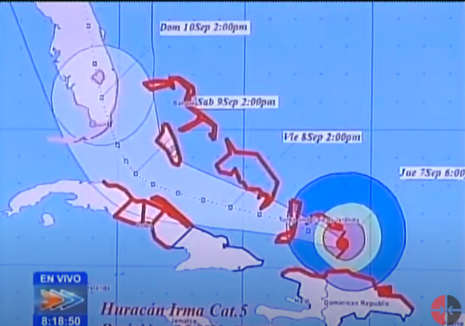
Ideas for Enhancements
Multiple layers of information
Interactive
Overlay with satellite imagery
Provide context
Dynamic cone produced with real-time ensemble data
Notes:
They provided a number of ideas for enhancements including: 1) producing a graphic with multiple layers that can show different storm parameters and/or hazards, 2) creating an interactive graphic so users can focus on areas and information of interest, 3) overlaying the graphic with satellite imagery so users can see the storm extent.; 4) providing mouseover explanations of different features to aid in understanding; and 5 and producing a dynamic cone produced with real-time ensemble data instead of the 5-year historical tracks.

Slide 14
Web-Based Sector Survey

Slide 15
Survey Respondents
Distribution of Respondents Across Sectors
491 respondents
Pacific and Atlantic regions
75% were either the primary decision-maker or part of top decision-makers
89% had 11+ years of experience

Slide 16
Key Topics Assessed
General
Cone Graphic
Prior storm experience
Forecast information sources
Forecast parameters
Use of NWS products for decision-making
Familiarity with and reliance on ensemble displays
Familiarity with the graphic
Assessment of features
Communication effectiveness
Interpretation of graphic
Importance to decision-making
Notes:
A lot in the report.

Slide 17
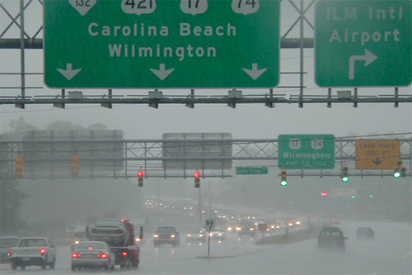
Survey Findings: Familiarity and Importance
Across all sectors, respondents are very familiar with the Cone Graphic
It is important to their activities, operations, and decision-making

Slide 18
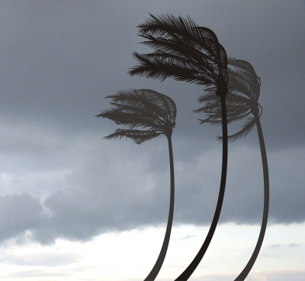
Survey Findings: Misunderstandings
The tourism and recreation sector also generally said they find the graphic effective and easy to understand
AND
Rated the graphic as important to their decision-making
Depicts areas that could experience strong winds (all sectors, esp. tourism and recreation)
Indicates when strong winds are likely to arrive (all sectors)
Covers all possible tracks for storm (all sectors, esp. tourism and recreation)
Notes:
While certain aspects of the graphic are understood, particularly that the graphic depicts whether a storm is a tropical storm or hurricane and that it does not depict storm surge., there are also several misunderstandings about the graphic, particularly among those that lacked prior storm experience and among tourism/recreation sector—even though this sector was more likely to agree than the others that they found the graphic effective and easy to understand. Misconceptions include (see bullets).

Slide 19
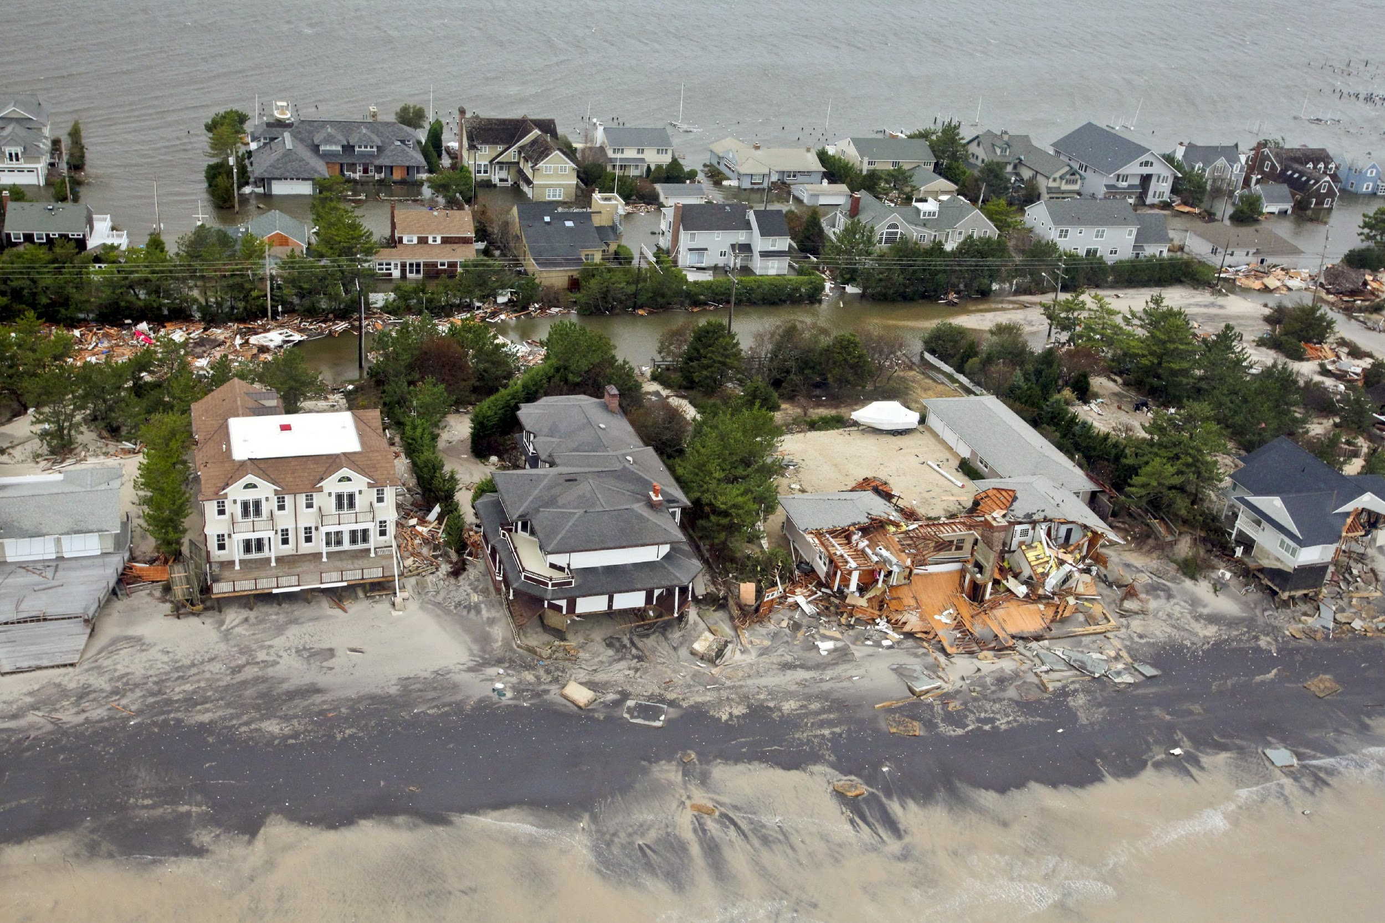
Survey Findings: Respondents with Prior Storm Experience
More likely to understand that impacts can occur outside of cone boundary
Less likely to believe that the graphic shows where storm is likely to go
Less likely to believe the center line and cone feature are effective
Notes:
Those with prior storm experience were more likely to understand that impacts can occur outside of the cone and less likely to agree that the graphic shows where the storm is likely to go and less likely to rate the center line or cone features as effective

Slide 20
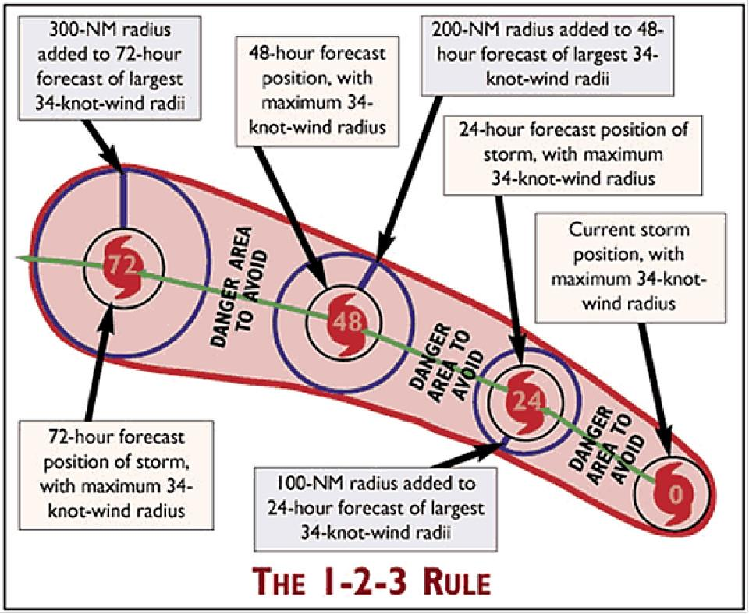
Survey Findings: Marine Sector
Rated the Cone Graphic as important to its decision-making
Some aspects of the Cone Graphic are hard to understand (legend in particular)
Some prefer Mariner 1-2-3 Rule graphic
Notes:
We’ve already talked about some findings unique to the tourism and recreation sector. Let’s touch on some aspects unique to the other sectors. The marine sector liked some aspects of the graphic, particularly its colors. But it also found aspects of the graphic hard to understand, calling out the legend in particular; some preferred Mariner 1-2-3 Rule graphic

Slide 21
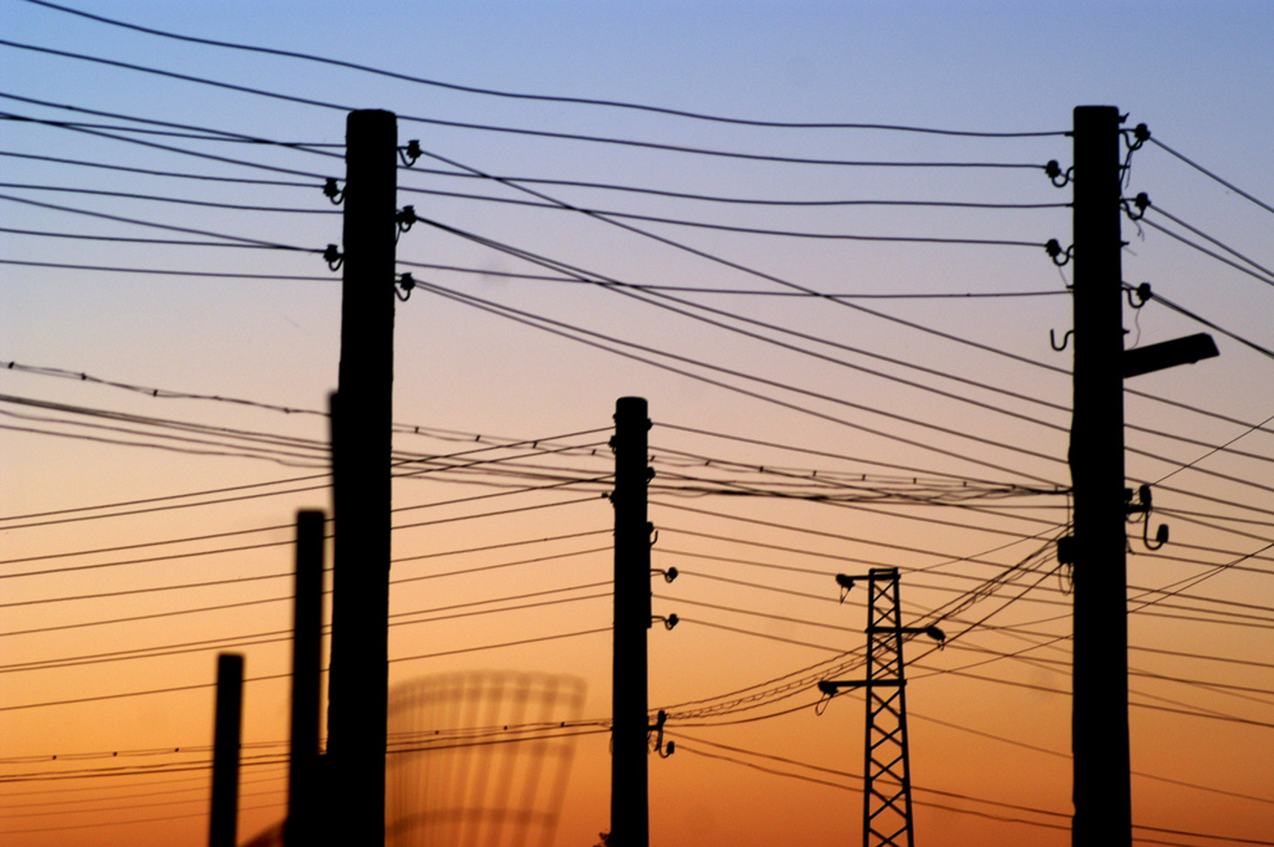
Survey Findings: Energy and Utilities
Helps them decide whether and when to prepare
Provides all the information needed for preparation decisions
Notes:
The energy and utilities sector was more inclined than the other sectors to agree that the graphic helps them decide whether and when to prepare. This sector was also more inclined to believe that the graphic provides all the information needed for preparation decisions.

Slide 22
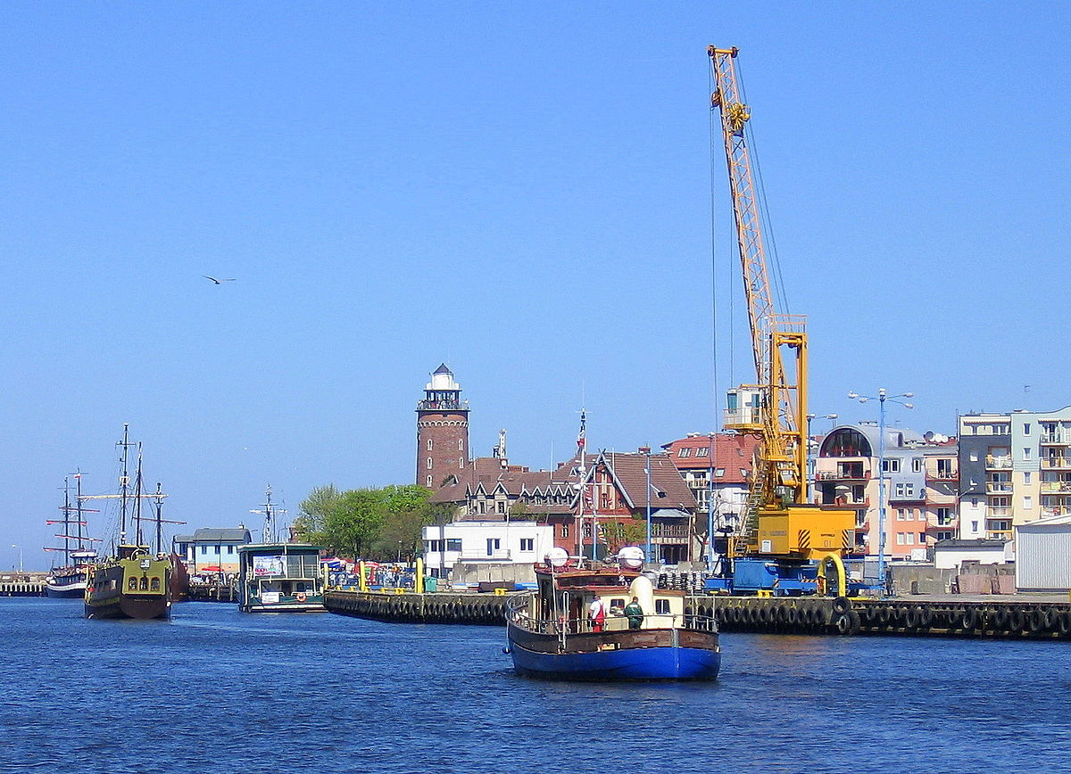
Survey Findings: Transportation
Less likely to understand the cone size depends on level of accuracy in previous track forecasts
Notes:
The transportation sector were less likely than the other sectors to understand cone size depends on the level of accuracy in previous track forecasts.

Slide 23
Key Overarching Findings

Slide 24
Familiar
The Cone Graphic is very familiar to all audiences, from members of the public to experienced professionals in the sectors studied.
Notes:
All of the research indicates that the Cone Graphic is very familiar to all audiences.

Slide 25
Valuable
It is valuable (even critical) to decision-making for international forecasters and the professionals in the sectors studied.

Slide 26
Misinterpreted
Aspects of the Cone Graphic are misunderstood or misinterpreted, even by professionals in the sectors studied.
Notes:
Misinterpretations by members of the public are well documented as we saw in the literature review. However, our survey also showed that some professionals with many years of experience also have some misunderstandings about the Cone Graphic. For example, there was a high level of agreement across all sectors that the cone size depends on the degree of uncertainty in the track forecast for a particular storm (which it does not). Those without prior storm experience were 1.6 times more likely to believe this. These findings signify there is confusion about how the cone is derived and what it represents. In addition, more than half of the respondents across all sectors agreed that the Cone Graphic covers all the possible tracks for a storm. Our survey also found across all sectors, there was moderately high agreement that the graphic depicts areas that could experience strong winds, and some agreement that the Cone Graphic indicates when strong winds are likely to arrive.

Slide 27
One of Many Pieces of Information
While the Cone Graphic is not the only piece of information that people use to make preparedness decisions…

Slide 28
Some Over-Reliance?
* Significant at the 10 percent level; ** significant at the five percent level; *** significant at the one percent level
… there may be some over-reliance on the Cone Graphic by some professional entities.
Notes:
The survey found that energy/utility entities were 2.5 times more likely to agree that they get all the information they need from the graphic and more than 2 times more likely than the other sectors to agree that the graphic helps them decide whether and when to prepare. Those that lacked prior experience with a storm with extensive impacts from a tropical cyclone also tended to agree that the Cone Graphic provided all the information they needed compared to those with prior experience. Some international meteorologists also felt that some entities relied too heavily on the graphic.

Slide 29
The Paradox
* Significant at the 10 percent level; ** significant at the five percent level; *** significant at the one percent level
The current Cone Graphic might have too much information to process cognitively...
And it yet it doesn’t have all the information
people want.
Notes:
Across all the research, there are criticisms that the Cone Graphic is a complicated figure that attempts to provide too many messages represented by too many graphical elements. At the same time, it doesn’t depict some of the parameters people want most--parameters that can help them make preparedness decisions—such as the size of the storm, intensity, confidence in the forecast track, where the worst weather will be, what the potential impacts might be, and what hazards (rainfall, tornadoes, storm surge, wind) to be concerned about.

Slide 30
Looking Ahead

Slide 31
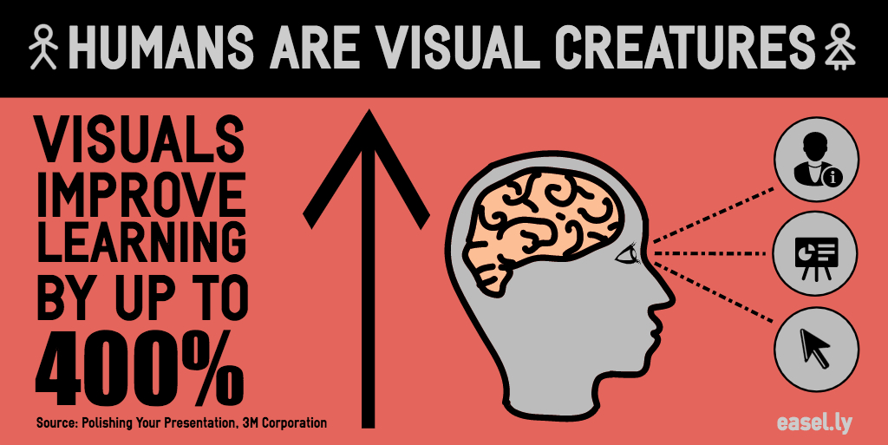
Notes:
Visualizations are powerful tools for explaining technical data and scientific processes. They can effectively compress and convey data in an understandable and memorable way. They can often provide insights that people may not glean from written text alone. With interactive functionalities, they can enable a user to be an active participant in learning—not just a viewer. But visualizations cannot fully deliver these benefits if viewers misunderstand or misinterpret them.

Slide 32
Can One Graphic Do It All?
Notes:
The research showed that audiences have different levels of understanding of the graphic. If the NHC considers enhancing or altering the visualization in the future, it will be important to consider ways to address the needs of sophisticated and non-sophisticated users alike. For example, members of the public may be simply monitoring the situation three to five days out while emergency managers and other decision-makers need information to inform decisions about staffing, moving equipment, etc.

Slide 33
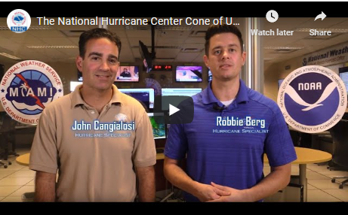
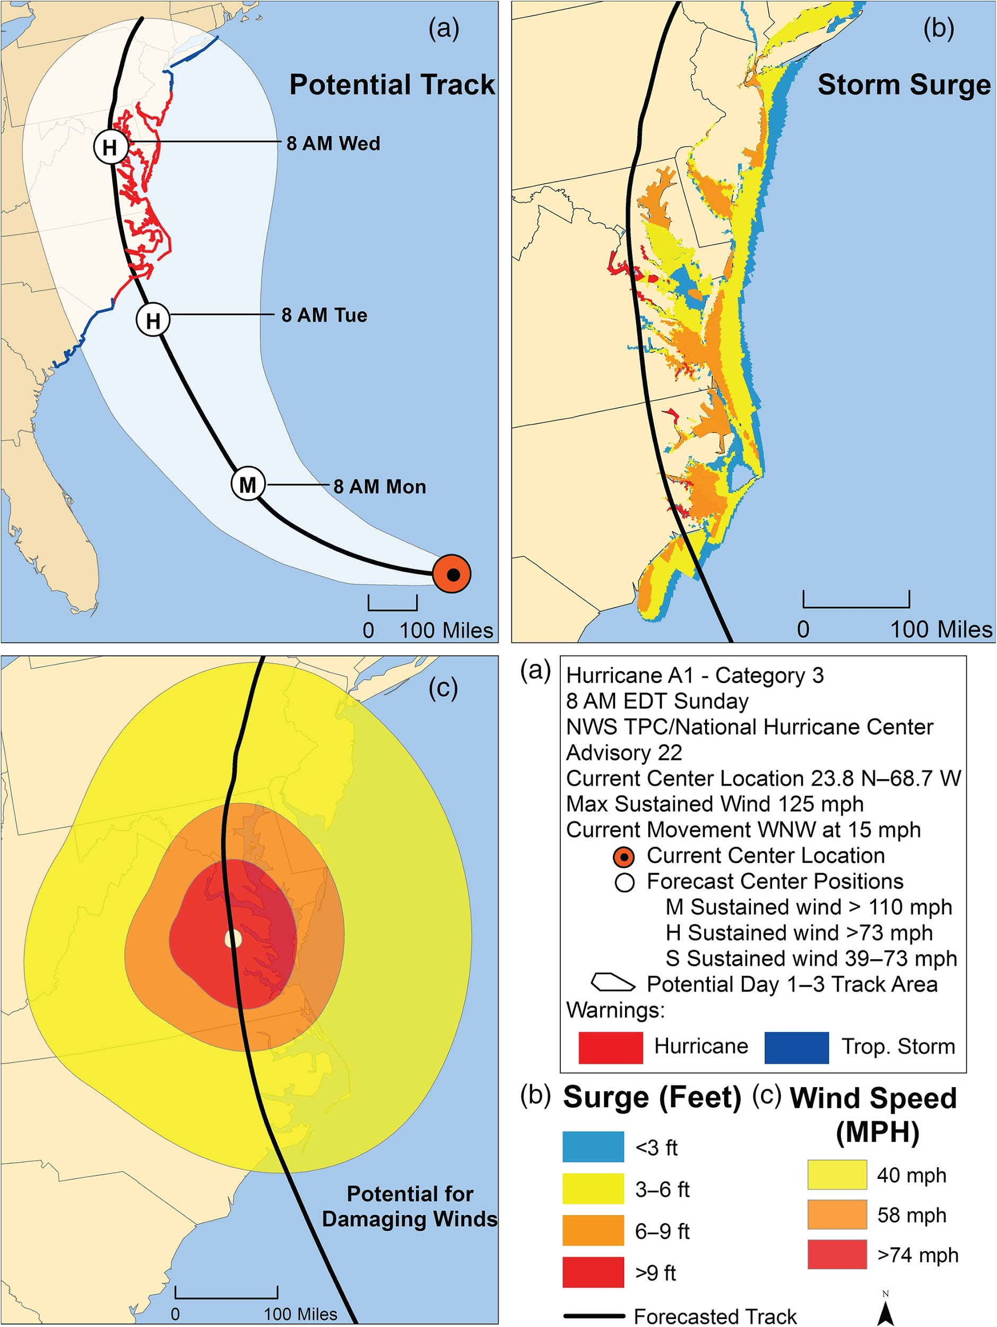
Education
Combination or supplemental graphics
New visualization
Cosmetic changes or digital enhancements
Possible Approaches
Source: Saunders, M.E. and Senkbeil, J.C. (2017), Perceptions of hurricane hazards in the mid‐Atlantic region. Met. Apps, 24: 120-134. doi:10.1002/met.1611
Notes:
There are many possible ways forward—or combination of approaches. For example, the NHC could simply continue building on efforts to provide education on the visualization, such as a recent NHC video explaining the graphic. It might also consider ways to enhance the current visualization (e.g., modernize the look, declutter the legend, reduce the number of elements included). Another approach would be to build off the work NHC has already done with its interactive Cone Graphic and test this graphic (or other prototypes) with user groups to determine if this kind of approach meets their needs. Throughout the research, there were repeated suggestions to use technology to improve the utility and user-appeal of graphic.
However, some studies asserted that cosmetic changes to the current graphic cannot address the fundamental problem with current misinterpretations. To address this, the NHC might consider developing and testing alternative visualizations , supplemental graphics, or combination approaches showing the types of information people want to see to help them make preparedness decisions.

Slide 34
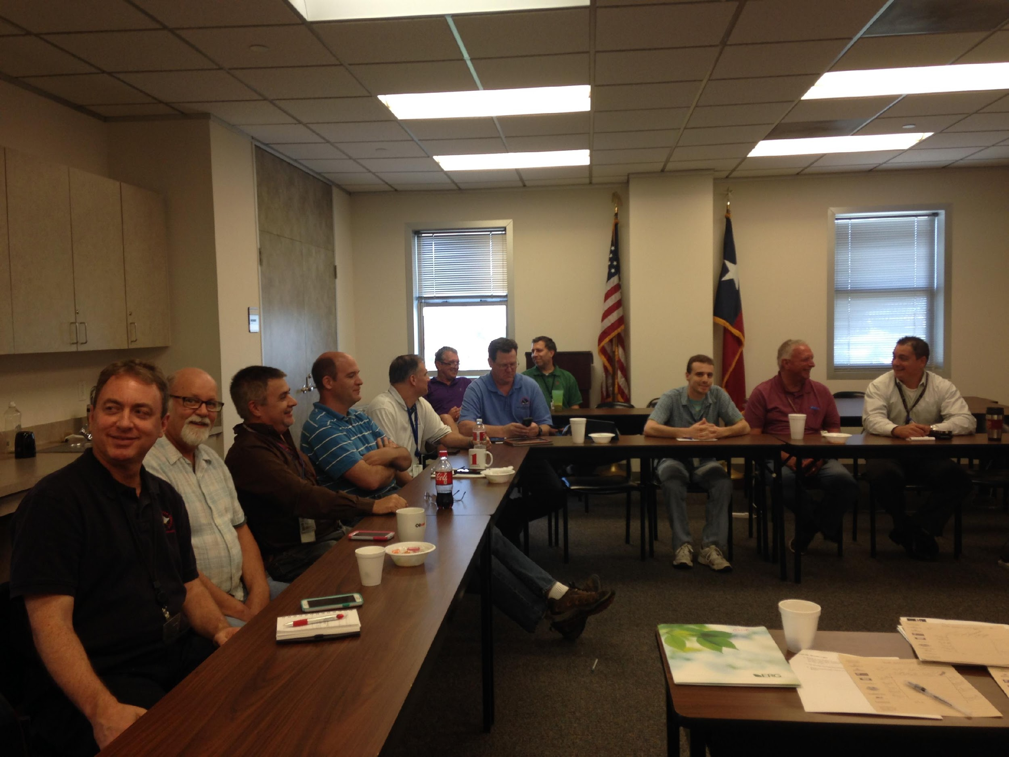
Test with User Groups
Notes:
Going forward, it will be important to test any changes or prototypes with user groups and consider implementing any changes incrementally. It should be noted that any kind of change can provoke rejection or opposition, particularly with a product that is so well-known. In the survey, while there were many suggestions for ways to improve the graphic, there were many commenters who also expressed satisfaction with the graphic—and a desire to keep it the way it is.

Slide 35
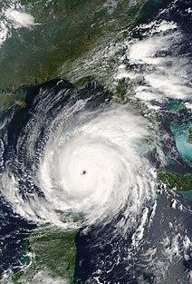
Questions?
Linda.Girardi@erg.com
Lou.Nadeau@erg.com
Jennifer.Sharp@erg.com

