Slide 1
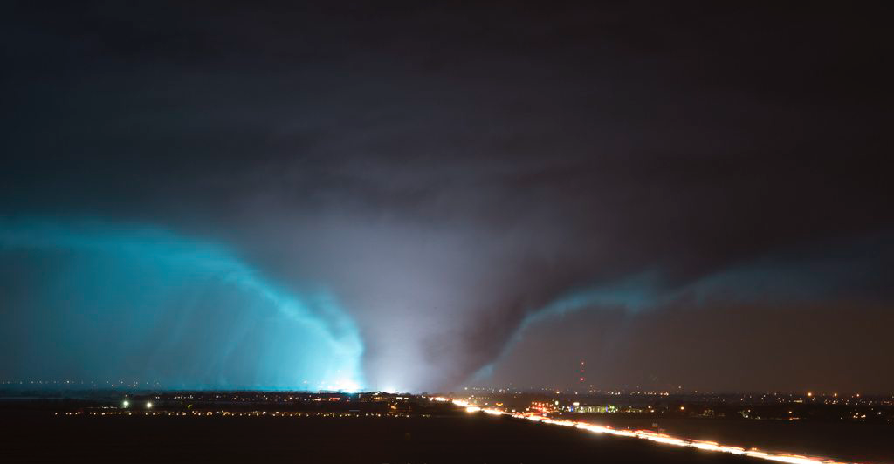
A High Resolution Communication Analysis of the Integrated Warning Team During the 26 December 2015 Sunnyvale/Garland/Rowlett TX Tornado
Dennis Cavanaugh – Mark Fox– Melissa Huffman – Sean Clarke
National Weather Service

Slide 2
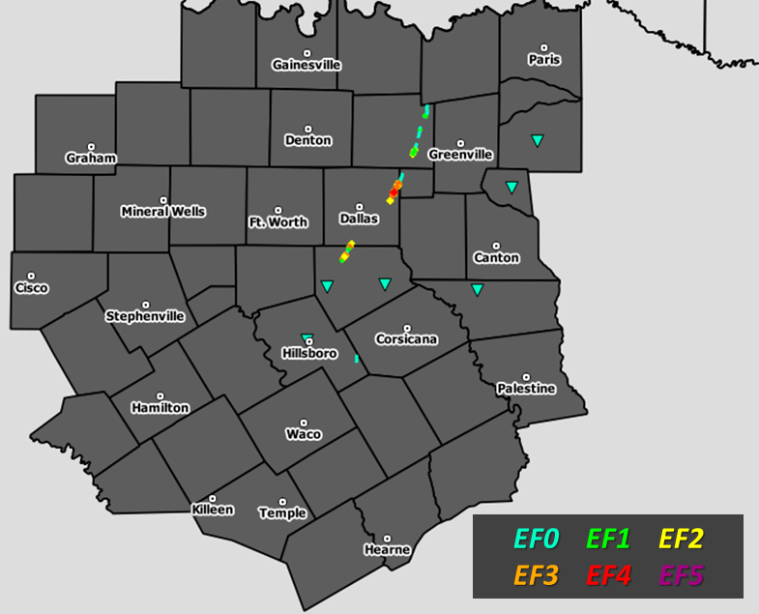
26 December 2015 Tornado Outbreak Overview
1 – EF4: Garland, Rowlett, Sunnyvale
12 Tornadoes Total
1 – EF3: Ovilla / Red Oak
1 – EF2: Lavon/Copeville
12 Fatalities
633 Injuries
est. $1 billion

Slide 4
Warning Systems
We’re all trying to get people in harm’s way to DO SOMETHING!!
TAKE PROTECTIVE ACTION!!
Notes:
So in the video, you can clearly see the impact of the tornado, but you also saw several players mentioned as part of a warning system. You see the television station talking about a tornado warning right off the bat, then you see the mention of when outdoor warning sirens were activated. You also hear radio traffic of first responders and storm spotters talking about the current position of a tornado. What you see is everyone working together as part of a warning system, intentional or not. The point of a warning system is to get people that are in harm’s way to take action. If you look at the stats from this event, many people did take action. Things could certainly have been worse.

Slide 5
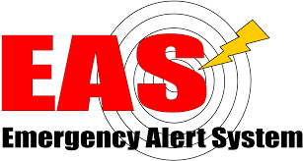
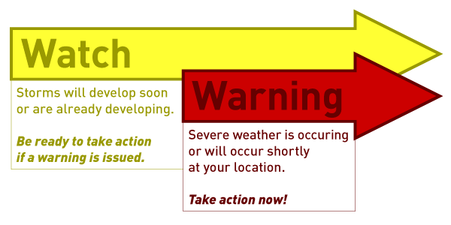
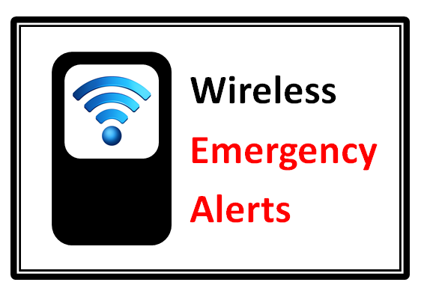
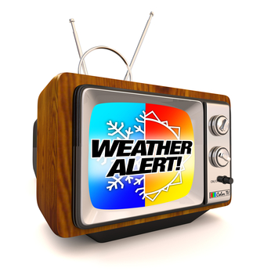
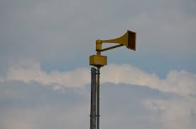
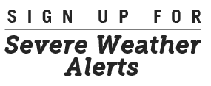
Available Information
Notes:
Looking back at the event, we know that a lot of information was available. We were able to confirm the transmission and receipt of information about this tornado via WEA, OWS, EAS, local TV stations, NWSChat, etc… so with all of this information AVAILABLE, how could you feel like you weren’t warned.

Slide 6
There was no warning… we had no idea it was coming.
From AAR presentation “Pay Attention to Me!” -- Mollie Rivas (Garland, TX OEM)
Notes:
Yet many people still felt like they were unwarned… this is a slide from a presentation given by the emergency management coordinator of Garland at the time. People felt like they didn’t receive a warning of what was headed their way… but why? We know warnings were broadcast from multiple sources…

Slide 7
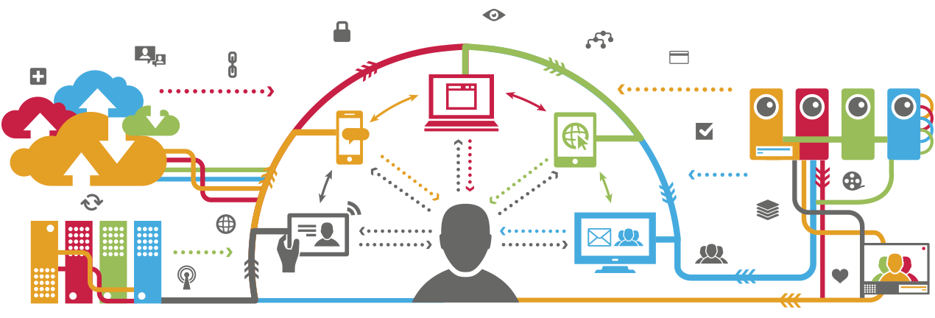
Trying to process information during the storm can be like trying to take a drink from a fire hydrant
From AAR presentation “Pay Attention to Me!”
-- Mollie Rivas (Garland, TX OEM)
Notes:
Is it possible that people are getting too much information? That’s a possibility… but this is something that we also study; the social science behind the communication of hazardous weather information. It’s more likely that people felt that the warning wasn’t meant for THEM or that there was a breakdown in understanding.
And that is what we are hearing over and over after these storms. No one told ME.
It can be too overwhelming to process all of those stimuli all of the time. It is imperative that humans reserve their fight or flight response for true emergencies. It is not healthy to have our stress hormones elevated more often than is necessary. This is why our brains tend to ignore the blast warnings and wait until it is perceived to be a direct threat to US.

Slide 8
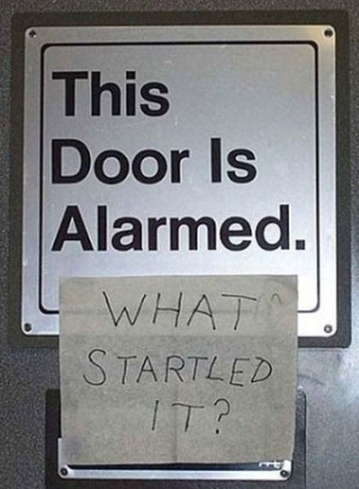
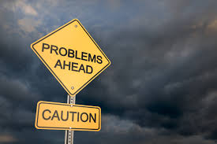
Warnings don’t have intrinsic value!
Notes:
So are people receiving too much information? Is that making it harder for them to take action? Research tells us that one of the problems with a warning is that it doesn’t have intrinsic value.

Slide 9
To have value, a warning must be
Received
Understood
Believed
Notes:
We know that for a warning to have value, it must be 1. Received 2. Understood 3. Valued before anyone will take action based on them.

Slide 10
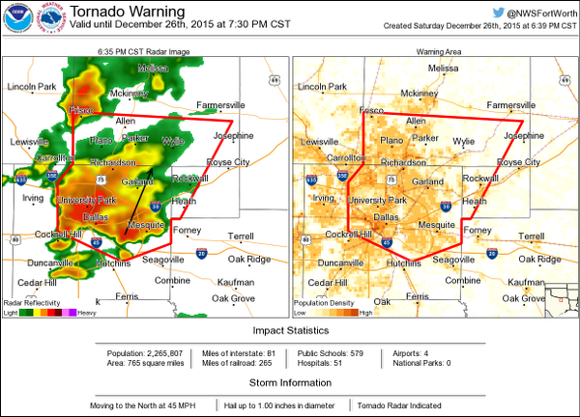
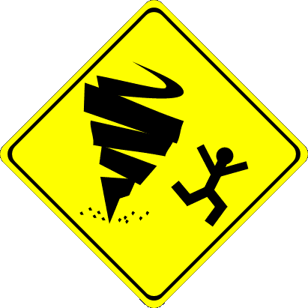
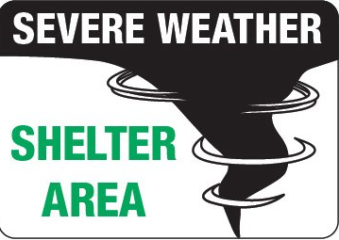
NWS Perspective
Notes:
From the NWS perspective, the primary way the NWS communicates hazards is through warnings. We communicate primarily through polygons, text, and the thought that when we hit “send” people in harm’s way will know something bad is coming and take cover as a response.

Slide 11
Previous Research: May 15th, 2013 Granbury/Cleburne tornadoes
Emergency Management
Emergency Management
NWS
VOST
NWS
VOST
IWT Communications Research:
Each IWT Member is a large “node”
Media
Public
Media
Public
Notes:
Our research team looked at the dissemination of warning information in the Integrated Warning Team network during the tornado outbreak of May 15th, 2013. We focused on where all information relevant to severe storms was communicated within the IWT. We analyzed communications on a fairly broad scale treating each component of the IWT as one large “node” or point of contact for analysis.

Slide 12
Summary
No IWT member is the sole communicator of hazard information.
IWT members must communicate with each other to increase the likelihood that a message will reach the public.
More IWT communication
=
More opportunities to provide threat confirmation
For the NWS … Warning DOES NOT STOP after hitting “Send”!
Notes:
Message amplification through the IWT provides more opportunities to confirm a threat

Slide 13
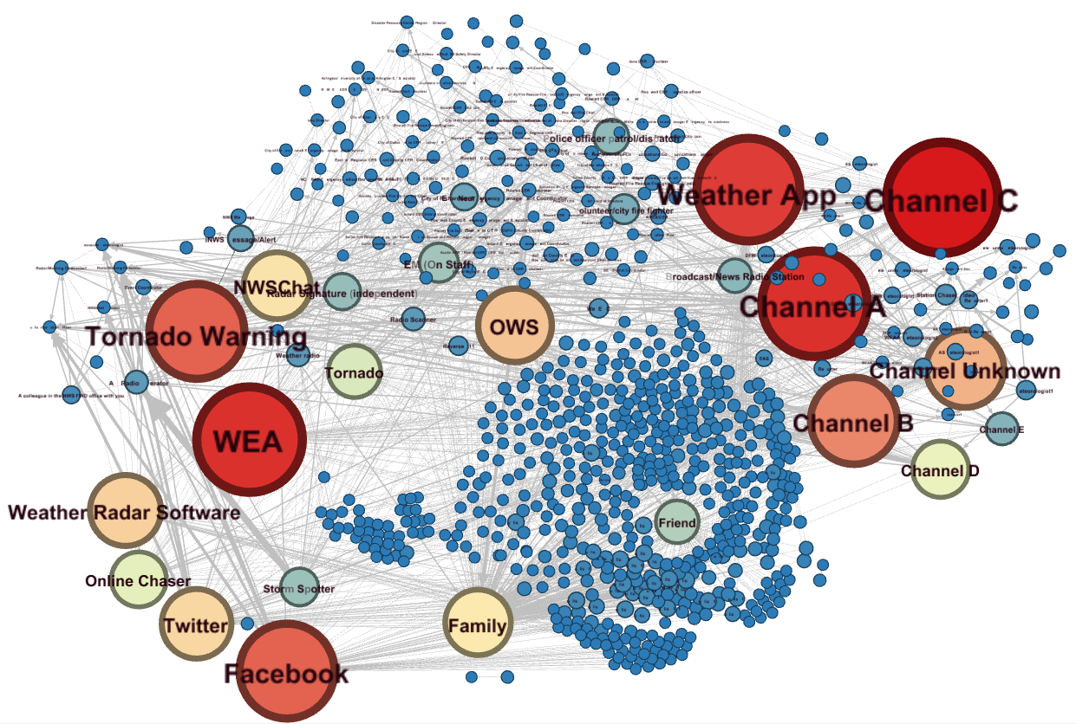
Digging Deeper:
Emergency Management
NWS
Media
Public
Social Media
Notes:
Our research team looked at the dissemination of warning information in the Integrated Warning Team network during the tornado outbreak of May 15th, 2013. We focused on where all information relevant to severe storms was communicated within the IWT. We analyzed communications on a fairly broad scale treating each component of the IWT as one large “node” or point of contact for analysis.

Slide 14
How was the research done?
Survey results from
Public (549)
Emergency Managers (94)
NWS staff and amateur radio (11)
Local Media (22)
Resulted in 3,139 documented communications
Asked
Where they found out about the tornado from first
Who they told
Where they got additional information about the storm

Slide 15
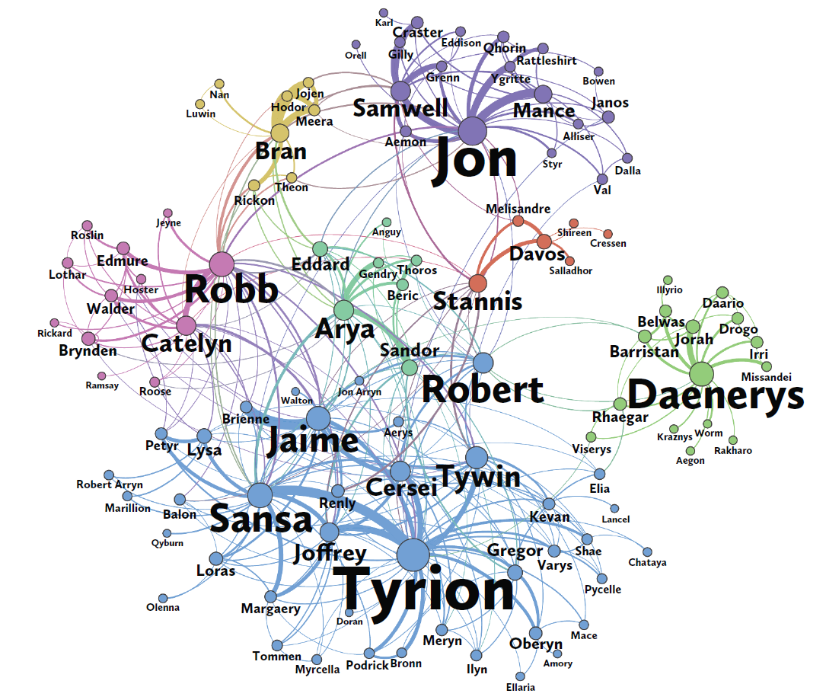
Social Network Analysis
Analyzes a network of people and relationships to understand the flow of information
Each person represents a node with edges connecting them to show their relationship
This can show where potential breakdowns in communication and potential weak points in the IWT did or could occur
Notes:
Once we have all of the data, we can go beyond tallying up survey results and take a deeper look at the flow of information related to this tornado utilizing social network analysis.

Slide 16
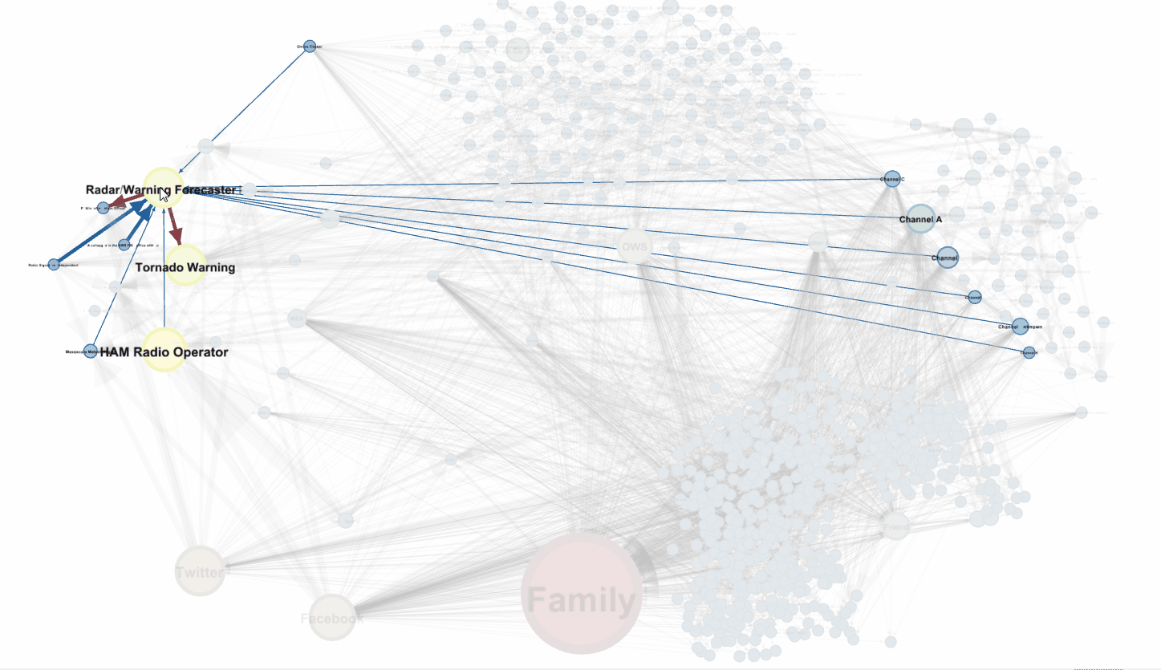
Notes:
An animation of tracking the communication of a tornado warning through the analysis network. The warning forecaster receives input from radar, colleagues in the office, the HAM radio operators, online chasers and local TV stations. That person issues the tornado warning. The warning sets off WEA, OWS, Weather Apps and is communicated by all local TV stations. That information starts to bounce around the network

Slide 17
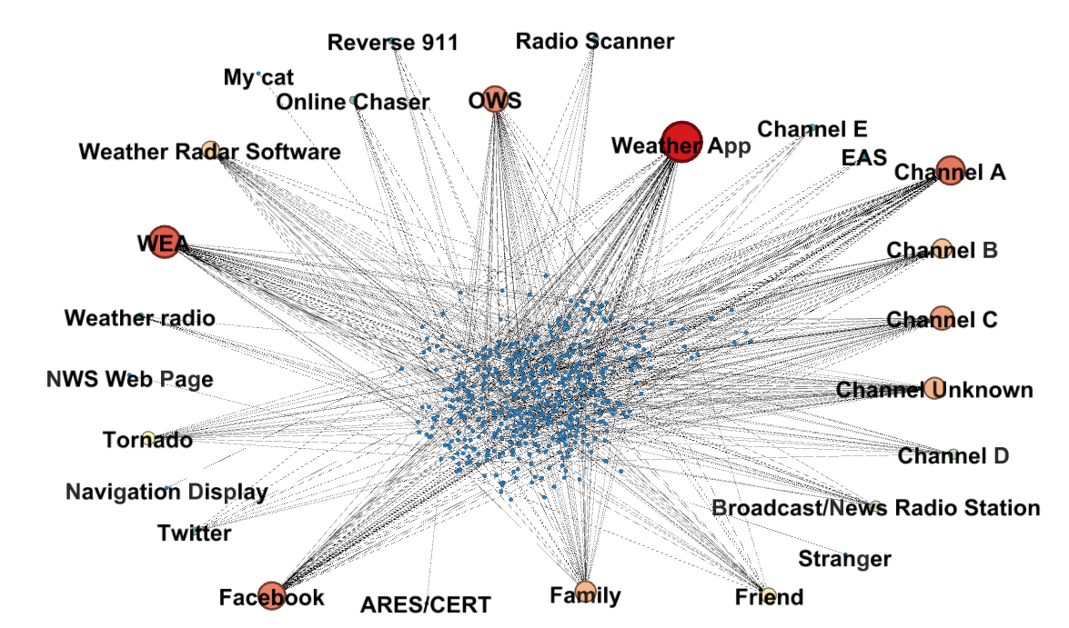
Public Only: How did you first receive a warning?
Ranking (536 total responses):
TV (aggregate) -- 168 (31%)
Weather App – 68 (13%)
WEA – 53 (10%)
Facebook – 45 (8%)
OWS – 42 (8%)
Family – 33 (6%)
Weather Radar Software – 27 (5%)
Friend – 22 (4%)
Tornado Itself – 19 (4%)
News/Radio Broadcast – 14 (3%)
* Facebook is very likely biased too high because many respondents learned about the survey from Facebook.
* Weather Radar Software is probably over represented as weather enthusiasts may be more likely to answer the survey

Slide 18
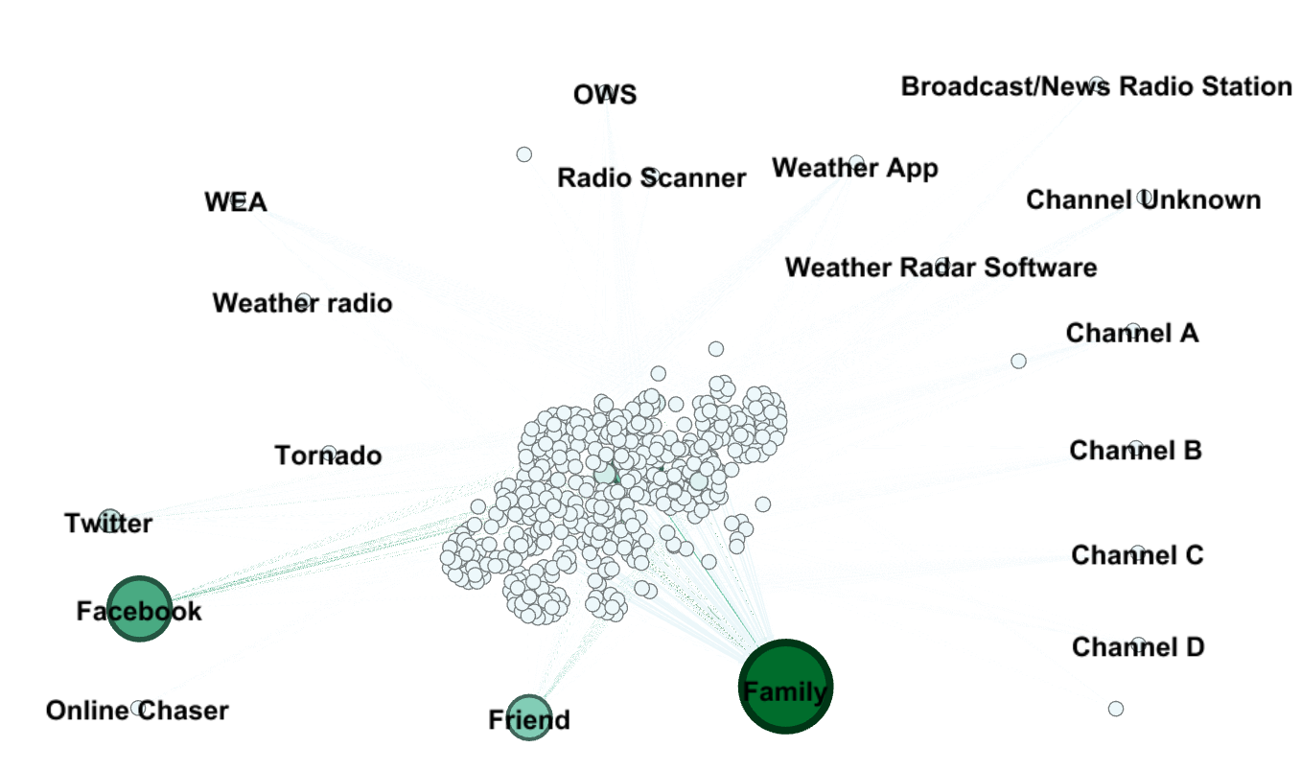
Public Only: Who did you tell after receiving?
255 of the 536 respondents, or 48%, told someone else!
Family (131)
Friend (52)
Facebook (36)
3. Twitter (36)

Slide 19
Public First Action + IWT: Out Degree (Senders of Info)
Notes:
Basically “where did you get information from?”

Slide 20
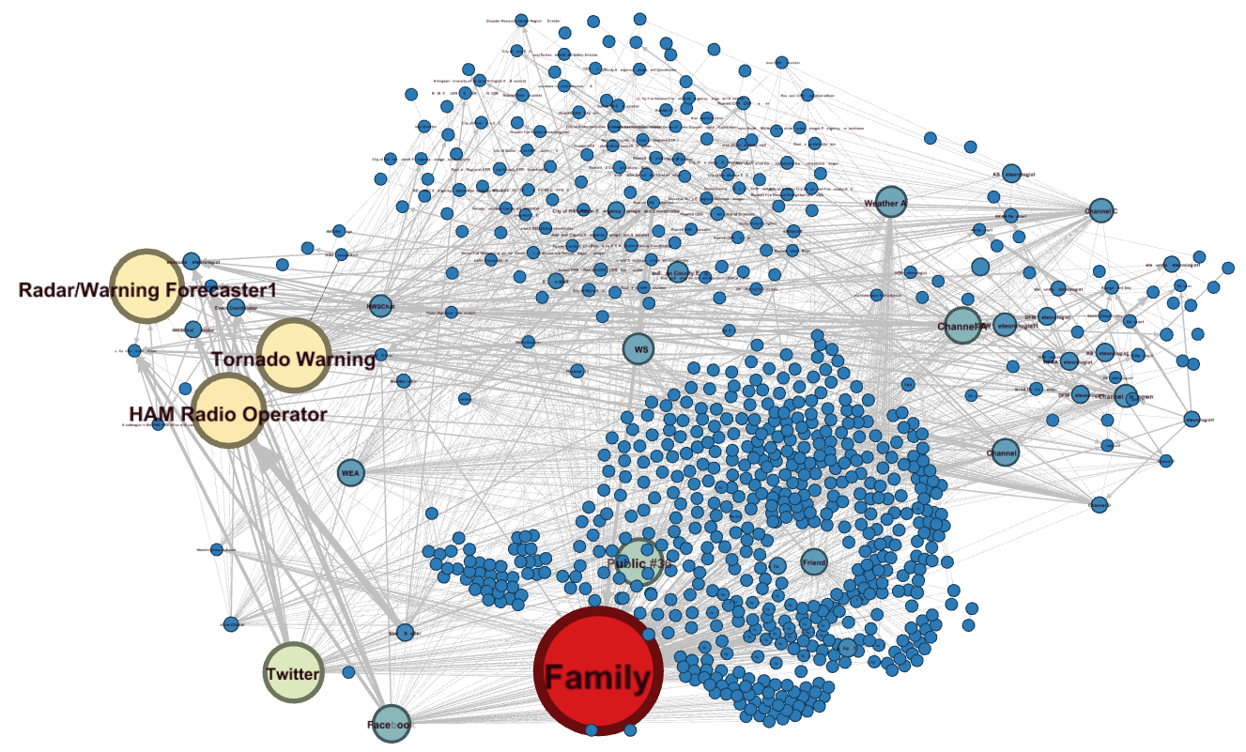
Public First Action + IWT: Betweeness Centrality
Notes:
Identifies important conduits of information. Note, this is not necessarily the most important communicator, but if these points break down, there will likely be a massive disruption of information within the network. Another way to look at this metric is a measure of network vulnerability. Note that the TV stations are not listed as a big vulnerability in the network despite being extremely important communicators. This is actually a huge credit to the local area TV networks; they were all broadcasting the same message at the same time. By broadcasting a consistent message between the NWS, EMs, and Public, they effectively reduced their network vulnerability and improved the resilience of the network! Also note that one way methods of communication really fall off here because there’s no way for these nodes to get information back after sending it out. For instance, WEA and OWS systems can’t receive information from the public.

Slide 21
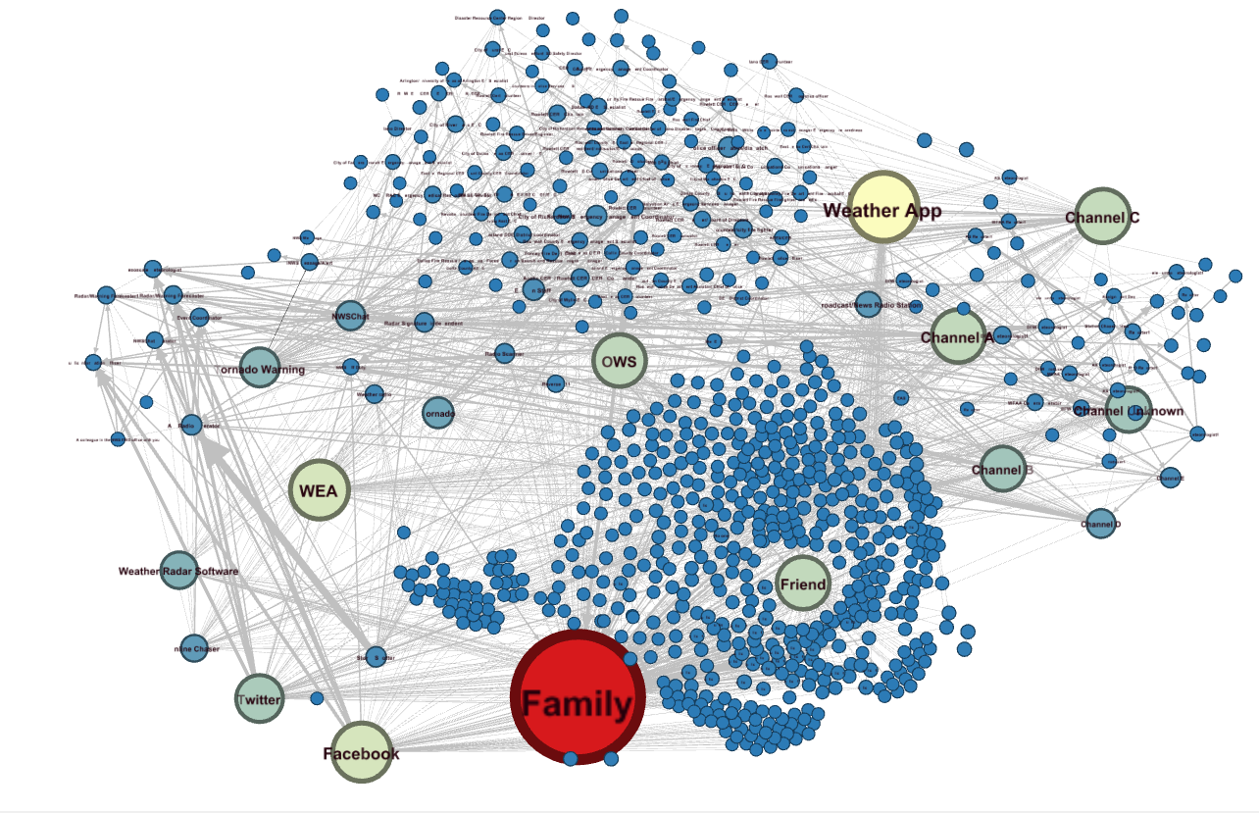
Public First Action + IWT: Page Rank
Notes:
Identifies the most effective communicators of the message. Note the NWS forecaster that issued the warning dramatically falls off the map here. This shows that issuing the warning has an impact, but once that warning is communicated, the message is largely in the hands of other parties or members of the IWT. Family is once again blown out of proportion here, but I think this demonstrates how important it is for the IWT to communicate a consistent message. The public is communicating back and forth with family and friends while participating on social media and getting new information from the IWT

Slide 22
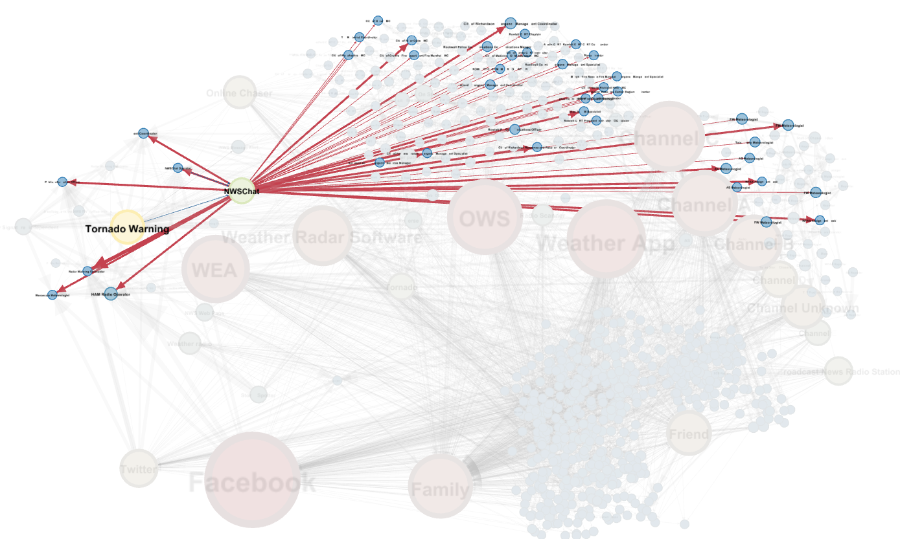
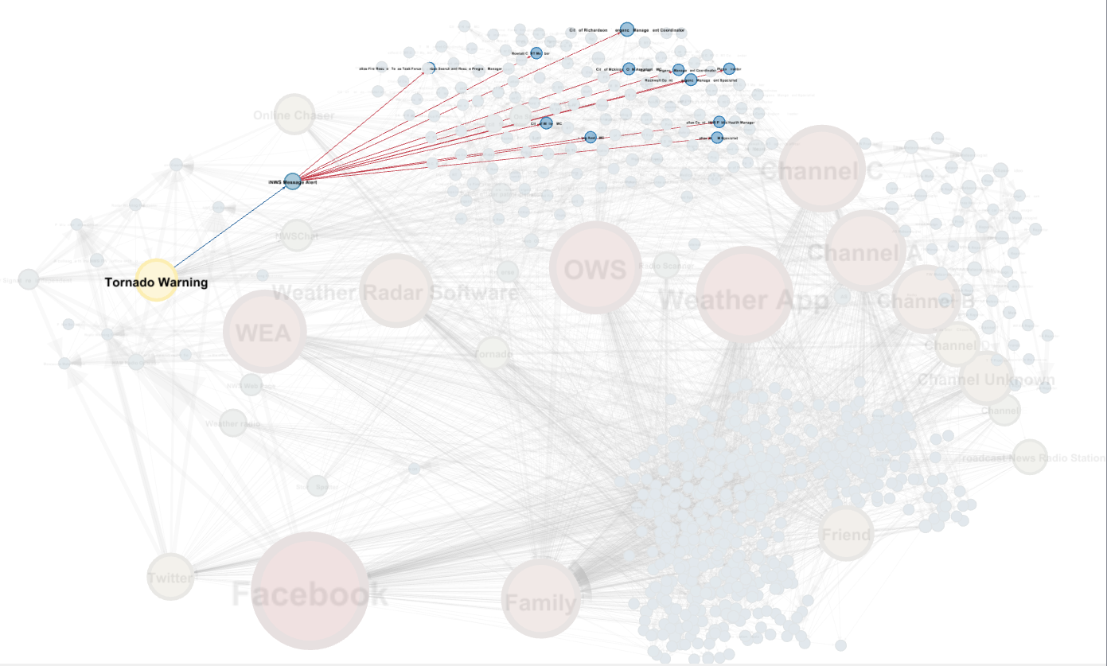
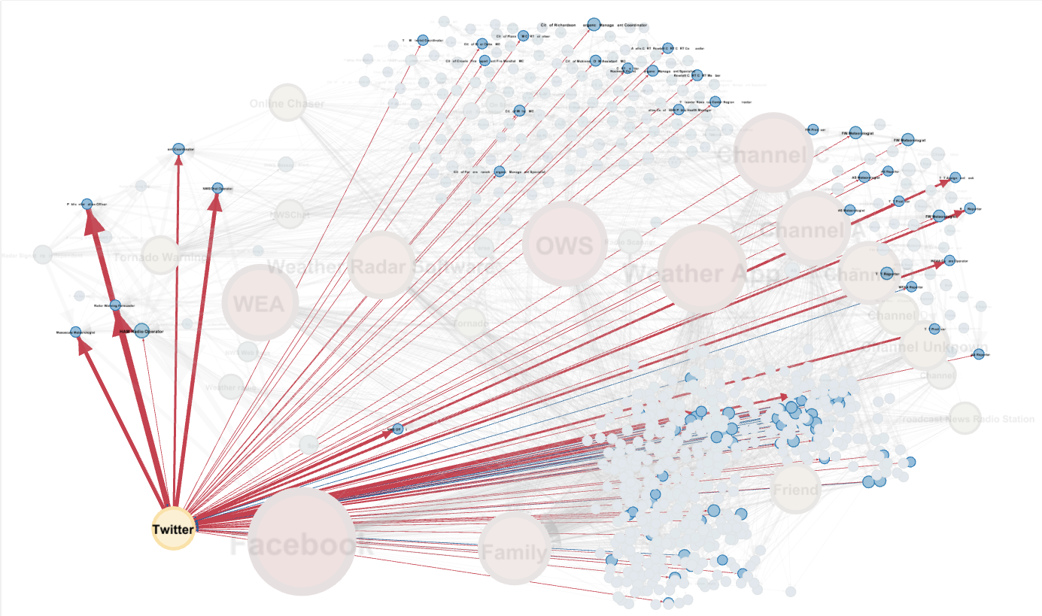
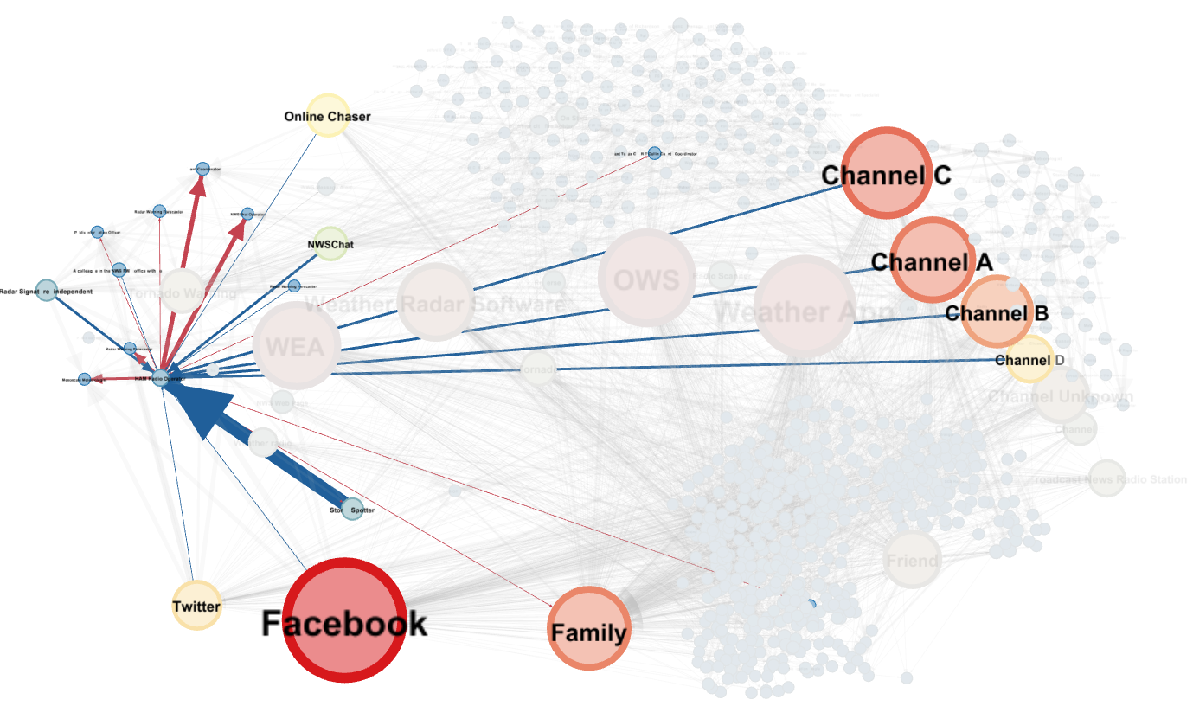
Communication Systems
NWSChat
iNWS
Twitter
HAM Radio
Notes:
Who was being communicated to the most frequently.

Slide 23
Observed TV Viewing Habits
Modeling Public Behavior
Survey, initial information source
Survey, initial + updated information sources
Actual ratings during the tornado
(6-7 PM, DFW market)
Channel A: 47
Channel B: 38
Channel C: 30
Channel D: 13
Channel (?): 34
Cable TV Wx: 6
Channel A: 137
Channel B: 148
Channel C: 117
Channel D: 68
Channel (?): 85
Cable TV Wx: 42
Channel A: 396,614
Channel B: 347,038
Channel C: 226,637
Channel D: 198,307
Cable TV Weather: Unk.
http://www.unclebarky.com/dfw_files/archive-dec-2015.html
Notes:
Main points here:
The survey results indicate a similar ratings sampling as TV ratings sampled during the time of the tornado.
The survey results suggest that people will tend to “shop around” for information and don’t necessarily stay on the same channel for information once an event starts.

Slide 24
Limitations of Research
Could only “zoom in” on one tornado.
Over representation of Facebook/family/associated biases of how we advertised the survey.
Our survey design could have been improved and must be if this research is ever attempted again.
Survey anonymity prevented us from discovering specific communications dynamics within the public.
Notes:
Who was documented as communicating the most frequently.

Slide 25
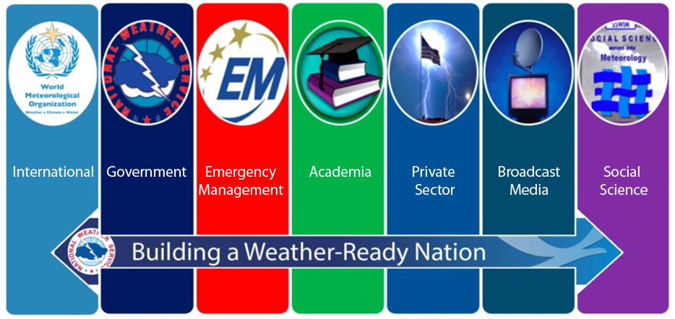
Conclusions
Consistent message transmission from the IWT improves resiliency through reducing vulnerability in the communication network.
The tornado warning IS important, but communicating within the IWT significantly improves the value of the warning.
EVERY member of the IWT plays a critical role in communicating hazardous weather information to the threatened population!
Notes:
Who was documented as communicating the most frequently.

Slide 26
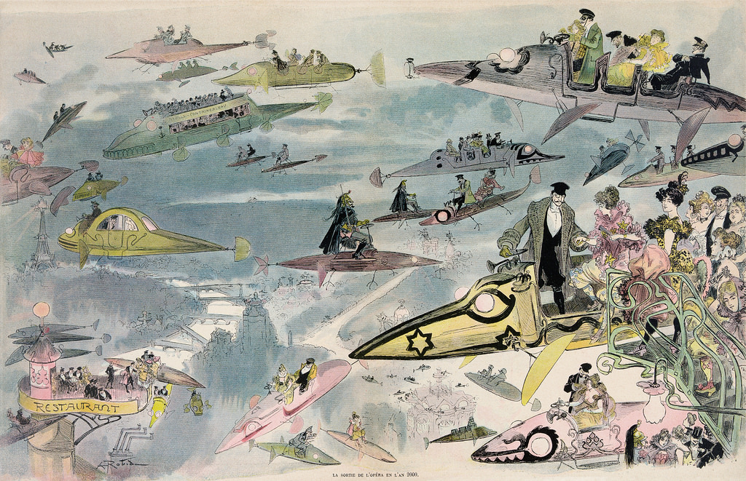
In the Future…
We’d like to publish our results in an AMS journal (maybe Weather, Climate, and Society again)
We’d like help getting the word out that we have scientific evidence supporting the IWT/WRN/iDSS philosophy of communicating hazardous weather info as a team.

Slide 27
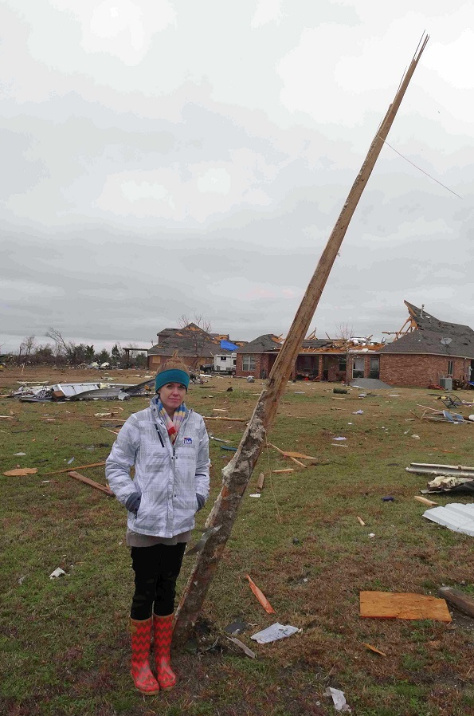
Questions?
Dennis Cavanaugh
dennis.cavanaugh@noaa.gov
Mark Fox
mark.fox@noaa.gov
Melissa Huffman
melissa.huffman@noaa.gov
Sean Clarke
sean.clarke@noaa.gov

