Slide 1
A real-time Coupled Wave/Atmospheric Regional Forecast and analysis System: CWARFS
Steven Lazarus, Mike Splitt, Claire DuPont (FIT)
Kate Howard (NCEP)
David Sharp, Pablo Santos, Peter Blottman
Florida Institute of Technology
21 July 2011
NOAA CSTAR GRANT #: NA07NWS4680004

Slide 2
Talk Outline
Overview of model configuration and project
Assessment Highlights
Transition to NWS

Slide 3
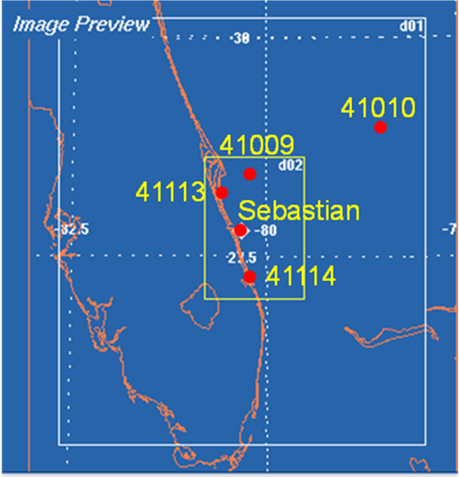
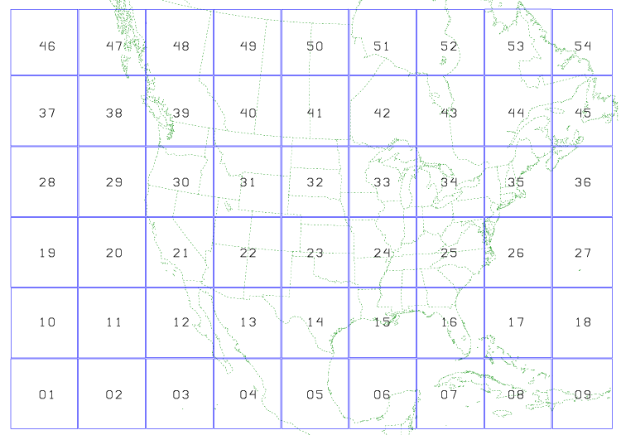
5 wave subdomains embedded in nested WRF run
National Weather Service's (NWS) Weather Research and Forecasting (WRF) Environmental Modeling System (EMS)
3 h NAM/GFS forecasts used for LBCs
0 h NAM/GFS used for ICs
Full model dynamics and physics
1.5 km resolution
4.5 / 10 km resolution
48 h WRF-EMS simulation
00 UTC
hourly output
Notes:
WRF was run at 10 km and a 10/4.5 one-way nest. All with the same physics…same outer domain as the 4.5 km
The WRF version 2.1.2.2e with the ARW core is used
Hourly initial and boundary conditions for the WRF 4.5 outer domain are provided by the 12 km NAM 218 or GFS forecast grids which, as mentioned before, were also used to force the wave model for the resolution sensitivity tests.
Run on the 00 UTC cycle NAM or GFS forecast, all three of the WRF domains (10 km, 4.5 km, 1.5 km) execute daily on an 8 node cluster.

Slide 4
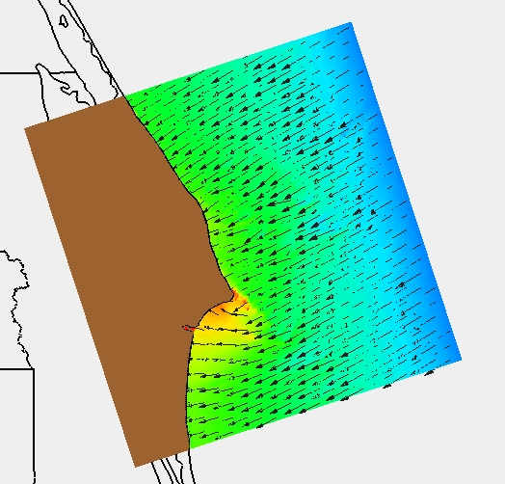
Wave Model (100 m resolution)
Coastal Modeling System (CMS)-WAVE
Based on WABED (Wave-Action Balance Equation and Diffraction model, Mase et al. 2005)
Employs a forward-marching, finite-difference method to solve the wave action conservation equation.
Capabilities
wind input, shoaling, refraction
diffraction
dissipation
wave-current interaction
adjustable friction factor
depth-limited breaking
CMS-Wave runs on all 8 nodes of a quad core 3.2 GHz Linux box
Notes:
Developed for the U.S. Army Engineering Research and Development Center (ERDC) for convenient coupling with 2 and 3-dimension hydrodynamic models designed for high resolution predictions in coastal waters
CMS-Wave/WABED is a 2-D wave spectral transformation (phase-averaged) model, which means it neglects changes in the wave phase while calculating wave and other nearshore processes (Lin et al. 2006).
Designed for nearshore regions, CMS-Wave is ideal for this study as the wave diffraction scheme in WABED is more robust compared to schemes included in other nearshore wave models like SWAN or STWAVE (Mase and Kitano 2000; Mase et al., 2005).
The WW3 provides the boundary conditions for the spectral nearshore wave model.
Nearshore Wave Modeling:
Note that WW3 does not have the following: wave-bottom interaction, wave-current interaction, and current induced wave breaking, shallow water wave-wave interactions (triads, phase locking)
Status of approaches:
Parameterizations are available for all processes, although there is much room for improvements and refinements.
Many not available in WAVEWATCH III, but relatively easy to implement. Tolman 2005
Issues M2D vs SWAN:
The SWAN model has a numerical scheme that is used to reach a solution of the wave energy equation by iteration. Is the wave energy equation a similar approach to that of the wave action con. Eqn mentioned above? Referred to as a 3rd generation model…

Slide 5
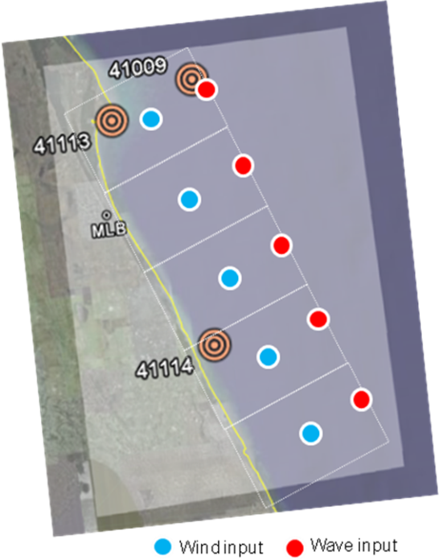
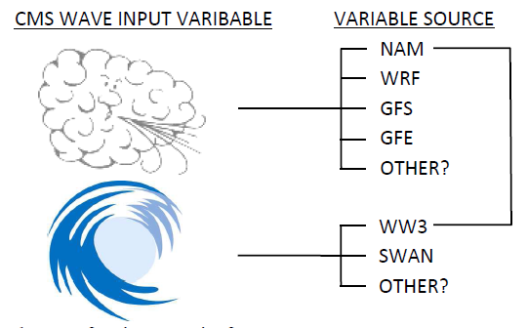
Wave Model Forcing (100 m resolution)
5 high-resolution (100 m) grids
~50 x 50 km
Coast parallel: North of Cape Canaveral south to Jupiter, FL
wave grids within the WRF 1.5 km nest
CMS-Wave is forced by time series inputs: BC’s from WAVEWATCH III (WW3) and wind forcing.
WW3
WINDS
Notes:
Time series are 3 h.

Slide 6
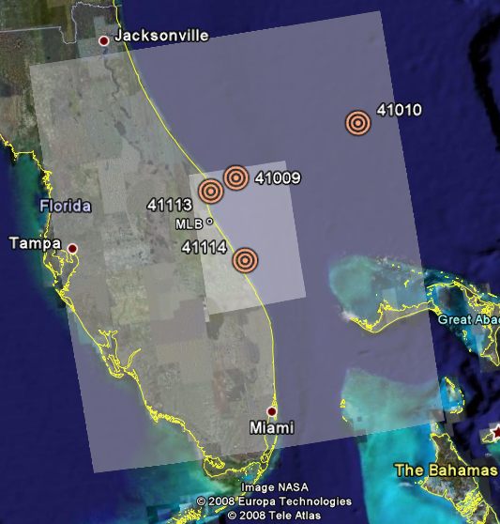
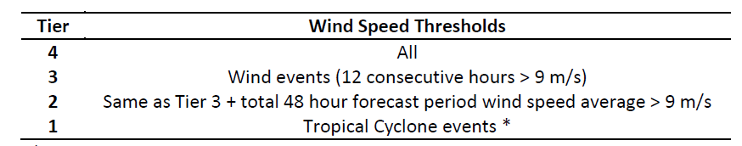
Assessment
Forecast wind variability within wave forecast domains (model model)
Wind forecast quality (WRF)
Wave forcing quality (WW3)
Wave model performance:
onshore versus offshore winds
Wave model performance for high wind events (wind speed > ~ 10 ms⁻¹)
Notes:
Bullet 1: Given that we have single pt. forcing…do we average around pt, take single pt, grid average?
Note the wind tier groups…The data are subdivided into Tiers and as described in Table 3, based on wind events that span an 8 month period from August 2008 to March 2009.
*Just one TC (Fay!).

Slide 7
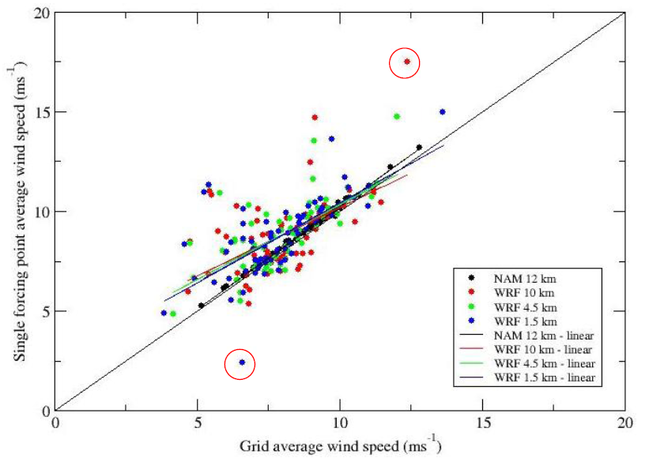
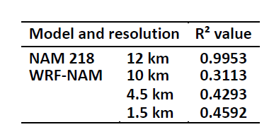
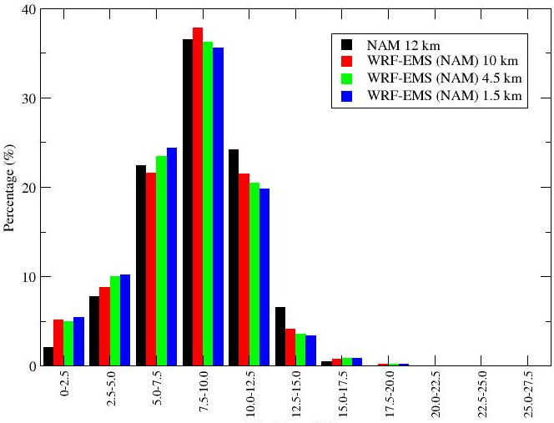
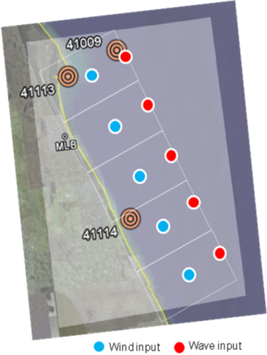
Subgrid Wind Variability: Tier 3
FAY
FROPA
Wind speed bins (ms⁻¹)
Notes:
Not much difference in variability for wind events between wave grids or between WRF-EMS resolutions. We end up using the wave model results to say if the variability is significant.
Two questions:
1 – is there subgrid variability and is it significant (if low variability then a single point would be “ok”)
2 – is the single point time series representative of the entire wave grid? (wave model only being forced by single point so forced to consider)
Tier 3 wind event comparisons between grid 1 average wind speed (ms-1) and average single forcing point wind speed (ms-1). All atmospheric resolutions shown: NAM 12 km (black) and WRF-EMS (10 km - red, 4.5 km - green, and 1.5 km - blue). A one-to-one line and linear best-fit trendlines for each resolution are also displayed. Red circles identify two outliers that will be examined in detail.
Table shows the square of the correlation coefficient (R²) for each of the WRF-NAM resolutions and the NAM in Figure 14. The NAM single point is highly correlated with the domain average and thus suggests that a single point forcing time series extracted from NAM is indeed representative of the wave domain wind field. There is a decrease in correlation from the NAM to the WRF-NAM 10 km, indicating more variability exists in the WRF.
Lower RIGHT: Tier 3 percentage (%) of wind speed forecasts which fall into wind speed bins (every 2.5 ms-1). NAM 12 km (black) and WRF-NAM (10 km – red, 4.5 km – green, 1.5 km – blue). Wind speed standard deviation (seen in Figure 9a) shown by a horizontal red arrow.
Two outliers from Fig. above – Fropa & TS Fay. For these two cases, CMS-Wave was run with both a single point and domain averaged wind forcing time series. A 25 pt average about the forcing point location was also used to force CMS-Wave for the first of the two cases.
For the TS Fay case, the single point time series is a better representation of the observed wind field at buoy 41009 and thereby produces the best wave forecast
For the FROPA case the grid average wind speed is a better representation of the observed wind field at buoy 41009…
TAKE Home – wave model results for the outliers were better for the single pt. forcing!

Slide 8
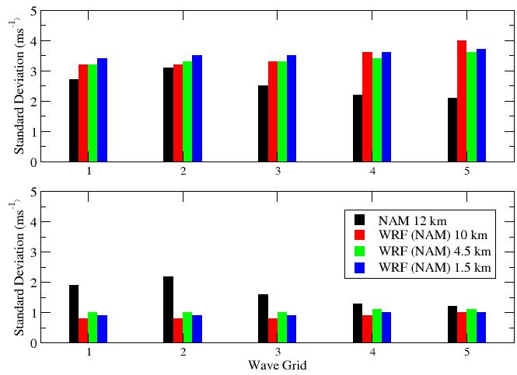
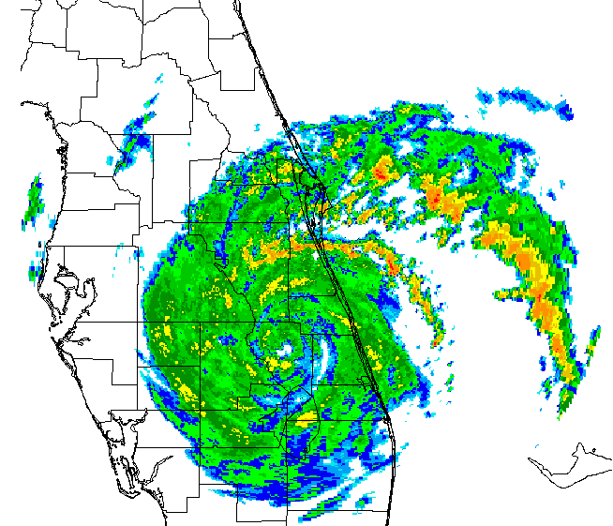
Subgrid Wind Variability: High Wind Events
TS Fay 19-21 August 2008
26 March 2008
Notes:
Wave grid (1-5) wind speed standard deviations (ms-1) for Tier 1 Tropical Storm Fay 19-21 August 2008 top and Tier 3 wind event 26 March 2009 (bottom).
The idea here is that a spread in sub-grid wind speed → what is representative average to force wave model to get representative wave height forecast…probabilistic forecasting?
Interestingly for the 26 March case, the NAM has higher standard deviations in wind speed when compared to the three WRF-NAM resolutions, which may be because the NAM forecasts higher wind speeds for that 24 h period (not shown). Again, the WRF-NAM shows insignificant differences across both resolution and wave domains. The NAM is the only model shown in Figures 12a and 12b that shows significant variations across wave domains.

Slide 9
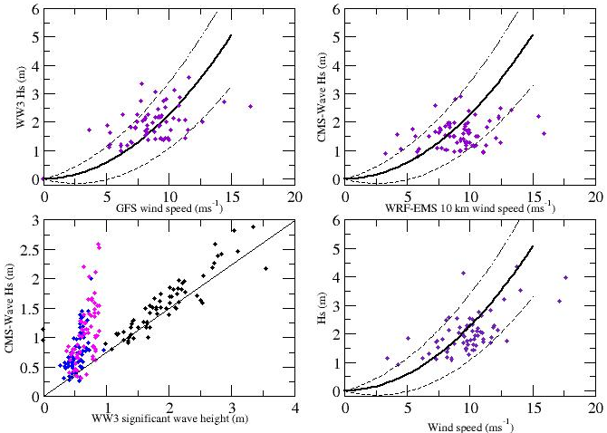
Wave Model Assessment: Tier 3
41009
41114
41113
Notes:
Theoretical equilibrium wave height (H_{s}) based on wind speed and wave height variability (δH_{s}) caused by potential wind speed variability
Lower left: 48 h average significant wave height for CMS-WAVE versus WW3 at buoys 41009 (black), 41113 (blue), and 41114 (magenta). For wind events > 9 ms⁻¹ and longer than 12 h. TIER 3.
“Theoretical” curves are plotted in Figures 39a, 39b, and 39d. Figures 39a-d all display 48 h averaged data for each Tier 3 wind event valid at buoy 41009. A – GFS forecast wind speed (ms-1, WW3 wind forcing) versus WW3 forecast Hs (m), B – WRF-NAM 10 km forecast wind speed (ms-1, CMS-Wave wind forcing) versus CMS-Wave forecast Hs (m). C - WW3 forecast Hs (m, CMS-Wave wave forcing) versus resulting CMS-Wave forecast Hs (m) (Buoy 41009 – black, 41113 – blue, 41114 – pink). D - Observed wind speed (ms-1) versus observed Hs (m).

Slide 10
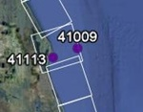
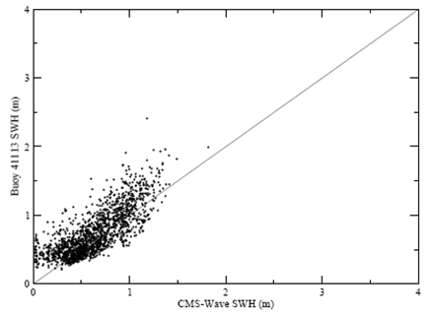
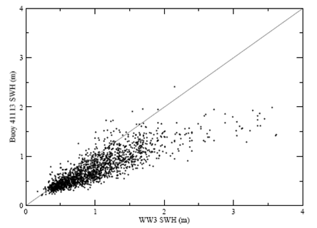
Wave Model Assessment
CMS-WAVE
WW3
Modeled (x-axis) vs. observed (y-axis) SWH for Sept. 2006- Dec. 2007 at buoy 41113.
Notes:
Significant wave heights from buoy 41113 are plotted against model generated significant wave heights from CMS-Wave and WW3 for the months of September 2006– December, 2007

Slide 11
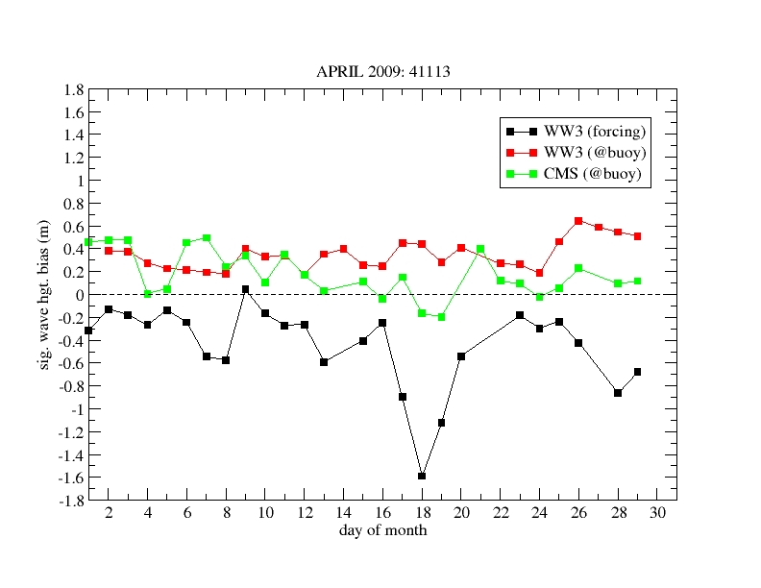
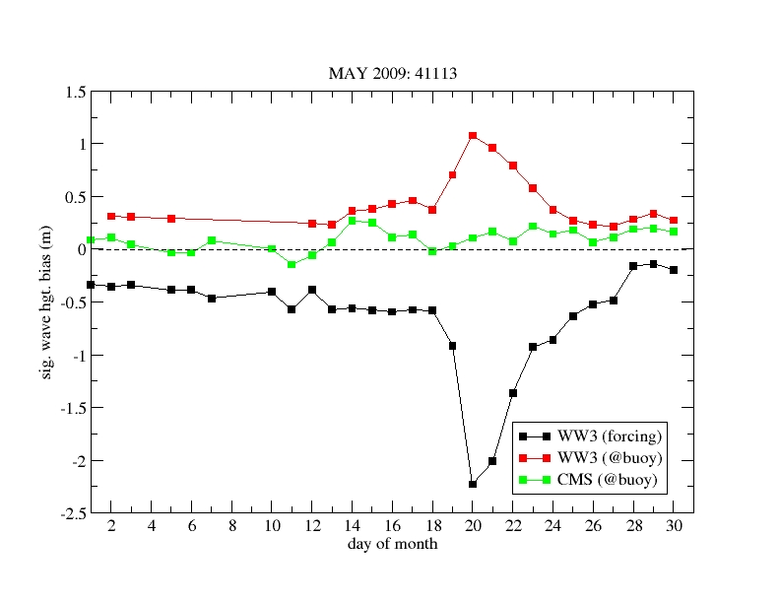
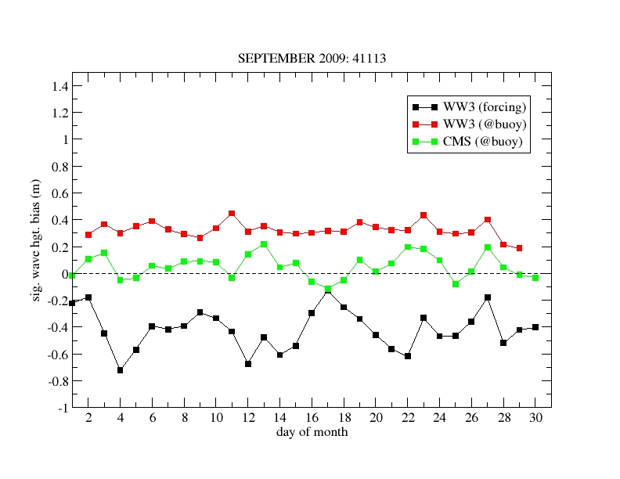
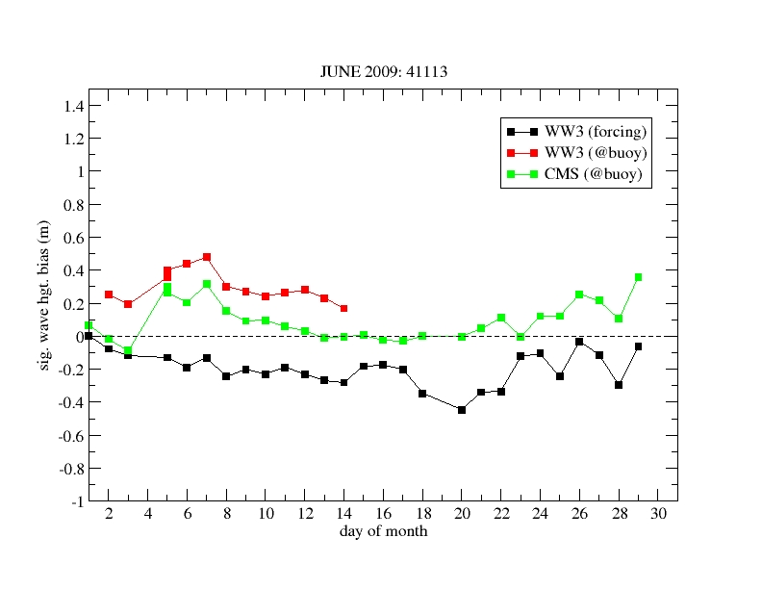
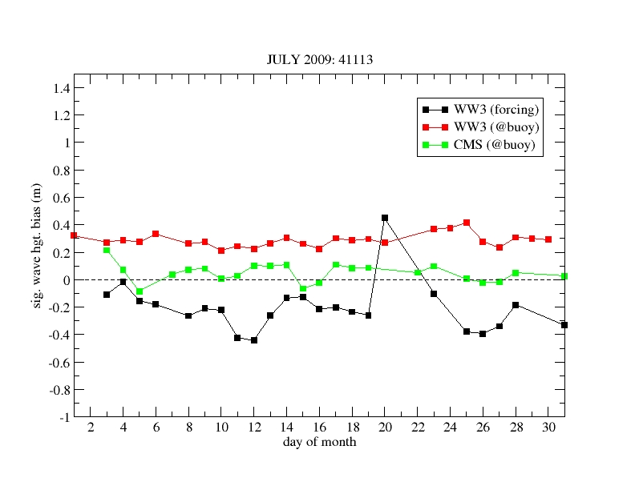
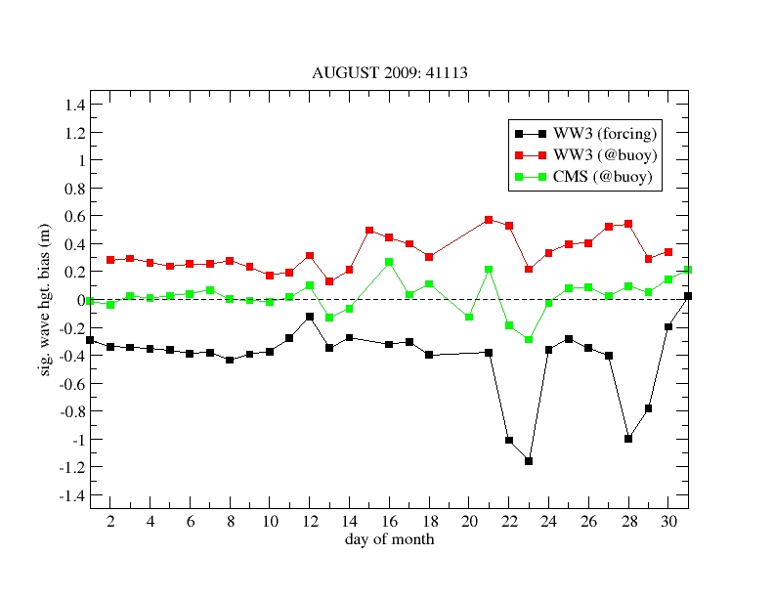
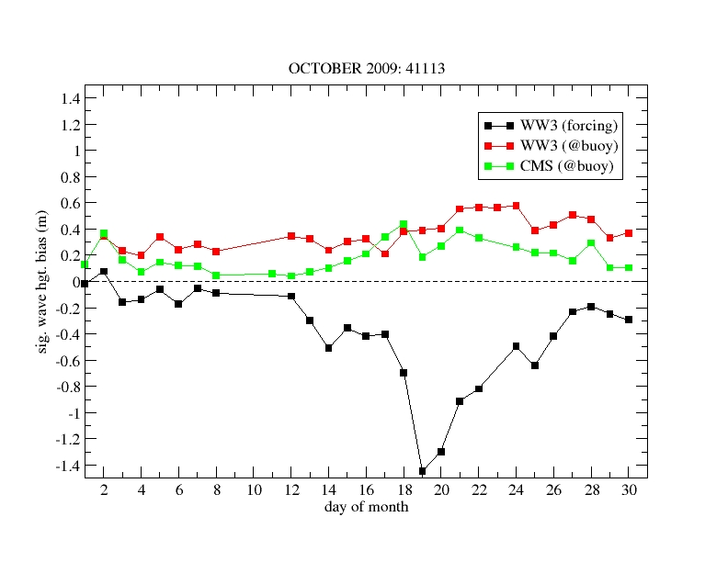
Significant Wave Height BIAS (41113)
Notes:
WW3 forcing is evaluated at buoy – just bring in the wave height…

Slide 12
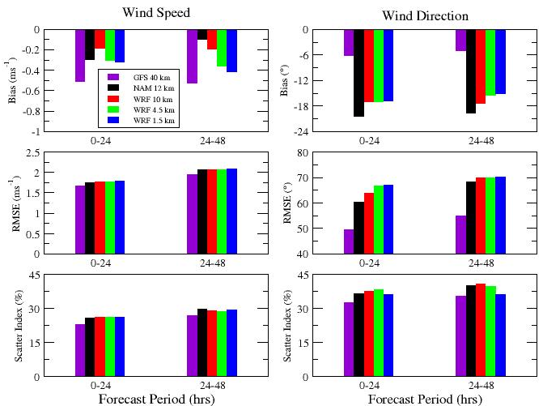
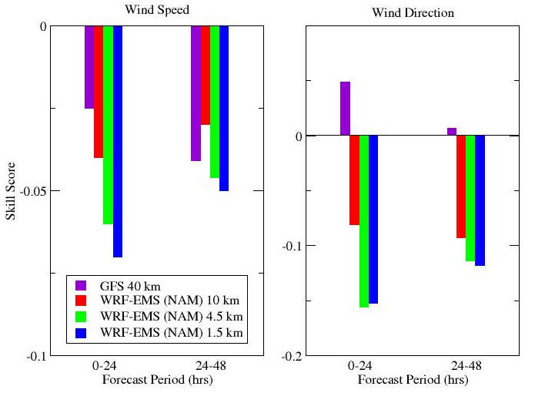
Wind Forecast / Forcing Validation @41009
213 48 h CMS Wave Simulations
GFS beats NAM!
Skill Score Versus NAM
NAM forced WRF-EMS not a significant improvement over NAM
On average, only slight differences between wind forecast errors for the three WRF-EMS resolutions
Notes:
Tier 4 wind speed (ms-1) (left) and direction (°) (right) bias (ms-1), RMSE (ms-1), and scatter index (SI - %) for two 24h forecast per
Figure above displays statistical results for 213 00 UTC 48h atmospheric model runs between August 2008 and March 2009. Bias, RMSE, and scatter index values were calculated for each 24h forecast period (0-24h and 24-48h) and were averaged across the eight month period. iods at buoy 41009: GFS (purple), NAM 12 km (black), and WRF-EMS (10 km – red, 4.5 km – green, 1.5 km – blue)
→All five atmospheric model options underforecast wind speed – NAM the least for 24-48 h and WRF 10 km for 0-24 h!
→GFS stands out with the lowest overall directional bias!
SKILL SCORE:
→NAM outperforms the WRF-NAM for both wind speed and direction (Fig. 18), suggesting that, on average, the WRF-NAM does not provide an improvement over the NAM
→NAM outperforms GFS and WRF-NAM for wind speed but the GFS outperforms the NAM in terms of wind direction.

Slide 13
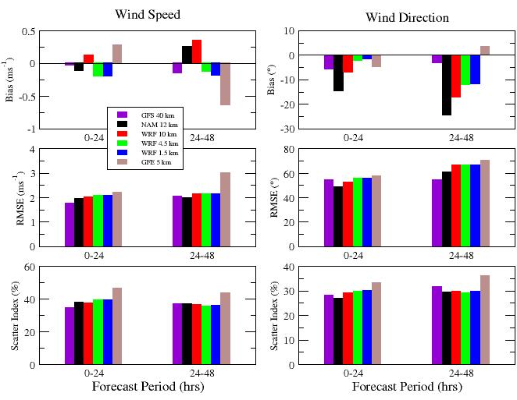
Wind Forecast/Forcing Validation GFE (May & June 2009)
Notes:
May and June 2009 bulk validation results (bias (ms-1), RMSE (ms-1), scatter index (SI - %)) for atmospheric models (GFS – purple, NAM – black, WRF-EMS (10 km – red, 4.5 km – green, 1.5 km – blue), and NWS GFE 5 km – brown) at buoy 41009.
Five atmospheric model wind forcing options (GFS, NAM 12 km, GFE 5 km, and WRF-NAM 10 km, 4.5 km, and 1.5 km) for May and June 2009
TAKE HOME: Albeit short period…
The statistics (RMSE and scatter index) for both wind speed and direction indicate that GFE does not perform as well as the models at buoy 41009 for the months of May and June.

Slide 14
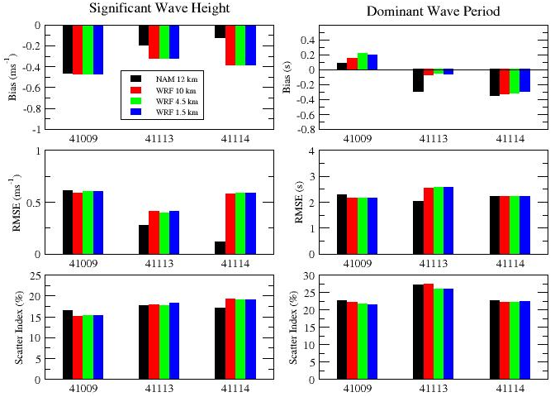
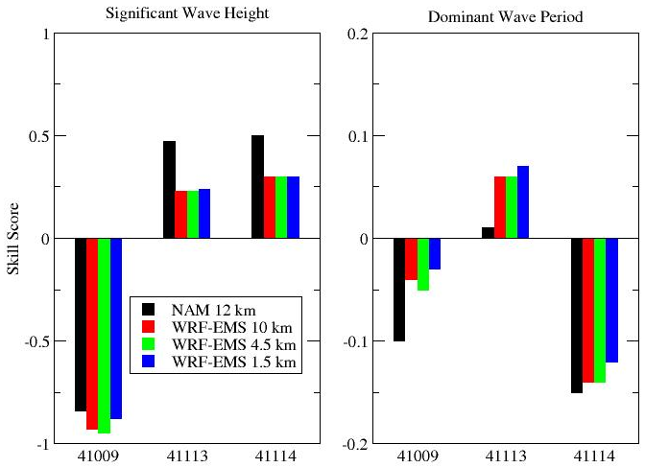
CMS-Wave forecasts – Tier 3 analysis
NAM & WRF-EMS forced CMS-Wave beats WW3 in nearshore
Skill Score Versus WW3
No significant differences in wave forecast errors between WRF-EMS resolutions
Errors at 41009 not unexpected for model built for nearshore
Notes:
At all three buoys…
TOP LEFT: Bias (ms-1), RMSE (ms-1), and Scatter Index (SI - %) for all Tier 3 CMS-Wave Significant Wave Height (m, left) and Dominant Wave Period (s, right) forecasts at NDBC buoys 41009, 41113, and 41114. Wind forcing: NAM 12 km (black), WRF-EMS (10 km - red, 4.5 km - green, and 1.5 km - blue)
TAKE HOME:
→CMS-Wave underforecasts at all three NDBC buoys in terms of significant wave height, as well as for dominant wave period at both of the coastal buoys, which is not surprising as all atmospheric models also underforecasted the wind speeds at all three buoys.
→Root-mean square errors for significant wave height and dominant wave period forecasts are similar at all three buoys with the exception of NAM, which has the lowest RMSE values in the nearshore region.
SKILL SCORE: BASELINE IS WW3
Skill score for all Tier 3 CMS-Wave Significant Wave Height (m, left) and Dominant Wave Period (s, right) forecasts at NDBC buoys 41009, 41113, and 41114. Wind forcing: NAM 12 km (black), WRF-EMS (10 km - red, 4.5 km - green, and 1.5 km - blue)
TAKE HOME:
→CMS-Wave exhibits an improvement over WW3 forecasts for significant wave height at the nearshore buoys (41113 and 41114) and dominant wave period at buoy 41113.
→NAM wind forcing yields the greatest improvement in significant wave height forecasts over that of WW3 at the nearshore buoys.
→The negative skill scores at 41009 indicate that the CMS-Wave forecasts of both Hs and Dp are inferior to those of WW3, which is not surprising as buoy 41009 is located at the eastern edge of wave domain 1 and is thus in deeper water (44 m) compared to 41113 (10 m) and 41114 (16 m). CMS-Wave is designed for the nearshore regions where the waves feel the affect of ocean bottom.

Slide 15
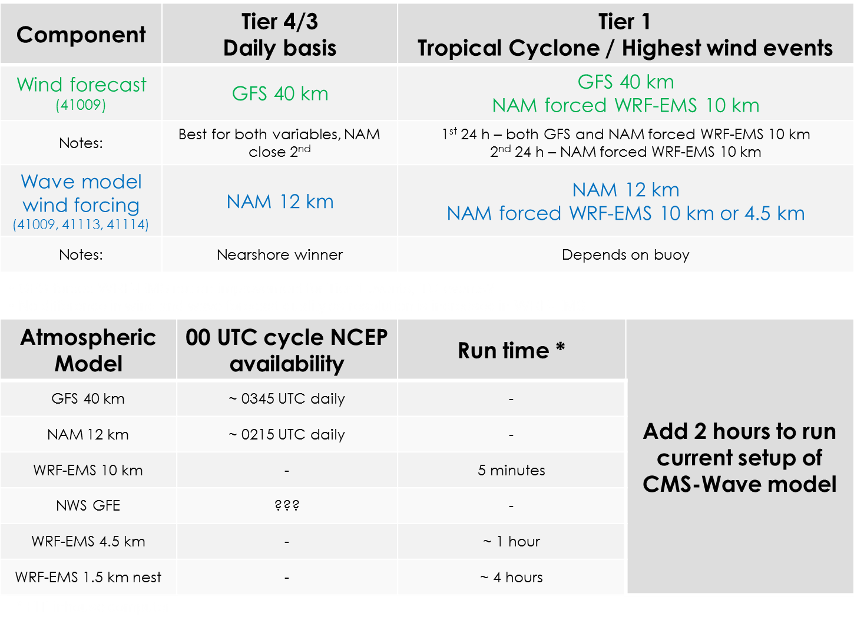

Slide 16
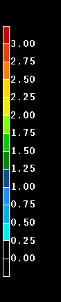
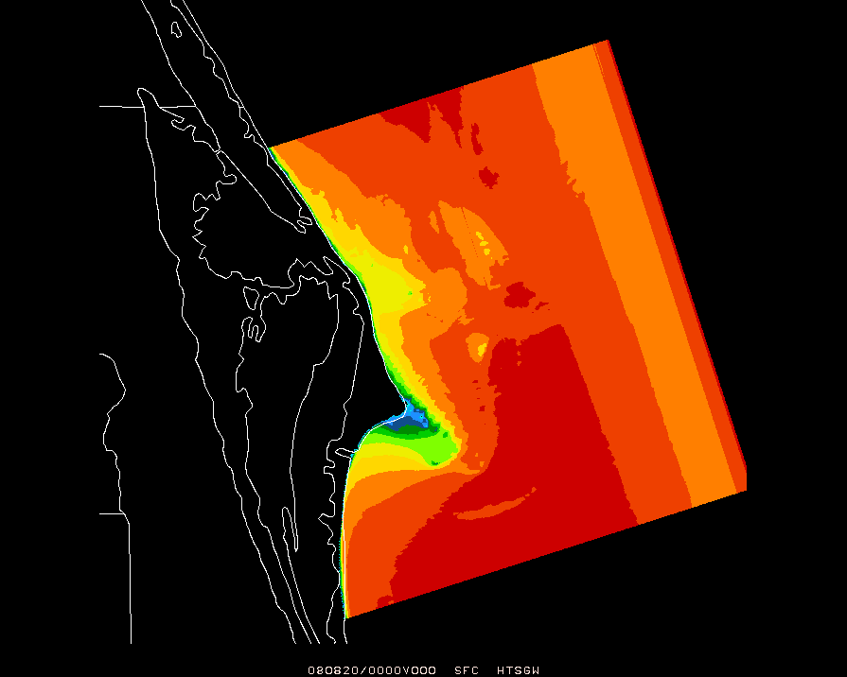
FIT Configuration (no flow model)
GFS
&
CMS-Wave
with 18 UTC WW3
48 h wave forecasts available
~ 0430 UTC
48 h WRF-EMS simulation
F06 WW3/GFS
00 UTC
hourly output

Slide 17
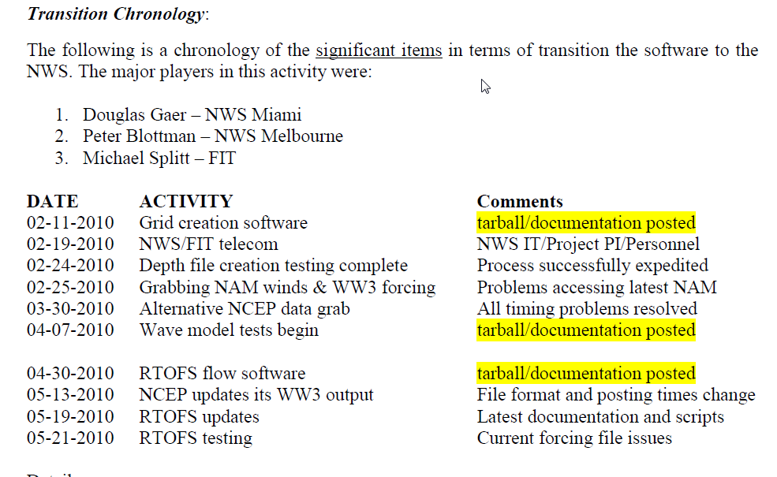
Transition to NWS

Slide 18
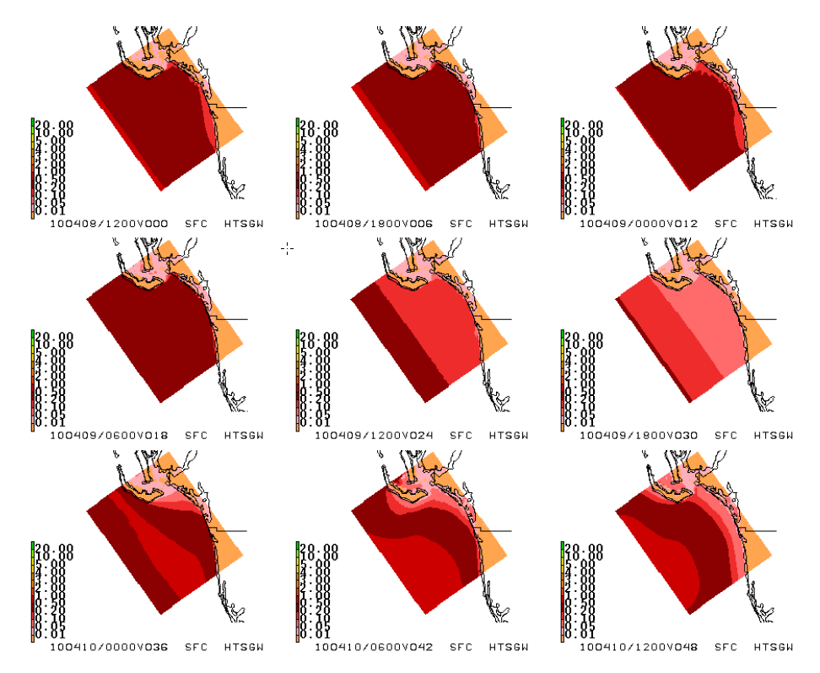
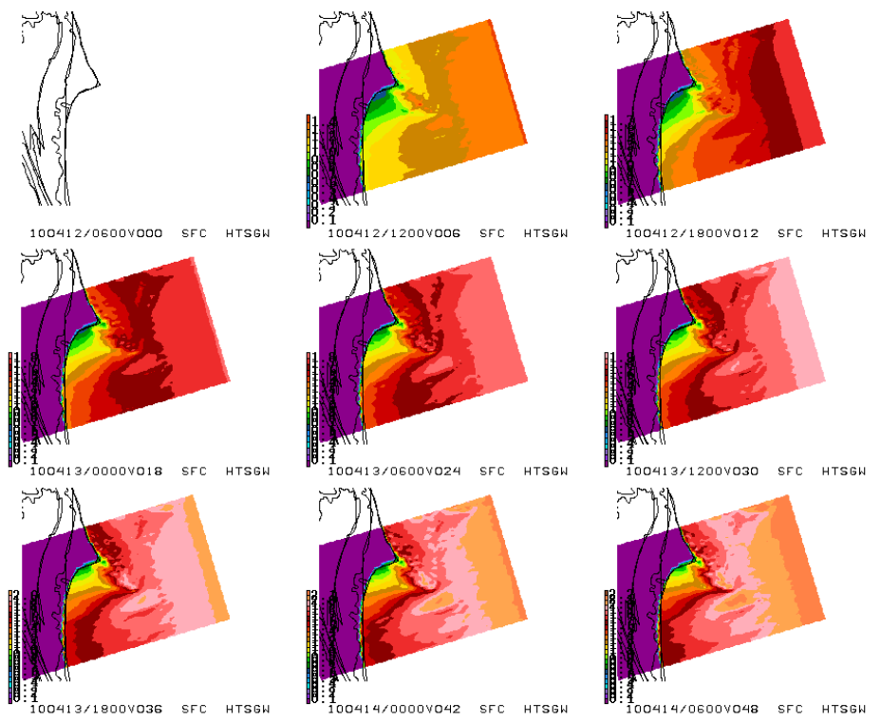
NWS office validation
48 h forecast significant wave height (m) for SW Florida. Initialized 12 UTC 8 April 2010 @ Miami NWS.
48 h forecast significant wave height (m) for east central Florida. Initialized 06 UTC 12 April 2010 @ Melbourne NWS.
Notes:
NWS Miami generated 9-panel significant wave height (m) 48 forecast initialized 12 UTC 8 April 2010. Region shown is SW Florida.
NWS Melbourne generated 9-panel significant wave height (m) 48 forecast initialized 06 UTC 12 April 2010. Region shown is the Central Florida east coast.

Slide 19
Build your own grids
“Build your own grids” software completed and tested at NWS offices
Forcing data download software completed and tested at NWS offices
Wave model and output software tested at NWS offices
  -Newer version of CMS-Wave is now being used
  -Expanded set off output variables
  -Scripts include ability to “flip grid” in scenarios with strong offshore flow.
  -Software has been modified to account for problems identified in runs ant NWS Miami
Flow model component nearly complete
  -NCEP RTOFS used for currents
  -Documentation and software delivered

Slide 20
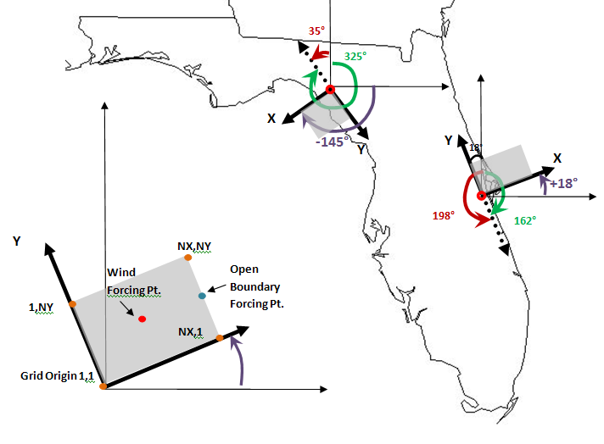
Automated Wave Model Set-Up
“Shore-relative” reference frame
Notes:
The wave grid is defined in a shore relative reference frame with the Y-axis of the grid along the shore with land to the left, and the X-axis pointed off shore. Figure shows sample grids at two different locations.
The wave model origin (inland somewhat) is shown in Figure 2 with a thick red circle. The latitude and longitude of the grid point is used to create the grid.
The wave model uses the corner of the grid associated with this point as the grid origin → problematic for LCC projection which always uses the lower left corner…(ok for east coast of FL, but…).

Slide 21
Grid Coordinate System
SHORE
X
I
X
II
X
Y
SHORE
X
Y
Y
Y
Designed
CMS
SHORE
X
IV
LCC
X
III
X
X
Y
Y
SHORE
Y
Y
LCC origin is
Always “SW”
Grid Corner
Notes:
Zoom in of previous fig.
TAKE HOME:
GRIDS will fall into one of 4 general classes due to the use of the Lambert Conic Conformal (w/ tangent cone) system for grid creation.

Slide 22
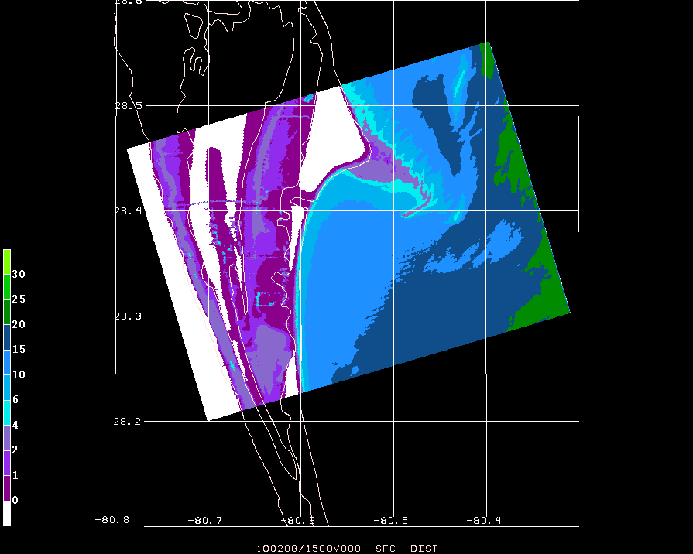
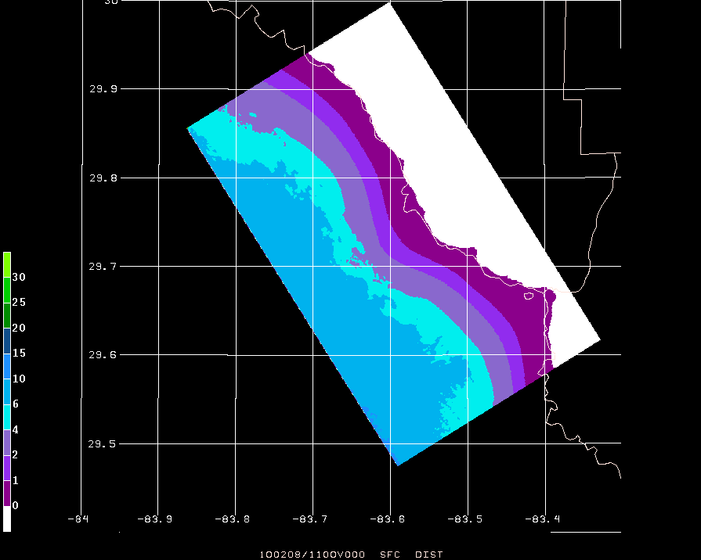
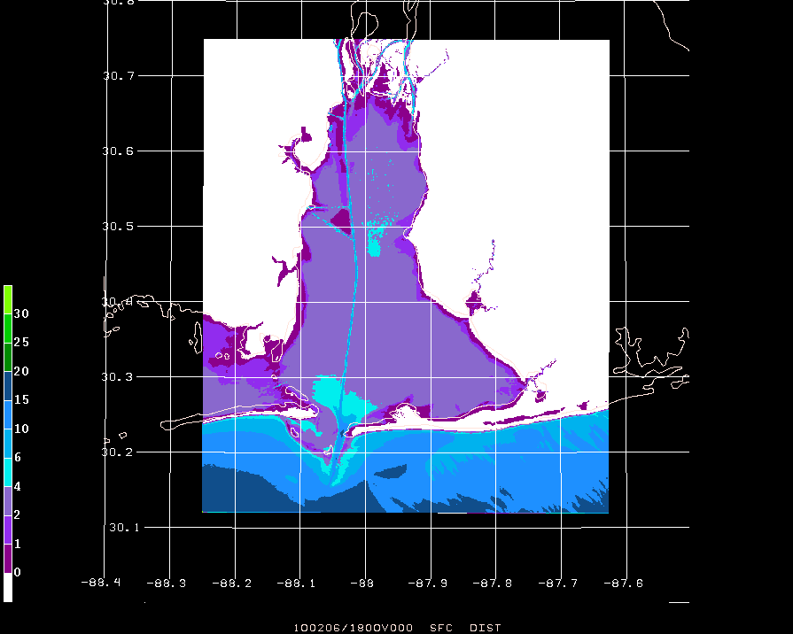
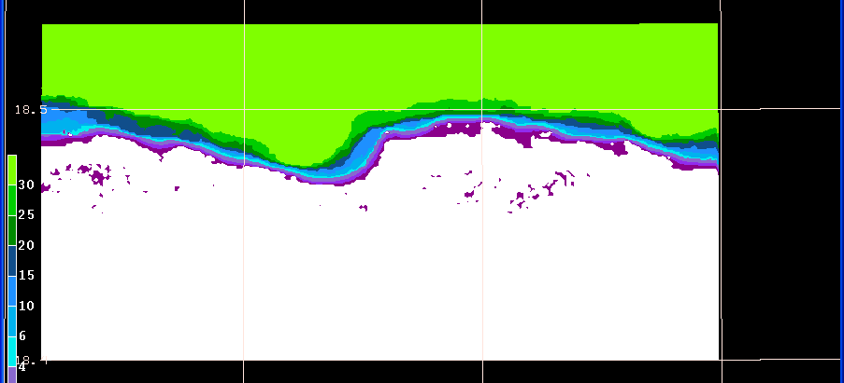
Grid Rotation
  CASE 1/Grid1 (land west/water east – EC Florida Coast)
  CASE 2/Grid 2 (land east/water west – NW Florida Coast)
  CASE 4 (land south, water north – Puerto Rico)
  CASE 3/Grid 3 (land north/water south – Mobile Bay)
Notes:
Documentation walks users through the 4 configs.

Slide 23
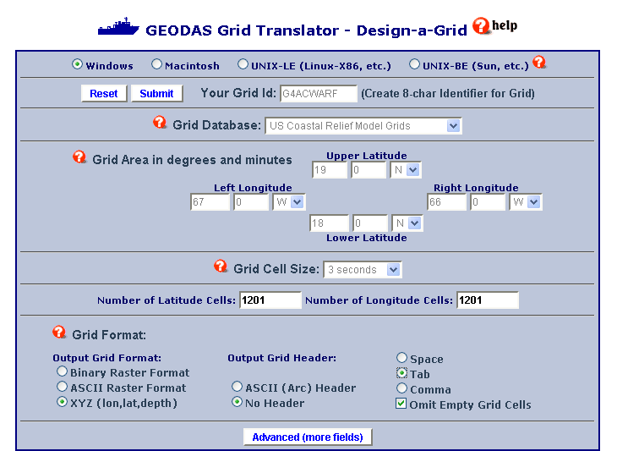
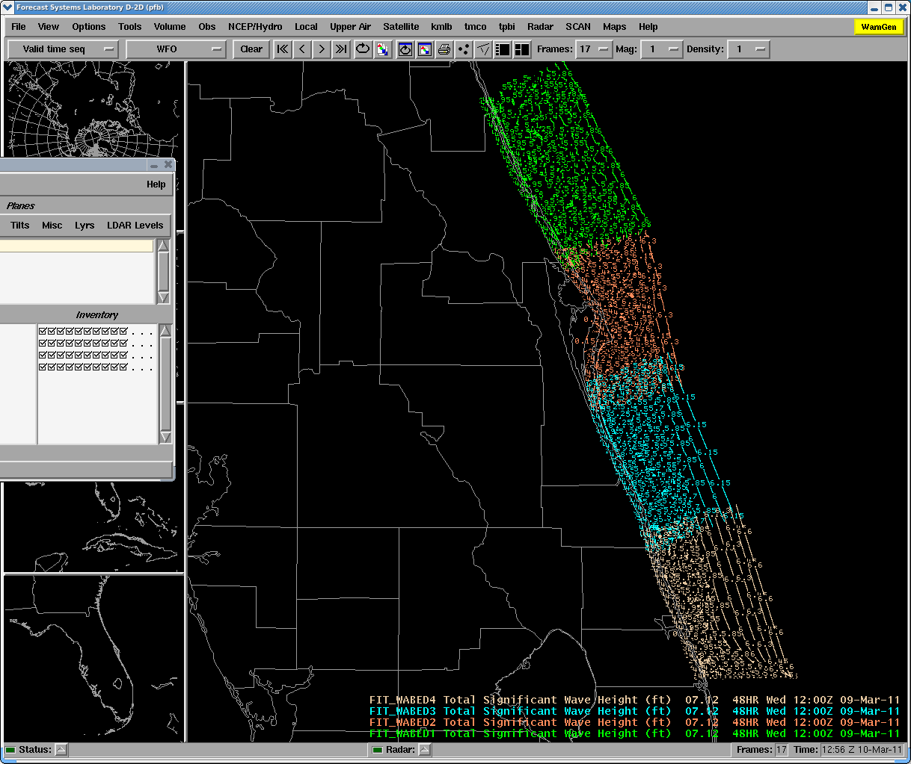
CWARFS grid set-up overview
  Maximum of 9 defined grid
  Uses GEODAS Bathymetry
  http://www.ngdc.noaa.gov/mgg/gdas/gd_designagrid.html
  Supporting scripts (wave grid design, model forcing, model execution, and AWIPS-friendly output)
  Resources required
  (perl, csh, gfortran, g2lib, g2clib, jasper, libpng, zlib)
Notes:
AWIPS display of 48 h forecast significant wave height (ft) valid 9 March 2011. Colors represent 4 distinct domains. Courtesy of NWS Melbourne FL.

Slide 24
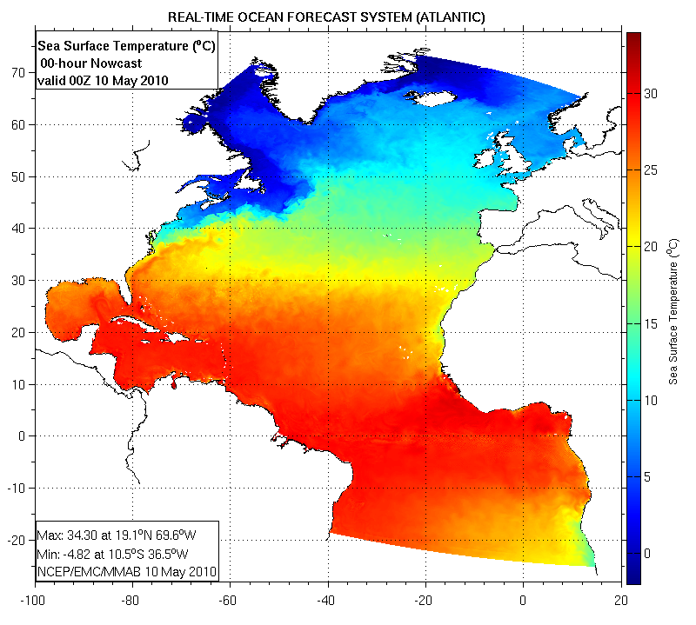
RTOFS (currents for flow model)
Real Time Ocean Forecast System (RTOFS):
  -Based on HYCOM
  -Run once a day (00Z)
  -Forced by GFS, tides, and rivers
Notes:
The CMS-Wave model can incorporate effects of surface currents. In the following set up, data from the NCEP Real Time Ocean Forecast System (RTOFS) is used to feed surface current information into the model. RTOFS surface current information from the 000 hour forecast are used as forcing for the full model run (The current forcing is not time evolving).

Slide 25
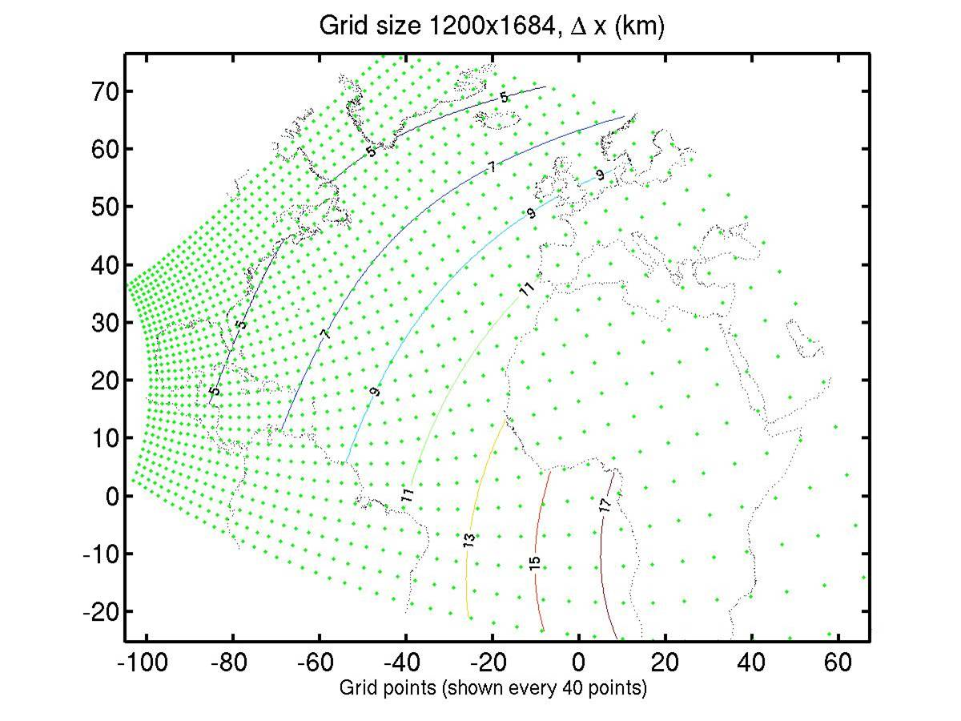
RTOFS (Flow Model)
Not part of the initial evaluation!
Rectilinear grid
~5km resolution East Coast U.S.
f000 output available around 0800 UTC

Slide 26
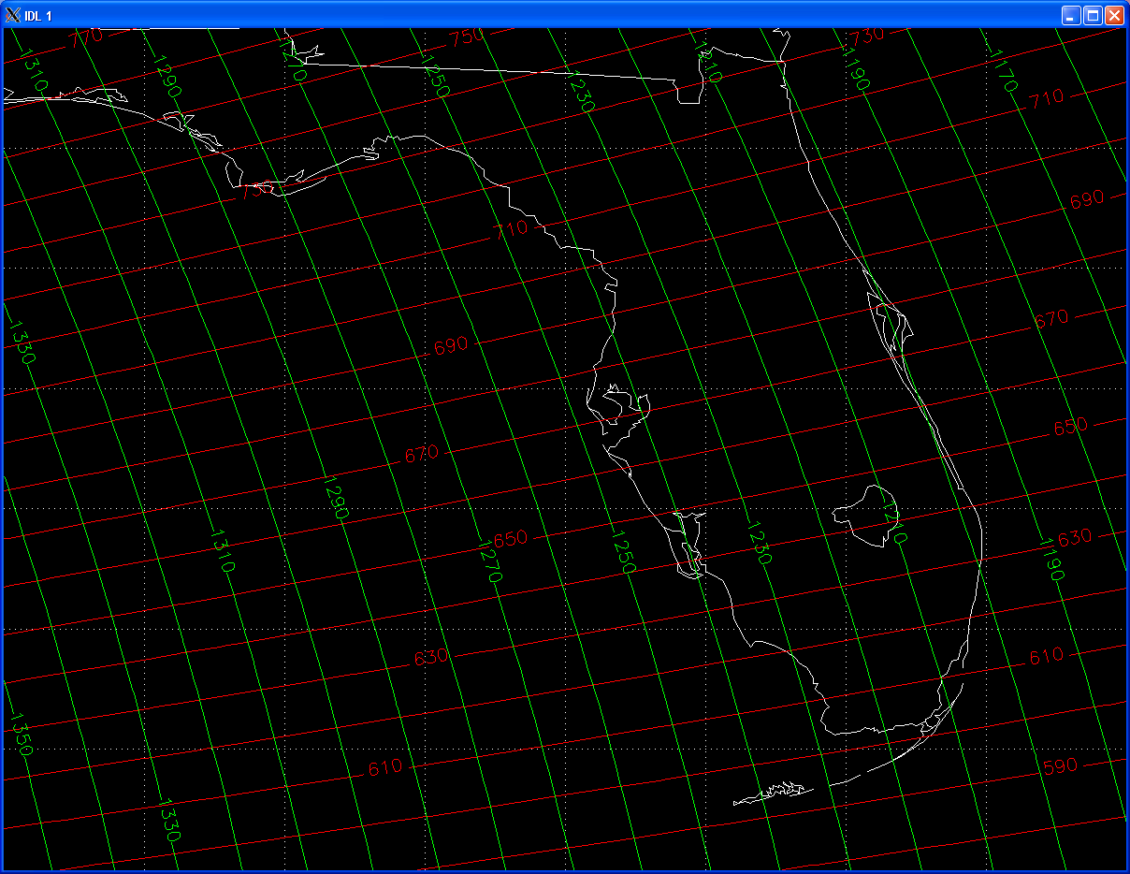
RTOFS grid near Florida
RTOFS:
x-axis oriented NNW along FL east coast. y-axis oriented to WSW
x
Y
LOOK-UP TABLE!
Notes:
Developed an expedited way (via scripting) to mine the high res. RTOFS grid for current info…Look-up table…
For efficient conversion of the RTOFS data to the CMS coordinate system the RTOFS IJ are converted to CMS IJ by creating a lookup table. The RTOFS grid in the Florida Region is shown in the following figure with the x-coordinate (I) in red and the y-coordinate (J) in green.
In order to significantly speed up the creation of the lookup table, identify RTOFS I,J index ranges that reasonably incorporate your grid (give some buffer!). The selections of these ranges exclude the remainder of the RTOFS grid and reduces the computation time several orders of magnitude.

Slide 27
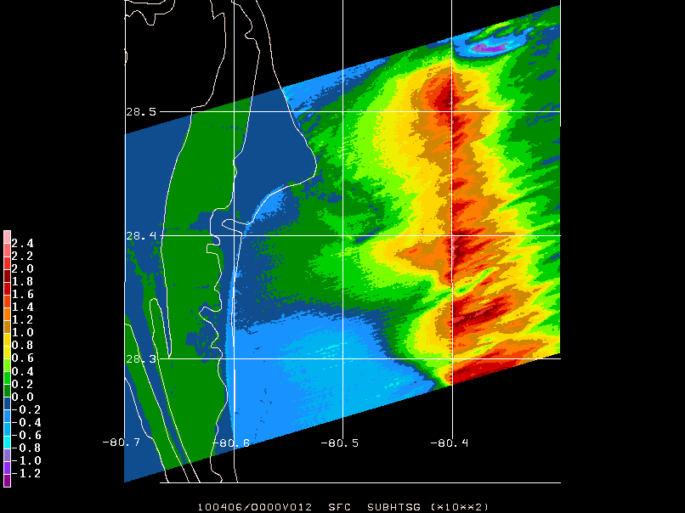
Flow Model test with strong shear (analytic)
Wave Height Difference (x 10² m) from no current run.
Notes:
Significant wave height difference (x 102 m) between an idealized/uniform northward moving current placed east of -80.4o. There are no winds and the current west of -80.4o is set to zero.

Slide 28
CWARFS/FLOW overview
  Create lat/lon file for each wave grid
  Create RTOFS lookup table for each wave grid
  RTOFS processing script
    Once per day data download
    Rotate RTOFS current u,v to wave model u,v
  Run CWARF with RTOFS
    Run for only designated grids
  Documentation and Script Updates
Notes:
RTOFS u and v component currents ( in the RTOFS reference frame) are converted to the CMS reference frame and placed in a support file such as: ~user/cwarf/gridN/FLOW/gridN_curr.dat

Slide 29
Where are we (5/30/11)?
ALL software installed at NWS Melbourne office (and most at Miami) and domains configured.
Successfully ported the wave domains into AWIPS using the grib2 decoder.
Using the GFS wind option
“The CMS/WABED has not been running recently as that server is being used for another project that will come to an end by the end of the summer. We should start the runs up again then (hopefully with some of the issues resolved).” IT Peter Blottman NWS Melbourne (7/18/2011).
“The model has been running well for several days now and hasn’t missed a cycle running 4 times a day. This is great news.” Peter Blottman.

Slide 30
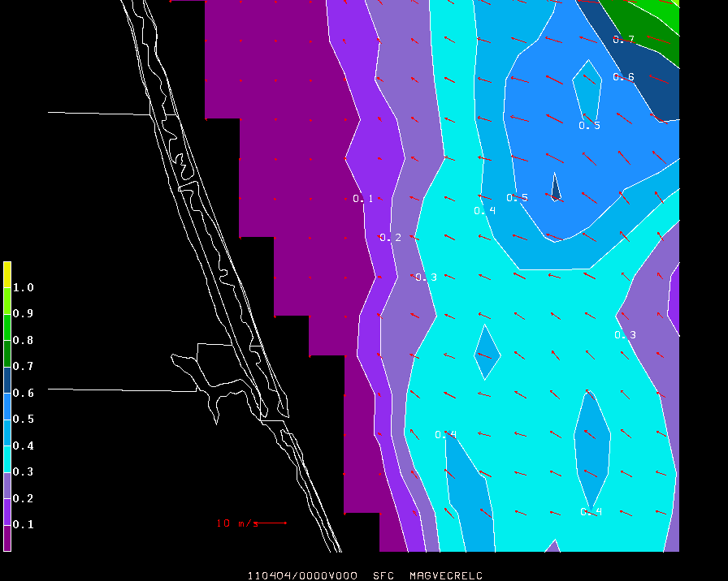
Issues/Problems/Fixes:
Sometimes a fast ramp up of wave heights over a short forecast period (related to high resolution RTOFS currents?)
NWS added comments to the runtime script regarding the ‘grid flipping’ setting which will make the flip/no flip option clearer. The grid flip option changes the forcing boundary to the opposite side of the domain for offshore flow.
RTOFS 00 UTC surface analysis currents valid 4 April 2011.

Slide 31
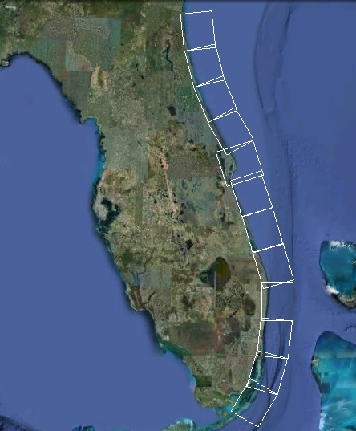
Wave Climate?

Slide 32
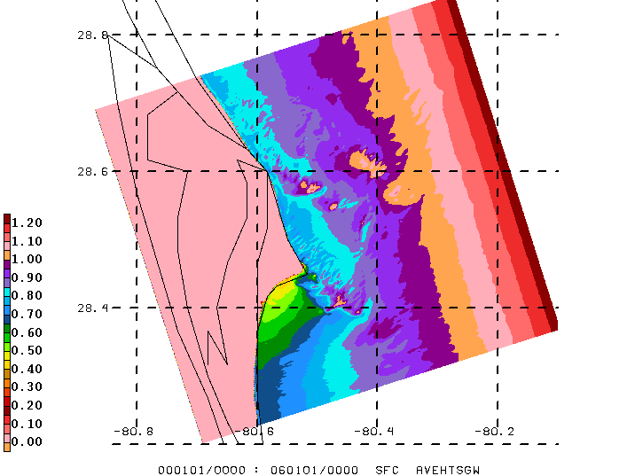
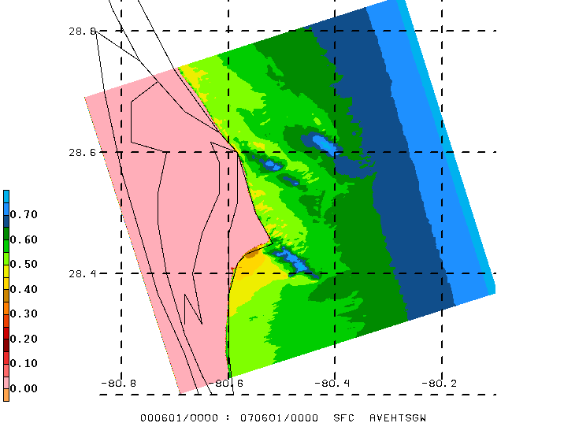
Wave Climate
9-year Wave climatology Summer/Spring

Slide 33

Questions?
Wave rose for hindcast CMS-Wave generated H_{s} at buoy 41113 for 2006-2007.
48 h CMS wave height (m) forecast initialized 00 UTC 18 July2011.
http://my.fit.edu/wx_fit/?q=obs/cmswave
Notes:
Wave Rose
Color bands on each petal indicate the magnitude of significant wave heights conserved by area; i.e. the larger the band, the greater the proportion of significant wave heights that fall in the given magnitude bin (0.25 m increments)
Length of each petal indicates the percentage of time swell comes from the given directional bin (10° increments)
Petals add up to 100%.

