Slide 1
Enhancing Data Utilization Through Adoption of Cloud-Based Data Architecture
Jonathan S. O’Neil, Director, NOAA Big Data Project (BDP)
Jack Settelmaier, Technical Lead (NRAP)
National Oceanic and Atmospheric Administration
VLab Forum 8/21/2019

Slide 2
Outline
What, Who, Why, How/Where
Big Data Project - cadence, personnel, roles
Data Usage Statistics / STI,R2O Use Cases
Results/Successes/Issues/Future
Questions
Notes:
Presentation outline

Slide 3
What

Slide 4
Our Mission
To understand and predict changes in climate, weather, oceans, and coasts, to share that knowledge and information with others, and to conserve and manage coastal and marine ecosystems and resources.

Slide 5
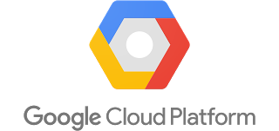
BDP Basics
Cooperative Research and Development Agreements
5 separate, but identical, 4-year agreements
Industry provides access to NOAA’s open data to all
Data remain open, are not to be sold
Collaborators monetize services based on data
NOAA provides data and expertise
Combines 3 powerful resources based on NOAA’s open data:
NOAA’s science and subject matter expertise
Industry’s data storage and access expertise
Cloud's scalable and on-demand processing capability
Notes:
The US Department of Commerce and the National Oceanic and Atmospheric Administration (NOAA) announced the NOAA Big Data Partnership (BDP) in April 2015. Through five cooperative research and development agreements (CRADAs) between NOAA and selected commercial and academic collaborators, NOAA is learning how the value inherent in its data may be leveraged to broaden the distribution and utilization of those data. Selected datasets of interest to the BDP collaborators and their business partners are being transferred from NOAA to the collaborators’ infrastructure. The partnership has already realized a number of dataset improvements, and new and novel applications that employ NOAA’s atmospheric, geophysical, and oceanographic data, at no net cost to the US taxpayer. For example, NOAA’s National Centers for Environmental Information (NCEI) has transferred the complete NEXRAD Level II historical archive to the CRADA collaborators.

Slide 6
Who

Slide 7
Big Data Project
Collaborators’ Data Offerings
AWS
https://aws.amazon.com/noaa-big-data/
Google Cloud Platform
https://cloud.google.com/bigquery/public-data/
https://explorer.earthengine.google.com/#index
IBM
https://noaa-crada.mybluemix.net/
Microsoft
https://azure.microsoft.com/en-us/services/open-datasets/catalog/nexrad-l2/
Open Commons Consortium
http://edc.occ-data.org/

Slide 8
Why

Slide 9
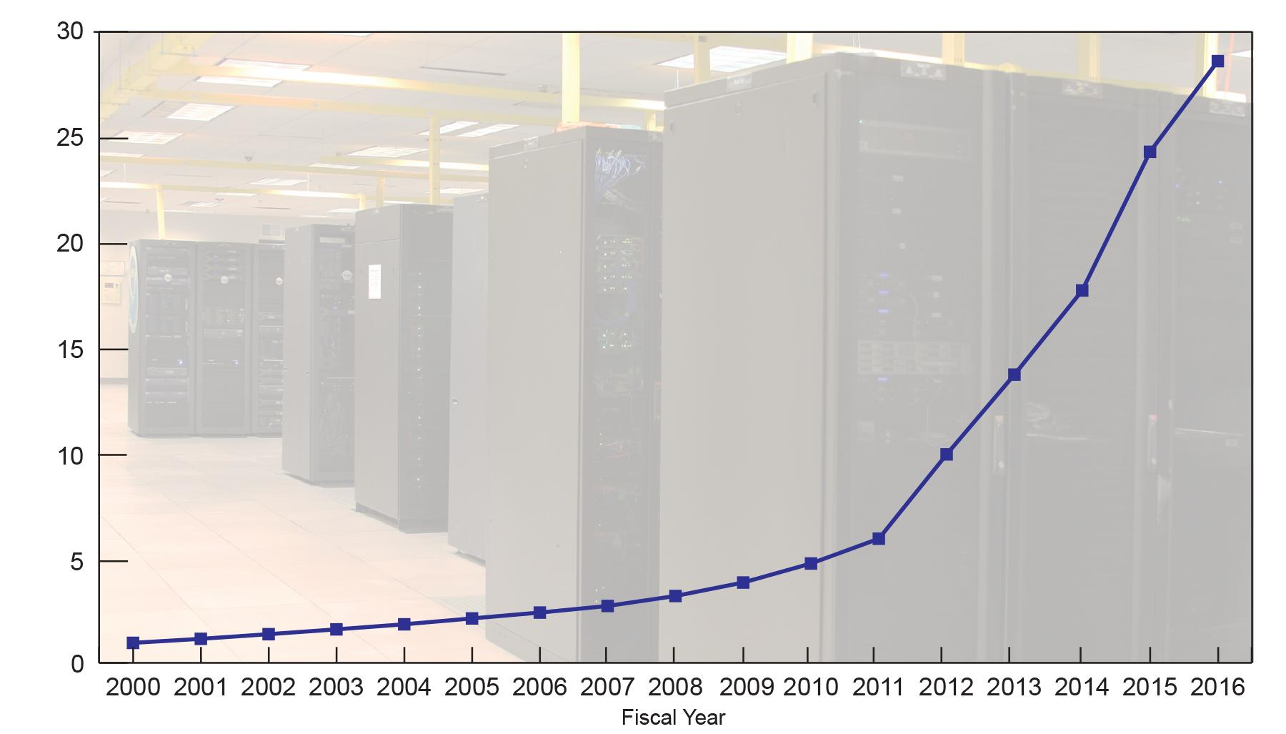
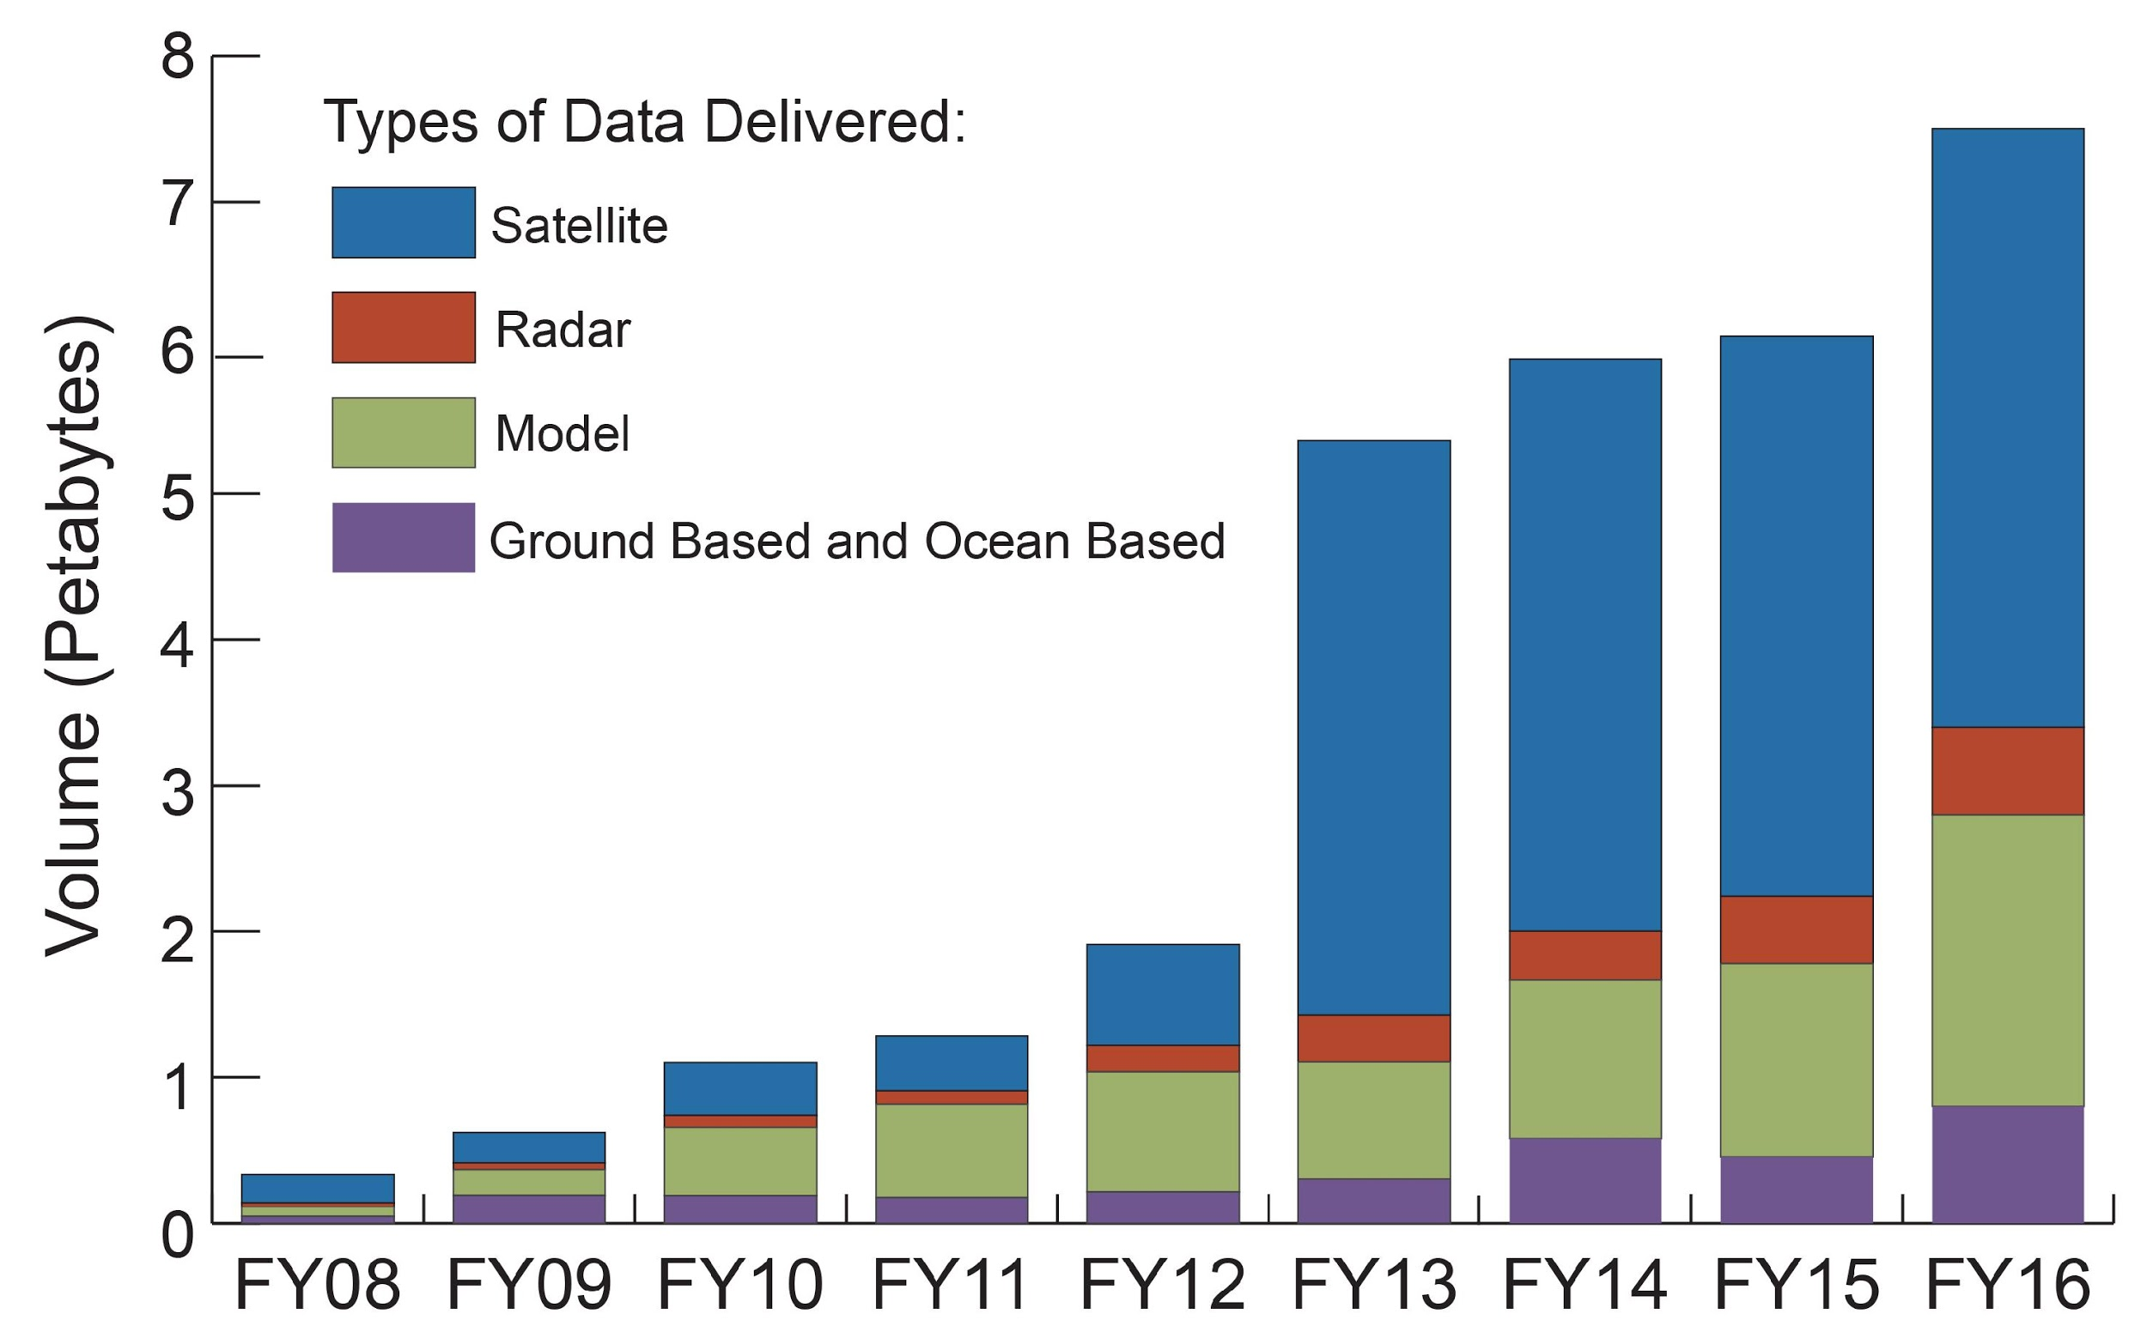
Increasing Volume and Demand for
NOAA Data
NOAA/NCEI’s Environmental Data Archive
2016 Total: 28.6 Petabytes
DEMAND
Due to increase
in satellite and
model data
BUDGETS (optimistic)
Volume (Petabytes)
Slide courtesy of NESDIS/NCEI
COSTS
Slide courtesy of NESDIS/NCEI

Slide 10
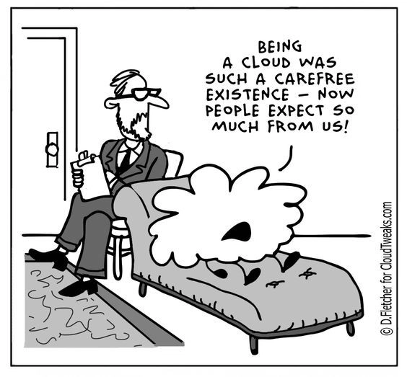
Collaborative Solutions
Improve data access
Facilitate use of the data
Improve NOAA’s cybersecurity posture
Develop new authenticity tools
Enable new economic &
research opportunities

Slide 11
How/Where

Slide 12
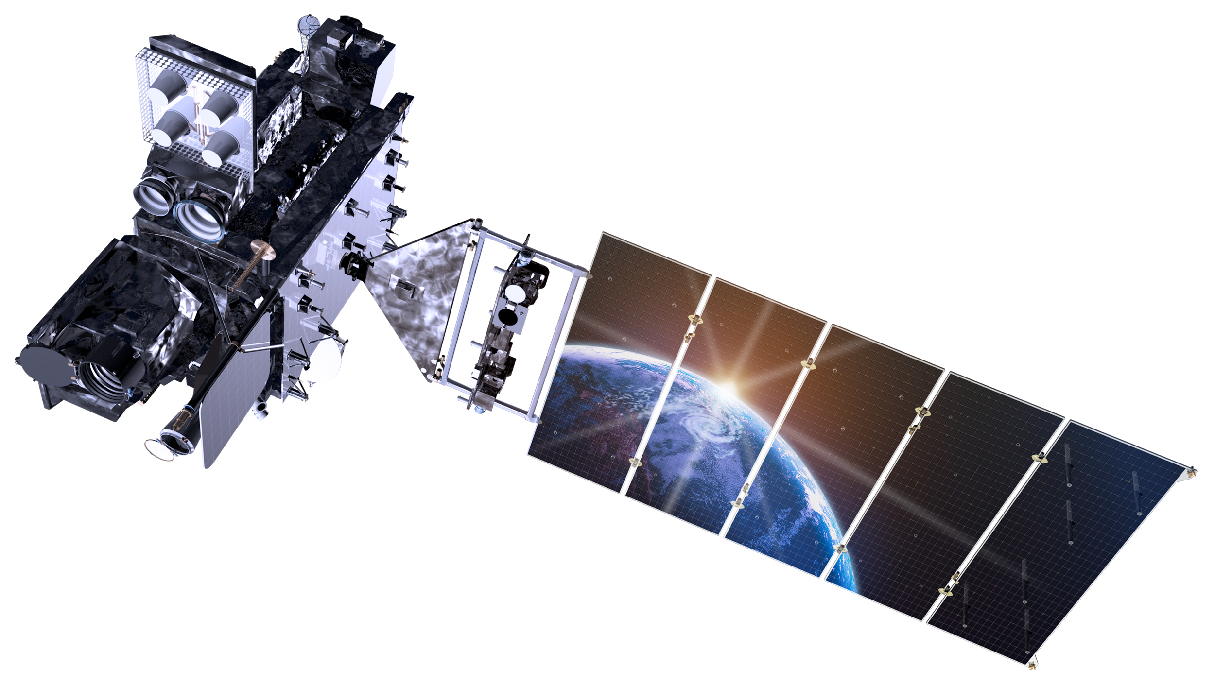
Traditional NOAA Satellite Data
Internet Access Strategy
Consumer Must Download Data to Use
Consumer
Ground System Data Distribution
Consumer
Consumer
Consumer
Consumer

Slide 13
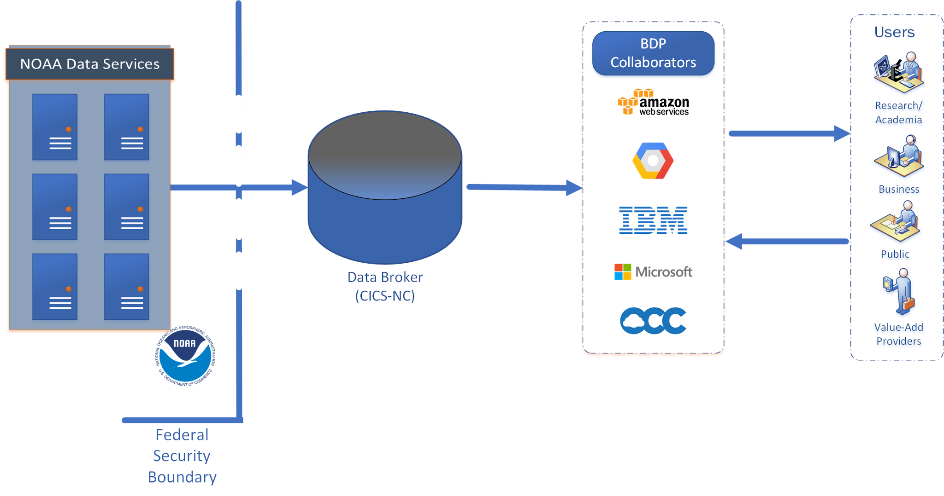
NOAA Big Data Project
Single Copy Services Many -- Use Data in Place
One-way transfer out of federal systems. Only a trusted user inside security boundary
Distributing a single copy of data can support all users.
Notes:
Improving NOAA's Cybersecurity Posture
Currently: Users access federal systems for distribution
Some mission-critical systems offer public access to data
External users have access inside federal security boundary
Potential: All data access occurs in non-federal system
Reallocate security assets and staffing to focus on mission-critical systems
Only verified trusted users granted access to federal systems

Slide 14
Data Broker Study:
Format Conversions
Pilot using Lambda functions converting GHCN-D granules from .gz to .csv:
Exceptions due to limitations built into Lambda functions (exceeds memory limit), requiring cloud instance to convert for most
Datasets under discussion:
NetCDF images -> cloud optimized geotiff
GRIB/GRIB2 data matrices -> NetCDF or other formats
Notes:
Examples of Data Broker explorations

Slide 15
Dataset Maintenance
NWC requested that we remove a parameter from the historical NWM datasets
Pilot using AWS FARGATE launching 20 Docker containers with
Python wrapper around the NCO (NCKS) tool
~26 hours to remove one parameter from ~75K objects
Notes:
Example cloud-based data maintenance possible

Slide 16
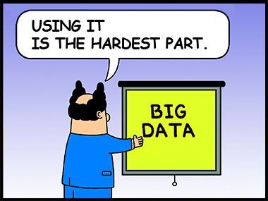
The Limiting Factor for Use of the Data
Use
Expertise
Cloud
Open Data
Notes:
Importance of NOAA Subject Matter Expertise (SMEs)

Slide 17
Value Driven Ecosystem
Uses
Information Consumers
Decision Support Tools
3rd Parties
Cloud Platforms
NOAA Data and Expertise
Notes:
NOAA data and expertise provide the foundation for a value-driven ecosystem.

Slide 18
BDP Project Cadence
Personnel, Roles

Slide 19
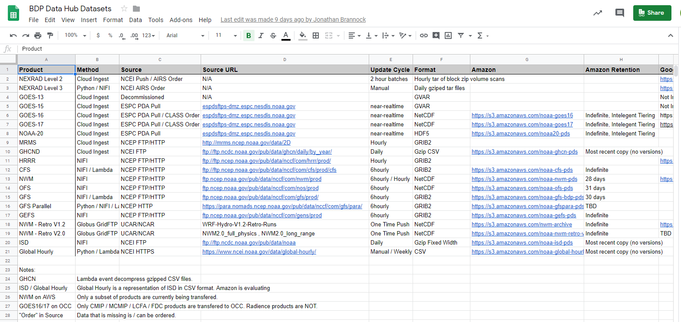
BDP Project Cadence
Personnel, Roles
Weekly/bi-weekly/monthly, per collaborator
NOAA “data pitches” to collaborators
Communications/Scheduling/Documenting
Technical and non-technical NOAA liaison staff
BDP Advisory Board

Slide 20
Data Usage Statistics
STI, R2O Use Cases

Slide 21
Big Data Project
Collaborators’ Data Offerings
AWS
https://aws.amazon.com/noaa-big-data/
Google Cloud Platform
https://cloud.google.com/bigquery/public-data/
https://explorer.earthengine.google.com/#index
IBM
https://noaa-crada.mybluemix.net/
Microsoft
https://azure.microsoft.com/en-us/services/open-datasets/catalog/nexrad-l2/
Open Commons Consortium
http://edc.occ-data.org/

Slide 22
NOAA’s BIG DATA PROJECT USE CASES
This document contains several use cases the Big Data Project (BDP) team has learned about from communications with end users and the Collaborators of the project. It is not until this last year of the experimental phase of the project that the BDP team has learned more about the various ways individuals, researchers, startups, and companies of different sizes have been utilizing the data accessed through the project. The BDP also gleaned valuable information from RFI responses. The RFI was published on October 1st 2018 on the Federal Register with an objective of informing the future direction of the Big Data Partnership. In that notice, NOAA indicated that it sought direct input and feedback from all users of the data on their experience accessing NOAA’s open data through one or more of the five BDP Collaborators’ cloud platforms.This document is a summary aimed at capturing the various use cases in greater detail, grouped by dataset.
References in this document to individuals, organizations, products, and services do not connote endorsement by NOAA or the Department of Commerce of such individuals, organizations, products, or services, or of their views.

Slide 23
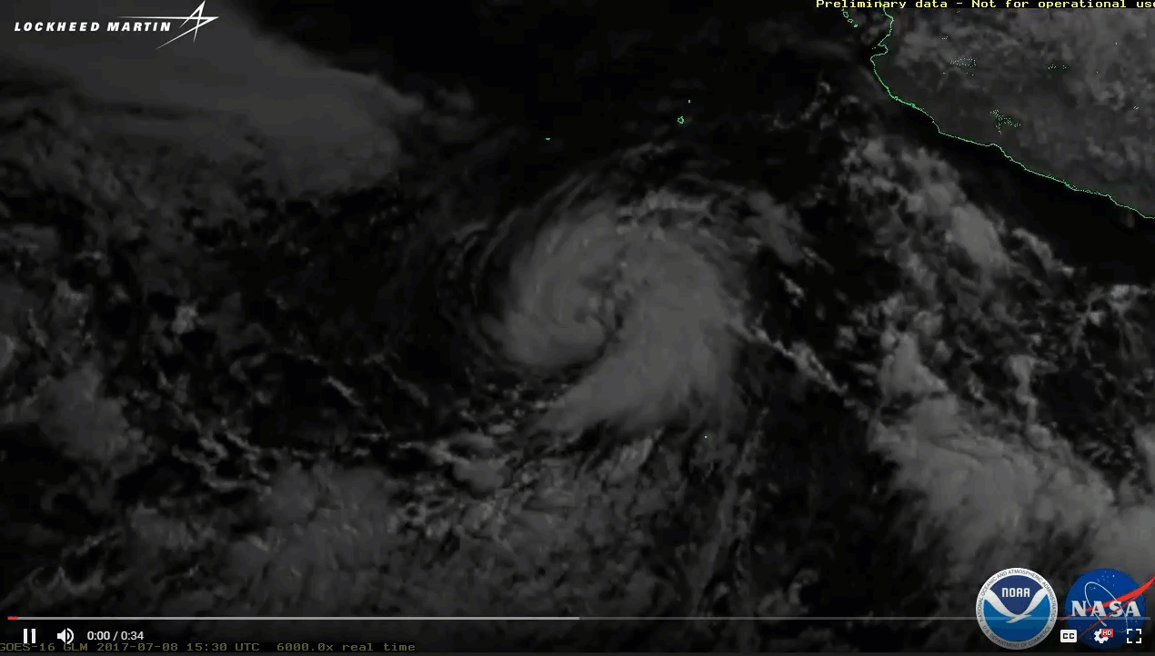
BDP and GOES-16
Overview of BDP Activity
Cooperative Institute for Climate and Satellites – North Carolina
Providing GOES-16 data from NOAA/NESDIS Ground System (PDA) to Collaborators.
1 source, 5 validated feeds to the CRADA Collaborators
Timing - As fast as they appear at NOAA/NESDIS distribution point
Latency - Single hop through CICS-NC systems, w/checksums
Impact - Minimal load on NOAA’s operational systems and networks
Observed additional latencies from CICS-NC transfer from NOAA Ground System to BDP Collaborator platforms
Maximum additional latency: 2 to 3 min (full disk ABI, Band 2)
Typical Range of additional latency: 4.5 to 5.5 seconds

Slide 24
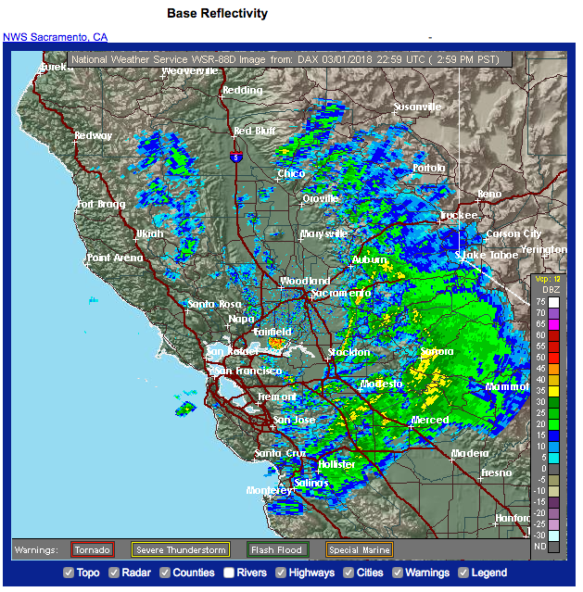
AWS and Weather Radar
Entire NEXRAD 88D Weather Radar Archive transferred to AWS, Google and OCC in Oct 2015 (~ 300TB, 20M files)
Following AWS service release:
Increased usage (2.3 times), 50% reduction on NOAA servers.
New uses – bird migration, mayfly studies
80% of NOAA NEXRAD data orders are now served by AWS.
(Ansari et al, 2017 BAMS)

Slide 25
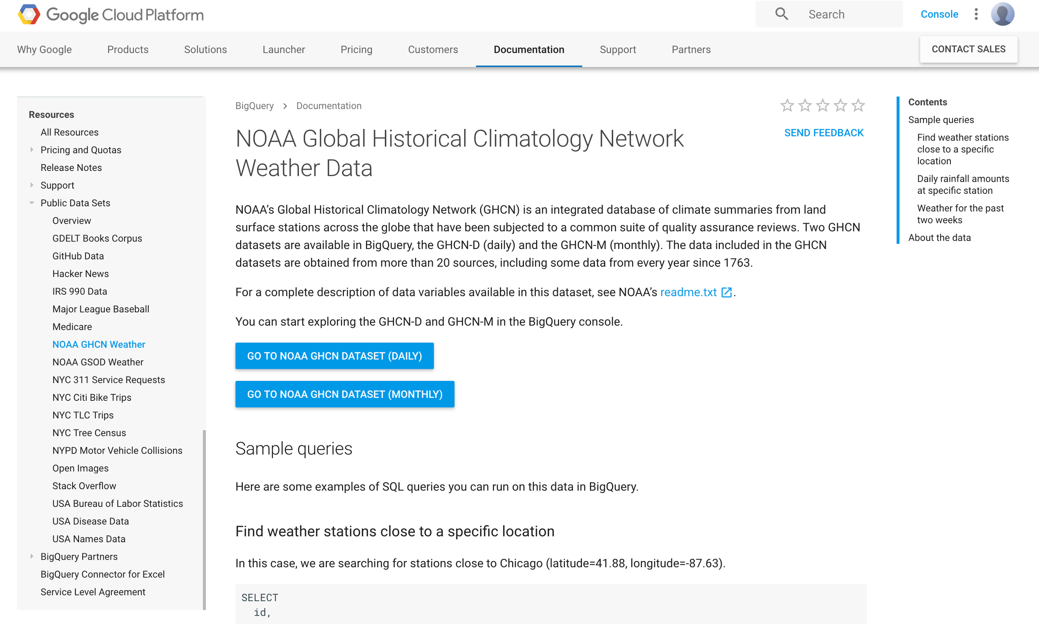
Climate Data in Google BigQuery
https://cloud.google.com/bigquery/public-data/noaa-ghcn
1.2 PBs of climate and weather data accessed through Google BigQuery, in 4 months
30-100x of NOAA deliveries in that time
Images in Google Cloud Platform
GOES-16 (began July 2017)
National Water Model data
Weather and Climate model output
Climate data records

Slide 26
OCC’s Environmental
Data Commons
http://edc.occ-data.org/

Slide 27
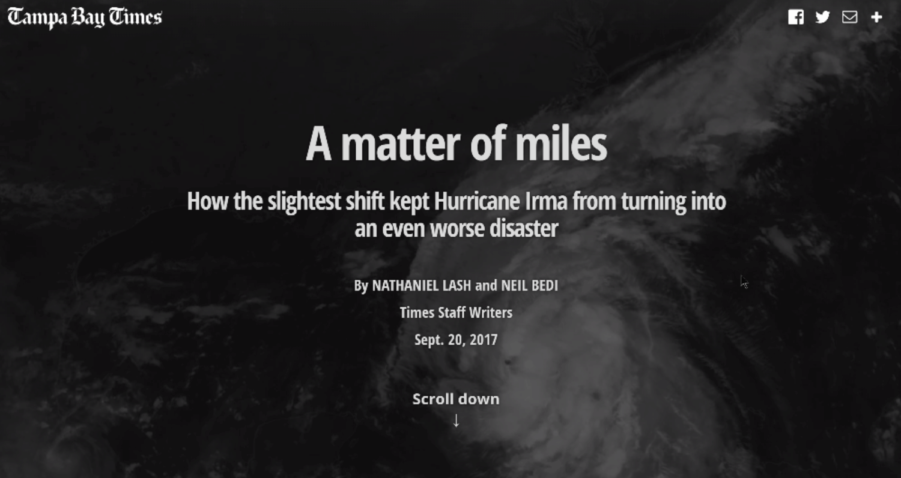

Slide 28
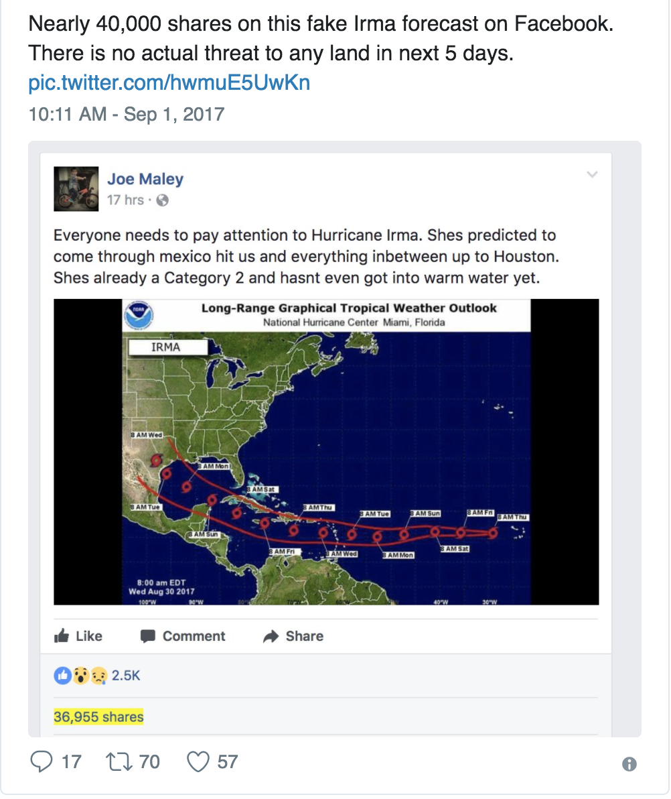
Ensuring Data Authenticity
Users trust NOAA data they access from NOAA sites
What about outside NOAA?
Collaborators’ sites?
Example: Fake Irma forecast

Slide 29
Data Broker’s Usage Statistics Analysis (presented at Earth Science Information Partners (ESIP) meeting

Slide 30
BDP Data Broker Update
Jonathan Brannock and Otis Brown
CISESS / NCICS
NCSU

Slide 31
Broker Roles
Impedance matching with each side of the transfer, i.e., use appropriate protocols for each interaction
Transfer data from NOAA to Cloud partners
Resolve operational problems
Ensure data integrity
Certify Cloud partner holdings
Add new datasets

Slide 32
Broker Operations
Inform Cloud partners of source data outages
Resolve source and/or destination outages
Resolve transmission errors
Maintain 24/7 operations with minimal data loss
Add new data sets as requested

Slide 33
Currently Brokered Datasets – ~5TB / day
Dataset | Size | Cloud Provider(s) | Source
GOES-16/17 ABI & GLM | ~1 TB daily | AWS, GCS, OCC | NESDIS/ESPC
GOES-15 GVAR | ~15 GB daily | OCC | NESDIS/ESPC
NEXRAD L2 | ~60 - 201 GB daily | AWS, GCS, OCC | NESDIS/NCEI
NEXRAD L3 | ~20 - 60 GB daily | GCS | NESDIS/NCEI
GHCN-D | ~30 GB daily | AWS | NESDIS/NCEI
National Water Model | ~115 GB daily | AWS, GCS | NWS/NCO
Ocean Forecast System | ~288 GB daily | AWS | NWS/NCO

Slide 34
Brokered Datasets (Continued)
Dataset | Size | Cloud Provider(s) | Source
NOAA-20 VIIRS DNB | ~60 GB daily | AWS | NESDIS/ESPC
Fire Products | ~1.1 GB daily | AWS,GCS | NESDIS/ESPC
ISD | ~750 MB daily | AWS | NESDIS/NCEI
Global Hourly | ~20 GB daily | AWS | NESDIS/NCEI
GFS | ~950 GB daily | AWS | NOS/CO-OPS
HRRR | ~920 GB daily | AWS,GCS | NWS/NCO
CFS | ~310 GB daily | AWS | NWS/NCO

Slide 35
Brokered Datasets Accession (Ranked)
Dataset | Count
GOES-16 | 754,659,402
GOES-17 | 80,221,671
NWM (Archive) | 11,530,076
GFS | 3,048,159
GHCNd | 1,116,821
NWM | 136,287
ISD | 114,879
GEFS | 63,598
Dataset | Bytes
GOES-16 | 3,163,532GB
GOES-17 | 584,946GB
NWM (Archive) | 142,768GB
GHCNd | 50,658GB
GFS | 41.800GB
GEFS | .377GB
GFS(para) | .297GB
OFS | .066GB
Statistics are for the total BDP period of record for each data set

Slide 36
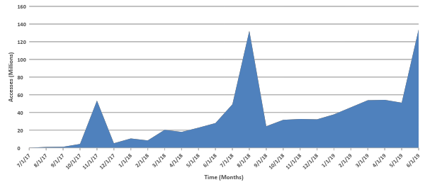
Accession Rates
Statistics are for the BDP Brokered datasets
Notes:
Statistics are for the BDP brokered datasets

Slide 37
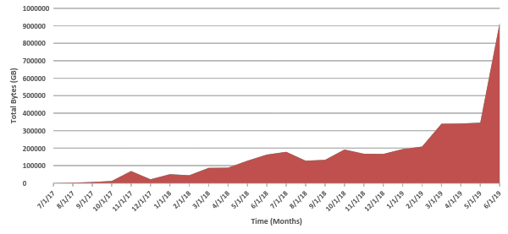
Accession Rates - Volume
Trend is ~16.33 TB/Month increase (7/17 – 5/19)
~900 TB of GOES-16/17 accessed in 6/19
Notes:
Statistics are for the BDP brokered datasets
Current plateau is ~350TB

Slide 38
BDP Terminology
BDP is “Big Data”
Volume – TB per day
Variety – NOAA environmental observations and model products
Velocity – Minimal latencies, in near-real time (secs – mins)
Notes:
BDP meets the 3 Vs criteria

Slide 39
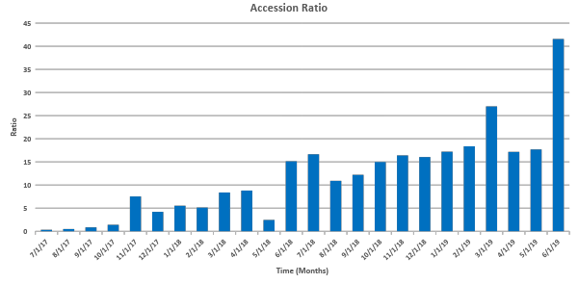
GOES-16 Data Statistics [AWS]
Notes:
Accession ratio -= Out/In
~doubled over the past year

Slide 40
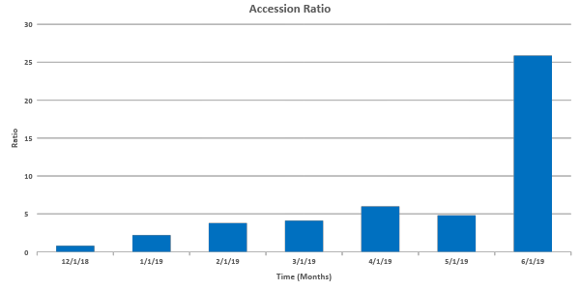
GOES-17 Data Statistics [AWS]
Notes:
Accession ratio -= Out/In

Slide 41
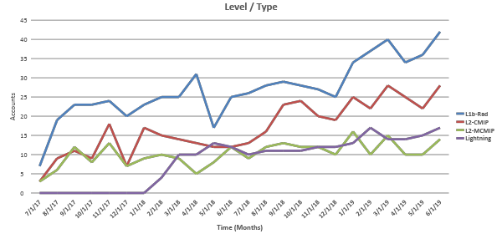
GOES-16/17 Data Statistics [AWS]
Notes:
By uniquely authenticated requestors
Binned by Level/type…

Slide 42
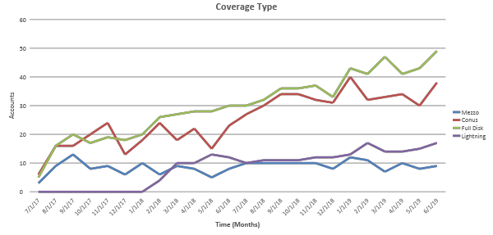
GOES-16/17 Data Statistics [AWS]
Notes:
By uniquely authenticated requestors
Binned by coverage type

Slide 43
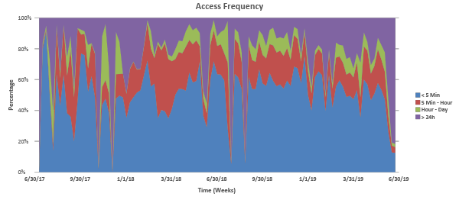
GOES-16/17 Access Statistics [AWS]
Age is the time from observation. Average frequencies are: ~50%, ~18%, ~8% and ~24%, respectively.
Notes:
Weekly access frequency for combined GOES-16/17 datasets. ~1/4 of the accesses are for data older than 24 hours

Slide 44
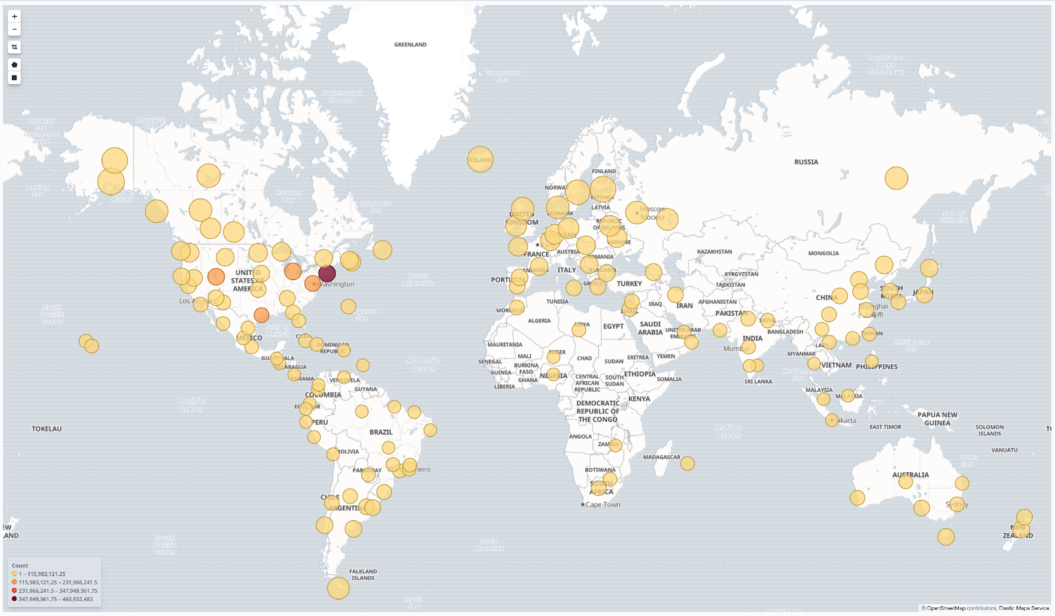
GOES-16 Access Locations [AWS]
Notes:
Broad audience for GOES-16

Slide 45
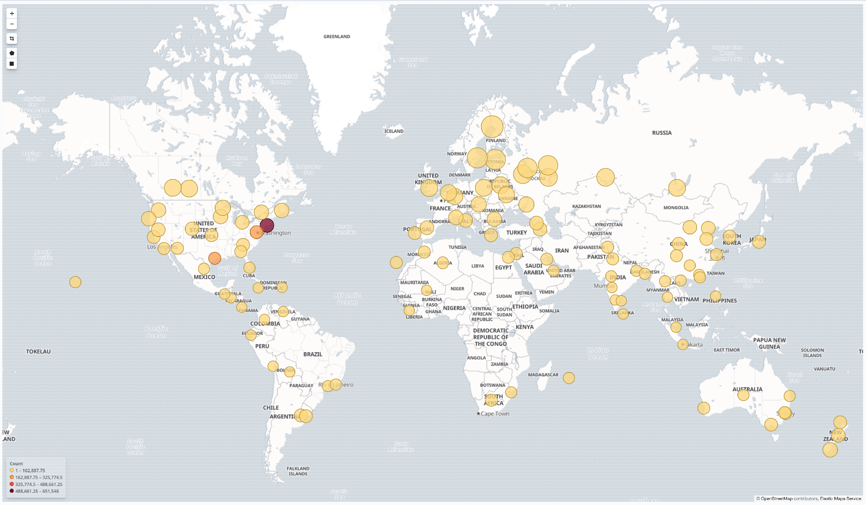
GHCNd Access Locations [AWS]
Notes:
Interesting consumption of GHCNd…global!

Slide 46
Data on Cloud Platforms
STI/R2O Use Cases

Slide 47
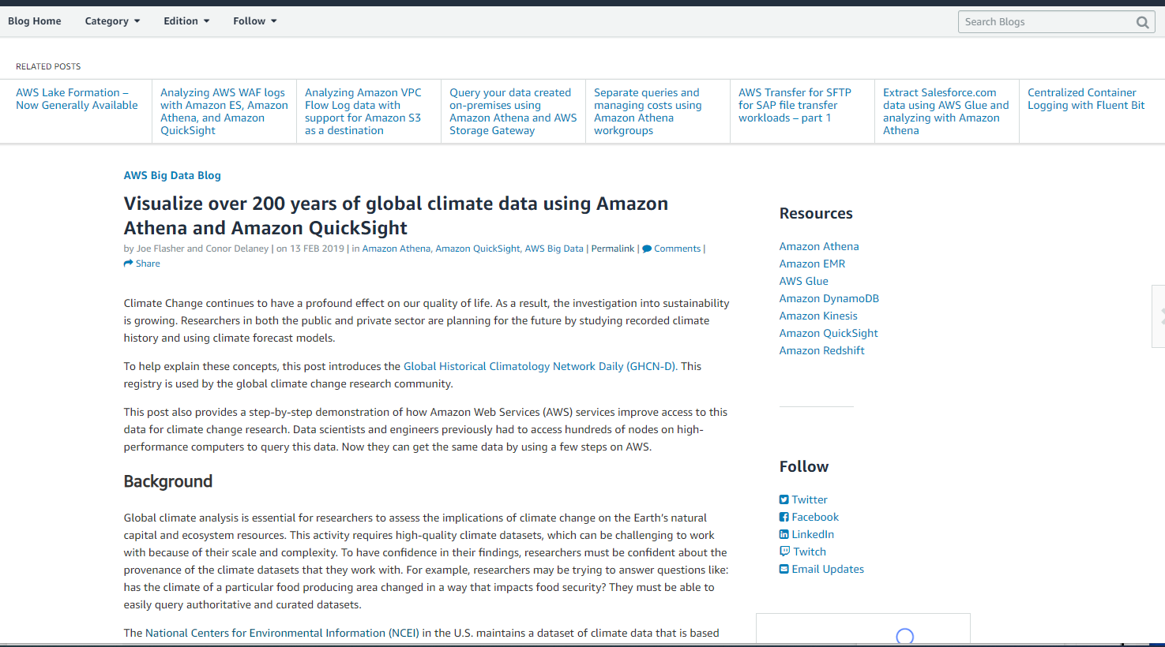
AWS GHCN-D Blog Post

Slide 48
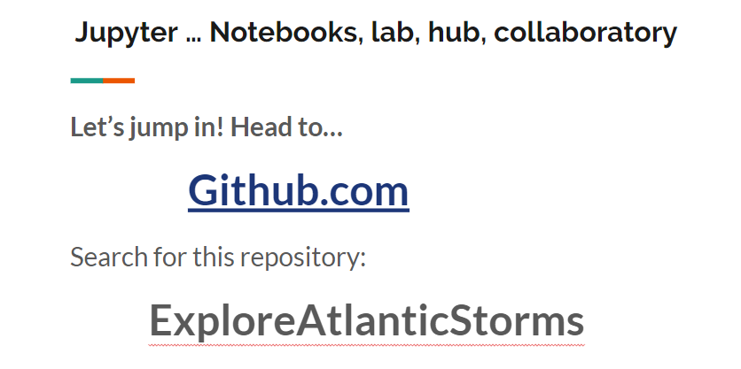
ESIP Presentation

Slide 49
Results/Successes/Issues
Future?

Slide 50
Big Data Project Results
Technical Proof-of-Concept proven successful
Over 70 datasets are being served now via Collaborator services
Higher levels of service, increased volumes, new users
Lessons-learned documented; Collecting User stories
Key Points
A Partnership based on NOAA public data access can work
Expertise is the scarce, valuable commodity in the relationship
NOAA must own data security & quality to secure value & brand
Opportunities that the Partnership aspect may provide
Grow & defend NOAA budgets with new advocates for NOAA data
Cost savings in data access infrastructure
Enhanced scale and reliability of services for NOAA data consumers

Slide 51
Big Data Project
Detailed Successes
Over 70 datasets are being served now via Collaborators (weather radar data, historical weather data, GOES 16/17 satellite imagery, lightning observations (GLM and Vaisala aggregate), fisheries data, and a variety of computer model outputs including the NWM, GFS, CFSv2 and HRRR.
Collaborators interested in continuing partnership contractually, post-CRADA
Significant increases in data usage have been observed*
GOES accession rates 10-15x + the incoming data rate
130% increase in weather radar data use over previous years
50% reduction in access loads on the NOAA systems
80% of archive data orders now fulfilled on collaborators’ systems.
Collaborators have stated that access to NOAA’s expertise has been the most valuable
Integration of NOAA data into collaborators’ existing cloud-based access and analytical tools has driven the largest increases in data usage.
Activities/labor costs associated with data delivery from NOAA to cloud have been collapsed into a “data broker” role (NOAA’s Cooperative Institute (CICS/CISESS))--identified as a KEY function for the project.

Slide 52
Big Data Project
Issues/Next Steps/Future
Sustained operational phase?
Cloud services strategy ties, cyber-security (data broker)
Data authenticity (origin/quality); Data management (curation)
User profiles and usage statistics
Open and non-open data
Budget and Cost Recovery (dedicated, not detailees)
NOAA Implementation Strategy?
Request for Proposals issued April-May, 2019

Slide 53
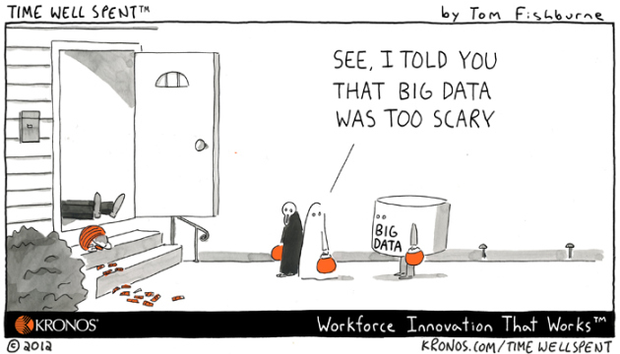
Questions?
adrienne.simonson@noaa.gov
#NOAABigData
http://www.noaa.gov/big-data-project

Slide 54
NOAA is seeking a Sustainable Partnership
Developed a Conceptual and Functional Framework
Achieved Line Office Concurrence
Defining Implementation Options
Analyzing the User information available
Gathering Use Cases
Request For Information conducted October 2018
Responses due October 22, 2018
Request for Proposals issued April-May, 2019

