Slide 1
Automated Detection of Weather Fronts Using a Deep Learning Neural Network
James C Biard Vexcel Imaging
Kenneth E Kunkel North Carolina Institute for Climate Studies North Carolina State University August 19, 2020

Slide 2
Motivation
The Goal – Understand how Precipitation Frequency estimates across North America (NA) will change as the climate changes.
Extreme precipitation associated with weather fronts is the dominant contributor over most of North America.
We need to understand how weather front behavior will change as the climate changes.
Automated front detection will be required.

Slide 3
The Problem Space
Weather front detection is still a manual process.
Visual recognition problems are often good candidates for Neural Network solutions.
A ”supervised learning” neural network approach requires truth data.

Slide 4
Training Data
We used NASA Modern-Era Retrospective analysis for Research and Applications, Version 2 (MERRA-2) with data from 1980-2018 for our inputs. We used pressure difference from a moving 30-day mean, near-surface air temperature, specific humidity, and vector wind velocity.
Used the Coded Surface Bulletin (CSB) digitized front polyline dataset with data from 2003-2018 for our labels to train against.

Slide 5
Training Data
Used a 1x1° data grid centered over North America (10–70N x 171–31W).
Converted the CSB polylines to gridded maps with lines drawn 3 grid cells wide.
CSB data grid layers:
Cold fronts
Warm fronts
Stationary fronts
Occluded fronts
No front

Slide 6
Neural Networks
Neural networks are composed of simplistic analogs of biological neurons organized in layers.
Here is the basic structure of a machine learning neuron.
$$O=f\left(b+ \sum_{i}{w_{i}}I_{i}\right)$$
A non-linear function of a linear superposition of a set of input values.

Slide 7
Neural Networks
$$b$$
$$I_{1}$$
$$×w_{1}$$
∑
$$f$$
$$O$$
. . .
$$×w_{n}$$
$$I_{n}$$

Slide 8
Neural Networks
A neural network is formed by building layers where the outputs from one set of neurons are used as inputs to another set.

Slide 9
Neural Networks
In the 1960s, mathematicians proved that any complex function of multiple inputs can be decomposed into a combination of linear superpositions and simple non-linear functions applied to the inputs.
This is, in essence, a neural network with one interior (hidden) layer.
The problem is finding the appropriate functions and weights!

Slide 10
Neural Networks
In supervised machine learning, the weights are found through hyper-dimensional gradient descent.
Produce outputs for a number of inputs with a network initialized with random weights and biases.
Use the discrepancy between network outputs and “truth” outputs to update the weights and biases to minimize the difference.
Repeat many times.

Slide 11
Neural Networks
Finding a good network design for your problem is an art.
Take care, because it is possible to memorize the right answer for each input rather than learn the underlying functional relationships (overfitting).

Slide 12
Network Design

Slide 13
Training
Trained with data from 2008-2012.
Randomly selected ¼ of the possible 17x17 grid cell input patches while also ensuring that there were twice as many “no front” patches as “front” patches.
Limited training and testing to region around CONUS where the rate of front crossings was 40/year or better.
Training took ~3 days on a NERSC GPU node.

Slide 14
Training

Slide 15
Training Results

Slide 16
Training Results
CSB Labels 2003 - 2018
 | Cold | Warm | Stationary | Occluded | None | Total
Counts | 8,551,914 | 4,631,517 | 12,797,269 | 3,893,614 | 182,795,286 | 212,669,600
Percent | 4.02% | 2.18% | 6.02% | 1.83% | 85.95%
MERRA-2 Predictions 2003 - 2018
 | Cold | Warm | Stationary | Occluded | None | Total
Counts | 8,950,546 | 2,785,315 | 10,867,527 | 4,098,013 | 185,968,199 | 212,669,600
Percent | 4.21% | 1.31% | 5.11% | 1.93% | 87.44%

Slide 17
Training Results
Confusion Matrix 2008-2015
 |  | Predicted
 |  | Cold | Warm | Stationary | Occluded | None
 | Cold | 4,118,370 | 166,264 | 754,909 | 231,514 | 3,280,857
 | Warm | 214,405 | 1,104,025 | 743,101 | 300,147 | 2,269,839
Actual | Stationary | 990,596 | 244,167 | 4,464,480 | 127,063 | 6,970,963
 | Occluded | 194,304 | 128,904 | 201,375 | 1,643,822 | 1,725,209
 | None | 3,432,871 | 1,141,955 | 4,703,662 | 1,795,467 | 171,721,331

Slide 18
Training Results
Front/No-Front Confusion Matrix 2003-2018
 |  | Predicted
 |  | Front | None
Actual | Front | 15,627,446 | 14,246,868
 | None | 11,073,955 | 171,721,331

Slide 19
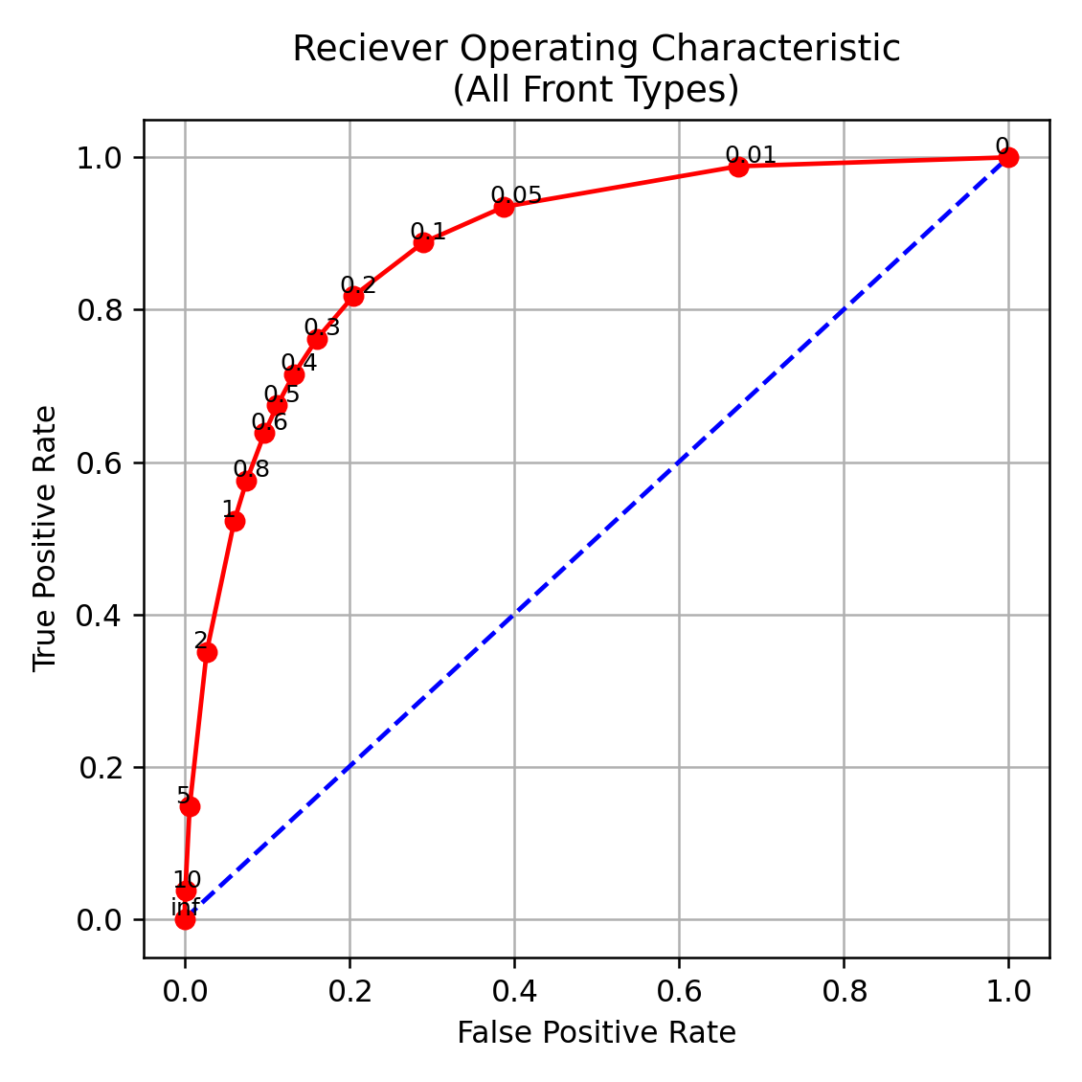
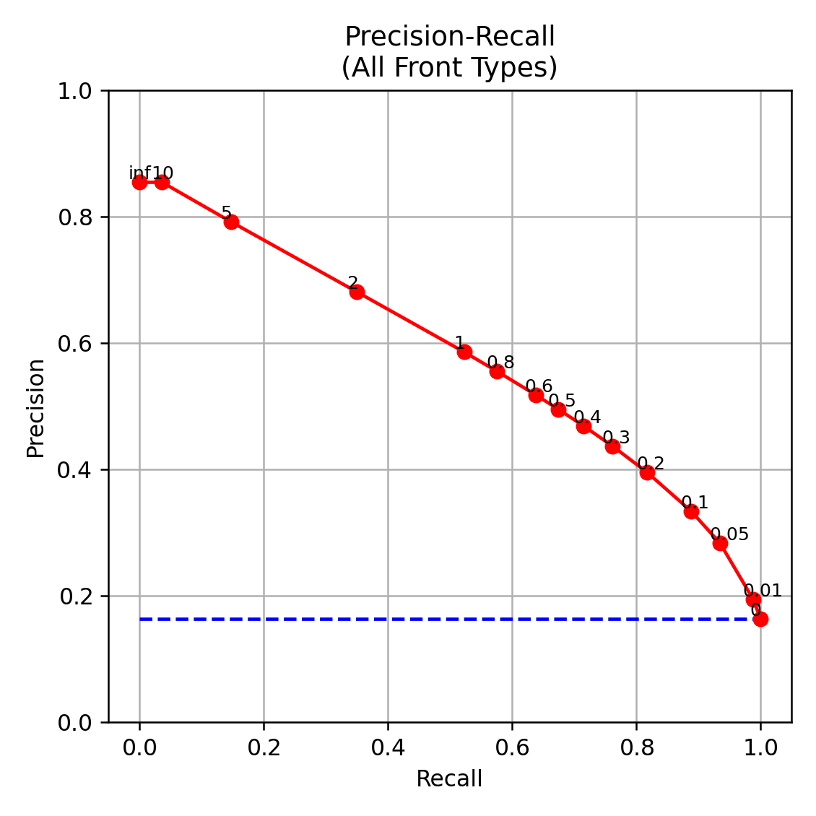
Training Results

Slide 20
Training Results

Slide 21
Training Results
The performance of the network may be better than the metrics suggest.
It may be more conservative about drawing weak fronts.
Slight geographic offsets count as misses.
Differences in type of front count as misses.

Slide 22
Front Climatologies
Goal of the front detection work was to develop front climatologies.
Decided to measure the rate at which fronts of each type crossed each 1°x1 ° grid cell.
Also measured the rate at which fronts of any type crossed each cell.
Calculated climatologies for CSB and for MERRA-2 network outputs.

Slide 23
Front Climatologies
For MERRA-2, extracted polylines from the front probability data grids produced by the network.
Produced hard-edged 3-cell-wide data grids on 3-hourly time steps.
Stacked the data grids to produce a “front event” time series for each front type for each grid cell.

Slide 24
Front Climatologies
Filtered each time series by removing the front events that were within 24 hours after each initial event to prevent overcounting.
Produced front-crossing rates by month and season from the counts.
Averaged the rates by month and season over years to produce monthly and seasonal front crossing rate climatologies.

Slide 25
MERRA-2 vs CSB Climatology
Produced climatologies as described for MERRA-2 network outputs.
Produced climatologies the same way for the CSB dataset.
Used the 2003-2018 overlapping time frame for each.
Also averaged the results over a CONUS-centered region spanning 20N – 50N, 125W – 65W.

Slide 26
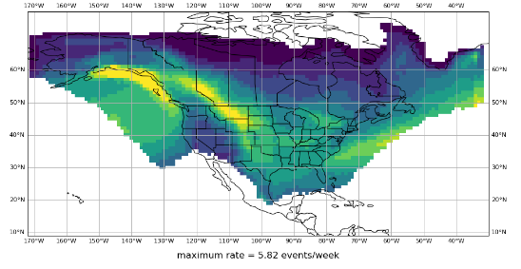
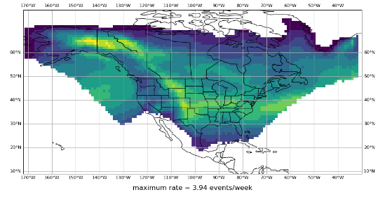
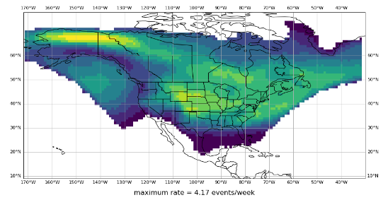
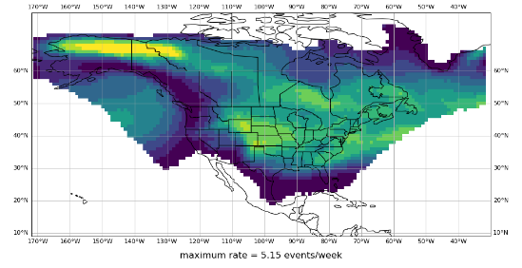
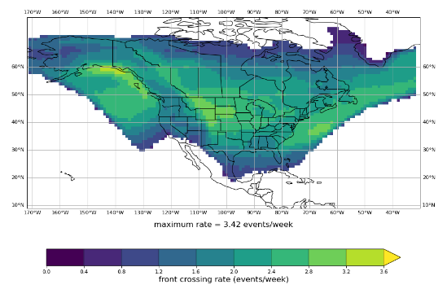
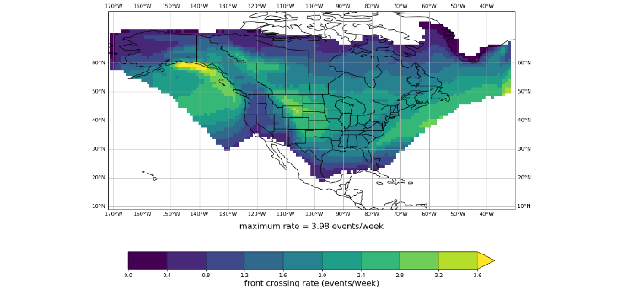
MERRA-2 vs CSB Climatology
CSB
MERRA-2
Dec-Jan-Feb
Mar-Apr-May
Jun-Jul-Aug
Sep-Oct-Nov

Slide 27
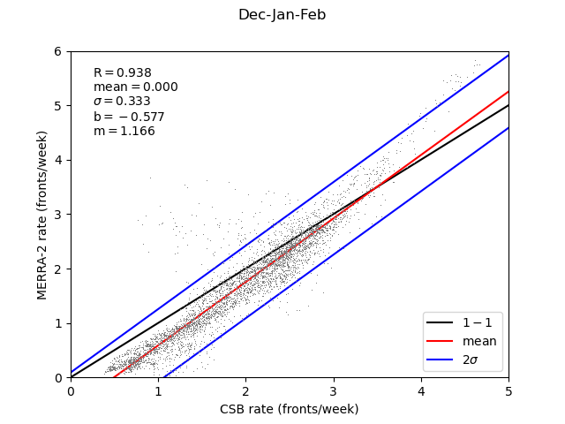
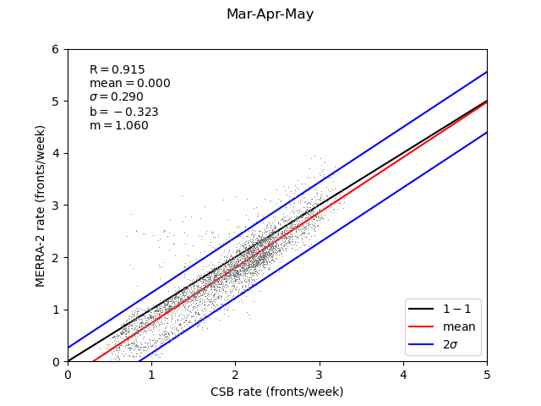
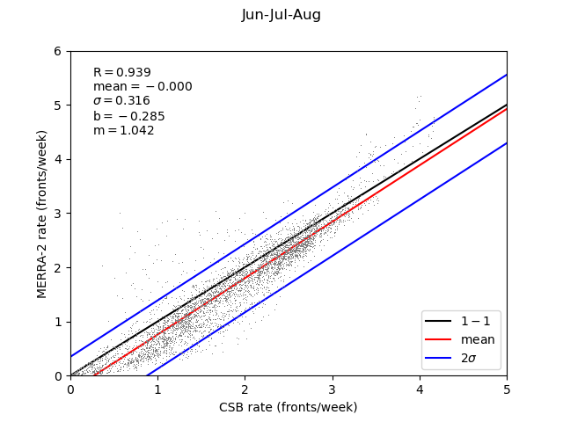
MERRA-2 vs CSB Climatology

Slide 28
MERRA-2 vs CSB Climatology

Slide 29
Conclusions
The network appears to perform well.
Hard to determine if further training is warranted.
Need to try different network architectures.

Slide 30
Questions?
Support for this project was provided by the U.S. Department of Defense Strategic Environmental Research and Development Program Contract # W912HQ 15-C-0010

