Slide 1
Synoptic-scale Environments and Dynamical Mechanisms Associated with Predecessor Rain Events Ahead of Tropical Cyclones
Benjamin J. Moore, Lance F. Bosart, and Daniel Keyser
Department of Atmospheric and Environmental Sciences,
University at Albany/SUNY, Albany, NY
Michael L. Jurewicz, Sr.
NOAA/NWS, Binghamton, NY
Master’s Thesis Seminar
8 July 2010
NOAA/CSTAR Grant NA07NWS4680001

Slide 2
Outline
Overview of a PRE
PRE-vious research
Data and Methods
PRE-relative composite analysis
PRE associated with TC Rita (2005)
Concluding remarks

Slide 3
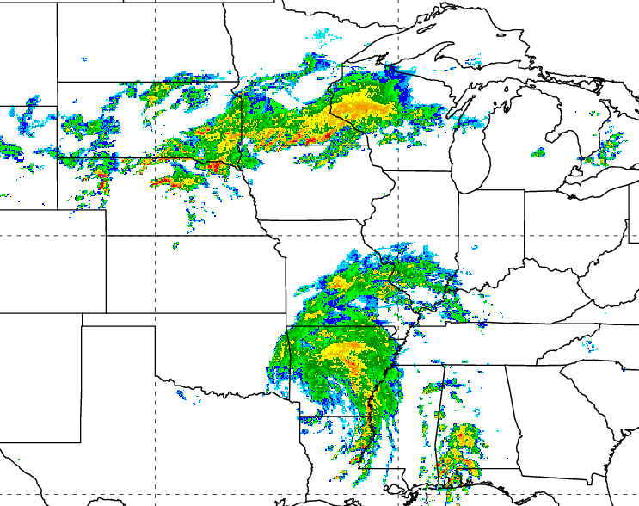
Predecessor Rain Events Ahead of Tropical Cyclones
Defined by Cote (2007) as distinct mesoscale regions of heavy rainfall [~100 mm (24 h)⁻¹] ~1000 km downstream of landfalling and recurving tropical cyclones (TCs)
Develop as a poleward stream of moisture from a TC interacts with a region of forcing for ascent
Pose a substantial flash-flooding risk due to:
Prolonged high precipitation rates
High precipitation efficiencies
PRE ahead of TC Rita
06Z 25 Sep 2005
PRE

Slide 4
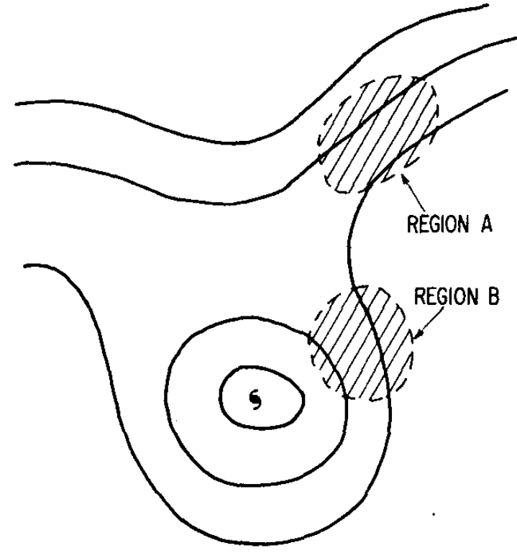
Previous Work on PREs
Bosart and Carr (1978): PRE ahead of TC Agnes (1972)
> 200 mm of rain fell ~1000 km ahead of poleward-moving TC Agnes
Moisture transported by the outer circulation of Agnes toward a region of QG forcing for ascent associated with short-wave trough
Distinction between TC rainfall and PRE rainfall
PRE
TC rainfall

Slide 5
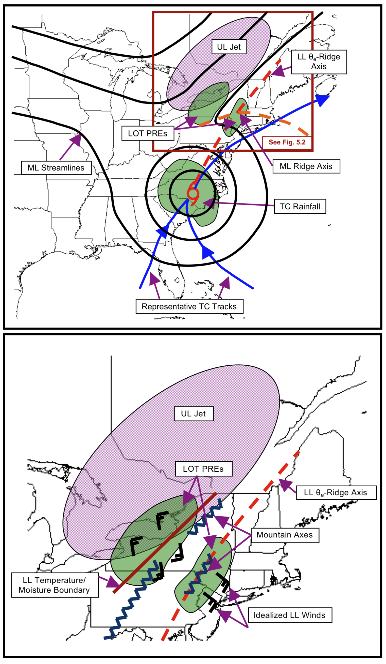
Previous Work on PREs
Cote (2007):
PREs tend to form in a region of confluence downstream of short-wave trough, within the equatorward entrance region of an upper-level jet streak
Precipitation focused along low-level baroclinic zones and along elevated terrain
Galarneau et al. (2010):
Low-level thermal advection and frontogenesis along a baroclinic zone important for PRE development
Ridging associated with diabatic outflow from TC intensifies jet streak
Schematic depiction of synoptic and mesoscale features associated with PREs from Cote (2007)

Slide 6
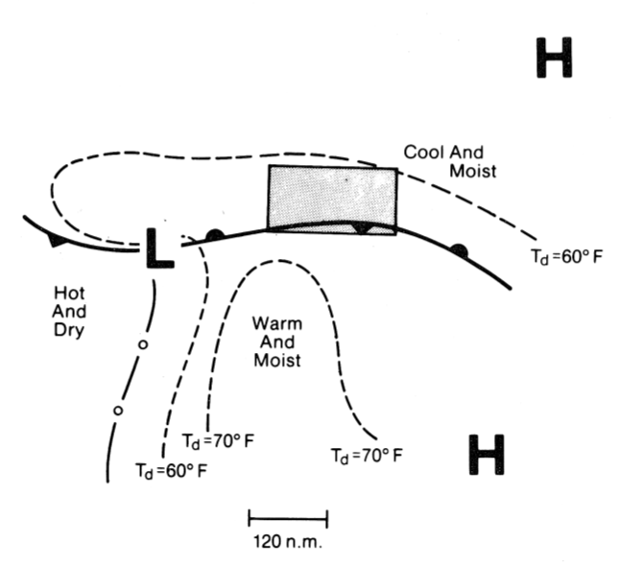
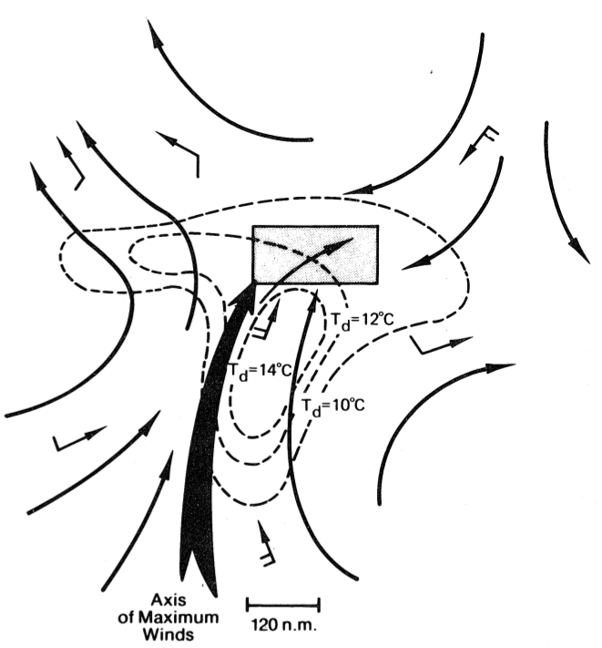
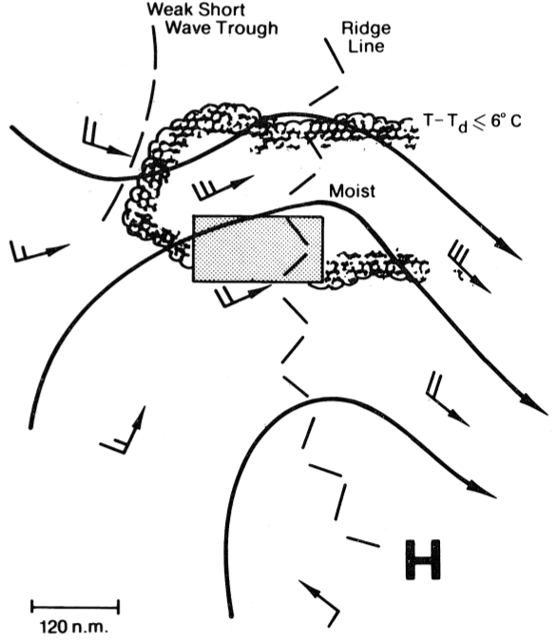
Favorable Environments for Heavy Rain
Maddox et al. (1979): “Frontal” type flash flood pattern
Surface
850 hPa
3
500 hPa

Slide 7
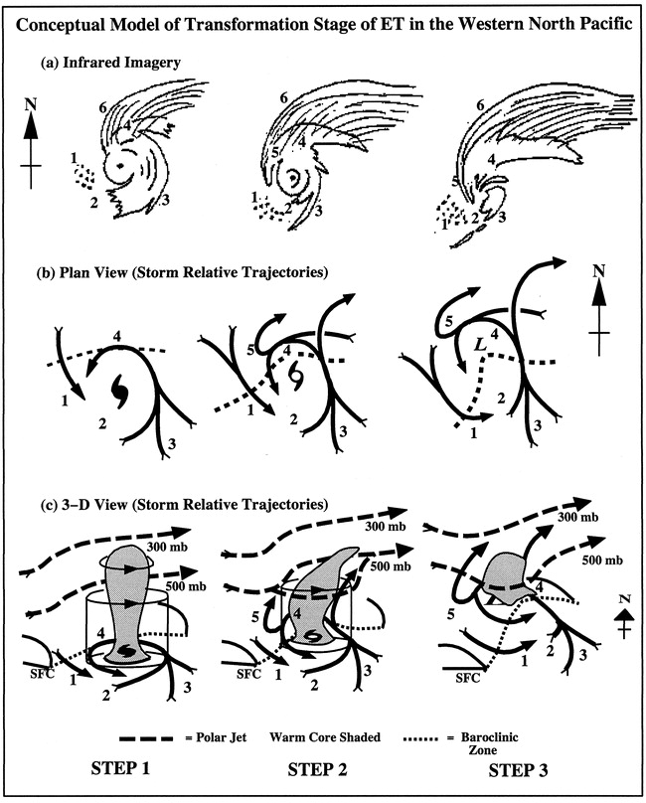
Role of the TC: Linkage to Extratropical Transition
Moisture transport on eastern flank of TC circulation
Forcing associated with frontogenesis and warm-air advection as TC circulation interacts with baroclinic zone (e.g., Klein et al. 2000; Harr and Elsberry 2000; Atallah and Bosart 2003)
Diabatic outflow associated with TC strengthens jet streak and enhance upper-level vorticity gradients (e.g., Bosart and Lackmann 1995; Atallah and Bosart 2003; Atallah et al. 2007)
Source: Klein et al. (2000)

Slide 8
Data and Methods
PRE identification criteria:
Deep tropical moisture associated with the TC advected from the TC by the lower-/middle-tropospheric flow into PRE region
Radar reflectivity values ≥ 35 dBZ for at least 6 h.
Average rainfall rate ≥ 100 mm (24 h)⁻¹ over duration of the PRE
Must be a clear horizontal separation between the PRE and the TC rain shield.
PREs during 1988–2008 identified using:
National base reflectivity radar mosaics (cases during 1995–2008)
1° GFS analyses and 2.5° NCEP–NCAR reanalysis data
NCDC Hourly Precipitation Dataset
NPVU quantitative precipitation estimates (QPE)
Unified Precipiation Dataset

Slide 9
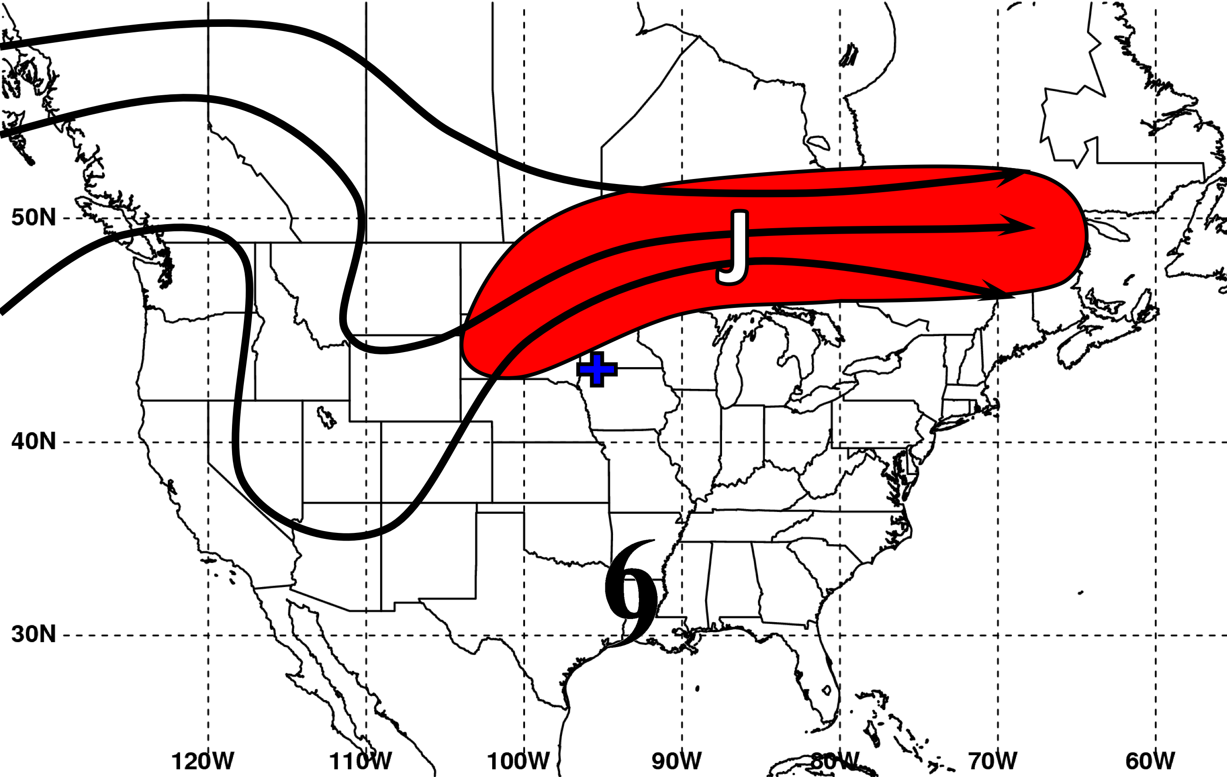
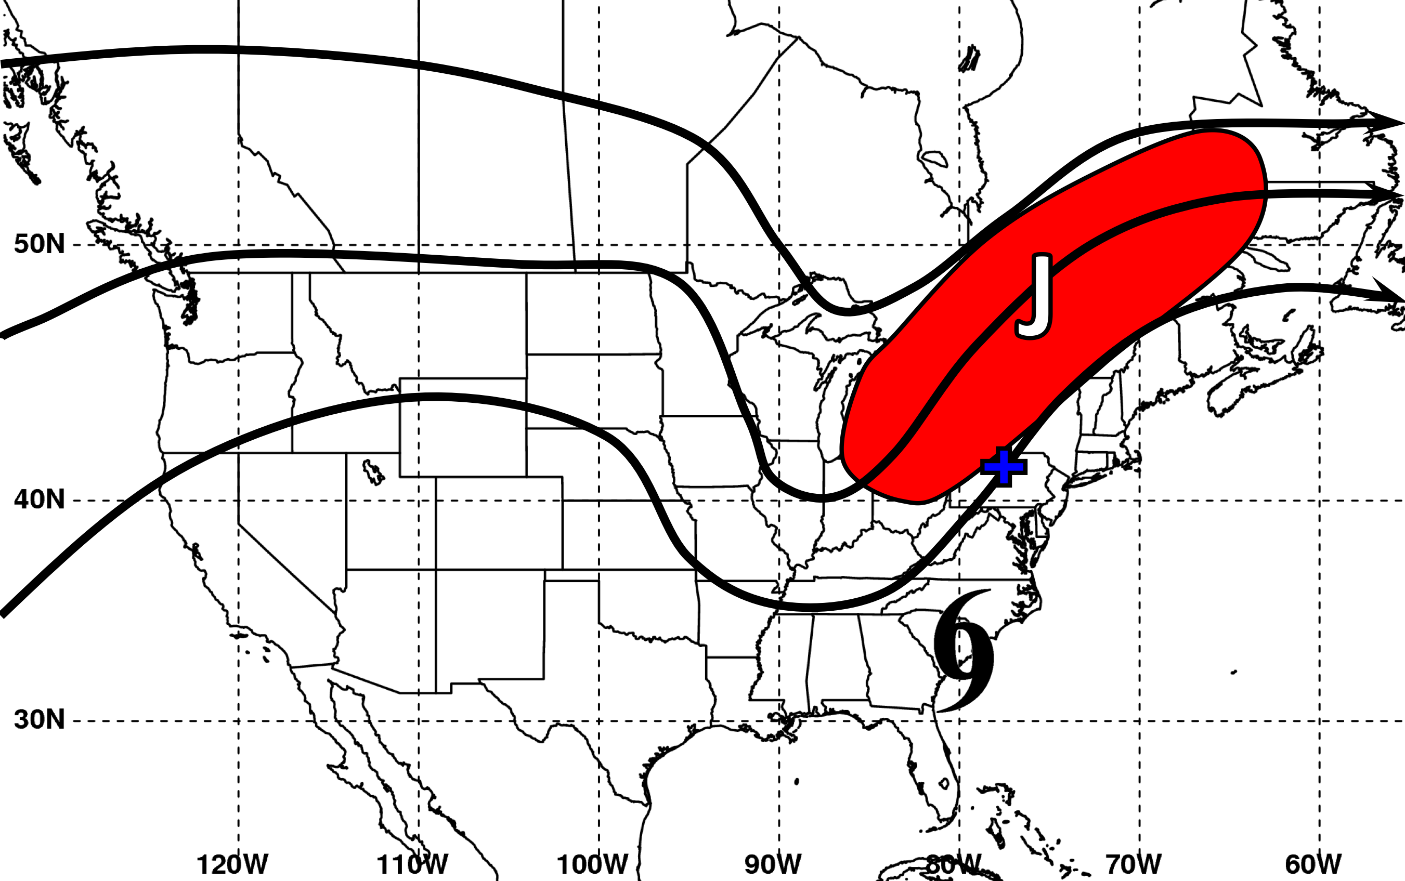
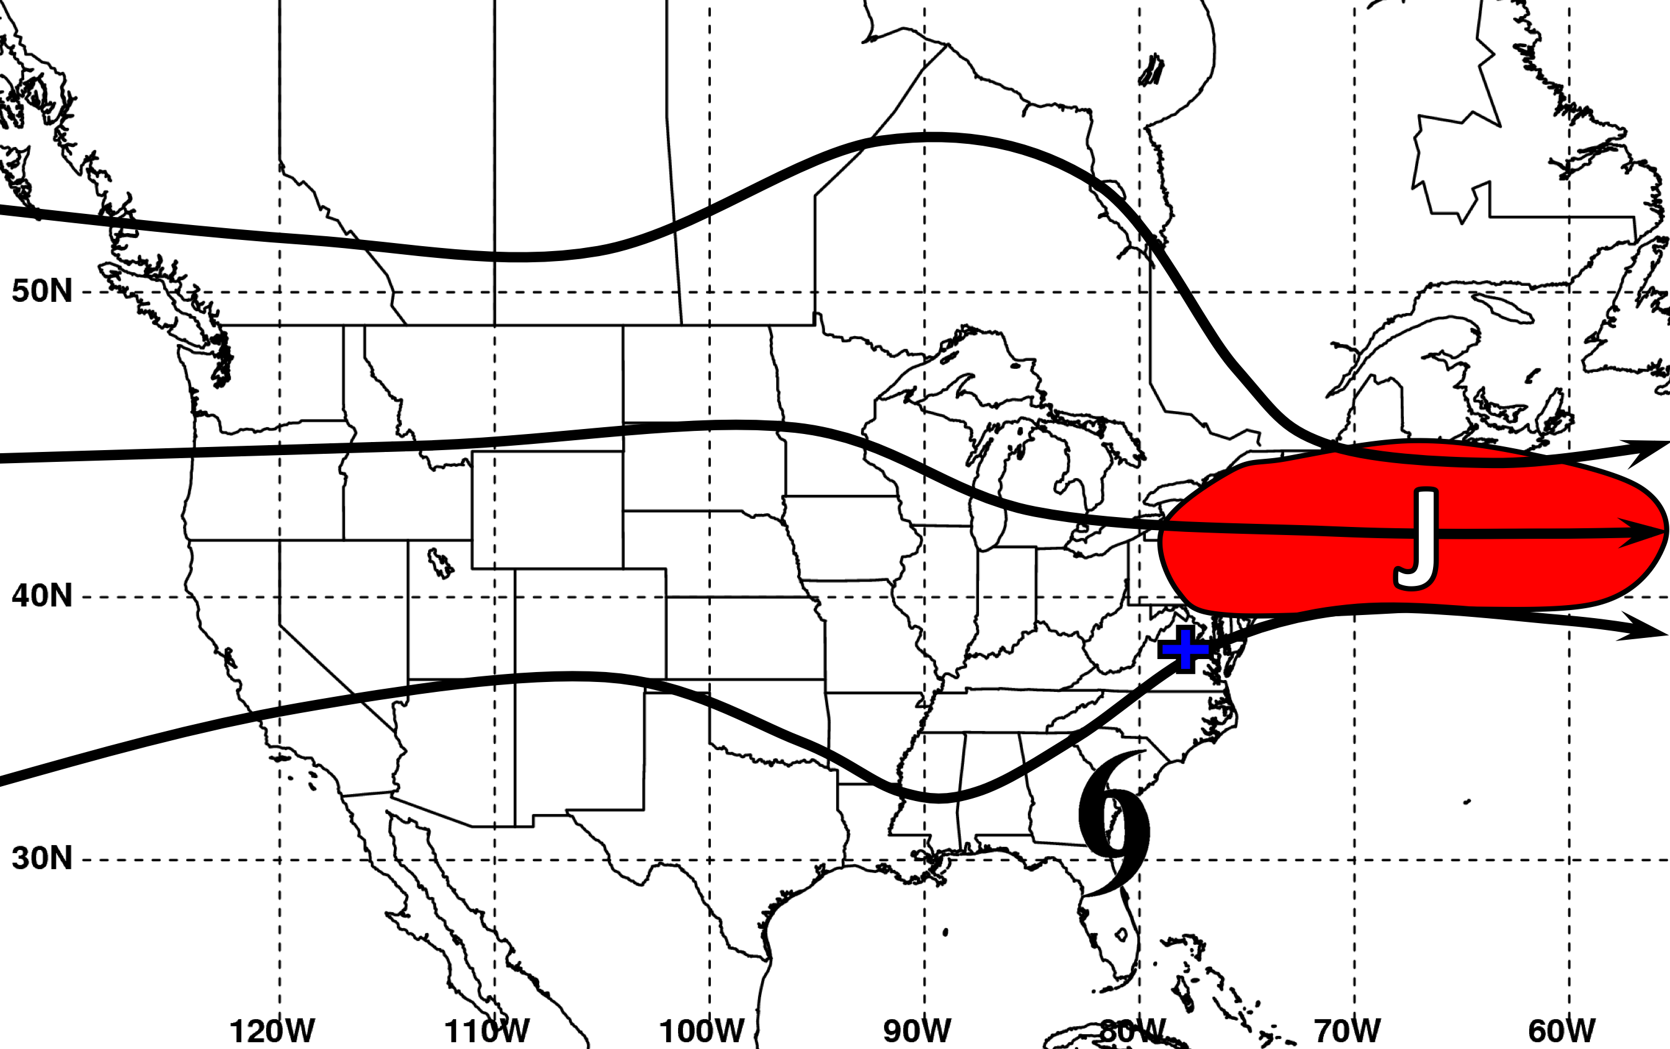
PRE Stratification Scheme
“Jet in Ridge”
“Southwesterly Jet”
“Downstream Confluence”

Slide 10
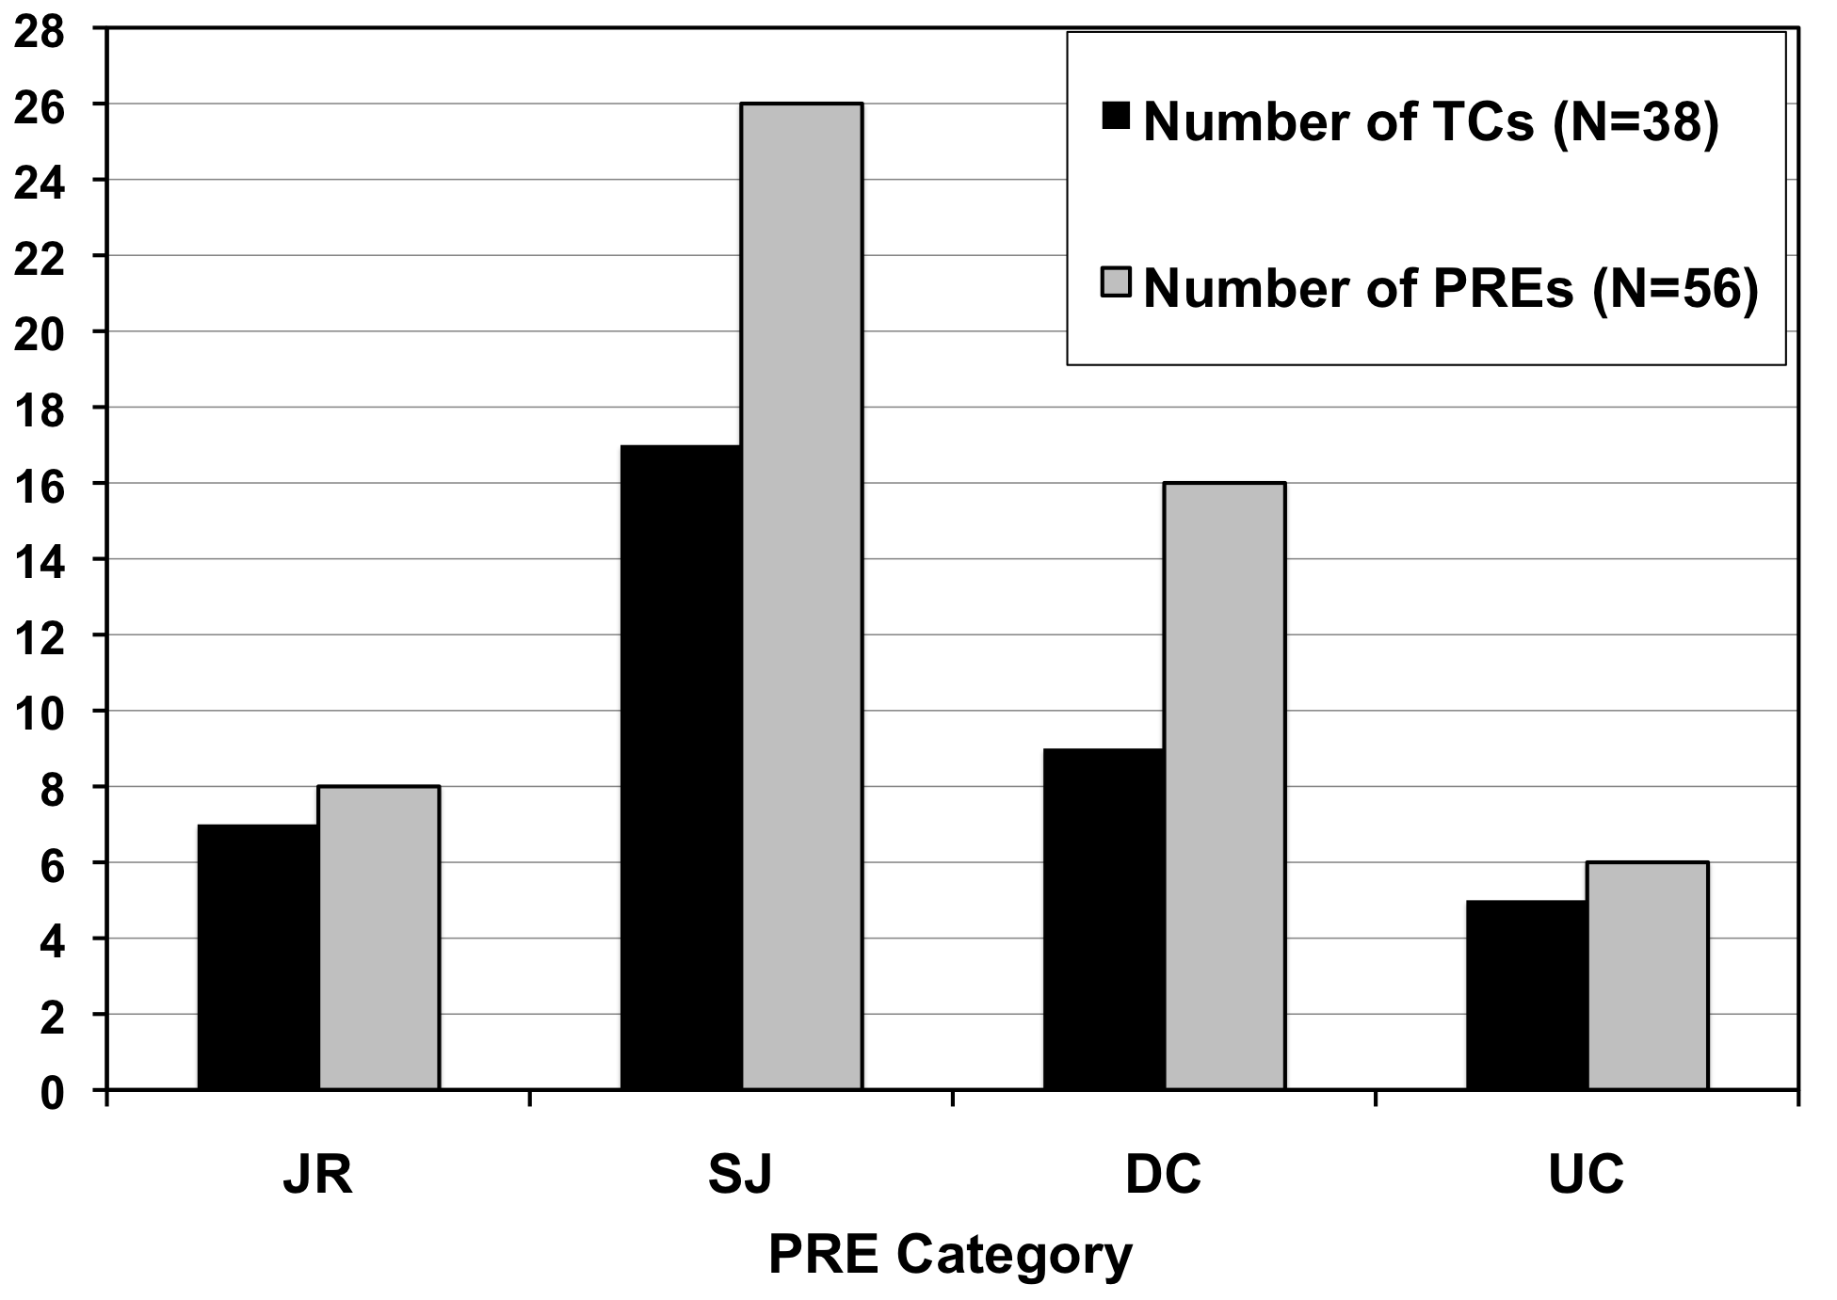
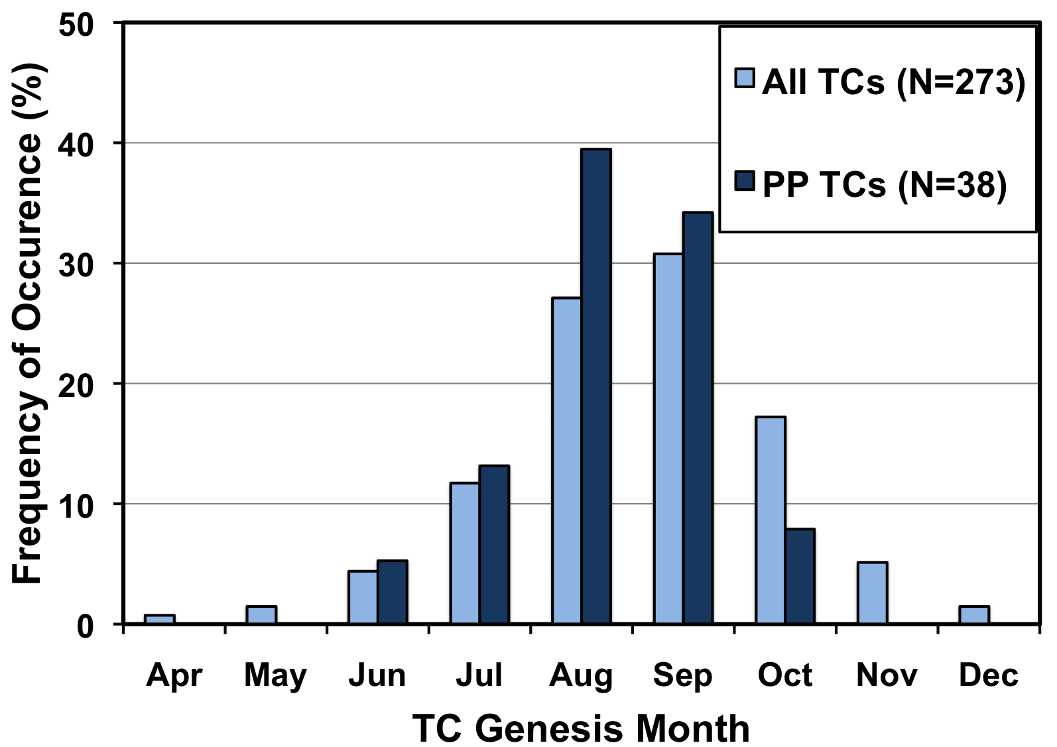
Summary of PREs 1988−2008
Jet in Ridge
Southwesterly Jet
Downstream Confluence
Unclassifiable

Slide 11
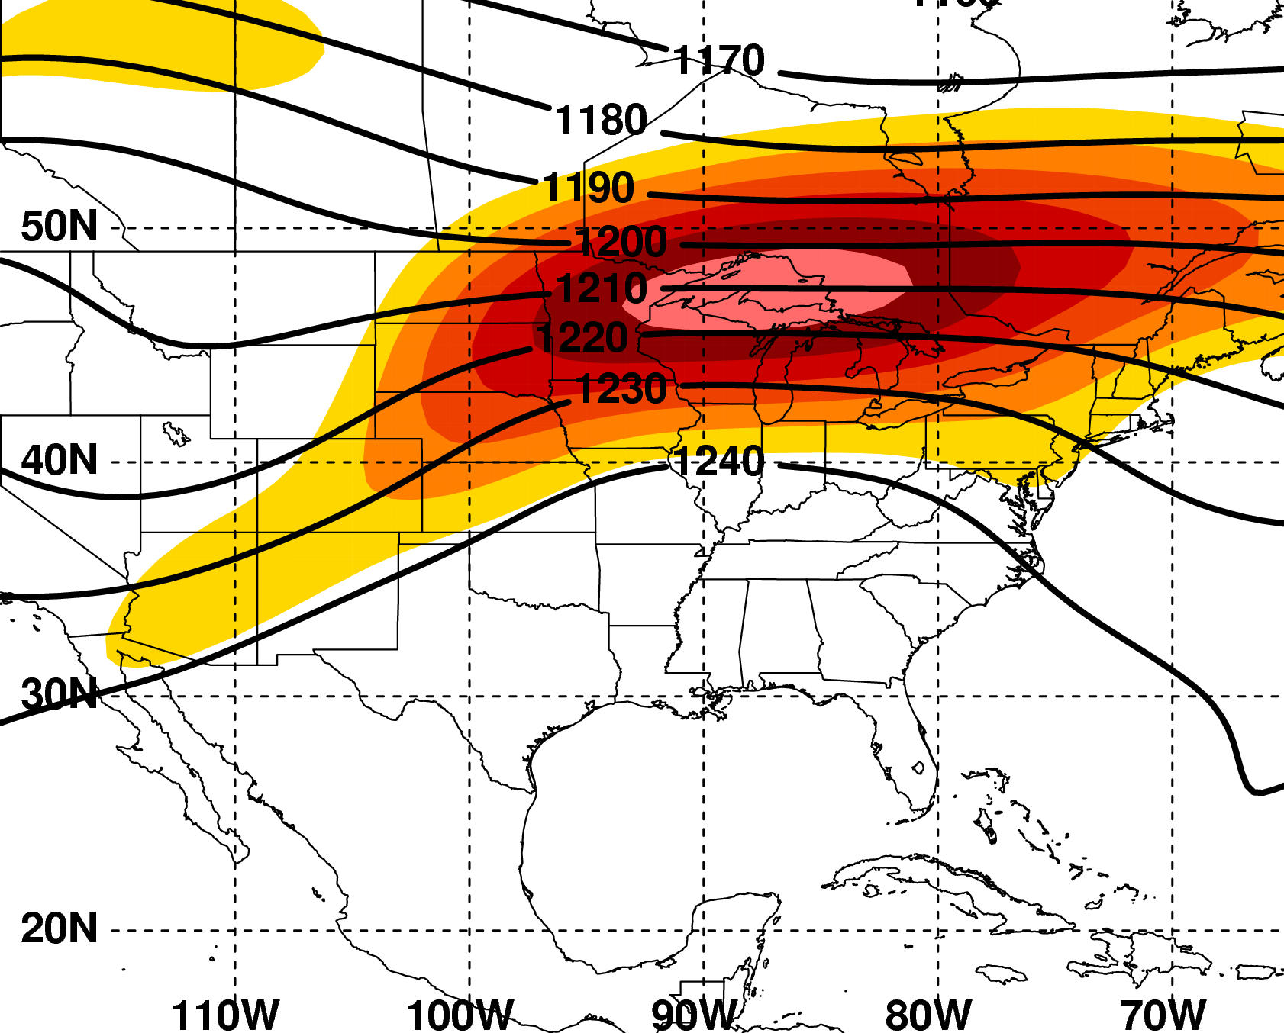
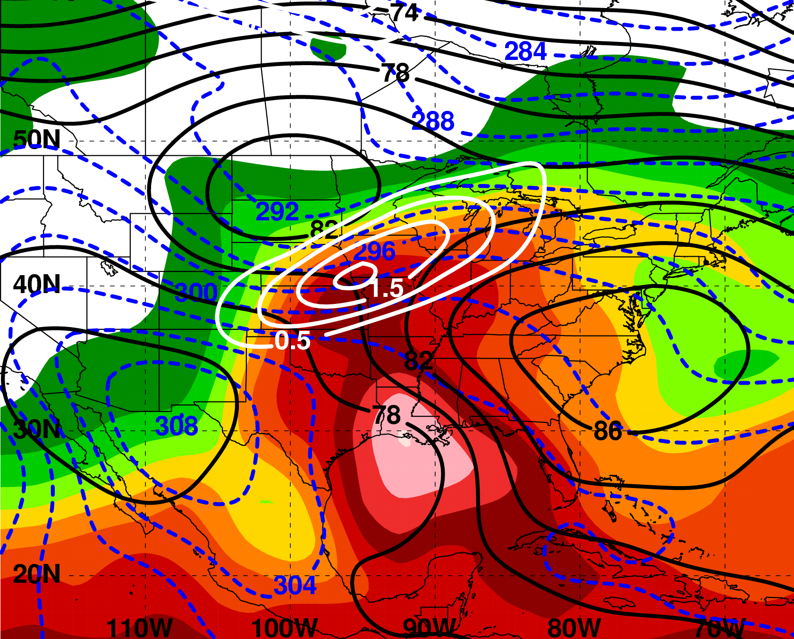
PRE-relative Composites
N = 7
“Jet in Ridge” Category
200 hPa
T−0 h
925 hPa
H
L
m s⁻¹
200 hPa Z (dam, black),
wind speed (m s⁻¹, shaded)
925 hPa Z (dam, black), θ (K, red), frontogenesis [10⁻¹ K (100 km)⁻¹ (3 h)⁻¹, white]; PW (mm, shaded)
2.5º NCEP–NCAR Reanalysis

Slide 12
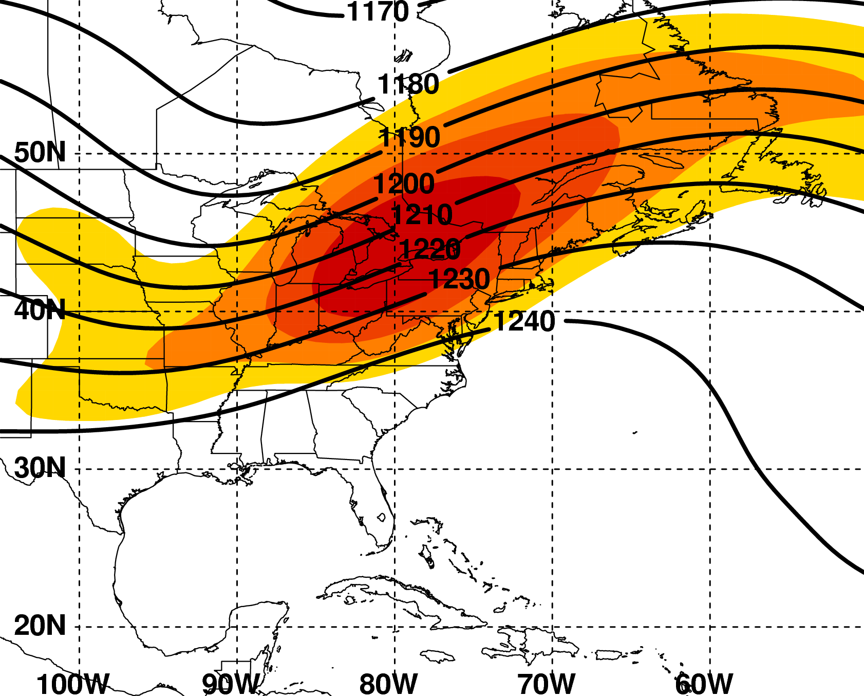
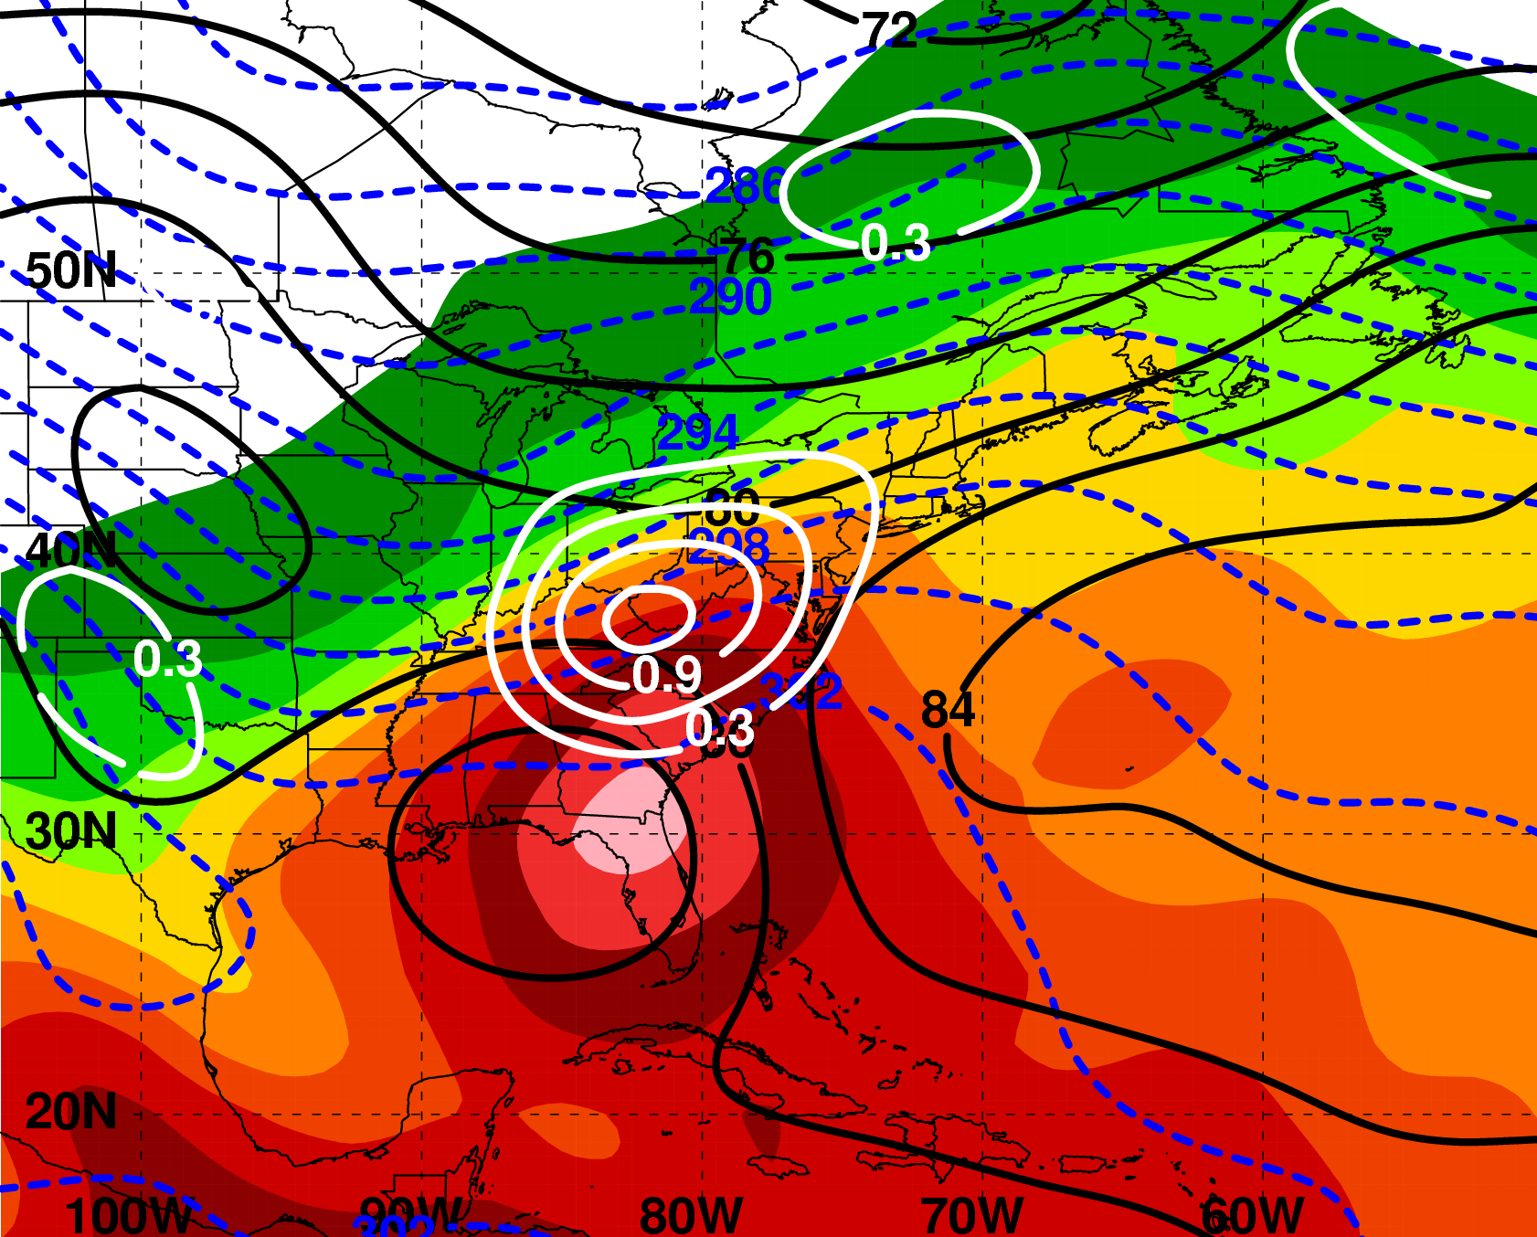
PRE-relative Composites
N = 17
“Southwesterly Jet” Category
200 hPa
T−0 h
925 hPa
H
200 hPa Z (dam, black),
wind speed (m s⁻¹, shaded)
925 hPa Z (dam, black), θ (K, red), frontogenesis [10⁻¹ K (100 km)⁻¹ (3 h)⁻¹, white]; PW (mm, shaded)
2.5º NCEP–NCAR Reanalysis
2.5º NCEP–NCAR Renalysis

Slide 13
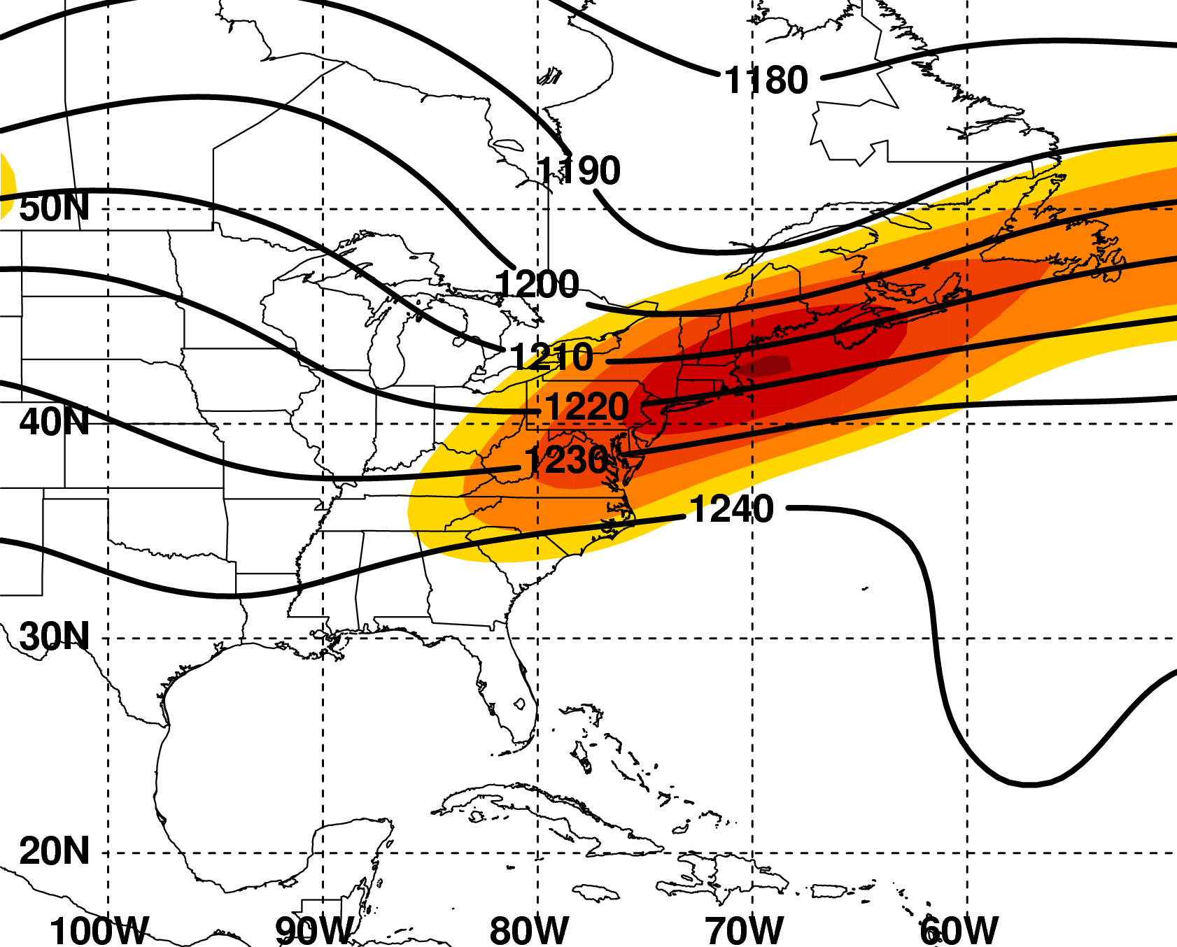
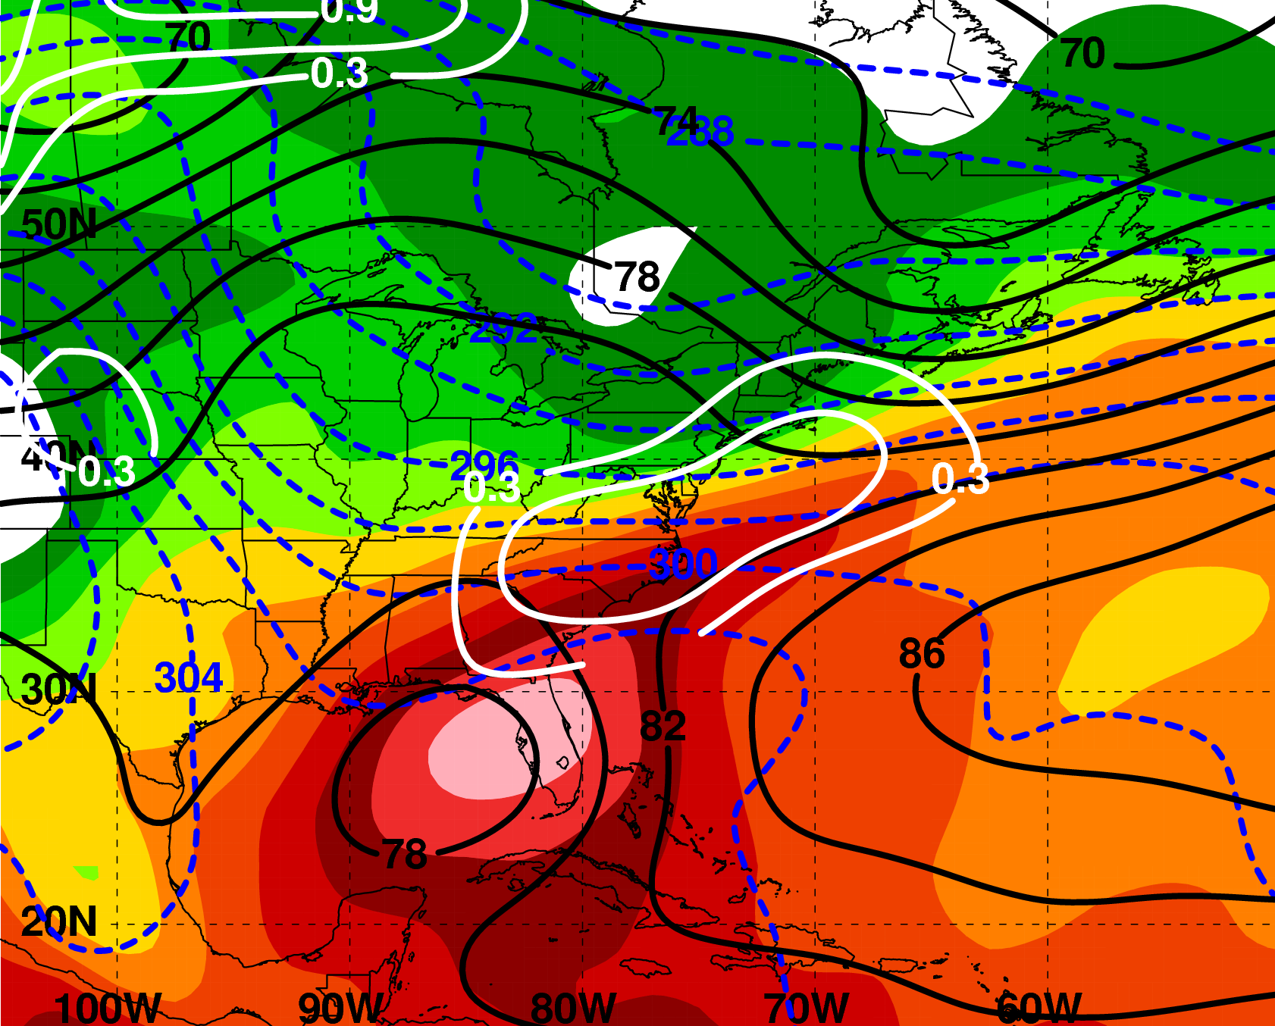
PRE-relative Composites
N = 9
“Downstream Confluence” Category
200 hPa
T−0 h
925 hPa
H
200 hPa Z (dam, black),
wind speed (m s⁻¹, shaded)
925 hPa Z (dam, black), θ (K, red), frontogenesis [10⁻¹ K (100 km)⁻¹ (3 h)⁻¹, white]; PW (mm, shaded)
2.5º NCEP–NCAR Reanalysis

Slide 14
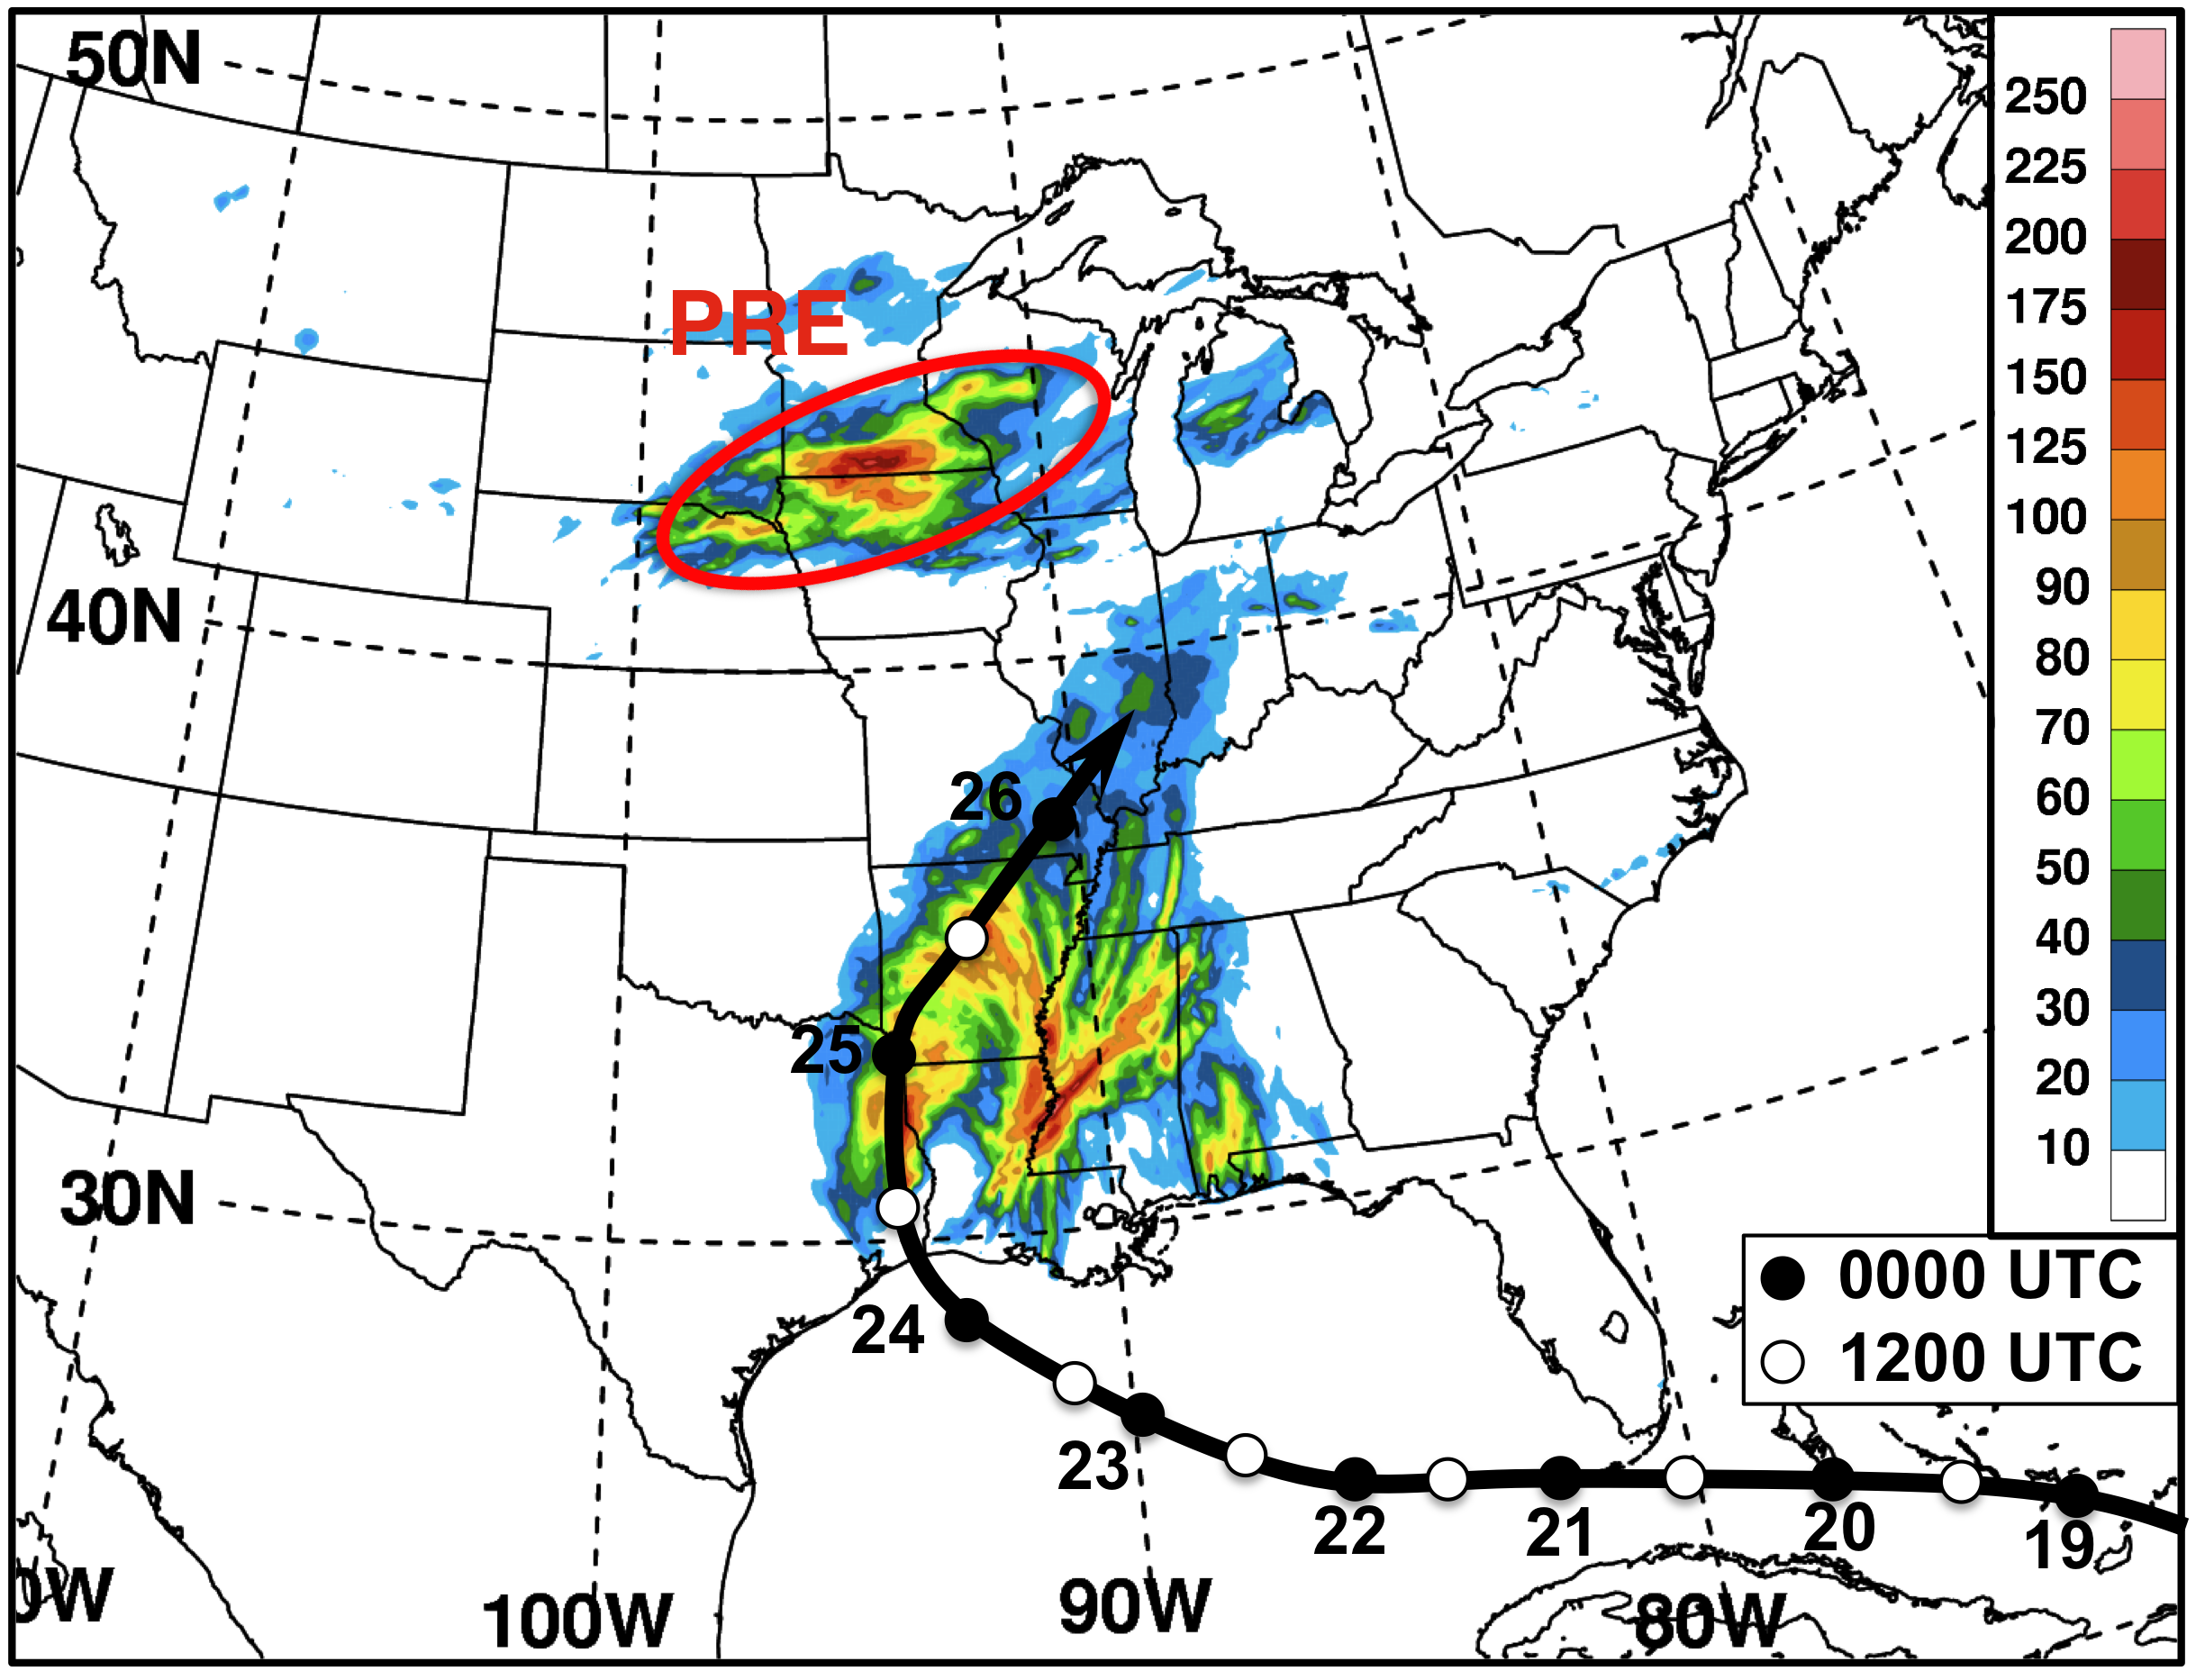
“Jet in Ridge” PRE associated with TC Rita 24–25 Sep 2005
1200 UTC 24 Sep – 0000 UTC 26 Sep 2005 total precipitation (mm, shaded)
generated from the NPVU QPE dataset

Slide 15
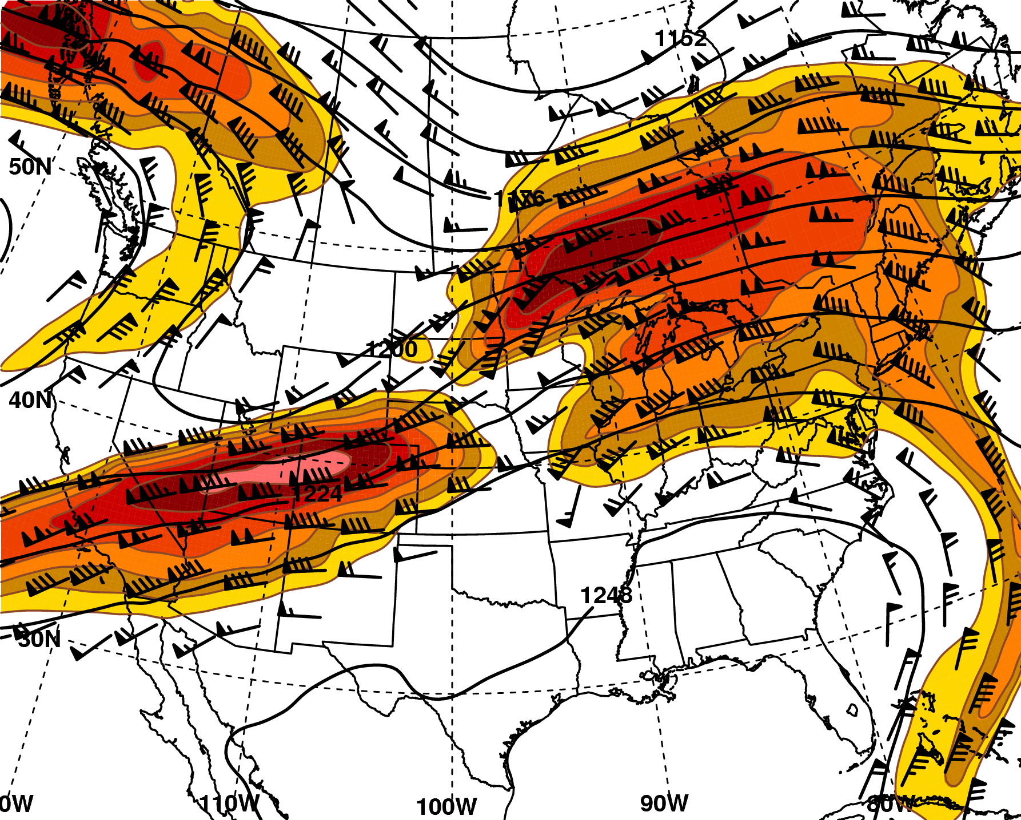
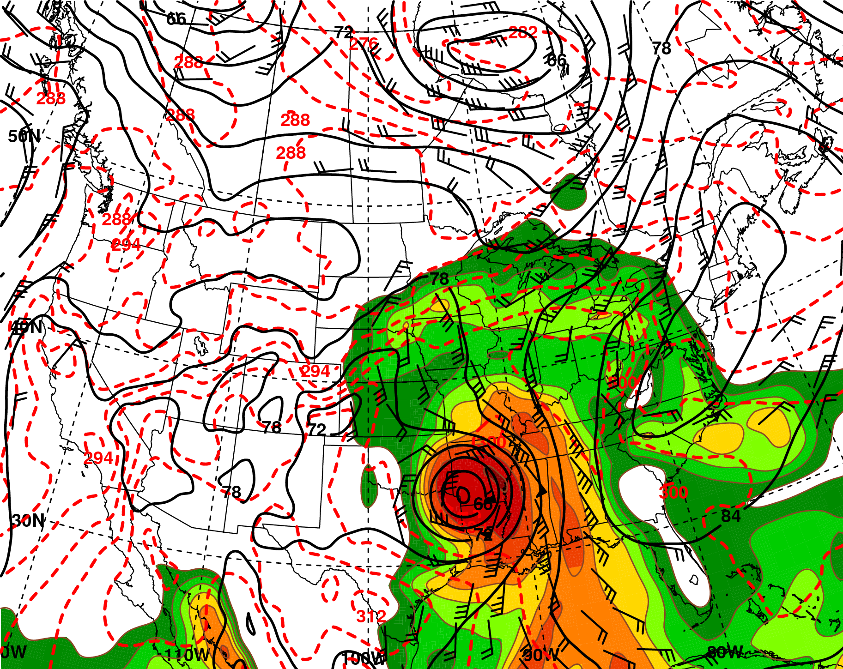
Synoptic Environment
0600 UTC 25 Sep 2005
200 hPa
925 hPa
H
L
mm
200 hPa Z (dam, black),
wind barbs (≥ 25 m s⁻¹, barbs),
wind speed (m s⁻¹, shaded)
925 hPa Z (dam, black),
θ (K, red), wind barbs (≥ 10 m s⁻¹, barbs); PW (mm, shaded)
1º GFS Analysis

Slide 16
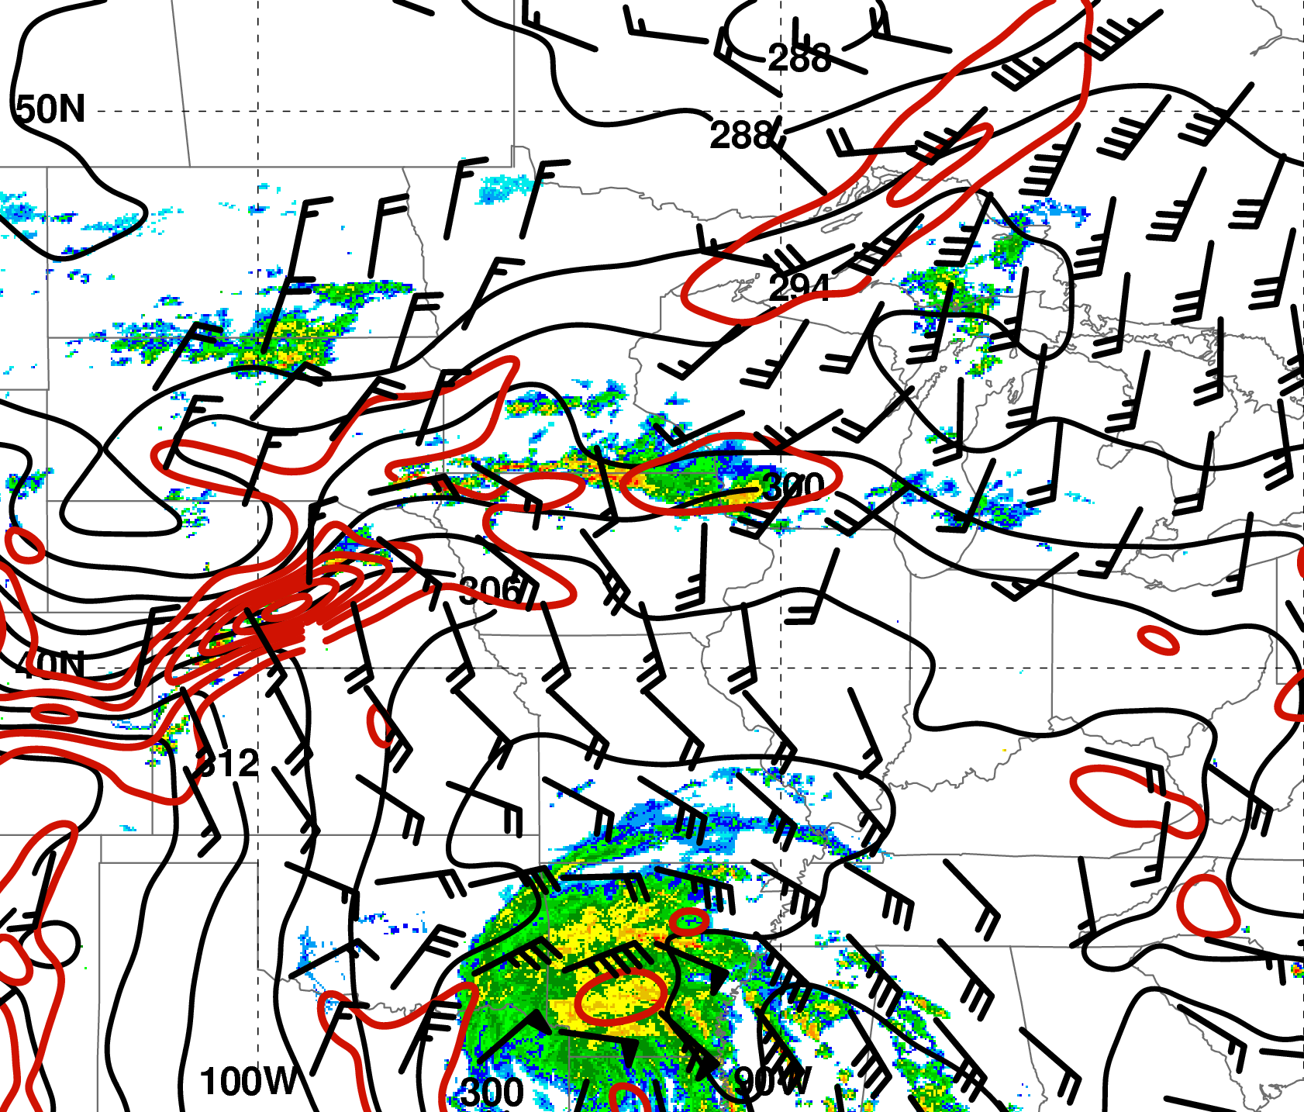
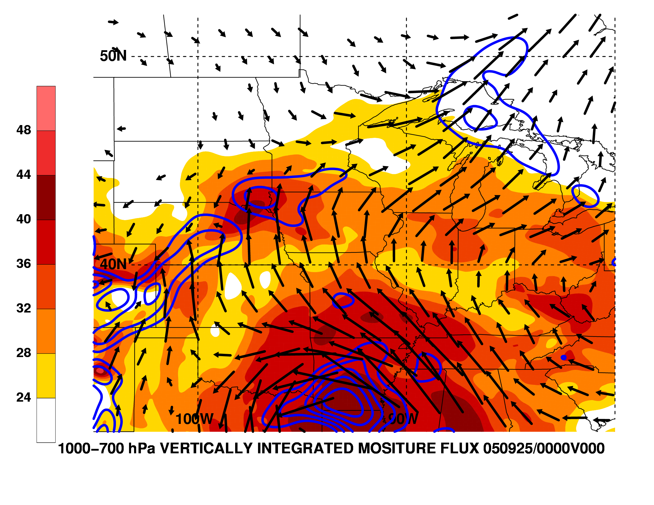
Mechanisms for Heavy Rainfall
0000 UTC 25 Sep
WSI NOWRAD reflectivity (dBZ);
925-hPa wind barbs (≥ 10 m s⁻¹),
θ (K, black),
frontogenesis [K (100 km)⁻¹ (3 h)⁻¹, red]
1000−700-hPa PW (mm, shaded),
vertically integrated WV
flux vectors (kg m⁻¹ s⁻¹),
WV flux convergence (10⁻³ kg m⁻² s⁻¹, blue),
20 km RUC Analysis

Slide 17
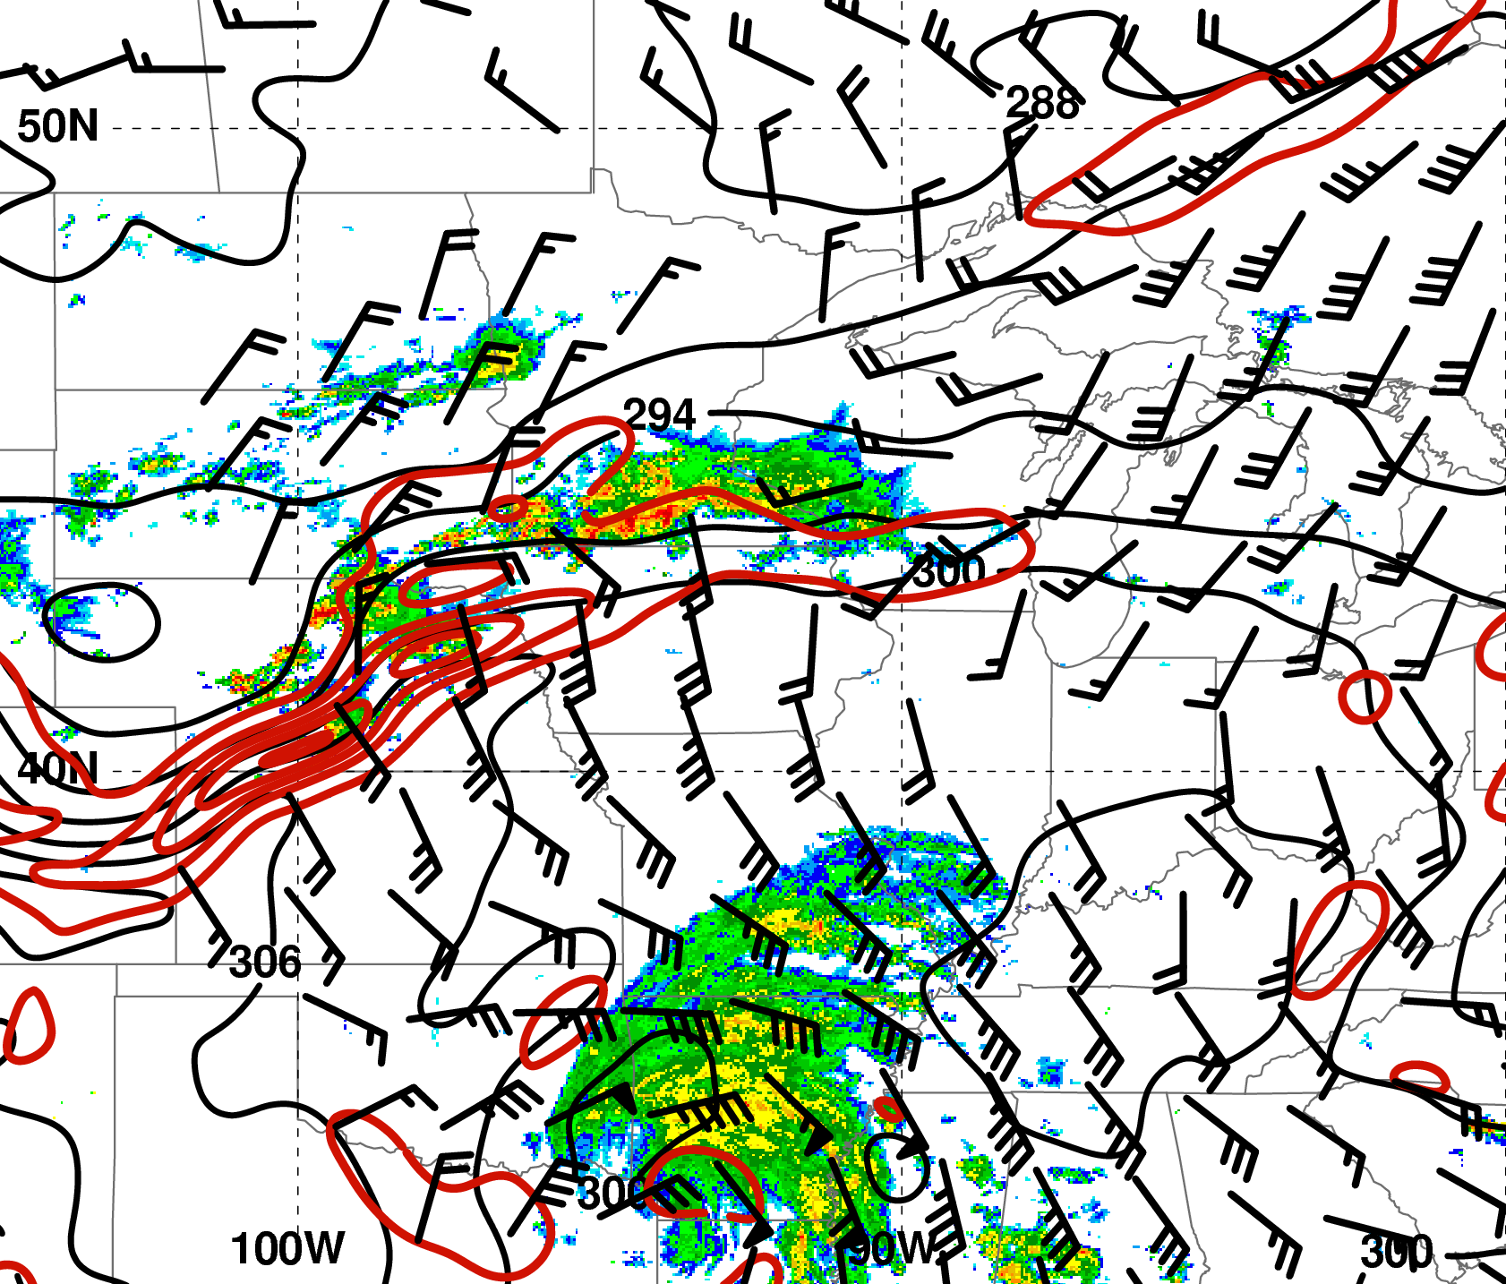
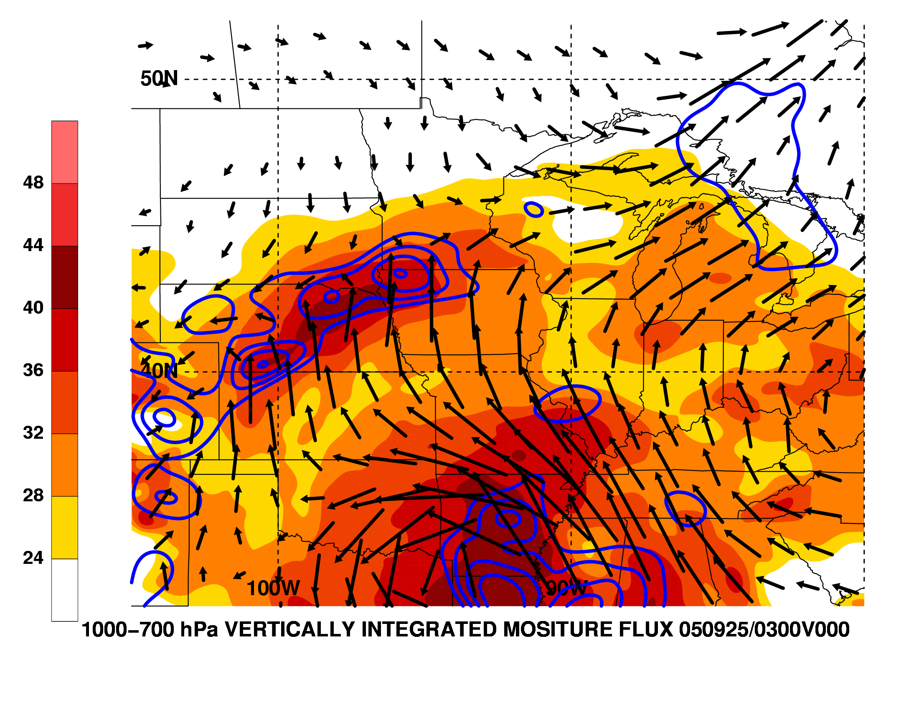
Mechanisms for Heavy Rainfall
0300 UTC 25 Sep
WSI NOWRAD reflectivity (dBZ);
925-hPa wind barbs (≥ 10 m s⁻¹),
θ (K, black),
frontogenesis [K (100 km)⁻¹ (3 h)⁻¹, red]
1000−700-hPa PW (mm, shaded),
vertically integrated WV
flux vectors (kg m⁻¹ s⁻¹),
WV flux convergence (10⁻³ kg m⁻² s⁻¹, blue),
20 km RUC Analysis

Slide 18
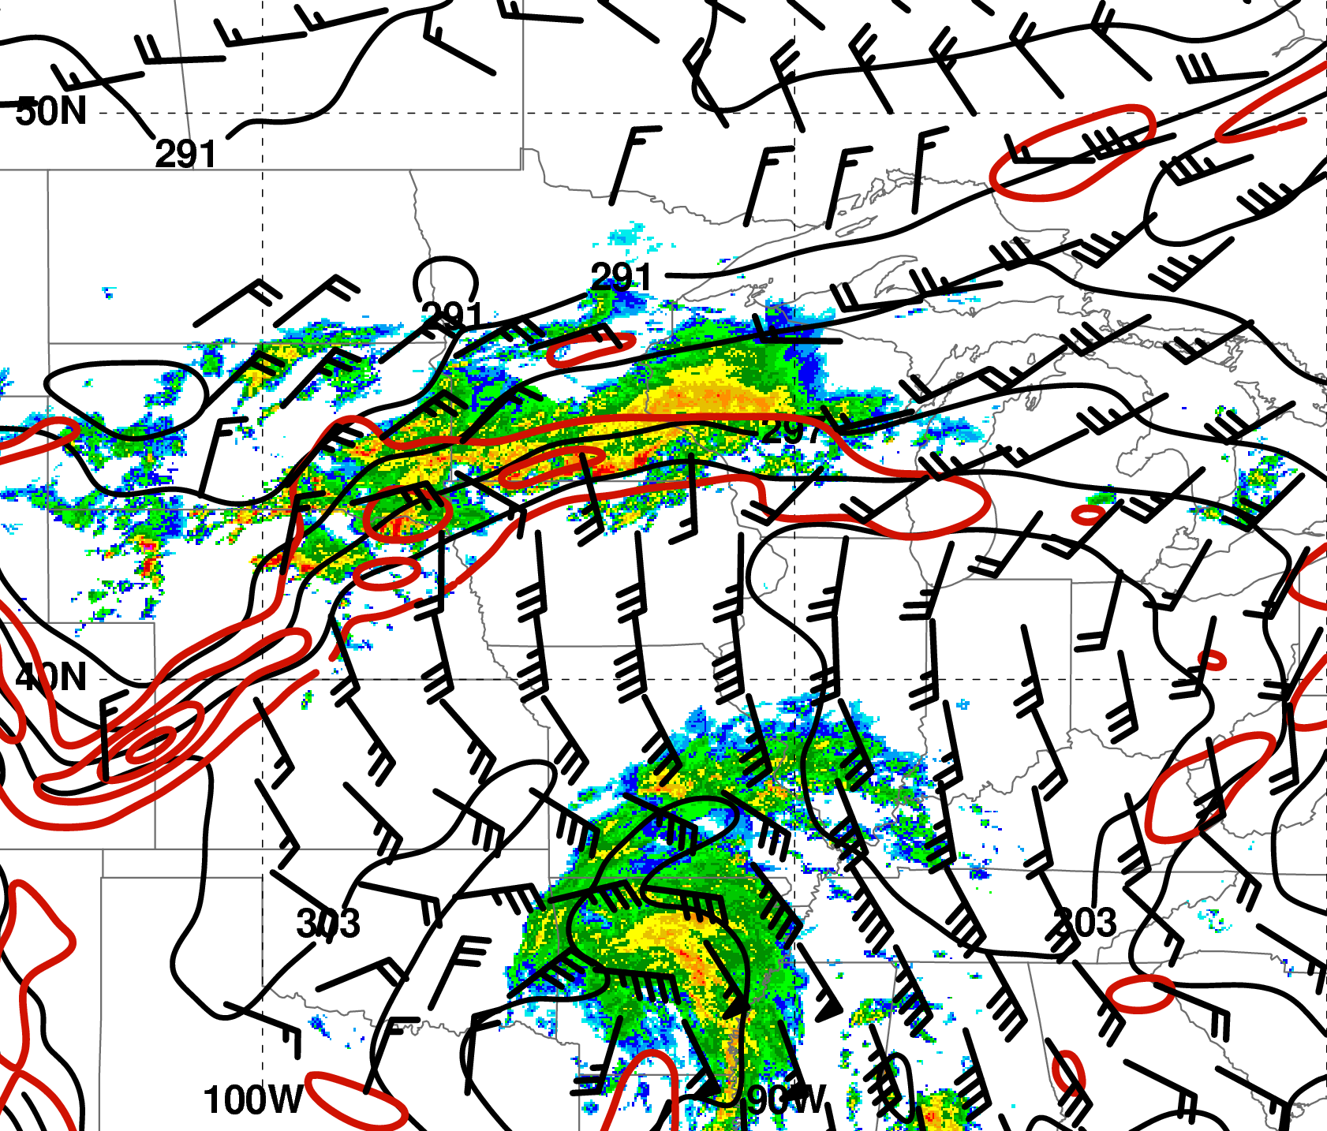
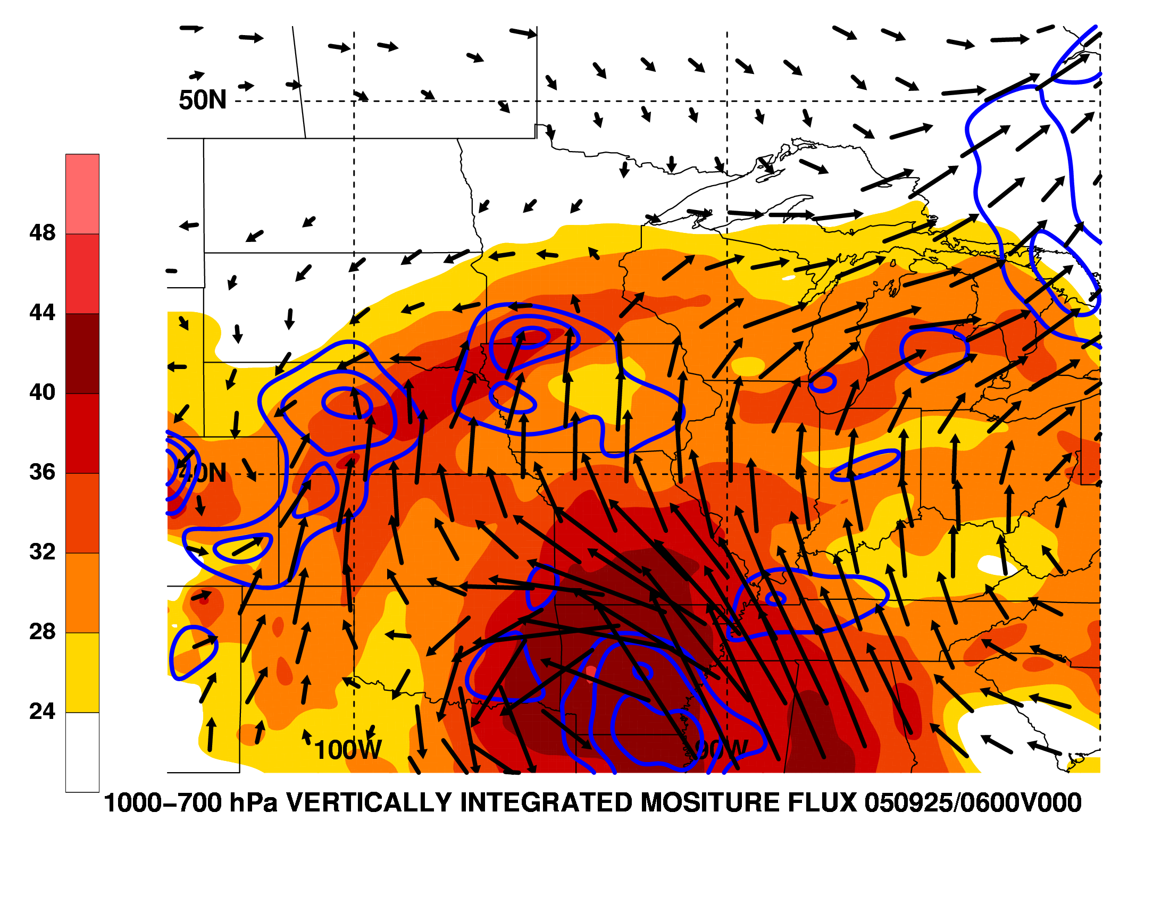
Mechanisms for Heavy Rainfall
0600 UTC 25 Sep
Midlevel shear
WSI NOWRAD reflectivity (dBZ);
925-hPa wind barbs (≥ 10 m s⁻¹),
θ (K, black),
frontogenesis [K (100 km)⁻¹ (3 h)⁻¹, red]
1000−700-hPa PW (mm, shaded),
vertically integrated WV
flux vectors (kg m⁻¹ s⁻¹),
WV flux convergence (10⁻³ kg m⁻² s⁻¹, blue),
20 km RUC Analysis

Slide 19
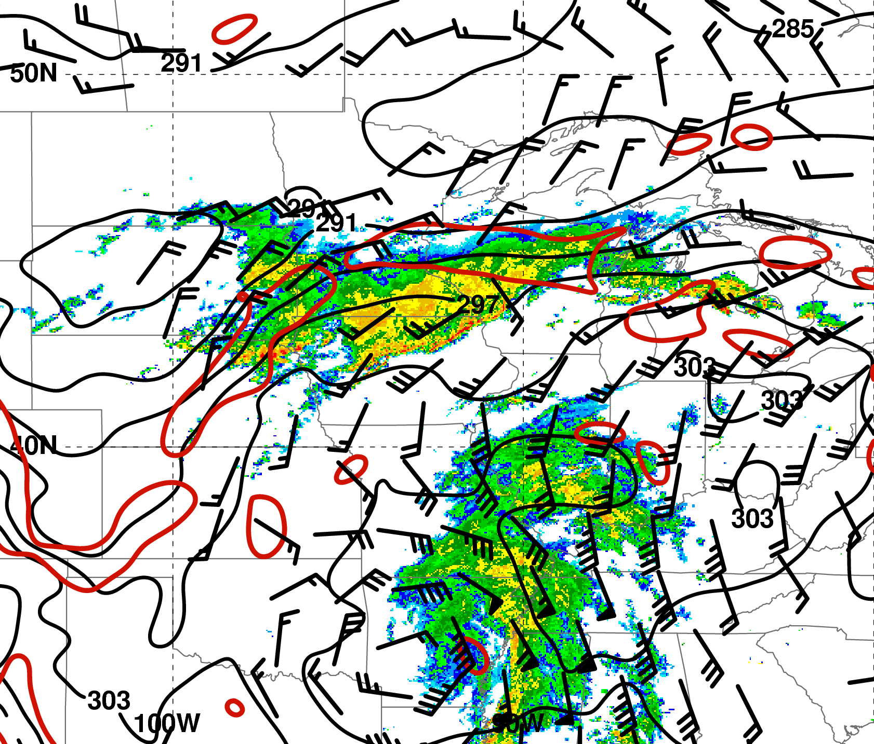
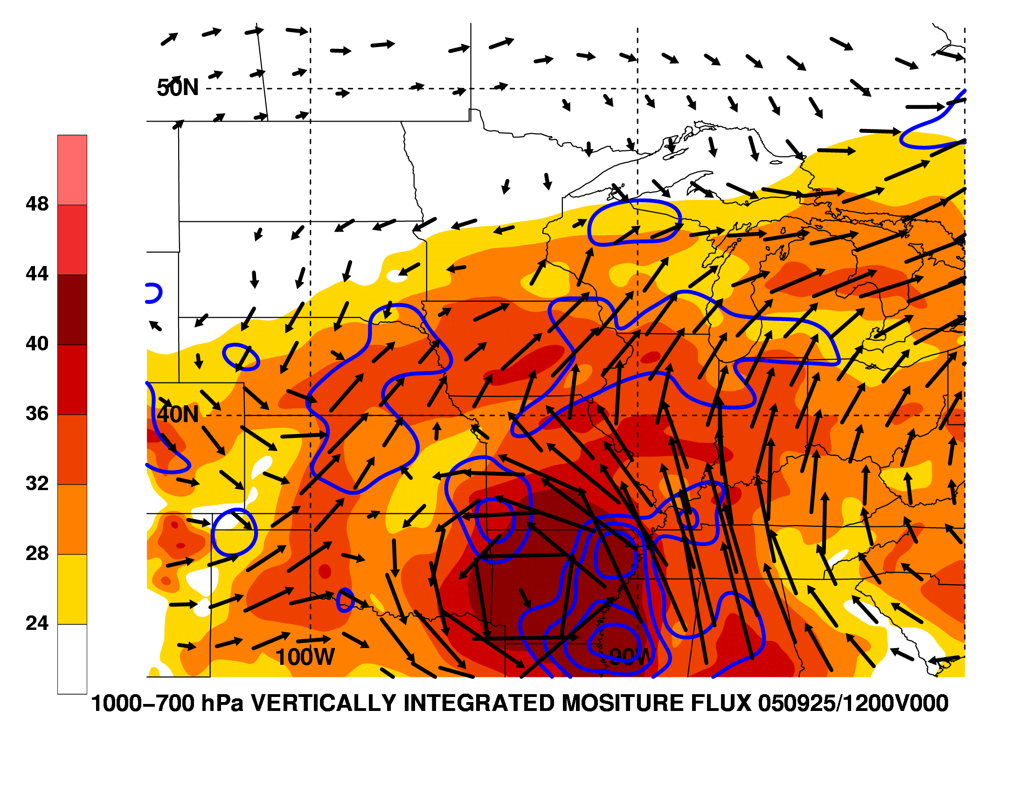
Mechanisms for Heavy Rainfall
1200 UTC 25 Sep
WSI NOWRAD reflectivity (dBZ);
925-hPa wind barbs (≥ 10 m s⁻¹),
θ (K, black),
frontogenesis [K (100 km)⁻¹ (3 h)⁻¹, red]
1000−700-hPa PW (mm, shaded),
vertically integrated WV
flux vectors (kg m⁻¹ s⁻¹),
WV flux convergence (10⁻³ kg m⁻² s⁻¹, blue),
20 km RUC Analysis

Slide 20
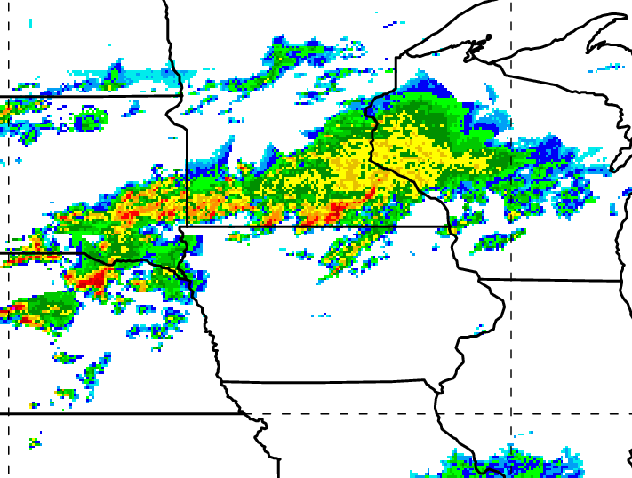
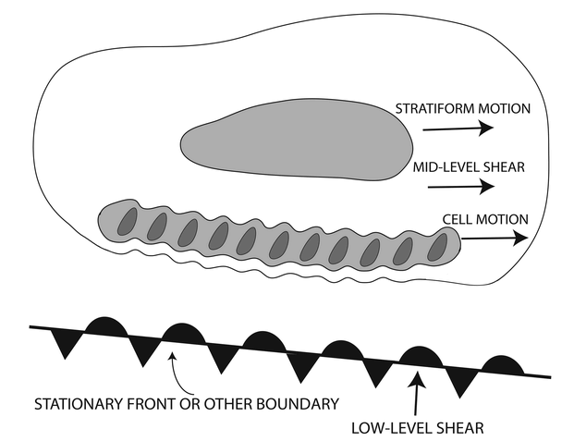
Linkage to Extreme-rain-producing MCSs
“Training line/adjoining stratiform” MCS
from Schumacher and Johnson (2005)
PRE associated with TC Rita
Midlevel shear
Low-level shear
05Z
25 Sep

Slide 21
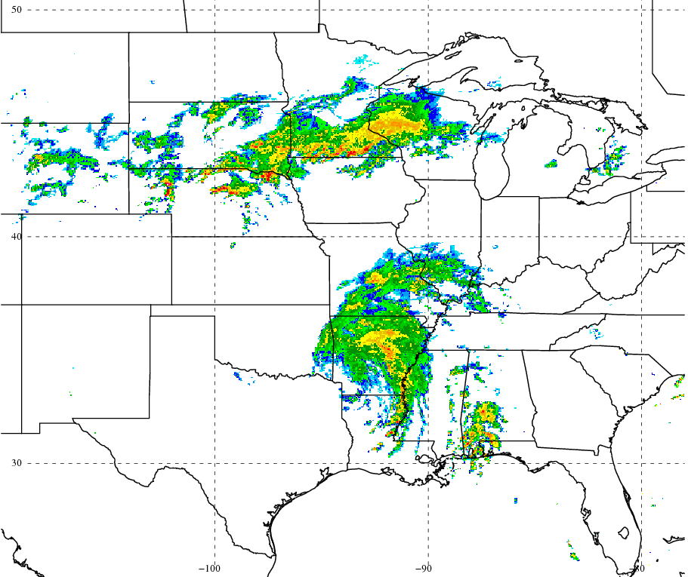
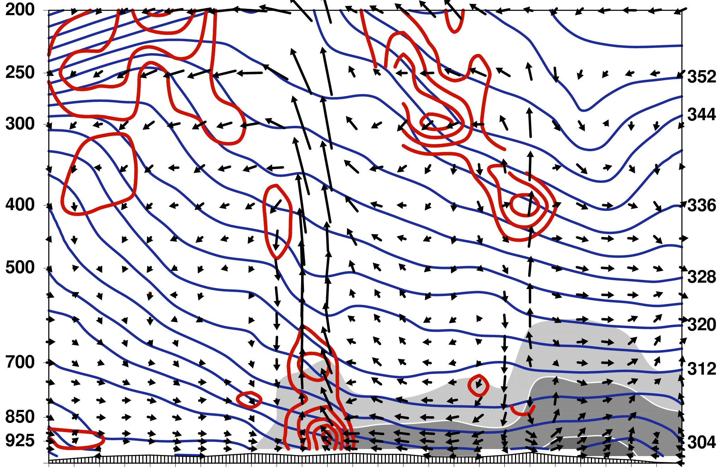
Cross-section View
0600 UTC 25 Sep
J
Pressure (hPa)
Potential
Temperature (K)
N
S
Tangential circulation vectors, θ (K, blue contours),
frontogenesis [K (100 km)⁻¹ (3 h)⁻¹, red contours],
mixing ratio (g kg⁻¹, gray shading)
1º GFS Analysis

Slide 22
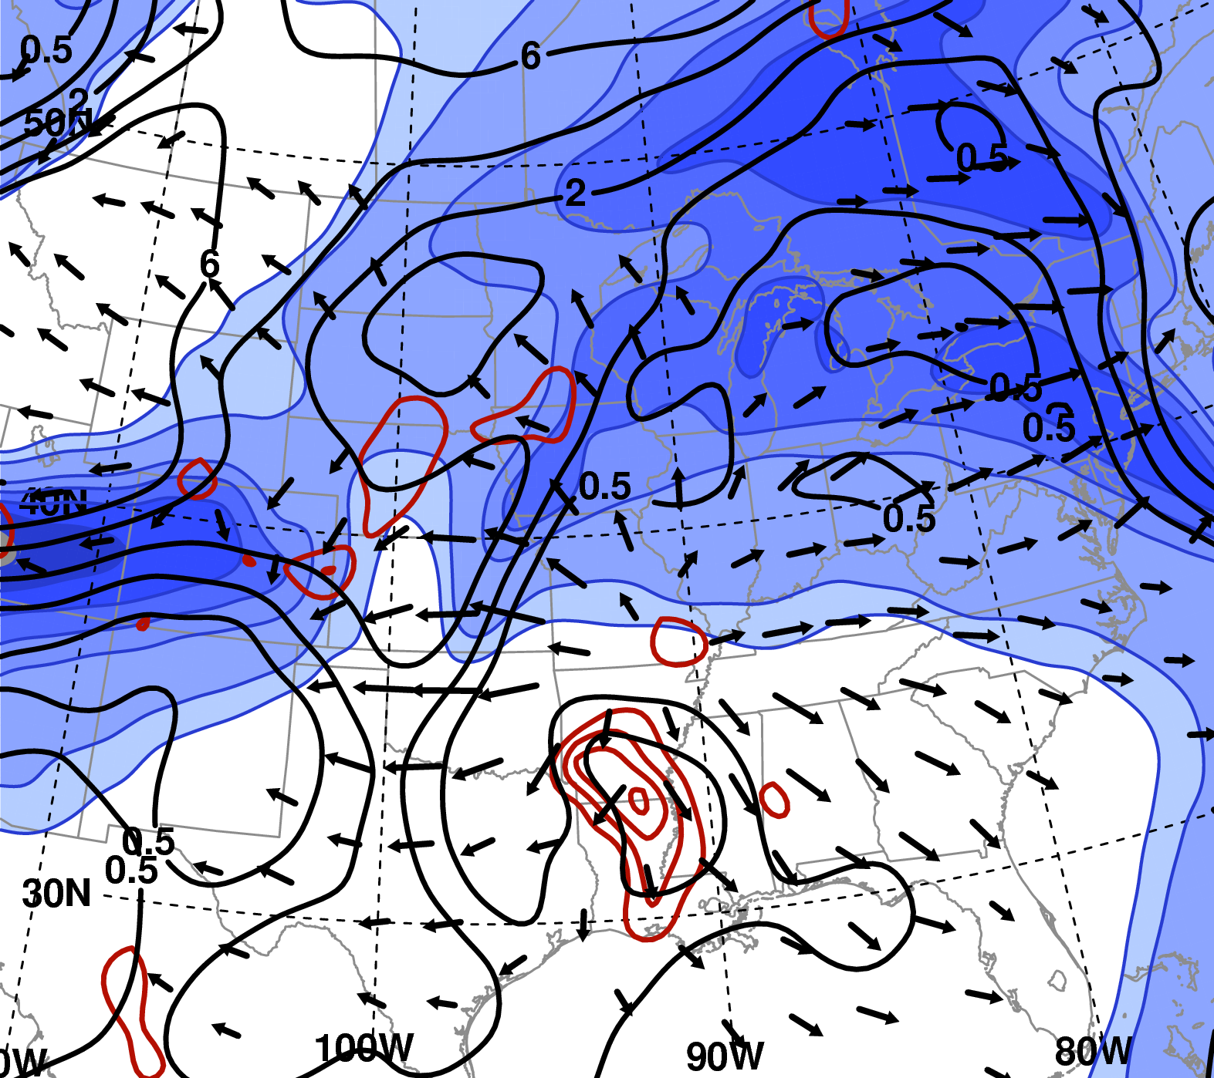
Impact of Diabatic Heating on the Upper-level Flow
0000 UTC 25 Sep
IR Satellite Imagery
1º GFS Analysis
200-hPa irrotational wind (m s⁻¹), wind speed (m s⁻¹, shaded); 250−200-hPa hPa potential vorticity (PVU, black); 700-hPa ascent (10⁻³ hPa s⁻¹, red)

Slide 23
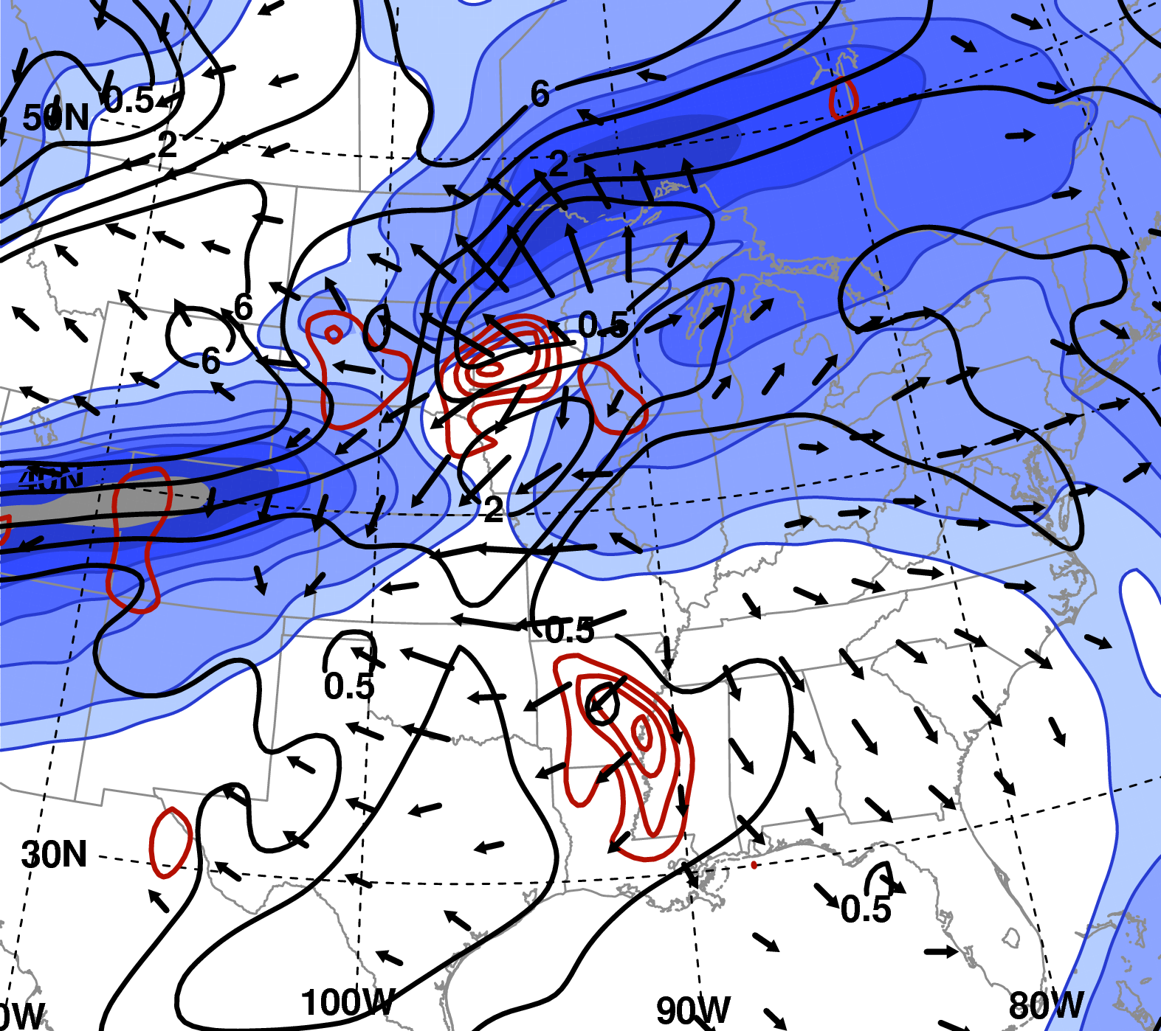
Impact of Diabatic Heating on the Upper-level Flow
0600 UTC 25 Sep
IR Satellite Imagery
1º GFS Analysis
200-hPa irrotational wind (m s⁻¹), wind speed (m s⁻¹, shaded); 250−200-hPa hPa potential vorticity (PVU, black); 700-hPa ascent (10⁻³ hPa s⁻¹, red)

Slide 24
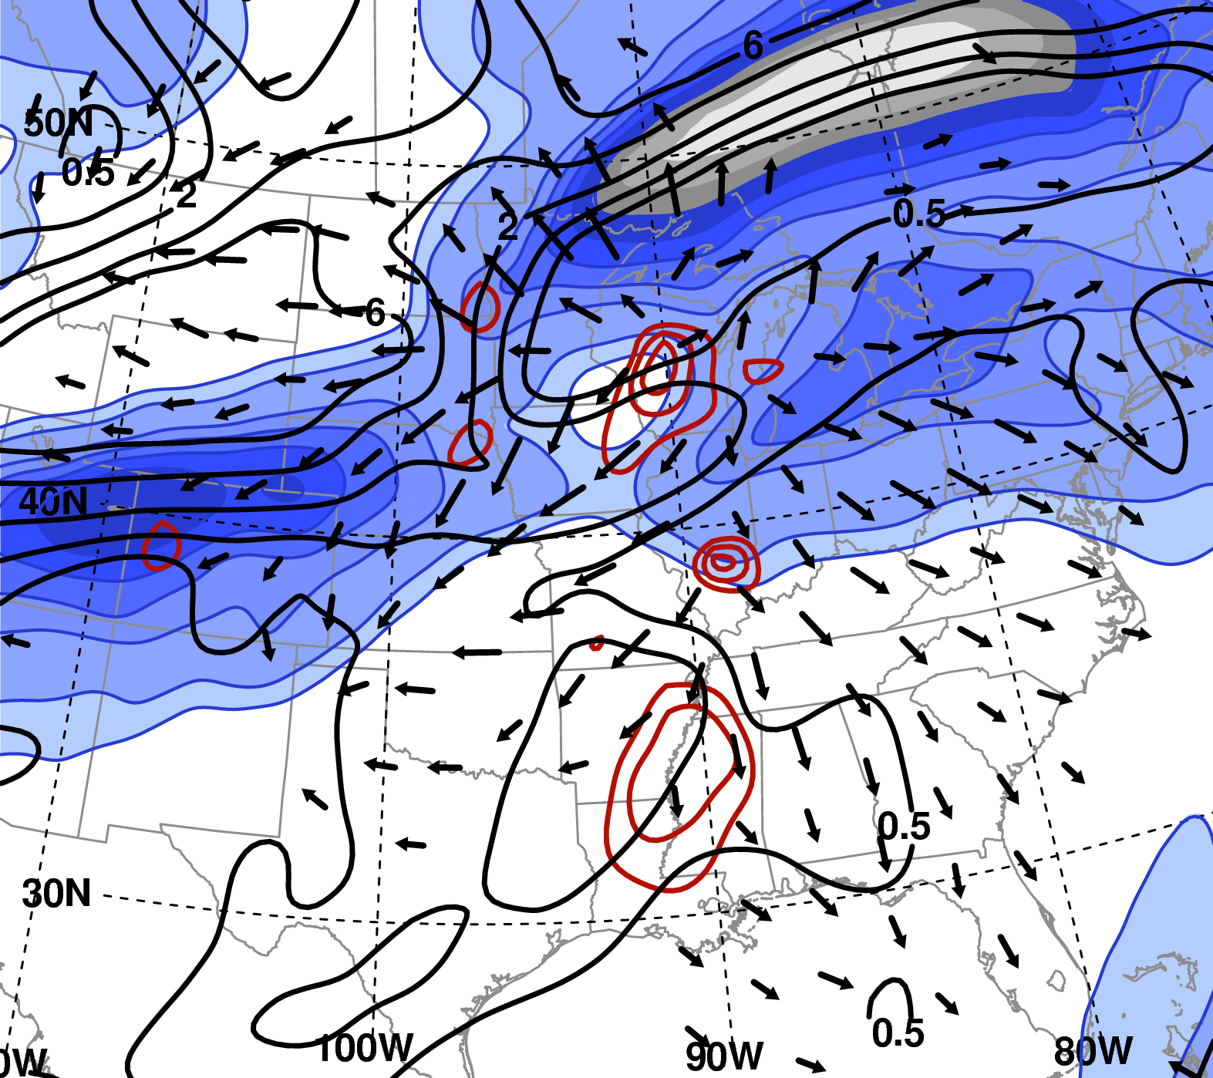
Impact of Diabatic Heating on the Upper-level Flow
1200 UTC 25 Sep
IR Satellite Imagery
1º GFS Analysis
200-hPa irrotational wind (m s⁻¹), wind speed (m s⁻¹, shaded); 250−200-hPa hPa potential vorticity (PVU, black); 700-hPa ascent (10⁻³ hPa s⁻¹, red)

Slide 25
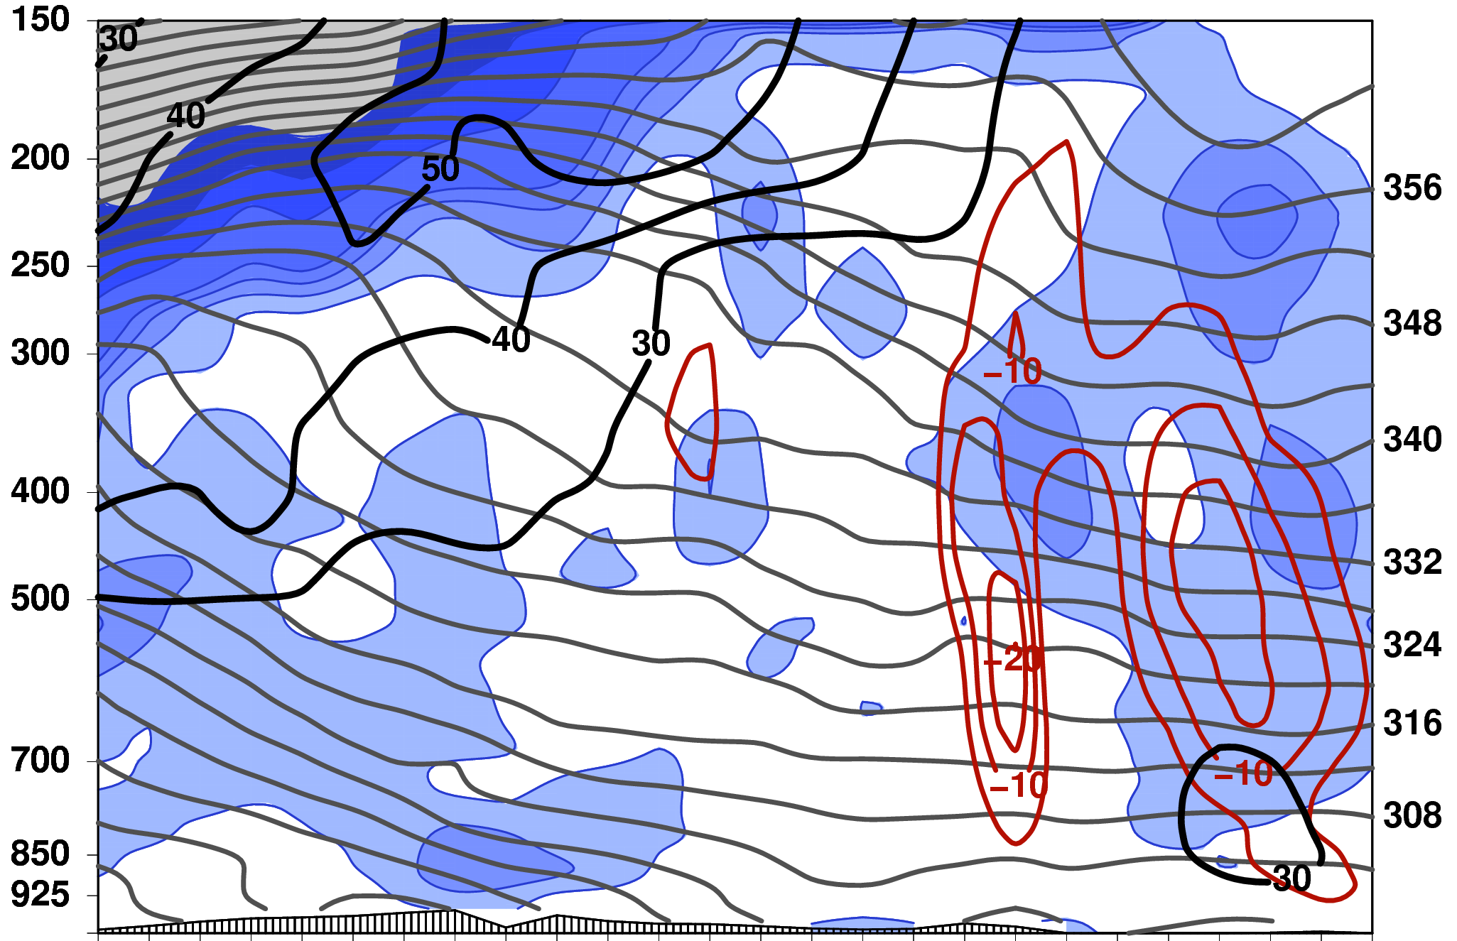
Cross-section view
0000 UTC 25 Sep
Pressure (hPa)
Potential
Temperature (K)
N
S
Upward vertical velocity (10⁻³ hPa s⁻¹, red), wind speed (m s⁻¹, black),
PV (PVU, shaded), θ (K, gray),
1º GFS Analysis

Slide 26
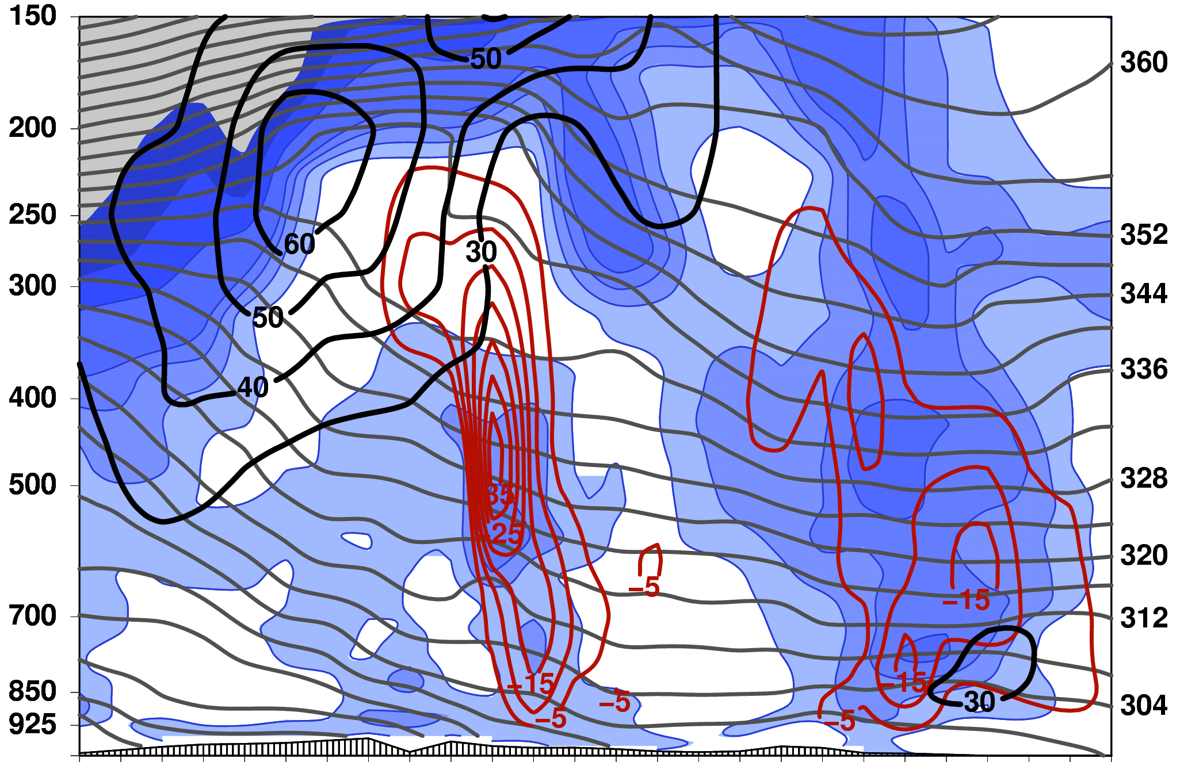
Cross-section view
1200 UTC 25 Sep
Pressure (hPa)
Potential
Temperature (K)
N
S
Upward vertical velocity (10⁻³ hPa s⁻¹, red), wind speed (m s⁻¹, black),
PV (PVU, shaded), θ (K, gray),
1º GFS Analysis

Slide 27
Concluding Remarks
Rita case summary
PRE developed as a continuous, strong poleward moisture surge from Rita impinged upon a quasi-stationary baroclinic zone
Low-level convergence and deformation at the terminus of the southerly low-level jet likely enhanced frontogenesis along baroclinic zone

Slide 28
Concluding Remarks
Rita case summary
Upper-/middle-level diabatic heating in the mature PRE likely eroded PV aloft, promoted frontogenesis, and contributed to the strengthening of upper-level jet
Long-lived PRE was likely due to a combination of:
Continuous moisture transport towards and moisture convergence within PRE region
Quasi-stationary region of low-level frontogenesis
Diabatically enhanced ageostrophic circulation within upper-level jet entrance region

Slide 29
Concluding Remarks
Key features of composites
PREs preferentially develop in the equatorward entrance region of an upper-level jet streak
Strong low-level flow downstream of TC oriented perpendicular to baroclinic zone → warm-air advection, frontogenesis, moisture transport from the TC
Categories differ with regard to:
Position of TC relative to key features (i.e., trough, jet, ridge, baroclinic zone)
Amplitude and configuration of upper-/middle-tropospheric flow
Degree of the interaction between the TC and the midlatitude flow

Slide 30
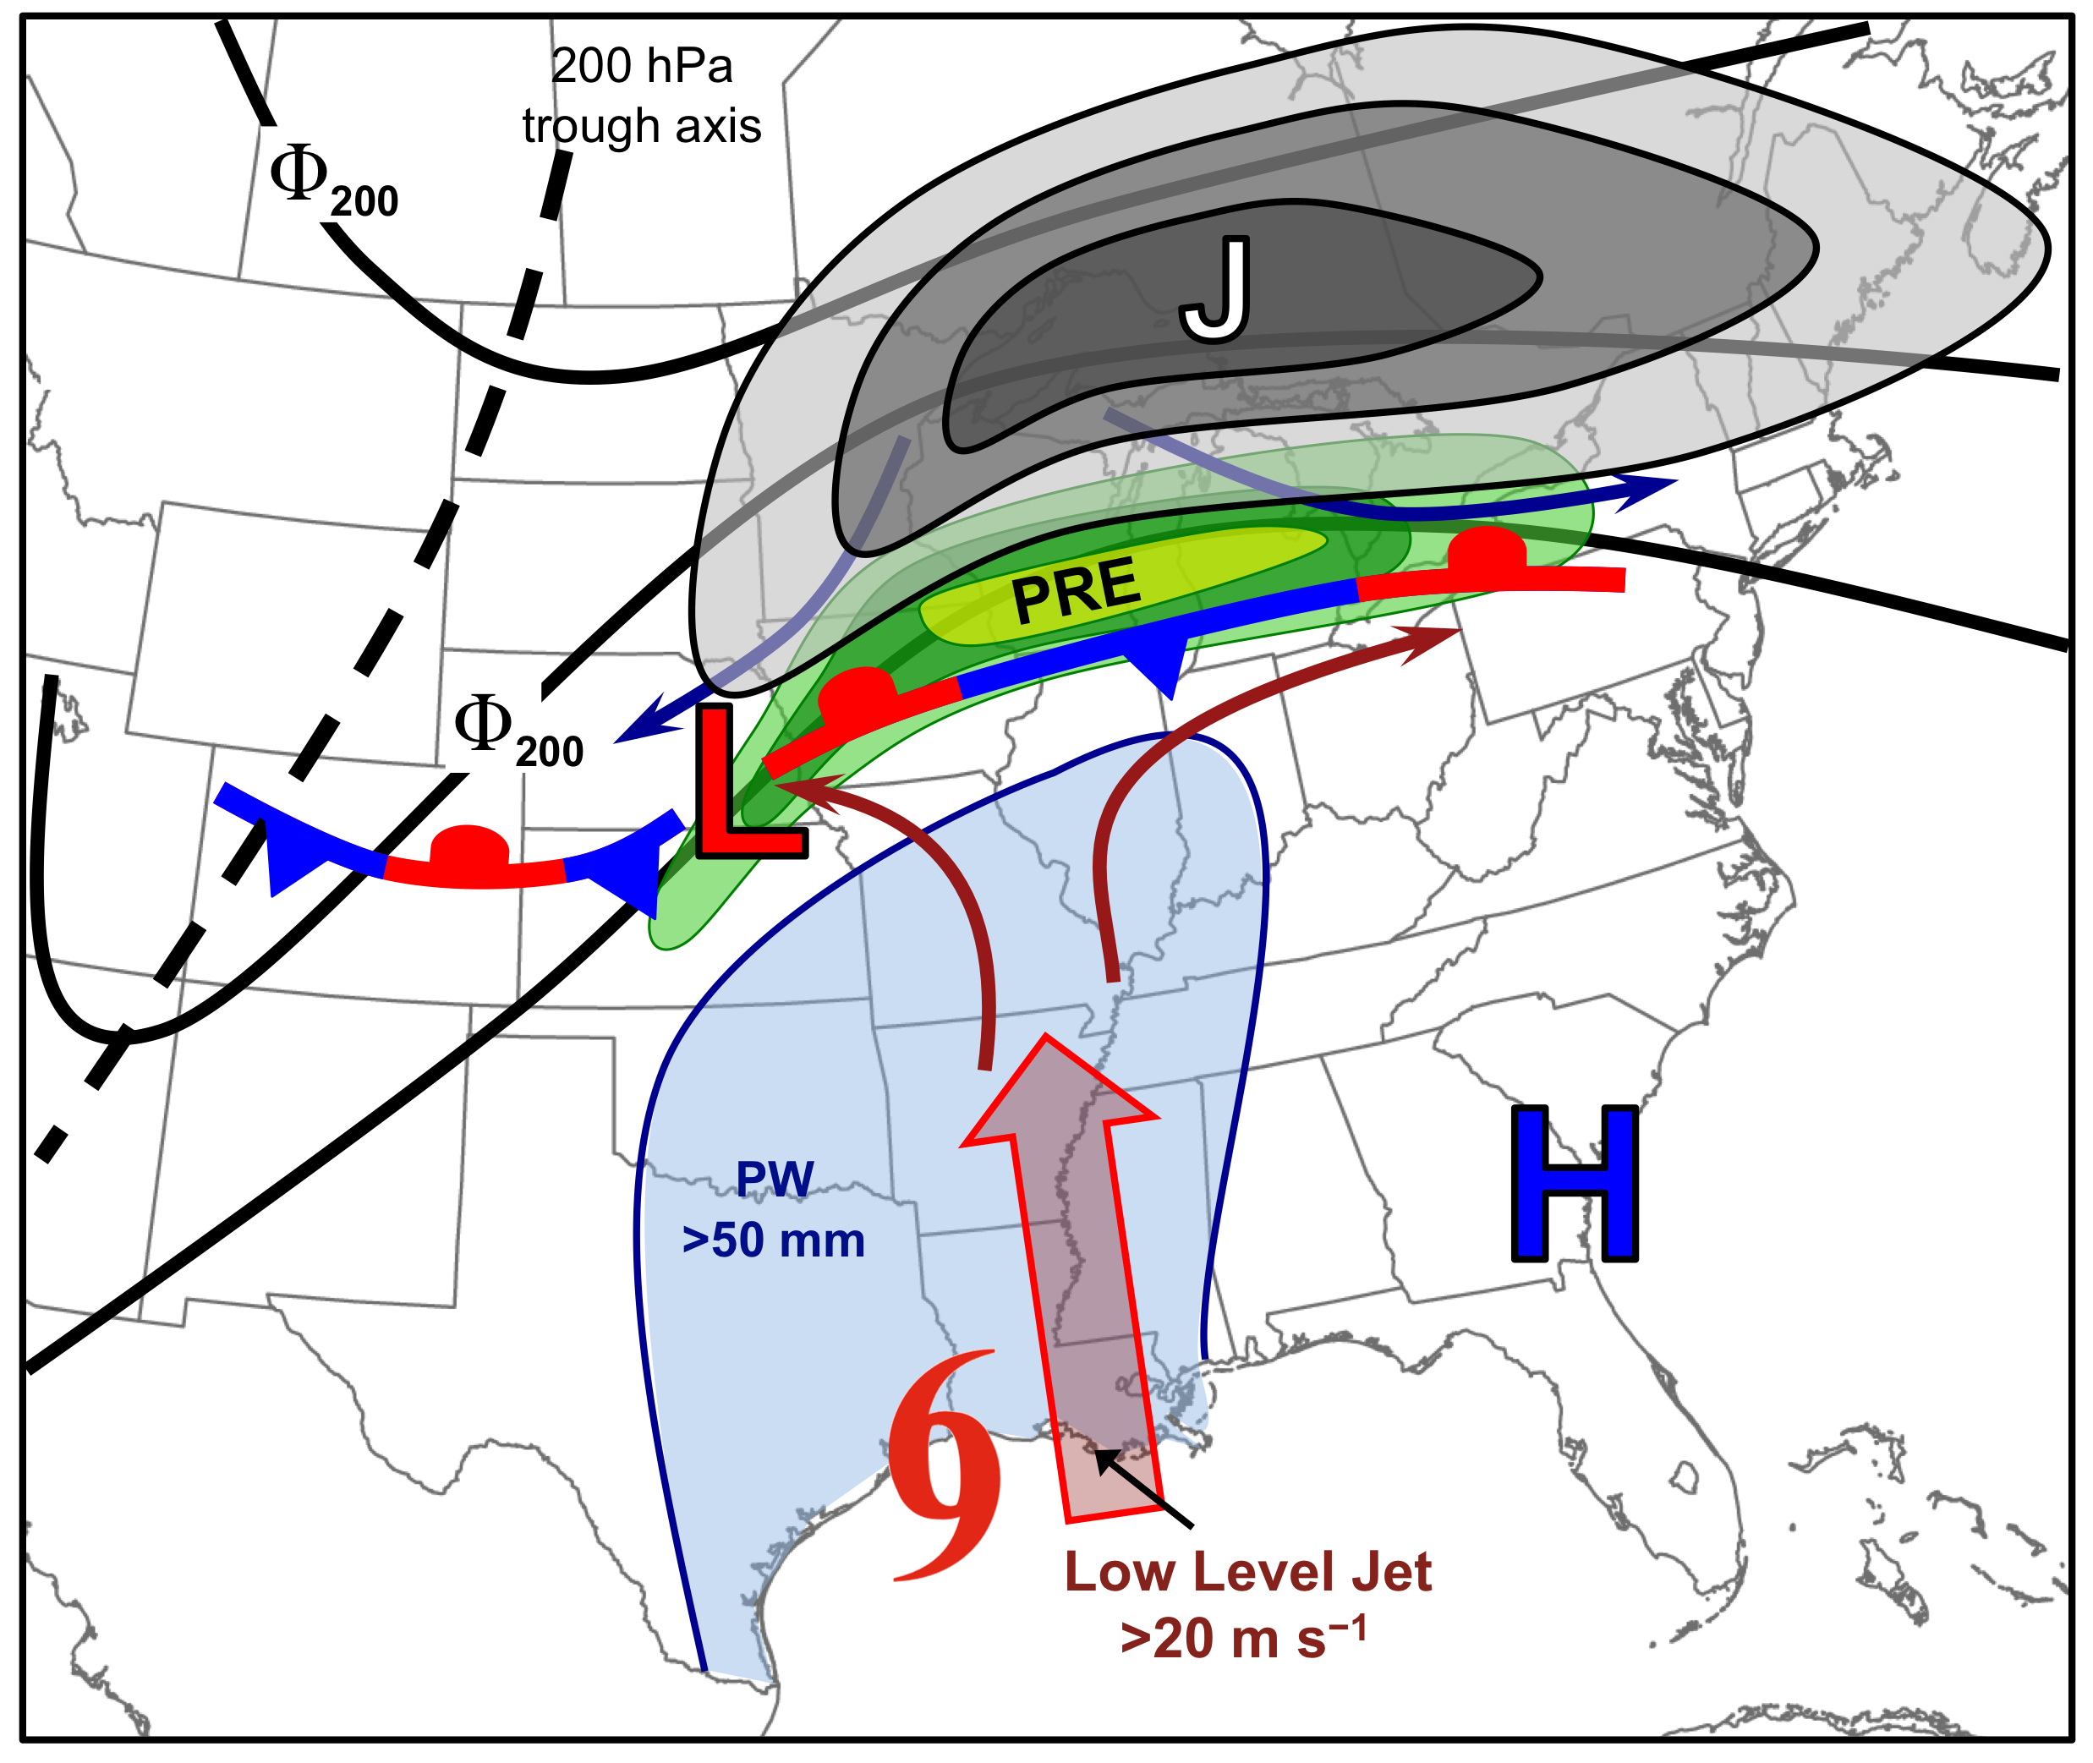
Synoptic-scale Environment of
“Jet in Ridge” PREs

Slide 31
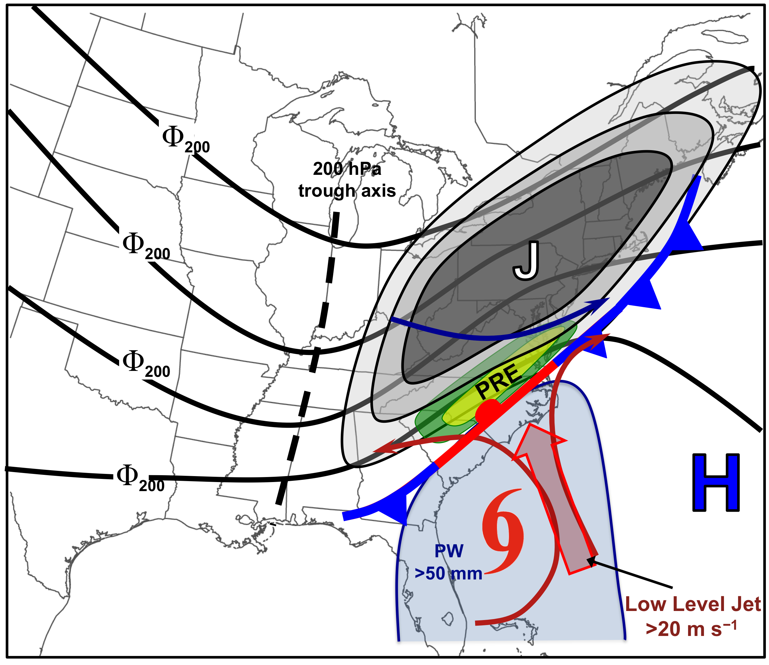
Synoptic-scale Environment of
“Southwesterly Jet” PREs

Slide 32
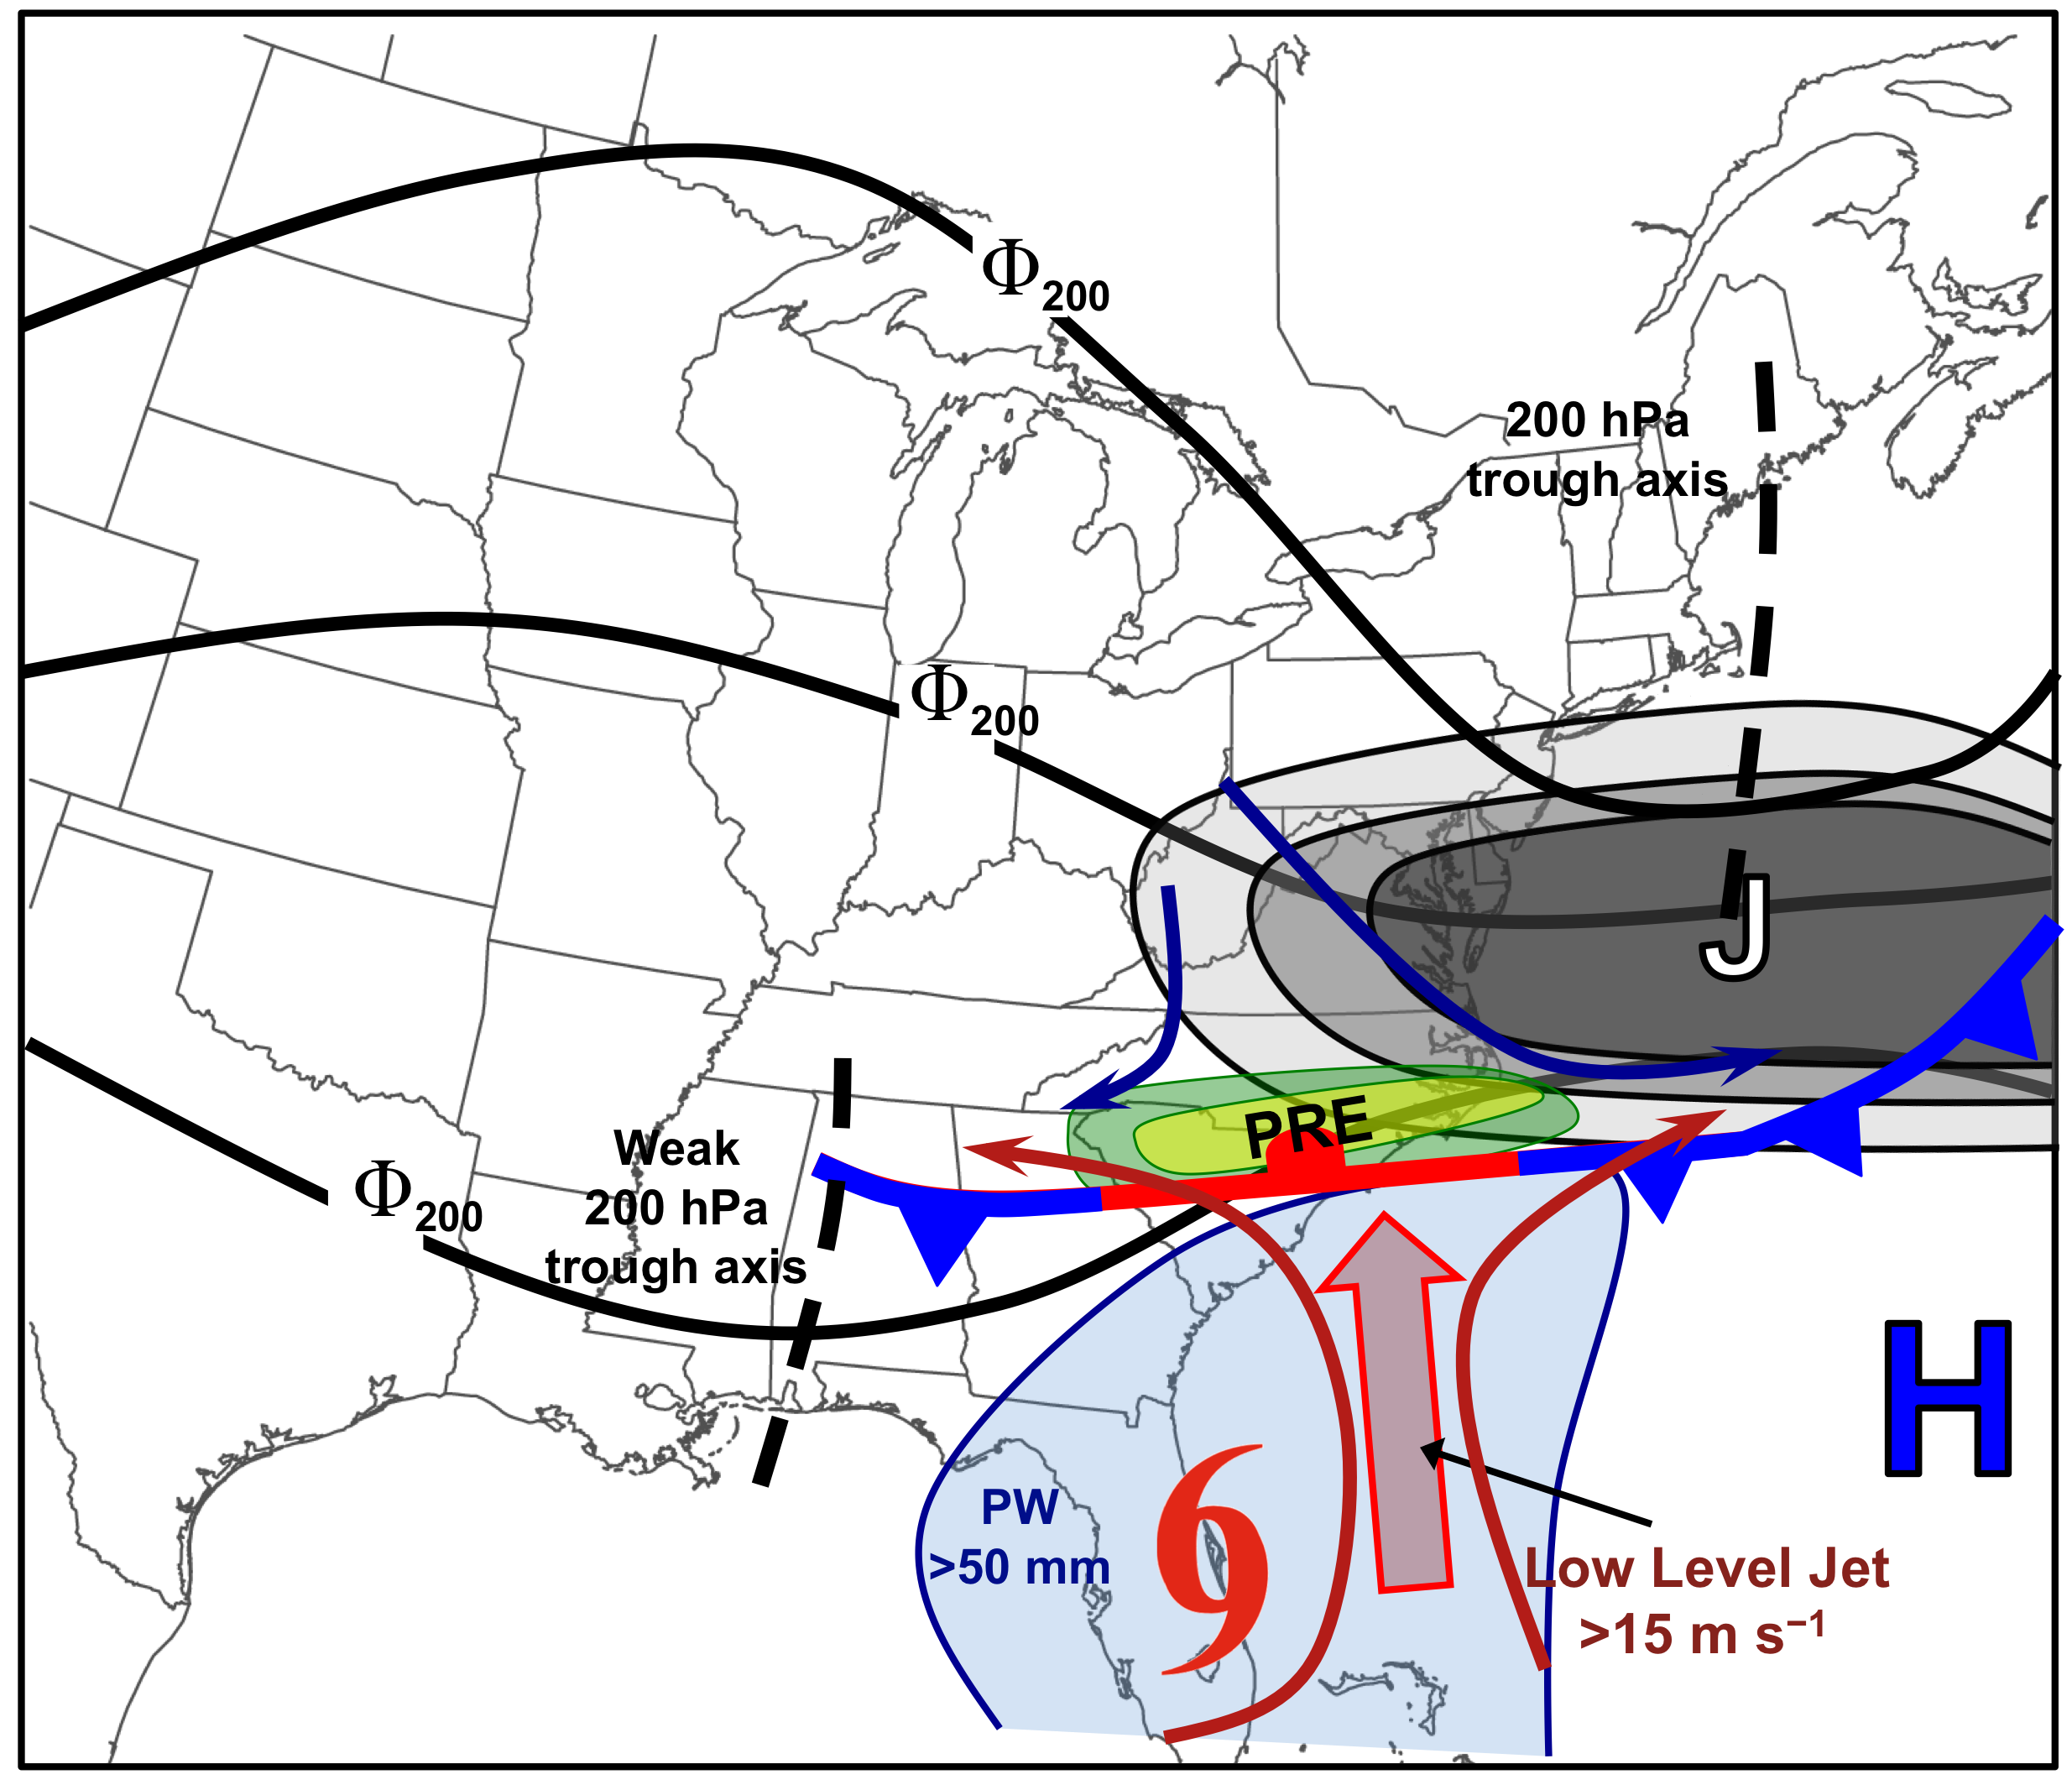
Synoptic-scale Environment of
“Downstream Confluence” PREs

Slide 33
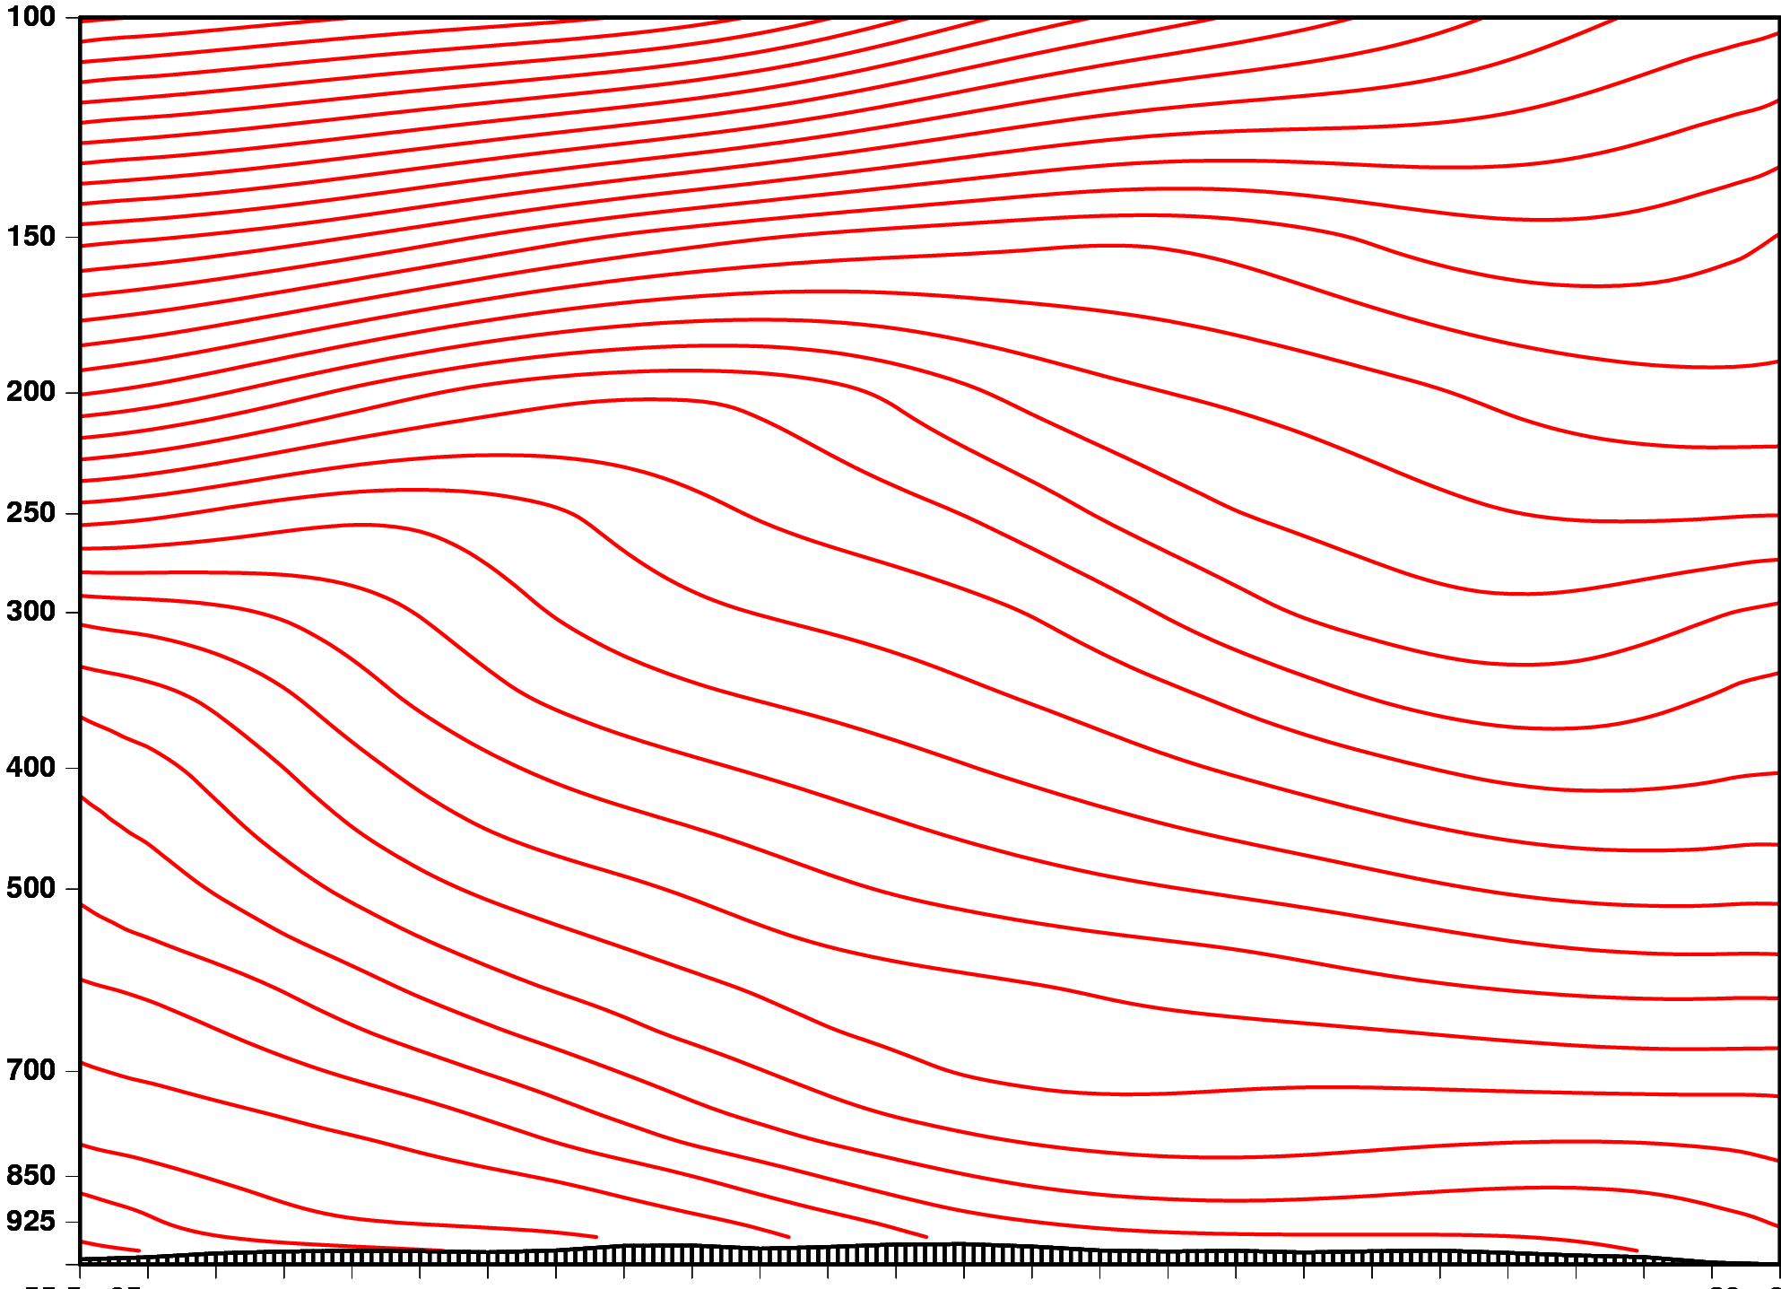
Schematic Cross Section
Pressure (hPa)
J
F
Latent Heat
Release
F
Moist low-level flow
N
S
~1000 km

Slide 34
PREs in the Context of the
Maddox et al. (1979) “Frontal” Pattern
Surface
“Jet in Ridge” PRE
500 hPa

Slide 35
PREs in the Context of the
Maddox et al. (1979) “Frontal” Pattern
Surface
“Southwesterly Jet” PRE
500 hPa

Slide 36
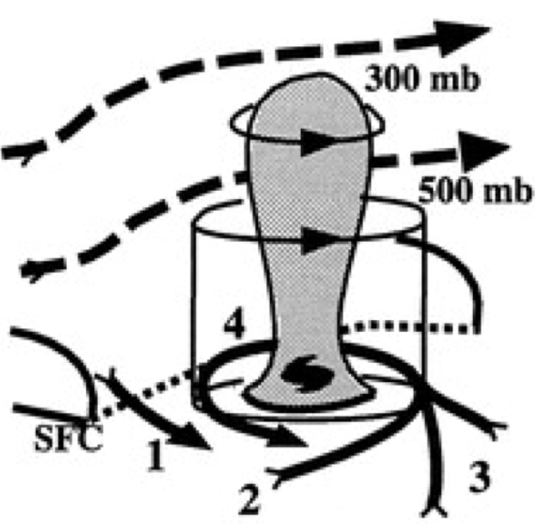
PREs in the Context of the
Maddox et al. (1979) “Frontal” Pattern
“Southwesterly Jet” PRE
Surface
500 hPa
Transformation stage of ET (Klein et al. 2000)

