Slide 1
Towards closing the gap in NOAA’s seamless suite of Forecast products. Prospects of “useful” Predictions for Weeks 3 & 4?
Muthuvel Chelliah
Climate Prediction Center/NCEP
August 20, 2014
Seminar at VLAB Forum, NWS Head Quarters, Silver Spring, MD.

Slide 2
This talk is going to be pretty straightforward,
based on relatively simple calculations, and
hopefully with some practical implications towards forecasts for weeks 3-4.
Thinking Outside the Box:
Prospects of “useful” Predictions for Weeks 3 & 4?
The motivation for this work came from this quote:
“Rather than work forward from a technology or a complex strategy,
work backwards from the needs of customers
and build the simplest product possible”
– Eric Ries, author of “The Lean Startup”

Slide 3


NOAA Seamless Suite of Forecast Products Spanning Climate and Weather
Service Center Perspective
Forecast
Uncertainty
Years
Outlook
Seasons
Guidance
Months
Threats Assessments
2 Week
Climate/Weather
Linkage
6-10 Day Forecast
Forecast Lead Time
1 Week
NDFD, Days 4 -7
Forecasts
HPC
OPC
TPC
Days
At present, there are NO “official” or “useful” forecasts, or even some sort of ‘guidance’ available for weeks 3 and 4 even on an exptl. basis.
Winter Weather Desk Days 1-3
Tropical Storms to Day 5
Severe Weather to Day 8
Fire Weather Outlooks to Day 8
:
Watches
Hours
SPC
AWC
SWPC
Warnings & Alert Coordination
Minutes
Benefits
Maritime
Health
Aviation
Agriculture
Commerce
Recreation
Life & Property
Fire Weather
Hydropower
Ecosystem
Environment
Space Operations
Emergency Mgmt
Energy Planning
Reservoir Control

Slide 4
NOAA’s Weather Prediction Ctr (WPC, formerly HPC) issues weather forecasts for each of the next 5 (6-7?) days.
Private Forecasters (The Weather Channel/ AccuWeather ) even extends this to about 10 days and beyond!!
The forecasts are issued for Total fields (deg. F, inch(es) of rain, etc).

Slide 5
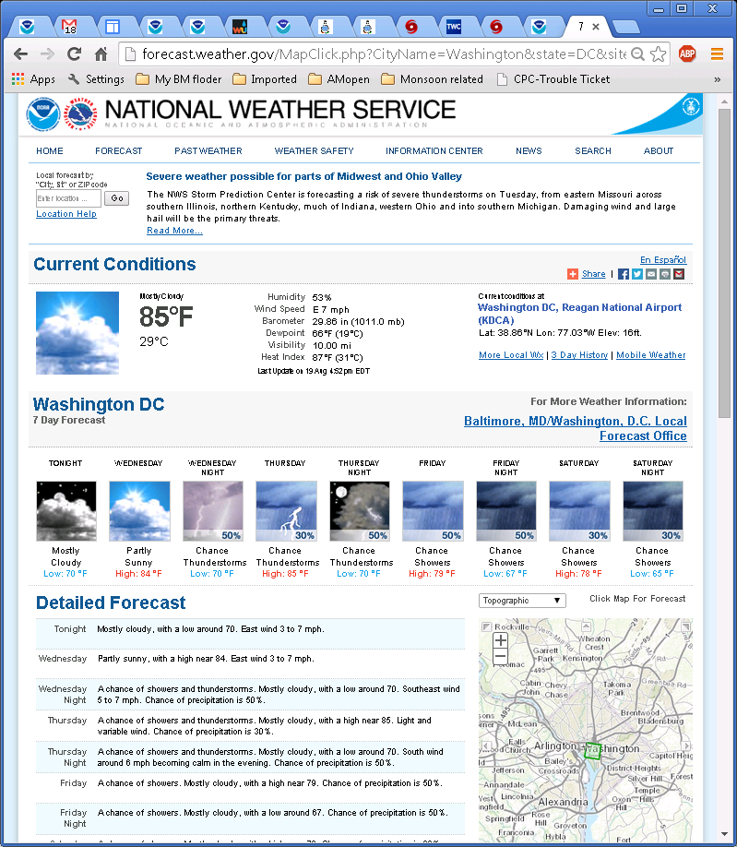
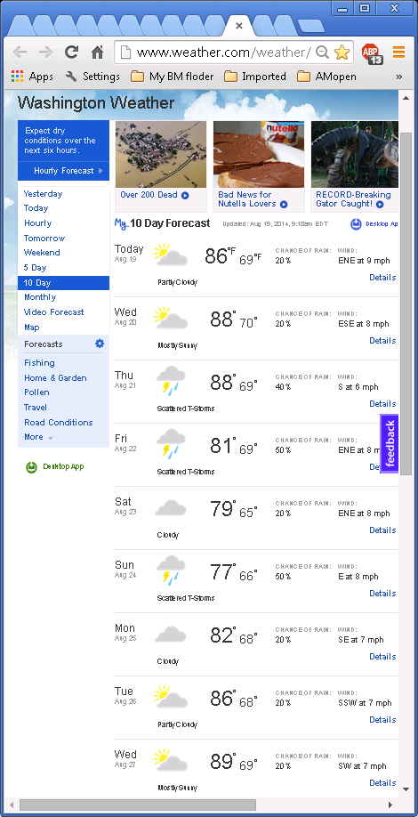

Slide 6
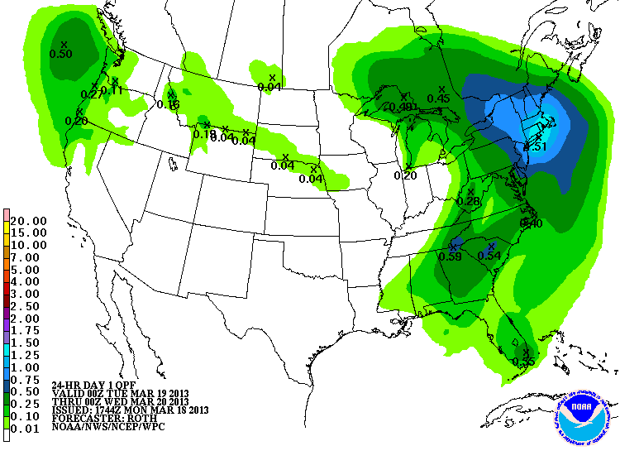
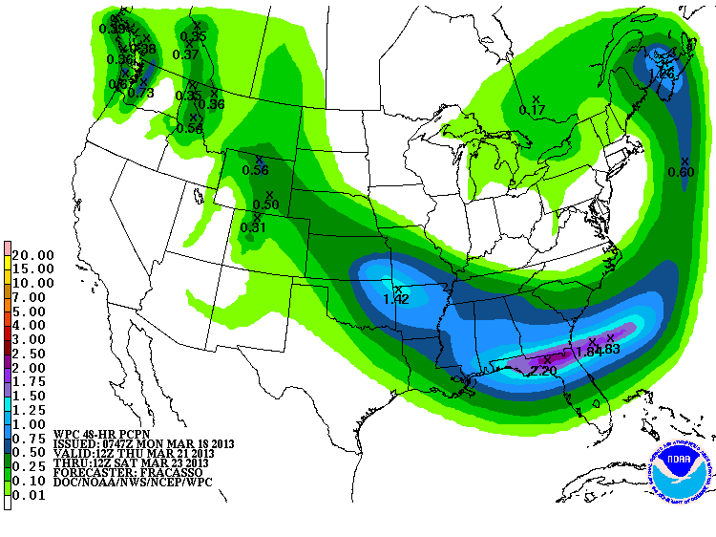
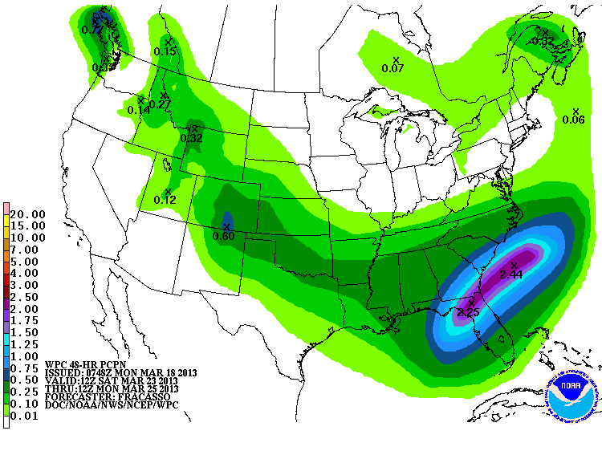
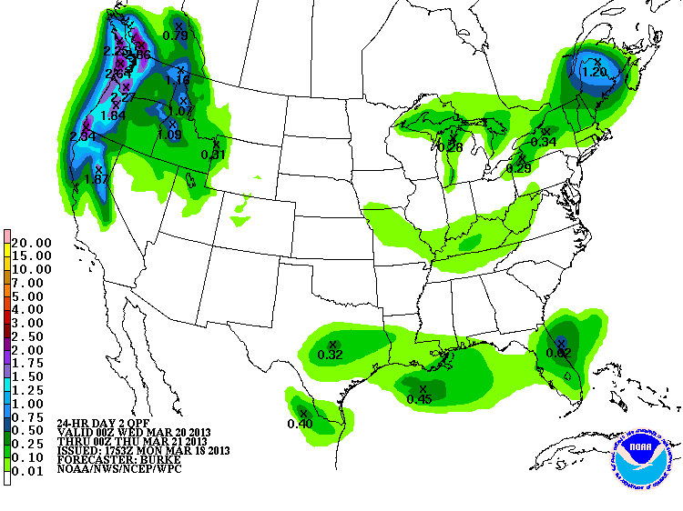
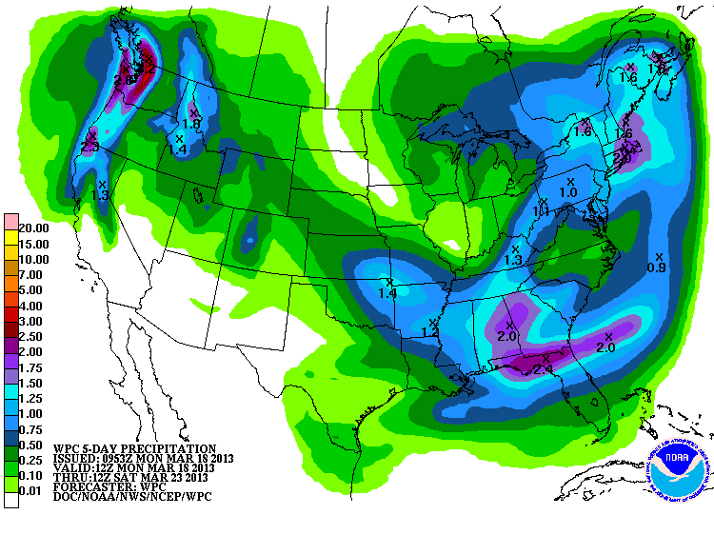
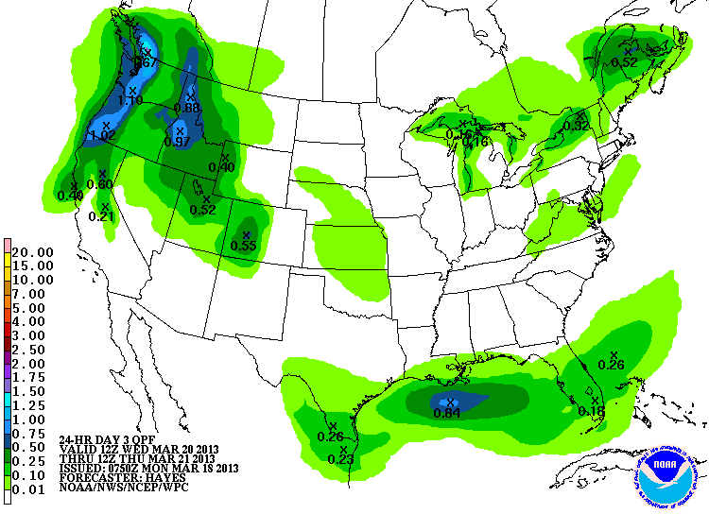
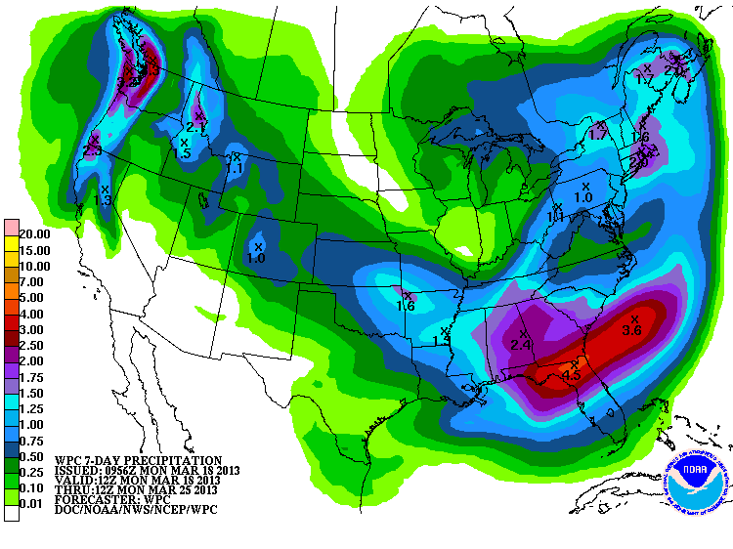
Day 1
Days 6-7
Days 4-5
Examples of
NCEP WPC’s(formerly HPC)
QPF (Quantitative Precipitation Forecasts) - Forecasts issued every day.
Day 2
Days 1-5
Day 3
Days 1-7

Slide 7
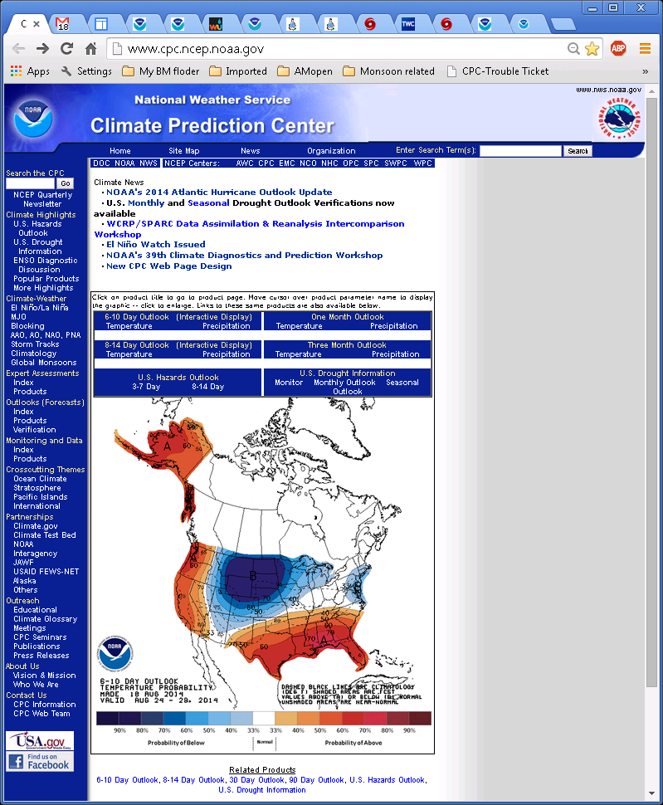
Climate Prediction Center (CPC) issues Temp & Precip forecasts over the US for time averages of:
next 6-10 days (referred to as Week 1P in this talk)
next 8-14 days (week 2)
next month, next few seasons, etc.
But the forecasts are issued as probabilities for above/ near/below conditions from some climatology.

Slide 8
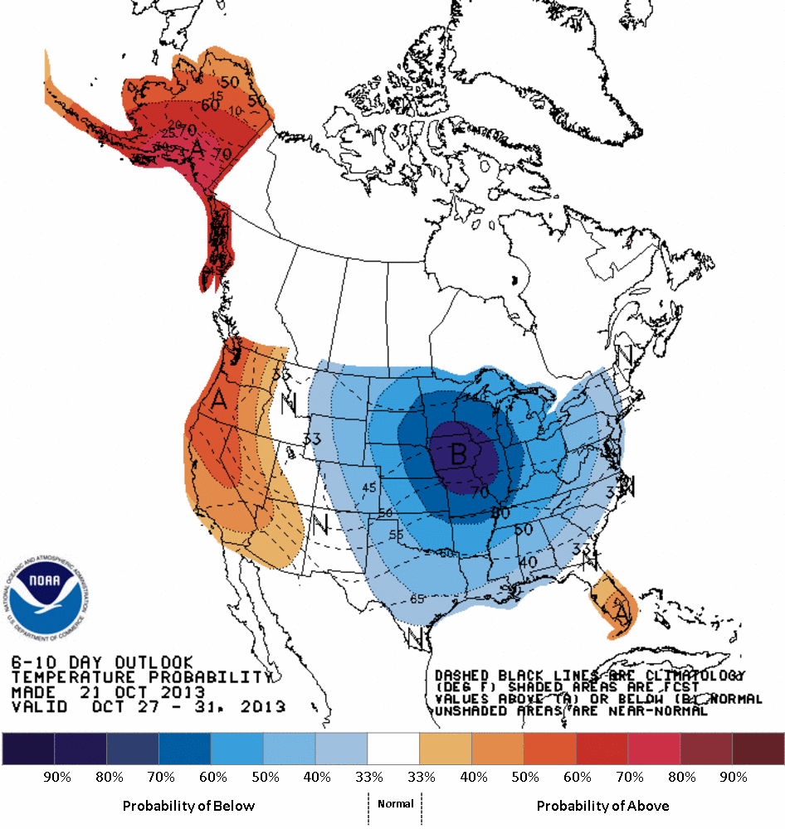
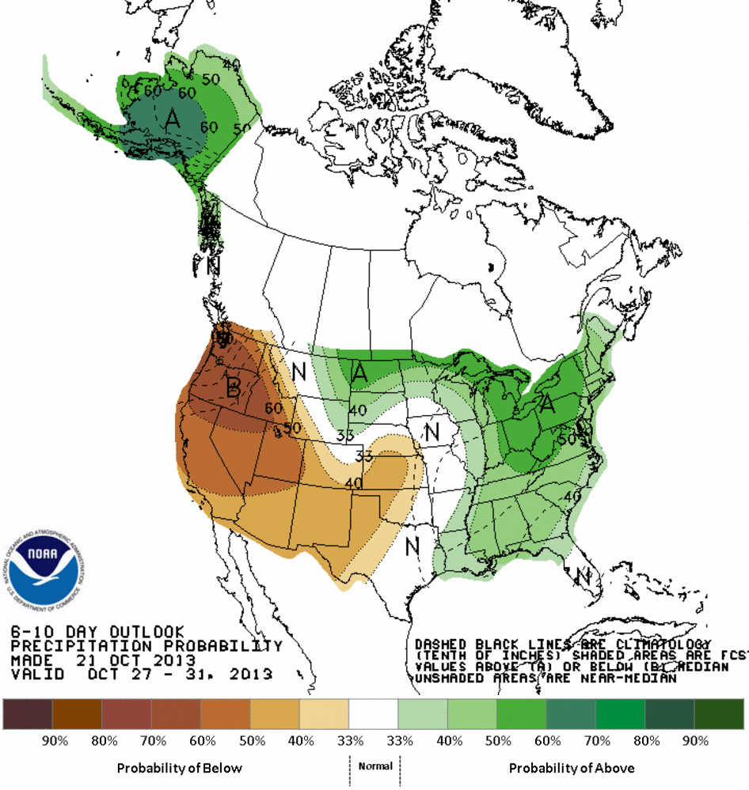
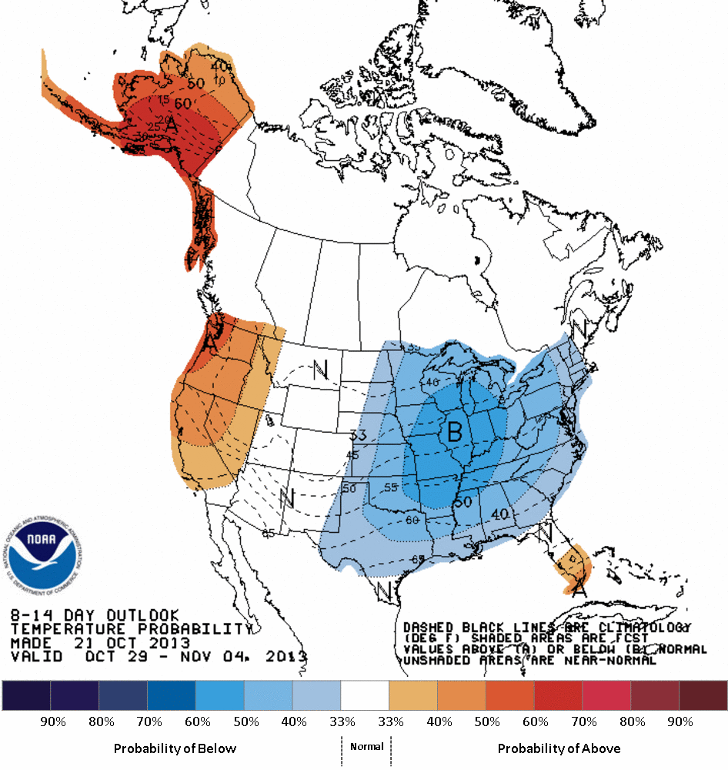
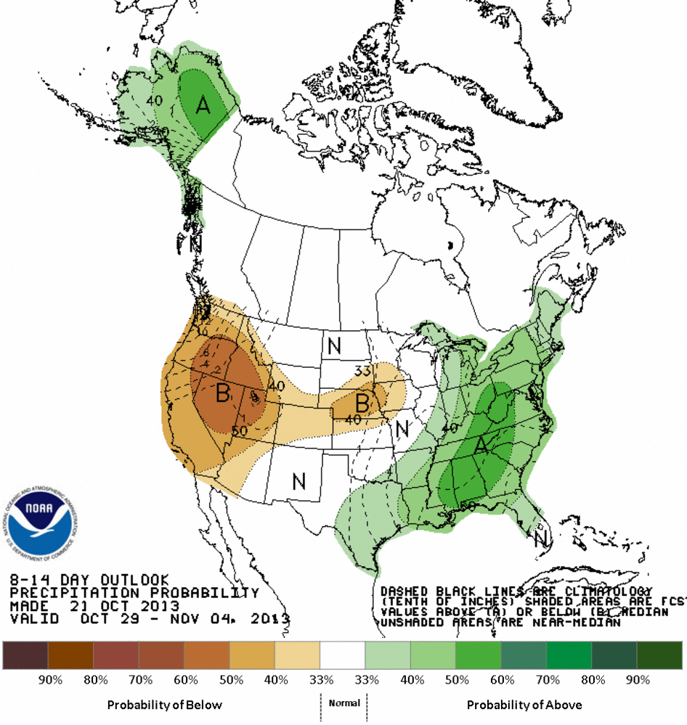
Typical Examples of CPC outlooks for 6-10 days and 8-14 days as anomalies (departures) from some climatology (1981-2010)
6-10 day Outlook Probability Temperature Precipitation
8-14 day Outlook Probability Temperature Precipitation

Slide 9
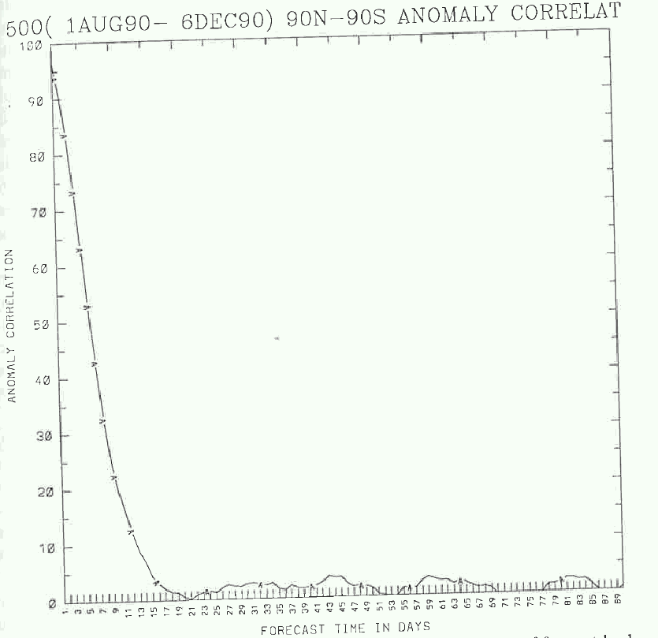
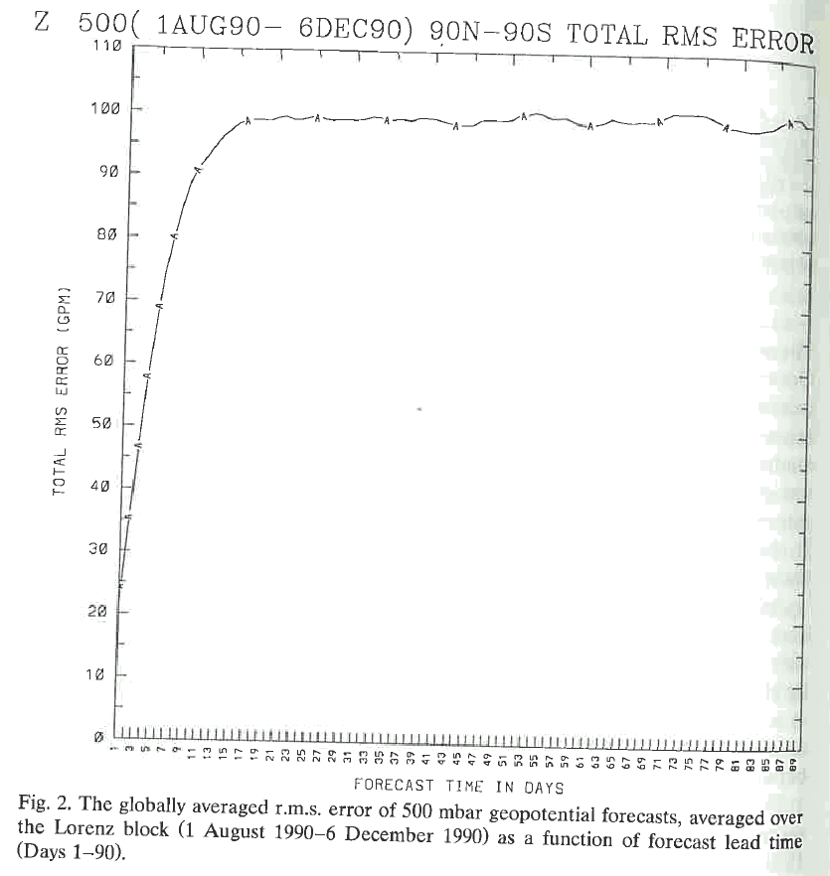
NWS started forecast of : 5-day means - circa 1940s, 6-10 (60’s/70’s ?) & 8-14 days ( ~ 2000?)
Monthly means – 1970’s, Seasonal means – 1990’s.
So, why does the ‘3-4 weeks hole’ in the forecast suite continue to exist?
Have the model forecasts in the weeks 3-4 time scale improved with time?
Long-range weather forecasts through numerical and empirical methods,
H.M. van den Dool. (Dynamics of Atmospheres & Oceans, 1994)
Based on the so called “DERF” (Dynamical Extended Range Forecast ) runs in the late 1980s and early 90’s.
1.0
0.5
0.2
10

Slide 10
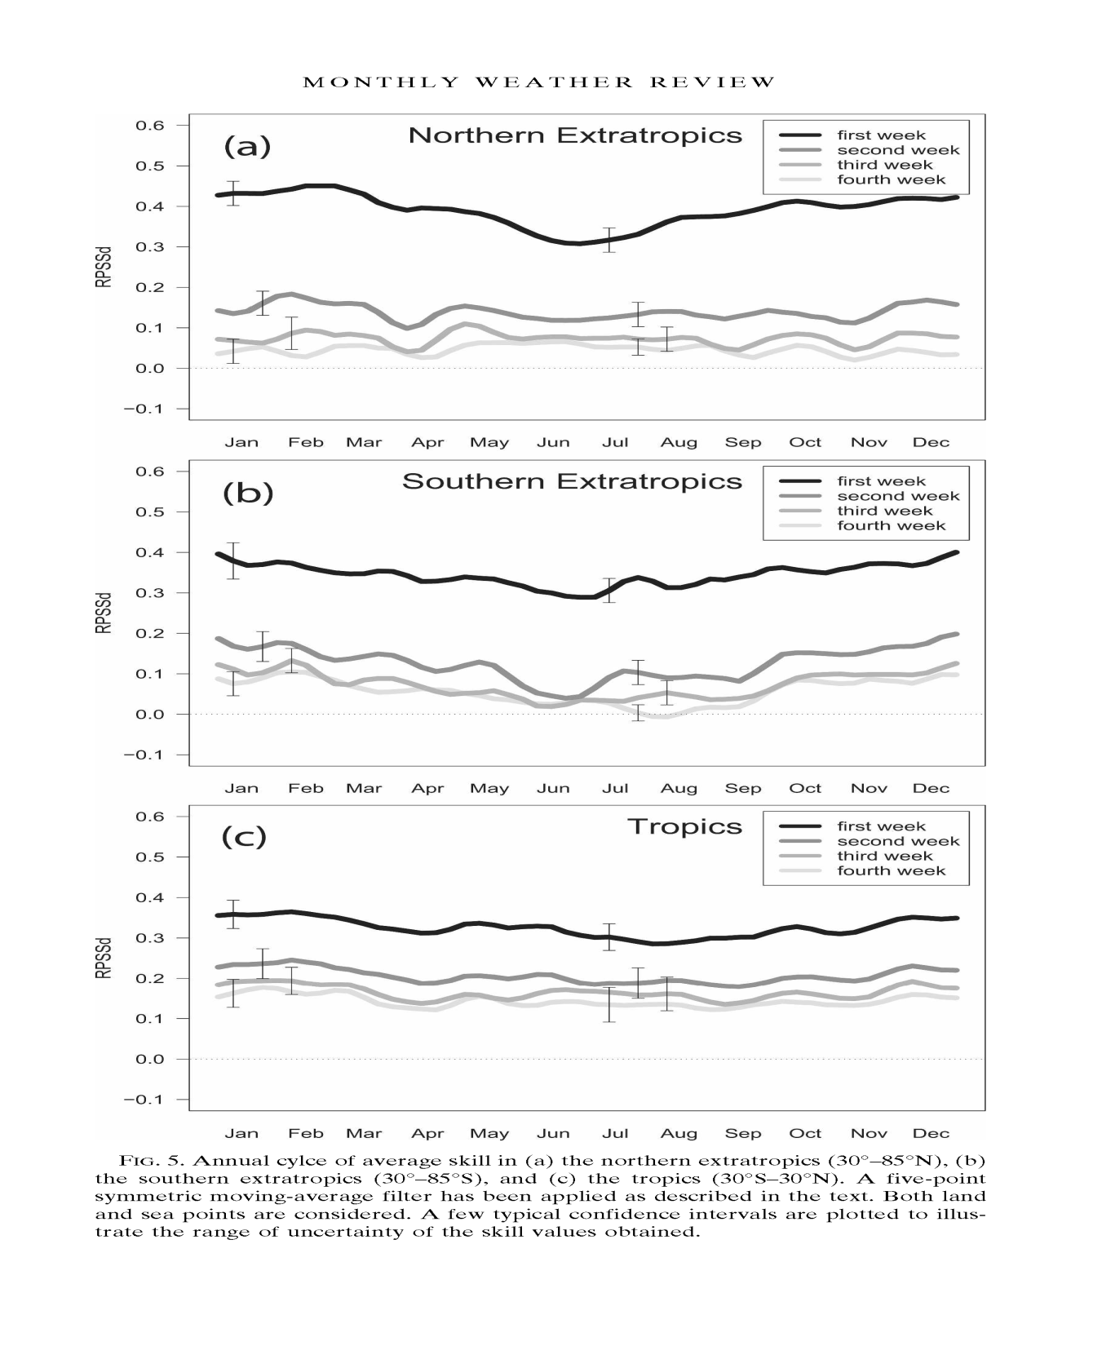
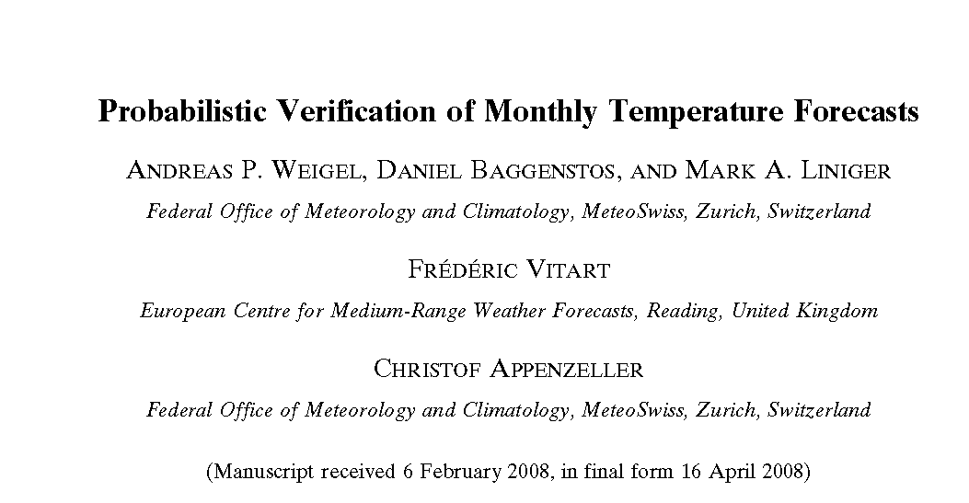
2008

Slide 11
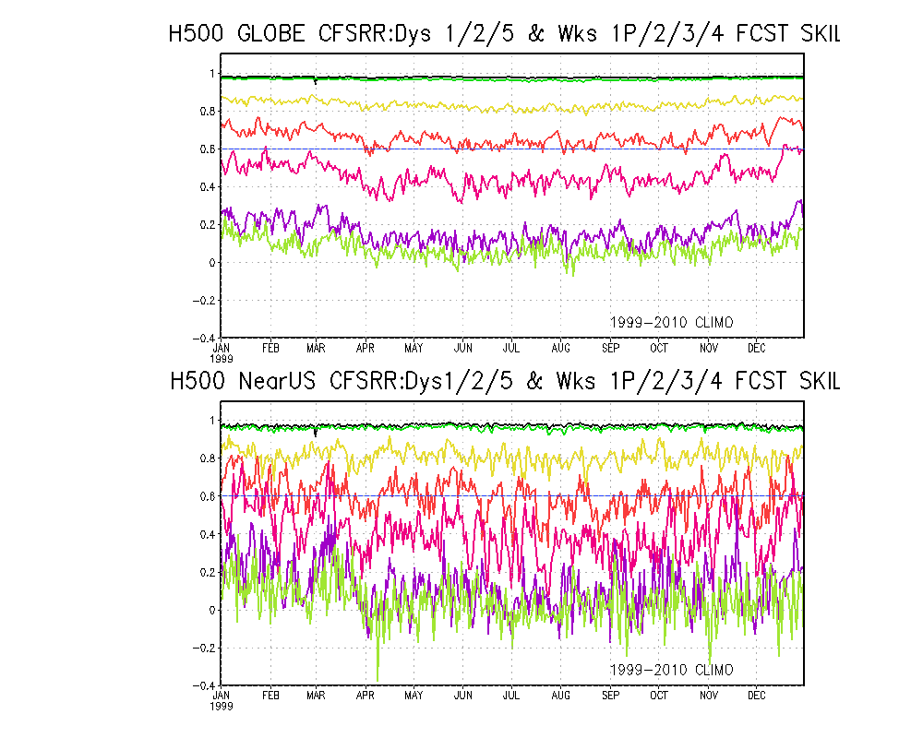
2013: Based on CFS V2’s 45 day forecast runs. (1999-2010), 4 ensemble member fcsts/day.
1
2
5
Wk 1P
Wk 2
Wk 3
Wk 4
1
2
5
Wk 1P
Wk 2
Wk 3
Wk 4
15 N – 55 N
130 W – 65 W

Slide 12
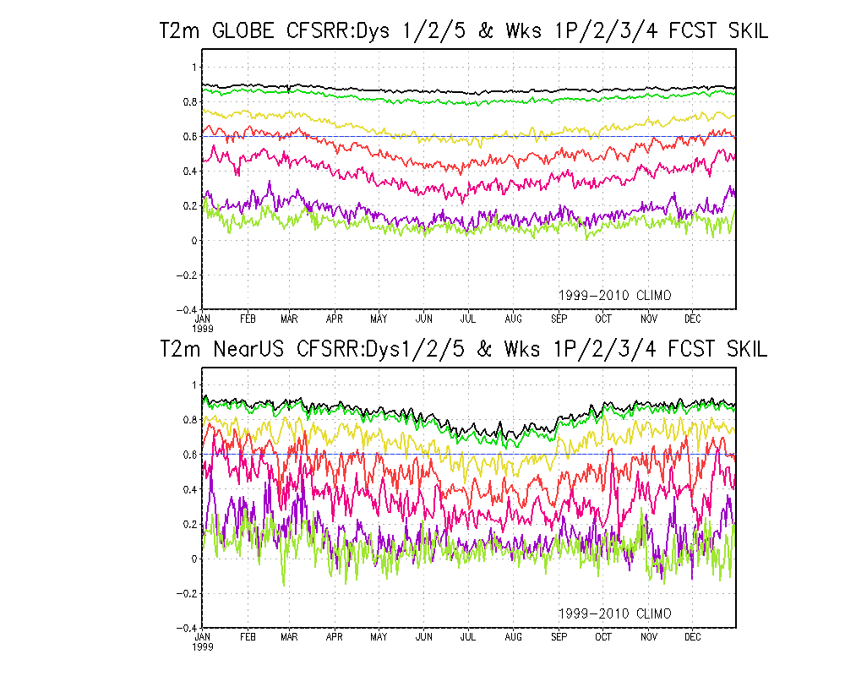
1
2
5
Wk 1P
Wk 2
Wk 3
Wk 4
1
2
5
Wk 1P
Wk 2
Wk 3
Wk 4
1
2
5
Wk 1P
Wk 2
Wk 3
Wk 4
This is the current “state of the art” weeks 3-4 fcst skill !!

Slide 13
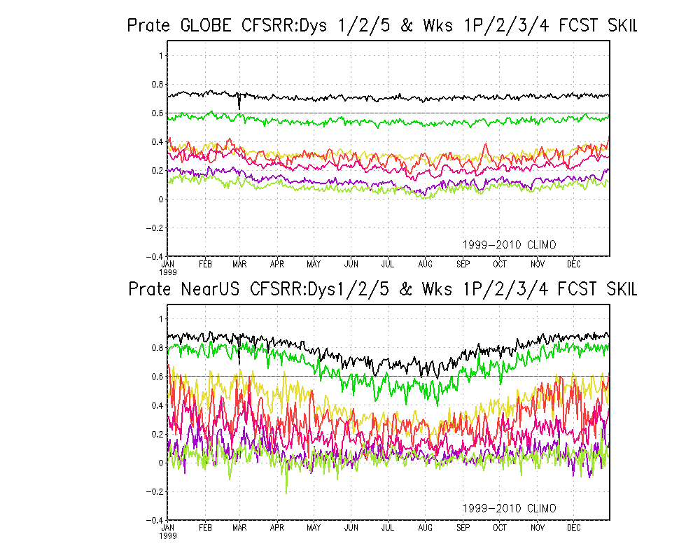
1
2
5
Wk 1P
Wk 2
Wk 3
Wk 4
1
2
5
Wk 1P
Wk 2
Wk 3
Wk 4
This is the current “state of the art” weeks 3-4 fcst skill !!

Slide 14
But, for the last twenty to thirty years, in spite of the vast improvements in our understanding data assimilation techniques, and modeling and so on, the predicted skill of anomalies in weeks 3-4 range have remained stubbornly low ~ 0.2.
So, if you keep asking the same question, and if you keep getting the same answer you don’t like for a long time, then it is time to start asking the question in a different way, or to ask a different question.
“We know that at shorter lead times (say for less than 7-10(?) days), the future state of the atmosphere is sensitive mainly to the initial condition of the FAST atmosphere,– depends on the time/flow patterns etc?)
While at longer lead times ( monthly (?) seasonal time scales & beyond), it is sensitive to the initial condition of the SLOW ocean (and possibly the intermediate land surface) component(s) only.”
This ‘time scale’ (3-4 weeks) in-between the ‘deterministic weather’ and the ‘probabilistic climate’ , It is neither weather nor climate!
What metrics are useful to verify the forecasts/guidance in this time period: weeks 3-4 !
Such as the ones used for weather, or the ones for climate?

Slide 15
To evaluate weeks 3-4 predictions we have always mostly used “anomaly/correlation” as the main metric where anomaly is computed as departure from some climatology (base period) - We suddenly switch from the immediate weather mode (next few days) and treat this period (weeks 2? 3, 4) as climate, using anomalies from a long term mean!!!
What then is the appropriate period for the Climatology? Longest period available? 50 years? WMO’s 30 years? 15 yrs? OCN? Observed (model analyses) Climatology from the same forecasting model? Or from another model (ECMWF)? What about model biases? Depending on the base –period used, the predicted anomalies will be different?
No matter what the base period is, do the public understand that? OR Does the public really care? All they need is some ‘guidance’, some ‘educated guess’ for how the ‘average’ weather will be like in the upcoming weeks, so they can go on with their lives!!
The general public understands: Yesterday’s/Today’s/Tomorrow’s Weather such as Totals: Snow, Rain/More rain/No rain… Heat wave/Cold in numbers 90’s upper 60s, 40’s ….
They understand: Changes from “recent/current weather” that they can remember: If we are NOW in a hot spell, or if in severe cold, or if it has been raining for a while – people want to know how soon is this going to change, or if the current conditions (good or bad) stay the same, or will it change in the future?
"The important thing in science is not so much to obtain new facts as to discover new ways of thinking about them." - William Lawrence Bragg (youngest ever ? Nobel Laureate in physics)

Slide 16
In the following, we show Climatological annual cycle of 1999-2010 mean Forecasts of:
Wk 1P(days 6-10), Wk 2, (shown for comparison only)
Wk 3, & Wk 4 Fcst. skill (correlation)
for 2 regions: GLOBE & large US region.
First we show for H500, T2m & Precip
Forecast start day
Forecast
Previous day
Day 1
Day 2
Day 5
Days 6-10
Week 1P
Days 15-21
Week 3
Previous 7 days
Days 22-28
Week 4
Days 8-14
Week 2
Analysis
In this study for the 3, 4 week forecasts, instead of computing the traditional anomaly correlation coefficient (where ‘predictand’ and ‘predictor’ anomalies are computed as departures from some climatology),
I propose and compute the correlation between the tendencies in the forecast (predictand) and the verifying analysis. The impact of tendency in climatology will be accounted for.

Slide 17
Traditional method: The traditional anomaly correlation – where anomaly (be it for 1/2/5 day or for weeks 1p/2/3/4) is computed as departure from ‘Traditional’ long term mean (here 1999-2010) climo.
-7dy Mean: Anomaly correlation between the forecast and verifying analyses where anomalies are computed as departures from the previous ‘7 day means’ immediately preceding the forecast day.
-7dy Mean – Clim.Tendency: Same as above, except that the climatological tendency part (for eg. From prev. week to wk3/wk4) is also subtracted before computing correlation.
-1 day (previous day) Mean: Anomaly correlation between the forecast and verifying analyses where anomalies are computed as departures from the ‘previous day’ means immediately preceding the forecast day.

Slide 18
T 2m.
Globe
Wk 1P
Wk 2
Wk 3
Wk 4

Slide 19
T 2m.
Near US
Wk 1P
Wk 2
Wk 3
Wk 4

Slide 20
Prate
Globe
Wk 1P
Wk 2
Wk 3
Wk 4

Slide 21
Prate
Near US
Wk 1P
Wk 2
Wk 3
Wk 4

Slide 22
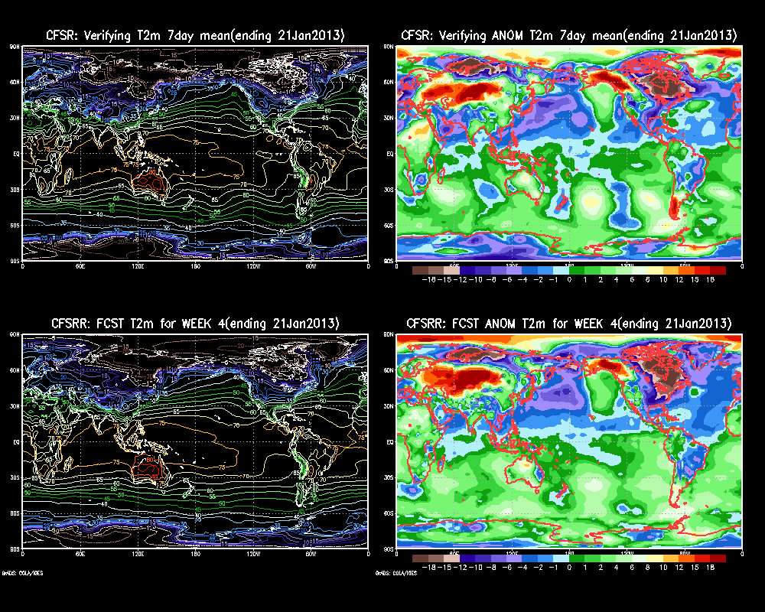

Slide 23
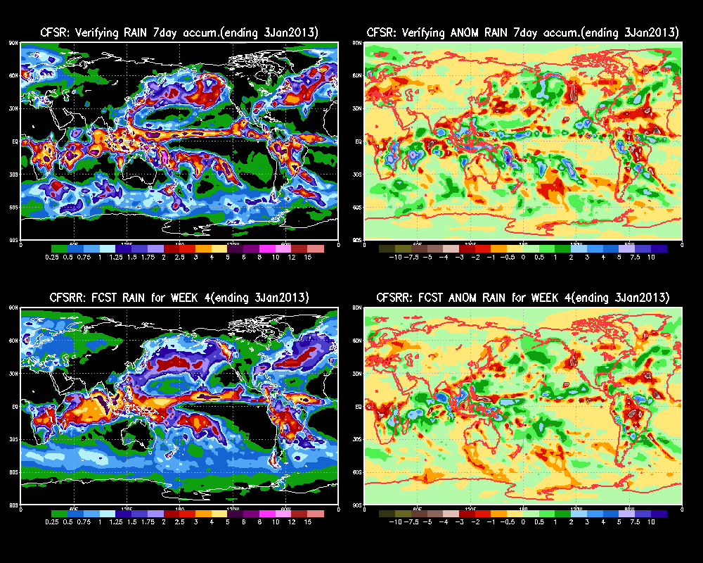

Slide 24
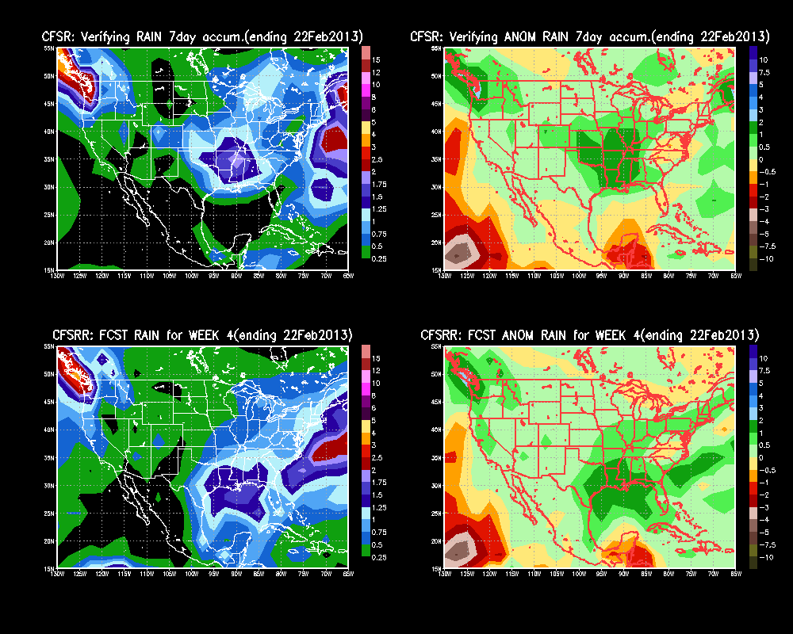

Slide 25
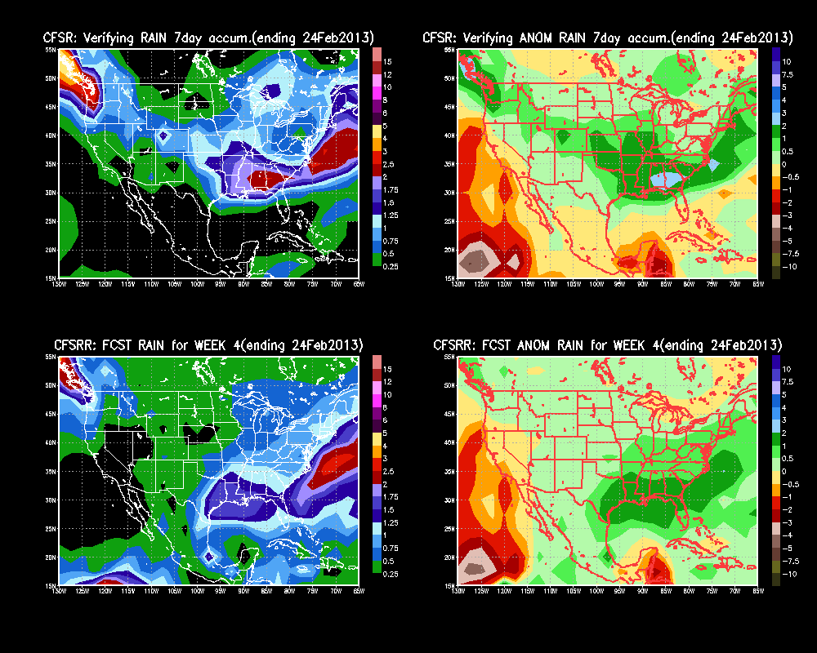

Slide 26
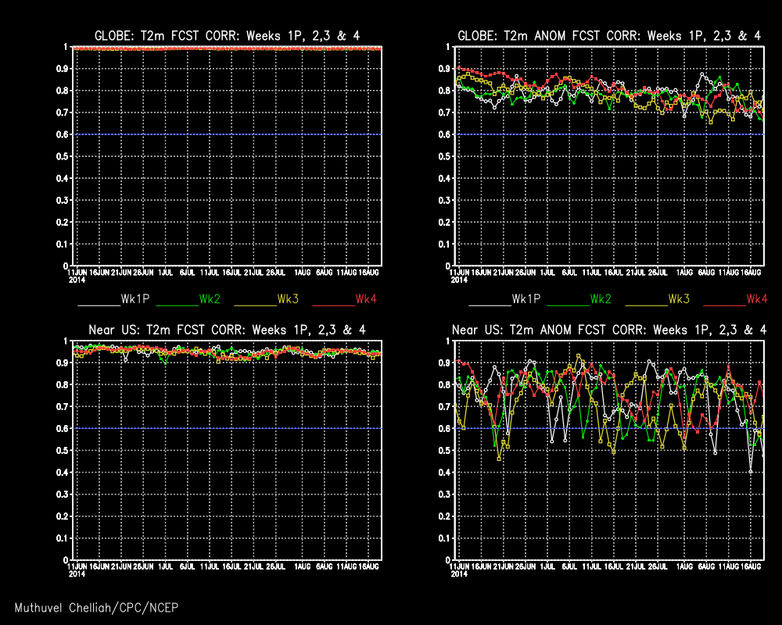

Slide 27
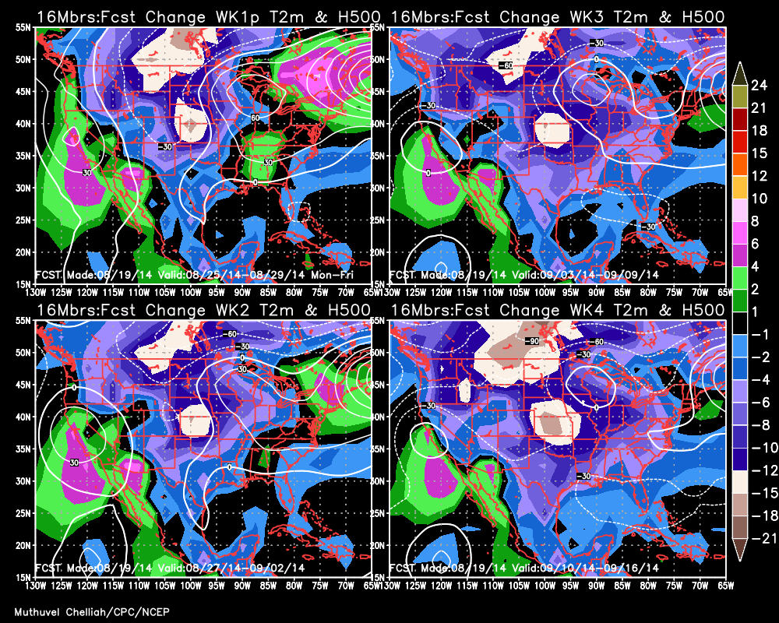

Slide 28
In summary:
In spite of the enormous progress that has been made in modeling , physical parameterizations, and data assimilation that lead to significant advances in weather prediction, real progress in the extended range - a few weeks to seasons - remain very slow. If we do not have an open mind and are not willing to think differently about how we make and verify forecasts in particular in the elusive weeks 3-4 time scale, then fifteen/twenty years from now, I am not sure whether we will be in a different place than we are now!
But if we are willing to experiment and think outside the box, and produce forecasts, or at least some sort of ‘guidance’ for ‘weeks 3 & 4’ along the lines presented here, even on an ‘experimental basis’, this study offers a new proposal to make and evaluate forecasts in the weeks 3-4 range, and let the public be the judge of whether these “forecasts” are of ‘any value’ to them. (No need for expensive long-term hindcasts, or delays in implementing model improvements)
I am making and updating in a ‘real time’ basis, and put these forecasts and recent skill scores in my experimental/personal website with appropriate caveats of course at http://www.cpc.ncep.noaa.gov/products/people/muthu/chek.cfsr.fcst/
A better website is under construction, which will soon replace the one above.
Prelim. write-up of this work is available online at recent 38th CDPW Digest.
(http://www.nws.noaa.gov/ost/climate/STIP/Collections.htm)
A manuscript is under preparation.
The END ☺
Thanks for listening!
Any questions?

Slide 29
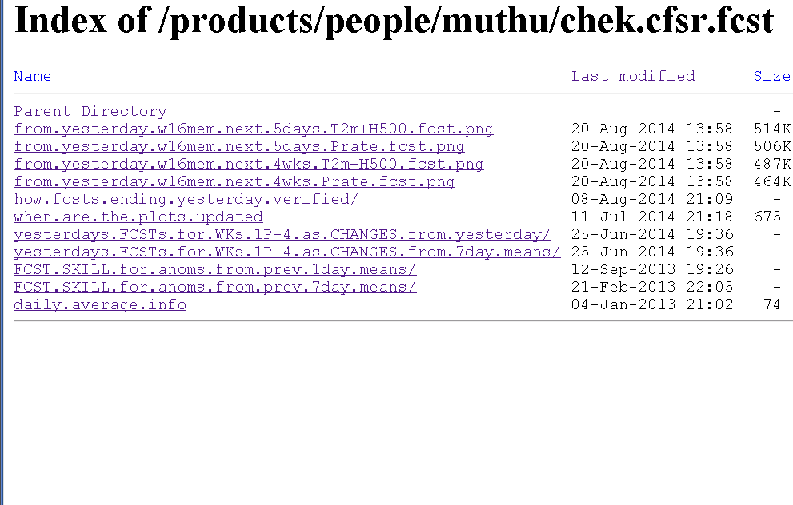
For this website, Google: CPC products Muthu

Slide 31
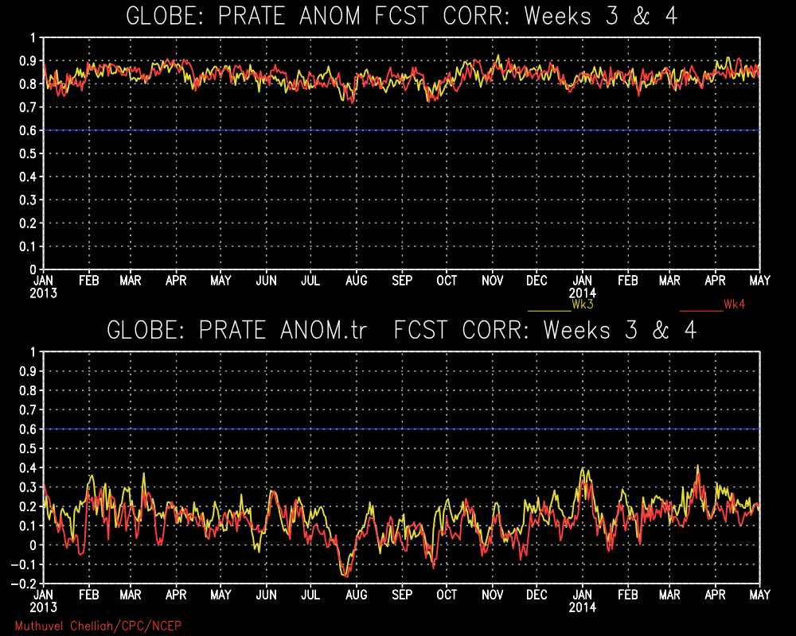

Slide 32
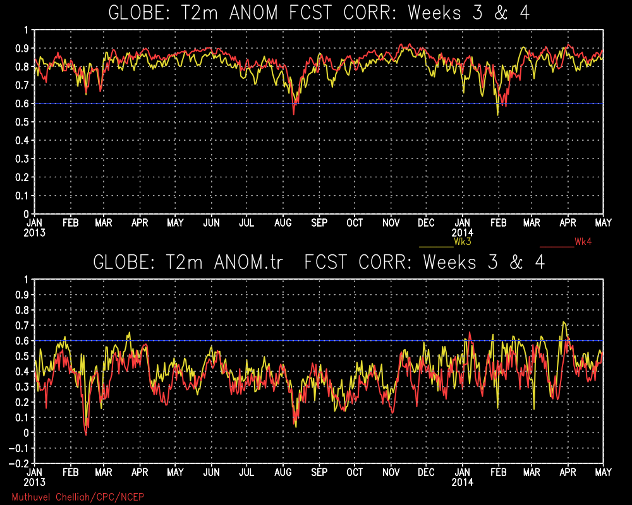

Slide 33
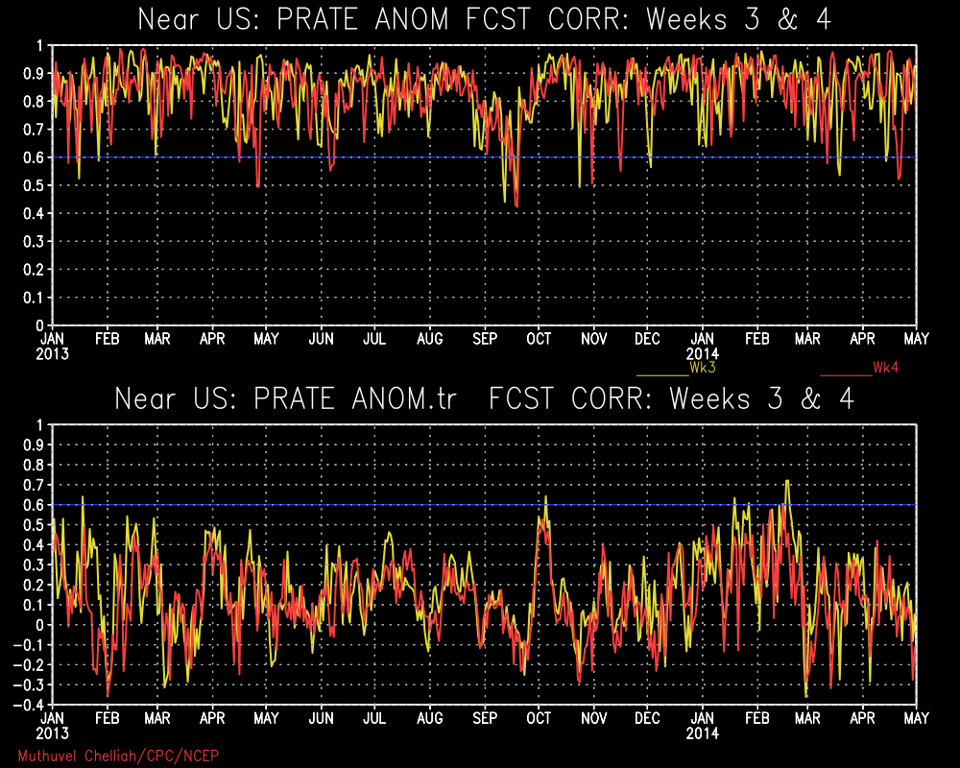

Slide 34
H500
Globe
Wk 1P
Wk 2
Wk 3
Wk 4

Slide 35
H500
Near US
Wk 1P
Wk 2
Wk 3
Wk 4

Slide 36
Thinking Outside the Box:
Prospects of “useful” Predictions for Weeks 3 & 4?

Slide 37
2013
What is the “status quo” of weeks 3-4 forecasts ? based on the state of the art NCEP CFS V2 model/data base!.
No need for me to tell this group about the available 45 day historical and operational forecast data sets based on CFSR v2 model.
Historical: 1999-2010 (complete years). 4 member runs/day
Operational: Started ? I started looking at them since 2012/13 winter
16 members every day (4 per 00/06/12/18 ZZ)

Slide 38
Full (Field) Fcst: Correlation in the full fields (no anomalies are computed) between corresponding CFSRR forecasts and CFSR analyses.
-7dy Mean: Anomaly correlation between the forecast and verifying analyses where anomalies are computed as departures from the previous ‘7 day means’ immediately preceding the forecast day.
-7dy Mean – Clim.Tendency: Same as above, except that the climatological tendency part (for eg. From prev. week to wk3/wk4) is also subtracted before computing correlation.
Traditional. Climo: The traditional anomaly correlation – where anomaly (be it for 1/2/5 day or for weeks 1p/2/3/4) is computed as departure from ‘Traditional’ long term mean (here 1999-2010) climo.
Null(climo) Fcst: Climatology is used as forecast. Correlation in the full fields (no anomalies are computed) between corresponding climo (as fcst) and CFSR analyses.
-1dy Mean: Anomaly correlation between the forecast and verifying analyses where anomalies are computed as departures from the ‘previous day’ means immediately preceding the forecast day.

Slide 39
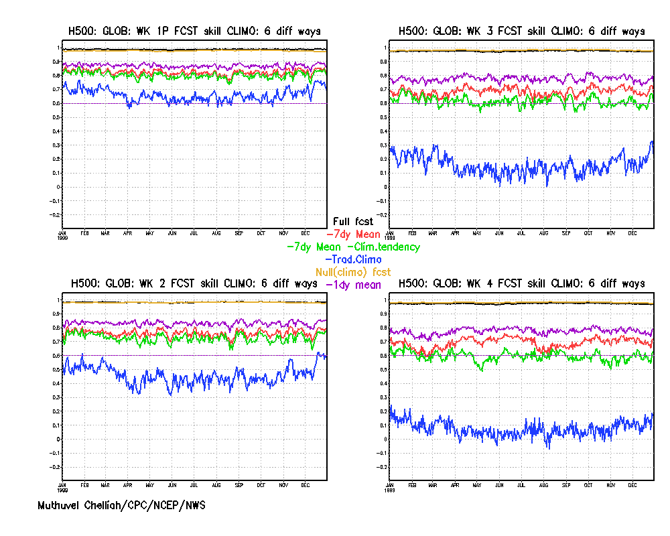
H500
Globe
Wk 1P
Wk 2
Wk 3
Wk 4

Slide 40
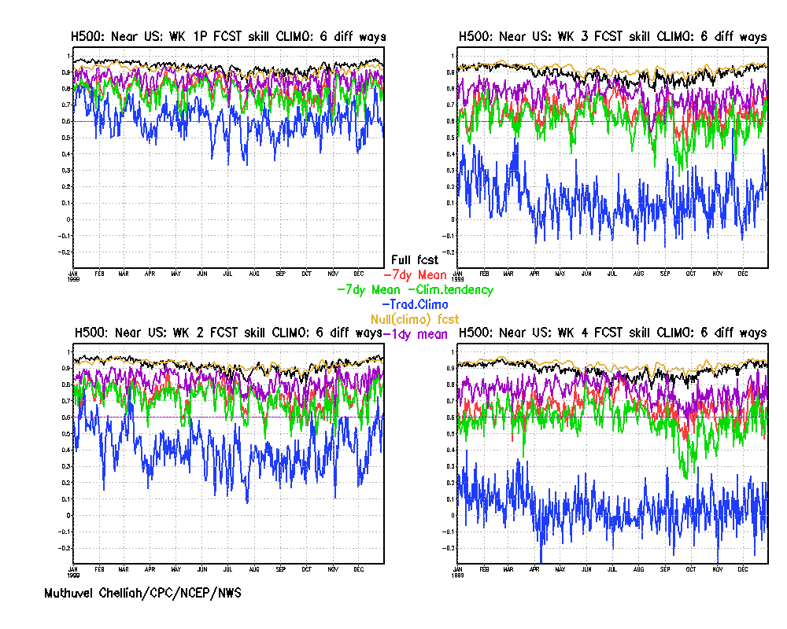
H500
Near US
Wk 1P
Wk 2
Wk 3
Wk 4

Slide 41
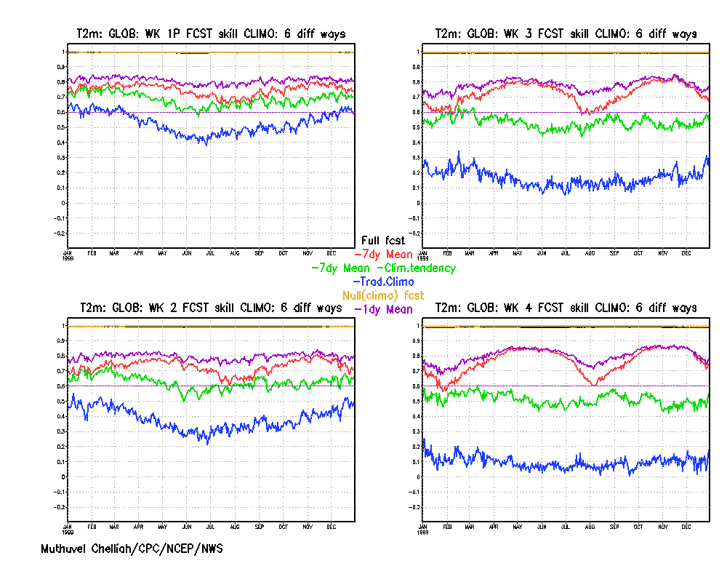
T 2m.
Globe
Wk 1P
Wk 2
Wk 3
Wk 4

Slide 42
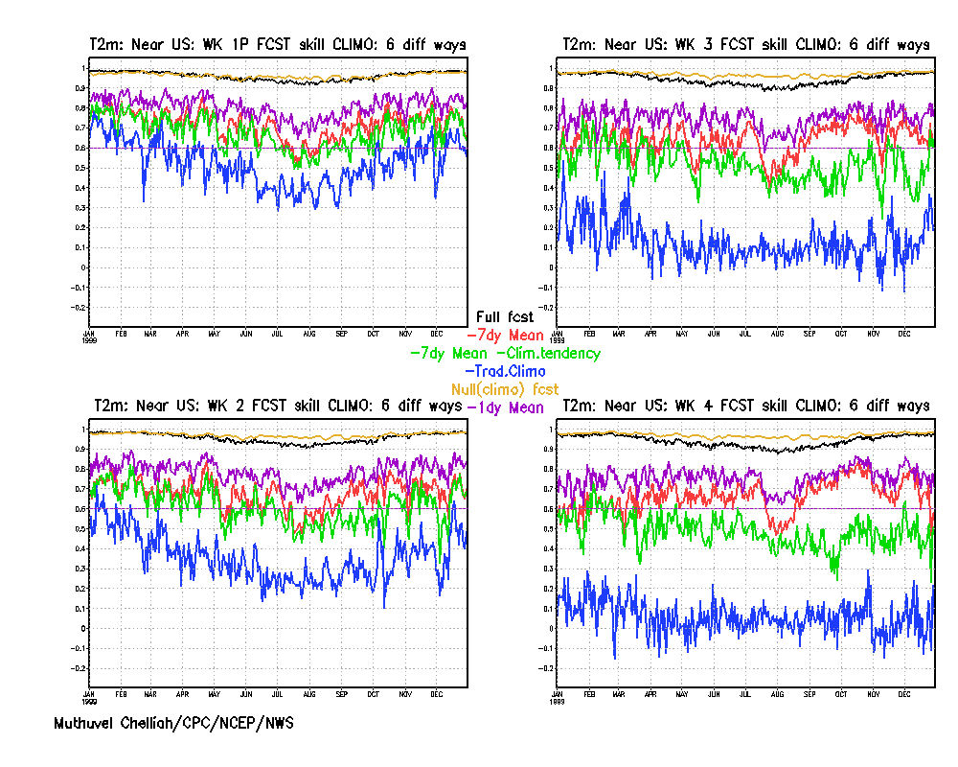
T 2m.
Near US
Wk 1P
Wk 2
Wk 3
Wk 4

Slide 43
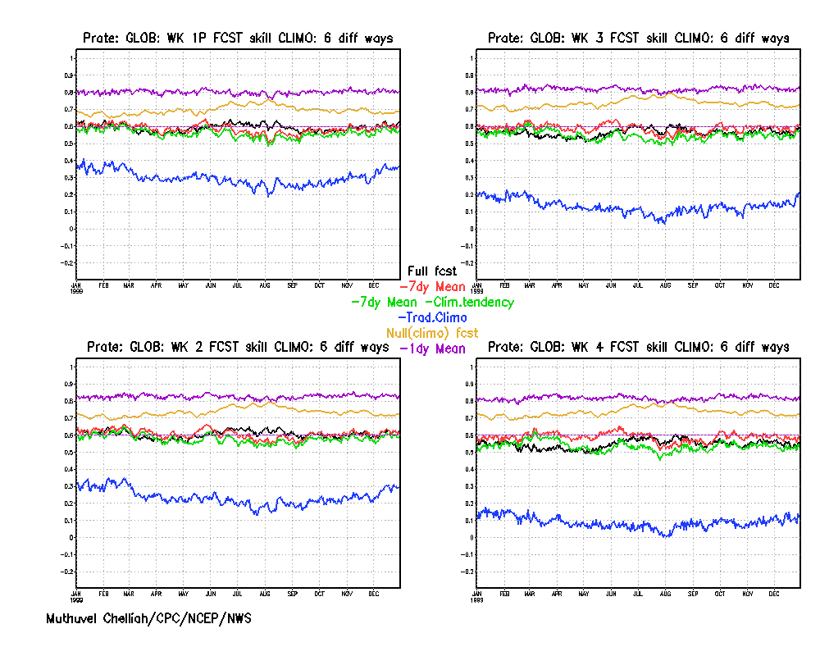
Prate
Globe
Wk 1P
Wk 2
Wk 3
Wk 4

Slide 44
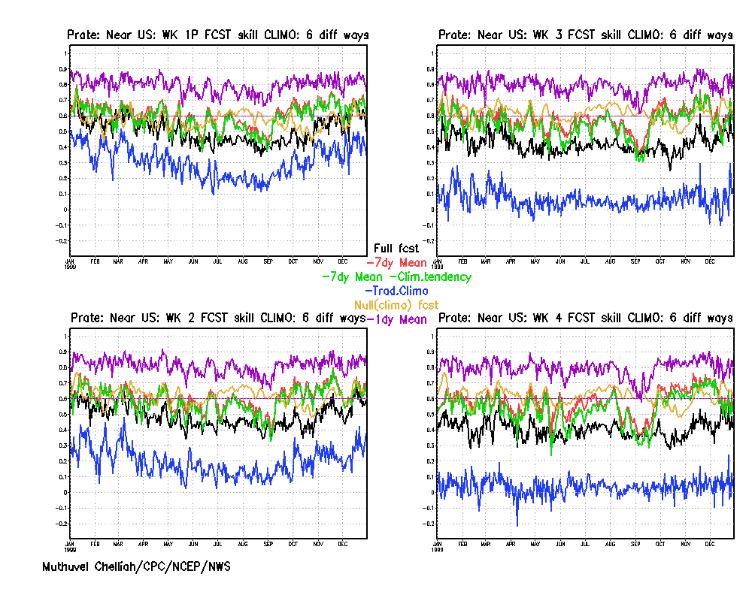
Prate
Near US
Wk 1P
Wk 2
Wk 3
Wk 4

