Slide 1



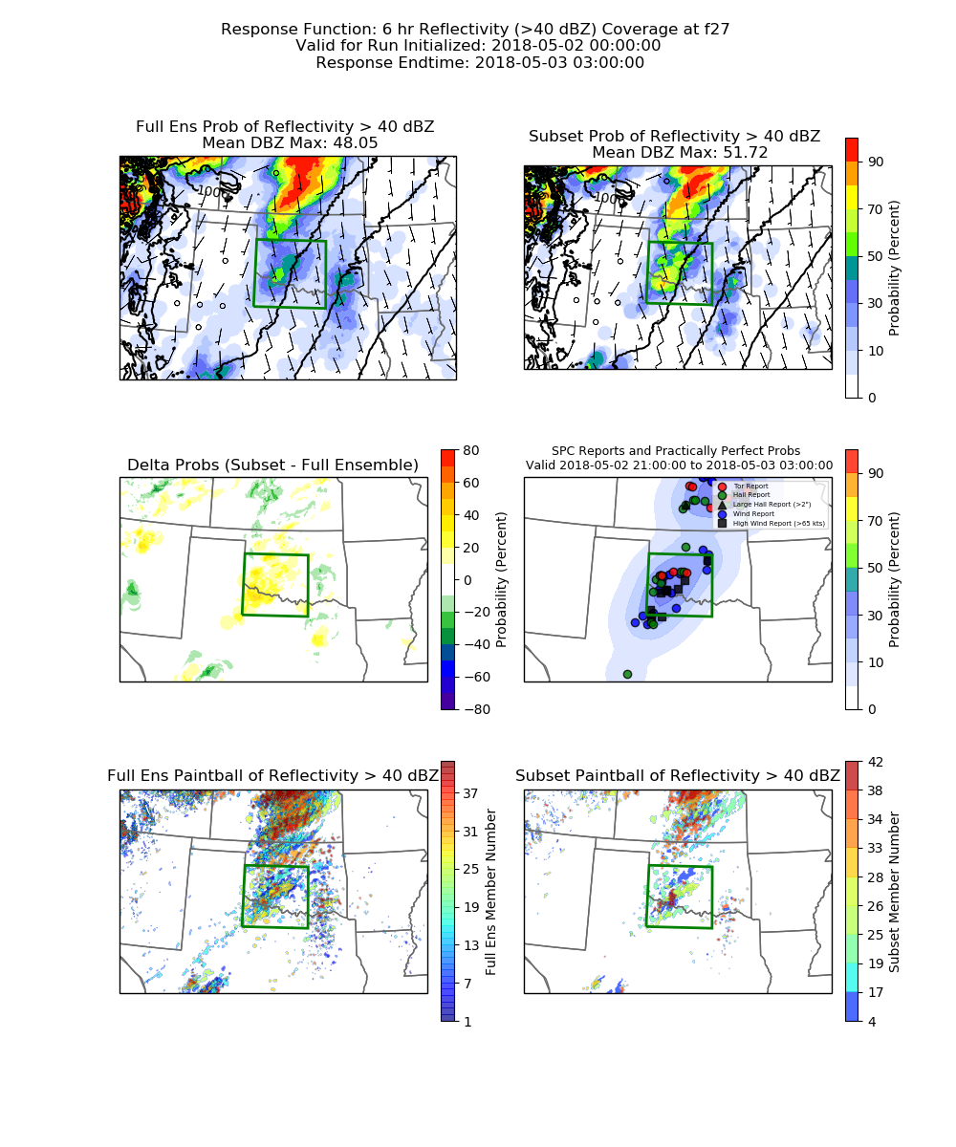
Extracting Ensemble Information in Real Time to Improve Forecasts of Severe Convection
Brian Ancell
Texas Tech University
Contributors
Austin Coleman, Chris Weiss, Billy Faletti, Abby Hutson
NOAA Vlab Forum
June 26, 2024

Slide 2
Motivation
Convection-permitting ensembles represent HUGE datasets with vast amounts of information about the predictability of high-impact weather

Slide 3
Motivation
Convection-permitting ensembles represent HUGE datasets with vast amounts of information about the predictability of high-impact weather
    Different forecast aspects depend on different things earlier in time

Slide 4
Motivation
Convection-permitting ensembles represent HUGE datasets with vast amounts of information about the predictability of high-impact weather
    Different forecast aspects depend on different things earlier in time
    Different hazards of the same storms can depend on different things earlier in time

Slide 5
Motivation
Convection-permitting ensembles represent HUGE datasets with vast amounts of information about the predictability of high-impact weather
    Different forecast aspects depend on different things earlier in time
    Different hazards of the same storms can depend on different things earlier in time
    → The dynamical story grows in complexity further back in time…

Slide 6
Motivation
Convection-permitting ensembles represent HUGE datasets with vast amounts of information about the predictability of high-impact weather
    Different forecast aspects depend on different things earlier in time
    Different hazards of the same storms can depend on different things earlier in time
    → The dynamical story grows in complexity further back in time…
One way to extract ensemble information specific to relevant high-impact forecast features is to apply ensemble sensitivity analysis (ESA)

Slide 7
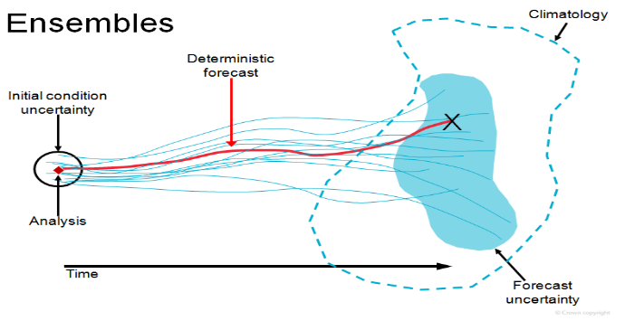
Ensemble Sensitivity
The Basic Recipe:
1) An ensemble of forecasts
2) The choice of a response function (R) at a forecast time
Notes:
Our students must take a leadership class as part of the core classes in the wind science and engineering program. But let’s talk about leadership from a different perspective today. Let’s talk about using everyday decisions and opportunities to build your leadership style for the future.
Lessons and mistakes can be the same despite their contrary meanings. By having both in your life, you gain better understanding and will know better next time when a similar situation arises.

Slide 8
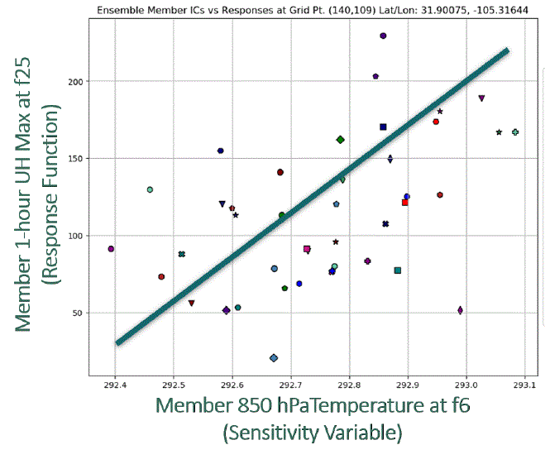
Ensemble Sensitivity
The Basic Recipe:
1) An ensemble of forecasts
2) The choice of a response function (R) at a forecast time
Linear Regression
∂R
Slope = = Ensemble Sensitivity
∂X_{o}
Covariance(R,X_{o})
=
Variance(X_{o})
Deep Fundamental Basis
Other Response Function Examples
Wind speed at a point at 24-hr forecast time
Coverage of heavy precipitation over an area of interest at 36-hr forecast time
Notes:
Our students must take a leadership class as part of the core classes in the wind science and engineering program. But let’s talk about leadership from a different perspective today. Let’s talk about using everyday decisions and opportunities to build your leadership style for the future.
Lessons and mistakes can be the same despite their contrary meanings. By having both in your life, you gain better understanding and will know better next time when a similar situation arises.

Slide 9
Why Ensemble Sensitivity?
Ensemble sensitivity quickly extracts the important early forecast features (and how they are important) to the evolution and predictability of a specific forecast aspect from large ensemble datasets
Notes:
Our students must take a leadership class as part of the core classes in the wind science and engineering program. But let’s talk about leadership from a different perspective today. Let’s talk about using everyday decisions and opportunities to build your leadership style for the future.
Lessons and mistakes can be the same despite their contrary meanings. By having both in your life, you gain better understanding and will know better next time when a similar situation arises.

Slide 10
Why Ensemble Sensitivity?
Ensemble sensitivity quickly extracts the important early forecast features (and how they are important) to the evolution and predictability of a specific forecast aspect from large ensemble datasets
Operational Usefulness
Dynamical understanding – what are the important early forecast features over many cases?
Subjective forecast adjustment – can more confidence be placed in members that are better in sensitive regions early in a forecast?
Objective forecast adjustment – can an automated process be developed to adjust ensemble probabilities based on the early forecast skill of members in sensitive regions?
Notes:
Our students must take a leadership class as part of the core classes in the wind science and engineering program. But let’s talk about leadership from a different perspective today. Let’s talk about using everyday decisions and opportunities to build your leadership style for the future.
Lessons and mistakes can be the same despite their contrary meanings. By having both in your life, you gain better understanding and will know better next time when a similar situation arises.

Slide 11
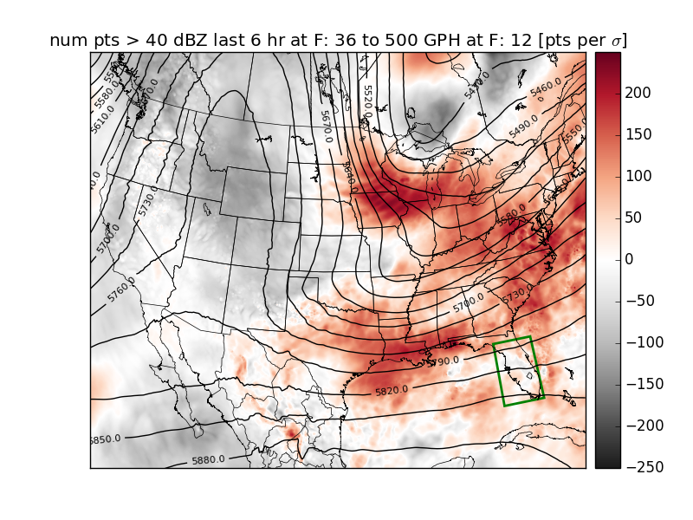
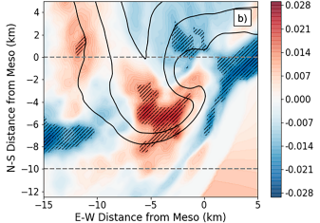
Why Ensemble Sensitivity?
ESA → Can be applied across multiple scales
Forecast Time → 1-2 days
Watch-Outlook Timescales
Synoptic-scale Processes
Forecast Time → 1-2 hours
Warning Timescales (WoFs application)
Storm-scale Processes
Notes:
Our students must take a leadership class as part of the core classes in the wind science and engineering program. But let’s talk about leadership from a different perspective today. Let’s talk about using everyday decisions and opportunities to build your leadership style for the future.
Lessons and mistakes can be the same despite their contrary meanings. By having both in your life, you gain better understanding and will know better next time when a similar situation arises.

Slide 12
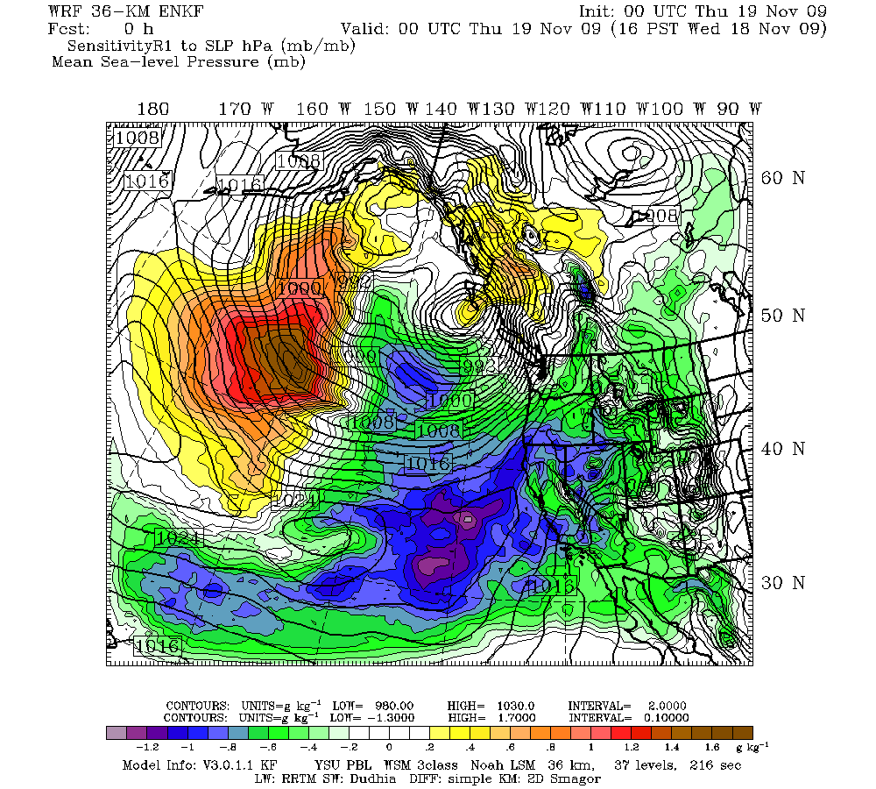
Ensemble Sensitivity
Change in R Sensitivity IC Perturbation
∆R ≈ ∂R/∂Xo * ∆Xo
24-hr forecast position of cyclone
L
Sensitivity of 24-hr cyclone central pressure to 00-hr SLP
mb/mb
Notes:
Our students must take a leadership class as part of the core classes in the wind science and engineering program. But let’s talk about leadership from a different perspective today. Let’s talk about using everyday decisions and opportunities to build your leadership style for the future.
Lessons and mistakes can be the same despite their contrary meanings. By having both in your life, you gain better understanding and will know better next time when a similar situation arises.

Slide 13

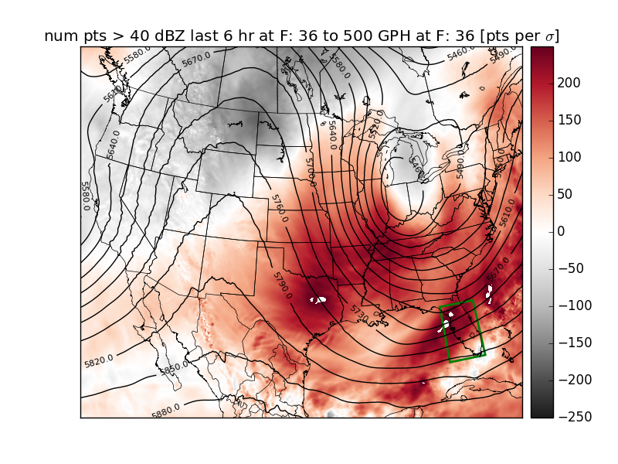
Time Evolution of Ensemble Sensitivity Fields
Response → 36-hr storm coverage (green box)
Sensitivity → 500hPa GPH
Sensitivity of 36-hr storm coverage to 500hPa GPH
36-hr
Num Pts.

Slide 14
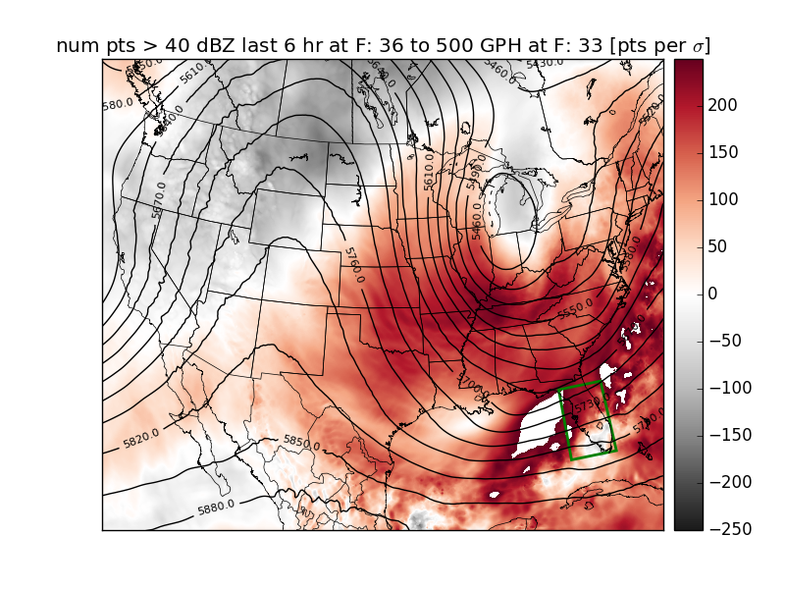
Time Evolution of Ensemble Sensitivity Fields
Response → 36-hr storm coverage (green box)
Sensitivity → 500hPa GPH
Sensitivity of 36-hr storm coverage to 500hPa GPH
33-hr
Num Pts.

Slide 15
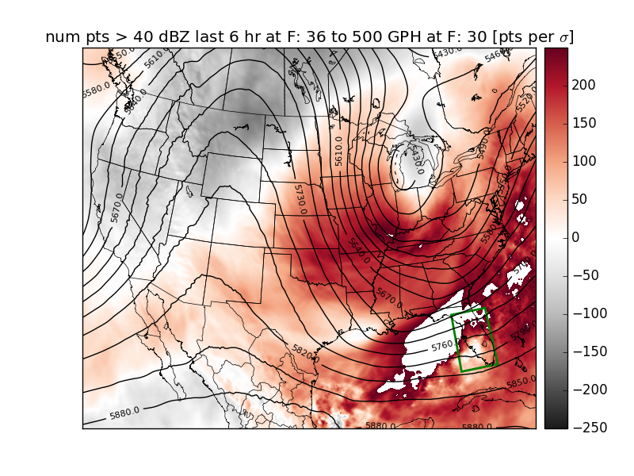
Time Evolution of Ensemble Sensitivity Fields
Response → 36-hr storm coverage (green box)
Sensitivity → 500hPa GPH
Sensitivity of 36-hr storm coverage to 500hPa GPH
30-hr
Num Pts.

Slide 16
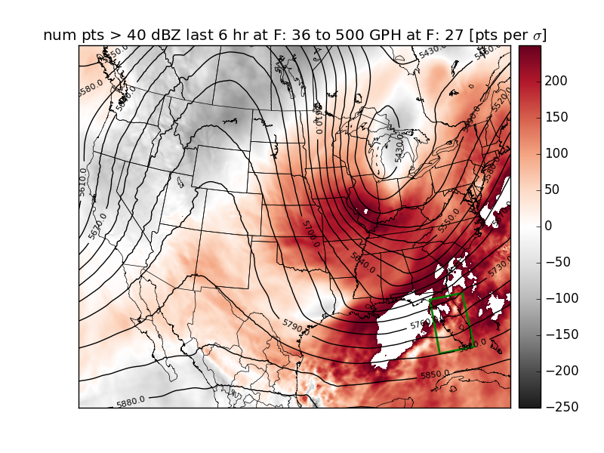
Time Evolution of Ensemble Sensitivity Fields
Response → 36-hr storm coverage (green box)
Sensitivity → 500hPa GPH
Sensitivity of 36-hr storm coverage to 500hPa GPH
27-hr
Num Pts.

Slide 17
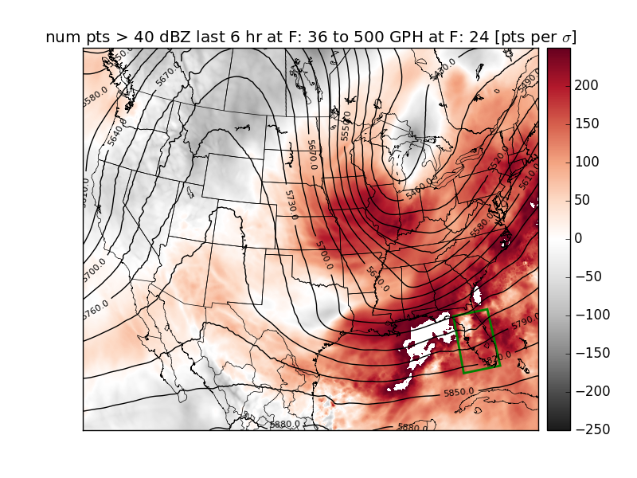
Time Evolution of Ensemble Sensitivity Fields
Response → 36-hr storm coverage (green box)
Sensitivity → 500hPa GPH
Sensitivity of 36-hr storm coverage to 500hPa GPH
24-hr
Num Pts.

Slide 18
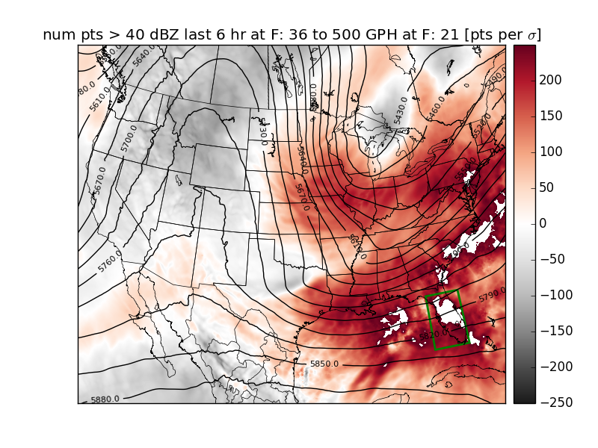
Time Evolution of Ensemble Sensitivity Fields
Response → 36-hr storm coverage (green box)
Sensitivity → 500hPa GPH
Sensitivity of 36-hr storm coverage to 500hPa GPH
21-hr
Num Pts.

Slide 19
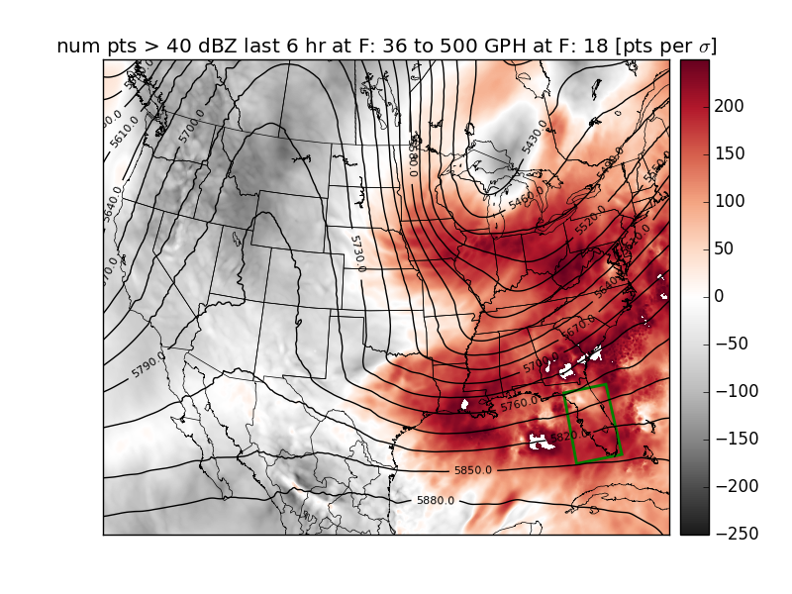
Time Evolution of Ensemble Sensitivity Fields
Response → 36-hr storm coverage (green box)
Sensitivity → 500hPa GPH
Sensitivity of 36-hr storm coverage to 500hPa GPH
18-hr
Num Pts.

Slide 20
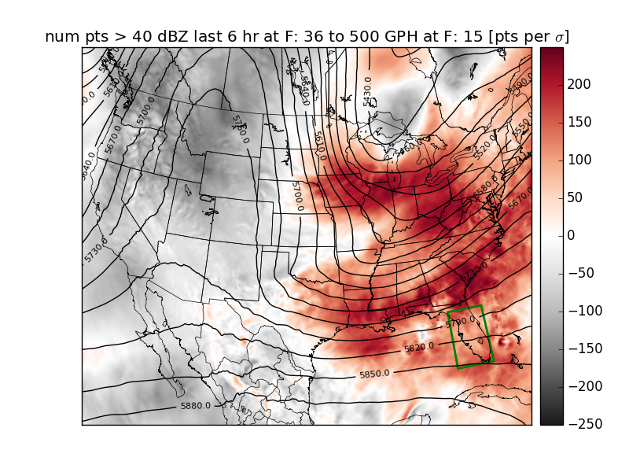
Time Evolution of Ensemble Sensitivity Fields
Response → 36-hr storm coverage (green box)
Sensitivity → 500hPa GPH
Sensitivity of 36-hr storm coverage to 500hPa GPH
15-hr
Num Pts.

Slide 21
Time Evolution of Ensemble Sensitivity Fields
Response → 36-hr storm coverage (green box)
Sensitivity → 500hPa GPH
Sensitivity of 36-hr storm coverage to 500hPa GPH
12-hr
Num Pts.

Slide 22
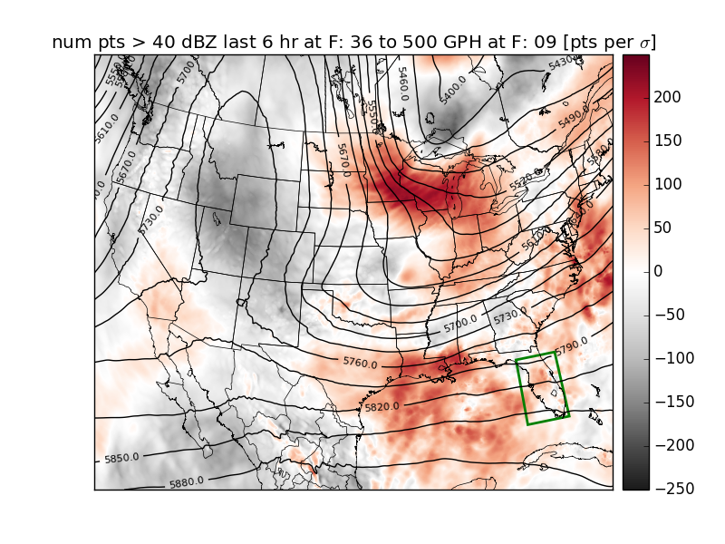
Time Evolution of Ensemble Sensitivity Fields
Response → 36-hr storm coverage (green box)
Sensitivity → 500hPa GPH
Sensitivity of 36-hr storm coverage to 500hPa GPH
9-hr
Num Pts.

Slide 23
Ensemble Sensitivity-Based Subsetting
Ensemble Sensitivity-Based Subsetting
A technique that adjusts ensemble probabilities by choosing an ensemble subset with the smallest errors in sensitive regions
Notes:
Our students must take a leadership class as part of the core classes in the wind science and engineering program. But let’s talk about leadership from a different perspective today. Let’s talk about using everyday decisions and opportunities to build your leadership style for the future.
Lessons and mistakes can be the same despite their contrary meanings. By having both in your life, you gain better understanding and will know better next time when a similar situation arises.

Slide 24
Ensemble Sensitivity-Based Subsetting
Ensemble Sensitivity-Based Subsetting
A technique that adjusts ensemble probabilities by choosing an ensemble subset with the smallest errors in sensitive regions
→ Produces “dead-end forecasts” to specifically improve high-impact forecasts of a chosen response function R
Notes:
Our students must take a leadership class as part of the core classes in the wind science and engineering program. But let’s talk about leadership from a different perspective today. Let’s talk about using everyday decisions and opportunities to build your leadership style for the future.
Lessons and mistakes can be the same despite their contrary meanings. By having both in your life, you gain better understanding and will know better next time when a similar situation arises.

Slide 25
Ensemble Sensitivity-Based Subsetting
Sensitivity-Based Subsetting: What We’ve Learned
Nonlinearity is not really a problem

Slide 26
Ensemble Sensitivity-Based Subsetting
Sensitivity-Based Subsetting: What We’ve Learned
Nonlinearity is not really a problem
Model physics ensembles add difficulty

Slide 27
Ensemble Sensitivity-Based Subsetting
Sensitivity-Based Subsetting: What We’ve Learned
Nonlinearity is not really a problem
Model physics ensembles add difficulty
Technique provides both success and failure

Slide 28
Ensemble Sensitivity-Based Subsetting
Sensitivity-Based Subsetting: What We’ve Learned
Nonlinearity is not really a problem
Model physics ensembles add difficulty
Technique provides both success and failure
common characteristics (flow, distribution, spread…)?

Slide 29
Ensemble Sensitivity-Based Subsetting
Sensitivity-Based Subsetting: What We’ve Learned
Nonlinearity is not really a problem
Model physics ensembles add difficulty
Technique provides both success and failure
common characteristics (flow, distribution, spread…)?
Current Work → Can we predict when the technique will work and when it won’t???

Slide 30
Ensemble Sensitivity-Based Subsetting
R = Simulated Reflectivity Coverage > 40dBZ (F21-F27)
FULL ENSEMBLE PROB
SUBSET PROB
DELTA PROB
VERIFICATION
Notes:
Our students must take a leadership class as part of the core classes in the wind science and engineering program. But let’s talk about leadership from a different perspective today. Let’s talk about using everyday decisions and opportunities to build your leadership style for the future.
Lessons and mistakes can be the same despite their contrary meanings. By having both in your life, you gain better understanding and will know better next time when a similar situation arises.

Slide 31
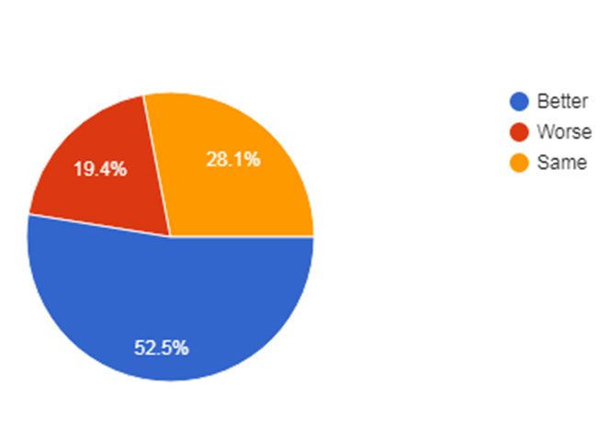
Ensemble Sensitivity-Based Subsetting
  Relative to the full ensemble, the forecast skill of the subset inside the response function box is...
  Better
  Worse
  Same

Slide 32
Ensemble Sensitivity-Based Subsetting
  Relative to the full ensemble, the forecast skill of the subset inside the response function box is...
  Better
  Worse
  Same
HWT Summary Stats (4 years)

Slide 33
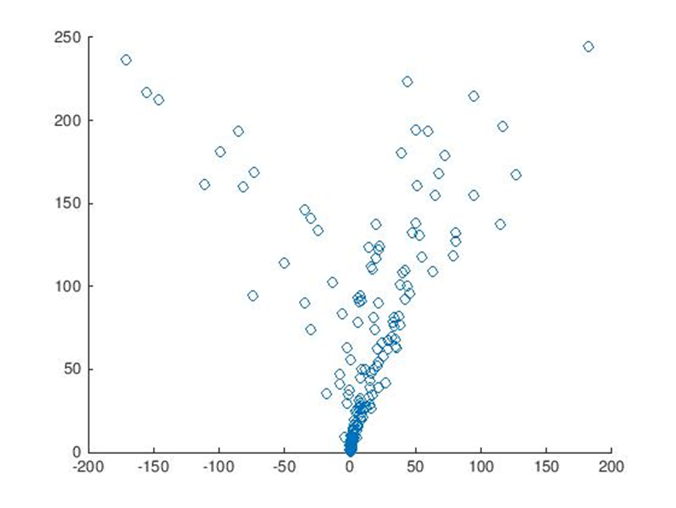
Ensemble Sensitivity-Based Subsetting
RESPONSE STD DEV
MAE CHANGE
(FULL – SUBSET)
Notes:
Our students must take a leadership class as part of the core classes in the wind science and engineering program. But let’s talk about leadership from a different perspective today. Let’s talk about using everyday decisions and opportunities to build your leadership style for the future.
Lessons and mistakes can be the same despite their contrary meanings. By having both in your life, you gain better understanding and will know better next time when a similar situation arises.

Slide 34
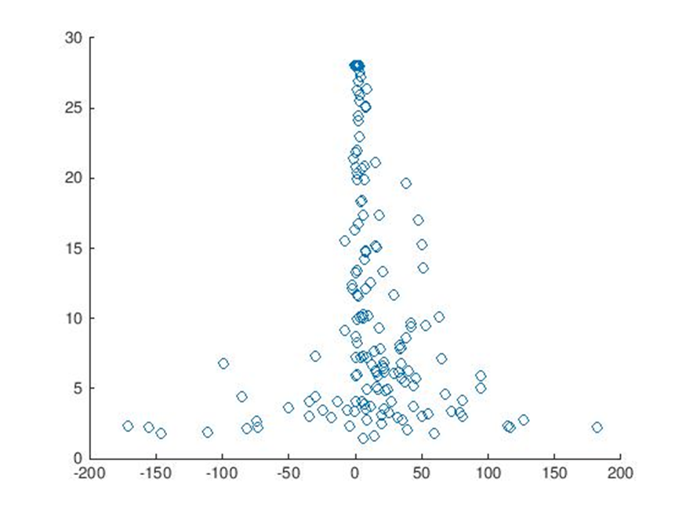
Ensemble Sensitivity-Based Subsetting
RESPONSE STD DEV
RESPONSE KURTOSIS
MAE CHANGE
(FULL – SUBSET)
MAE CHANGE
(FULL – SUBSET)
Notes:
Our students must take a leadership class as part of the core classes in the wind science and engineering program. But let’s talk about leadership from a different perspective today. Let’s talk about using everyday decisions and opportunities to build your leadership style for the future.
Lessons and mistakes can be the same despite their contrary meanings. By having both in your life, you gain better understanding and will know better next time when a similar situation arises.

Slide 35
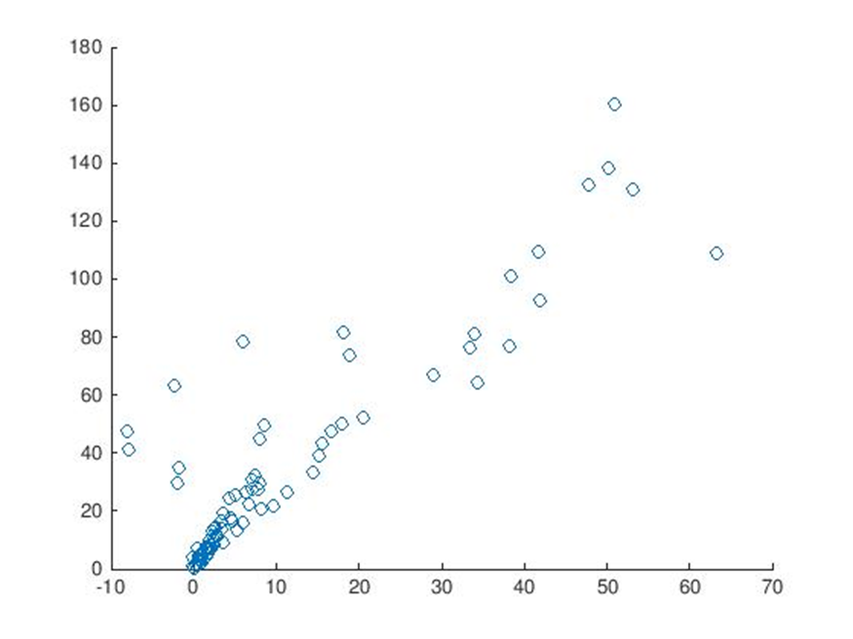
Ensemble Sensitivity-Based Subsetting
RESPONSE STD DEV
RESPONSE KURTOSIS
RESPONSE STD DEV
MAE CHANGE
(FULL – SUBSET)
MAE CHANGE
(FULL – SUBSET)
MAE CHANGE
(FULL – SUBSET)
Notes:
Our students must take a leadership class as part of the core classes in the wind science and engineering program. But let’s talk about leadership from a different perspective today. Let’s talk about using everyday decisions and opportunities to build your leadership style for the future.
Lessons and mistakes can be the same despite their contrary meanings. By having both in your life, you gain better understanding and will know better next time when a similar situation arises.

Slide 36
Ensemble Sensitivity-Based Subsetting
RESPONSE STD DEV
RESPONSE KURTOSIS
RESPONSE STD DEV
MAE CHANGE
(FULL – SUBSET)
MAE CHANGE
(FULL – SUBSET)
MAE CHANGE
(FULL – SUBSET)
Preliminary Insights
→ Response std. dev. does not correlate well to success
→ Response kurtosis associated with success for large values
→ Large kurtosis recovers successful mode of std. dev.
Notes:
Our students must take a leadership class as part of the core classes in the wind science and engineering program. But let’s talk about leadership from a different perspective today. Let’s talk about using everyday decisions and opportunities to build your leadership style for the future.
Lessons and mistakes can be the same despite their contrary meanings. By having both in your life, you gain better understanding and will know better next time when a similar situation arises.

Slide 37
Summary
Ensemble sensitivity is a quick, flexible, statistical tool that reveals features linked to the predictability of a specific forecast aspect of interest later in time
    Deep dynamical basis
    Used for dynamical understanding and beneficial forecast adjustment

Slide 38
Summary
Ensemble sensitivity is a quick, flexible, statistical tool that reveals features linked to the predictability of a specific forecast aspect of interest later in time
    Deep dynamical basis
    Used for dynamical understanding and beneficial forecast adjustment
Substantial research on ensemble sensitivity-based subsetting shows it has fundamental potential to improve forecasts in an operational environment at multiple scales

Slide 39
Summary
Ensemble sensitivity is a quick, flexible, statistical tool that reveals features linked to the predictability of a specific forecast aspect of interest later in time
    Deep dynamical basis
    Used for dynamical understanding and beneficial forecast adjustment
Substantial research on ensemble sensitivity-based subsetting shows it has fundamental potential to improve forecasts in an operational environment at multiple scales
How sensitivity-based subsetting can perform in a realistic framework is a key question toward operational use

