Slide 1
Satellite Training and Operations Resource (STOR)
stor
Frank Alsheimer
STOR Team Lead

Slide 2
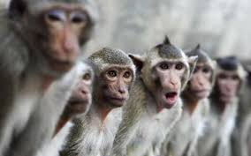
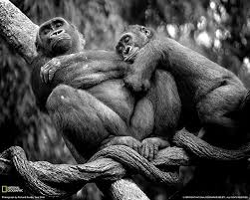
Meet the STOR Team
Field members
Frank Alsheimer (CAE)
Brian Carcione (HUN)
Bill Line (PUB)
Dr. Stephen Bieda (AMA)
Dave Barber (AAWU)
OCLO rep: Brian Motta (FDTD)
NOAT rep: Bill Ward (PR SSD)

Slide 3
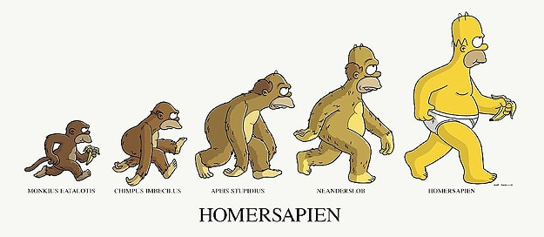
The evolution of the STOR
SURT (2013-2015)
STAT (2015-2017)
SAT-FC (2016)
GOES-R PREP COURSE (2016-2017)
STOR (2017-2018)

Slide 4
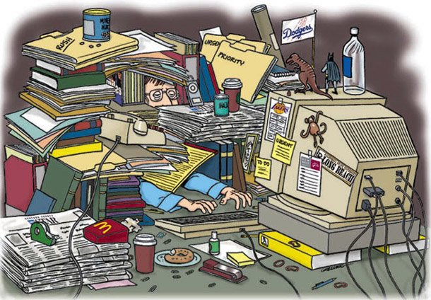
STOR Team Objectives
Create a mechanism for the multitude of entities providing satellite reference, training, and other related information to register content on the STOR page.
Working with Office of the Chief Learning Officer (OCLO) representatives to determine appropriate reference material to be made available on the STOR and the AWIPS Interactive Reference (AIR) Tool.

Slide 5
STOR Team Objectives
Working with the GOES-16 L2 Applications Training Advisory Team and the LEO Training Advisory Team to keep them abreast of the latest status and developments of the STOR effort and ensure the work done by those teams is properly contained in the STOR.
Maintaining a well-organized page to allow users to access the desired material on STOR with relative ease.

Slide 6
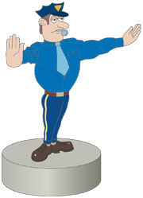
STOR Team Objectives
Updating the material on the STOR to make sure the latest versions are available.
Directing users to the Commerce Learning Center for any official training where completions need to be tracked. This will be based on information from OCLO and the NWS Operational Advisory Team (NOAT).

Slide 7
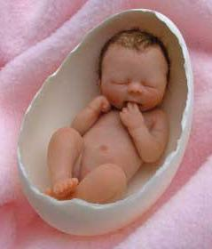
AWIPS Interactive Reference (AIR)
Born out of a decision made at a Satellite Proving Ground Meeting in 2015.
Initial concept developed at NASA/SPoRT.
AIR now lives with the Meteorological Development Lab. (MDL).
Gives AWIPS users quick access to reference material pertinent to the image on their screen.

Slide 8
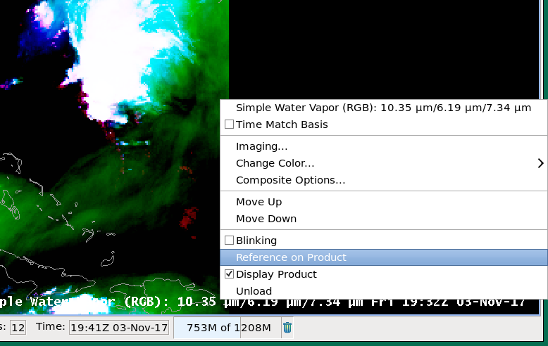
How to Access the AIR

Slide 9
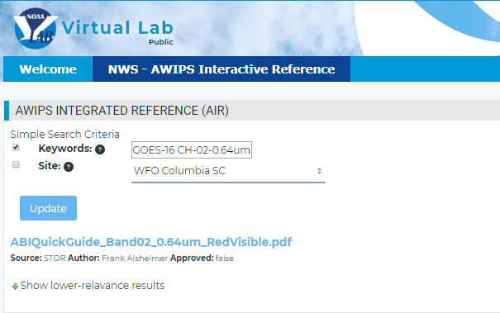
Initial AIR Screen in Firefox

Slide 10
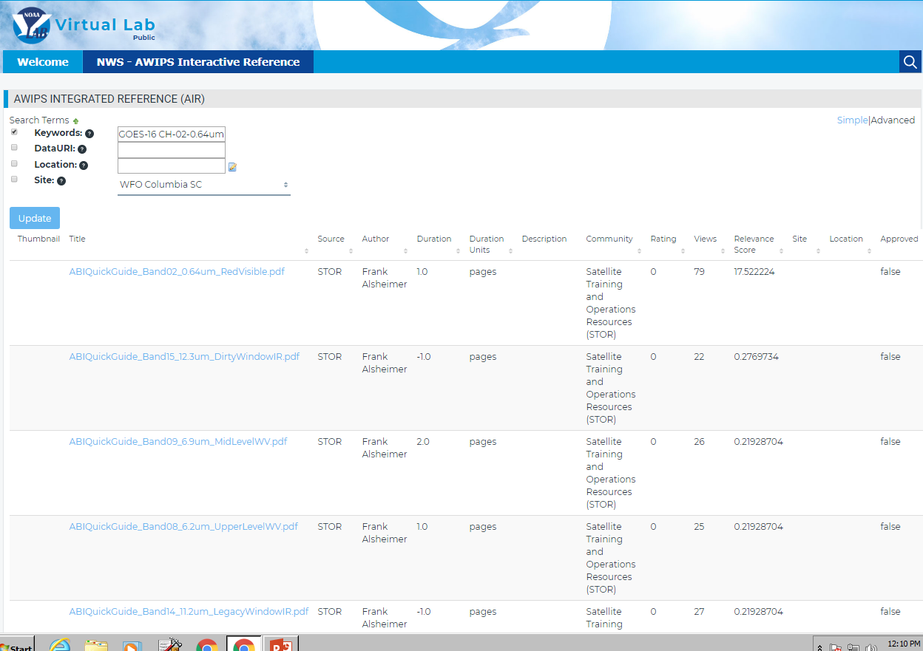
Advanced AIR Screen

Slide 11
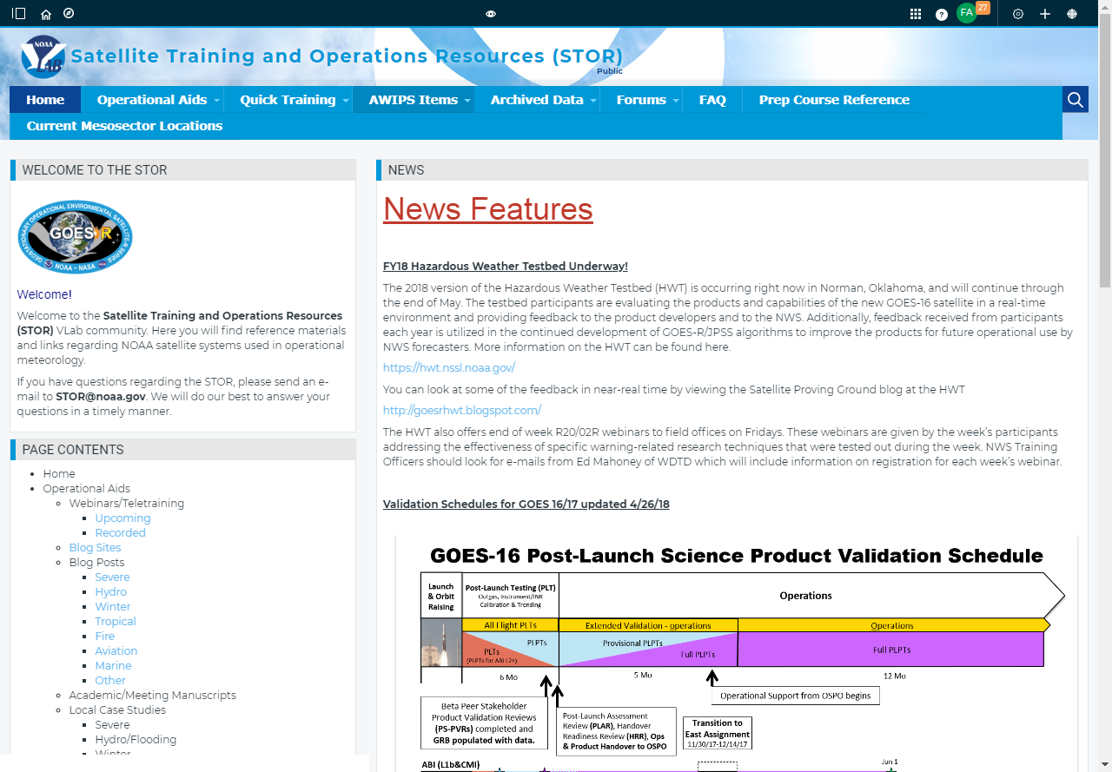
STOR Vlab Page
https://vlab.ncep.noaa.gov/web/stor
It includes:
News Features
Product Validation Schedules
Blog Posts/Sites
Quick Guides
Quick Briefs
AWIPS Procedures
AWIPS Color Curves
Sources of Archived Data
VISIT Teletraining Calendar
Link to Mesosector Locations
Link to Satellite Help Desk

Slide 13
There’s still work to do!
Continue to populate STOR/AIR with updated references from GOES and LEO STAT teams
Import the following items from the field for sharing
Color Curves
Procedures
Case Studies
Training Plans
Add information to FAQ and manuscript sections
The team charter states that the team is expected to sunset at the end of 2018, at which time the STOR will transition to OCLO for ownership/maintenance.

