Slide 1
The Integrated Dissemination Program
March 20, 2019

Slide 2
Topics
What is IDP (Integrated Dissemination Program)?
What applications run on IDP
How IDP is supported
Questions

Slide 3
What is IDP?
NOAA's Integrated Dissemination Program (IDP) was established to transform the Weather Services' 170+ web sites and 20+ operational dissemination capabilities to an integrated, enterprise-wide, dissemination service with redundancy capabilities.
IDP is supported and maintained within NCEP Central Operations (NCO). The IDP portfolio of applications are managed by the Office of Dissemination.
The Office of Dissemination is the first stop in the process of migrating an application onto IDP.
Today there are roughly 10 new projects waiting for their turn to be onboarded
The Office of Dissemination evaluates all incoming applications and sets priorities
Notes:
Don’t know if you want to mention email as well (EDIS).

Slide 4
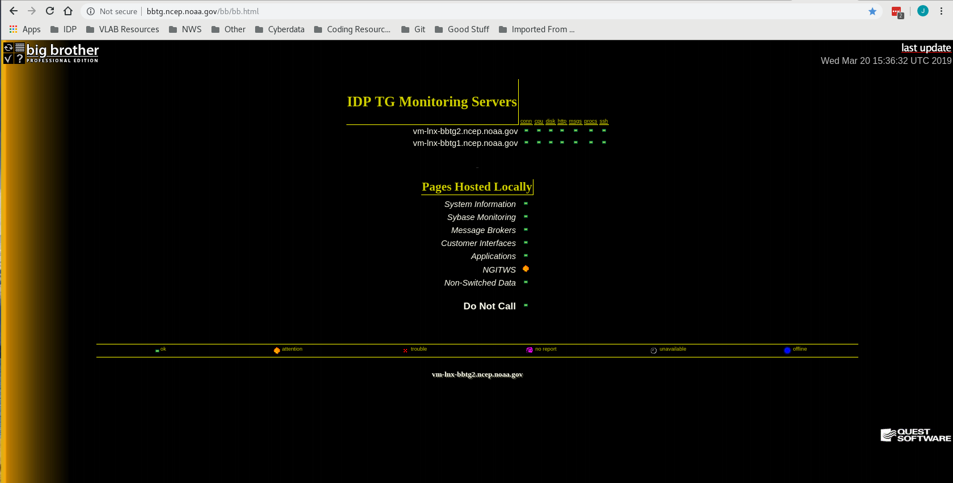
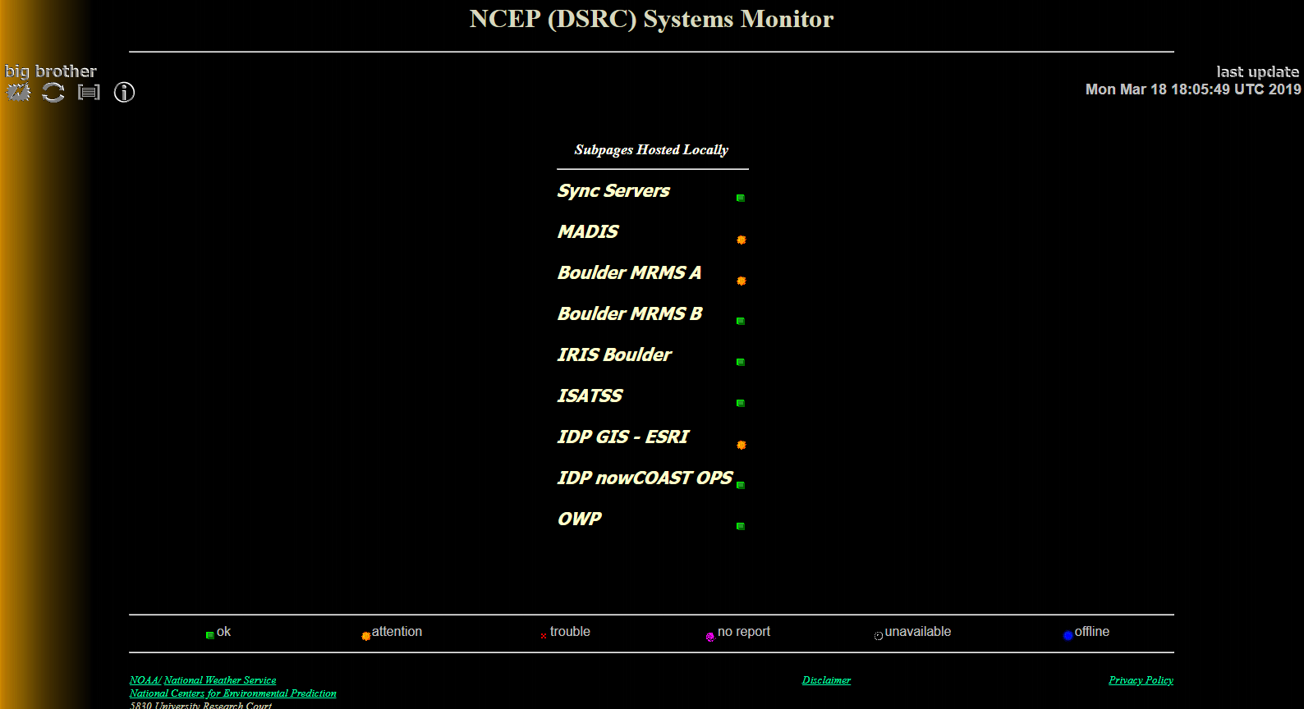
Tiered Support of IDP
NCO supports all aspects of IDP including
Tier 1 support is provided by the Operations and Monitoring Branch (OMB). The SDM and Tech Control teams provide 24x7 monitoring of the IDP hardware, the operational virtual machines (VMs), and the operational application running on these VMs.
Notes:
Don’t know if you want to mention email as well (EDIS).

Slide 5
Tiered Support of IDP
Tier 2 support is provided by the Implementation and Data Services Branch (IDSB). Responsibilities of the Onboarding Team (OBT) include:
Provide 24x7 support for the application and output, troubleshooting operational issues using numerous tools
Test and implement any updates or fixes to the application.
Work with development organizations to onboard new applications
Respond to customer requests with regards to data availability/quality. Work with Tier 3 to resolve data quality issues.
Work with the developers to optimize the application
Perform failovers of the operational application to support system patching and data center failovers. Complete validation of the operational application after application failovers.
Tier 3 support is provided by the application’s development organization according to the agreement stated within the roles and responsibilities document
Notes:
Don’t know if you want to mention email as well (EDIS).

Slide 6
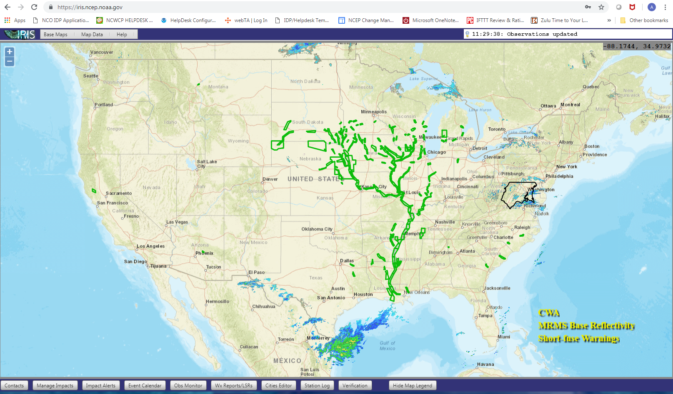
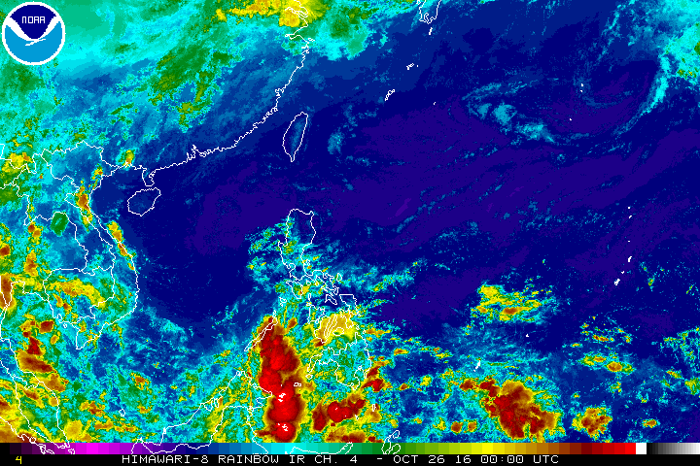
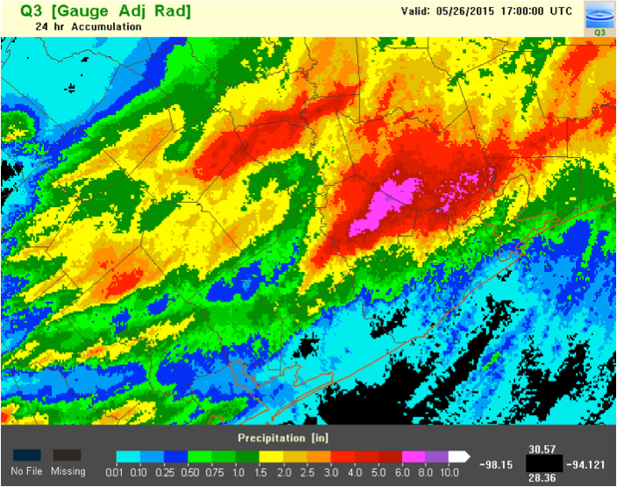
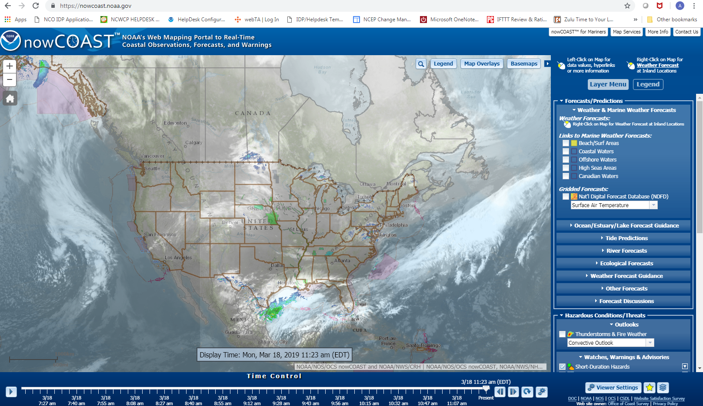
About the IDP Applications
MADIS (Meteorological Assimilation Data Ingest System) (https://madis-data.ncep.noaa.gov/MadisSurface/)
MRMS (Multiple-Radar / Multiple-Sensor) (https://mrms.ncep.noaa.gov/data)
NGITWS (NextGen IT Web Services)
Weather.gov API (https://api.weather.gov)
DataStreme (AMS DataStreme)
EDIS (Email Data Input System)
Himawari (Japanese Geostationary Satellite Himawari-8)
IRIS/iNWS/HCE (Integrated Real-time Impacts Services and Hazards Collection Extended) (https://iris.ncep.noaa.gov/) (https://inws.ncep.noaa.gov)
NowCOAST (NowCOAST (https://nowcoast.ncep.noaa.gov/))
IDP-GIS (IDP-GIS) (https://idpgis.ncep.noaa.gov)
HCL (Hazards Collection Legacy)
iSatSS (GOES 16 and 17 Satellite Subsystem)
OWP Post Processing (Office of Water Prediction) (https://nomads.ncep.noaa.gov/pub/data/nccf/com/nwm/post-processed/)
GMDSS (Global Maritime Distress and Safety System)
NLETS (National Law Enforcement Telecommunications Systems)
NWSTG National Weather Service Telecommunications Gateway

Slide 7
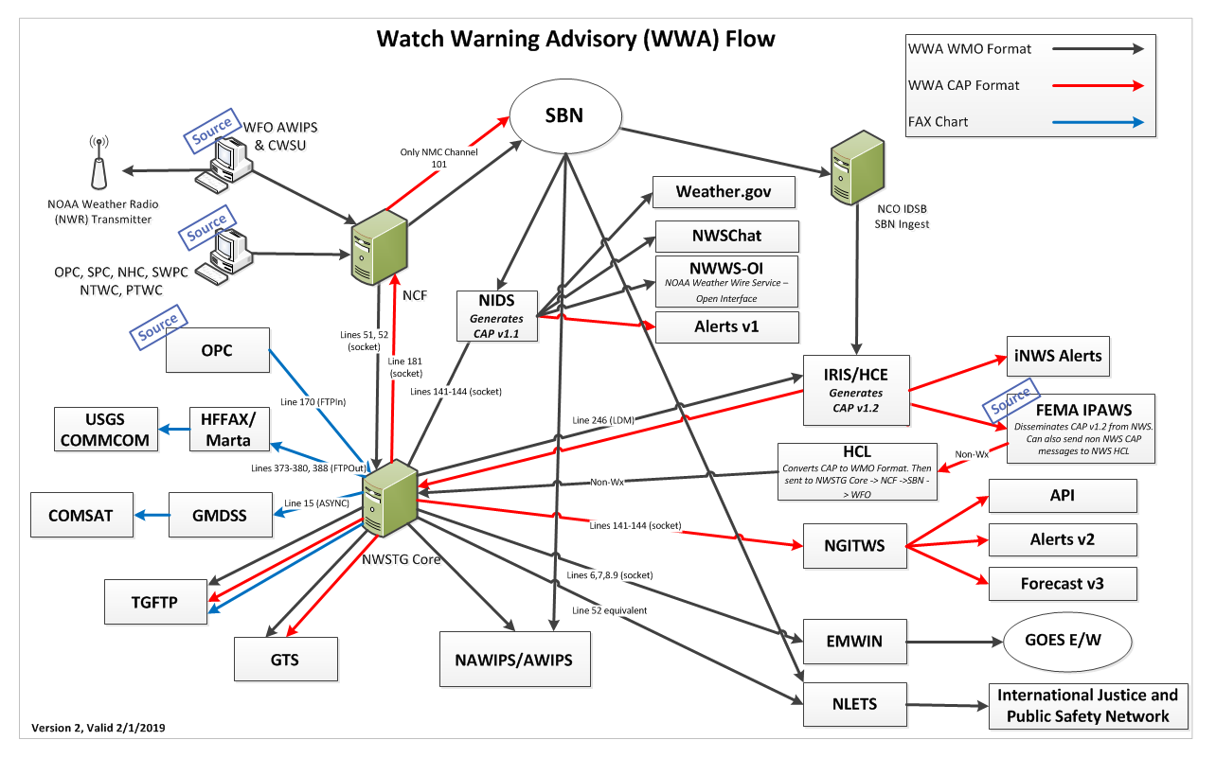
Watch, Warning and Advisory (WWA) Data Flow

Slide 8
Software/Infrastructure Supportability
The applications running on IDP vary widely in scripting/programming languages, as well as software and database layers. The OBT supports:
C, C++, Perl, Python, Fortran, Java, Javascript, Bash
PostgreSQL, MySQL, SQL Server, MongoDB Databases
Message queues such as RabbitMQ and LDM
The OBT is required to have a unique skill set to not only understand numerous languages, but also network and system infrastructure
We support Red Hat Enterprise Linux 6, 7 and AIX
Use of numerous tools to troubleshoot network and systems to include:
VCenter
Citrix
Scrutinizer

Slide 9
Application Infrastructure
All new applications on IDP consist of two instances at NOAA Center for Weather and Climate Prediction (NCWCP), College Park, MD, and the David Skaggs Research Center (DSRC), Boulder, CO, and independently provide primary and backup functionality
Both data centers are scalable, robust, secure, and supported 24x7x365 operationally
Aim to perform failovers without users ever noticing
Continuous system scanning and monitoring for security vulnerabilities and detection of security threats or intrusions
Utilize both local Citrix Load Balancing infrastructure and commercial Akamai services
IDP runs on a cluster of Dell Virtual Machines (VMs) that are capable of easily adding cores, memory and storage.
Cores, memory and I/O bandwidth are shared in resource pools using VMware and NetApp
Each VM consists of 2.5GHz/processor, each processor has 213GB of memory
Each data center consists of 4.2 petabytes of storage
Each data center consists of 412 VMs just supporting IDP
Notes:
iNWS Alerts are ones seen on mobile phones
FEMA IPAWS sends emergencies to FEMA

Slide 10
Frequency of Onboarding Implementations
The upgrade frequency of existing applications is about twice a year
The OBT is typically working 4 upgrades to existing applications at a given time
Work closely with the development organization
Regression testing
Functional testing
Performance testing
Validation testing
Only 1 new application at a time is activated on a path to operations
This effort consists of multiple teams across NCO to include, OBT, Dataflow, Network, and Infrastructure
This typically takes between 7-11 months from kickoff to implementation

Slide 11
Normal Day
NCO is a complex, fast-paced work environment
Strive to meet deadlines for project plans and balance supporting operational issues that arise unexpectedly.
NCO plans on average that 2 people stay dedicated to just supporting operations and maintenance
To complete our mission we have between 6-8 staff, mixed between contractors and feds
The OBT is a rotating 24/7 on-call team that is dedicated to ensuring all IDP applications are running optimally for our NWS and external partners

Slide 12
Questions

Slide 13
Backup Slides

Slide 14
The Onboarding Process
Project Kickoff
Requirements
Gathering
Development
Tier Setup
Code
Handoff
Production
Tier Setup
QA Tier Setup
30-Day
Test
Application
Operational
In IDP
Operations
Readiness

Slide 15
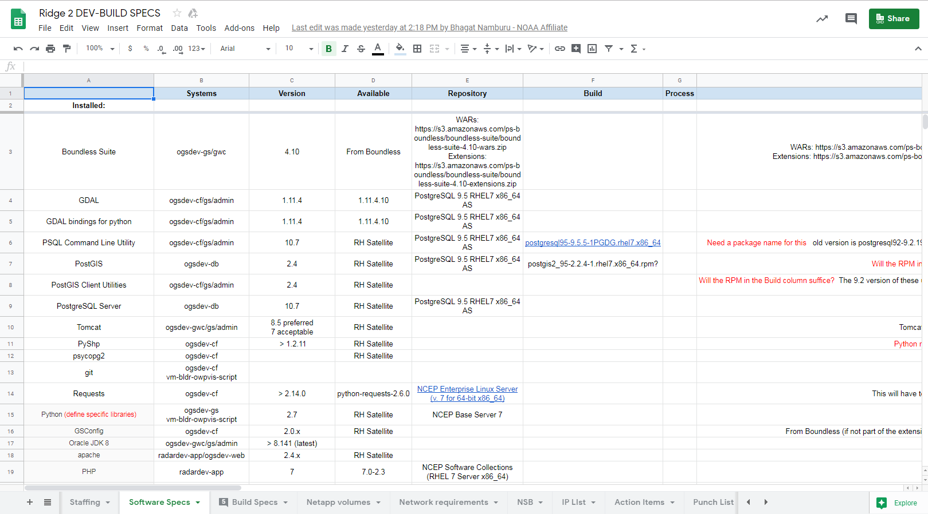
Operations Planning: Build Specs
Build Specs Include:
App Specs
Software Specs
Build Specs
Netapp Volumes
Network Requirements
Action Items
Punch List
Puppet Classes
User Accounts
Monitoring

Slide 16
IDP Onboarding Sequence
1
2
3
Dev Tier gets provisioned first. Developers develop and install on this hardware to prove the software works in the NCO virtualized environment. Any adjustments to the resources allocated would be done at this stage.
QA tier gets provisioned once the developers have verified the development tier is working as expected. Installation is performed on the QA tier and a battery of fitness tests are performed on the environment to prove the fitness of the application to run at NCO. After this is complete we put the application in a 30 day test mode in which the application is left undisturbed and is monitored 24x7. During this time the onboarding team develops comprehensive custom monitoring scripts.
Upon successful completion of the 30 day test the application gets promoted to the operational tier. By this time comprehensive monitoring scripts have been developed, the entire onboarding team has been trained to operationally support the application. The SDM and TOC have been briefed as well as the NCO director.

Slide 17
Process: 30 Day Entrance Checklist
☐ |  | Systems are up to date with respect to patching and included in regular patch cycle
☐ |  | Roles and Responsibilities document signed by all necessary parties
☐ |  | Notification sent as required by NCO or by NWS Directive 10-1805
☐ |  | Prepare doco/conduct training so anyone on OBT can support the app
☐ |  | Add application to the Primary page
☐ |  | Add applications failover/validation steps to the Data Center Failover Templates; including IWSB scripting, if necessary
☐ |  | All output data verified
☐ |  | Developer assertion that output is as expected
☐ |  | Data available in real-time and confirmed by end users
☐ |  | Acceptance Test plan executed and results reviewed approved by TL
☐ |  | All downstream dependencies within NCO have been tested and verified by developers (including IDP and WCOSS dependencies!)
☐ |  | OMB review of monitoring
☐ |  | Monitoring moved to operational BB
☐ |  | Email sent announcing start date of 30-day test
☐ |  | Email sent to all NCO branches about 24/7 support
Notes:
When do you talk about creating monitoring scripts?

Slide 18
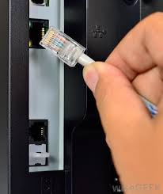
Operational Readiness Test
Acceptance testing - does it function as envisioned by the developers?
Go through each function it is expected to perform
In some cases create special test situations
30 Day test - does it function in normal operation?
Can catch situations the developers never thought of
Extended testing (“trample testing”) - characterize how things fail (not how they work) when:
Network goes down
Host is rebooted at random times
Host loses access to remote disks
Host loses DNS service
Helps improve monitoring scripts and troubleshooting procedures

Slide 19
Process: Go Live Briefing
☐ |  | Pass 30-day test
☐ |  | Create Public Release Notes document for users and execs
☐ |  | Prepare a go-live briefing
☐ |  | Go-Live briefing reviewed by TL
☐ |  | Go-Live briefing reviewed by Branch Chief
☐ |  | Go-Live briefing reviewed by Development Organization
☐ |  | Submit RFC for go-live (could be right after briefing depending on timing)
☐ |  | Update the IDP data description to include the new app
☐ |  | Prepare doco/conduct training so anyone on OBT can support the app

Slide 20
Process: Implementation Day
☐ |  | Check SOE and confirm CWD is not active
☐ |  | Send rfc_notify to begin implementation
☐ |  | Perform implementation
☐ |  | Send rfc_notify to complete implementation
☐ |  | Send notification to Executive mailing list -- nco_exec_notify@noaa.gov with public release notes

