Slide 1
Rapid Refresh Forecast System A case study for using cloud resources to reduce R2O transition times
October 22, 2020
EMC : Arun Chawla, Jacob Carley, James Abeles, Raj Panda
GSL : Curtis Alexander, Christina Holt, Christopher Harrop, Daniel Abdi
NSSL : Louis Wicker

Slide 2
Outline
NPS Production Suite and UFS
RRFS
Using the Cloud for development

Slide 3
Shared Community Infrastructure Support for UFS Development
Infrastructure for data assimilation: Joint Effort for Data assimilation Integration (JEDI)
Infrastructure for coupling models together:
NOAA Environmental Modeling System (NEMS) coupler
based on the Earth System Modeling Framework (ESMF)
using National Unified Operational Prediction Capability (NUOPC) conventions
Infrastructure for interoperable physics:
Common Community Physics Package (CCPP) framework
Infrastructure for Code Management:
Git based repositories with Gitflow
1. Coupling components New ESMF/NUOPC mediator (CMEPS/NEMS)
2. Interoperable atmospheric physics
CCPP & CPF frameworks
3. Community-friendly workflow CIME - CROW unification, CIME Case Control System
4. Hierarchical model development capabilities Extensions of CIME data models, unit, & system testing
5. Forecast Verification: Comparison to Observations
Extension of MET+
6. Software Repository Management
NCAR manage_externals tool
7. User / Developer Support
DTC and CESM Capabilities
NOAA-NCAR MoA Work Areas

Slide 4
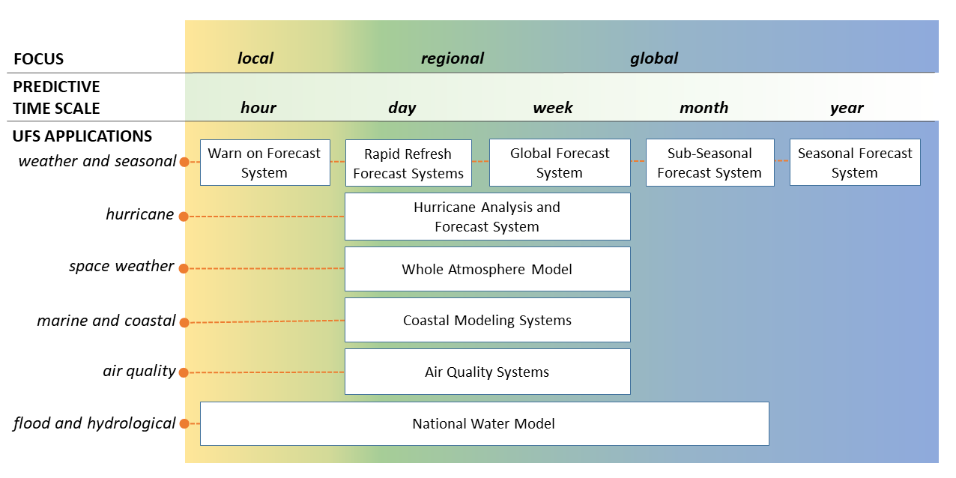
NPS Transitioning to UFS Applications

Slide 5
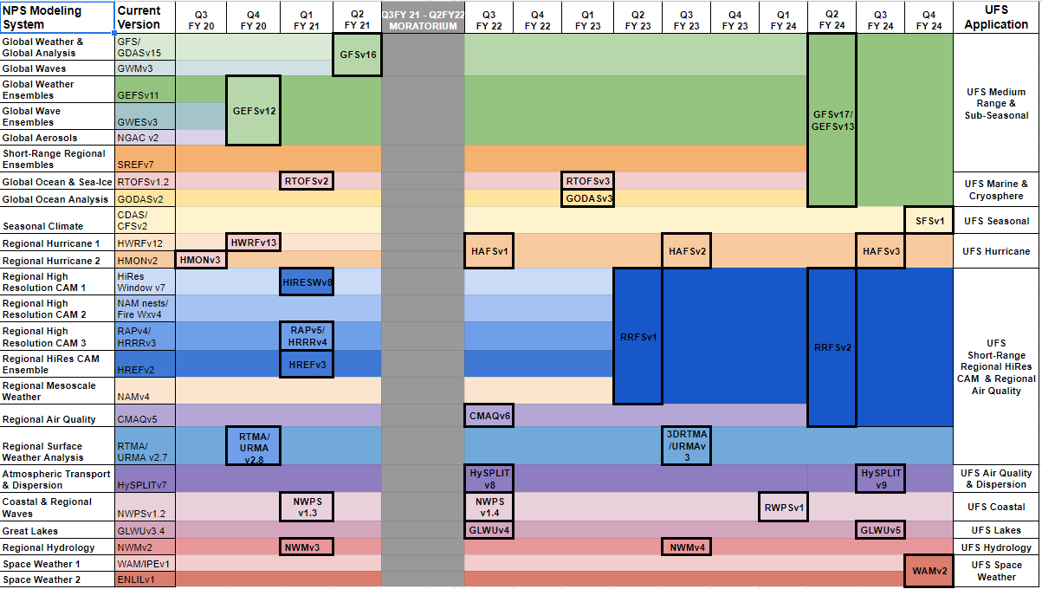
Toward a simpler, UFS-based Production Suite (notional)

Slide 6
UFS: Simplification of Regional Model Production Suite
Long Term
GFS/GEFS
to subsume
RAP/NAM/SREF
Global (10-15 km, 4-24/day)
GFS
GEFS
CONUS/OCONUS
CAM (3 km, 2-24/day)
Rapid Refresh
Forecast System
RRFS to subsume
HRRR/NAMnest/HREF
RRFS
What is the RRFS and how do we get there?
Sub-CONUS
CRM (1 km, on-demand)
Warn on Forecast
System
WoFS
*Material courtesy of C. Alexander

Slide 7
The Rapid Refresh Forecast System
Rapid Refresh Forecast System (RRFS)
Based on the UFS-Limited Area Model (LAM)
Underpinned by the Finite-Volume Cubed-Sphere dynamical core (FV3)
Rapidly updated (hourly)
Convection-allowing (~3 km)
Ensemble data assimilation (est. 30 or 40 members)
Ensemble forecasts (est. 10 members)
18h+ hourly
36-60h every 6 to 12 hours
When? ~FY23
Exact configuration for data assimilation still under development
Facilitate replacement of several current regional systems
e.g., NAM+nests, RAP +HRRR, HiRes Windows, HREF
How do we get there? And with what resources?

Slide 8
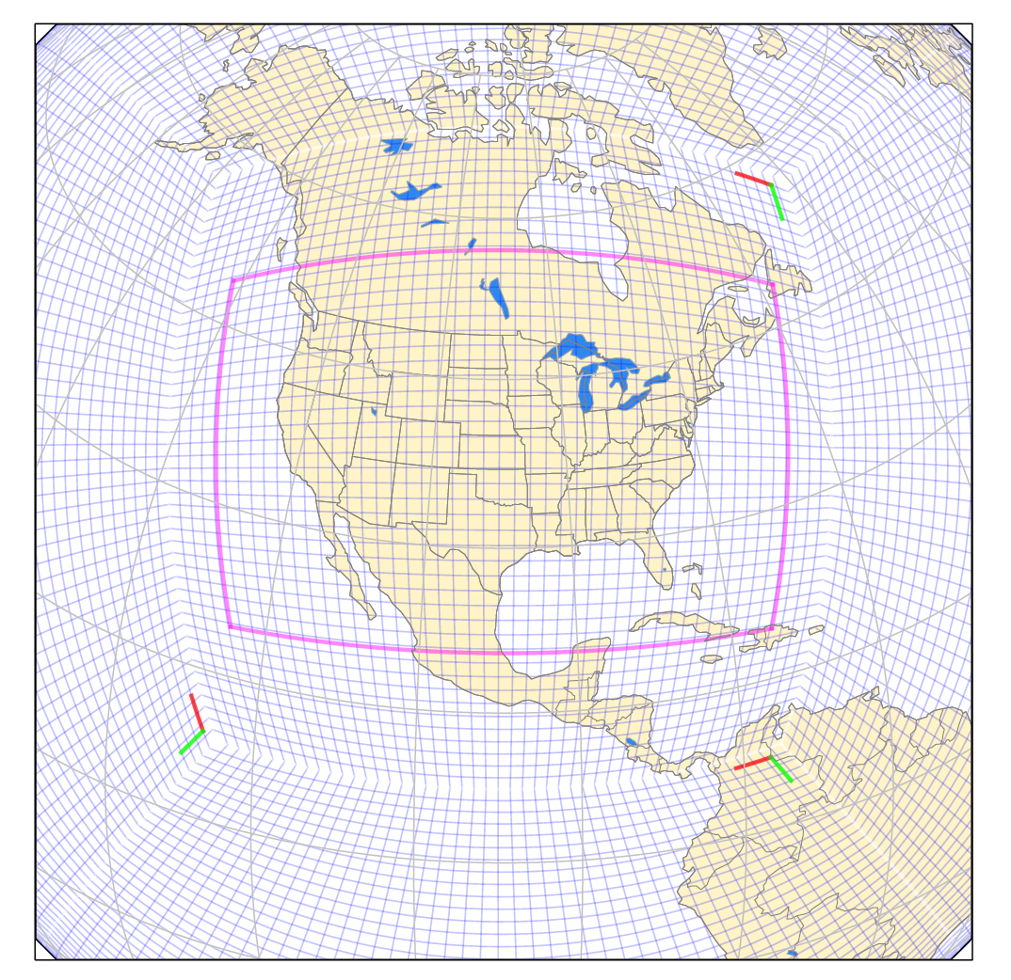
LAM vs Nest
FV3 was originally a global model with a nesting capability
No limited area component
Practical reasons drive need for LAM
More efficient
Focused development
Rapidly updating data assimilation, etc.
Little impact on forecast quality for short-range forecasts

Slide 9
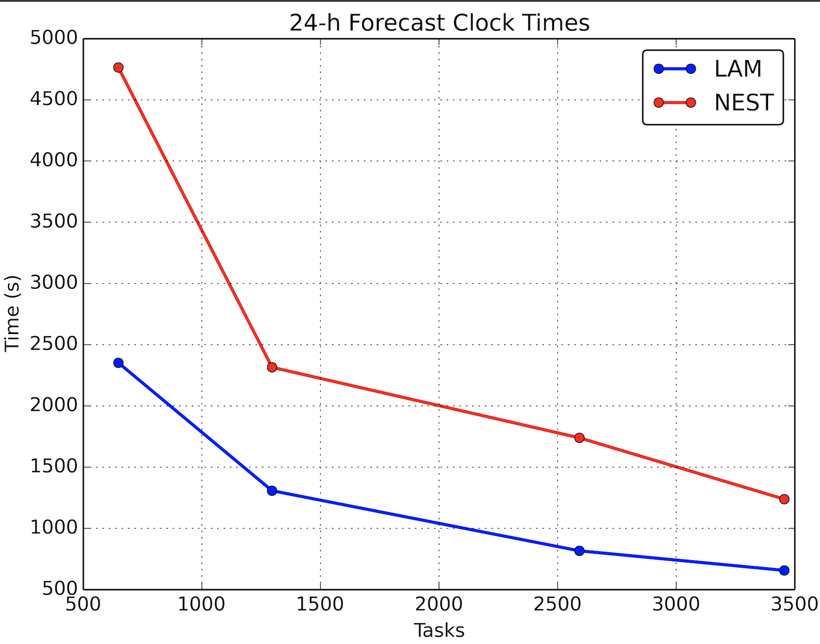
LAM vs Nest Clock Times
Using NOAA Hera R&D HPC System
LAM needs less than half tasks required to get output in same amount time as NEST
For a given set of tasks, the LAM completes the forecast in about half the amount of time as NEST

Slide 10
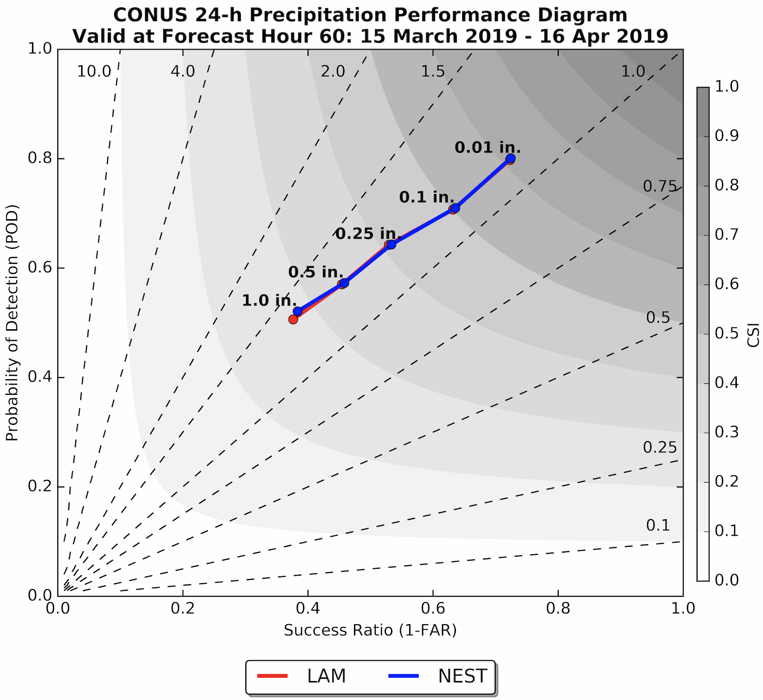
Nest vs LAM for Precip
Compare Nest and LAM
60 hour forecasts
Performance Diagram for 24-h accumulated precip (March 15 - April 16 2019)
Similar performance across all thresholds
LAM seems to work - so where can we start testing?

Slide 11
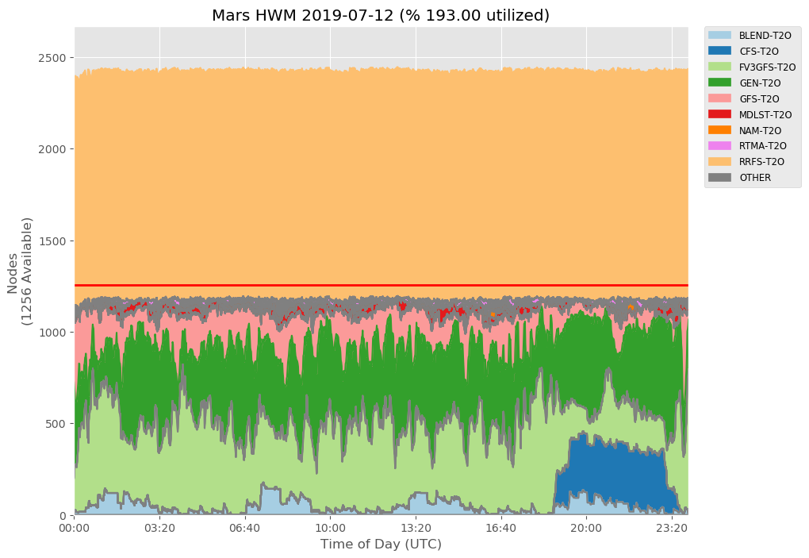
RRFS Development Resource Needs
WCOSS Phase 3 High Water Mark
FV3-CAM [RRFS] development needs
High water mark on WCOSS Phase 3 Development system
Current usage [non-CAM]
RRFS development requires considerable computational resources that are not currently available to developers

Slide 12
Can We Do this on the Cloud?
Hurricane Disaster Supplemental Supported Project
Port, deploy, and test RRFS prototype(s) in the cloud
Flexible
If this works it opens many possible doors for future R&D resource needs, especially for early development that may not need real time testing
UFS has been run in the cloud before
Efforts to put RRFS on cloud will enhance system portability for the UFS infrastructure
Is cloud HPC slow?
#136 on June 2019 top500 list is a cloud instance!

Slide 13
Moving to the Cloud - overview
Multiple computing components
Preprocessing, Data Assimilation, Forecast, Post Processing, Visualization, etc.
Performance characteristics & requirements
Some components (e.g. forecast) will need 10s of nodes with fast interconnect
Some (e.g. Post Processing) will need only a few nodes with moderate speed interconnect
Data movement & storage
Data movement between NOAA HPC systems and the Cloud
Publicly available data access via internet into the Cloud
Majority of data storage in the Cloud and some in NOAA systems
Workflow
All computing components and data movement tied together through workflow

Slide 14
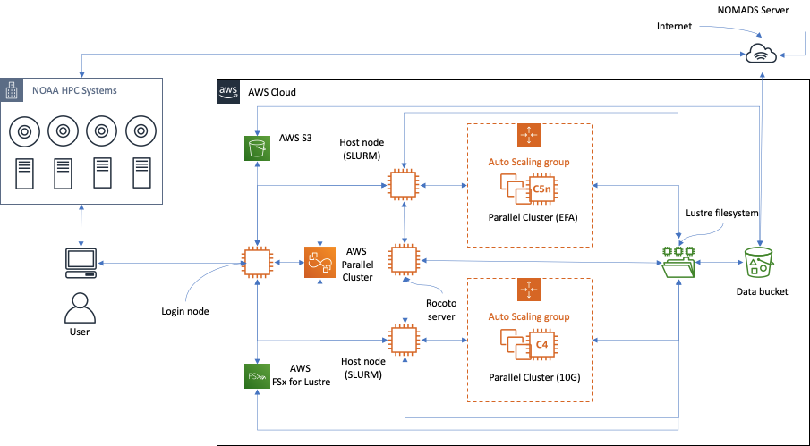
Architecture

Slide 15
Cloud deployment
Resource mapping
Map each computing component to specific Cloud services/resources – must meet performance or run time requirements
Type of instance, choice of file system, storage, etc.
Cost estimation
Cloud offers a wide variety of computing resources with varying cost structures
Estimate cost of computing with the chosen resources
Workflow
Ensure enabled workflow meets performance and cost estimates
Ongoing
Cloud Service Providers (e.g. AWS) are constantly revising cost structures, adding new hardware and features several times a year
Multi-year project such as RRFS would need periodic assessment & revision of deployment to reduce cost

Slide 16
Resource mapping & cost estimation - UFS example
Applications built on NOAA systems can run on AWS instances
Preliminary work indicated binaries from WCOSS & RDHPCS (Orion, Hera) systems can run in AWS
AWS ”c5n” instances and NOAA systems (WCOSS Phase3.5, Orion, Hera) have similar (Intel Xeon Skylake) processors
UFS can be run on AWS “c5n” instances with similar performance as on NOAA systems
Use NOAA systems for performance optimization
Much optimization (configuration-related) work can be done on WCOSS & RDHPCS systems – saves spending money on Cloud systems
Verification work needs to be done in the Cloud
Estimate AWS cost for optimized application configuration
Cores per node is different: 40 cores/node on WCOSS & RDHPCS while 36 cores/node on AWS ”c5n” instances

Slide 17
UFS - CONUS (details)
Grid dimensions (1741 x 1037)
Time step = 36s
Forecast duration = 60 hours
History file output = every hour
CCPP Physics scheme: FV3_GFS_v15_thomson_mynn

Slide 18
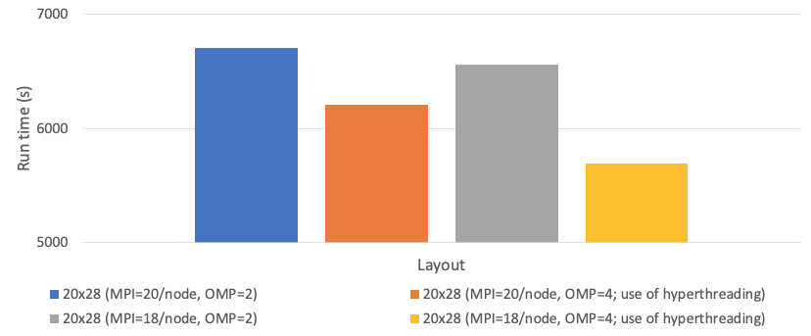
UFS - CONUS (60hr forecast on Hera)

Slide 19
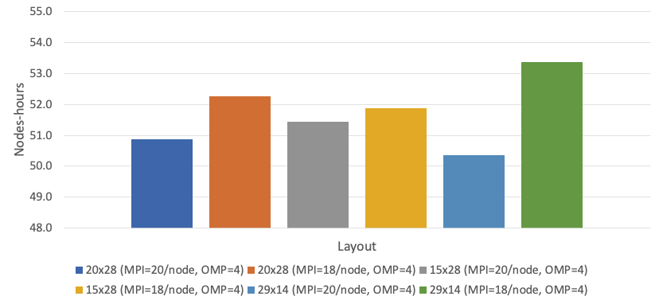
UFS - CONUS 60hr forecast on Hera (node-hours)

Slide 20
Cost estimation for AWS - unknowns
Flexibility in run time (e.g. can be > 3hrs) -> use of different instance types
Best interconnect (EFA) only comes with more expensive instance types
If 10g Ethernet performance is acceptable – may lead to more cost-effective computing
File system performance
Multiple options (parallel Lustre & EFS) available – will require benchmarking
Processor frequency differences

Slide 21
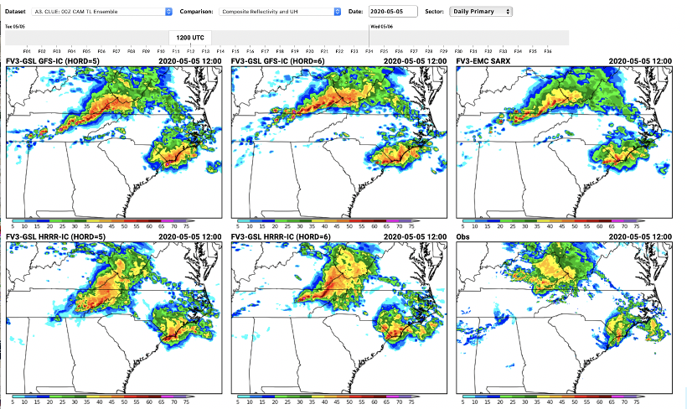
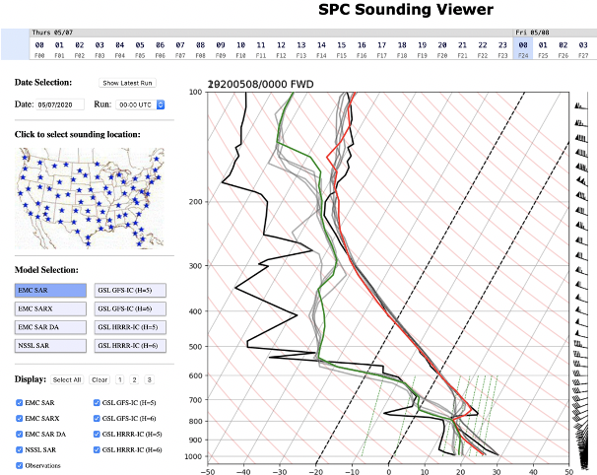
Prototyping at NOAA Testbeds
Collaborative engagement at NOAA testbeds is a critical part of the development process for RRFS. Some of our cloud resources will be used to execute RRFS prototype components for testbed evaluation.

Slide 22
Closing
RRFSv1 planned for implementation in 2023 timeframe
Next generation, rapidly-updated convection-allowing NWP system
Leveraging the cloud for development
Expand beyond conventional compute resources
Project is in early phases
Prototype systems to be demonstrated at upcoming NOAA Testbeds (HWT, FFaIR, WWE)

