Slide 1
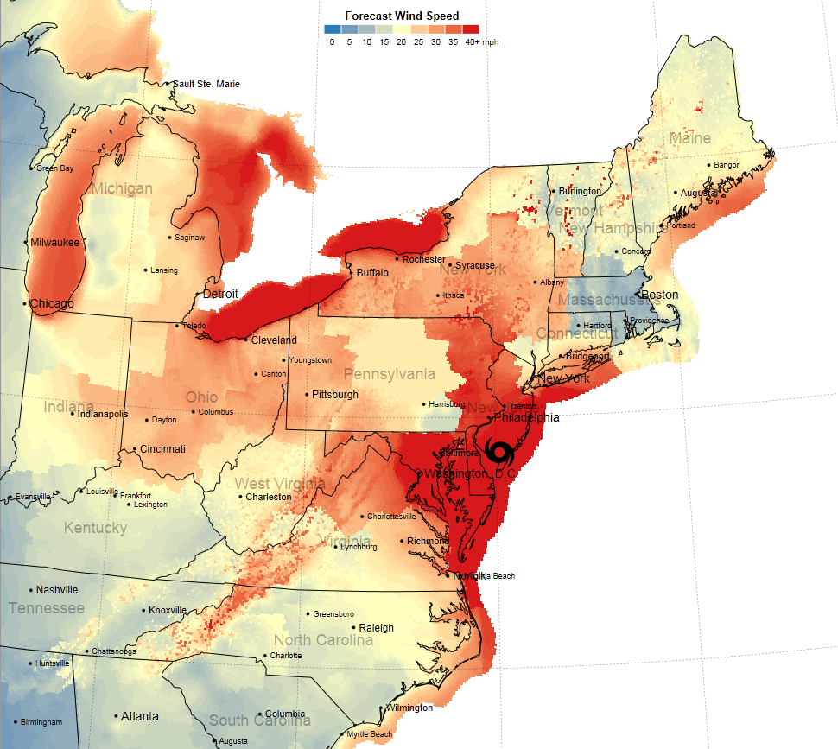
Improving Methodologies for Operational Forecasts of Winds and Wind Gusts during Tropical Cyclones
Forecast wind gusts from the NDFD valid 00 UTC 30 October 2013 – image from the NY Times
Jonathan Blaes and Donald Reid Hawkins
NOAA VLab Forum
16 March, 2016

Slide 2
Improving Methodologies for Operational Forecasts of Winds and Wind Gusts during Tropical Cyclones (TCs)
Outline
Current Deficiencies in Creating TC Wind and Wind Gust Forecasts
Background on the CSTAR TC Wind Project
Creating TC Wind/Wind Gusts Forecast at a WFO
Improving Tropical Cyclone Sustained Wind Forecasting
Improving Tropical Cyclone Wind Gust Forecasting
Examples from Hurricane Arthur (2014)
Acknowledgements
References

Slide 3
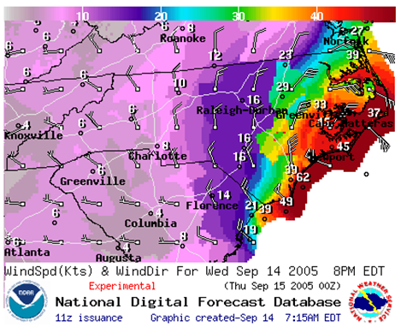
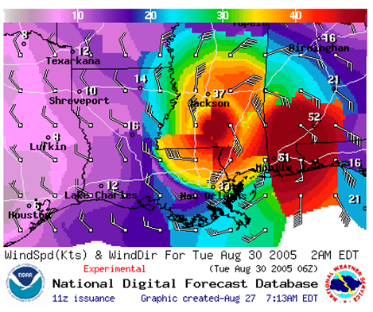
Visuals of the Problem
NDFD 69 hour wind forecast valid 06 UTC August 30, 2005 for Hurricane Katrina.
NDFD 15 hour wind forecast valid 00 UTC September 14, 2005 for Hurricane Ophelia.

Slide 4
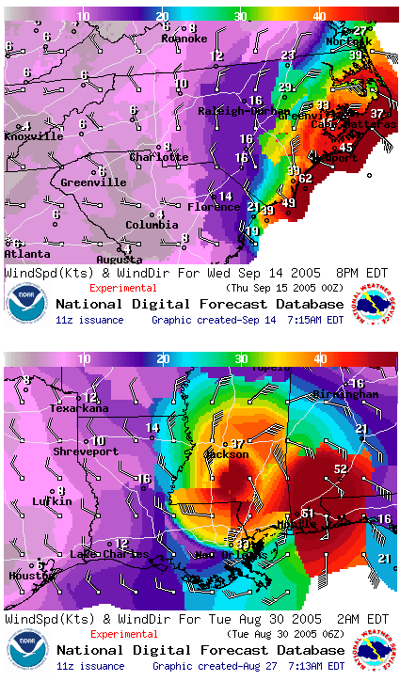
Problem - Numerous Deficiencies in the Approach to Creating Tropical Cyclone Wind and Wind Gust Forecasts
Guidance lacks both spatial and temporal resolution
Varying forecast strategies and methodologies
Limited inclusion of science
GFE tools that are inefficient or deficient (TCMWindTool does not account for decay, terrain, etc.)
Limited external collaboration
Limited shift to shift forecast consistency
Limitations on time in the forecast process
The end result is often an inconsistent and poorly collaborated forecast with limited foundation in science that may be inaccurate and is difficult for users to interpret.

Slide 5
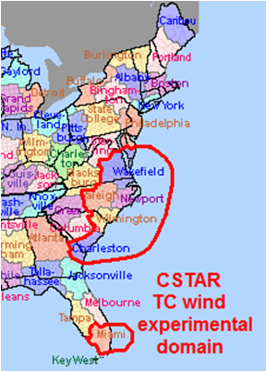
NC State CSTAR TC Wind Project
Highest rated problem (2008) among cluster WFOs.
Started in July 2010 and lead by NC State Student Bryce Tyner and PI Anantha Aiyyer.
Team members are from 6 different WFOs and the NHC; lead by WFO ILM SOO, Reid Hawkins.
Major activities…
NDFD TC wind verification
Land decay study
Climatologically-based TCM bias correction
Gust factor study
Development of the WindReductionFactor and WindGustFactor GFE methodologies
TCMWindTool improvements
Tyner, B., A. Aiyyer, J. Blaes, and D. R. Hawkins, 2015: An examination of wind decay, sustained wind speed forecasts, and gust factors for recent tropical cyclones in the mid-Atlantic region of the United States. Wea. Forecasting, 30, 153–176.

Slide 6
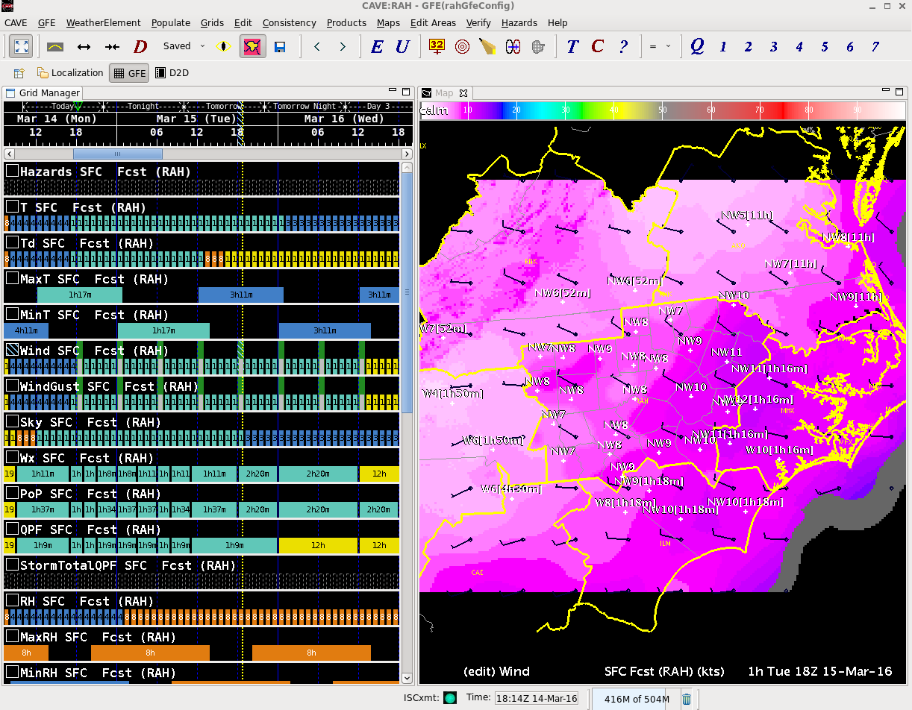
Creating TC Wind/Wind Gusts Forecast at a WFO
Forecasters use the Gridded Forecast Editor (GFE) to forecast “grids” of dozens of variables such as MaxT, RH, PoP, and Wind at a WFO while ensuring the forecast is consistent with neighboring WFOs & national centers.
Wind | Wind Gust
Min 3-hourly resolution | Min 3-hourly resolution
Thru 168 hours | Thru 84 hours

Slide 7
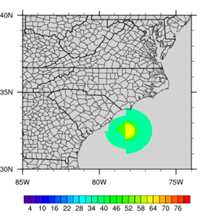
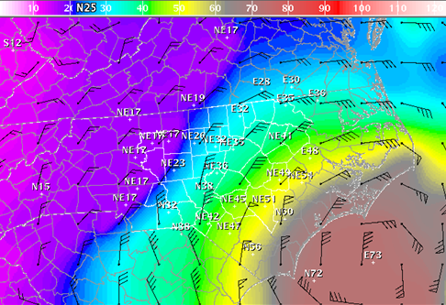
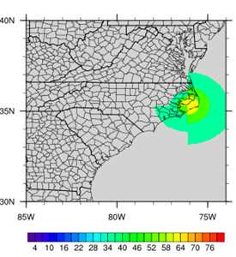
Creating TC Wind Forecasts at a WFO
During TCs, WFOs are tasked with downscaling the NHC TCM wind forecast text product, which is largely unchanged from the 1980s, and which contains at best 12-hour resolution forecasts of the four quadrant max wind radii for up to 4 wind speeds to a 2.5km, 3-hourly to hourly wind forecast grid at each WFO.
12Z | 13Z | 14Z | 15Z | 16Z | 17Z | 18Z | 19Z | 20Z | 21Z | 22Z | 23Z | 00Z

Slide 8
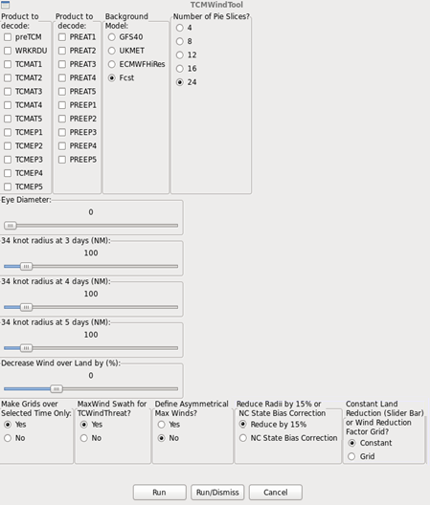
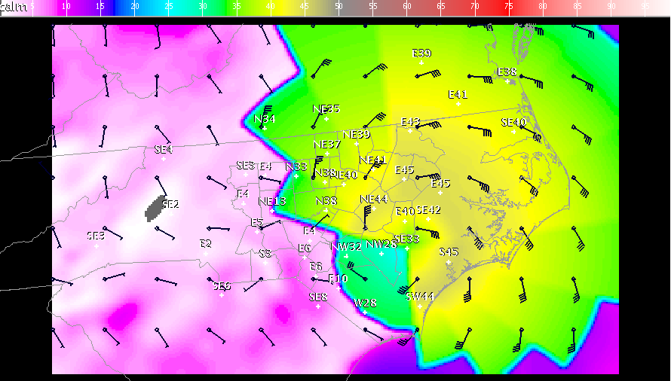
The Steps to Create a TC Wind Forecast at a WFO
Forecasters take the NHC TCM wind guidance and use a tool in GFE called the “TCMWindTool” to develop wind forecasts. The default tool is rather primitive allowing only linear decay in the sustained wind speeds when interpolating between TCM forecast times and a single land reduction.
The default output often requires significant post editing to remove non-meteorological artifacts.

Slide 9
TC Sustained Winds

Slide 10
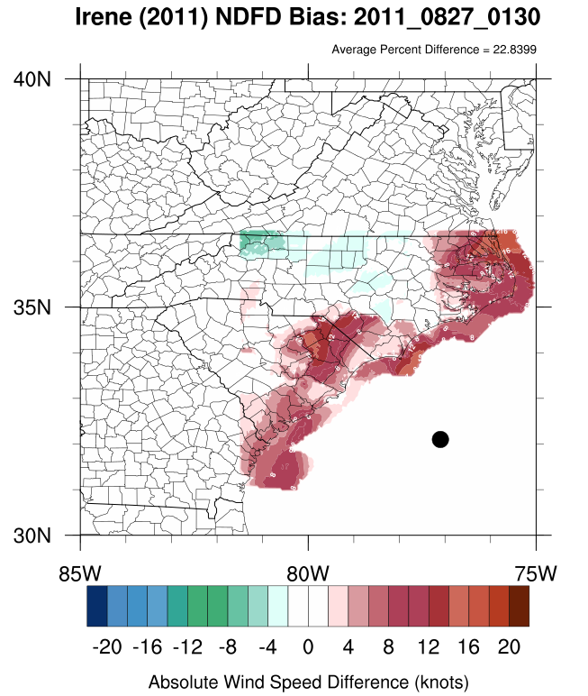
NDFD Verification
Completed an objective verification of National Digital Forecast Database (NDFD) forecasts of sustained wind speeds for TCs in the study region.
The analysis was completed using a combination of the Hurricane Research Division’s (HRD) Hurricane Wind Analysis System (H*Wind) and hourly surface observations from the State Climate Office of NC CRONOS database.
The H*Wind surface analyses are advantageous in that they blend model data with obs from U.S. Air Force and NOAA aircraft, ships, buoys, and land-based surface platforms (Powell and Houston 1998).
NDFD forecasts were verified by comparing the latest forecast cycle prior to verification. Archived NDFD wind forecasts available beginning in December 2005.
TCs used in the study: Ernesto (2006), Barry (2007), Gabrielle (2007), Cristobal (2008), Hanna (2008), Earl (2010) and Irene (2011)

Slide 11
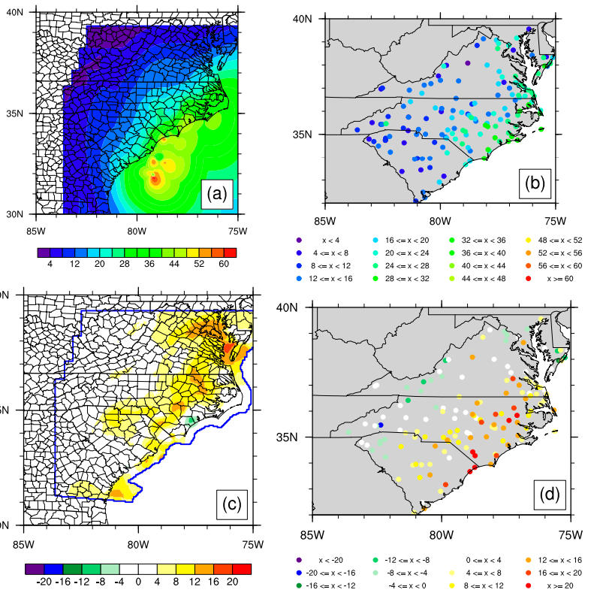
NDFD Verification Hanna (2008)
Max H*Wind-analyzed wind speed (kt) over all available analysis times
Max CRONOS wind speed (kt) station data
Wind speed difference between NDFD and H*Wind (NDFD 2 H*Wind; kt)
Wind speed difference between NDFD and CRONOS (NDFD 2 CRONOS; kt)

Slide 12
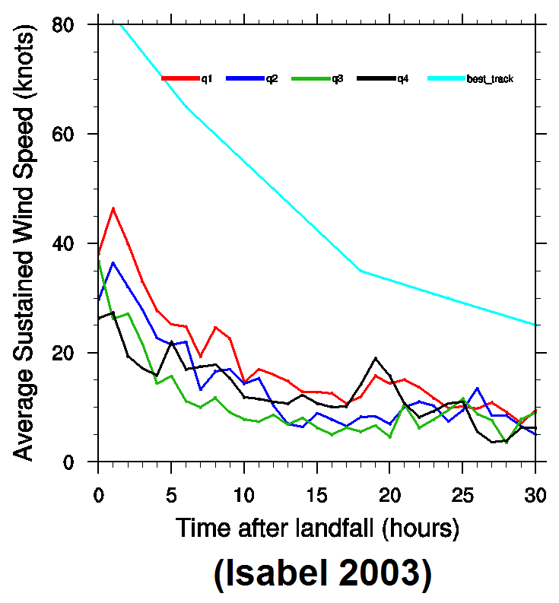
Land Decay Study
The amount of reduction factor that is needed to reduce the raw TCMWindTool output will vary considerably (both spatially and temporally).
In general, experience has shown that the raw TCMWindTool output and the resulting NDFD wind forecasts frequently contain a positive bias.
The TCMWindTool assumes linear decay and only allows the use of one universal land decay value.
Previous tools and methods failed to incorporate this basic science and forecasters did not have a means to include it.
The land decay study provided a benchmark for forecasters and a starting point to improve the method.

Slide 13
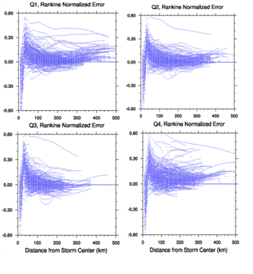
Vortex Wind Model Study
The default TCMWindTool uses a Modified Rankine (MR) vortex wind model when creating the base sustained wind grids.
We examined 271 available HWind analyses and calculated the error as the difference between the interpolated wind speeds and the analyzed wind speeds.
Systematic errors in the Modified Rankine (MR) interpolated wind speeds as a function of storm quadrant and distance from storm center were noted.
Large positive values in the normalized error from the radius of maximum winds out to a distance approximately 100-150 km from the storm center.
More…
https://cimmse.wordpress.com/2013/05/16/potential-new-interpolation-method-in-tcmwindtool/
Notes:
We examined 271 available HWind analyses and calculated error as the difference between the interpolated wind speeds and the analyzed wind speeds. The error was normalized by the estimated maximum sustained wind speeds in the TCM product to allow for inter-storm comparison. For each analysis time and storm quadrant, error was binned in intervals of 5 km distances from storm center out to the 34 knot maximum wind radius and average error was calculated within the bins.

Slide 14
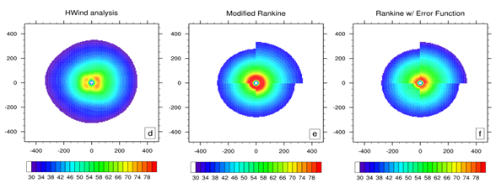
Creating a Gridded Wind Field from the TCM Guidance
We developed the Modified Rankine Vortex Error Function (MREF) to provide an improved wind interpolation method
MREF provides a climatologically-based, bias correction, to MR in the TCMWindTool
Reduces wind speeds just outside of Rmax, consistent with H*Wind analyses
Increases moderate wind speeds within 34-50 knot wind radii
Reduces wind speed on left quadrants, consistent with forecaster experiences
Reduces overall wind speed closer to H*Wind analysis values for all quadrants
Hurricane Gustav 28 August, 2014
Analysis
Default
Updated

Slide 15
WindReductionFactor GFE Methodology
We settled on a methodology that includes a new GFE element called the WindReductionFactor (RF) grid which is the percentage of the wind reduction that is collaborated to lower the raw TCMWindTool output.
The RF grid is initially populated via a climatologically based starting point. Forecasters can spatially and temporally edit the RF grid for a variety of meteorological and topographical features.
Updated tools use the Modified Rankine Vortex Error Function (MREF) bias correction and allow forecasters to use non-constant land reduction factors.

Slide 16
WindReductionFactor GFE Methodology
The Reduction Factor (RF) grid contains the percentage of the wind reduction that is collaborated to lower the raw TCMWindTool output.
The amount of reduction will vary considerably, but a combination of heuristic experience and some limited studies* suggest that the forecaster will need to integrate several reduction elements shown in the table below.
A climatologically based common starting point has been also developed.
Simplified overland wind reduction factor guidance
5% exposure/sea-land reduction - within ~10km landward of beaches or
15% exposure/sea-land reduction - between 10-20km landward of beaches or
20% exposure/sea-land reduction - between 20-50km landward of beaches or
30% exposure/sea-land reduction - beyond 50km landward of beaches
Plus
Variable reduction - based on air mass characteristic or boundary layer stability or
Variable reduction - based on linear intensity artifacts from the TCMWindTool output or
Variable reduction - based on land decay correction or
Variable reduction - based on terrain and land use
Marine wind reduction factor guidance
0-5% TCM gross inflation correction - over marine domain

Slide 17
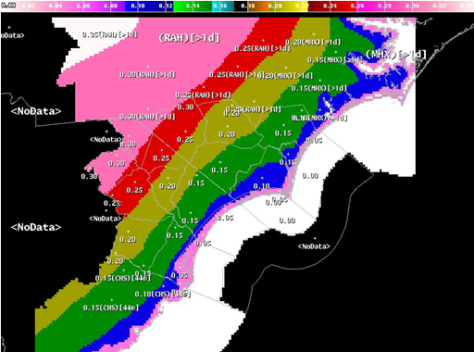
WindReductionFactor Common Starting Point Across WFOs

Slide 18
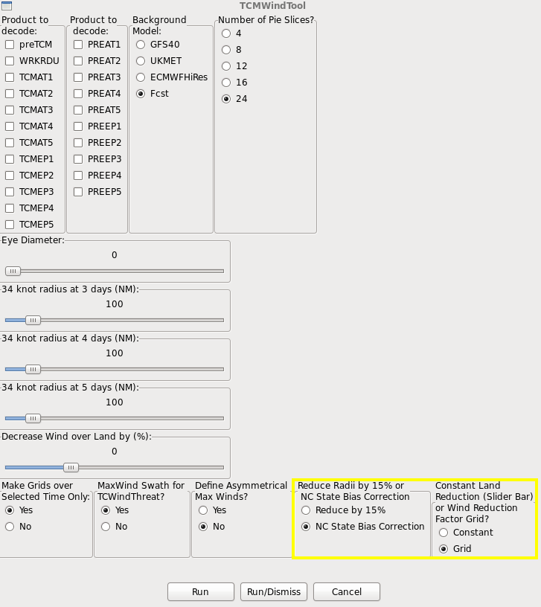
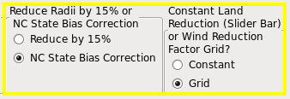
TCMWindTool improvements (R2O)
With support from the 2013 NOAA Hurricane Conference, the climatologically-based TCM bias correction and the WindReductionFactor grid methodology were incorporated into the TCMWindTool for 2014
The improved TCMWindTool was evaluated by four CSTAR WFOs during Hurricane Arthur.

Slide 19
WindReductionFactor GFE Methodology
Advantages include:
Common starting point and method.
More easily integrate the impact of decay, friction, fetch, stability, etc. (science) into the reduction factor.
Forecasters can collaborate RFs visually in GFE via ISC.
RFs can vary spatially and temporally.
RFs persist from shift to shift promoting continuity.
Reduction factors (RFs) can be created prior to the TCM product arrival.

Slide 20
TC Wind Gusts

Slide 21
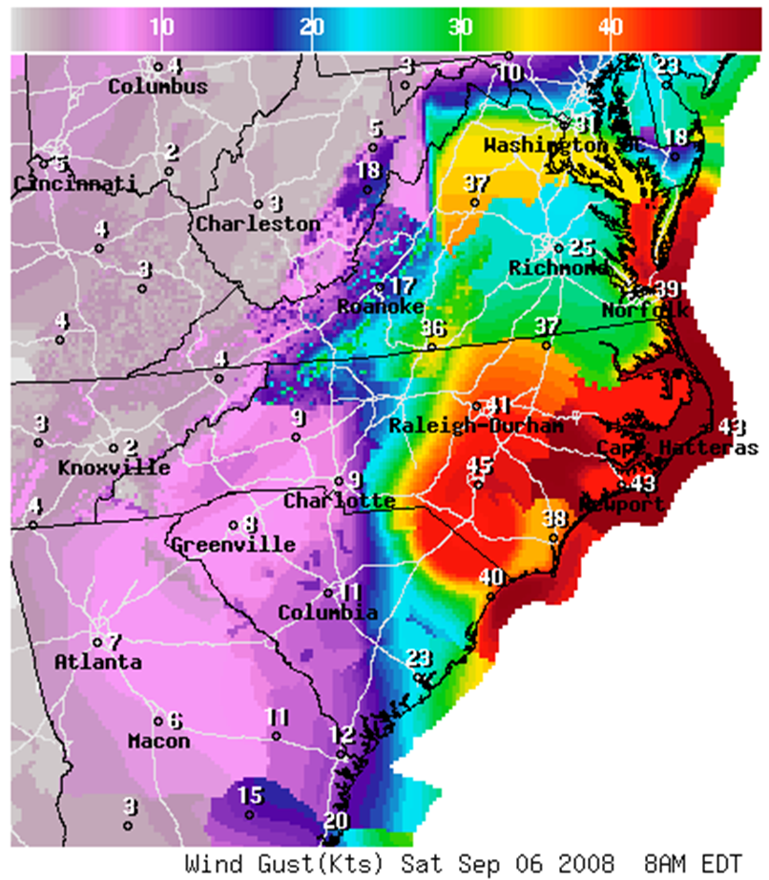
Creating TC Wind Gusts Can Be Even More Problematic
The deficiencies identified in creating wind grids are compounded when creating the wind gust grids at WFOs.
Wind gust grids are typically created by taking the magnitude of the wind forecast and increasing it by some value. Shaky input adjusted with shaky methods leads to trouble.
The determination of that value is the trouble spot as our survey indicated various strategies and methods (adding a fixed value or using a multiplier) that were often constant across time and space. There is no common starting point.
These values were often not collaborated externally with limited shift to shift forecast consistency.
NDFD 48 hour wind gust forecast valid 8AM EDT on 06 September 2008 during Hurricane Hanna.

Slide 22
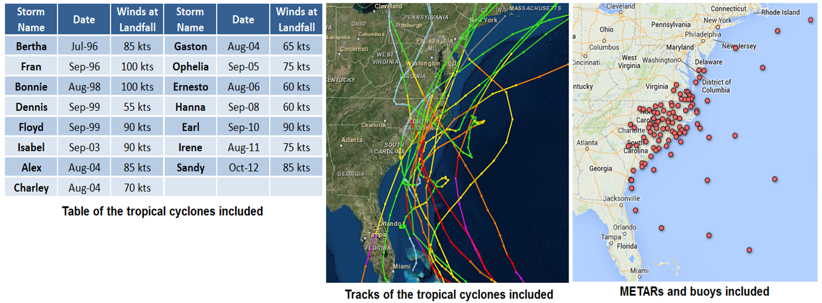
Wind Gust Factor Study
Examined the sustained winds, wind gusts, wave heights, and gust factors for 15 TCs that impacted the Carolinas and Virginia. Only hourly observations with wind speeds of 10 knots of more were included. Analysis was conducted in two groups: land and marine observations. The hourly wind gust factor for each location was computed as the ratio of the wind gust to the sustained wind speed (Vickery and Skerlj 2005).
G = Umax/Ū
Where Gust Factor (G), Wind Gusts (Umax) and Sustained wind (Ū)
If Umax = 47 kts and Ū = 34 kts then G = 47/34 = 1.38
Notes:
We examined the sustained winds, wind gusts, wave heights, and gust factors for ten tropical cyclones that impacted the Carolinas and Virginia. Only hourly observations with wind speeds of 10 knots of more were included. Data analysis was conducted in two groups: land observations and marine observations. The hourly wind gust factor for each location was computed as the ratio of the wind gust to the sustained wind speed (Vickery and Skerlj 2005).
For the land locations, observations from between 21 and 45 ASOS or AWOS METAR locations impacted by the various storms were included. The locations varied for each storm and were selected to capture the variations in the wind field. A total of 14,938 gust factors were computed.
For marine locations, only observations from buoys that have an anemometer height of 5 meters were included to remove any of the variability introduced by different observational heights. Only observations in which the wave heights observed were less than 5 meters were included. This was done to remove any uncertainty in the quality of the wind observations in large waves as high sea states associated with high surface winds can shelter the buoy and reduce the buoy’s wind speed observation (Skey et al. 1995). A total of 1,720 marine gust factors were calculated.

Slide 23
Wind Gust Factor Study
For the land locations, observations from between 22 and 53 ASOS or AWOS METAR locations impacted by the various storms were included.
The locations varied for each storm and were selected to capture the variations in the wind field.
A total of 13,121 gust factors were computed.
For marine locations, only observations from buoys that have an anemometer height of 5 meters were included to remove any of the variability introduced by different observational heights.
Only observations in which the wave heights observed were less than 5 meters were included. This was done to remove any uncertainty in the quality of the wind observations in large waves as high sea states associated with high surface winds can shelter the buoy and reduce the buoy’s wind speed observation (Skey et al. 1995).
A total of 3,026 marine gust factors were calculated.

Slide 24
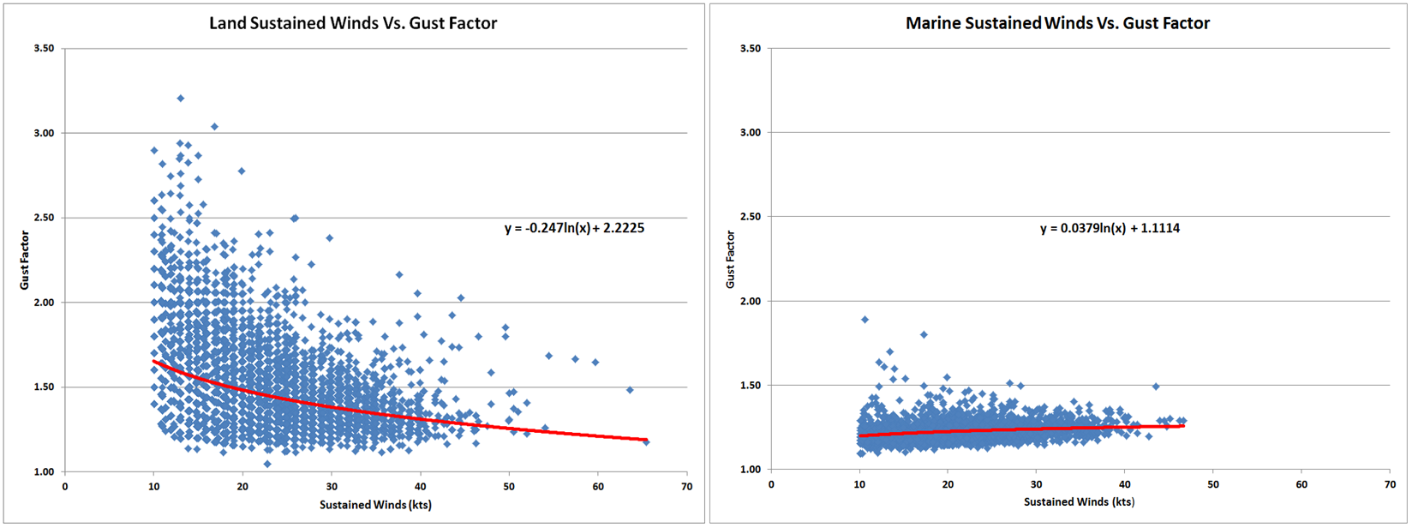
Sustained Winds vs. Gust Factors
Land
Marine
Note the greater variation in gust factors for the land locations which show an inverse relationship between the wind speed and gust factor as well as a decrease in the variability of observations as wind speeds increase.
The marine locations depict a much more compact distribution with less variability and a slight upward trend in gust factors as the wind speed increases.
Notes:
The charts above are scatter plots of the sustained winds versus gust factors for all fifteen storms for land locations (left) and marine locations (right) along with a best fit regression curve. Note the greater variation in gust factors for the land locations which show an inverse relationship between the wind speed and gust factor as well as a decrease in the variability of observations as wind speeds increase. The marine locations depict a much more compact distribution with less variability and a slight upward trend in gust factors as the wind speed increases.

Slide 25
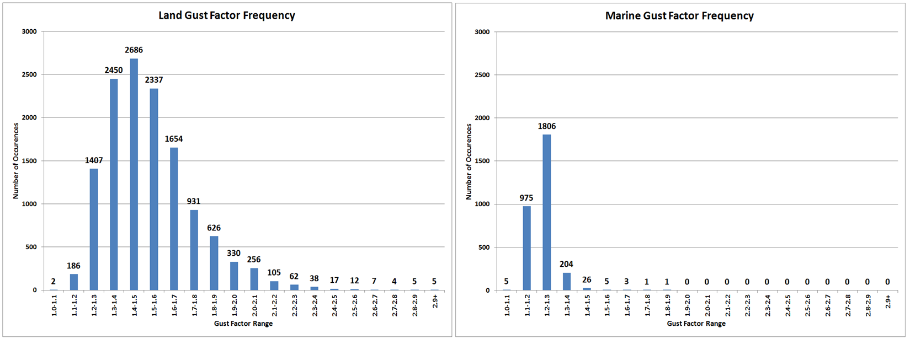
Gust Factor Frequency
Land
Marine
For the land observations, note the large number of observations with a large distribution and considerable spread.
The standard deviation is 0.218 around the mean of 1.53 with the most frequent land GF ranging between 1.4 and 1.5.
The marine locations show a much smaller range.
The marine GF is most frequently located between 1.2 and 1.3 with 1,806 of the total 3,026 gust factors (60%) ranging between 1.2 and 1.3.
The standard deviation is 0.056 around the mean of 1.23.
Notes:
Histograms of the frequency of gust factors are shown above for land locations (left) and marine locations (right). For the land observations, note the large number of observations with a large distribution and considerable spread. This results in a standard deviation of 0.218 around the mean of 1.53 with the most frequent land GF ranging between 1.4 and 1.5. The GF for the marine locations show a much smaller range. The marine GF is most frequently located between 1.2 and 1.3 with 1,806 of the total 3,026 gust factors (60%) ranging between 1.2 and 1.3. The marine observations contain a standard deviation of 0.056 around the mean of 1.23.

Slide 26
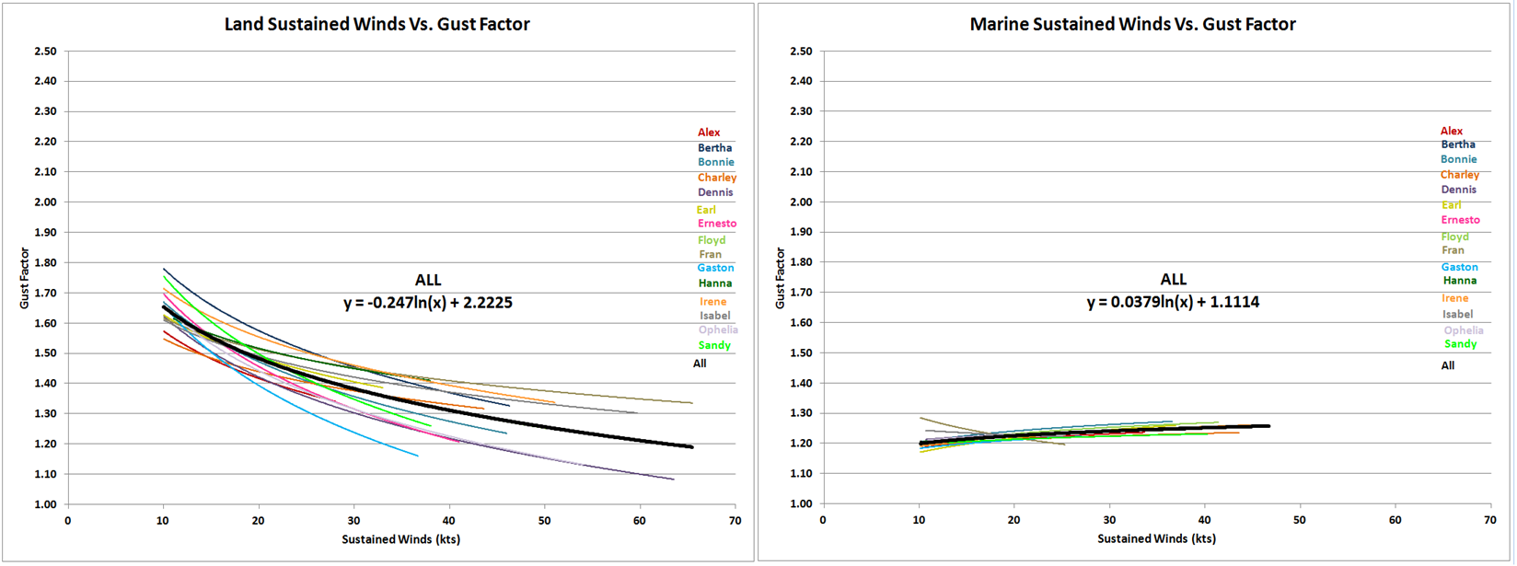
Regression Curve by Storm
Land
Marine
Regression equations for each of the storms are shown individually in colors below with a combined curve, merged for all storms, shown in black for land locations (left) and marine locations (right).
The land observations show large variations but a similarly shaped curve likely indicating the variations in gust factors driven by air mass, terrain, roughness and other factors.
The marine locations are very consistent which is not surprising given the similar air mass and surface roughness in the marine environment with wave heights less than 5 meters.
Notes:
Regression equations for each of the storms are shown individually in colors below with a combined curve, merged for all storms, shown in black for land locations (left) and marine locations (right). The land observations show large variations but a similarly shaped curve likely indicating the variations in gust factors driven by air mass, terrain, roughness and other factors. The marine locations are very consistent which is not surprising given the similar air mass and surface roughness in the marine environment with wave heights less than 5 meters.

Slide 27
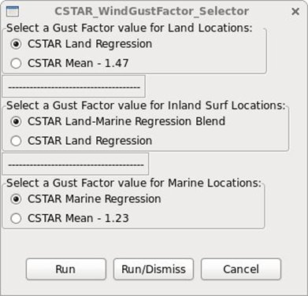
WindGustFactor GFE Methodology
We settled on a methodology that includes a new GFE element called the WindGustFactor (GF) grid which is the ratio between the wind gust and the sustained wind speed for a specific period of time.
The GF grid is initially populated via a GFE tool that uses the sustained winds as an input into a regression equation that produces the GF grid.
After the GF grid is initially created, forecasters can spatially and temporally edit the GF grid for a variety of meteorological and topographical features.

Slide 28
WindGustFactor GFE Methodology
Advantages include:
Common starting point and method.
Forecasters can more easily integrate the impact boundary layer stability, friction, exposure, etc. into the forecast process.
The gust factor grids can be edited spatially and temporally across the GFE domain.
A more science-based process that results in an improved wind gust forecast.
Forecasters can now visually collaborate with other WFOs in GFE with ISC
The wind gust process is not a black box anymore!

Slide 29
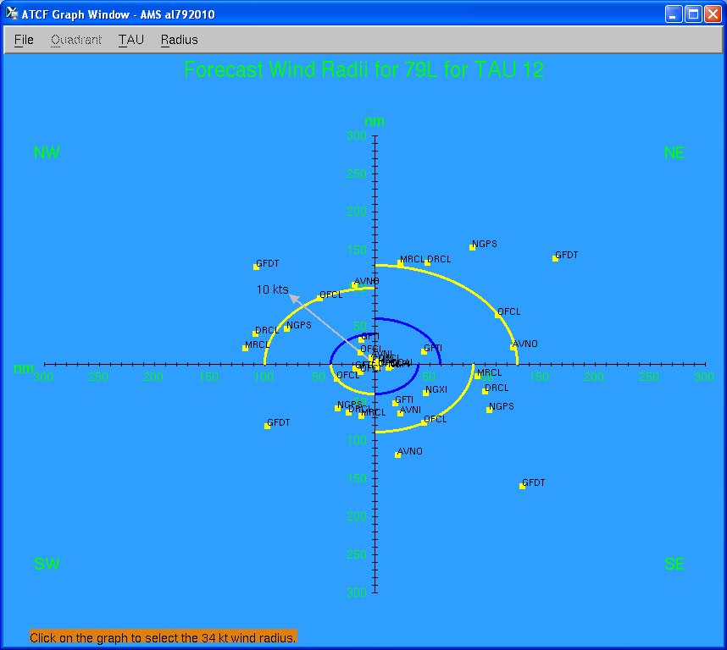
Training and Science Support
Training materials were developed and shared to elevate the knowledge base for TC wind forecasting. Topics included:
NHC forecast process and constraints
Typical NDFD forecast bias
Factors contributing to wind decay including exposure, friction, and stability.
Simplified overland and marine wind reduction factor guidance.
Distribution of wind gusts with sustained wind speeds over land and marine locations
Considerations for wind gust factors including variations in boundary layer conditions from CAD, enhanced mixing with drier air wrap around, boundary interaction, etc.

Slide 30
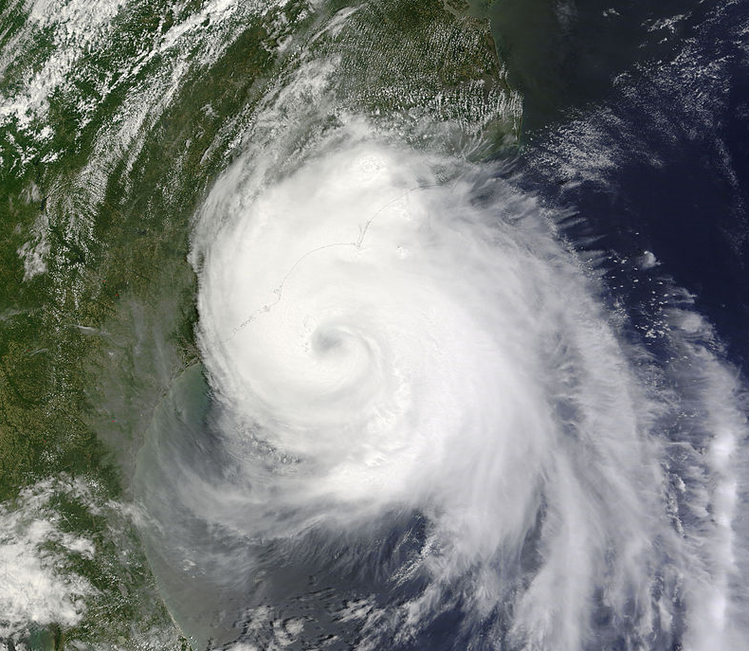
Examples from Hurricane Arthur (July 2014)
These new methodologies were tested by WFOs CHS, MHX, RAH, and ILM during Hurricane Arthur.
Note that OPC does not use this technique and their grids were typically prepared before the coastal WFOs started on their grids which resulted in some inconsistency.

Slide 31
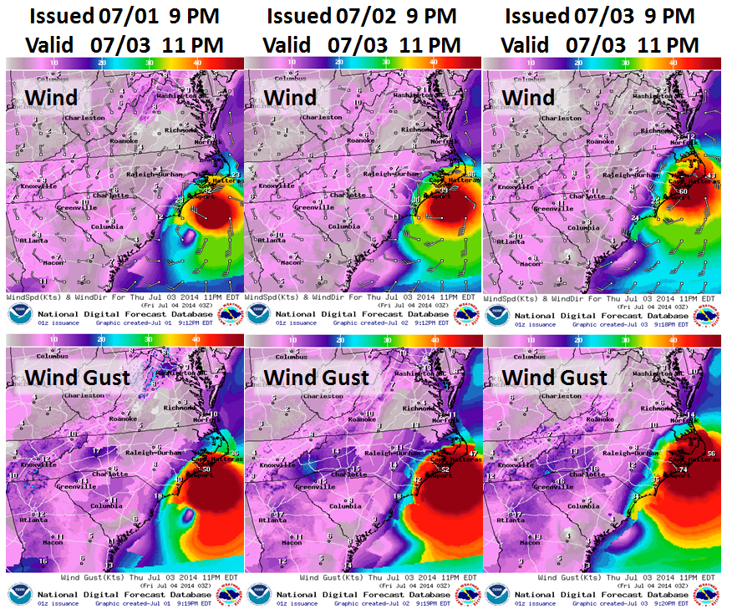
Hurricane Arthur (July 2014)

Slide 32
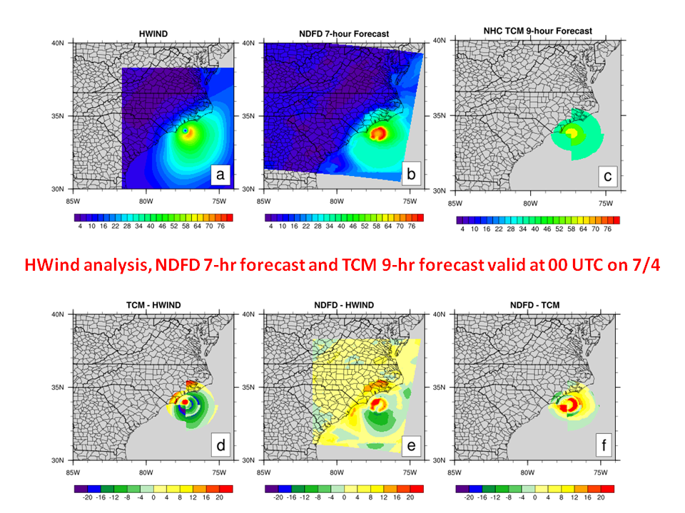
Hurricane Arthur (July 2014)

Slide 33
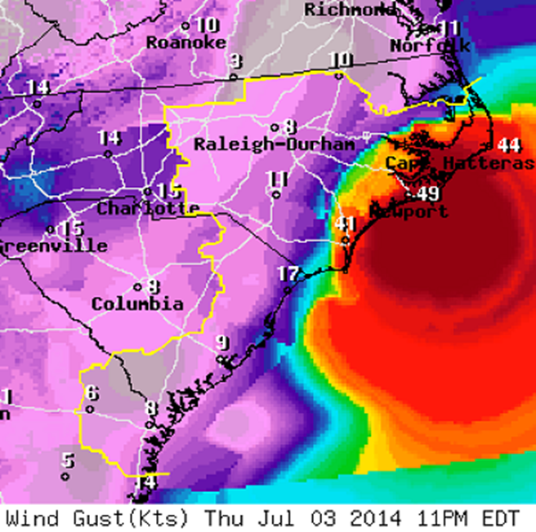
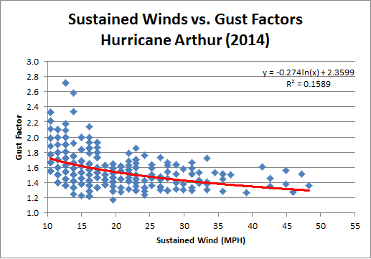
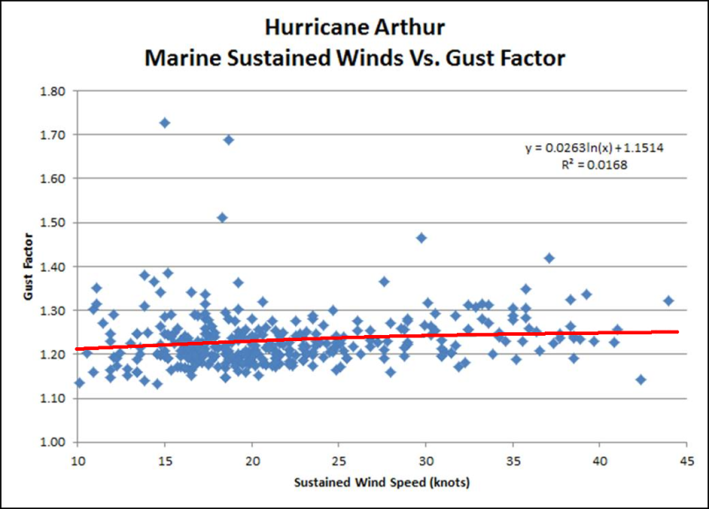
Hurricane Arthur (July 2014)
The 23-hour wind gust forecast valid at 11pm EDT on 3 July, 2014 shown to the right demonstrates a consistent and well collaborated wind gust forecast from the 4 WFOs using the new methodology (to the right or east of the thin yellow line.)
Both land and marine gust factors for Arthur found good agreement with the CSTAR database of 15 storms.

Slide 34
Hurricane Arthur Summary
After Arthur, forecasters provided mainly positive feedback. They noted much improved consistency and a perceived improvement in the quality of the regional wind forecast using this approach compared to past experiences. While some issues were identified, the result was an improvement of previous methods.
Some of the feedback provided by forecasters included:
“It certainly led to better coordinated wind grids”
“Produced realistic output”
The integrated tool was “even more efficient than in past years, likely due to the tweaks to the TCMWindTool.”
“The process seemed to go well and I think the output was reasonable”
“The tool allows for more science”
This event demonstrates a notable research to operations success.

Slide 35
Summary and Next Steps
Currently a half dozen WFOs in the mid-Atlantic and Southeast are participating in the evaluation of these new tools and methodologies.
We have successfully used the tools during a handful of TC events, although most of those events have been lower end hurricanes or tropical storms that followed a climatologically favored track parallel to the coast.
We hope to expand tools across more of our CSTAR cluster and hope to use them during a stronger TC with a more perpendicular landfall.
More work is required in the generation of the climatological reduction factor starting point which is largely heuristically based.
Additional details are available on our mid-Atlantic/Southeast science sharing blog. https://cimmse.wordpress.com/category/cstar/tc-inland-and-marine-winds/

Slide 36
Acknowledgements
Thanks to the NOAA CSTAR program for providing resources to work on this difficult forecast problem. CSTAR Grant NA10NWS4680007
Bryce Tyner and Dr. Aiyyer at NC State for their persistence and patience in working with WFOs.
WFO CSTAR team members included Donald Reid Hawkins, Frank Alsheimer, David Glenn, Robert Bright, John Billet, Gail Hartfield, Larry Brown, Carl Morgan, Harry Gerapetritis and Jonathan Blaes along with Michael Brennan who served on our team from NHC.
Support from Shannon White, Pablo Santos and the NOAA Hurricane meeting and Thomas Lefebvre for GFE coding.
Mark Powell provided Hwind* data for use with the Arthur verification.
Multiple non-CSTAR NC State Students contributed to the Gust Factor activities, chiefly Victoria Oliva. In addition, Rebecca Duell and Lindsey Anderson from NC State contributed along with Dan Brown.

Slide 37
References
Durst, C. S., 1960: Wind speeds over short periods of time. Meteor. Mag., 89, 181–186.
Conder, M. R., and R. E. Peterson, 2000: Comparison of Gust Factor Data from Hurricanes. Preprints, 24th AMS Conf. on Hurricanes and Tropical Meteor. Fort Lauderdale, FL. J53-J54.
Krayer, William R., Richard D. Marshall, 1992: Gust factors applied to hurricane winds. Bull. Amer. Meteor. Soc., 73, 613–618.
Paulsen, B. M., J. L. Schroeder, 2005: An Examination of Tropical and Extratropical Gust Factors and the Associated Wind Speed Histograms. J. Appl. Meteor., 44, 270–280.
Powell, M. D., and S. H. Houston, 1998: Surface wind fields of 1995 Hurricanes Erin, Opal, Luis, Marilyn, and Roxanne at landfall. Mon. Wea. Rev., 126, 1259.
Powell, Mark D., Samuel H. Houston, Timothy A. Reinhold, 1996: Hurricane Andrew’s Landfall in South Florida. Part I: Standardizing Measurements for Documentation of Surface Wind Fields. Wea. Forecasting, 11, 304–328.

Slide 38
References
Schroeder, J. L., M. R. Conder, and J. R. Howard, 2002: “Additional Insights into Hurricane Gust Factors,” Preprints, Twenty-Fifth Conference on Hurricanes and Tropical Meteorology, San Diego, California, 39-40.
Vickery, P.J., and P.F. Skerlj, 2005,: Hurricane gust factors revisited, J. Struct. Eng., 131, 825-832.
Vickery, Peter J., Dhiraj Wadhera, Mark D. Powell, Yingzhao Chen, 2009: A Hurricane Boundary Layer and Wind Field Model for Use in Engineering Applications. J. Appl. Meteor. Climatol., 48, 381–405.
Yu, Bo, Arindam Gan Chowdhury, 2009: Gust Factors and Turbulence Intensities for the Tropical Cyclone Environment. J. Appl. Meteor. Climatol., 48, 534–552.

Slide 39
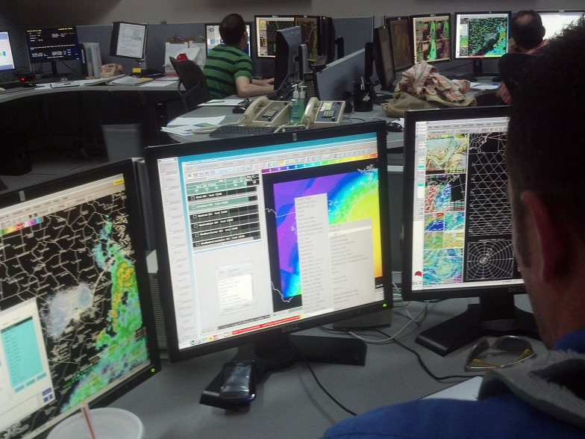
Questions
Josh Weiss, General Forecaster at WFO ILM, shown using some of the new GFE tools during Hurricane Sandy.

