Slide 1
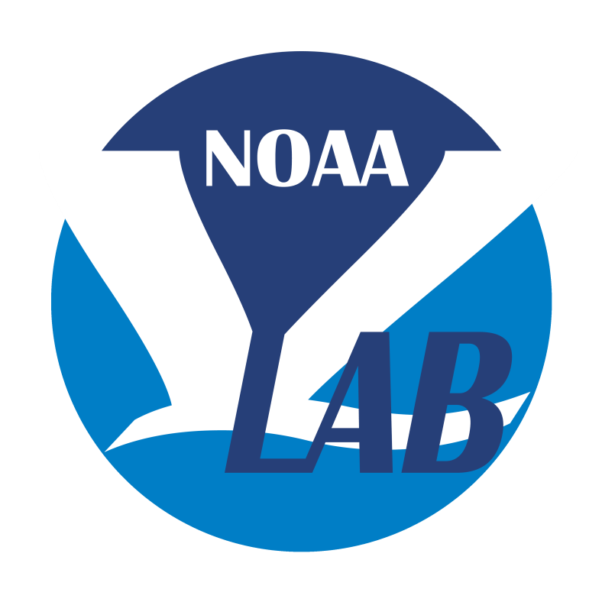
Taking Stock: Progress Towards Improving R2O in NWS
100th VLab Forum
Dr. Stephan Smith
Director, NOAA VLab
NWS Meteorological Development Lab
Office of Science and Technology Integration

Slide 2
NWS R2O: A Strategic Concern
NWS Strategic Plan 2000-2005:
“Reduce the time required to implement proven research and technology into operations”
NWS Strategic Plan 2011:
“Develop, in partnership with the research community, common modeling and operating infrastructures as well as test beds to facilitate scientific and technological development and to accelerate the transition of research into operations”

Slide 3
National Academy of Public Administration (NAPA) Study (2013)
“To ensure that NWS Research to Operations (R2O) and Operations to Research (O2R) receive appropriate priority and support, the Panel recommends that it consolidate the current distributed management of this function.”

Slide 4
What has been brought to bear on R2O since 2009?
NOAA Testbed and Proving Ground Committee
STI Portfolio
OSTI Headquarters office
NOAA Line Office Transition Managers Committee
R2O Policy
NAO 216-105
NWS Directive 80-8
NWS Operations Proving Ground
NOAA Virtual Lab
NWS Governance
SOO-DOH Projects
R2O Funding Opportunities:
E.g. RTAP, USWRP, CSTAR, QWAQ, JTTI, etc
Weather Research and Forecasting Innovation Act
NWS Evolve Program Management Office
Unified and Community Modeling

Slide 5
From September 2015
National SOO-DOH Meeting
College Park, Maryland
PEOPLE
Three Key Factors to Successful R2O

Slide 6
PEOPLE
Skilled in application of new science
and technology
CULTURE
Transparency, collaboration, and commitment to transition
CAPACITY
Efficient and adaptable IT Infrastructure

Slide 7
Key partnerships for Field-Driven R20
SOOs/DOHs/SSDs and National Development Orgs
(EMC, MDL, NWS, NCEP Service Centers)
Agency Scientific Leadership
SOOs/DOHs and ITOs
Enabling Distributed R2O
From Talk-the-Talk
to Walk-the-Walk

Slide 8
NWS Science and technology Integration
CSTAR
STI
MDL
RL 3
NCEP
SOOs
DOHs
NWC
NOAA Testbeds
VLab
CDTE
Fast-Track Transition
OPG
RL 8
NWS Operational Units
RL 9
Coordinate and manage local research applications and R2O for national implementation
Ensure consistency
Bring discipline to the R2O process
Development – Assessment – Implementation – Service Delivery

Slide 9
VLab Growth (4 years)
May 2014 - May 2018
sessions/week
Collaboration Services
1,259
278
Development Services
3,402
458

Slide 10
VLab Status

Slide 11
Number of VLab Software Repositories

Slide 12
SOO-DOH projects

Slide 13
SOO-DOH projects
14 projects are currently active
4 projects are on track to be completed in FY19

Slide 14
Success Stories
ProbSevere
Near-Storm Environment Awareness (NSEA) Project
Multi-Radar, Multi-Sensor (MRMS)
NBM and RTMA Feedback Forums
Weather Archive and Visualization Environment (WAVE)
FV3GFS VLab Community and code management
Satellite Training and Operations Resources (STOR) VLab community

Slide 15
PEOPLE
Skilled in application of new science
and technology
CULTURE
Transparency, collaboration, and commitment to transition
CAPACITY
Efficient and adaptable IT Infrastructure

Slide 16
Where are we falling short? What opportunities exist?
Backlog of RL8 projects awaiting implementation on major NWS operational systems (IDP, WCOSS, AWIPS).
The O in NWS R2O generally means FISMA High, 24x7x365, and 99.99 uptime. This kind of operational system is expensive to maintain, inflexible to adapt, and slow to evolve. However, many potential R2O projects do not need this kind of a robust, high availability operating environment.
O and M footprint growing inexorably. No formal sunsetting process in place.
From Weather Act: A technology transfer initiative, carried out jointly and
in coordination with the Director of the National Weather
Service, and in cooperation with the United States weather
industry and academic partners, to ensure continuous development
and transition of the latest scientific and technological
advances into operations of the National Weather Service and
to establish a process to sunset outdated and expensive operational
methods and tools to enable cost-effective transfer of
new methods and tools into operations.

Slide 17
Take-aways
Much tangible progress has been made towards improving NWS R2O over that last 9 years.
We are doing much better at managing R2O and innovation within the agency.
However, we are unable to onboard technically mature and scientifically validated R&D projects into operations at a sufficient pace, resulting in schedule delays and a growing backlog of projects waiting to transition.
To alleviate this backlog, perhaps we need to consider establishing a tiered approach to NWS operations, rather than the current ‘one-size fits all’.

Slide 18
Questions?
Thanks: Stephan.Smith@noaa.gov

